Slide 1
OSA Office Hours
Viji Somasundaram, Director
& OSA Team Members
March 12, 2020

Slide 2
Director Updates
Welcome New Staff
Please join us in welcoming Nikki Braconier to the Office of Student Assessment.
Nikki will be the new ACT consultant.
Continue to contact Duane Dorn with questions for the next few weeks.

Slide 3
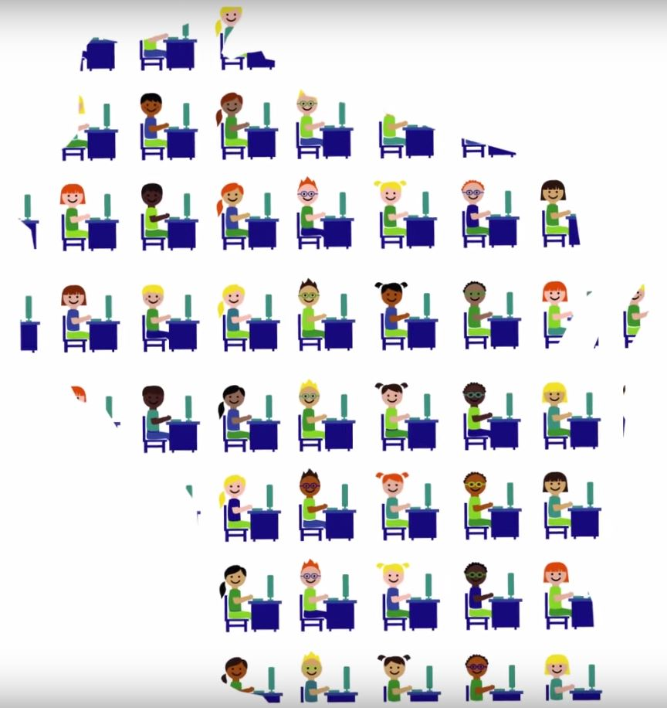
Assessment Updates

Slide 4
ACCESS for ELLs
Assessment Window Calendar:
April 24: Data is available in WIDA AMS, post-reporting data validation opens.
May 1: Paper ISRs are delivered.
May 8: Post-reporting data validation closes.
Mid-June: 2019-20 ACCESS data is in WISEdash for Districts.
Mid-July: SGPs are loaded to WISEdash for Districts.

Slide 5
ACCESS for ELLs
Scores and Data
Data downloads are available on April 24 through the WIDA AMS.
ISRs are delivered on May 1.
Parent Resources
Translated ISRs are available in 40+ languages in the WIDA AMS.
WIDA parent resources with translations:
https://wida.wisc.edu/teach/learners/engagement
parent handouts
parent guides for score reports
parent letters

Slide 6
DLM
Test Window: March 23 - May 1
DLM Test Window for ELA, Mathematics, Science, and Social Studies.
Create testing rosters for ELA and Math in grades 3-11, Science in grades 4 and 8-11 (only), and Social Studies in grades 4, 8 and 10 (only).
Notes:
The test window will open March 23 and run until May 1 for ELA, Math, Science and Social Studies. As a reminder, districts need to create a roster for each student for each subject they will be tested in. Make sure that you pay close attention to what subjects are tested at each grade level and do not roster students for tests they should not be taking. For example you would roster a third grade student in ELA and Math but you would not roster the student in Science and Social Studies. Testlets will be released to any rostered students. Students taking the incorrect tests will create problems down the road so we want to pay close attention to rostering.

Slide 7
DLM
Educator Portal
Districts should have completed loading and validating data in KITE Educator Portal.
Test Administrators should also have completed the required test administration training and accepted the security agreement in Educator Portal.
Test administrators will not have access to test tickets until both of these steps are completed.
Notes:
Please make sure that if you haven’t already, that you finish loading and validating your district’s students, rosters and users in Educator Portal. This will assure that testlets will start being assigned on the first day of testing. Also use the data extracts to monitor the progress of your districts test preparation and administration. Pay close attention to the security agreement abstract to make sure that your teachers have read and accepted the agreement. The agreement is automatically populated to decline the security agreement so if teachers are not reading it carefully and submitting the agreement, they will have actually declined it and will not be able to administer testlets. Test administrators will not have access to test tickets until both of these steps are complete and accepted.

Slide 8
DLM
KITE Student Portal 7.0
The Student Portal has been updated.
Download and install the latest version.
The program download and instructions are located on the DLM website under Kite Suite.
A prompt to download a new version will appear when the older version is opened.
Notes:
This is a reminder that KITE student portal has been updated. Make sure that you have downloaded and installed the latest version. If you have not, a prompt will appear letting you know this needs to be done.

Slide 9
DLM
Test tickets will only appear on March 23 if:
students are correctly entered into the portal, and
students are rostered in a DLM subject for ELA, Math, Science, and Social Studies, and
students have a completed PNP/FCS submitted.
Notes:
In order for test tickets to appear on March 23, students need to be entered and rostered correctly in Educator Portal. Teachers also need to complete and submit the personal needs and preferences profile and the First Contact Surveys for their students. Finally, the teacher needs to have completed their training on Moodle.

Slide 10
DLM
What if a Student Moves During the Test Window?
Previous district “exits” student from portal, new district must use Enrollment Template to enroll student, OR
State or DLM Helpdesk will need to transfer the student for the district.
DO NOT use “find student” feature during the test window.
Notes:
If a student moves during the test window, the previous district needs to exit the student and the new district must use the Enrollment Template to enroll the student. This needs to be a coordinated effort between the districts. The easier option is to contact me and I will happily verify the move and transfer the students for you. These steps are important so we make sure that the testlets completed follow the student and nothing gets lost in the move.

Slide 11
DLM
DLM Additional Items
Materials Collection Lists
ELA, Math , Science
Writing Samples Collection
Can be loaded securely into Educator Portal.
Upload student writing sample upon completion.
Notes:
Materials collection lists are available on the Dynamic Leaning Maps websites, the links are provided. These are some items that are used during the assessment to help get you ready,. When you are able to view the Testlet information Page after the test window opens, the TIPS will provide more precise items. Remember they are substitutable and you can use items that are more familiar to the student.
Every year, we try to collect writing samples to validate the scoring on the Writing Testlets. DLM has provided an easy upload on Educator Portal this year so it is easier and more secure to collect. Any writing sample you get would be beneficial to DLM, so please upload any writing you are able to.

Slide 12
Forward: Trainings and Manuals
Trainings:
New DAC/SAC Training
Update DAC/SAC Training
Test Administration Training
Grade 10 Social Studies Test Administration Training Slides
DTC Trainings, November 2019
Manuals
DRC INSIGHT Portal Guide (eDIRECT)
Test Administration Manual
Accessibility Guide
Forward Test Window:
March 23 - May 1, 2020
https://dpi.wi.gov/assessment/forward/resources
https://dpi.wi.gov/assessment/forward/accommodations
Notes:
We are about a week away from the start of the Forward Exam testing window. The window opens on Monday, March 23rd and closes on Friday, May 1st. As part of your preparation for Forward Exam testing this spring, you need to watch the DAC/SAC and Test Administrator recorded training presentations, available on the Forward Exam Trainings webpage. The Forward Exam manuals listed on this slide are available on the Forward Exam Resources webpage. We want to remind you that all test administrators must have a copy of the Test Administration Manual with them during testing sessions. The manual contains a script that TAs must read to students at the beginning of testing sessions. New this year, we also have the script available in Spanish. The Spanish script is posted with the manuals on the Resources webpage.

Slide 13
Forward: Additional Resources
DAC, SAC, and TA To-Do Checklists
Student and Administrator Tutorials and Online Tools Training
Practice Tests and TDA Resources
Technology Readiness Resources
DAC “Prior to Testing” Checklist
All resources are available through links on the Forward Exam Resources webpage: https://dpi.wi.gov/assessment/forward/resources.
Notes:
This slide lists some additional resources to help prepare for testing. The To-Do Checklists for DACs, SACs, and Test Administrators, the student and administrator video tutorials and Online Tools Trainings, and technology readiness resources are all available on the Resources webpage. Earlier this week you should have received an email with the Prior to Testing Checklist. This is not a comprehensive list to get ready for testing, only a quick double check prior to testing to make sure you are on track.
Students should be given the opportunity to use the Online Tools Training, and to become familiar with the different item types and the exam layout, prior to testing. Students will also benefit from viewing the practice tests and the text-dependent analysis samples. New this year, we have the text-dependent analysis Writer’s Checklist translated into Spanish. For the ELA test, only the test directions are translated into Spanish. The Writer’s Checklist is considered part of the directions for the TDA and therefore is allowed to be translated. The Spanish version of the Writer’s Checklist can be found on the Resources webpage, under text-dependent analysis resources.

Slide 14
Forward: Test Setup
DRC INSIGHT Portal (eDIRECT) Test Setup Became Available on March 9
Add accessibility features
Request student transfers into district
Transfer within district and add new students
Create or modify test sessions
Enter not-tested codes
Print test tickets
Notes:
Test set up is now open in the DRC INSIGHT Portal. Last week DRC placed all students into test sessions by subject area, grade, and school. You can now print test tickets, or you can set up new sessions prior to printing tickets, if desired. In addition, you can now enter accessibility features at the individual student level, add students or move students between test sessions, edit demographics, enter not-tested codes, and request transfers into your district. Instructions to do all of these are provided in the DRC INSIGHT Portal Guide. As a reminder, you need to add accessibility features for students in the INSIGHT Portal before printing tickets. However, if you do print a ticket and then realize that the student does not have their needed accessibility feature assigned and the student has not yet started testing, you can just destroy the ticket, enter the accessibility feature, and then print a new ticket for that student.
If you have questions at any time before, during, or after testing this spring, please feel free to call me or Jennifer Teasdale in OSA. We are happy to help.

Slide 15
ACT with writing
Makeup and Emergency Dates
March 17: standard time ACT makeup test day
March 17-27: makeup accommodations testing window for ACT
March 31: standard time ACT emergency test day
March 31-April 10: emergency accommodations testing window for ACT
Who are the emergency test dates for?
If you have grade 11 students who have not yet completed the ACT, you may use the makeup or emergency test dates.
Scores from all three sets of dates (initial, makeup, and emergency) are used for accountability.
Notes:
The makeup and emergency test dates for the ACT with writing are listed on the screen. Any grade 11 students that have not yet tested should be granted the opportunity to test on one of these dates. Scores from all three test dates will be used when making accountability determinations.

Slide 16
ACT: How to Place Orders for the
Emergency Test Date
Order Window: March 17-20
Order materials in PearsonAccessNext
Resources (see page 13): PANext User Guide for the ACT
ACT Accommodated
Call ACT Accommodations to order
1-800-553-3244 x1788
Notes:
The deadline to order materials for the makeup date has already passed. Schools that plan on testing on the March 31 emergency test date will need to place their order in PAnext between March 17 and March 20. Instructions for ordering can be found on page 13 of the PANext User Guide.

Slide 17
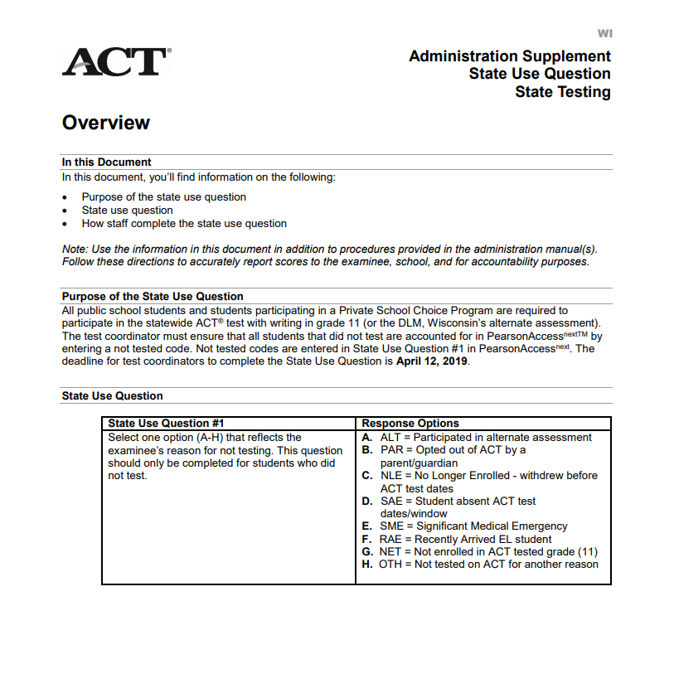
Students Who Take DLM or Do Not Test
If students take the DLM or do not take the ACT for any other reason, please indicate the reason under State Use Question #1 on the student details screen in PearsonAccessNext.
The deadline for entering these codes is April 17.
Instructions are in the WI Administration Supplement.
Notes:
Students who take the DLM or do not test should be accounted for in PANext by indicating the reason for not completing the ACT. Directions can be found in the WI Administration Supplement. Please note that the deadline for entering this information in PANext is April 17.

Slide 18
Score Report Schedule ACT
5-8 weeks after testing, sent in batches
Printed student report sent to student’s home
Printed student report sent to the school
Student score labels sent to the school
Checklist report sent to the school
Scores sent to colleges the student selected during the non-test session
By June 12
High School Profile Report available in PAnext
District Profile Report available in PAnext
Student level data file for the district available in PAnext
ACT Score Report Schedule
Notes:
Scores for individual students will be mailed to student addresses between 5 and 8 weeks after testing. In addition, printed student
reports will be sent to schools during this same time frame. By June 12, the high school profile report, the district profile report and a
student level data file will be available in PAnext.

Slide 19
Aspire
Testing Window: April 6 – May 6, 2020.
Notes:
The testing window for ACT Aspire will be from April 6 - May 6 for 9th and 10th grade students.

Slide 20
Aspire: Technical Readiness
Use the Technical Readiness Guide to complete these activities:
Install proctor cache software and the newest version of TestNav
See TestNav System Requirements
Conduct final technology readiness testing
Technology training available at Technical Readiness Training Webinar.
Notes:
Technology coordinators should use the Technical Readiness Guide to assist with the installation of technology components. In addition, a technology readiness webinar is available to assist with installation.

Slide 21
Aspire: Test Administration Readiness
Use the PAnext User Guide for ACT Aspire and the PNP Creation Guide to complete these activities (in this order):
Confirm the student data in the portal
Enter all online accommodations in Personal Needs Profiles (PNP) in the portal
Create groups in the portal (optional)
Create test sessions
Notes:
District and school staff should be verifying the accuracy of student data, entering personal needs profiles for students needing accommodations, and creating test sessions for students. The PAnext User Guide and the PNP Creation Guide are valuable resources as you complete these tasks.

Slide 22
Aspire English Learner Supports
The following accessibility supports are available to EL students (in addition to the default embedded system tools and open access tools available to all users):
Translated test directions for all subjects
Word-to-word dictionaries for Math, Science, and Writing sections
Text-to-Speech (Spanish audio) item translation
Extra time
Please see the ACT Aspire Accessibility User’s Guide for detailed information.
Notes:
English Learner supports such as translated test directions; word-to-word dictionaries for Math, Science and Writing; text-to-speech item translation; and extra time are available to your English Learner students. The ACT Aspire Accessibility User’s Guide provides guidance on each of these supports.

Slide 23
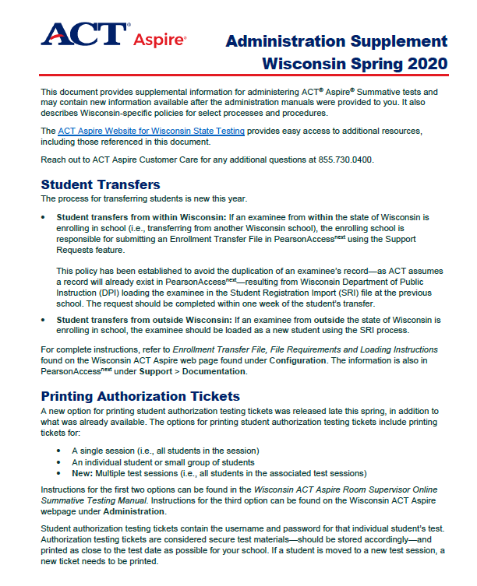
Resources: Aspire Wisconsin Supplement
Two page document that includes information on:
Student Transfers
Printing Authorization Tickets
Reason Codes for
Will not Test
Do not Report
Administration Supplement - WI
Notes:
The Administration Supplement provides guidance on how to initiate student transfers, how to print authorization tickets and how to apply Will not Test and Do not Report reason codes.

Slide 24
Reading Readiness Reimbursements
Reading Readiness Reimbursements
District Assessment Coordinators received the reimbursement request form on March 5.
Coordinators should provide information on:
Number of students screened
Screener that was used
Amount district is seeking for reimbursement
Reimbursement request form should be submitted to DPI by March 27.
Reimbursement for the 2019-20 school year will occur in May/June of 2020.
Notes:
Districts are able to be reimbursed for Reading Readiness expenses. On March 5, 2020, Assessment Coordinators should have received the reimbursement request form. Coordinators are asked to submit information about number of students screened, name of screener utilized, and amount sought for reimbursement for each grade by the March 27 deadline. Districts will receive their reimbursements in May or June of 2020. If you are the DAC for your district and have not received the reimbursement form, please contact me as soon as possible.

Slide 25
Reading Readiness: Additional Information
More information can be found at:
General information: http://dpi.wi.gov/assessment/reading-readiness
FAQ: http://dpi.wi.gov/assessment/reading-readiness/FAQ
Department Contact
Duane Dorn: duane.dorn@dpi.wi.gov; (608) 267-1069.
Notes:
More information on the requirements of screening can be found in the following locations. Feel free to contact me at your convenience if you have follow-up questions.

Slide 26
NAEP
What’s happening in NAEP schools now?
NAEP 2019-20 Long-Term Trend
Age 13 schools have completed testing.
Age 9 schools have completed testing.
Age 17 schools begin testing next week and should be completing the last of the pre-assessment tasks.
What’s coming up next?
NAEP 2021! Stay tuned for information about changes to NAEP. We should receive school samples in May and will notify districts as soon as we have the sample.
Notes:
What’s happening now in NAEP schools?
The age 9 test window is open through tomorrow, March 13; all sampled schools in Wisconsin are done testing.
Age 17 testing begins next week March 16 through May 22. Schools completed their student list submissions and should be finished or finalizing tasks to prepare for their assessments. These tasks include reviewing and verifying lists of students selected to take the assessment, completing information for students with disabilities and English Learners, notifying parents, and planning for assessment day. NAEP field staff representatives are in touch with all of their age 17 schools.
Age 17 Best Practices - this is to follow up on the Best Practices kit each high school received. These four emails contain timely one-pagers on encouraging and supporting student participation on NAEP. The last one was just emailed last week.
In cases of widespread illness in schools, we will work with each school on a case-by-case basis to determine NAEP testing options (aim for 90% student participation rate, schedule make-up testing, reschedule test date within window, etc.).
What’s coming up soon for NAEP?
NAEP 2021 (school year 2020-21) is right around the corner. We should receive school samples from NCES in May, and we will notify District Administrators and DACS of the schools sampled in their districts. There will be some changes to the sample sizes, format of testing, and testing time in 2021. Stay tuned for more information.
You can find contact information for NAEP field staff representatives on each school’s MyNAEP page. Or as always, contact Angela Dugas with any questions.

Slide 27
Discussion & Dialogue

Slide 28
Thank You
Office of Student Assessment
608-267-1072 osamail@dpi.wi.gov
The next OSA Office Hours is
Thursday, May 21
9:30-10:30 am.

