Slide 1

Compiling CACFP Claims
Wisconsin Department of Public Instruction
Child and Adult Care Food Program
Child Care Institutions
Outside of School Hours Care Centers
Guidance Memorandum #3C
http://fns.dpi.wi.gov/fns_centermemos
Notes:
This session covers both types of child care claims-child care centers (including Head Starts and OSHC)
Every agency is required to submit claims on-line; however, we recommend you complete a paper copy of the claim each month prior to submitting on-line. We also recommend viewing the webcast on how to submit your CACFP claim on-line after viewing this one on preparing it.

Slide 2
Claim Documentation
  Household Size Income Statements
  Household Size-Income Record
  Time of Service Meal Count Records
  Attendance Records
  Days of Operation
  Dated Menus (listing substitutions, changes, updates, etc.)
  Production Records (Children ages 1-12 years)
  Infant Meal Records, if applicable
  Recipes
  Child Nutrition Labels/Product Analysis Sheets
  Original Food receipts, invoices etc.

Slide 3
Claim Deadline Dates
Claiming Month | Last Day for Online Submission
January | April 1 (March 31 on leap years)
February | April 29
March | May 30
April | June 29
May | July 30
June | August 29
July | September 29
August | October 30
September | November 29
October | December 30
November | January 29
December | March 1 (February 29 on leap years)

Slide 4
On-Line Claiming
Required
Maintain confirmation page from the internet claim site
Notes:
On-line claiming is required for all child care institutions and outside of school hours care centers. On-line claiming shortens the time needed to process the claim, resulting in faster payment. A confirmation page showing the amount of reimbursement that will be received can be viewed when the claim information has been successfully submitted on-line. Print a copy of this page and maintain it with the other records that support the monthly claim.

Slide 5
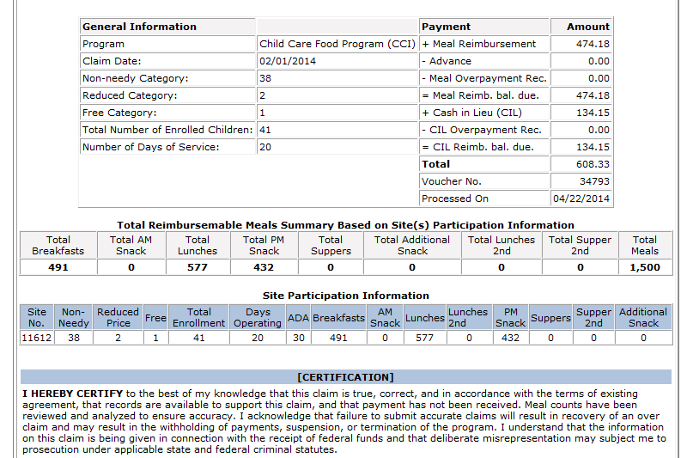
Online Confirmation Page

Slide 6
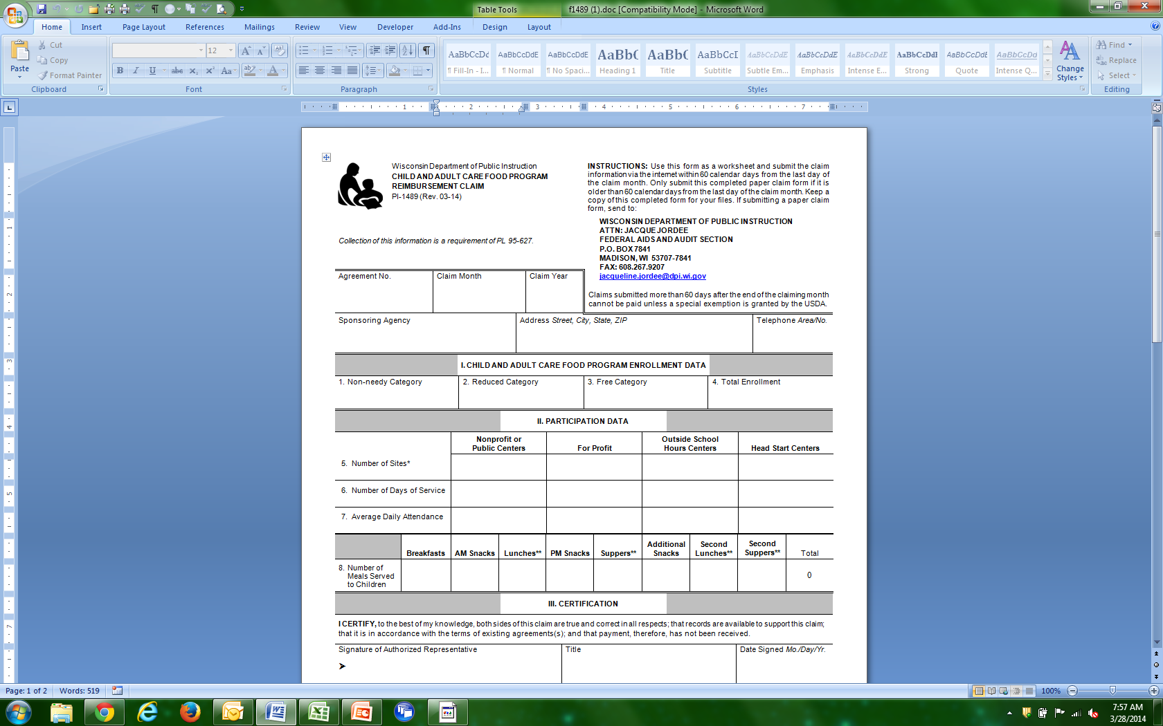
Notes:
This is an example of the paper copy of the CACFP reimbursement claim – for child care centers, Head Starts and Outside of School Hours Sites. Prior to submitting your on-line claim, it is recommended that you complete sections 1 through 8 of the paper claim form. We will go through each section
The claim must include an accurate report of enrollment by need category for the month which is highlighted here in red,
It must include an accurate record of the number of days of meal service (highlighted in purple),
an accurate record of the average daily attendance (highlighted in green), and
an accurate record of the number of meals and snacks meeting CACFP requirements served during the month (highlighted in blue).

Slide 7
Claim Due Date
Claim submission deadline of 60 days after the end of the claim month
Notes:
Federal regulations impose a claim submission deadline of 60 days after the end of the claim month. For example, an October claim cannot be paid if it arrives later than December 30th.

Slide 8
ENROLLMENT DATA
I. Child and Adult Care Food Program Enrollment Data
Notes:
Section I of the claim is for you to report the Enrollment Data.
Complete BOXES 1-4 by filling in the totals of non-needy, reduced, free and total enrolled children from your Household Size-Income Record.

Slide 9
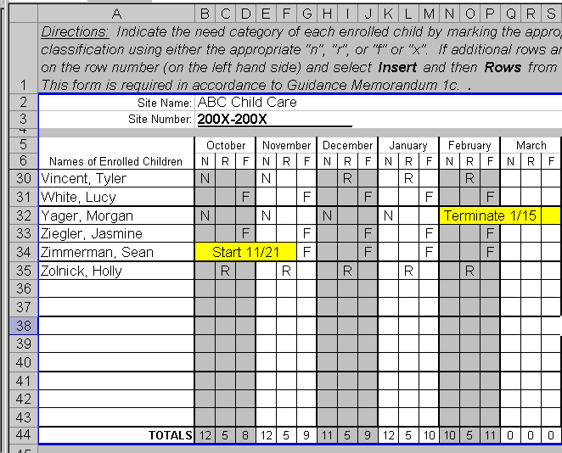
Notes:
From the Income Record (shown here), you would transfer the number of children in the non-needy, reduced, and free categories from the bottom of the respective month to the proper places on the claim form. In this case, the totals are 12 non-needy, 5 reduced, and 10 free. Remember that any enrolled child without a current, valid income statement on file must be considered non-needy.

Slide 10
ENROLLMENT DATA
I. Child and Adult Care Food Program Enrollment Data
12
5
10
27
Notes:
Section I of the claim is for you to report the Enrollment Data.
Complete BOXES 1-4 by filling in the totals of non-needy, reduced, free and total enrolled children from your Household Size-Income Record.

Slide 11
For-Profit Centers
Monthly eligibility requirement
25% of the children must be county-funded (W2 Child Care Assistance, i.e. Shares) or 25% must be determined as free or reduced
Failure to meet the 25% means the center cannot be reimbursed for that given month
Notes:
In order for for-profit centers to file a claim for a given month, they must be able to prove that at least 25% of the children they serve are from low-income households. This percentage can be based on either the number of enrolled children or the licensed capacity of the center, whichever is less. You may calculate this percent in one of two ways.
Divide the number of children for whom the center received county funding (also called W2 CC Assistance) during the month by the total number of children enrolled or the licensed capacity. If that number is 25% or more, a for-profit center can file a claim for the month. OR
Divide the number of children who currently qualify in the free and reduced categories based on the income statements you have on file, by the total number of children enrolled or the licensed capacity. If that number is 25% or more, a for-profit center can file a claim for the month.
These methods are exclusive and cannot be combined within a given month; however, either method can be used for any month. Failure to meet the 25% means that the for-profit center cannot be reimbursed for that month.

Slide 12
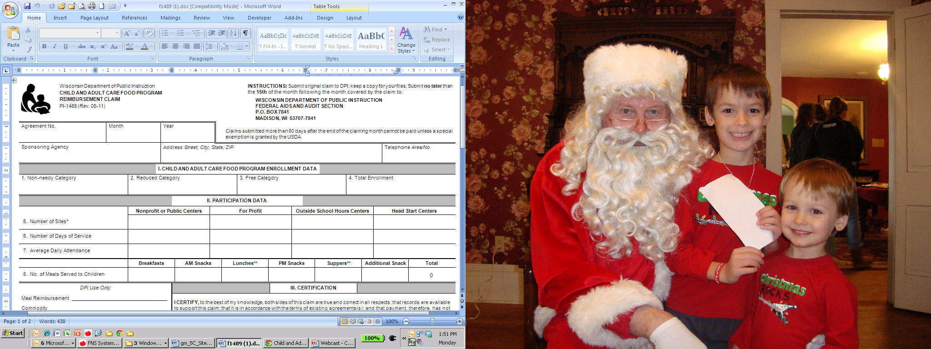
Participation Data
II. Participation Data
1
23
Notes:
The next section of the claim form to complete is Part II. Participation Data using the applicable column(s). Depending on what type of agency you are, complete the appropriate column.
On LINE 5, you report the total Number of Sites. If you have only one site participating on the CACFP, you would put “one” on line 5. If you have 2 or more sites participating on the CACFP, you record the number of sites participating that month. I will discuss how sponsoring organizations complete Section II of the claim a little later
On LINE 6, you list the Number of Days of Service the site was open and serving meals during the month.

Slide 13
Average Daily Attendance
Use daily attendance records, NOT meal counts
ADA Total children in attendance days of operation
Round all fractions up to the next whole number
Notes:
Now let’s talk about how to compute the average daily attendance or ADA. Using the daily attendance records, NOT meal counts, determine the number of children in attendance each day the site was open and claiming meals. Then add up each day’s total to get a monthly total.
Divide the monthly total by the number of days of service that month to determine Average Daily Attendance. Remember to round all fractions up to the next whole number for ADA.

Slide 14
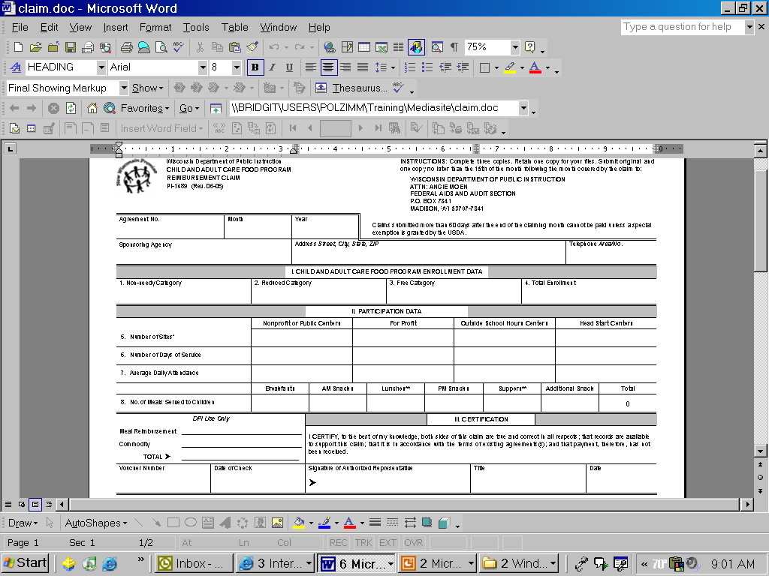
Participation Data
II. Participation Data
5. Number of sites
1
6. Number of days of service
23
7. Average Daily Attendance
21.1
→ 22
Notes:
For example, if the ADA is 21.1, you’d round up to 22.

Slide 15
Number of Meals Served to Children
II. Participation Data
Notes:
LINE 8 of the claim form is where you report the total Number of Meals Served to Children from your meal count records.

Slide 16
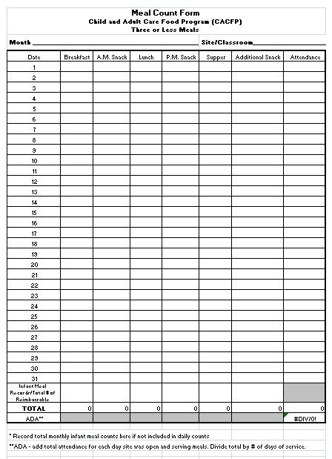
Notes:
Meal counts may be recorded on the DPI form titled “Meal Count Form” or a similar agency-designed form. Meal counts are required to be recorded at the time of the meal service or immediately after. It must be an actual count of the children eating at each meal or snack. The totals from the bottom of this form are then transferred to line 8 of the claim form.

Slide 17

Claiming Meals for Reimbursement
2 meals and 1 snack or 2 snacks and 1 meal per child per day
Greater than 3 Meals
Guidance Memorandum #9C
Notes:
CACFP regulations limit the number of meals and snacks that can be claimed on a daily basis to no more than 2 meals and 1 snack or 1 meal and 2 snacks per child per day.
If a center elects to claim meals and snacks that exceed these limits, they must keep track of meal counts by child name using the “Greater Than 3 Meals Record” or a similar agency-designed form that has been pre-approved by DPI. This helps to ensure that no more than 2 meals and 1 snack or 1 meal and 2 snacks are claimed per child per day. Please refer to Guidance Memorandum #9C for the mentioned forms.

Slide 18
Number of Meals Served to Children
II. Participation Data
539
546
555
1640
Notes:
Report the total number of meals for the month by meal type on line 8 of the claim form. In this example, record the total breakfasts for the month, the total lunches, PM snacks and then add up the total number of meals served to children for the month.

Slide 19
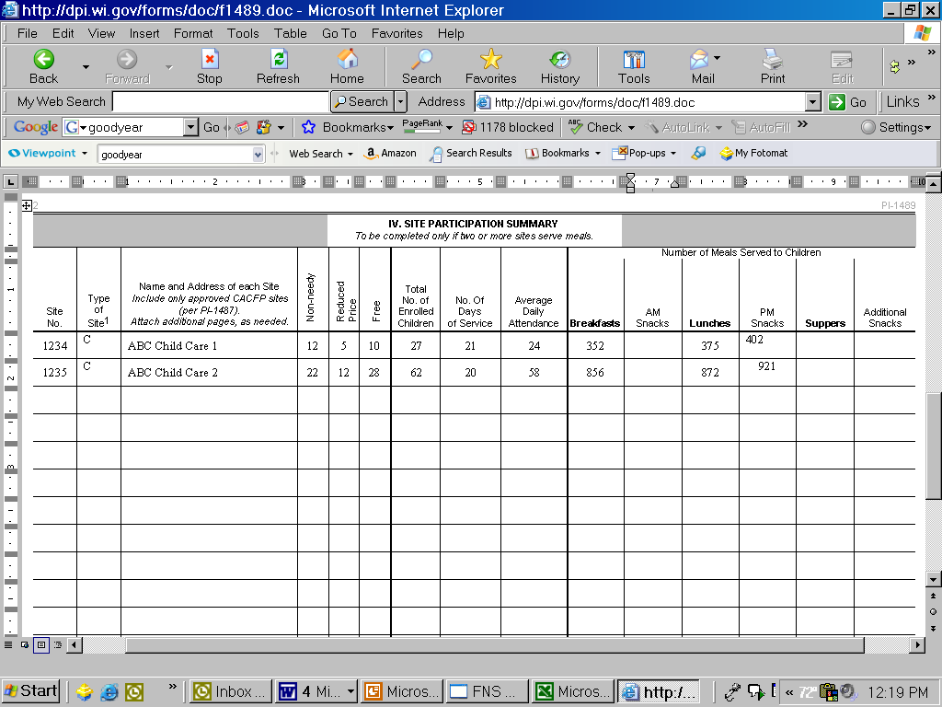
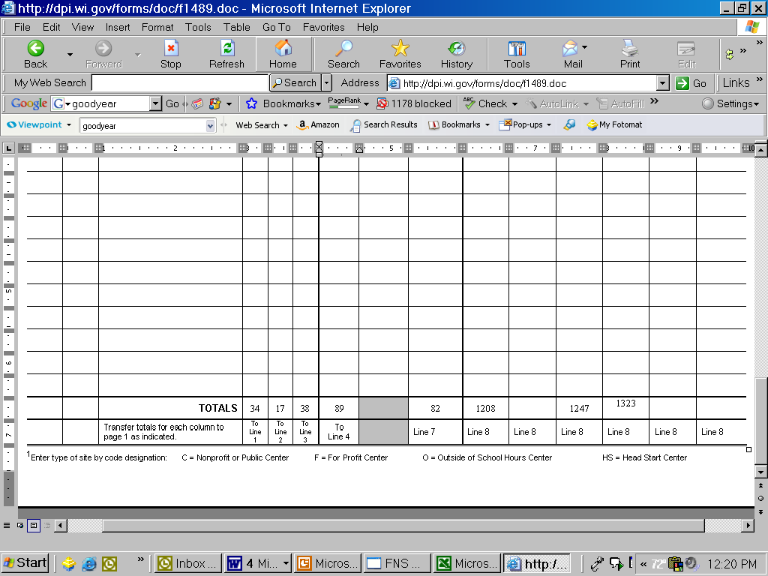
Site Participation Data for
Sponsoring Organizations
1
2
3
4
5
6
7
8
9
10
11
ABC Child Care 1
ABC Child Care 2
Notes:
Sponsoring organizations with more than one site on the CACFP must provide the individual site information on the back of the claim form. We will discuss the applicable columns to complete before entering in the on-line claim. These columns are numbered in red across the top.
In column 1, the Site Number must be the DPI-assigned site code number.
In column 2, list the name of each site.
Columns 3-6 are for you to report enrollment data for each site.
Enrollment data must be reported by need category (non-needy, reduced, or free) for each site.
The numbers reported for non-needy, reduced, and free must equal the total enrollment for the month for each site.
The totals from the bottom row - which are highlighted with the red box - can then be transferred to Boxes 1-4 on the front of the claim form (which you’ll see on the next slide). These totals will be entered in the on-line claim.
In column 7, report the number of days of service for each site. If sites differed in the total days of service, transfer the highest number to the front of the claim for the days of service. In this example 21 days is the higher number and would go on line 6 on the front of the claim.
In column 8, calculate average daily attendance for each site.
Columns 9-11 are where you would report the number of meals for the month by meal type for each site.

Slide 20
Participation Data:
Sponsoring Organizations
34
17
38
89
2
21
82
Notes:
To complete the paper claim, you would transfer the sites’ totals for free, reduced and non-needy and the total enrollment from the back of the claim to the front of the claim. Include the highest number of days of service. For Average Daily Attendance, add each site's ADA for the total ADA.

Slide 21
The U.S Department of Agriculture prohibits discrimination against its customers, employees, and applicants for employment on the bases of race, color, national origin, age, disability, sex, gender identity, religion, reprisal, and where applicable, political beliefs, marital status, familial or parental status, sexual orientation, or all or part of an individual’s income is derived from any public assistance program, or protected genetic information in employment or in any program or activity conducted or funded by the Department. (Not all prohibited bases will apply to all programs and/or employment activities.)
If you wish to file a Civil Rights program complaint of discrimination, complete the USDA Program Discrimination Complaint Form, found online at http://www.ascr.usda.gov/complaint_filing_cust.html, or at any USDA office, or call (866) 632-9992 to request the form. You may also write a letter containing all of the information requested in the form. Send your completed complaint form or letter to us by mail at U.S. Department of Agriculture, Director, Office of Adjudication, 1400 Independence Avenue, S.W., Washington, D.C. 20250-9410, by fax (202) 690-7442 or email at program.intake@usda.gov.
Individuals who are deaf, hard of hearing or have speech disabilities may contact USDA through the Federal Relay Service at (800) 877-8339; or (800) 845-6136 (Spanish).
USDA is an equal opportunity provider and employer.

