Slide 1
Crediting Grains/Breads
Notes:
Creditable grains must be enriched or whole-grain meal and/or flour, bran, and/or germ.
“Enriched” adds back what was lost during processing.
“Fortified” adds something not originally present.

Slide 2
Flow Chart for Determining GR/B Creditability FBG p. 3-7
https://www.fns.usda.gov/tn/food-buying-guide-for-child-nutrition-programs
Notes:
To determine if a bread/grain is creditable, you need to ask the following questions about the product. These questions are presented in a chart in the FBG on page 3-7.
Questions A–E will determine the creditability of most purchased G/B products
Is the food product labeled as “whole grain”?
Is the food product labeled as “enriched”?
Is the food product a fortified cereal?
In the ingredient statement, is the primary grain ingredient labeled “enriched”? Primary grain ingredient is the first listed grain ingredient in the ingredient statement.
In the ingredient statement, is the primary grain ingredient designated as a whole grain?
After we determine the grain is creditable, you need to determine the serving size.

Slide 3
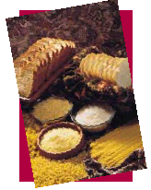
Determine Serving Sizes
Notes:
Determining the serving size is necessary to credit the grain/bread for the targeted number of G/B servings needed for a meal service

Slide 4
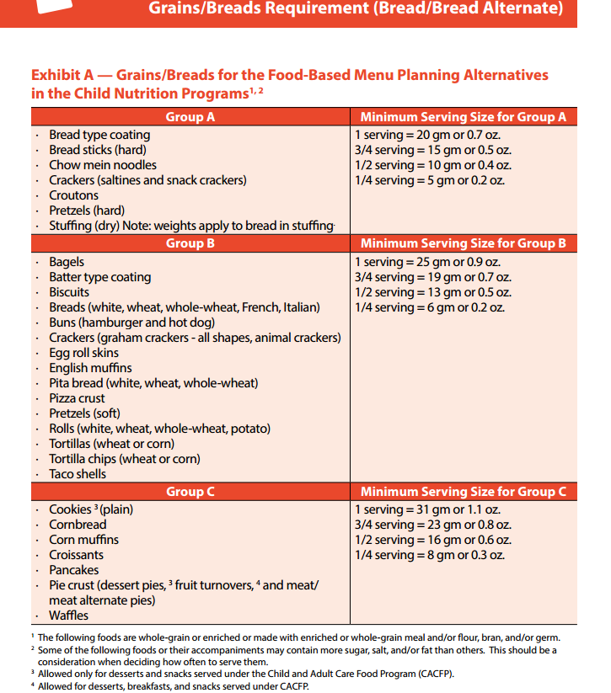
Exhibit A (Handout) Grains/Breads Chart
6-12 year olds require 1 serving each
1-5 year olds require ½ serving each
Notes:
Refer to pages 48-49 of the Crediting Handbook for the CACFP for the Grains/Breads chart.
Exhibit A includes commonly available food products. The products have a creditable grain as the primary ingredient. It is necessary to identify the group in which a G/B food product is listed before determining the weight that contributes one serving of G/B. Groups are based on average grain content and similar concentrations of creditable grains. G/B products are divided into groups by weight, based on 14.75 grams of grain content in one serving of G/B. This information is represented in Exhibit A. It can also be found in the FBG, pages 3-15–3-16.
Exhibit A is used for products that are whole grain, enriched, or fortified (if a cereal) or products that have creditable grain as the primary grain ingredient. Each group in Exhibit A provides the minimum serving size needed to supply 1 full G/B serving.
Foods with similar concentrations of creditable grains are grouped together. Items in groups D through G, such as grain fruit bars or toaster pastries, require larger serving sizes because they contain less grain by weight.
Now let’s go through an example of grains/breads and how to credit them.

Slide 5
How many snack crackers equal a CACFP serving?
Resources needed:
Grains/Bread Chart
Nutrition Facts Label from Package of Crackers
Notes:
Lets figure out how many snack crackers we will need to meet the CACFP meal pattern at snack. We need to have the grains/breads chart & the nutrition facts label from the package of crackers available in order to determine how many crackers to serve to each age group.

Slide 6
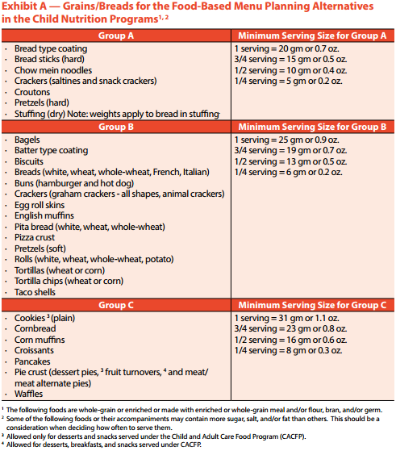
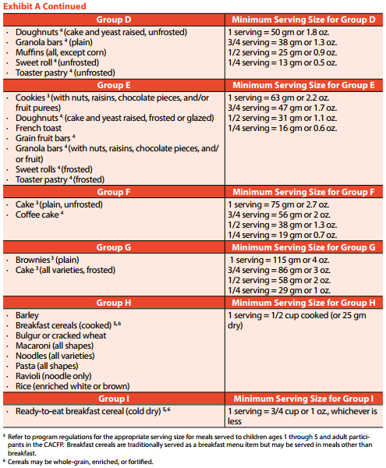
Resource 1: Grains/Bread Chart
Notes:
Resource #1: Grains/Bread Chart

Slide 7
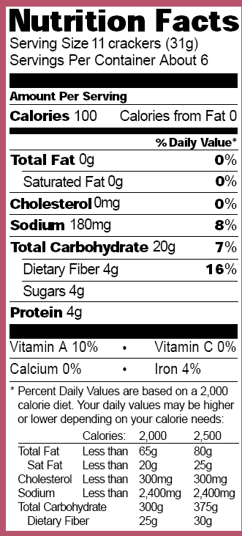
Resource 2:
Nutrition Facts Label
Refer to the serving size
Notes:
Resource #2: Nutrition Facts Label

Slide 8
Grains/Bread Chart
Group A: Crackers – saltines and snack crackers
Ages 1-5: ½ serving = 10 grams
Ages 6-12: 1 serving = 20 grams
Resource 2: Nutrition
Serving Size: 11 crackers (31 g)
6-12 year olds
1-5 year olds
How many crackers does each child need?
Notes:
(CLICK) First, find the creditable grain in the GR/B chart. Saltine crackers fall under Group A.
Next, determine the weight needed for each age group. According to the GR/B chart, children ages 1-5 need a ½ serving of G/B which equals 10 grams. (CLICK) Children ages 6-12 need a full serving or a serving weighing 20 grams of snack crackers. (CLICK) Then, go to the Nutrition Facts Label to determine what a serving size is and how much a serving weighs. (CLICK) In our example of snack crackers, 11 crackers weighs 31 grams. (CLICK) (CLICK) So, how many crackers does each child need?

Slide 9
1-5 year olds need
11 crackers x 10 gm = 110 gm
↓
110 ÷31 grams=3.5 crackers
↓
Round up to 4 crackers per 1-5 year old
Notes:
To figure out how many crackers each child needs, you just need to do a simple ratio equation. From the Nutrition Facts Label on the cracker box, it says that 11 crackers = 31 grams. From the GB chart, it says that a serving for a 1-5 year old is 10 grams,
(CLICK) so multiply 11 by 10 to get 110 and (CLICK)
(CLICK) divide by 31 to get 3.5 crackers. (CLICK)
(CLICK) Round up to 4 crackers per 1-5 year old.

Slide 10
6-12 year olds need
11 crackers x 20 gm = 220 gm
↓
220 ÷31 grams = 7.09 crackers
↓
Round up to 8 crackers per 6-12 year old
Notes:
Do the same equation for 6-12 year olds. Since a serving for a 6-12 year old is 20 grams,
(CLICK) multiply that by 11 crackers to get 220. (CLICK)
Divide that by 31 to get 7.09 crackers. (CLICK)
(CLICK) Round that up to 8 crackers per child.

Slide 11
How many boxes should you buy?
Age Group | # Eating | Multiply | Required crackers | Total
1-2 | 7 | X | 4 | 28
3-5 | 13 | X | 4 | 52
6-12 | 9 | X | 8 | 72
Adults | 5 | X | 8 | 40
Total Crackers Needed |  |  |  | 192
11 x 6 = 66 crackers/box
192 ÷ 66 = 2.9 or 3 boxes
Notes:
To figure out how many boxes to buy you will need to know how many children will be eating in each age group, multiply that by the number of required crackers. Add up the number of required crackers for each age group to give you the total. You will also need to know how many crackers there are in a box & the nutrition facts label can help you determine that. Take the serving size times the servings per container. The total crackers needed to provide to the children is divided by the number of crackers in one box. Always round up.

Slide 12
Food Item: Snack Crackers
Calculating Quantities to Purchase
6-12 year olds
1-5 year olds
Age Group | # Eating | Multiply | Required Ounces | Total
1-2 | 7 | X | .4 oz. | 2.8
3-5 | 13 | X | .4 oz. | 5.2
6-12 | 9 | X | .7 oz. | 6.3
Adults | 5 | X | .7 oz. | 3.5
Total Ounces Needed |  |  |  | 17.8
Notes:
Now, let’s do this another way. This is for a different type of snack cracker in a 16 oz box that you’re serving family style. If you already know the total number of children (and adults) present, now you want to calculate how many 16-oz boxes of snack crackers to buy or use. We’ll use the same number of children by age group as before.
So, you take the number of children per age group times the number of required ounces per the grains/breads chart. Add up the required ounces to get the total amount needed, 17.8 ounces.

Slide 13
How many 16-ounce boxes are needed?
Divide the total ounces needed by the number of ounces in a box:
17.8 oz÷16 oz = 1.11 boxes
You must buy 2 16-ounce boxes of Snack Crackers
Notes:
So, how many 16 oz boxes of crackers do we need. In total we need 17.8 ounces divided by 16 ounces in a box equals 1.11 boxes. You would round that number up to 2 boxes to purchase.

Slide 14
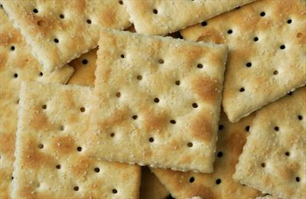
Create a cheat sheet for Grains/Breads
Snack Items, Grain/Breads | 1-2 Year Olds | 3-5 Year Olds | 6-12 Year Olds
Cheese Snack Crackers | 10 | 10 | 20
Graham Crackers | 3 crackers (3/4 sheet) | 3 crackers (3/4 sheet) | 6 crackers (1 ½ sheets)
Saltine Crackers | 3 | 3 | 6
Notes:
Creating a cheat sheet for the common grains/breads served at your agency can save time in figuring out how much to serve each time. This is especially helpful if the teachers are required to provide the snack & they don’t have access to the production records. Just providing the CACFP meal pattern to each teacher would not be sufficient information for them to figure out how much to serve to each child beings each grains/bread item falls into different categories. When creating this cheat sheet you will want to be sure that the same product (brand name) is used each time because it will vary with each brand. This can be posted in the kitchen, each classroom, cafeteria, etc.

