Slide 1
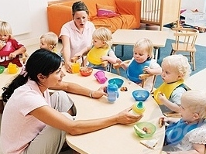
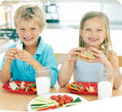
Family Style Dining
Notes:
One major activity that can positively influence children’s eating habits is by serving meals family style.

Slide 2

What to expect from our time together!
How to set the stage for family style dining
Viewing “Pass the Peaches Please” https://www.youtube.com/watch?v=knOgg6EF21w
Ellyn Satter’s Division of Responsibility
Slowing down the tempo
Meals as part of the curriculum
Designing your VISION

Slide 3
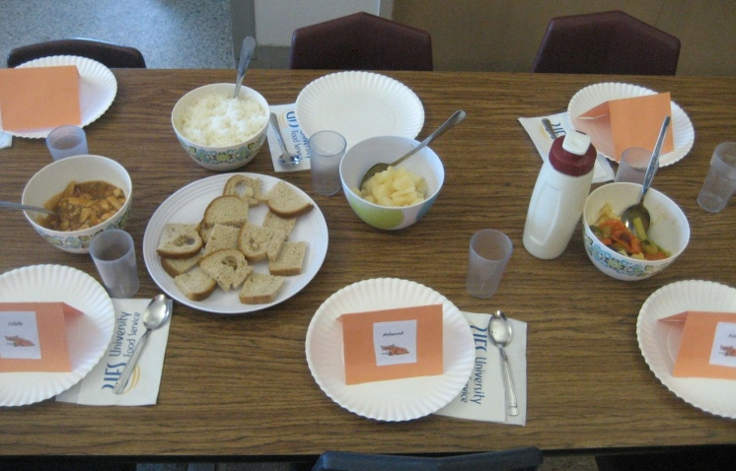
USDA CACFP Regulations Regarding Family Style Dining
How much food should be on the table when serving family style.
Measure amounts initially so that
you can see what a serving size looks like.
Use bowls and serving utensils that
young children can handle.

Slide 4
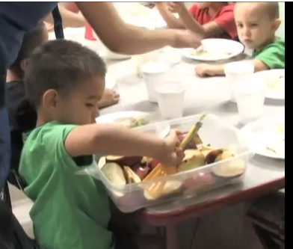
What successful family style dining looks like:
Source: Arizona Department of Health Services
Arizona Child Care: Champions for Change
http://www.youtube.com/watch?v=nj_s89ydnBs
Notes:
Show 4:41 through 6:37

Slide 5
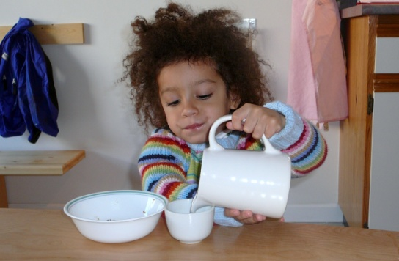
What will the children learn with Family Style Dining?
Pouring
Passing
Serving
Sharing food
Promoting language & fine motor development
Teaching manners
Enhancing child’s self-concept by providing opportunities to make decisions & take responsibilities
Notes:
The children are going to learn all types of skills during the family style meal service.

Slide 6
Benefits of family style dining…. what we learn by doing
Eating is a sensory experience.
Eating can be a mathematical experience -setting the table, counting, eating a fraction of the whole.
Eating is a social experience, learning the give and take of conversation as well as please and thank you.
Notes:
Eating is a sensory experience and touches all senses. This makes it the perfect setting for teaching small children who learn through sensorial experience. (Piaget’s Sensory Motor stage of learning.). We experience food by tasting, smelling, touching, seeing and sometimes hearing.
Examples of things to ask the children as they are eating: Let’s count how many peas we have on our plate, what color are the peas?
When you put the peas in your mouth are they hard and crunchy or soft and squishy?
What’s your favorite thing that we are eating today? What things are we suppose to eat with our spoons or forks and what things can we eat with our fingers?

Slide 7
Advantages for children
Reinforces social skills
  Take turns, pass food to others, manners (please & thank you), and help set the table
Strengthen serving skills
  Practice fine and gross motor skills, pass food without touching it, learn not to eat with the serving utensils
Gives children control of their eating
  Take small servings to start and feel confident that additional helpings will be available
Encourages children to try new foods
Notes:
Social skills—allows the children to take turns, pass food to others, use their manners (please & thank you), and allow them to help set the table.
Serving skills—practice fine and gross motor skills, learn to pass food without touching the food, and learn not to eat with the serving utensils.
Giving children control of their eating—take small servings of food and take more during the meal service, take food at a later time during the meal service, and feel confident that additional helpings will be available throughout the meals.
Trying new foods—children that don’t feel pressured and feel in control of their eating are more likely to try new foods; children may need to see new food 8-10 times before they want to try it.
Source: http://www.doe.k12.de.us/ddoe/files/pdf/FamilyStyleMealService.pdf

Slide 8
Advantages for Staff/Teachers
Interactive
  Teachers and staff act as role models, demonstrating appropriate mealtime behavior
Satisfying
  Teachers and staff can eat the same nutritious meals that the children are eating
Relaxing
  With all of the food on the table, the teachers will not have to return to the kitchen for more food
  By eating during the designated meal time, teachers and staff will not have their meal time interrupted by other responsibilities
Notes:
Interactive—teachers and staff act as role models, demonstrating appropriate mealtime behavior.
Satisfying—With reduced food waste, there is enough food for everyone, including teachers and staff. Teachers and staff can eat the same nutritious meals that the children are eating.
Relaxing—With all of the food on the table, the teachers and staff will not have to return to the kitchen for more food. By eating during the designated meal time, teachers and staff will not have their meal time interrupted by other responsibilities.

Slide 9
Family Style Dining
Pros
  Children can decline foods
  Teaches children to make choices
  Create independence
  Enhance social competence
  Promote self esteem
Cons
  Challenges with children under age 2
    Spills
    Takes more time
Notes:
There are definitely more pros to family style service than cons. The major negative aspects are spills and that it will take a little more time. With the proper tools, patience, and practice; family style dining will become easier for the children and the teacher/adult sitting with the children.

Slide 10
Value to the Children
“I did it all by myself!”
Sense of self accomplishment
Notes:
Children enjoy having some independence and can be reinforced by family style meal service.

Slide 11
Adults at the table
Eat with children
Children will model the adult
Will encourage appropriate meal conversation
Assist children as they pass food
Notes:
Adults play an important role at the table during the family style meal service. By eating with the children, you are being the role model by trying new foods, providing good conversation during the meal service, and help the children who have difficulty passing &/or pouring.

Slide 12
Recommended Equipment & Materials
Appropriate size chairs
Age appropriate spoons, cups, and bowls
Child size serving pieces, pitchers, & glasses
Appropriate size flatware

Slide 13
Division of Responsibility
Adults do the:
  what, when, and where of feeding
Children do the:
  how much and whether of eating
Satter E. Child of Mine, Bull Publishing, 2000
Notes:
During the meal service, remember the Ellyn Satter rules for Division of Responsibility. The adult is responsible for what, when, and where of feeding. The children choose how much and whether they are going to eat.

Slide 14
Adult Responsibilities
Choose and prepare food
Provide regular meals and snacks
Make eating times pleasant
Show children what they have to learn about food and mealtime behavior
Prevent grazing for food or drinks between mealtimes

Slide 15
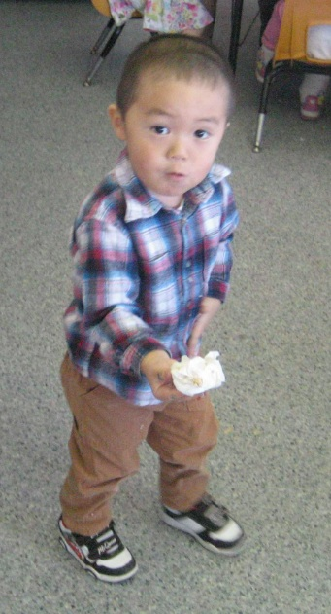
Adult Responsibilities
Let children grow into the bodies that are right for them

Slide 16
Child Responsibilities
Children will eat
They will eat the amount they need to grow normally
They will enjoy an increasing variety of food and beverages
They will learn to behave well at the table
They will grow predictably

Slide 17
Negative Control
When adults restrict foods/calories, children tend to gain MORE weight
When adults pressure, bribe, or force children to eat more, children eat LESS
Kids feel bad about eating, mealtime is not pleasant for anyone

Slide 18
Division of Responsibility
You get your points when you put it on the table, not when your child eats it. Back off. Generations of parents have somehow been taught that children don’t like vegetables and generations of parents have created that reality by forcing, enticing, and rewarding their children to eat vegetables. Let your child learn to like vegetables at her/own speed and in her own way. The same goes for you.” E. Satter

Slide 19
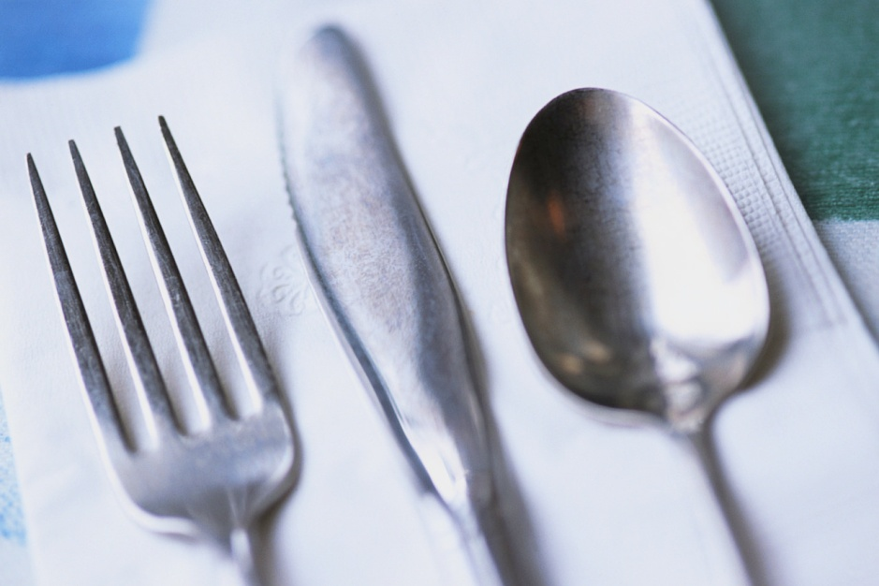
Pass the Peaches Please
Montana Office of Public Instruction Team Nutrition
10 minute video
https://www.youtube.com/watch?v=knOgg6EF21w

Slide 20
How to start family style dining….. start slowly
Slow down, meals are part of the curriculum.
Plan ahead for spills and utensils that may fall on the ground.
Start small by serving and passing one item of the meal.
Teachers assist with serving and passing,
initially, then allow children to complete
the task.
Notes:
Picture books or stories can be read to children while waiting for all of the children to wash hands before eating so that when sitting down at the table, all individuals sit at the same time and do not have to wait for others to gather.
Plan enough time for the meal service. Remove time restraints by building the eating experience into the curriculum. Eating is as important as the art project, or any other learning concept, that you have planned for the day.

Slide 21
Making Family Style Successful
Begin using family style service with one dish at a time or for snack
Seat picky eaters next to non-picky eaters
Be persistent—it will take time & practice:
  Children are in a more relaxed atmosphere
  Children are building lifetime skills at an early age
Notes:
To make family style dining successful, you may want to start with passing one meal component at a meal service. You could also try this as a non-meal activity during playtime.
It can be helpful to have non picky eaters sit next to picky eaters so they can be encouraged to try new foods as they watch the person they are sitting with.
For some of your centers, trying family style meal service will be very new to the children. It will take some time for children to understand what is expected of them but be consistent with them each day and overtime meal time will improve.

Slide 22







Learn about food through experiences….
Using picture books to introduce a topic
Set up a pouring table during play time to practice pouring and scooping
Plan menus with children
Encourage cooking experiences
Notes:
Children learn though experience. Set up a water table with water or with sand, beans or rice so children can practice scooping and pouring. Put pitchers, scoops, serving spoons, plastic plate and bowls to practice with.
Plan menus with children directing the selection into healthy choices. For example ask to choose the vegetable that should be served by giving a choice of broccoli, carrots or beets. Which vegetable should we put on the menu?
Require all children to remain seated as children finish eating while the teacher directs the table discussion. Slowly dismiss children to wash after eating and get ready for the next planned activity.

Slide 23

Division of Responsibility
Fundamental to parents’ (or child care provider’s) job is trusting children to decide how much and whether to eat. If parents do their jobs with feeding, children will do their jobs with eating:
Children will eat
They will eat the amount they need
They will learn to eat the food their parents (or caregivers) eat
They will grow predictably
They will learn to behave well at the table
© 2009 Ellyn Satter

Slide 24
Creating our Environment for Learning
Slowing down the temp of your meal.
How do you see this as an important part of family style dining.
How do we set up an “environment” for learning during the family style eating time.
Building Mealtime Behaviors and Enviornments by the University of Idaho
http://www.cals.uidaho.edu/feeding/pdfs/BMER.pdf

Slide 25
Bringing It All Together
Family Style Meal Service is desired as “best practice” in child care.
Work on your routine slowly.
Use every moment as a teachable moment.
Enjoy yourself during this time of day

Slide 26
Objectives
Workshop participants can describe the basic principles of Ellyn Satter’s Division of Responsibility
Develop a vision of family style dining at my child care center or family child care home.
Make Mealtimes pleasant and utilize the dining experience for many teachable moments.
Consider the meal time as part of the curriculum and plan accordingly.
Incorporate learning experiences before, during and after the meal.

