Slide 1
Food Buying Guide (FBG) for Child Nutrition Programs
United States
Department of
Agriculture (USDA)
Food and Nutrition Service (FNS)
http://www.fns.usda.gov/tn/foodbuying-guide-child-nutrition-programs
Notes:
Let’s start with the Food Buying Guide (FBG) for Child Nutrition Programs
As mentioned earlier, you may order one through Team Nutrition if you are not sure if you have one available. Most agencies receive a hardcopy when they initially start with the program. You can also view it on the team nutrition website. The FBG is a:
Purchasing guide to assist with buying the right amount of food and the appropriate type of food for your program.
Use to calculate the appropriate amount of food to meet the meal pattern.
This guide can be used to determine if a food is creditable for the CACFP meal pattern.
Provides additional information to assist in planning, preparing and serving nourishing meals.
FBG is a source of current yield information published by the USDA to support menu planning, food purchasing, food production, and portioning in the CNP.
The FBG is tabbed by components.
M/MA
F/V
Grains/Breads
Milk
It also contains several other items that are useful when it comes to preparing meals for child nutrition programs.

Slide 2
Food Buying Guide Column: Information Provided in the Yield Tables
Notes:
So, what information do the yield tables in the food buying guide provide? Each column provides information that will assist you in preparing the correct amount for the number of children being served. The six columns are:
1. Food As Purchased, AP
2. Purchase Unit
3. Servings per Purchase Unit, EP (Edible Portion)
4. Serving Size per Meal Contribution
5. Purchase Units for 100 Servings
6. Additional Information

Slide 3
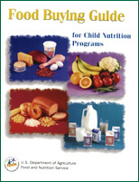
Column 1: As Purchased
Notes:
Column 1: As Purchased
Indicates the name of the food item & the form(s) in which it is purchased.

Slide 4
Column 2: Purchase Units
Notes:
Column 2: Purchase Units
Indicates the basic unit of purchase for the food. Most items are listed in pounds.

Slide 5
Column 3: Servings per Purchase Unit, EP (Edible Portion)
Notes:
Column 3: Servings per Purchase Unit, EP (Edible Portion)
Indicates the number of servings of the given size. Lets look at an example on the next slide.

Slide 6
Column 3: Servings per Purchase Unit, EP (Edible Portion)
Notes:
Fresh cranberries are listed as 1 pound in column 2.
Column 3 indicates 15.6 servings per purchase unit if ¼ cup raw, chopped fruit (column 4) is served.
This tells us we can expect to obtain 15.6 - ¼ cup servings from 1 pound of good quality fresh cranberries.

Slide 7
Column 4: Serving Size per Meal Contribution
Notes:
Column 4: Serving Size per Meal Contribution
Describes the serving size by weight, measure, or number of pieces/slices.

Slide 8
Column 4: Serving Size per Meal Contribution
Notes:
For example, for each 3.7 oz raw chicken drumsticks, Column 4 reads: 1 drumstick equates to about 1.8 oz cooked chicken with skin.

Slide 9
Column 5: Purchase units for 100 servings
Notes:
Column 5: Purchase units for 100 servings
Indicates the number of purchase unites needed for 100 servings.

Slide 10
Column 6: Additional information
Notes:
Column 6: Additional information
Provides other information to help you calculate the amount of food you need to purchase and/or prepare. For many of the food items, this column shows the quantity of ready-to-cook- or cooked food you will get from a pound of food as purchased.

Slide 11
Column 6: Additional information
Notes:
For example, it tells you 1 pound of fresh, whole, 125-138 count apples will yield 0.78 pounds of raw, cored, peeled ready-to-cook or serve apples.

Slide 12
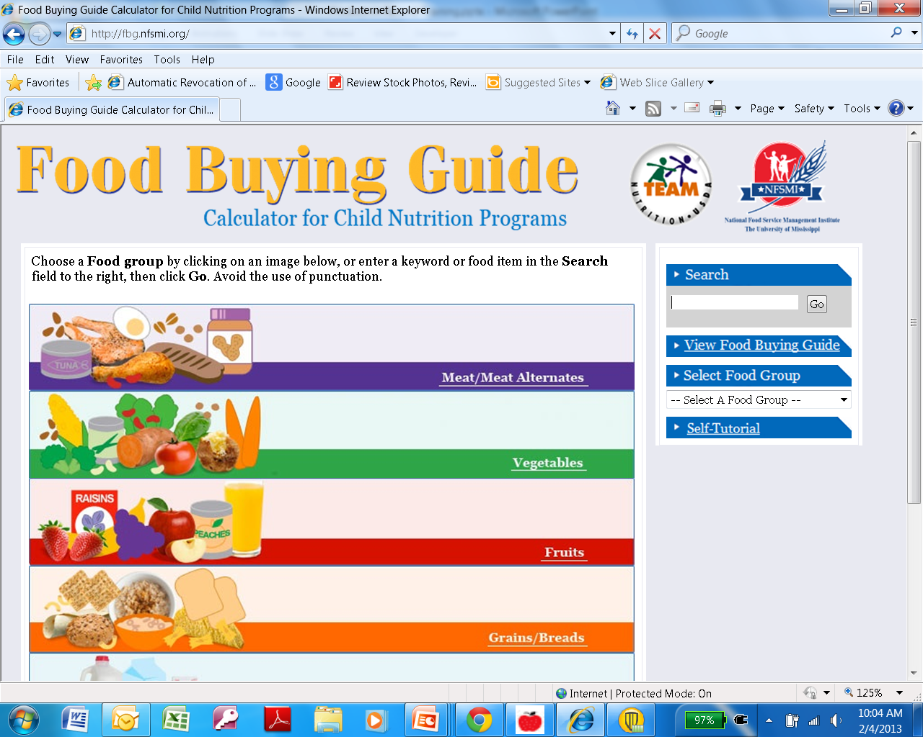
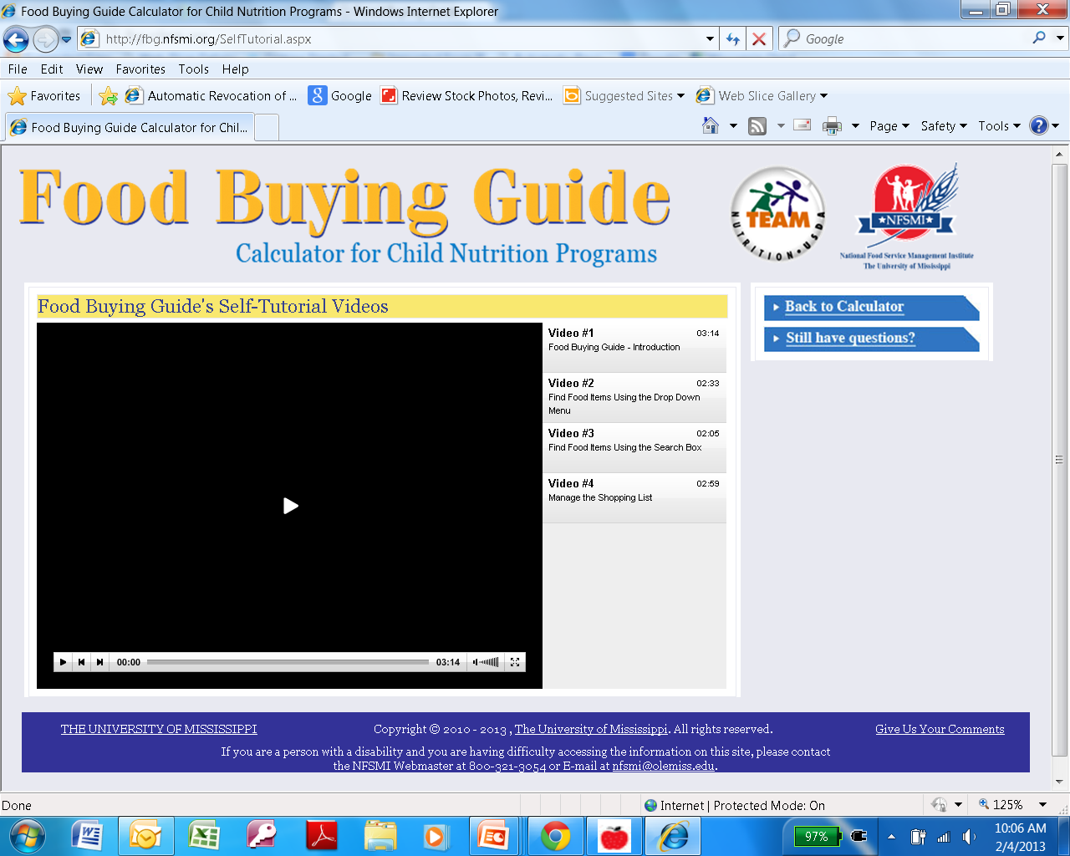
Food Buying Guide Calculator
http://fbg.nfsmi.org/
Self tutorial on website
Notes:
This was created by the National Foodservice Management Institute (NFSMI) for child nutrition programs to assist in calculating the amounts to purchase & prepare. There are 4 Self-Tutorial Videos you can view that will walk you through using the calculator. This website also provides a link to view the online version of the Food Buying Guide. It is an electronic version of the FBG. You will still need to know how much you need to meet the minimum amounts of the CACFP meal pattern. This tool can help you create a shopping list that can be printed &/or e-mailed to you.
Let’s go through an example of how to use the calculator.

Slide 13
Food Buying Guide Calculator
1
2
3
http://fbg.nfsmi.org/
Notes:
We will use the same component (ground beef, no more than 30% fat) as used on the previous slide.
(CLICK) First, click on “Select Food Category”.
(CLICK) Second, choose the category you need: “Beef & Beef Products”.
(CLICK) Third, scroll down until you find the item you are looking for: “Beef, ground…no more than 30% fat”

Slide 14
Food Buying Guide Calculator: Ground Beef
Step 1
Step 2
Step 3
Step 5
Step 4
Notes:
(CLICK) Step 1: Enter in the serving size needed (in this case – ounces because we already calculated total number of cooked ounces needed).
(CLICK) Step 2: Enter the total number of ounces needed (54.5 rounded up to 55).
(CLICK) Step 3: Click, “Add to List”
(CLICK) Step 4: Then the amount you need to purchase will appear in the shopping list shown here at the bottom of the screen; 5lbs.
(CLICK) Step 5: Continue to “Add More Items” to calculate the other items for the meal
This is a great tool if you struggle with using the FBG binder. Also, the Food Buying Guide Calculator along with the FBG is a great tool to see if the food item you are serving would be a creditable component for the CACFP. If those two items are not available, you can always review the Crediting Handbook for the CACFP which will be discussed next.

Slide 15
Food Buying Guide Section 5: Other Foods
Foods in this section do not meet the requirement for any component
Ketchup
Mustard
Chili sauce
Salad dressing
Syrup
Cream cheese
Egg product (frozen egg whites/yolks)
Bacon
Coconut
Jams, jellies, preserves
Pickle relish
Popcorn
Potato chips or potato sticks
Pudding
Dried or evaporated milk
Notes:
In the FBG, there is a section dedicated to non-creditable foods, section 5. They are commonly served with a meal but not creditable towards any of the components of the CACFP meal pattern.
Other foods that are not creditable but are commonly seen on menus at centers are:
Jell-O
Fruit Snacks
Ice Cream, sherbet, frozen yogurt
Box macaroni and cheese (made with powder cheese)
Tofu and tempeh (without a CN label)
Cheese product, imitation cheese (i.e.-velveeta cheese)
Fruit or full strength 100% juice in gelatin salads may be credited if each serving contains a minimum 1/8 cup fruit, vegetable or full-strength fruit or vegetable juice.
Juice that is not 100% (such as kool aid, juice drinks) are not creditable. There are several meat & meat products that must be credited as well.

Slide 16
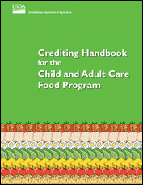
Crediting Handbook for the CACFP
http://www.fns.usda.gov/tn/crediting-handbook-child-and-adult-care-food-program
Notes:
Available through Team Nutrition. If you want additional copies you can go onto the TN website to print a copy off.
Foods not listed in Crediting Handbook for the CACFP or not listed in the Food Buying Guide are not creditable; the food item cannot be used to count toward any meal component.
Not an all inclusive list; only includes commonly served foods in child care programs.
Provides general guidance on menu planning.
Includes a menu checklist that can be used to help with serving a variety of foods.
Provides ideas for dark green vegetables, red & orange vegetables, starchy vegetables, beans & peas to add variety.
Includes a list of common whole grains and tips to add more whole grains to your menu.

Slide 17
Production Record Exercise:
Determining Amounts Prepared
Notes:
Refer to the production record handout listed below the presentation.

Slide 18
M/MA Calculate total amount of meat/meat alternate (ground beef, raw) needed using Meal Pattern Requirements
Ages | Est. Meal Count |  | M/MA |  | Amt. Needed
1 & 2 | 7 | x | 1 oz | = | 7 oz
3 – 5 | 13 | x | 1.5 oz | = | 19.5 oz
6 - 12 | 9 | x | 2 oz | = | 18 oz
Adult | 5 | x | 2 oz | = | 10 oz
Total amount of m/ma needed for lunch: |  |  |  |  | 54.5 oz
Notes:
From the meal pattern chart, the requirements for the m/ma component for lunch/supper are circled here on this slide.
Using the estimated number of children to be served, from the previous slide, we calculate the amount of ground beef we need to prepare.
We have (7) 1-2 year olds that require a minimum 1 oz meat for a total of 7 oz meat.
There are (13) 3-5 year olds that require 1.5 oz meat for a total of 19.5 oz.
There are (9) 6-12 year olds that require 2 oz meat for a total of 18 oz.
And there are 5 adults eating, that require 2 oz meat for a total 10 oz.
When you add all of these amounts together we see that we need to prepare a minimum 54.5 oz ground beef.

Slide 19
Cooked or Raw Ground Beef?
Cooked
Notes:
However, is that 54.5 oz cooked ground beef or 54.5 oz raw ground beef?
The answer is cooked, and beef is one of many food items when once cooked form yields less meat than the raw form. So, we need to use the Food Buying Guide.

Slide 20
Food Buying Guide page 1-15
Locate the food in the Food Buying Guide in the form you intend to purchase (Column 1), then locate the form of the food you intend to serve (Column 4).
Refer to (Column 2) to find the purchase unit. Refer to (Column 3 & 4) for the number of servings & serving size you will get per purchase unit.
1 | Food As Purchased, AP | 2 | Purchase Unit | 3 | Servings per Purchase Unit, EP | 4 | Serving Size per Meal Contribution | 5 | Purchase Units for 100 Servings | 6 | Additional Information
BEEF GROUND, fresh or frozen
Beef, Ground, fresh or frozen Market Style no more than 30% fat |  | Pound |  | 11.2 |  | 1 oz cooked lean meat |  | 9.0 |  | 1 lb AP = 0.70 lb cooked, drained, lean meat
 |  | Pound |  | 7.46 |  | 1-1/2 oz cooked lean meat |  | 13.5
Divide the number of servings needed by the number of servings you will get per purchase unit.
54.5 oz ÷ 11.2 oz = 4.87 lb
Round up to 5 lbs = Amount of raw ground beef to prepare
Notes:
Most agencies should have a food buying guide that you received during a previsit or review. If you do not have a guide you can request one. There is information at the end of this presentation that tells you how you can get a copy.
Page 1-15 of the Food Buying Guide (FBG) lists Beef, ground, fresh or frozen.
The FBG is saying that you will get (11.2) 1 –ounces servings of cooked beef per pound of raw beef. So, to determine how much raw ground beef we need to make to be sure we have 54.5 oz cooked ground beef for our spaghetti you divide our needed amount, 54.5 oz, by 11.2 oz. And we need 4.87 pounds. We will round this up to 5 pounds, so we need to prepare 5 pounds of raw ground beef.
The FBG does provide alternate information if you were to be working with a different serving size other than 1 ounce. For example if we were preparing only 1.5 oz servings, we can use the second row that tells us that one pound of raw meat when cooked produces 7.46 (1.5) oz servings of cooked beef.
There is also additional Information in (Column 6). For raw beef it tells us that 1 pound of raw beef yields .70 pounds of cooked, drained meat. (.70x16oz = 11.2oz) or column 5 tells us that if we are preparing (100) 1-oz servings we need to start with 9 pounds of raw ground beef.
The FBG also lists ground beef by the different amounts of fat (for example 30% fat, 26% fat, etc.) The higher the fat content (30%), the lower the yield of cooked meat.

Slide 21
M/MA
Ground Beef
5 lbs
(raw)
Tomato Sauce
Mixed Fruit
Spaghetti Noodles
Whole
1%
Notes:
So, now that we know we need 5 lbs of raw hamburger we write that under the column “Amounts Prepared.” and we also indicate in the comments box that it is raw.

Slide 22
FBG Exercises
The Amounts Required, based on the meal pattern and number of children, were calculated for you in the Meal Preparation and Production Records presentation
The calculations are on slides 26-40

Slide 23
How many pounds of bananas do we need?
Need 26.25 cups total
Convert 26.25 cups to ¼ cups; 26.25 ÷ 0.25=105, ¼ cups
105, ¼ cups ÷7.07=14.85, round up to 15 lbs
Notes:
Day 1 (Monday) Breakfast
How many pounds of bananas do we need?
We need 26 ¼ cups of bananas in total. (CLICK)
We will use the ¼ cup raw, ½ inch sliced fruit. (CLICK)
Next, you need to convert the total number of cups into ¼ cups. (CLICK) Take 26 ¼ cups divided by 0.25 which is 105 ¼ cups.
Next, we need to know how many servings we will get in one pound of bananas, 7.07 lbs. (CLICK)
(CLICK) The last step is to take 105 ¼ cups divided by 7.07 which is 14.85 lbs, round up to 15 lbs needed to purchase.

Slide 24
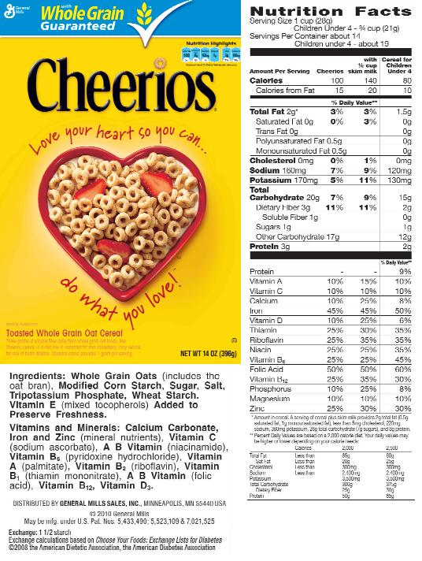
How many 14 oz boxes of Cheerios® will be needed?
Serving Size (1 cup): 28 gm
Servings per container: 14
Box size: 14 oz
Need 33 ounces in total
33 ounces ÷ 14 = 2.36, round up to 3-14 oz boxes
Notes:
How many 14 oz boxes of Cheerios ® will be needed?
The information provided on the nutrition facts label & the box size should have helped you determine the amount.
Since we need 33 ounces in total (CLICK), you would take that divided by the number of ounces in the box which is 14 ounces (CLICK);
(CLICK) 33 divided by 14 is 2.36 so round up to 3 boxes.

Slide 25
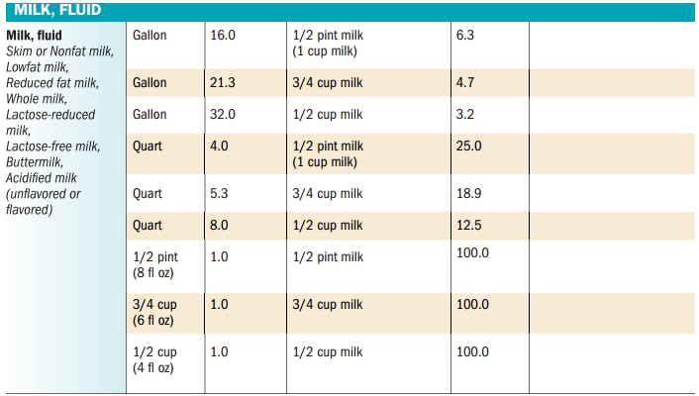
How many gallons of milk are needed for whole & skim?
Notes:
There are 16 cups in 1 gallon (CLICK); we need 5 cups of whole milk & 38 ¾ cups of skim milk. Take 5 divided by 16 to get ½ gallon of whole milk. Take 36.75 divided by 16, that comes out to 2 ½ gallons needed.

Slide 26
Scenario B: Day 1 (Monday) Breakfast
Notes:
This is how the three components from Monday’s breakfast can be documented on the production record. As you can see, I included pounds (CLICK) for the amount of bananas I purchased, I used the comment section to indicate 3, 14 oz boxes of cereal are needed, (CLICK) & included gallons next to the milk.

Slide 27
How many French toast sticks will each child need?
Grains/Bread Chart, Group E
1) 1-5 year olds & adults need 31 grams for ½ serving
5 sticks x 31 gm = 155÷114 gm = 1.36, 2 sticks
2) 6-12 year olds need 63 grams for 1 serving
5 sticks x 63 gm = 315 ÷ 114 gm = 2.76, 3 sticks
Serving Size: 5 sticks (114 gm) Serving per box: 4
How many boxes are needed?
1) Figure out how many sticks in total are needed:
1-5: 50 x 2=100 sticks
6-12: 10 x 3=30
2) 4 servings/box x 5 sticks=20 sticks per box
3) 130 sticks ÷ 20 = 6.5 boxes, round up to 7 boxes
Notes:
Day 2 (Tuesday) Breakfast
How many French toast sticks will each child need? 5 sticks is a serving size @ 114 grams (CLICK)
multiply that by 31 grams for 1-5 year olds plus adults to convert to grams; divide by 114 gm in 5 sticks, you get 1.36—round up to 2 sticks for each 1-5 year old plus adults (CLICK)
5 sticks multiplied by 63 grams for 6-12 year olds to convert to grams; divide by 114 gm in 5 sticks, you get 2.76—round up to 3 sticks for each 6-12 year old (CLICK)
How many boxes of French toast sticks will you need to purchase/prepare? (CLICK)
First you need to determine how many total sticks you will need for breakfast. Multiply the total number of 1-5 year olds plus adults by 2 sticks (50 x 2) (CLICK); 100 sticks. Do the same steps for the 6-12 year olds; 3 sticks x 10 (CLICK); 30 sticks. In total we need 130 sticks.
Next you need to determine how many sticks are in one box, that can be done by multiplying the serving size of 5 sticks by the number of servings in the box which is 4 servings; that is 20 sticks per box. (CLICK) Take 130 total sticks divided by 20 is 6.5 boxes, you will need to purchase/prepare 7 boxes.

Slide 28
Scenario C: Day 2 (Tuesday) Breakfast
Notes:
For the French toast sticks, you can enter the number of sticks prepared (CLICK)or the number of boxes prepared. If you enter the number of boxes, (CLICK) include the number in each box along with the serving size (i.e. 5 sticks = 114 grams). Typically, when we are reviewing production records during an audit the more information available the better. Also, it is common to see an item served but the package is no longer available to review to ensure the minimum amounts were met.

Slide 29
How many pounds of chicken do we need to prepare?
Need 67.5 oz m/ma in total
67.5 ÷ 11.2 = 6.03, round up to 6.25 lbs
Notes:
Day 1 (Monday) Lunch
How many pounds of chicken do we need to prepare?
We need a total of 67.5 oz of m/ma. There are 11.2 (CLICK), 1 oz servings in 1 lb. Take 67.5 oz divided by 11.2=6.03 lbs, (CLICK) round up to 6.25 lbs

Slide 30
How many pounds of frozen veggies will we need for this meal?
Need 11 cups
Convert 11 cups to ¼ cups; 11 ÷ 0.25 = 44, ¼ cups
44, ¼ cups ÷10.6 = 4.15, round up to 4.25 lbs
Notes:
How many pounds of frozen veggies will we need for this meal?
We need 11 cups & we want the vegetables cooked & drained so we will use the 10.6 servings per pound option (CLICK). First we need to convert the 11 cups to ¼ cups. (CLICK) Take 11 divided by 0.25, you get 44 ¼ cups. Next you will take 44, ¼ cups divided by 10.6=4.15 lbs, (CLICK) round up to 4.25 lbs of frozen veggies to purchase/prepare

Slide 31
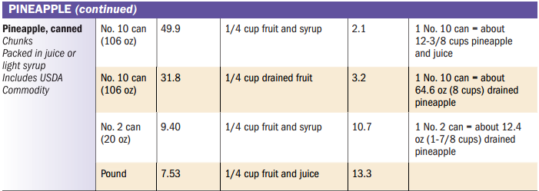
How many number 10 cans are needed for the pineapple?
44, ¼ cups ÷ 31.8 = 1.38, round up to 2, no. 10 cans
Notes:
How many number 10 cans are needed for the pineapple?
Based off the previous slide, we know we need 11 cups in total & that equates to 44 ¼ cups. We will be serving the fruit drained (CLICK), we will get 31.8 (CLICK) ¼ cup portions in 1, #10 can. Take 44 ¼ cups divided by 31.8 to get 1.38, (CLICK) round up to 2, #10 cans must be available to meet the minimum amount for this meal service.

Slide 32
How much rice is needed for this meal service?
Need 12 ½ cups
Convert 12 ½ cups to ¼ cups; 12.5 ÷ 0.25=50, ¼ cups
50, ¼ cups ÷32=1.56, round up to 1.75 lbs dry rice
Notes:
How much rice is needed for this meal service?
The steps are very similar to the fruit/vegetable items. You will first need to convert the 12 ½ cups (CLICK) into ¼ cups. 12.5 divided by 0.25 which is 50(CLICK), ¼ cups servings. Next, take 50 divided by 32 servings in 1 lb of rice equals1.56, (CLICK) round up to 1.75 lbs of dry rice must be prepared.

Slide 33
Scenario D: Day 1 (Monday) Lunch
Notes:
You want to be sure that you specify the type of chicken used as this will make a difference. This applies to fruit & veggies as well—are they canned? Frozen? Fresh? You will get different yields from frozen veggies compared to fresh. If you are using canned fruits, you can simply put in the number for the can size such as #10.

Slide 34
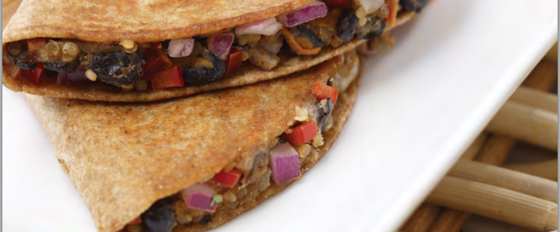
How many servings of the Fiesta Wrap recipe will need to be prepared to meet the minimum amounts for the M/MA?
1 Fiesta Wrap : 1 oz m/ma & 1 GR/B
1) 1 Wrap x 15 (1-5 year olds) = 15 wraps
2) 1 ½ Wraps x 35 (3-5 year olds, adults) = 52.5, 53 wraps
3) 15 + 53 = 68 wraps, make the recipe for 100 servings
Notes:
Day 2 (Tuesday) Lunch
How many servings of the Fiesta Wrap recipe will need to be prepared to meet the minimum amounts for the M/MA?
Note: 1 Fiesta Wrap contributes 1 oz m/ma & 1 gr/b for the CACFP meal pattern.
If one wrap equates to 1 oz meat/meat alternate & 1 grain bread, (CLICK) we will need 15 wraps in total for the 1 & 2 year olds. For the 3-5 year olds plus adults, they need 1.5 oz meat/meat alternate. We have 35 in total, (CLICK) multiply that by 1.5=52.5 or 53 wraps. (CLICK) 15 + 53 = 68 wraps in total needed; there are recipes for yields of 25, 50, & 100 servings. You would want to prepare for 100 servings to ensure there are enough wraps to meet the minimum amount for all age groups.

Slide 35
Scenario E: Day 2 (Tuesday) Lunch
Notes:
For items that used a recipe, it is good practice to reference ‘recipe’ (CLICK) on the production record. Some recipes have numbers & you could write recipe #25. This is helpful for combination food items such as chicken nuggets. If you make homemade chicken nuggets but don’t indicate that it is a recipe or homemade (HM) we may think it needs a CN label.

Slide 36
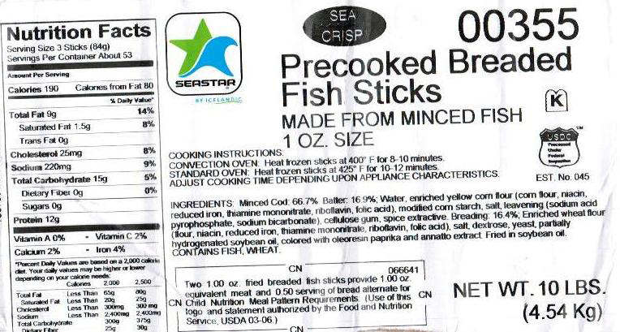
How many fish sticks are needed for each child?
2 Fish Sticks = 1 oz m/ma, ½ GR/B
1-2 Year Olds
3-5 year old, adults:
1 oz ÷ 1 = 1 serving
1 serving x 2 fish sticks = 2 sticks per child
2 sticks x 15 = 30 sticks for 1-2 year olds
1.5 oz ÷ 1 = 1.5 servings
1.5 servings x 2 sticks =3 sticks per child
3 sticks x 35 = 105 sticks for 3-5 year olds & adult
Total:
30 sticks + 105 sticks = 135 fish sticks need to be prepared
Notes:
Day 4 (Thursday) Lunch
How many fish sticks are needed for each child?
First, we need to know what information on the CN label: 2 fish sticks equal 1 oz m/ma & ½ gr/b.
Next, we take the minimum amount needed for each age group divided by the CN label contribution; (CLICK) 1 divided by 1 oz=1 serving multiplied by serving size of 2 sticks equals 2 sticks for each 1 & 2 year old. Repeat the same steps for the 3-5 year olds plus adults. (CLICK) 1.5 x 1 = 1.5 servings x 2 sticks = 3 sticks for each 3-5 year old & adults.
How many fish sticks in total should be prepared?
Then we can take the total projected number of 1 & 2 year olds times 2 sticks (2 x 15 =30 sticks). Repeat the same process for 6-12 year olds; 3 sticks x 35=105 sticks. (CLICK)
Add up 30 + 105=135 sticks in total should be prepared to meet the minimum amount.

Slide 37
How much coleslaw should be prepared?
Need 11 cups in total
11 cups ÷ 0.25 = 44, ¼ cups
Need to make 50 servings
Notes:
How much coleslaw should be prepared?
Per the recipe, ¼ cup of coleslaw equates to ¼ cup vegetable. Convert the 11 cups needed into ¼ cups, 11 divided by .25=44, ¼ cups servings are needed. (CLICK) You will need to prepare the coleslaw for 50 servings.

Slide 38
How many pounds of fresh cantaloupe are needed?
Need 11 cups fruit
Convert 11 cups to ¼ cups; 11 ÷ 0.25 = 44, ¼ cups
44, ¼ cups ÷ 5.73 = 7.67, round up to 7.75 lbs
Notes:
How many pounds of fresh cantaloupe are needed?
We already know we need 44, ¼ cups of fruit. Take 44 divided by 5.73 (CLICK)=7.76 lbs, round up to 7.75 lbs

Slide 39
Scenario F: Day 4 (Thursday) Lunch
Notes:
The reference of CN labels on the production records indicates to us if they are being used & if they are being used correctly. You can put CN behind the name of the item. If the item contributes to more than one component, put the name of the item in the spot (like I have with the fish sticks for the grain/bread) along with CN. In the comment section you can include the serving size for each age group to assist with serving the correct number to the children. (CLICK)

Slide 40
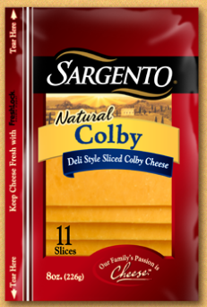
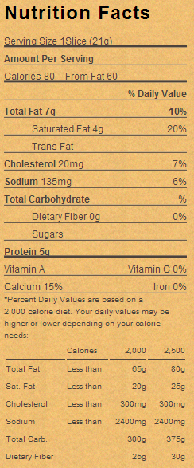
How many slices of cheese should 1-5 year olds (plus adults) receive? 6-12 year olds? - Snack
How many slices of cheese per child?
1-5 year olds, adults need ½ ounce m/ma:
50 x ½ slice = 25 slices
6-12 year olds need 1 oz m/ma:
20 x 1.5 slices = 30 slices
NOTE:
1 ounce = 28.3495 grams
How many packages of cheese are needed?
25 slices + 30 slices = 55 slices
55 slices ÷ 11 slices per package = 5 packages
Notes:
Day 1 (Monday) Snack
How many slices of cheese should 1-5 year olds (plus adults) receive? 6-12 year olds?
First, you will need to know how many grams are in an ounce beings 1 slice is 21 grams (CLICK). 1 slice does not equate to 1 ounce, which is 28.3495 grams (CLICK). Next, you need to know the serving size for the age groups at snack:
(CLICK)
1-5 year olds plus adults need ½ ounce of meat/meat alternate & there are 50 projected; take 50 x 0.5=25 slices
6-12 year olds need 1 ounce of meat/meat alternate & there are 20 projected. Beings one slice does not equate to 1 ounce they will need to be served 1 ½ slices x 20=30 slices for 6-12 year olds
(CLICK)
In total you will need to have 55 slices of cheese to meet the minimum amount.
How many packages of cheese are needed to meet the minimum requirement?
Per the package there are 11 slices; Take the total amount needed of 55 slices divided by 11 slices per package to give you 5 packages.

Slide 41
Scenario F: Day 4 (Monday) Snack
Notes:
Include information about the product in the comment section. I indicated how many slices were in a package & how many slices are needed for each age group. These notes will assist anyone who needs to fill in for the cook & or help serve the food.

Slide 42
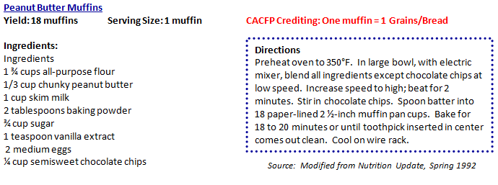
How many recipes of the Peanut Butter muffins will have to be prepared for this snack?
1 Muffin = 1 GR/B, Recipe yields 18 muffins
Need 45 servings of GR/B in total
45 servings ÷ 18 muffins = 2.5, round up to 3
Notes:
Day 2 (Tuesday) Snacks
How many recipes of the Peanut Butter muffins will have to be prepared for this snack?
The recipe indicates that one muffin equals one grain bread & yields 18 muffins (CLICK). You need 45 servings (CLICK) of grain bread to meet the minimum requirement for Tuesdays snack. Take 45 servings in total needed divided by 18 muffins per recipe equals 2.5 (CLICK) or 3 recipes

Slide 43
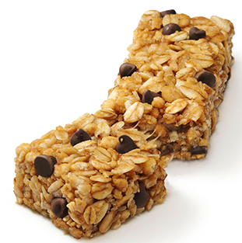
How many granola bars are needed for each child?
®
Group E of the Grain Bread Chart
1-5 year olds & adults need 31 grams
1 x 31 gm = 31 gm ÷ 24 gm = 1.29, 2 bars
6-12 year olds need 65 grams
1 x 63 gm = 63 gm ÷ 24 gm = 2.625, 3 bars
How many total granola bars are needed?
1-5, adults: 50 x 2 = 100
6-12: 20 x 3 = 60
100 + 60 = 160 bars
1 bar = 24 gm
Notes:
Day 3 (Wednesday) Snack
How many granola bars are needed for each child?
In order to determine the number of granola bars should be served to each age group, you need to read the nutrition facts label to determine how much each bar weights. Next, determine where they would fall in the grain bread chart. Beings these have chocolate pieces you will use Group E to determine the amounts.
(CLICK)
1-5 year olds plus adults need ½ serving grain/bread at snack or 31 grams; the serving size is 1 bar; take 1 x 31=31 then divide that by the weight of the bar of 24 grams equals 1.29, round up to two bars for each 1-5 year old plus adults.
For the 6-12 year olds we follow the same steps; they require 1 serving of grain/bread at 63 grams; 1x63=63/24=2.625 bars, round up to 3 bars for each 6-12 year old.
How many bars in total are needed for this PM snack?
To figure out the total number you will need to know the projected numbers for each age group.
(CLICK)
1-5 plus adults: 50 x 2 bars = 100 bars
6-12 year olds: 20 x 3=60
100+60=160 bars in total are needed

Slide 44
Scenario F: Day 4 (Wednesday) Snack
Notes:
Indicating how many bars are to be served to each age group can be put in the comment section. (CLICK) Another option is to indicate how many boxes were used & how many bars in each box along with the serving size per the nutrition facts label.
As promised, I will have Kim start passing out the completed production record that you can use as a sample guide to assist in the completion of your production records.
The different scenarios covered are meant to assist you in planning for the meals you will be serving to the children.

Slide 45
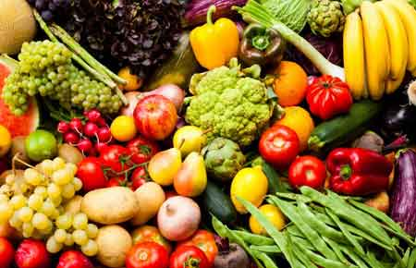
THANK YOU!
Any questions related to the conference may be sent to: cacfptraining@dpi.wi.gov
Notes:
Thank you so much for attending the session on Meal Preparation: What To Do Before You Start Cooking. Please feel free to send any questions to the training e-mail that may have not been answered. It is also located on your agenda as well.

Slide 46
The U.S Department of Agriculture prohibits discrimination against its customers, employees, and applicants for employment on the bases of race, color, national origin, age, disability, sex, gender identity, religion, reprisal, and where applicable, political beliefs, marital status, familial or parental status, sexual orientation, or all or part of an individual’s income is derived from any public assistance program, or protected genetic information in employment or in any program or activity conducted or funded by the Department. (Not all prohibited bases will apply to all programs and/or employment activities.)
If you wish to file a Civil Rights program complaint of discrimination, complete the USDA Program Discrimination Complaint Form, found online at http://www.ascr.usda.gov/complaint_filing_cust.html, or at any USDA office, or call (866) 632-9992 to request the form. You may also write a letter containing all of the information requested in the form. Send your completed complaint form or letter to us by mail at U.S. Department of Agriculture, Director, Office of Adjudication, 1400 Independence Avenue, S.W., Washington, D.C. 20250-9410, by fax (202) 690-7442 or email at program.intake@usda.gov.
Individuals who are deaf, hard of hearing or have speech disabilities may contact USDA through the Federal Relay Service at (800) 877-8339; or (800) 845-6136 (Spanish).
USDA is an equal opportunity provider and employer.

