Slide 1
GOALS OF CIVIL RIGHTS
Equal treatment for all applicants and beneficiaries
Knowledge of rights and responsibilities
Elimination of illegal barriers that prevent or deter people from receiving benefits
Dignity and respect for all
CACFP Civil Rights Training - FDCH Sponsor Staff, Rev. 7/22

Slide 2
What is Discrimination?
The act of distinguishing one person or group of persons from other, either intentionally, by neglect, or by the effect of actions or lack of actions based on their protected classes.
What Is a Protected Class?
Any person or group of people who have characteristics for which discrimination is prohibited based on a law, regulation, or executive order.
CACFP Civil Rights Training - FDCH Sponsor Staff, Rev. 7/22

Slide 3
Discrimination = Four D’s
…an individual or group is:
Denied benefits or services that other receive
Delayed receiving benefits or services
that others receive
Treated Differently than others to their disadvantage
Given Disparate treatment something
which does not seem discriminatory, but
has a discriminatory impact in practice
CACFP Civil Rights Training - FDCH Sponsor Staff, Rev. 7/22

Slide 4
Examples of Discrimination
Refuse a child’s enrollment based on disability
Failure to provide reasonable accommodations
to disabled individuals
Serving meals at a time, place, or manner
that is discriminatory
Selectively distributing applications and income forms
Failure to provide the same eligibility criteria
to all children
Failure to provide materials regarding CACFP in different translations, as needed
CACFP Civil Rights Training - FDCH Sponsor Staff, Rev. 7/22

Slide 5
Components of Civil Rights Compliance
Public Notification System
Outreach and Education
Data Collection
Reasonable Accommodations
Language Assistance
Civil Rights Complaint Procedures
Technical Assistance and Training
Customer Service
Conflict Resolution
CACFP Civil Rights Training - FDCH Sponsor Staff, Rev. 7/22

Slide 6
Equal Access
All participants who attend must be provided equal access to the benefits of the CACFP
To withhold the program from any eligible age group is age discrimination
Infants must be offered infant formula and food at the child care; parents cannot be asked or required to supply these items.
CACFP Civil Rights Training - FDCH Sponsor Staff, Rev. 7/22

Slide 7
Public Notification
Must include information on:
Eligibility
Benefits & Services (i.e., free or reduced-price meals)
Program availability
Applicant rights and responsibilities
Procedures for filing a complaint
Nondiscrimination policies
Any programmatic changes (i.e., changing location of a meal site)
CACFP Civil Rights Training - FDCH Sponsor Staff, Rev. 7/22

Slide 8
Methods of Public Notification
Public Release – Issued by State Agency
Informs the general public that your agency sponsors the CACFP and that meals are provided at no separate charge.
Post “And Justice for All” Poster
(required of sponsor only)
Includes the USDA’s required nondiscrimination statement and lists the USDA contact information for filing a complaint of discrimination.
Other methods of public notification (optional):
Bulletins
Letters/Leaflets/Brochures
Internet/Computer-based Applications
CACFP Civil Rights Training - FDCH Sponsor Staff, Rev. 7/22

Slide 9
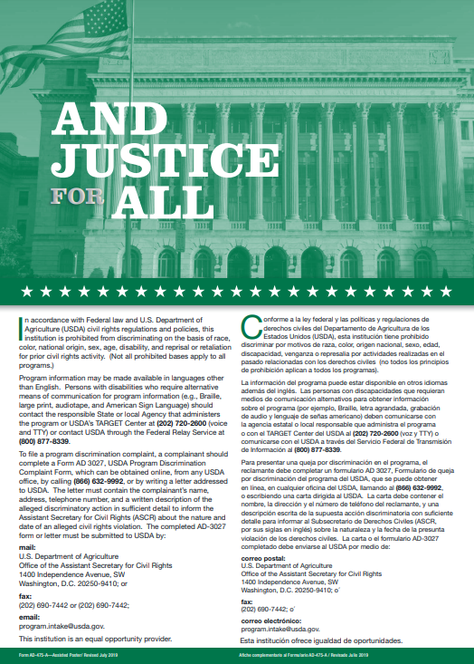
“And Justice for All” Poster
All sponsors participating in Child Nutrition Programs must display the USDA’s non-discrimination poster in a prominent area where participants and potential participants have access
Examples: cafeteria/food service area, office, central bulletin board
Must be posted in admin building/office
Must be 11” x 17” format
DPI provides posters to sponsors free of charge.
Complete this order form to order additional posters, if needed.
CACFP Civil Rights Training - FDCH Sponsor Staff, Rev. 7/22

Slide 10
Public Notification System
All FDCH sponsors participating in the CACFP must provide informational materials in the appropriate translation concerning the availability and nutritional benefits of the program
News Media Release: DPI annually issues a statewide media release for all FDCH sponsors.
CACFP Civil Rights Training - FDCH Sponsor Staff, Rev. 7/22

Slide 11
Public Notification System
Sponsors must:
Give copies to providers
Providers must:
Post in visible location of home
AND/OR
Give copies to families
Sponsor contact info here:
Agency name
AR name
Phone number
Address
Amanda S. Cullen, RDN, CD, Director
Community Nutrition Programs Wisconsin Department of Public Instruction P.O. Box 7841 Madison, WI 53707-7841 608-267-9129
Located under Guidance Memo H on website
CACFP Civil Rights Training - FDCH Sponsor Staff, Rev. 7/22

Slide 12
Outreach and Education
Reach as many potential participants as possible
Ensure program access
Pay attention to under-represented groups
Include the required nondiscrimination statement on all appropriate FNS and agency publications, web sites, posters, and informational materials
When using graphics, reflect diversity and inclusion
CACFP Civil Rights Training - FDCH Sponsor Staff, Rev. 7/22

Slide 13
Nondiscrimination Statement (NDS)
At a minimum, the full USDA Nondiscrimination Statement (NDS) must be on:
Application form(s) for the CACFP
Notification of eligibility or ineligibility of CACFP
Notification of adverse action
Program (Home) webpage (or a link to it)
Public information, including program literature
The full NDS is on the next slide. Agencies may copy and paste the full NDS from the document available under Guidance Memo H (http://dpi.wi.gov/community-nutrition/cacfp/guidance-memo)
CACFP Civil Rights Training - FDCH Sponsor Staff, Rev. 7/22

Slide 14
Nondiscrimination Statement (5/22 revision)
In accordance with federal civil rights law and U.S. Department of Agriculture (USDA) civil rights regulations and policies, this institution is prohibited from discriminating on the basis of race, color, national origin, sex (including gender identity and sexual orientation), disability, age, or reprisal or retaliation for prior civil rights activity.
Program information may be made available in languages other than English. Persons with disabilities who require alternative means of communication to obtain program information (e.g., Braille, large print, audiotape, American Sign Language), should contact the responsible state or local agency that administers the program or USDA’s TARGET Center at (202) 720-2600 (voice and TTY) or contact USDA through the Federal Relay Service at (800) 877-8339.
To file a program discrimination complaint, a Complainant should complete a Form AD-3027, USDA Program Discrimination Complaint Form which can be obtained online at: https://www.usda.gov/sites/default/files/documents/USDA-OASCR%20P-Complaint-Form-0508-0002-508-11-28-17Fax2Mail.pdf, from any USDA office, by calling (866) 632-9992, or by writing a letter addressed to USDA. The letter must contain the complainant’s name, address, telephone number, and a written description of the alleged discriminatory action in sufficient detail to inform the Assistant Secretary for Civil Rights (ASCR) about the nature and date of an alleged civil rights violation. The completed AD-3027 form or letter must be submitted to USDA by:
mail: U.S. Department of Agriculture Office of the Assistant Secretary for Civil Rights 1400 Independence Avenue, SW Washington, D.C. 20250-9410; or
fax: (833) 256-1665 or (202) 690-7442; or
email: program.intake@usda.gov
This institution is an equal opportunity provider.
CACFP Civil Rights Training - FDCH Sponsor Staff, Rev. 7/22

Slide 15
Nondiscrimination Statement
If the material or document is too small to permit the full statement (previous 2 slides) to be included, the material MUST, at a minimum, include:
“This institution is an equal opportunity provider.”
CACFP Civil Rights Training - FDCH Sponsor Staff, Rev. 7/22

Slide 16
Collecting and Recording Participation Data
Race and ethnicity data is used to determine how effectively your program is reaching potentially eligible children and where outreach may be needed.
Establish a system to collect race and ethnicity data on an annual basis
Program applicants may not be required to furnish race and ethnicity
You may inform the household, however, that collection of this information is strictly for statistical reporting and has no influence on eligibility determination for the program.
Data collectors may not second guess, change, or challenge a self-declaration of race and ethnicity made by a participant unless such declarations are blatantly false.
CACFP Civil Rights Training - FDCH Sponsor Staff, Rev. 7/22

Slide 17
Data Collecting and Reporting
Collect ethnicity data first, then race data
1. Ethnicity categories:
Hispanic or Latino
Non-Hispanic or Non-Latino
Race categories
(instructions should specify “mark one or more”)
American Indian or Alaskan Native
Asian
Black or African American
Native Hawaiian or other Pacific Islander
White
CACFP Civil Rights Training - FDCH Sponsor Staff, Rev. 7/22

Slide 18
Obtain race / ethnicity data through…
Voluntary self-identification or self-reporting USDA issued guidance that visual observation and identification is no longer an allowable practice in obtaining race and ethnicity from CACFP participants
CACFP Enrollment Forms: The race and ethnicity data may be collected on the enrollment forms submitted to the sponsor
If a household does not provide race and ethnicity information, use other documentation the sponsor collects that identifies the enrolled children’s race and ethnicity data
CACFP Civil Rights Training - FDCH Sponsor Staff, Rev. 7/22

Slide 19
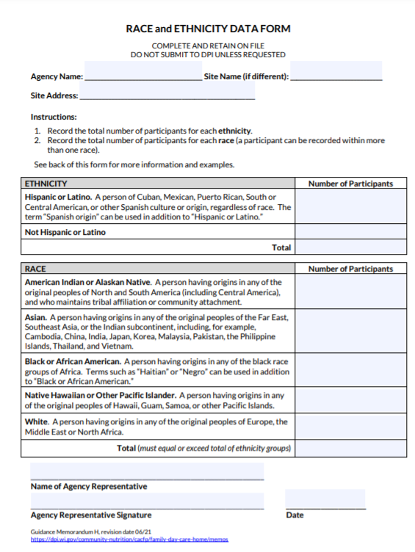
Sample Race and Ethnicity Data Form
This data may be:
Annually compiled by other means than this sample Race and Ethnicity Data Form.
Collected and maintained within a database to annually compile into a printed report
Located under
Guidance Memo H
on website:
http://dpi.wi.gov/community-nutrition/cacfp/guidance-memo
CACFP Civil Rights Training - FDCH Sponsor Staff, Rev. 7/22

Slide 20
Data Management
Collection systems must ensure that data collected/retained are:
Collected and retained by each provider
Kept secure and confidential
Submitted, if requested, to FNS Regional or Headquarters Offices
Kept on file for 3 years plus the current program year
Identify all sources of information used
CACFP Civil Rights Training - FDCH Sponsor Staff, Rev. 7/22

Slide 21
Conflict Resolution
The USDA recommends using an Alternative Dispute Resolution (ADR) program
ADR Definition: use of a neutral third party (usually a person acting as a facilitator) to resolve informally a complaint of discrimination through use of various techniques such as fact finding, mediation, peer panels, facilitation, ombudsman support, or conciliation.
For more information, visit:
Federal Sector Alternative Dispute Resolution | U.S. Equal Employment Opportunity Commission (eeoc.gov)
CACFP Civil Rights Training - FDCH Sponsor Staff, Rev. 7/22

Slide 22
Reasonable Accommodations for Persons with Disabilities Providing Food Substitutions
A disability is defined as any physical or mental impairment substantially limiting one or more “major life activities”, including digestion.
This includes food allergies and intolerances.
Programs are required to reasonably accommodate participants whose disabilities restrict their diets by providing substitutions or modifications for their meals, when supported by a proper medical statement
The medical statement must:
(1) Be from a licensed healthcare professional authorized to write medical prescriptions under Wisconsin law
These are:
Licensed Physicians; Physician Assistants; and Advanced Practice Nurse Prescribers (APNP)
(2) Include a description of impairment (reason for request) and how to accommodate the impairment (e.g., food(s) to be avoided and recommended substitution(s))

Slide 23
Language Assistance
Limited English Proficiency (LEP)
Definition:
Individuals who do not speak English as their primary language and have limited ability to read, speak, write, or understand English.
Recipients of Federal financial assistance have a responsibility to take reasonable steps to ensure meaningful access to their programs and activities by persons with LEP.
CACFP Civil Rights Training - FDCH Sponsor Staff, Rev. 7/22

Slide 24
Limited English Proficiency (LEP)
Children should not be used as interpreters.
Volunteers may be used, but make sure they understand interpreter ethics – particularly confidentiality!
Example: Sponsor staff with Spanish language skills could assist a household in completing a Household Size-Income Statement but would need to be trained on the importance of keeping all information received from the household confidential.
CACFP Civil Rights Training - FDCH Sponsor Staff, Rev. 7/22

Slide 25
Limited English Proficiency (LEP)
See www.lep.gov for more information and resources
Documents translated in Spanish and Hmong (Wisconsin specific forms):
https://dpi.wi.gov/community-nutrition/cacfp/child-care/translations
Household-Size Income Statement Forms in other languages (USDA Forms):
https://www.fns.usda.gov/cacfp/english-meal-benefit-income-eligibility-form
Note: the USDA document includes the various forms for all CACFP components; identify the appropriate form within the English version first to know which of the translated documents to give households.
CACFP Civil Rights Training - FDCH Sponsor Staff, Rev. 7/22

Slide 26
A shortage of resources does not eliminate the translation requirement
Suggestions:
Share resources to save money
Use interpreter from another area
Train bilingual staff to be interpreters
Contact grassroots organizations to discuss translation or assistance from within the community
Language line phone services may be available for a subscription fee through your local telephone service provider
CACFP Civil Rights Training - FDCH Sponsor Staff, Rev. 7/22

Slide 27
Right to File a Complaint
Any person who believes they or someone they know has been discriminated against based on Federal protected classes (i.e, National origin, race, etc.) has a right to file a complaint within 180 days of the alleged discriminatory action. Complainants:
Should complete the USDA Program Discrimination Complaint Form (AD-3027) Found online at: https://www.usda.gov/sites/default/files/documents/USDA-OASCR%20P-Complaint-Form-0508-0002-508-11-28-17Fax2Mail.pdf
May contact either of the following offices to submit a complaint:
USDA- Office of the Assistant Secretary for Civil Rights: Refer to slide 14 for the address, fax number, and email address.
Wisconsin DPI: Director, Community Nutrition Programs,125 South Webster Street, P.O. Box 7841, Madison, WI 53707-7841, 608.267.9129
CACFP Civil Rights Training - FDCH Sponsor Staff, Rev. 7/22

Slide 28
Handling Civil Rights Complaints
Complaints can be written or verbal
Anonymous complaints should be handled as any other complaint
All verbal or written complaints must be forwarded to WI DPI or USDA’s Office of the Assistant Secretary for Civil Rights within three days of receiving a complaint
Sponsors must give complainants a Civil Rights Complaint Form to complete (slide 27 has web link)
Document all potential complaints in the Civil Rights Complaint Log
Have a central location where the sponsor keeps completed Civil Rights Complaint Forms and the Civil Rights Complaint Log
CACFP Civil Rights Training - FDCH Sponsor Staff, Rev. 7/22

Slide 29
The following information should be included in a Civil Rights Complaint
Name, address, phone number of complainant, if provided (not required)
Specific name and location of entity delivering the benefit or service
The nature of the incident, action, or method of administration that led the complainant to feel discriminated against
CACFP Civil Rights Training - FDCH Sponsor Staff, Rev. 7/22

Slide 30
The following information should be included in a Civil Rights Complaint (Continued)
The basis on which the complainant feels discrimination exists [race, color, national origin, sex (including gender identity and sexual orientation), age, or disability]
The names, titles, and business addresses of persons who may have knowledge of the discriminatory action
The date(s) during which the alleged discriminatory actions occurred, or if continuing, the duration of such actions
CACFP Civil Rights Training - FDCH Sponsor Staff, Rev. 7/22

Slide 31
Civil Rights Training for Agency Staff
All staff who work with the CACFP must receive training on all aspects of civil rights compliance annually
Topics -What is Discrimination?
-Collecting/recording racial/ethnic data
-Where to display posters
-What is a Civil Rights complaint
-How to handle a Civil Rights complaint
Use DPI’s Civil Rights Training Power Point
(Located under GM H > Civil Rights Training tab)
Keep training records: List of staff who received training, when they received it, and training materials
CACFP Civil Rights Training - FDCH Sponsor Staff, Rev. 7/22

Slide 32
Customer Service
All participants must be allowed equal opportunities to participate in Child Nutrition programs regardless of race, color, national origin, sex (including gender identity and sexual orientation), age, or disability
All participants must be treated in the same manner (i.e., seating arrangements, serving lines, services and facilities, assignment of eating periods, methods of selection for Household Size-Income Statement approval)
CACFP Civil Rights Training - FDCH Sponsor Staff, Rev. 7/22

Slide 33
Understanding Differences: Respectful Language
Put the person first
Example: USE “person with a disability”, NOT “disabled person”
Use culturally sensitive language
Example: USE “Asian”, NOT “Oriental”
Use inclusive/respectful terms
Example: USE “chair”, NOT “chairman”
The Side Road – Business Communication:
http://www.sideroad.com/Business_Communication/politically-correct-language.html
CACFP Civil Rights Training - FDCH Sponsor Staff, Rev. 7/22

Slide 34
Ask yourself each time you interact with participants…
How would I want to be addressed?
Am I treating this person in the same manner I treat others?
Have I informed this person exactly what information I need to make a determination on their Household Size-Income Statement?
Have I given this person the opportunity to clarify all relevant factors or inconsistencies and ask questions?
Have I provided this person with needed information to make necessary decisions?
CACFP Civil Rights Training - FDCH Sponsor Staff, Rev. 7/22

Slide 35
Civil Rights “Must Do List”
Sponsors must train & monitor providers to ensure:
The CACFP is provided in a nondiscriminatory manner
Meals are offered to all children in care and meal substitutions are supplied to children with disabilities
Providers supply formula and foods to infants, giving parents the option to supply only if they choose
The Building for the Future flier is posted or given out to all families of enrolled children
The current USDA nondiscrimination statement & complaint filing procedure is printed on materials available to the public which mention USDA and/or CACFP, including websites (sponsors & providers)
CACFP Civil Rights Training - FDCH Sponsor Staff, Rev. 7/22

Slide 36
Civil Rights “Must Do List”
Sponsors must:
Conspicuously place the “And Justice for All” poster within the sponsor’s administrative office
Annually compile Civil Rights Data and retain on file for 3 years plus the current year
Provide informational materials in the appropriate translation concerning the availability and nutritional benefits of the CACFP
Train staff annually on Civil Rights and retain training records
Develop & fully implement your Civil Rights Complaint Procedure
Make available to all staff: Civil Rights Complaint forms, Civil Rights Log and Civil Rights complaint procedure
Refer all Civil Rights complaints to DPI or USDA
CACFP Civil Rights Training - FDCH Sponsor Staff, Rev. 7/22

