Slide 1
Maximize Your Menu
Cooking Demonstration
by Chef & Author,
Monique Hooker

Slide 2
Fifth Season
Buying in Season
Utilizing “Seconds”
Processing Day
Existing Staff
Kitchens
Introduce New Menu Items
Harvest of the Month Activities
Use in Menus & Recipes Entire Year
Pizza, Calzones, Wraps, Pasta, Muffins, Soup
Notes:
Fifth Season is putting away food for later use (=Freezer)

Slide 3
Harvest of the Month
Local & Seasonal Food Featured Each Month
Displays
Tastings
Nutrition Education
Beets, Spinach, Asparagus for example
Fun Facts
New Recipes
Monthly Newsletter for Parents
Harvest of the Month: http://www.harvestofthemonth.cdph.ca.gov/
Include Featured Food in Meals & Snack

Slide 4
Classroom Nutrition Education
Notes:
Kdg. nutrition education lesson on healthy eating by Kait Keeley – First year AmeriCorps Nutrition Ed Member.

Slide 5
Display & Tastings in the Cafeteria
Notes:
AmeriCorps Nutrition Education Member was involved in education in the cafeteria and classroom.

Slide 6
Asparagus From Local Farm Served for Lunch
Notes:
Asparagus purchased directly from a local farm was featured on the menu in May.

Slide 7
Roasted Beets

Slide 8
See Me Eat It

Slide 9
Sweet Roasted Beets

Slide 10
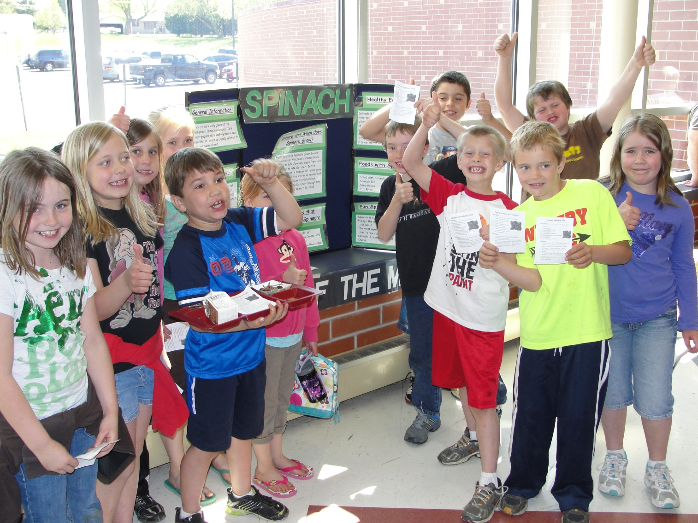
Learning About Spinach

Slide 11
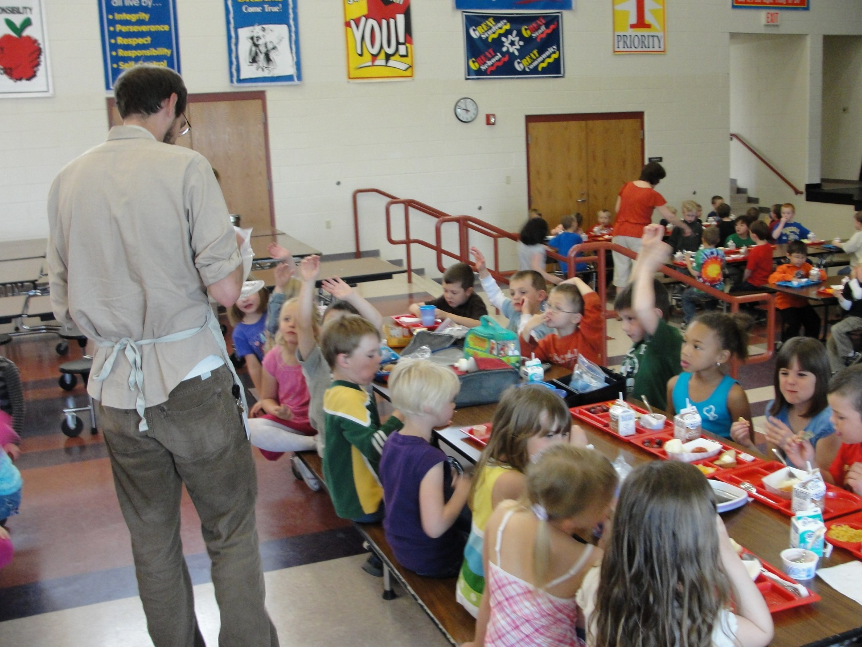
Fresh Spinach Tasting

Slide 12
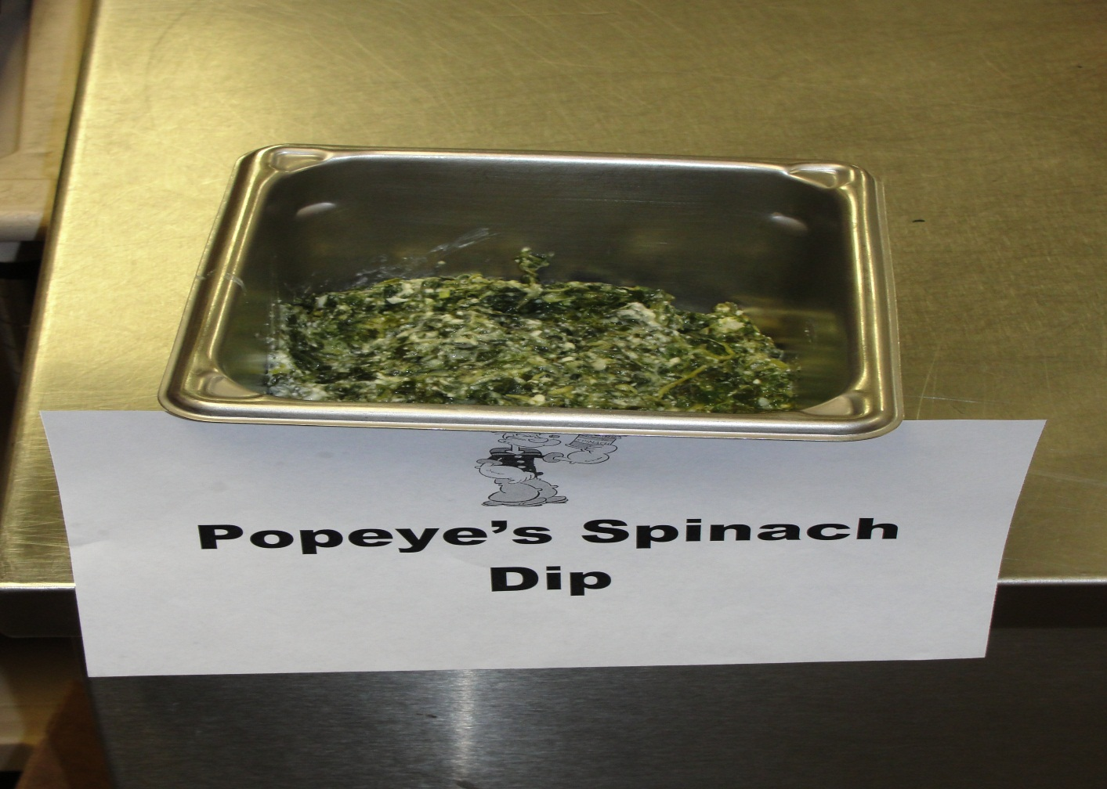
Spinach Dip

Slide 13
Colorful Harvest
Notes:
Began with 2009 Pilot project of the Food and Farm Initiative in partnership with Viroqua Schools. Project spanned 4 months and involved over 30 volunteers. Program continues with increased volunteers & farms involved.
One gleaning day each month. Almost 3,000 lbs of produce was gleaned, washed, packed in school kitchens and distributed in 158 fresh food boxes to elderly, limited income residents of Park View Manor.
Monthly cooking demos by local chefs instructed residents on how to prepare the produce in the box each month. Recipes were included with each box.
Eleven local produce farms participated the first year of the project.

Slide 14
Garden Lesson

Slide 15
Flatbread in the Making

Slide 16
Flatbread

Slide 17
Regulations of Purchasing Locally Grown Foods
Whole, uncut produce may be purchased directly from a farm
Currently there are no requirements on farm food safety inspections for raw, fresh fruits & vegetables
Assurances that farms are practicing food safety measures are important
Notes:
WI’s food law states that only safe and wholesome food can be offered for sale.
Farmers in WI are considered “approved source” for F & V they raise themselves – no license is required to sell any quantity to any person or business.
All schools follow HACCP (food safety) plans in their kitchens. Local purchasing does not fall outside of those plans. Expectations are the same for every vendor.
Schools are looking for food safety assurances.

Slide 18
Food Safety Audit Programs
Voluntary Audit-Based Program
GAP: Good Agricultural Practices
Verify farms conform to specific agricultural practices to produce fruits and vegetables in the safest manner possible
GHP: Good Handling Practices
Verify farms conform to specific practices used in handling and packing operations that minimize microbial contamination
Notes:
USDA Trained and licenses auditors
DATCP is currently conducting a food safety assessment with all types of producers to find out what works and what doesn’t – expected to have recommendations by the end of March for rolling out a program for producers.
There are a variety of tools available – checklists, etc for growers and buyers of local produce.
WI Local Food Marketing Guide.

Slide 19
Questions?

Slide 20
Thank you!
Monique Hooker
E-mail: monique@mwt.net
Phone: 608-648-2409

