Slide 1

Program Policies
…Enhancing Healthy Eating and Physical Activity in your Center
Notes:
Welcome to this session on Enhancing Healthy Eating and Physical Activity in your Center.
This session will cover policy development.

Slide 2
Congratulations
on Building
Lifelong Healthy Habits!!
Notes:
Thank you all for coming –and congrats for taking this time to build upon making Healthier Habits for optimal child growth and development an important element in your program! Our goal is to help children eat well and be active today and create a lifetime of good eating and exercise habits.
We know children are facing a serious health crisis. 18 M children under the age of 5 are overweight/obese.

Slide 3

“Early childhood settings, including both child care centers and informal care, present a tremendous opportunity to prevent obesity by making an impact at a pivotal phase in children’s lives.”
-Solving the Problem of Childhood Obesity Within a Generation: a Report to the President from the Childhood Obesity Task Force.
https://letsmove.obamawhitehouse.archives.gov/sites/letsmove.gov/files/TaskForce_on_Childhood_Obesity_May2010_FullReport.pdf
Notes:
Now we have national support….Recognizing the importance of child care settings in helping our youngest children get off to a healthy start, public and private child care providers across the nation are making changes. Approximately 1,600 centers serving 280,000 children will implement new practices to encourage healthy eating and physical activity and limit screen time as a result of new commitments from the Department of Defense.
Thanks to the national focus on childhood obesity prevention and our state wide coalitions, we have many resources now that cover improving childhood habits covering nutrition, activity, sleep to name a few, and more will continually be developed to assist us in what ever setting we may be working in.

Slide 4

“Children learn healthy habits from the adults and caregivers in their lives. We have the opportunity to supply a generation with nutritious foods and healthy habits in an environment that is fun, safe and they trust us.”
Jan Pelot, Wood County Head Start, WI Rapids
Notes:
It is here, at the local level, right here and now that all of you, bring the greatest promise! You can make a difference in the health habits of 1000’s of children and families right in your community! WI has 235T children in Child Care.
Managing CCC’s is complicated business! Like many providers, You find your staff is doing fabulous job, but you also are finding there are other areas that need improvement. Often thoughts and practices around feeding children, for example, take a back seat to other pressing issues. You may be doing what is required for the child care food program but now you want to step it up a notch and bring your center’s feeding and other practices into focus!! Guess what, it doesn’t’ have to be another thing on your plate… next slide
**Day after day I am getting calls from providers that are excited about the Wellness Grant and stating this is just want we need –to be able to bring some focus on health and wellness in their program and to have funds to help! More on the grant later.
**For purposes of today, I will focus most of my examples on food and feeding practices, which is where I am most familiar with.

Slide 5
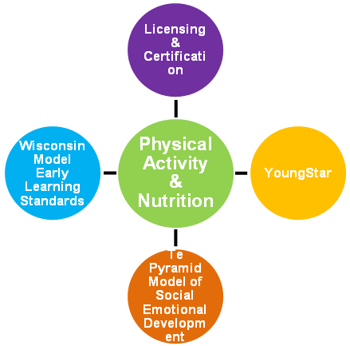
How Does this Fit into Existing
Childhood Initiatives?
Notes:
Nutrition and Physical Activity have a place in nearly every aspect of the Early Care & Education field in WI.
Licensing & Certification
YoungStar
WI Model Early Learning Standards.
The Pyramid Model of Social Emotional Development

Slide 6
Promote Health & Wellness
Motivated Staff
Basic knowledge
Adventurous spirit
Willingness to try new things
Notes:
Having these health campaigns and existing initiatives are key. We do need to recognize that by having a motivated staff, with basic knowledge, having an adventurous spirit and willing to try new things is a big part of the process!
You can promote health and wellness through program policies. During this session, we will look at incorporating and promoting health and wellness (nutrition and physical activity practices) in your child care program through program policies. Recognizing that with a motivated staff, a basic knowledge base and an adventurous spirit…having the willingness to try new things, every childcare program can have an impact on the health and activity levels of young children.

Slide 7
Policies are a Great Place to Start!
What policies have you developed? Have they become your standards?
Notes:
Helping to improve your center’s environment often starts with establishing direction that will lead into program recommendations or policies. Get sample ideas from the audience. How many of you have policies set for staff: role modeling, eat with children and from their menu…center requires healthful birthday snacks. Prohibit soda and candy vending.
Example: As a participant of the CACFP, it requires certain foods and amounts to be served, but it doesn’t require that the child eat the food. Therefore a center may use the Division of Responsibility in Feeding by Ellyn Satter for developing a feeding policy. This will lead to good eating habits even for the choosiest eater. This policy, set as a standard, should also be shared with families so that parents can understand and adopt in their home.
What where when=Parents, If How Much=children.

Slide 8
Policies can Help
Create consistent messages
Provides clear guidelines
Provide a basis for evaluation and ID what areas needing improvement
Educate new staff/parents on current practices
Notes:
These policy examples are designed to support and sustain the changes you want to make in your child care center. 1. for staff, parents, and licensing or CACFP officials that explain and reinforce nutr/PA habits
2. Guidelines for staff and parents
3. Evaluation-we will be doing an activity later relating to this
4. Educating staff/new staff an parents on current nutr/PA practices

Slide 9
Policies can Help
Guide decisions and choices
Communicate program’s benefits
Prevent problems and provide solutions
Notes:
Cont.
Guide decisions and choices made every day. Be willing to re-evaluate, but also important to have follow through
Communicate benefits…great PR tool when recruiting new families, looking at applying for grants
Prevent problems, provide solutions. Get Everyone on board with the process..
Are there others I am missing? Any to add?

Slide 10
Program Policies are as Good as they are Implemented…
Why Nutrition and Physical Activity Policies
-Statistics, Assessments
Who is on board… admin, staff, parents
-Parent, staff surveys/interviews
Shared decision making. TEAM approach
- Consensus and commitment
Notes:
Many benefits to having Policies: Briefly touch on these elements for to improve your center’s environment: (Use these steps as a basis with staff training).
Why Policies? Think of starting with the troubling health facts we know about young children today---would this be enough to implement a policy or strengthen one you currently have?
“What If I told you that over 1 in 3 children In your care are at great risk of suffering from HD, Diabetes, up to 60% exhibit risk factors for heart disease, less than half have adequate CV endurance and 1 of 5 could die prematurely, How would your react? Unfortunately, research on youth health and wellness shows this risk is very real for US. Are you shocked or is this familiar news? CDC-American children are becoming more sedentary, fatter and less fit and as a result at risk of poor health, today and in the future. What if I also told you that YOU and as part of a cc program, could help prevent the problems from happening, what would you do? Again, Is this information enough to move you to the next level? Probably not… Take this further!
Assessment is often an overlooked step, but a critical part of helping answer the Why Policies? Understanding where you are and where to start…Assessment of current practices and philosophies. (some of you may be doing this with YoungStar). Taking the time to assess your program increases the chances that you will make the right changes with the most impact to children, staff and parents. How many of you have done assessments recently? Was it an eye opener? Do Activity One. Let’s Move Checklist, AE/HB Guidebooks
Base the need for and content of the policy on the results. Don’t feel like you must change everything over night. Choose one or two areas-consider the goals of your center, and work on improving . Did you find out you want to change outdoor activity-send one classroom out at a time to reduce injuries, include more nutrition curriculum like with gardening, add whole grains in your menus?
2. Who is on board? Parent, staff survey. Get staff/parent input in learning what is important to them, input developing and enough time to commit to policies(timelines)
(Activity II-to bring out staff philosophy, may be a barrier, which brings up Role Modeling). based on the expectations of parents
Shared Decision Making/Team- When more policies are being considered, this means more work, potential challenges and expectations that may seem or become overwhelming. No doubt, hard work, some extra hours and staff/parent consensus, willingness to be responsible, commitment will help to overcome these barriers. You may use memos to keep staff informed, or establish teams within your center(climate committee).
Be realistic, keep it simple and do one step at a time. Have those involved work on something that is familiar to them, and prioritize…what is most important.
Spend the last 15 minutes to do some policy planning/sharing

Slide 11
Program Policies are as Good as they are Implemented…
Benchmarks and Timelines
-Steps, tasks, completion dates
Consistent Health Messages
-Promoted to all and on a consistent basis
Ongoing evaluation
-Reassess, measure progress with QIP
Notes:
Timelines—Benchmarks, Steps along the way that will let a program know it is on track. tasks identified, and when completed, policies in place. Policies and policy changes communicated throughout center (at orientation, fliers, newsletter, handbook, parent boards, employee handbook/standard operating procedures).
This goes right into the next element: Important to deliver consistent health messages. Making healthy food choices and physical activity available to children is important. It is also important to educate parents and the community about the benefits of a healthy childcare environment and motivate them to take action.
Research finds that when there is consistent health messages, children ask for healthy foods, children and the provider ate healthier, helped plan menus, less food waste, tried new foods, when providers participating in physical activity
Ongoing evaluation for quality improvement—based on standards. How do you decide the policy is effective, are they improving outcomes for children and families, staff? Don’t put something into policy that you will not be doing. Re assess and review periodically.—See QIP!
Before we break out into small groups….Take a minute to reinvigorate…get our blood and brains humming.
Get into similar groups..shelters? Child care? After school hours?
Spend the last 15 minutes to do some policy planning/sharing:

Slide 12
Model wellness policies reflect important best practices
- Nutrition standards for assuring only healthy meals and snacks and beverages.
- A recommended minimum for the amount of daily physical activity, recommended types of activities, and limitations on the amount of time spent watching TV or videos.
- Plans for nutrition and physical activity education for children, teachers and parents.
Notes:
Model wellness policies can include:
Standards that are fully consistent with current nutr. Science and US Dietary Guidelines, state licensing requirements with regard to both nutrition and physical activity recommendations and other sources, AAP

Slide 13
Wellness Policies
Improve the health and nutrition of children participating in child care settings by implementing or strengthening wellness policies
  Improve the nutritional quality of food
  Encourage physical activity
  Involve parents/caregivers
Notes:
It’s not only good enough to do a couple of those strategies or to say that your center is doing these things. You need to implement a written policy that will ensure your agency will be able to sustain the changes you want to make.
You need to develop and implement policies promoting the health and nutrition improvement for children
During this session, we will look at incorporating and promoting health and wellness (nutrition and physical activity practices) in your child care program through program policies.
Since parents/caregivers and child care providers share the responsibility for children during important developmental years, their involvement is critical to improving the health and nutrition of children. To help ensure children are receiving consistent messages from their homes and day care settings, it will be essential for providers to include parents and caregivers in the planning and implementation stages of their wellness policies.

Slide 14
Wellness Policies vs.
Licensing Policies
Wellness policies go beyond licensing rules:
  Each meal and snack served shall meet the USDA CACFP minimum meal requirements
  Menus shall include diverse types of foods
  Enough food shall be prepared for each meal so that second portions of vegetables or fruit, bread and milk are available to children
  Mealtime:
    Staff shall sit at the table with the children during mealtime
    Meals shall be served with time allowed for socialization
Notes:
In the past, we’ve asked to see agencies’ wellness policies and a lot of agencies submitted what they thought were nutrition or wellness policies, but they actually were just the standard licensing policies. While licensing rules are a good base for policies, having a wellness policy in place needs to go above and beyond and be more specific than what is required by licensing.

Slide 15
Program Policy Development
Evaluate current policy and identify areas in need of improvement
Refer to recommendations and sample policies
Consult with those affected by policy
  Survey, questionnaires, meetings, discussions
Write the policies
  Info on how to develop a policy and sample QIP
    Pages 5-9 (HB) & pages 6-9 (AE)
  Self-Assessment and QIP
    Pages 51-5 7 (HB) & pages 57-64 (AE)
  Parent Communication - Page 65 in Appendix (HB)
Notes:
We’re not going to go into a lot of detail on how to write policies – both AE and HB (which we’ll talk about next) can help you with that. But here are just some general rules when developing policies. Refer to the pages listed here in both HB and AE for more information.
At your center, you may want to start a discussion about what changes are important to staff members and what the challenges are to making these changes. Get suggestions on possible solutions to the challenges. Get input from as many people as possible. Have director take notes. This may help with staff buy-in and be useful information for action planning.

Slide 16
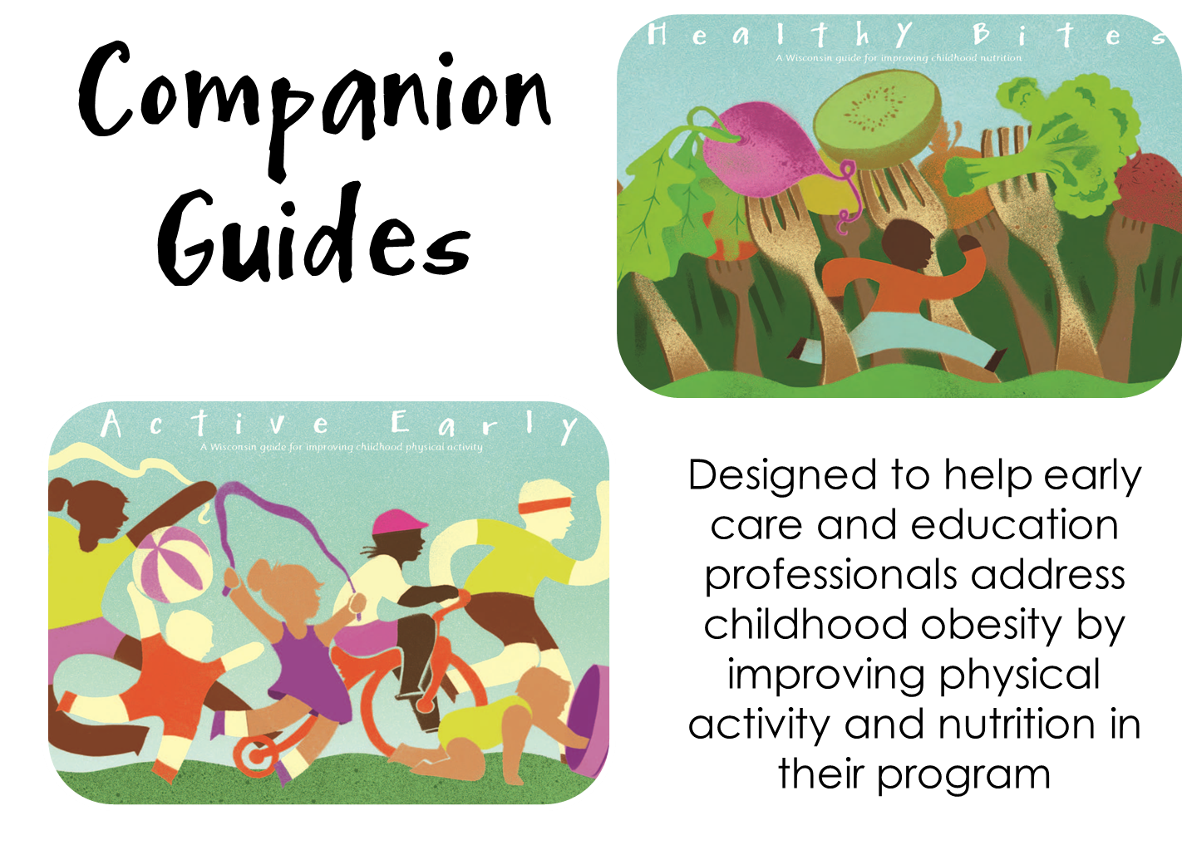
http://fns.dpi.wi.gov/fns_cacfpwellnesswhy
Notes:
To help you determine which wellness policies you’d like to implement at your center, we created AE and HB.
Active Early and Healthy Bites were created as companion guides designed to help early care and education professionals address childhood obesity by improving PA and nutrition in their program. Both guides were developed in a collaborative process with many different organizations. Since both nutrition and PA must go hand-in-hand, we intentionally designed the guides to look similar so that they would be associated with one another and then used together.
You can download a copy at the website listed here – or you can contact your consultant to obtain a copy based on availability

Slide 17
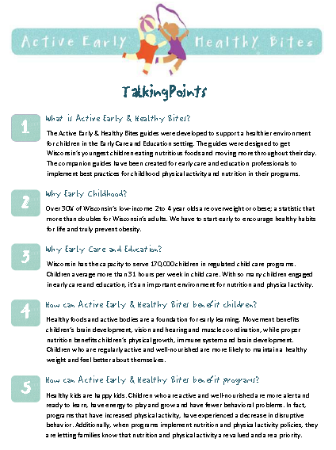
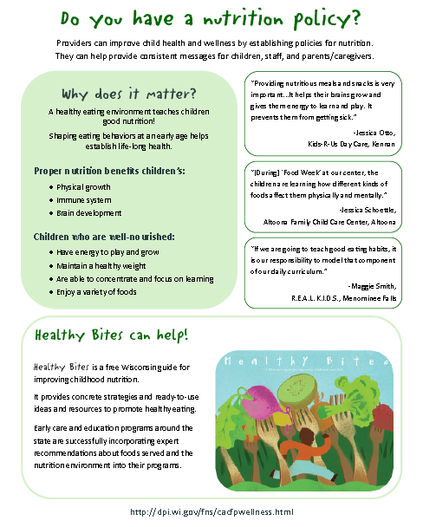
http://fns.dpi.wi.gov/fns_cacfpwellnessbp
Notes:
We’ve also developed communication pieces to train your staff and parents on why a nutrition and PA policy is important and talking points which explain why AE and HB should be used in your facility as well as how to use the guides. They both may be found on CACFP Wellness website.

Slide 18
https://healthykidshealthyfuture.org/
Physical Activity
Screen Time
Food
Beverages
Infant Feeding
Notes:
Recommendations for infants, preschoolers, toddlers

Slide 19
Policy Development Review
Assessment
Review sample program policies
Consult with those affected (surveys)
Design policies supporting the change desired
Consensus
Communicate health messages
Evaluate
Notes:
Policy Developement

Slide 20
How do you hit a Target you can not see or do not have…
Are you a wandering Generality or a Meaningful Specific?
Notes:
One more thing…I like to consider this analogy with policy development, like goal setting. Think of your center this way or how you are approaching this process. I use this in my life.
By Zig Ziglar, Motivational speaker:
Become a Meaningful specific and you will succeed!

Slide 21
Resources
http://teamnutrition.usda.gov/childcare.html
www.brightfutures.org/nutrition
https://www.fns.usda.gov/cacfp
https://healthykidshealthyfuture.org/
http://health.mo.gov/living/dnhs_pdfs/ChildCareModelPolicies.pdf

Slide 22
A Smile is a Curve that Set’s Everything Straight!
-Phyllis Diller
Notes:
Thank you all very much!

