Slide 1
The Perkins Grant
Comprehensive Local Needs Assessment
Introduction and Overview
Chris Lenske
Grant Specialist, CTE Team
5/8/2023
Notes:
Welcome to the Perkins Grant Comprehensive Local Needs Assessment Introduction and Overview presentation. In this presentation, we hope to set the stage for the work Perkins recipients will soon undertake in preparation for the next 2-year grant cycle.

Slide 2
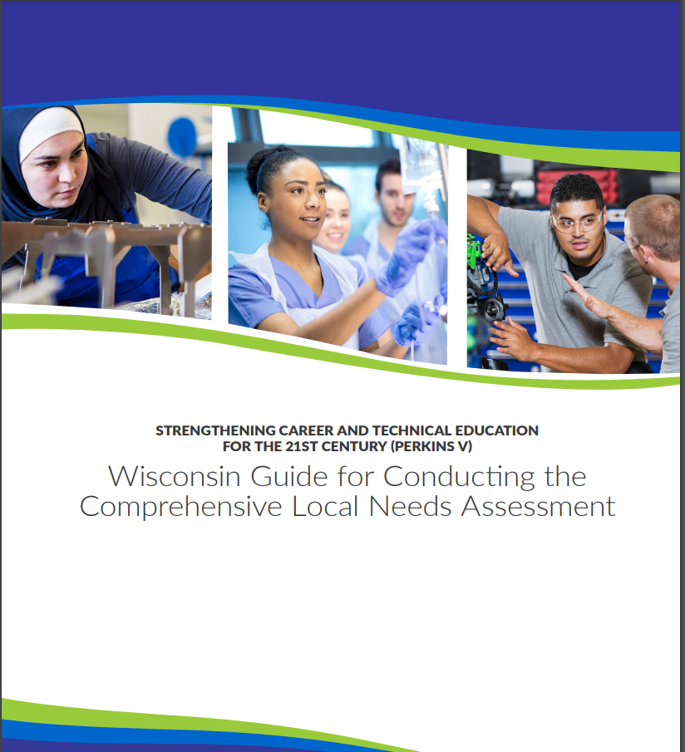
Wisconsin’s CLNA Guide
CLNA Training Series
Introduction and Overview of the CLNA requirement
Focus Area: Performance on Accountability Indicators
Focus area: Career Pathway Evaluation (including LMI and SSQ)
Focus Areas Educator Recruitment, Retention and Training and Equity and Access
https://dpi.wi.gov/cte/carl-perkins/grants/formula-grants
Notes:
Throughout the presentation, we’ll be referencing the 2023 Comprehensive Local Needs Assessment Guide throughout the presentation. It can be found on the Perkins application webpage link displayed on the screen if you’d like to follow along.
Today’s presentation will focus on pages 1-11 of the guide.
In addition to this presentation, we will post a series of training sessions targeted to the required focus areas of the CLNA:
Focus Area: Performance on Accountability Indicators
Focus area: Career Pathway Evaluation (including LMI and SSQ)
Focus Areas Educator Recruitment, Retention and Training and Equity and Access
[Perkins website: https://dpi.wi.gov/cte/carl-perkins/grants/formula-grants]

Slide 3
Today’s Topics
Perkins Law Overview
Comprehensive Local Needs Assessment (CLNA) Requirements
CLNA Planning
Notes:
The topics for today will include an overview of the Perkins law related to the needs assessment;
The requirements of how to conduct the CLNA
and
CLNA Planning: Basically getting things in order so that you can proceed in an efficient and meaningful way.

Slide 4
Perkins V Overview
Key Themes of Perkins V
Data-driven decision-making
Increased stakeholder involvement
Quality Career Pathways
Enhanced efforts to serve special populations
Notes:
Key themes of the Perkins V law is that any agency that is a recipient of Perkins funds or wishes to apply for funds must focus on:
Data-driven decision-making
Increased stakeholder involvement in the CLNA
Quality Career Pathways development and evaluation and
Enhanced efforts to serve special populations
Let’s focus on the first bullet for a minute. What does data-driven decision making mean?
Any decisions about CTE programming and use of funds must be determined by the results of a robust needs assessment - we call it the comprehensive local needs assessment or CLNA.
Why is that? Well, when funds are tight and there are competing priorities, an assessment helps local leaders identify, understand, and prioritize the activities that will closing gaps and result in better outcomes for students.
When done well, it will provide your agency a set of findings that paints an accurate picture of local CTE program outcomes (both your successes and gaps) and then assist with strategic planning to address the gaps.
These themes create an incredible opportunity to:
Take a hard look at the current CTE and career planning landscape
Ensure that local CTE programs are serving each learner equitably
That those who are touched or have the potential to be touched by the system, have input on priorities.
Determine strategies that address the identified needs in a way that reduces gaps and improves outcomes
Make certain that career pathways are aligned with and validated by local and regional workforce needs and economic priorities that will lead to successful student outcomes in postsecondary work or education.
And, last but not least, a priority of Perkins is to target efforts toward special population groups of students as defined by Perkins. This does NOT mean special education students, but rather, all of the demographic groups defined as special populations who have historically been left out of CTE. A list of special population students can be found in Appendix G.

Slide 5
Perkins Law Overview
Sec 131(b): “To be eligible to receive financial assistance under this part, an eligible recipient shall— (A) conduct a comprehensive local needs assessment related to career and technical education and include the results of the needs assessment in the local application submitted under subsection (a); and (B) not less than once every 2 years, update such comprehensive local needs assessment.”
Notes:
Section 131(b) in the law explains the requirement of the CLNA.
“To be eligible to receive financial assistance under this part, an eligible recipient shall— (A) conduct a comprehensive local needs assessment related to career and technical education and include the results of the needs assessment in the local application submitted under subsection (a); and (B) not less than once every 2 years, update such comprehensive local needs assessment.”
In Wisconsin we require the CLNA on a two-year cycle.

Slide 6
Perkins Law Overview
Section 135: Local Uses of Funds
Funds must be used to develop, coordinate, implement, or improve CTE programs to meet the needs identified in the comprehensive needs assessment. There must be a clear linkage between the needs assessment and how funds are spent. And only used for programs that are of sufficient size, scope and quality to be effective.
Notes:
Section 135: Local Uses of Funds
“Funds must be used to develop, coordinate, implement, or improve CTE programs to meet the needs identified in the comprehensive needs assessment. There must be a clear linkage between the needs assessment and how funds are spent. And only used for programs that are of sufficient size, scope and quality to be effective.”
The linkage is done through your Perkins grant application when you lay out your CLNA findings and what you are prioritizing for purchases.

Slide 7
CLNA Requirements
Why a needs assessment?
What is it?
What is it not?
What are the benefits/opportunities of the process?
Notes:
Other than a requirement under the law, what would you say the benefits are of conducting a needs assessment prior to making program decisions? Not only Perkins, but any initiative? [pause]
What is a comprehensive needs assessment? What is it NOT?
The CLNA
It’s a systematic, intentional and in-depth process that is used to determine strengths and weaknesses of an education agency or a program.
It’s where conducting a root-cause analysis, through broad stakeholder engagement, is the key to informing practices, policies and priorities
We know it’s most effective when used as part of an ongoing continuous improvement cycle that includes short-term and long-term goals and implementation targets
It is NOT an activity isolated from other agency efforts.
The CLNA process is a great opportunity to:
• Ensure that local CTE programs are serving each learner equitably, by looking at district policies as well as internal and external factors that may play a role
• Make certain that career pathways are aligned with and validated by local and regional workforce needs and economic priorities;
• Determine strategies that address the identified needs in a way that reduces data gaps and improves student outcomes;
• Provide a structured way to engage key stakeholders in a continuous improvement process to identify critical issues are (both threats and opportunities) to moving initiatives forward.
• Learn the extent to which the findings align with the local and state vision for CTE
• Direct resources towards career pathways that lead to high-skill, high-wage, and in-demand occupations and to activities that address equity and opportunity gaps
When the CLNA process is complete, LEAs will have a set of findings that paints an objective and more accurate picture of a local CTE program’s current outcomes and needs and a plan for moving forward.

Slide 8
CLNA Requirements
The CLNA:
Serves as the driver for local initiatives and spending
To improve student outcomes;
To improve (not maintain) your CTE pathways
To ensure equitable access for all students
Review of disaggregated CTE data
Significant stakeholder engagement
Notes:
You’ll be able to take what is learned through the process and use it as the driver of local initiatives and spending priorities targeted toward:
improving student outcomes
improving the size, scope and quality around career pathways and
ensuring equitable access for all students
The assessment must include a review or analysis of your disaggregated CTE data that’s collected by the district and is housed in the WISEdata portal.
The required stakeholder consultation is laid out in pages 7-8 of the guide, which includes, not only who must be consulted, but different ways in which stakeholders can be included at every level of the process from simply providing feedback in a survey to participating in focus groups, to having a role on your CTE leadership team. This includes every demographic of students: those involved in CTE and those not involved, and their support systems.
Appendix B reflects that many of the same stakeholders are required for the assessment of other grant programs under ESSA.
Think about how you can leverage individuals and information already gleaned by your district.
Stakeholder engagement can be leveraged to:
obtain data through participation in surveys and focus groups;
help analyze findings and determining root causes; and
identify and/or implement an improvement plans and strategies;
In other words, the CLNA process will guide districts and consortia to envision future programming and develop strategies to achieve the vision.
To do this your assessment and analysis of data may look at:
district policies;
how external factors play a role;
how internal strengths and weaknesses impact outcomes; and
identification of what the critical issues are (both threats and opportunities) to moving initiatives forward.
THEN Determine:
How you’ll know that you’ve succeeded in closing a gap.
What strategies will get you there and how will they be prioritized?
How will stakeholders be involved?

Slide 9
CLNA Requirements - Stakeholders
(1) representatives of CTE programs including teachers, school counselors, principals, administrators, and specialized instructional support personnel and paraprofessionals;
(2) representatives of CTE programs at postsecondary educational institutions;
(3) representatives of local workforce development boards & local or regional businesses or industries;
(4) parents and students including students from each special population group
(5) representatives of each special population group;
(6) representatives of regional/local agencies serving out-of-school, homeless, foster and at-risk youth;
(7) representatives of Indian Tribes and Tribal organizations in the State, where applicable
(8) any other stakeholders that DPI requires - Regional Career Pathways Collaboratives/agencies
Notes:
Required Stakeholder groups at minimum include those represented in the list on the slide. Your regional pathway collaboratives can be a help, as they are already meeting with many of these groups in your region on a regular basis.
(1) representatives of CTE program teachers, school counselors, principals, administrators, and specialized instructional support personnel and paraprofessionals;
These are your internal/district and school level people. If you are a consortium, you’d pull people together from your member districts.
(2) Second, representatives of CTE programs at local postsecondary educational institutions, including faculty and administrators;
These are your technical college, UW and private college partner contacts and faculty.
(3) representatives of local workforce development boards and a range of local or regional businesses or industries;
These include your career pathway advisory committees, industry associations; specific employers; One Stop Shops and Regional Employment Development Organizations.
(4) parents and students including students from each special population group (particularly those that are reflected in disproportionate engagement and persistence in your CTE program). See Appendix G for a list of special population groups. Get involvement from a number of students in each group, as the needs, experiences and perspectives of each group can and will be very different.
While one common way to engage students is through general CTE feedback, you are missing an opportunity if you don’t engage them in your root cause analysis. So find a way to plan for that.
Meaningful engagement of any youth, particularly those students and families from traditionally disenfranchised groups requires thoughtfulness and preparation on the part of the CLNA leadership team.
(5) representatives of each special population group
These are community agencies and individuals who provide support to special populations (such as places of worship, homeless and runaway program liaisons, and the boys and girls clubs). These are advocates or ambassadors who specialize in the needs of individual groups of students in the district or community at large.
(6) representatives of regional or local agencies serving out-of-school, homeless, foster, and at-risk students
These are the DWD WIOA programs, foster care agencies, and others who can be a voice for students and families; helping give rise to experiences and perspectives of a given group. They can even assist you in identifying students and parents who would be willing to participate in some way.
(7) representatives of Indian Tribes and Tribal organizations in the State, where applicable
Here the ESSA rules apply - meaning that districts who are within a 50-mile radius (20 U.S.C. (a) 7424 (c) (3)(C)] of a nation or a district who receives Title VI funds.
(8) and finally, any other stakeholders that DPI, requires. In the case of Wisconsin, this means your Regional Career Pathways Collaborative agencies
Page 10 has contacts links for every agency required to be involved in your CLNA process, from foster youth programs, homeless programs, workforce development and more.

Slide 10
CLNA Requirements
Stakeholders continued…
Quality Engagement
Know why you’re reaching out to each stakeholder
Know how you want them to be involved
Know who you want to be involved
What is their role in your process?
Early and ongoing communication
Notes:
Quality stakeholder engagement involves more than simply checking a box or answering a survey. It consists of conversations, and creating spaces where individual stakeholder groups, particularly students, parents, and community-based organizations, feel comfortable (and not vulnerable), sharing perspectives related to data gaps your agency may be experiencing. You’ll need to plan well in advance so that people can make arrangements to participate
Take stock on why you’re reaching out to each stakeholder. Is it about informing, needing their input, or are you seeking an action. Are there short-term goals for certain stakeholders?
A must, is asking for input or feedback before final decisions are made and use it the information you get.
Then, how will you loop stakeholders in as the process moves forward. Make sure your communication does not include a lot of abbreviations or jargon.
Communicate early and often. Take it a step further and turn these new connections into long-term relationships.
Appendix F of the guide, lays out all of the different ways that student voice can be brought into the discussion. This can be used as a template for other groups as well.
They key is always to engage in a meaningful way, including root cause analysis, determining activities to undertake and the prioritizing activities and spending.

Slide 11
CLNA Focus Areas
1. Student performance on federal accountability indicators 2. Progress toward improving equity and access
3. Recruitment, retention, and training of faculty and staff
4. Career pathway alignment to labor market needs
5. Size, scope, and quality of career pathways offered
6. Progress toward implementing career pathways
Notes:
There are six focus areas of the CLNA. We will dedicate training to each of them, starting with:
Student Performance on Accountability Indicators
Progress toward improving equity and access
Recruitment retention and training of faculty and staff and
the last three are tied together into one through a Pathway Evaluation of Progress that takes into account pathways that are aligned to and meet labor market needs, that are if sufficient Size, Scope and Quality to be effective, and an assessment of where the Pathway is and where it needs to go.

Slide 12
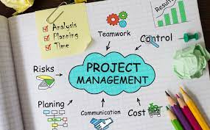
CLNA Planning
CLNA First Steps
Identify Leadership Team
Work Plan with assignments and timeline
Determine data for review
Determine stakeholders and outreach/engagement strategies
Notes:
So, how do you prepare to conduct such a robust process? One key is to start early. You can’t expect to wait until Aug or Sept to begin pulling people together and developing your timeline.
You’ll simply run out of time and won’t be able to conduct a robust process as required.
It’s important to recognize that not everyone can do everything, and that it’s too much for one person to do alone.
What can work well, is to designate someone to lead the work and get it started, but many people can have a role: Create a team.
Identify who can best serve the various elements of the process? You may even be able to leverage teams that already exist for purposes of the ACP Career Readiness Team; the Every Student Succeeds Act various assessments; and other initiatives.
Consider including your district’s
Data steward
Director of Curriculum and Instruction
Pupil Services Director
Teachers (CTE and academic) and
even consider students for roles on your leadership team.
The next steps, which you’ll want to start by early June, is to begin laying the groundwork for the process, and the meetings you’ll have down the road; as well as who will be involved and how.
Create a Timeline with due dates.
Backwards plan (starting with the end date deliverables and then determine the timeline that will get you there)
Determine Who’s going to do what activities; when the activities need to happen and how they will happen. For example, if you plan to do a survey, someone needs to develop and vet the questions, someone needs to distribute them, collect them and collate or organize the data obtained so that it can be presented for discussion.
Have members of the team identify the disaggregated data that will be important to review for the identification of gaps when comparing data sets. This can include:
Concentrator enrollment and outcome data; ACT test scores; demographics of students, community, and personnel; and district employment data; district policies, practices, trends, climate, and culture data
Stakeholder input through meetings, surveys, questionnaires, interviews, focus groups then compile with a focus on trends.
Determine the stakeholders you plan to engage as well as your outreach or engagement strategies. Consider:
Who will be included?
Who from the team will do the engaging and how?
How will you engage each of the required stakeholder groups? What are the different vehicles and tools you can used to connect with different stakeholder groups? Consider locations that are easy for your stakeholders to reach and will help them to be at ease.
What are the best ways to reach out and stay in touch with each stakeholder groups for continued discussion?
Be strategic as to the specific areas on which input from stakeholders will be helpful. You likely will not need input from every stakeholder on every topic. One way to do this is to anticipate stakeholders’ concerns or areas of interest.
Keep materials and infographics simple and brief.
Consider: How will you communicate that this process will be different from any failed attempts of the past. Planning for a way to circle back is always a plus.

Slide 13
CLNA Planning
Question
How will you leverage your regional career pathway collaborative connections to assist with broad stakeholder input?
What data or connections do regional pathway collaboratives have that can assist you in your assessment?
Notes:
Partner organizations can help in engaging stakeholders.
Leverage existing networks before creating new ones.Ask partners to connect existing community and peer networks. These groups have connections to people already involved in work groups that have a level of understanding of critical issues related to CTE and career pathways and LMI.
Appendix E: includes a basic CLNA checklist. Feel free to modify it as needed for your purposes.

Slide 14
CLNA Planning
Strategic planning
The results of your CLNA should lead to a plan that includes goals, activities, priorities and aligned spending for a 2-year period that will meet the needs and ultimately close data gaps.
Include: How you’ll know that you’ve succeeded in closing a gap.
What strategies will get you there and how they’ll be prioritized.
Notes:
CLNA planning leads to strategic planning.
The results of your CLNA should lead to a plan that includes goals, activities, priorities and spending outlined for a 2-year period that will meet the needs and ultimately close data gaps found in each of the focus areas.
Write down how you’ll know that you’ve succeeded in closing a gap.
What strategies will get you there and how they’ll be prioritized

Slide 15
Questions??
CONTACT:
Christine A. Lenske
Grant Specialist, CTE Team
christine.lenske@dpi.wi.gov
608-266-3911

