Slide 1
Perkins Grant CLNA
Focus Area:
Pathways Evaluation of Progress
2023
Chris Lenske
Grant Specialist CTE Team
Notes:
[PUT LINK FOR GUIDE IN CHAT https://dpi.wi.gov/sites/default/files/imce/cte/CPA/CLNA_Guide_v5.pdf ]
Welcome again to the webcast series on completing the Comprehensive Local Needs Assessment for the upcoming two-year grant application cycle. Today’s topic focuses on doing an analysis of your career pathways. The Pathways Evaluation of Progress, is one of the focus areas of the assessment and your Perkins grant application.

Slide 2
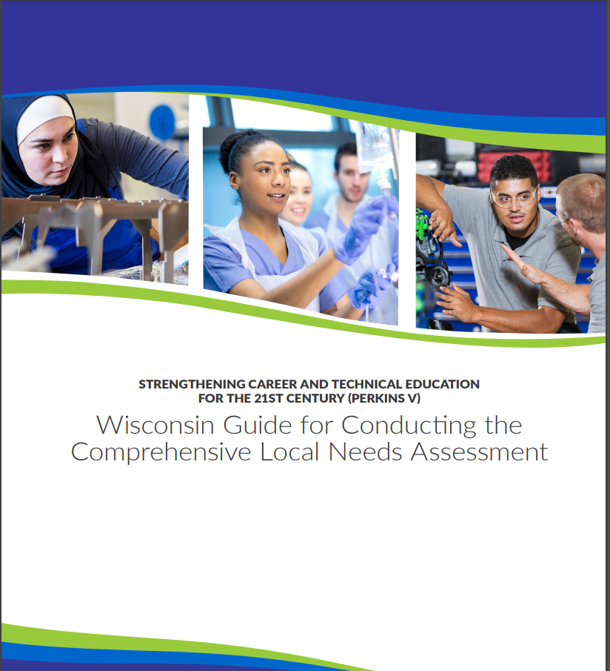
Wisconsin’s CLNA Guide
CLNA Training Series
I. Introduction and Overview of the CLNA requirement
II. Focus Area: Performance on Accountability Indicators
III. Career Pathway Evaluation (including LMI and SSQ)
IV. Educator Recruitment, Retention and Training
V. Focus Area: Equity and Access
V. Putting it all together in preparation for the Perkins application
https://dpi.wi.gov/cte/carl-perkins/grants/formula-grants
Notes:
As you know by now, DPI is conducting a series of training to provide technical assistance for the CLNA process required by the Perkins Act.
If you haven’t watched the Introduction and Overview of the CLNA process webcast, it’ll be most helpful for your leadership team to do so together or individually before the end of summer. The information sets the stage for the CLNA process; team responsibilities; and the required activities around reviewing data, and engaging the required stakeholders.
That training along with the Performance on Accountability Indicator training can be found on the Perkins Technical Assistance webpage. The CLNA training for the other focus areas will occur throughout the summer and into fall.
For today’s presentation we’ll be focused on pages 23-31 of the Wisconsin Guide for Conducting the CLNA. I’ve put the link for the guide in the chat https://dpi.wi.gov/cte/carl-perkins/grants/formula-grants
Today we’ll discuss the data that should be reviewed for this focus area, including LMI information, Size, Scope and Quality elements and engagement in the pathway by students, families, faculty and staff.

Slide 3
Data Driven Decision Making
The Purpose of the CLNA requirement: Data-driven decision making
Determine team
Determine and gather data for the review and format
Determine stakeholders and outreach/engagement strategies
Analysis of data and determine root causes of gaps
Create plan for closing data gaps
Identify goals and develop strategic plan
Identify impactful strategies/activities that will close the data gaps. (Which activities will be supported with Perkins funds?)
Notes:
Through this training, we want to make it clear that Perkins V law requires agencies and consortia who wish to apply for Perkins funds, to conduct a comprehensive local needs assessment in order to facilitate and guide data-driven decision making related to CTE, equity, and use of Perkins funds.
This means that any decisions related to priorities, activities, and Perkins grant spending must be driven by the most pressing needs reflected through assessment data gaps, the root causes of those gaps, and the targeted activities that will be implemented for the sole purpose of reducing the gaps over the next two years.
It is no longer good enough to say, “we’ve always done it this way” or “we believe this activity is good for kids” or “our teachers want to purchase xyz for their class”, especially if what is being done doesn’t actually close gaps and move student outcomes forward from where they are now.
So, how do you do that?
First, you determine your leadership team and the roles that each team member plays in the process. I cannot stress enough that this is not a one person task. There are teams and assessments for many other grant funded programs in the district. Leverage those resources that already exist and may already have the information you’re looking for.
The team gathers data for review through the various methods available to you. Depending on the focus area, the data and the data source will be different.
The team determines stakeholders and the process for engaging them for input and feedback for each focus area and it’s data. Stakeholders can include those within your agency, but you must also engage those outside of your agency, such as students, parents, and community based supports.
Analyze the data - looking for disproportionality and outcome gaps between student groups. Stakeholders are the best resource for helping to determine the root cause, or the “why” of your gaps.
There must be a deliberate shift of the team away from doing what has always been done, to creating a strategic plan for closing gaps, which includes goal setting, identification of desired outcomes, and specific activities that will lead to accomplishing the goals and desired outcomes. Closing the data gaps, is the ultimate goal of Perkins funding.
Look at what was done in the last two two-year cycles, do you have the same issues? Perhaps you didn’t really address the root causes of gaps. This is your chance to take a fresh look.

Slide 4
Career Pathways Evaluation of Progress
Labor Market Information (LMI)
Size, Scope and Quality
Pathway Evaluation of Progress
Notes:
The introduction to the CLNA webcast went into detail regarding how to set up your team, a work plan, and timeline.
This presentation will focus on the specific data related to the assessment of
Local Labor Market Information,
SSQ and
Career Pathway Progress evaluation
We’ll also touch on stakeholder engagement for this focus area as well as your root cause analysis and planning for each pathway.
In the guide, you’ll see that LMI, SSQ and Pathway Evaluation are listed as separate focus areas. To help with targeting your efforts, we have them combined as a whole - to be analyzed for each pathway.
So, Let’s start with LMI …

Slide 5
LMI Data Sources
Industry Projection Reports and Emerging Occupations Reports on DPI’s Labor Market Information page https://dpi.wi.gov/cte/labor-market-information/industry-projection-reports-career-cluster
Websites on emerging occupations for your area: Regional Economic Development Organizations; Workforce Development Board; Chambers of Commerce and industry or trade associations
Career pathway courses offered
Related course syllabi to assess skills that are currently being taught
Notes:
Here the law requires you to consider the alignment between each CTE career pathway and the labor market needs and wages of your local area, region, and/or the greater State of Wisconsin.
Industry Projection Reports highlight total openings for each career cluster is available on DPI’s Labor Market Information page.
Websites for industry reports on emerging occupations for your regional area can be obtained through your Regional Economic Organizations, Workforce Development Boards, Chambers of Commerce and Industry or trade associations, which can all provide data for you to review. Also note what these resources say about pathways that will offer the most career opportunities, advancement and wages.
What you’re being asked to do here is confirm that each pathway you offer will indeed be needed in the future - locally, regionally, or across the state, and that those pathways will provide viable employment opportunities and growth for future employees.

Slide 6
Occupational Openings Example
Notes:
Here is an example of the Southeast Workforce Development Area long term occupational projection.
Again to to find what jobs are going to have the most openings and the best pay.
In your application you’ll be asked to share how many openings in the jobs will be available in 8 years
Also consider the education required and the entry level pay.
Which jobs or careers will have opportunities for advancement and leadership?
Think about some of the discussions that might be interesting to have about this data with your stakeholders. [pause]

Slide 7
LMI
Questions to explore
What jobs related to your career pathway are projected to grow?
How do the career pathways offered align with industry projections and emerging occupations? Are there other emerging jobs we should be preparing students for?
What skills will they need in the future for these jobs and do we provide them?
Are we teaching students the right skills for jobs that will be most in demand?
What jobs/training/ do you want to most want to focus on?
What gaps exist between what we are offering and what is needed? Between enrollment and projected job openings?
Notes:
Once you’ve pulled your LMI data together, the questions to consider as you look at your pathway are:
What industry sectors are projected to grow the most (locally or statewide)?
What emerging jobs should you be preparing students for?
How do your career pathways align with these industry projections and emerging occupations?
Are you teaching students the right skills for the jobs that will be most in demand in the future? In other words, are the CTE courses offered relevant? How do you know?
What jobs or training do you most want to focus on for a pathway, and what are the different ways students get the skills needed to pursue employment or further their education upon graduation?
How do CTE career pathway enrollments match projected job openings or trends?
Consider how employers, institutions of higher education, and community partners can be engaged in determining solutions or being a part of the solution.
Regional Career Pathway Collaboratives can be of assistance to you in learning more about what is needed and how to close the gaps that exist between what is being offered and what is needed.
If what you currently offer is not aligned to employment needs and high wages, you should not be targeting Perkins funds to those pathways. Certainly you can support those with local funds, but you may want to ask yourselves why you are using resources for an area that may not be very promising for your students and their self-sufficiency.

Slide 8
Assessing Pathway Size, Scope and Quality (SSQ)
Size: Minimally, one career pathway that meets scope and quality elements.
Scope: Progression of courses that build on each other & align with workforce needs.
Quality: Course rigor and alignment to state academic standards and appropriately licensed educators are teaching the courses and… at least 2 additional experiences
Work-based learning experiences specific to the pathway
Industry recognized credentials (IRCs)
Early college credit or dual credit specific to the pathway
CTSO aligned with the pathway
Notes:
Next you review the extent to which the courses and experiences offered align with business and industry needs and further education and training requirements.
For assessing the Size, Scope and Quality of Pathways being offered, the law requires grant applicants to assess whether they are offering a sufficient number of career pathway courses, and opportunities to meet the needs of students to further pursue a career pathway upon graduation. This includes linkages to the next level of education; and ultimately whether the courses offered develop student knowledge and skills to prepare them for success in a career pathway.
To help with this, the DPI has defined what sufficient size, scope and quality to be effective means.
Sufficient Size means any agency that wishes to receive Perkins funds, must have at least one pathway that meets the minimum LMI and SSQ requirements.
Sufficient Scope means that career pathway courses progress from introductory to more advanced courses, that build on each other, and may include options for postsecondary education articulation, encompassing the full breadth of the subject matter, and that the courses align with workforce employment and skills needed.
Sufficient Quality means that:
• CTE career pathway instruction is rigorous and aligns curriculum to state academic standards. And, those who teach the courses are appropriately licensed or credentialed in the CTE content.
• Further, the career pathway provides at least two additional opportunities for students either in:
Work-based learning (WBL) as outlined in Perkins V and Wisconsin’s guide to WBL.
In opportunities that lead to needed industry-recognized credentials (IRCs).
In opportunities to obtain early college credit or dual credit for required courses or in
CTSO activities that align with the specific career pathway curriculum and course standards.

Slide 9
Data to Review - Size and Scope
Size and Scope
The total career pathways that have a course sequence starting with introductory and building to more advanced course(s)
Course offerings: Sequences from introductory to more advanced with courses aligned to curriculum standards for each pathway.
Communications - type and frequency of communication regarding courses and quality offerings (WBL, IRCs, DC, CTSOs)
Notes:
So, what does the data for SSQ consist of?
For Size - The bottom line is: does your career and technical education program offer at least one pathway for students to engage in that will lead to further training or employment in a needed pathway. And, does it have at least two of the quality components year after year on a continuous basis for all students.
For Scope: Look at:
The course sequence for each pathway - Does it start with an introductory level course and build to more advanced course(s). Are there options for students each year to take a first level and a second level? Do curriculum standards show a depth and breadth of offerings over time? Consider what courses may be needed but are not being offered. What is missing? What is the reason? And, how will that be address it over the next two years?
Also look at your Communication; the course descriptions in your course guide and other informational materials and presentations. Are they clear/understandable? Do students have a clear understanding as to the role a course plays in a pathway of interest? What is the district culture or climate around which students are encouraged to persist in a pathway or not.

Slide 10
Data to Review - Quality
Quality
The number of opportunities for extended/advanced learning in each pathway
Demographics of students engaged in each quality element
# of WBL opportunities and procedures for accessing opportunities
# of dual credit agreements and the number of students who enroll and finish
# of IRCs available vs. those obtained by students
CTSO activities and alignment to career pathway curriculum
Notes:
When you review the quality elements that you offer, a wide variety of data and materials can inform the evaluation of the pathway.
Consider:
The number of opportunities for extended or advanced learning in each pathway: In other words, how many quality elements do you offer? Do you offer all five? Why or why not? By looking at the data gaps you can determine which quality elements you need to bolster or which need to be added for the pathway.
Again disaggregate enrollment data by demographic groups for each of the quality elements you offer. For example, if you offer WBL opportunities, what are the demographic groups of those you enroll and those that do not? Ask why. Who persists in the experience and who does not. How many different opportunities are available for each pathway. Not everyone might be able to participate in youth apprenticeship.
Look at the # of dual credit agreements in place and which students enroll and which students do not. Ask why certain students do not.
Look at The # of students who enroll and finish DC. Who doesn’t finish? Ask, why if there are certain groups of students who do not seem to persist.
Look at the # of IRCs available for the pathway vs those actually obtained by students. Is there a gap? Who is obtaining the credentials and who is not? Why?
Evaluate CTSO enrollment as well as the activities and their alignment to the career pathway curriculum. What groups of students participate and what groups don’t for a given pathway?
So - these are your data points, but what are you looking for? What is your data telling you? Next we’ll look at some of the questions to explore as you look at your data.

Slide 11
Data to Review - Pathway Evaluation of Progress
CTE vs. concentrator enrollments for the past several yrs.
Total number of students who could be served vs. the number served
Disaggregated data on which students persist and which students do not.
Course offerings (frequency) vs. industry skill requirements
Impact of programs - which students (demographically) pursue further training or work? Which do not?
Student course interest (requests) vs. offerings
Ongoing communication reflecting education opportunities in each pathway.
Culture and Climate
Notes:
Data to be evaluated should include much of the following (always disaggregating your data when it comes to student engagement) in order to see who is engaged and who is not.
How many CTE participants you have from each demographic group vs. concentrator enrollments for the past several years for the pathway
What type of trends do you see in pathway course enrollments. Who is a participant and who becomes a concentrator - and, who doesn't
Course offerings vs industry needs
What proportion of the student population is accessing CTE? Is it enough to meet industry needs over the next eight years?
To what extent is there student interest (that they sign up for a course), but the course is not actually available to them?
Which students have positive outcomes by going on for further training (including college) or employment in the field?
Review communication plan including the course guide, announcements, open house, flyers, ACP discussions, etc. Is communication free from bias?
Look at your communication avenues. Are they effective? Your data is the feedback your get from teachers, students and parents.
What is the culture and climate of school personnel, students, the community related to student engagement in the pathway? Is the pathway welcoming? Do students see a path for themselves regardless of their demographic group?

Slide 12
Pathway Evaluation of Progress - Questions to explore
Where are data gaps?
How fully are my programs aligned and articulated across secondary and postsecondary education?
Are a sufficient number of courses and course sections offered within each pathway year to year? Are there students who want to enroll in pathway courses but are unable to do so?
Do some pathways lack employer engagement in either career-based learning experiences or work-based learning experiences?
Which postsecondary education partnerships need further nurturing or support to move forward with college credit?
Do some pathways offer more opportunities for skill development than others?
How does each pathway offered compare in quality? What needs to be built up and what is needed?
Notes:
Look at where there are gaps in data between each student population as well as gaps between what is needed and what is actually being offered or taken advantage of by students.
What questions come to your mind as you look at the data? What are you curious about?
Think about the questions that will take you deeper to get an understanding of what is going on in the pathway offerings or outcomes?
If there are disproportionate engagement of student groups, there could be equity issues in student’s abilities to access offerings.
Are there certain pathways where members of certain special population groups or race are under or over-represented?
As you look at your pathway individually or comparatively consider:
How fully are the pathways aligned and articulated across secondary and postsecondary education? Are they up to industry standards? Is there sufficient rigor in the curriculum to offer success for students moving forward? How do you know?
Are a sufficient number of courses and course sections offered within each pathway year to year or are offerings inconsistent? Why is that?
Are there students who consistently want to enroll in a pathway course who are unable to do so? and Why is that?
Do some pathways lack employer engagement in work-based learning experiences? How can those relationships and collaborative mentoring be better nurtured?
Which postsecondary education partnerships need further nurturing or support to move forward with college credit?
Do some pathways offer more opportunities for skill development than others, both in the classroom, or laboratory, advanced learning or through WBL experiences?
How does each pathway offered compare in quality? What needs to be built up and why?
Is there communication that is biased or lacks clarity? Why? What can be done to improve the will have the biggest impact for the demographic group not getting your message?
Always seek to understand the “Why” behind what you see in your data.

Slide 13
Pathway Evaluation of Progress - Questions to explore Cont…
Where are data gaps?
In which career pathways are students of color or members of each special population group underrepresented?
What type of trends do you see in pathway course enrollments. Who is a participant and who becomes a concentrator - and, who doesn't
What proportion of students are accessing CTE pathways?
Which students in which pathways have positive outcomes of further training or employment and which pathways and students do not?
Notes:
As you can see, there is lots to explore…
What does your disaggregated data tell you about who is participating and concentrating? Who is persisting in an opportunity and who is not?
What type of trends do you see in pathway course enrollments. Who is a participant and who becomes a concentrator - and, who doesn't
What proportion of the student population is accessing CTE? Is it enough to meet industry needs over the next eight years?
Which students have positive outcomes by going on for further training (including college) or employment in the field?
Again, always seek to understand the “why” is this happening. Once you come up with your hypothesis, ask “why” that is the case and keep going further to narrow down what is the main issue impacting your data.

Slide 14
Root Cause Analysis
Stakeholders provide the key answers
WHY is something happening or not happening?
When provided with the answer, ask WHY again and again until you get to the root cause (test your hypotheses with stakeholders)
Determine the best way to address the root cause in a way that will lead to change
Notes:
As I started to allude to, once you’ve identified the data gaps within a pathway or across pathways, your task is to determine why the gaps exist.
There could be any number of reasons - but how will you know which is the real reason - the reason, that if you address it, you will see a change? This is your root cause.
There is no way to know these things without doing a root cause analysis involving educators, students, parents, counselors, local business and industry partners. If enrollment is low, seek to understand why enrollment is low. Is it lack of interest? But why? Has there been poor communication to all students and parents in a way that they understand when it comes to scheduling or exploring a career pathway? Are there issues with scheduling or teacher talent? If so, why? And then, what needs to be done differently?
When attempting to get to the root cause of the data gap, use the 5 whys with your stakeholders to determine why certain gaps or discrepancies exist. Once you have identified the root cause of gaps, explore the best way to address it. Set your goals and activities that will lead to the outcomes you want by closing the gap.

Slide 15
Career Pathway Evaluation of Progress - Overlap
“Career Pathway Evaluation of Progress” overlaps, with other needs assessment focus areas. Consider if there are:
Certain pathways that do better or worse when it comes to certain performance indicators?
Opportunities for better alignment across academic, technical, and employability standards and curriculum [Performance on Accountability Indicators]
Opportunities for use of instructional strategies that will support each student population who wishes to participate and move forward in a career pathway? [Equity and Access and ERRT]
Untapped opportunities or strategies for supporting pathway faculty recruitment, retention & training in areas that will expand and enhance pathway offerings [ERRT]
Notes:
The focus area of “Career Pathway Evaluation of Progress” overlaps, with other needs assessment focus areas to provide a complete picture of an applicant’s CTE program and offerings.
For example, look to see if there are certain pathways offered that do better or worse when it comes to certain performance indicators? Why is that and what needs to be addressed and how?
Are there opportunities for better alignment across academic, technical, and employability standards and curriculum [This could also impact your Performance on Accountability Indicators]
Are there opportunities for use of creative instructional strategies that will support each student population who wishes to participate and move forward in a career pathway? [This also impacts the Equity and Access and ERRT focus areas]
Are there opportunities or strategies for supporting career pathway faculty recruitment, retention and training in areas that will expand and enhance CTE offerings [ERRT]
Strategic planning is a great conversation for the leadership team, stakeholders and district decision-makers to have on what needs to be prioritized over the next two year cycle.

Slide 16
ACTE Quality CTE Program of Study Self-Evaluation Tool
PDF outline: https://www.acteonline.org/wp-content/uploads/2019/01/HighQualityCTEFramework2018.pdf
PDF rubric for self scoring: https://www.acteonline.org/wp-content/uploads/2019/01/HighQualityCTEFramework2018_WithRubric.pdf
Online tool: https://www.acteonline.org/high-quality-cte-evaluation/
Notes:
To help with the process, we want to make you aware of a tool that you may find helpful in completing your evaluation. It was developed by, The Association for Career and Technical Education for evaluating pathways.
The PDF version provides the outline and then a rubric for self scoring. There are certain sections you may choose to focus on for this year’s assessment.
There is also an online version.
With that, [next slide]

Slide 17
Christine Lenske
Grant Specialist, CTE
608-266-3922
christine.lenske@dpi.wi.gov
Notes:
I want to wish you a great day and don’t hesitate to reach out to CTE content consultants or myself with any questions you have regarding completion of the CLNA.
The CLNA is a great opportunity to address what you need to move your pathways forward and provide meaningful educational opportunities for each and every one of your students.

