Slide 1
Best Practices for Engagement of Learners in the CLNA
January 11, 2024
Notes:
Chris
Hello Everyone and welcome to this webcast on Best Practices for Engagement of Learners in the Comprehensive Local Needs Assessment, or the CLNA!
My name is Chris Lenske and I’m the Grant Specialist on the CTE team at the Department of Public Instruction.
I am so happy to bring you this presentation which will highlight youth perspective on engaging with leaders in decision-making. I think it’s always a great change of pace to hear directly from young people.

Slide 2
Facilitators
Erica Koepsel, Providers and Teens Communicating for Health (PATCH) , erica@patchprogram.org
Chris Lenske, DPI/CTE , christine.lenske@dpi.wi.gov
Karin Smith, DPI/CTE , karin.smith@dpi.wi.gov
Notes:
Chris
Our facilitators today will be Erica Koepsel from the PATCH program, myself, and Karin Smith, DPIs Education consultant for ACP and Dual Enrollment.
PATCH regularly engages young people in discussions with other youth and adults, so offers us their expertise in this area today.

Slide 3
Special Guests
Jamillah - Senior - Racine, WI
Jayvyn - Senior - Middleton, WI
Mallory - Senior - Marathon, WI
Ryan - Junior - Onalaska, WI
Notes:
Chris
And… Our special guests are students from the PATCH program who will share with us their perspectives on the best way to engage young people in program input and planning. We’ll introduce you to them in just a bit.

Slide 4
Learner Engagement in the CLNA
Section 134 (d) of the Perkins law requires that an eligible recipient shall involve a diverse body of stakeholders in the CLNA process including:
(4) students; including those from each special population group;
(8) any other stakeholders that the eligible agency may require. In the case of Wisconsin, this includes: − Students of traditionally marginalized racial and ethnic groups, genders.
Notes:
Chris
So, why are we talking about this today?
[Read slide…]
Engaging young people in such a process however, can be easier said than done. Our guests will shed light on some promising practices to, not only get students to the table, but to get their input in a meaningful way. We don’t want them to just be there so that we can check a box. We do actually want to hear from them and learn about their perspectives.

Slide 5
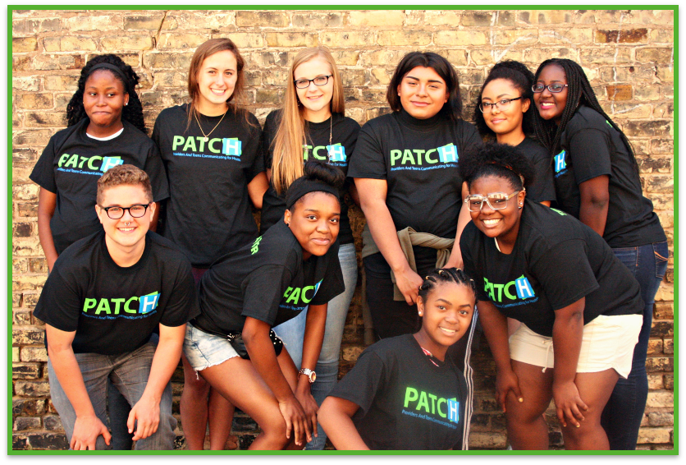
PATCH
Working to improve adolescent health and wellbeing alongside and in true partnership with youth.
Notes:
Patch has it’s model: WITH youth FOR youth...because THEY are the experts.
Another organization who puts youth voice to the forefront is, Foster Club, a Nationally known agency that engages child welfare youth from across the country, whose motto is Nothing About Us Without Us (communicating, that they need to be at the table for discussions about their lives, instead of systems alone who do not have to deal with the impact of decisions made).
Educators as well, must pay attention to our young people… exploring what is working for them and what is not, in our outreach to them, their CTE program experiences and learning. What motivates them? What do they care about? What do they want for their future?
With that I’m going to hand it over to Erica to introduce the panel and facilitate the discussion….

Slide 6
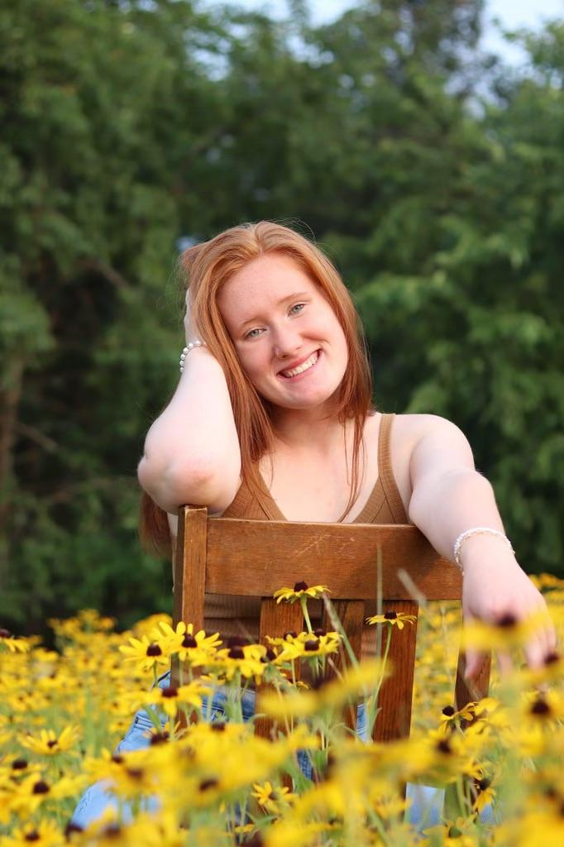
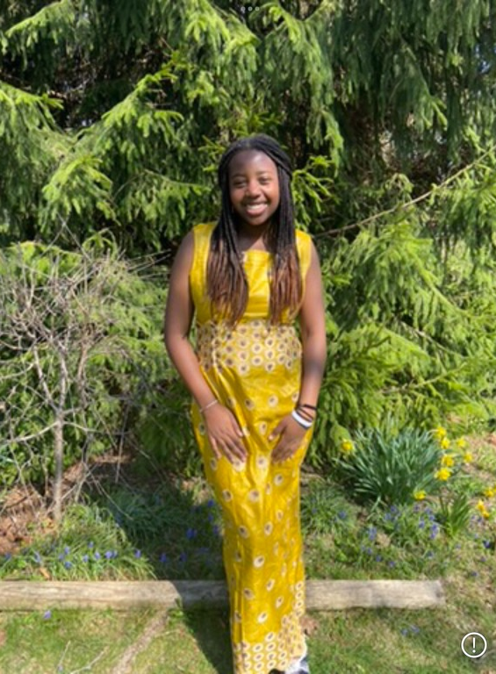
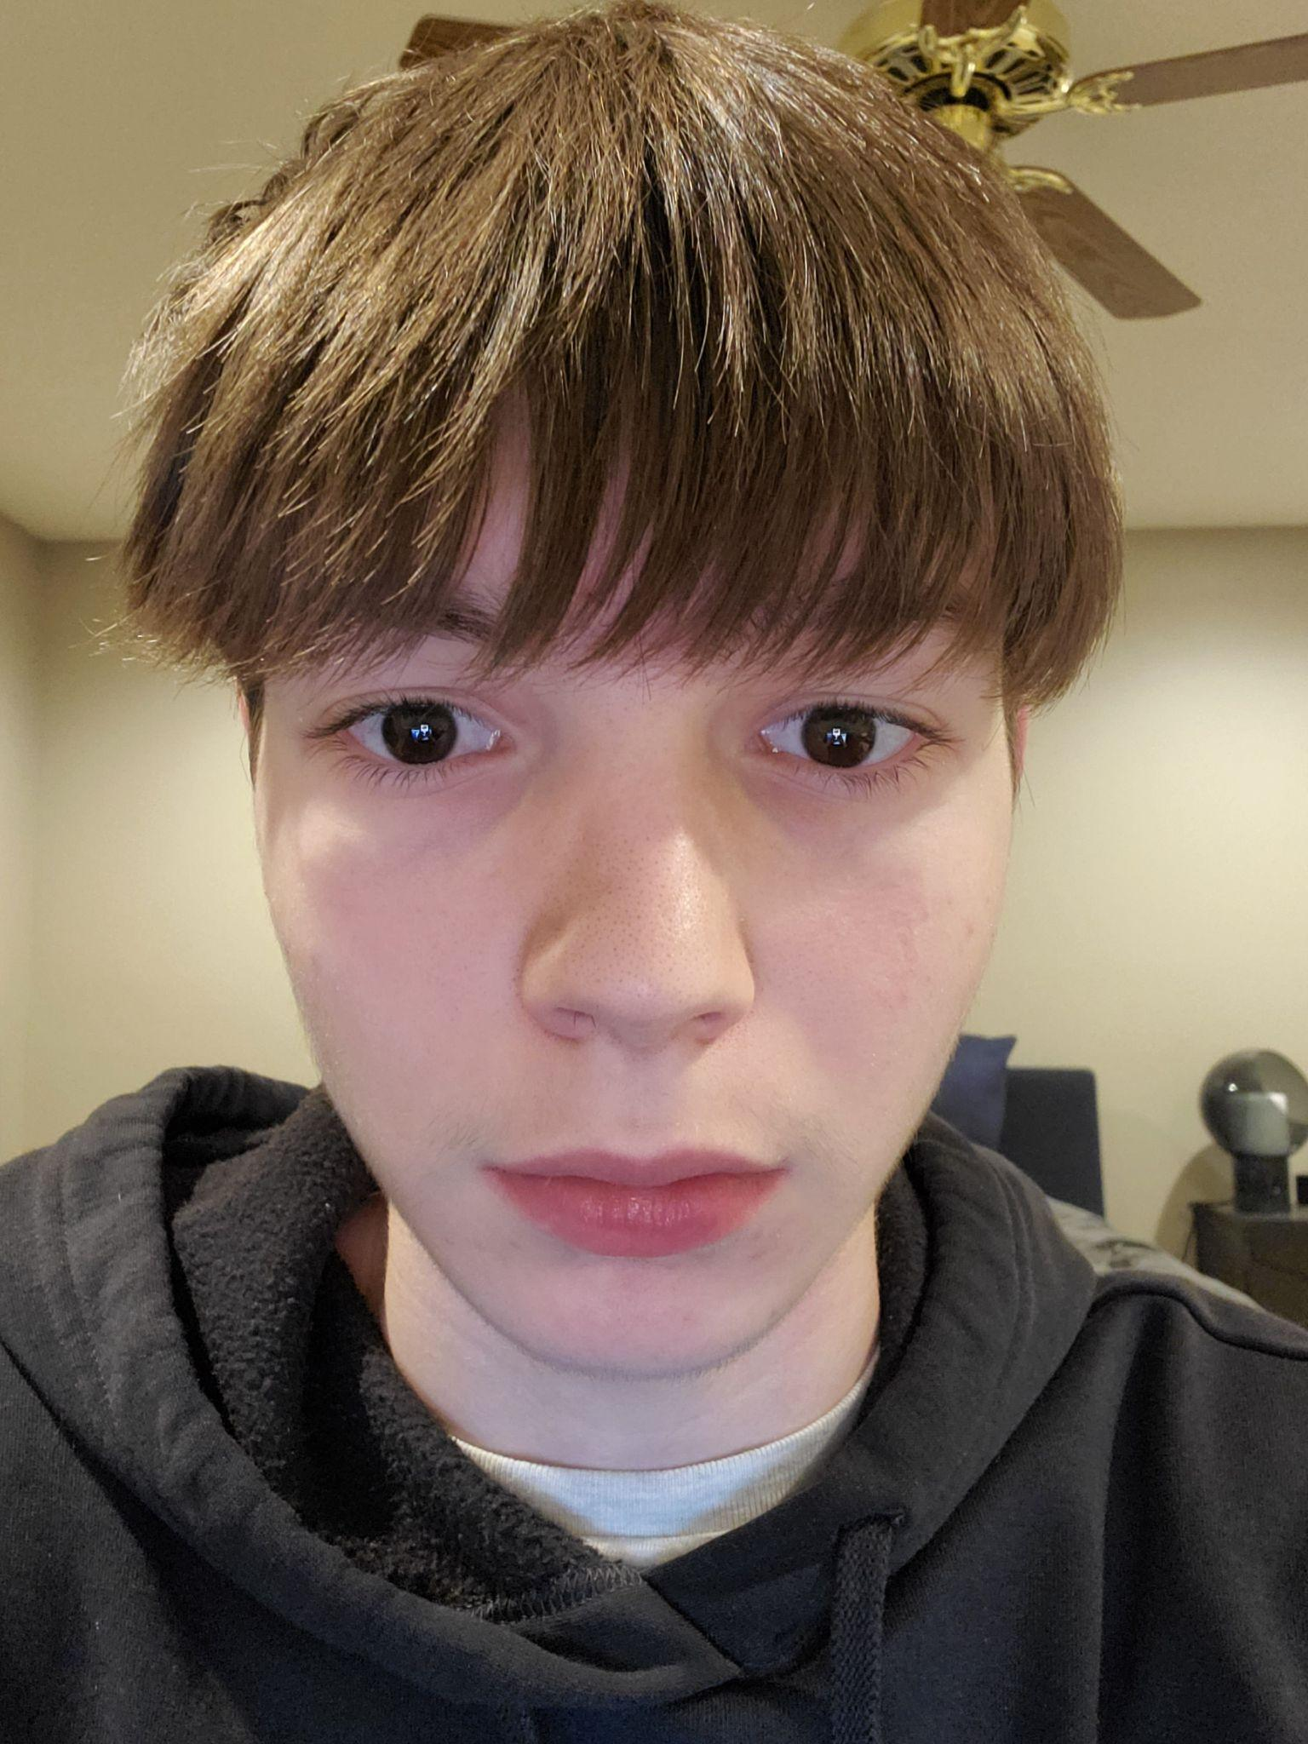
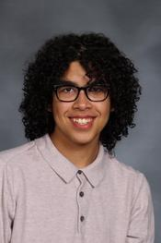
Learner Engagement Panel
Mallory
Jamillah
Ryan
Jayvyn
Notes:
[After they are introduced, stop the slide share. ]
{Erica to introduce Mallory while she’s in transition between things.}
{When done with planned questions go into Q&A with audience questions in the chat}

Slide 7
Recommendation & Resource Roundup
Be genuine & authentic with youth
Use various strategies to reach a variety of youth
Be sure to set the space and establish trust
You may need to do some extra education about CTE.
Notes:
Erica - This will be a short round up and I will plan to create resources based on what youth share in the panel. Honestly not sure I have much more.

Slide 8
Youth Voice in Career Readiness Project Findings
#1 Most students learn about career readiness activities from teachers. But they go to their families for help.
However, students with disabilities are more likely to go to teachers for help.
#2 The career readiness activities recent high school graduates report as the most interesting are:
Career and technical education courses
Work-based learning, including internships, Youth Apprenticeships, and working in a school store
Project-based learning
#3 Students need teachers to be engaged, excited, and encouraging during career readiness activities.
#4 Students want:
More career readiness activities that start earlier and occur more often
Career readiness activities to be hands-on and interactive, aligned to their interests, and include “real” people from the jobs they are interested in
To understand all their postsecondary education options
Notes:
Karin

Slide 9
Youth Voice in Career Readiness Project Findings
#5 Students need to see how learning is relevant in all their classes.
#6 Students are more engaged in their learning when they have more choice and voice.
#7 The top reasons that students report “discourage participation in career readiness activities” are:
Lack of awareness
Feel they do not belong or the activities aren’t for them (top reason for students with disabilities)
It’s too overwhelming
The activities are repetitive or not aligned with their interests
Too many competing priorities
#8 High school graduates feel the most important skills to teach in K-12 are communication, critical thinking, and self- or time-management.
Notes:
Karin

Slide 10
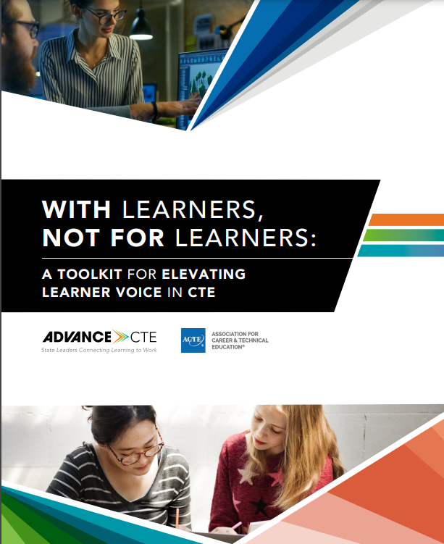
With Learners, Not For Learners
With Learners, Not For Learners: A Toolkit for Elevating Learner Voice in CTE
Published by Advance CTE and the Association for Career and Technical Education
Notes:
Karin

Slide 11
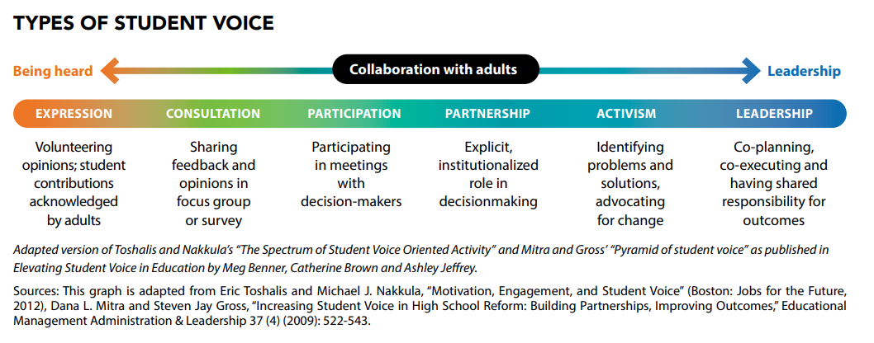
Types of Learner Engagement
Notes:
Karin

Slide 12
Learner Engagement Commitments
Learners are engaged meaningfully.
Learners are treated as valued as trusted stakeholders.
Engagement is inclusive of all learner voices.
Learners are prepared to engage effectively through training, resources, and supports.
Learners have multiple avenues for engagement.
Learner engagement is sustained through regular,
institutionalized processes.
Learners are recognized for their
contributions.
Notes:
Karin

Slide 13
Methods of Engagement
Social Media
Surveys
Focus Groups
Participatory Action Research
Program Review/Needs Assessment
Conferences/Events
Advisory Board/Committee/Workgroup
Notes:
Karin

Slide 14
Questions to Ask About Career Pathways
What career pathway program(s) are offered at our school that interest you? Why?
What supports or services would make participating and being successful in a career pathway program easier for you?
How does the content you learn in your CTE classes feel relevant to you personally?
What types of work-based learning have been or would be the most valuable to you?
How could the dual enrollment courses offered at our school help prepare you for college?
Notes:
Karin

Slide 15
Questions to Ask About Career Readiness
How do you learn about career readiness activities at our school?
What could we do to encourage more students to participate in career readiness activities?
What has made you feel uncomfortable, marginalized or discriminated against when participating in career readiness activities?
What has made you feel welcome, supported or valued when participating in career readiness activities?
What career readiness activity has helped you the most? The least?
Notes:
Karin

Slide 16
Questions to Ask About ACP
Which individuals or organizations do you turn to for help with academic and career planning or support?
In what ways does ACP help you feel connected to your long-term goals?
In what ways do you see yourself as a driver of your own career exploration and planning?
How has ACP positioned you for your future?
If you could change one thing about ACP in our school, what would it be?
How could I, as school counselor, educator, or administrator, improve your ACP experience?
Notes:
Karin

Slide 17
Additional Learner Voice Resources
Youth Voices in Youth Employment: A roadmap for promoting meaningful youth engagement in youth employment programs, by the Youth Employers Funder Group
Youth Voice Toolkit, by the Afterschool Alliance
Hart’s Ladder of Participation, taken from Organizing Engagement website
Youth Adult Equity Assessment, by Milwaukee Succeeds
Notes:
Karin

Slide 18
Notes:
Chris
I want to offer a BIG thank you to our guests today: Erica, Mallory, Jamilla, Ryan and Jayvyn! Thank you SO very much for taking time out of your day to meet with us.
It was really enlightening and it was really the highlight of my day.
And thank you to all who joined us today for this great topic and discussion!

