Slide 1
Getting Started
For the school

Slide 2
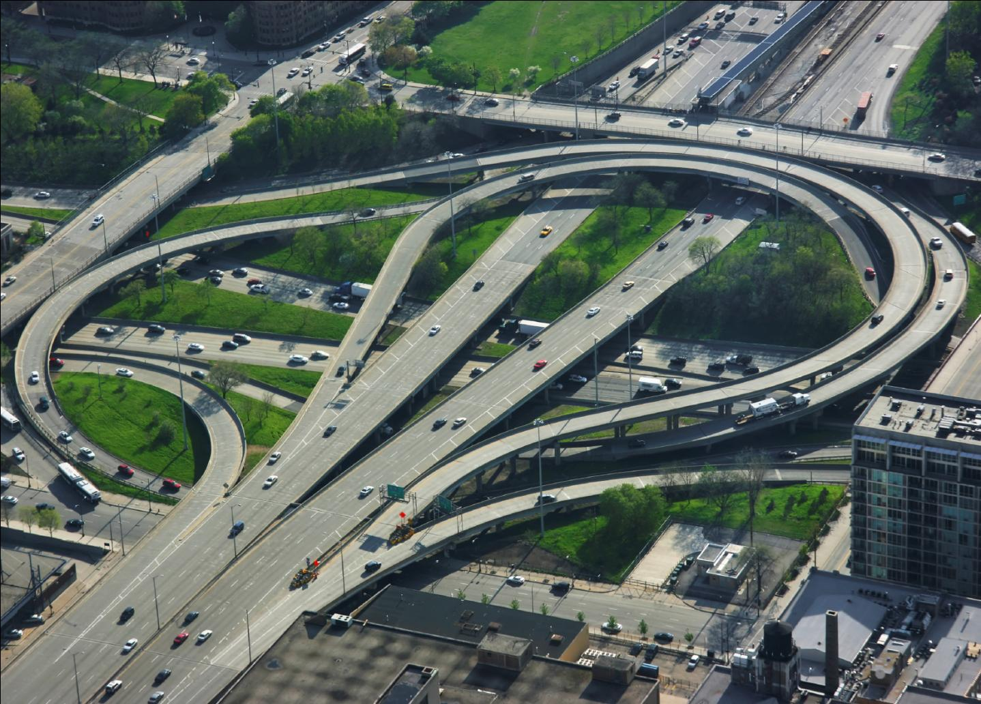
School improvement can be a complicated journey.
Lots of people have ideas on where to go and what to do.
They just don’t always have the same idea on how to get there.

Slide 3
The journey can become complicated and messy.
The destination gets lost in the mess.

Slide 4
I
Indistar ®
Indistar ®

Slide 5
I
Okay, so maybe this is a slight exaggeration.
Indistar

Slide 6
Indistar® isn’t faster than a speeding bullet. It isn’t even the “magic bullet” every school would like to find, but it does get everyone headed in the same direction and moving toward the same destination.

Slide 7
Ever try to drive in a city without a map or a GPS? Indistar® provides the map that EVERYONE follows. It guides a school in figuring out where it is NOW, where it wants to GO, and HOW to get there.

Slide 8
Indistar® clears up the confusion on who should be doing what and who has the best ideas by putting the school back in the driver’s seat.

Slide 9
The ultimate goal in school improvement is for the people associated with the school to drive its continuous improvement for the sake of their own children and students.

Slide 10
Indistar® gets a school moving on the right path, and keeps it moving—continuous improvement.

Slide 11
A New Way
The Old Way
Accountable for Rules and Regulations
Data = Student Outcomes Only
Culture of Compliance
Annual Paper Plan
Mail, Fax Paper Reports
Focus on Programs
Top-Down Initiative, with Oversight
Indistar
Accountable for Effective Practice
Data = Practice + Student
Culture of Candor and Support
Continuous Improvement Process
System-Generated, Electronic Reports
Focus on Effective Practice
School Initiative, with Support

Slide 12
So…let’s get started. We know that Indistar® gets a school on the right path. We know it is a new way of thinking and doing school improvement. But…what exactly is Indistar® ?

Slide 13
Indistar® is a web-based tool that guides a district or school team in charting its improvement and managing the continuous improvement process.
Indistar® is called different things in different states. For example, Maine calls it Maine Star, the Bureau of Indian Education calls it Native Star, and Idaho and Oklahoma call it the WISE tool. The system is tailored for the purposes of each state, its districts, and its schools.
Indistar® is premised on the firm belief that district and school improvement is best accomplished when directed by the people closest to the students. While the state provides a framework for the process, each district team and school team applies its own ingenuity to achieve the results it desires for its students—students it knows and cares about.

Slide 14
Before you start to think this is just another computer program that promises to increase student assessment scores, we want you to keep this in mind…
the web program makes it convenient, the work of the teams is what makes the difference.

Slide 16
We’re going to use a little advanced organizer here to get us oriented for what is to come.
First, we’re going to talk about the backbone of Indistar® : Indicators of effective practices.
Second, we’ll talk about who works with the indicators-the cornerstone of Indistar ® : Teams.
Third, we’ll talk about how the work gets done and who helps.
Finally, because we know you are curious, we’ll show you the website, all the moving pieces, and all the levels of people who are involved in helping a school get to its goal destination.

Slide 17
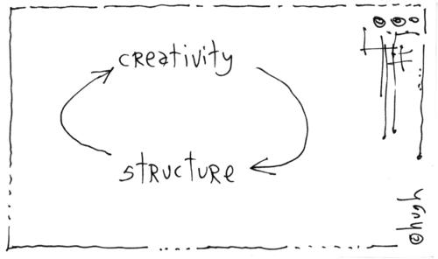
Indicators of Effective Practice
in·di·ca·tor [in-di-key-ter] (noun) A pointer or a gauge for assessing progress toward the destination.
Indicators provide the structure for building a continuous school improvement plan, while still allowing each school flexibility and creativity on how it implements the plan. Indicators point the way toward effective practices.
Indicators are:
Guideposts for effective practice
Plain language, behavioral (Who does what?)
Aligned with research base (Wise Ways)
Drivers of planning and improvement

Slide 18
Indicators of Effective Practice-Samples
Teams
All teams operate with work plans for the year and specific work products to produce.
Teachers
All teachers maintain a record of each student’s mastery of specific learning objectives.
Principals
The principal spends at least 50% of his/her time working directly with teachers to improve instruction, including classroom observations.
Instructional Teams meet for blocks of time (4 to 6 hour blocks, once a month; whole days before and after the school year) sufficient to develop and refine units of instruction and review student learning data.
All teachers differentiate assignments (individualize instruction) in response to individual student performance on pre-tests and other methods of assessment.
The principal challenges, supports and monitors the correction of unsound teaching practices.

Slide 19
Indicators of Effective Practice-Final Notes
There are indicators for all levels of school staff: teams, teachers, principals.
On the indicators for teachers, the first two words are “All teachers.” “All” means “all.” Not some. Not most. ALL.
Indicators are meant to be discussed and worked on in teams that are practicing within a culture of candor.
Which is the perfect segue into the next section.

Slide 20
Teams: The cornerstone of Indistar®
Teams
Leadership Team
The team that manages the Indistar® process and is ultimately responsible for making decisions for the school and for school improvement.
Instructional Teams
Teams that include teachers in grade level groupings, grade-level clusters, or subject areas. Responsible for planning instruction for students.
School Community Council
A team that includes parents as the majority of its members and looks at how the school and families work together for the benefit of students.
Time
Teams need time to do their work and structure to do effective work. Indistar® provides benchmarks of work to be completed at specific points in time during the year.

Slide 21
Teams: Culture of Candor
Accountability to students and to each other
Willingness to polish the craft together with high expectations for the adults
Openness to the data about student outcomes and about the practices that contribute to the outcomes
Guest Login-Transparency
Focus on the practice and not the person

Slide 22
Teams: Expectations
1. Attend scheduled team meetings regularly
2. Assess progress toward success Indicators with a culture of candor
3. Plan for adjustments
4. Receive feedback from coaches
5. Select one member to be the “process manager” to enter information into the web system

Slide 23
The support system: State, District, Coaches
The coach is assigned to work directly with the school team to support its work in the Indistar® system. The coach may view the work of the school to which he/she is assigned.
The district may be working on its own set of indicators as a way to improve its support to the schools. The district provides a district liaison to work directly with the school. The district may view the work of the school.
The state provides support to the school through the statewide system of support. The state adopts Indistar®, selects indicators, sets benchmarks, provides coaches, trains districts/coaches/schools. The state may review all the work of the districts and schools through the state administrative page.

Slide 24
The support system: Extras
Technical support from ADI
Wise Ways
Indicators in Action
To keep everything running smoothly, we also offer:
Indicators in ActionTM—videos that show the indicators being implemented in real schools with real teachers,
Wise Ways®—research briefs to guide the team in making decisions on the indicators, and
Technical assistance from Academic Development Institute’s helpful client relations team.

Slide 25
And now, the moment you’ve all been waiting for…

Slide 26
A quick reminder before we get all caught up in the wonders of the web world…

Slide 27
INDISTAR®
THE WEB SYSTEM
NOW SHOWING IN YOUR SCHOOL.

Slide 28
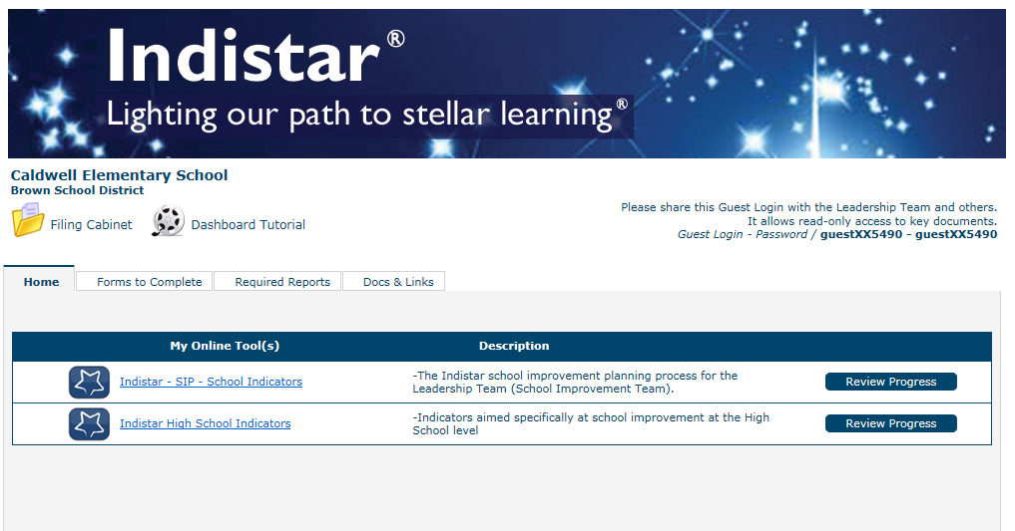
Welcome to the Dashboard: Control Central
0
Every school is assigned a unique login and password that gives it access to its own school’s dashboard. The login is given to the principal and a staff member that the principal names as the process manager. The principal and process manager are the only two people in the school who work in the actual web system.
When the principal or process manager logs in, they start at the dashboard.

Slide 29
Dashboard: Features
School Name
Filing Cabinet
Guest Login
Indicator-Based Planning Tools
Reports to review progress
Forms to Complete
Other Documents/Web Pages
Required Reports : Reports to Submit

Slide 30
Main Menu
When the School Indicators link is selected from the dashboard, the Main Menu screen appears.
The School Improvement Process is a continuous cycle of Assess, Create, and Monitor the work on the indicators of effective practice.
Also provided are tutorial videos, resources, reports, a place to set up agendas and keep minutes, and access to coaching comments.
“Where are we now?” provides a quick glimpse of the work of the school team in graphs and reports.
Convenient access to tech support or to view state contacts is also provided on the main menu.

Slide 31
Getting Set Up
Edit School Information
During the initial set up of Indistar®, the state or district provided the information for the school. When the principal and process manager receive their login and password, they should check the information for accuracy and to make sure a current email address is provided for both.
Demographics/
Assessment
Indistar® provides a place for the school to enter demographic information as well as assessment information.
School Team
As mentioned earlier, the Leadership Team or School Improvement Team—whatever it is called in your school—is the cornerstone of the work with Indistar® and continuous school improvement. Team members should be selected for their willingness to serve and their enthusiasm for moving the school forward. A school team must be entered before a school can assess indicators.

Slide 32
Got that done? Feeling pretty good? Great!!! Now…the real work begins.

Slide 33
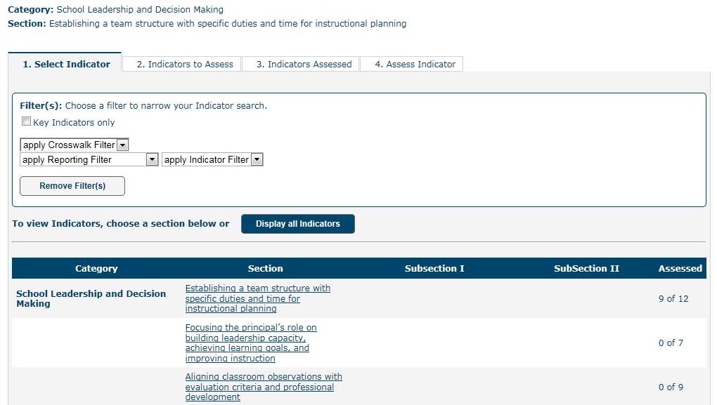
Assess Indicators
This is where the work of the team kicks in. A word to the principals out there—don’t be thinking you can do this all by yourself. You can’t. You need the team. To the principals that think the team members can do it all by themselves—they can’t. They need you.

Slide 34
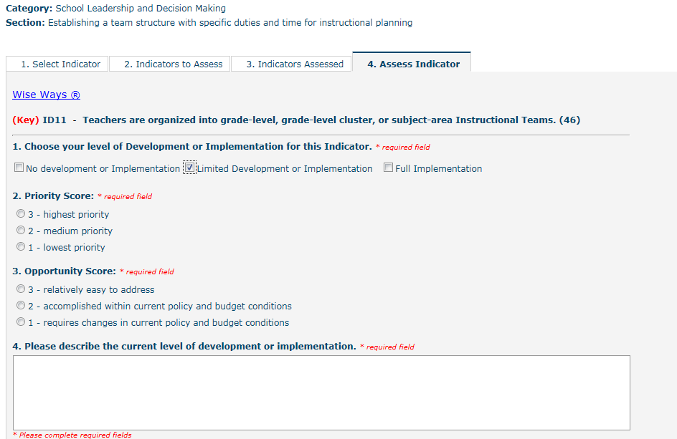
Assess Indicators
At the leadership team meeting, after reading the research provided in the Wise Ways®, the team will discuss the indicators. The team decides if the indicator has no development or implementation in their school, limited development or implementation, or full implementation in their school. Don’t forget the culture of candor. There are no “extra points” for saying you are fully implemented on an indicator.

Slide 35
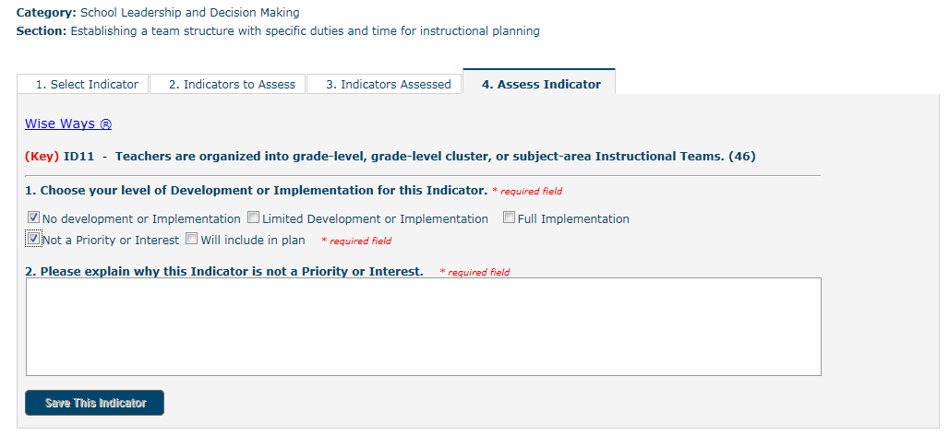
Assess: No Development or Implementation
If the team decides there is no development or implementation it then decides if the indicator is not a priority or if it will be included in the school improvement plan.
If it is not a priority, the team must provide information on why it is not a priority.

Slide 36
Assess: Will Include in Plan/Limited Development
If the team decides it will include the indicator in their plan or if the team assesses the indicator as Limited Development, then the team will decide if the indicator is a high priority (priority score) and how easy it will be to accomplish (opportunity score).
The team will also need to describe the current level of development of that indicator in the school.

Slide 37
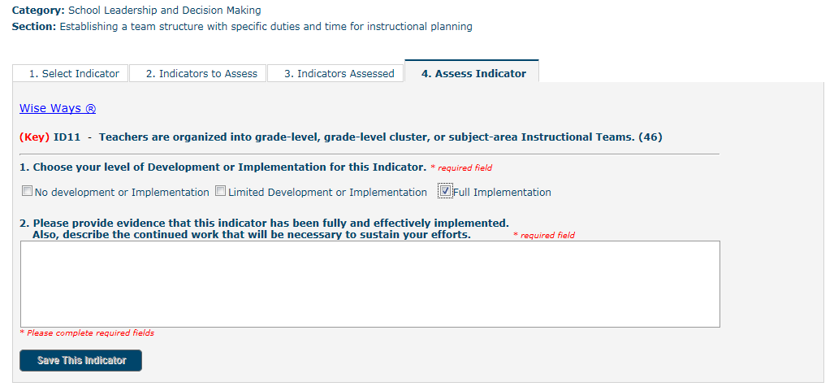
Assess: Full Implementation
If the team decides the school is already fully implementing the indicator, the team will give evidence that the indicator is fully implemented and describe how the implementation will be sustained.
Keep in mind, the evidence provided is to prove to the school and its stakeholders (students, teachers, staff, parents, school boards, etc.) that the indicator is fully implemented.

Slide 38
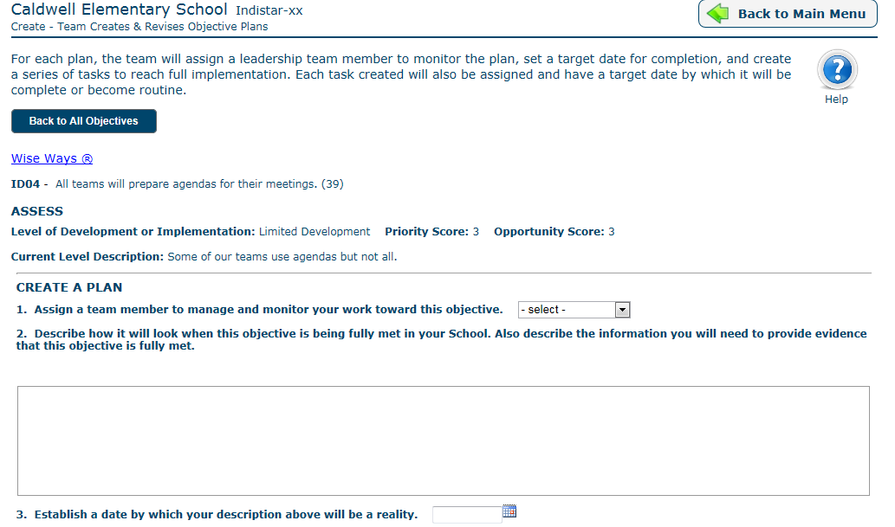
Create Objective Plans
Indicators that were assessed as being included in the plan or limited development are now called objectives and move into “Create” to develop a plan for that objective. Indicators that were assessed as not a priority or fully implemented will not appear in Create.

Slide 39
Create
In Create, the leadership team assigns a team member to be responsible for the Objective, describes how the Objective will look in the school when it is fully implemented, describe what they will need to gather to provide evidence when it is fully implemented, create tasks to reach the Objective, assign people to the tasks, and assign dates by which it will all be completed. Whew. No one ever said school improvement was easy work.

Slide 40
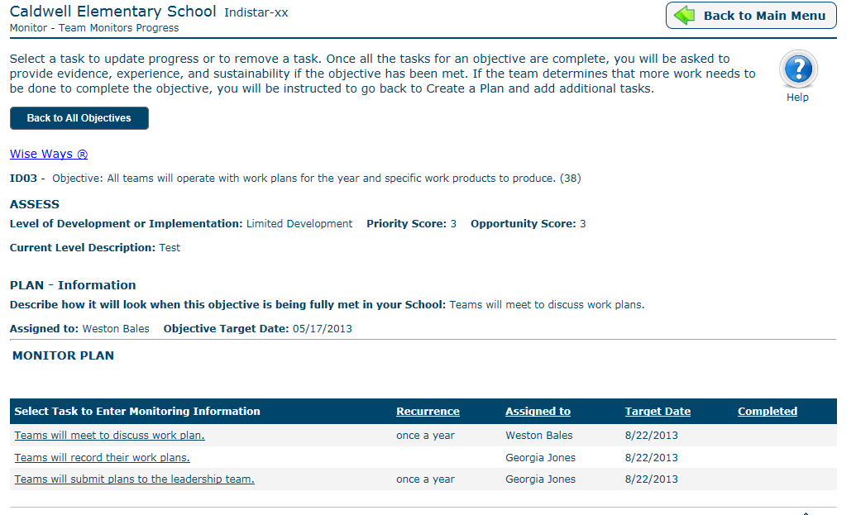
Monitor the Plan
Monitor is where the rubber meets the road. It’s been all fine and good to create a school improvement plan. You’ve been doing that for years. Write the plan. Make a copy for the state. Put it on the shelf. Once a year, dust it off and make a few adjustments.
Not in Indistar®. This is CONTINUOUS school improvement. The plan has been made. Now it’s time to roll up the sleeves and get to work putting the plan in action.

Slide 41
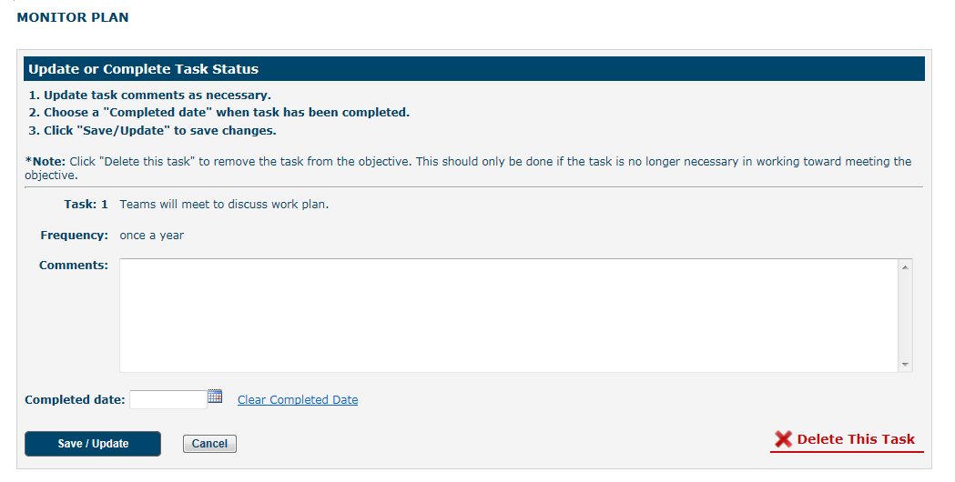
Monitor the Plan
At each leadership team meeting, the team reviews the list of tasks that were created for each Objective, checking with the team member responsible for the progress of the work. In Monitor, the team will check off each task as it is completed. When all of the tasks are completed for one Objective, the team will decide if the Objective has been met. If it has—CELEBRATE! Then give your evidence of full implementation, describe your experience in completing the Objective, and explain how you will sustain the work.

Slide 42
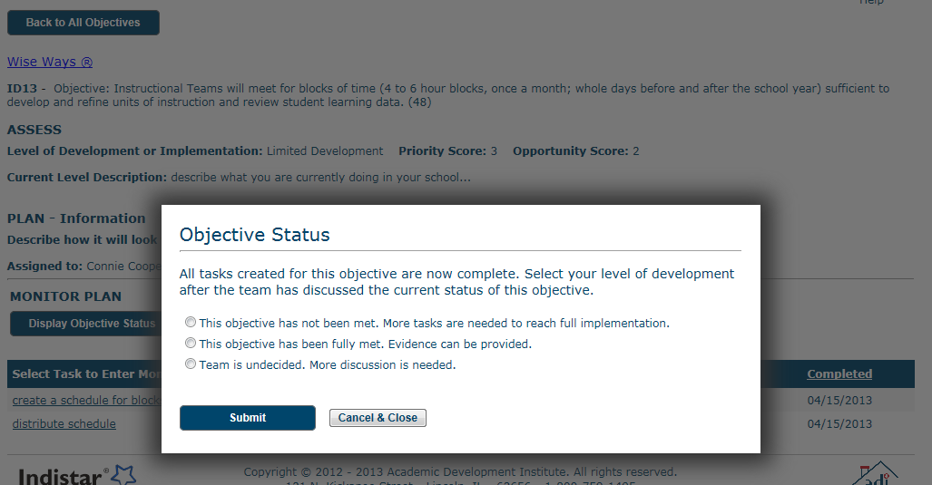
Monitor the Plan
Sometimes, just completing the tasks doesn’t quite reach the goal. That’s okay. Just go back and create more tasks. Sometimes, the team can’t reach a decision if the Objective has been fully implemented or not. That’s okay too. The system will keep reminding you that it either needs more tasks, or the team needs to determine that it is fully implemented.

Slide 43
I
Remember, you are going to get a LOT of support. Not only from your state, district, and coach, but also from all the resources and tools found in the system itself: Wise Ways®, Indicators in ActionTM, links to helpful websites, and ADI’s technical assistance.
Indistar ®

Slide 44
Some Extra Information: Levels of Access
Principal and Process Manager – Enter and edit information
Guest Login – Read-only school progress reports and plans for faculty, parents, school board
Coach and District Liaison– Read-only and enter coaching comments
District—Enter and edit information in district process and read-only and enter coaching comments in school process
State—Read-only and enter coaching comments in the district process and read-only in school process

Slide 45
Some Extra Information: We’re talking convenience, Vern
Continuous Improvement Process with the school satisfying itself for benefit of its students
Plan Your Meetings (Agendas, Minutes, Worksheets)
Electronic Submission of Reports
Resources
Coaching Comments

Slide 46
It Bears Repeating
There’s no magic in the web system. It does help keep a school focused on what really matters, and keeps the conversations centered on the professional practices of the people most closely connected to the students in the building, but the real magic happens in the work of the teams.

Slide 47
Thank you. You’ve been a great audience.
For technical assistance please contact:
Academic Development Institute
Email: indistar@adi.org
Your school coach
Or your state’s system administrator

