Slide 1
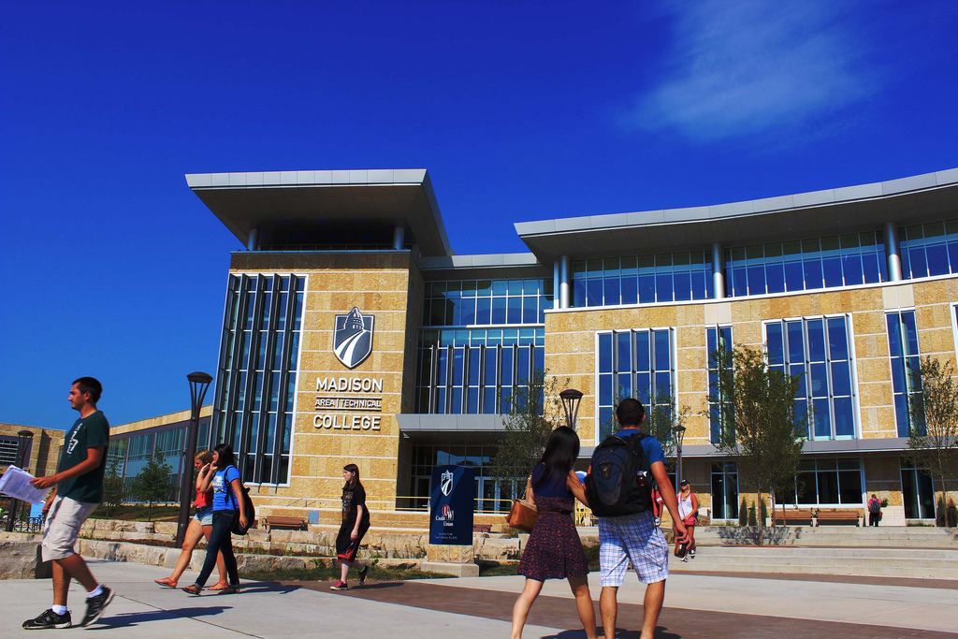

Slide 2
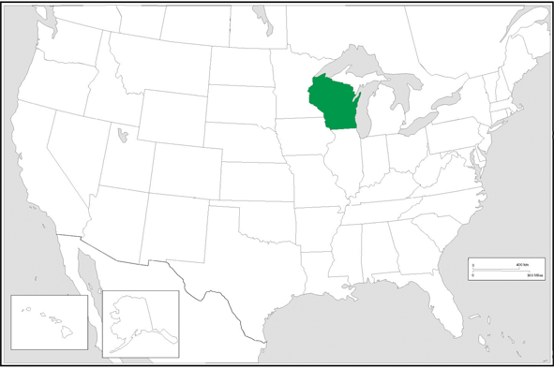
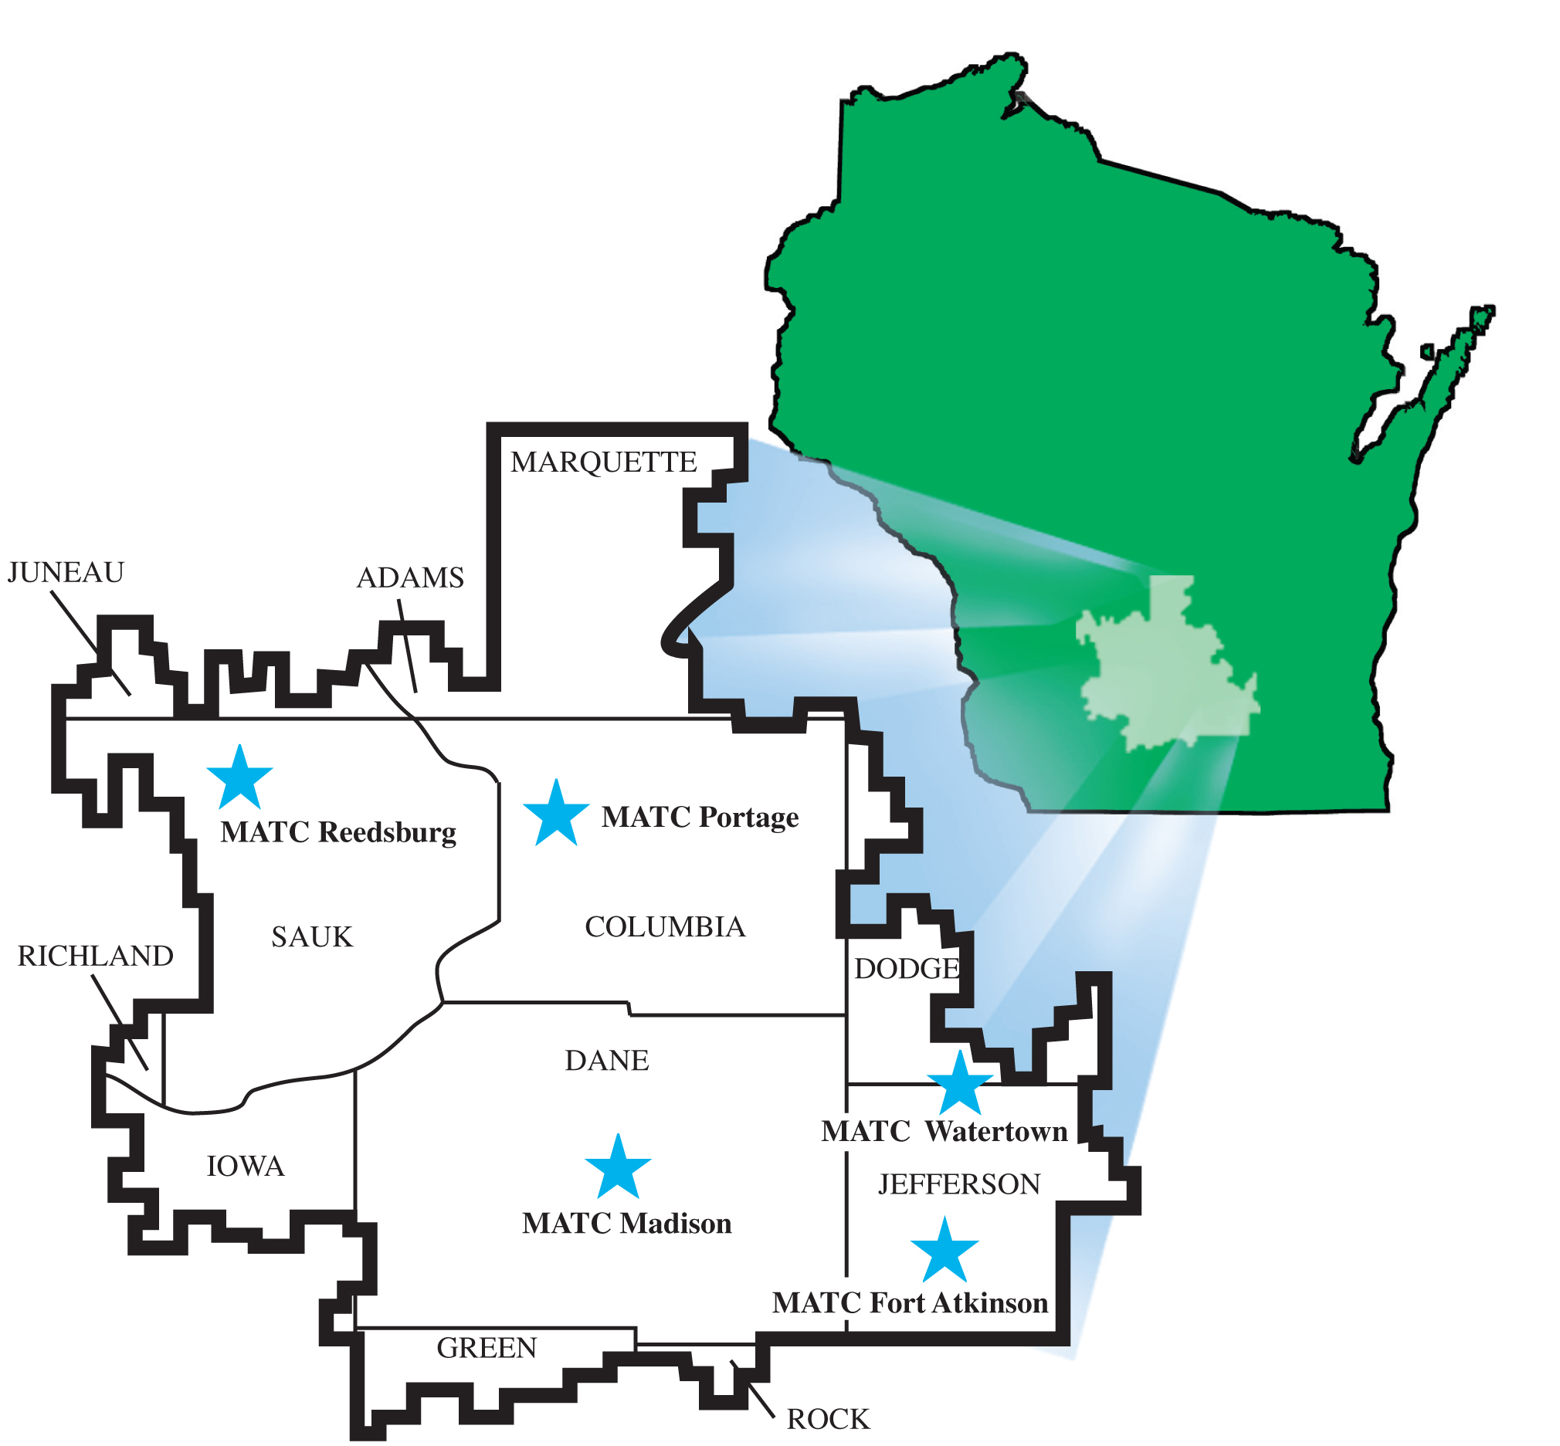
The college is one of the largest of 16 Technical College Districts in Wisconsin.

Slide 3
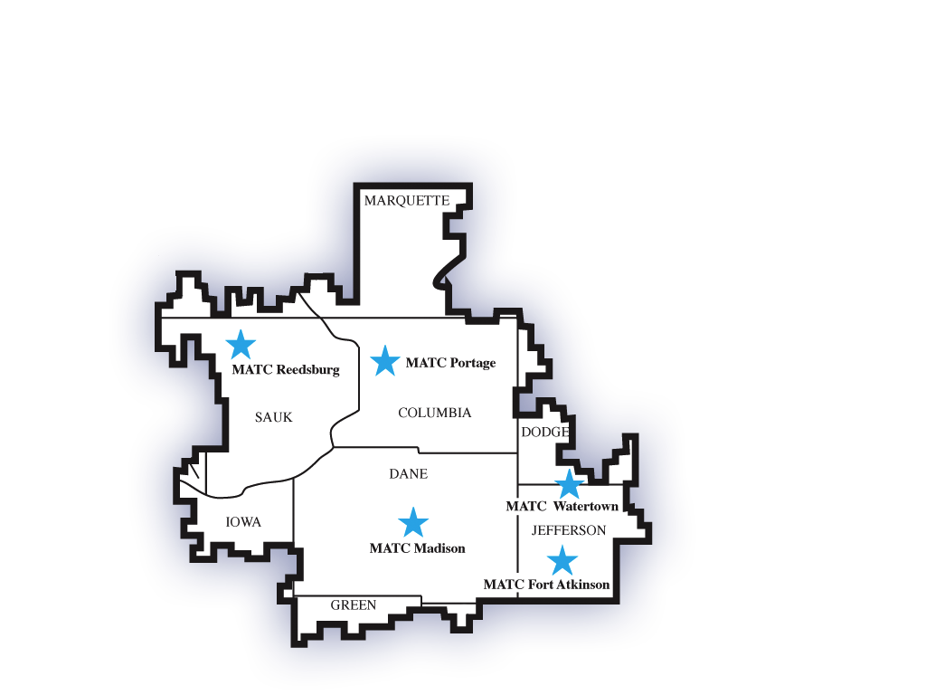
Serving 38,000 students
Annual Unduplicated Headcount
9,800 FTE
24,000 degree credit
12,300 continuing education
4,300 adult basic education
2,000 community service
1,500 English as a Second Language (ESL)
• 9 Campuses in 5 cities
Notes:
12 Counties
40 School Districts
MATC served more than 44,000 students during 2006-07
Nearly half degree credit
Thousands more in non-degree classes
We serve nearly 45,000 students a year ...
including 20,000 in credit classes ...
and a wide array of services ... 
from ESL, to developmental courses, to apprenticeship
from business outreach, to community service, to transfer – and reverse transfer 
We have campuses in five cities
Watertown
Fort Atkinson
Portage
Reedsburg
and Madison
We employ over 2,000 people who work to strengthen our economy and our communities.

Slide 4
Holistic Internationalization
Faculty Development
International Students
Education Abroad
Partnerships & Consortia
International Visitor
Delegations & Exchanges
Curriculum Internationalization

Slide 5
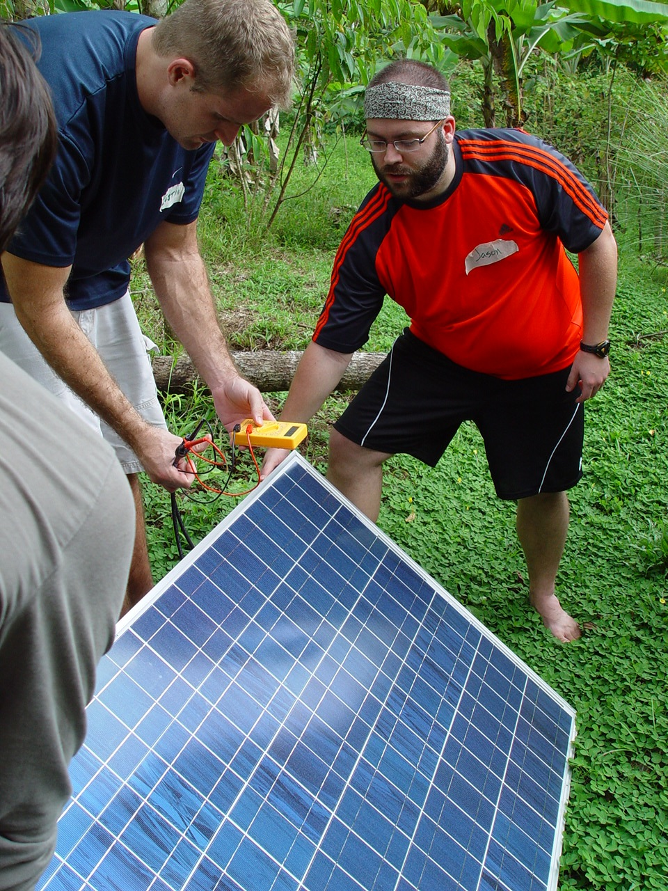
Defining Global Competencies
Global Work Skills
Cultural Awareness
Intercultural Communications
World Languages
Global Interdependence
International Travel Skills
Global Citizenship
https://madisoncollege.edu/program/global-studies

Slide 6
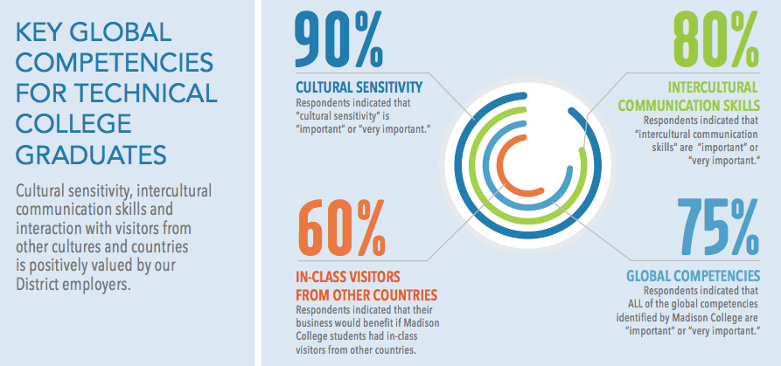
Employer Validation of Global Competencies
Madison College Academic Plan 2014

Slide 7
Global Studies Certificate
Certificate fosters international activity among faculty and encourages students to take courses outside their narrow degree requirements.
Over 50 courses linked to certificate across college departments
Synergy between language learners, study abroad, and global courses
New Univ. of WI Global Passport Program for dual credit and access to hundreds of UW-Madison global courses

Slide 8
Integration of World Languages
The Center for International Education works with academic areas to offer a broad portfolio of world language offerings.
College Transfer Courses in:
朋友 同事 – Chinese
– Arabic
¡Comprensión! – Spanish
Étude – French
Verständnis – German (via Study Abroad)
学習 – Japanese (via Study Abroad)
Plus Adult Continuing Education offerings in: Arabic, Chinese, French, German, Italian, Japanese, Norwegian, Polish, Russian, and Spanish

Slide 9
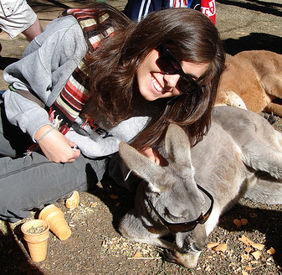
Comprehensive Education Abroad
Madison College provides a broad portfolio of education abroad opportunities for our students including:
Semester study at partner institutions
Summer language immersion programs
Short term cultural tours, and service learning programs.

Slide 10
Bringing It All Together: The Community College Sustainable Development Program

Slide 11
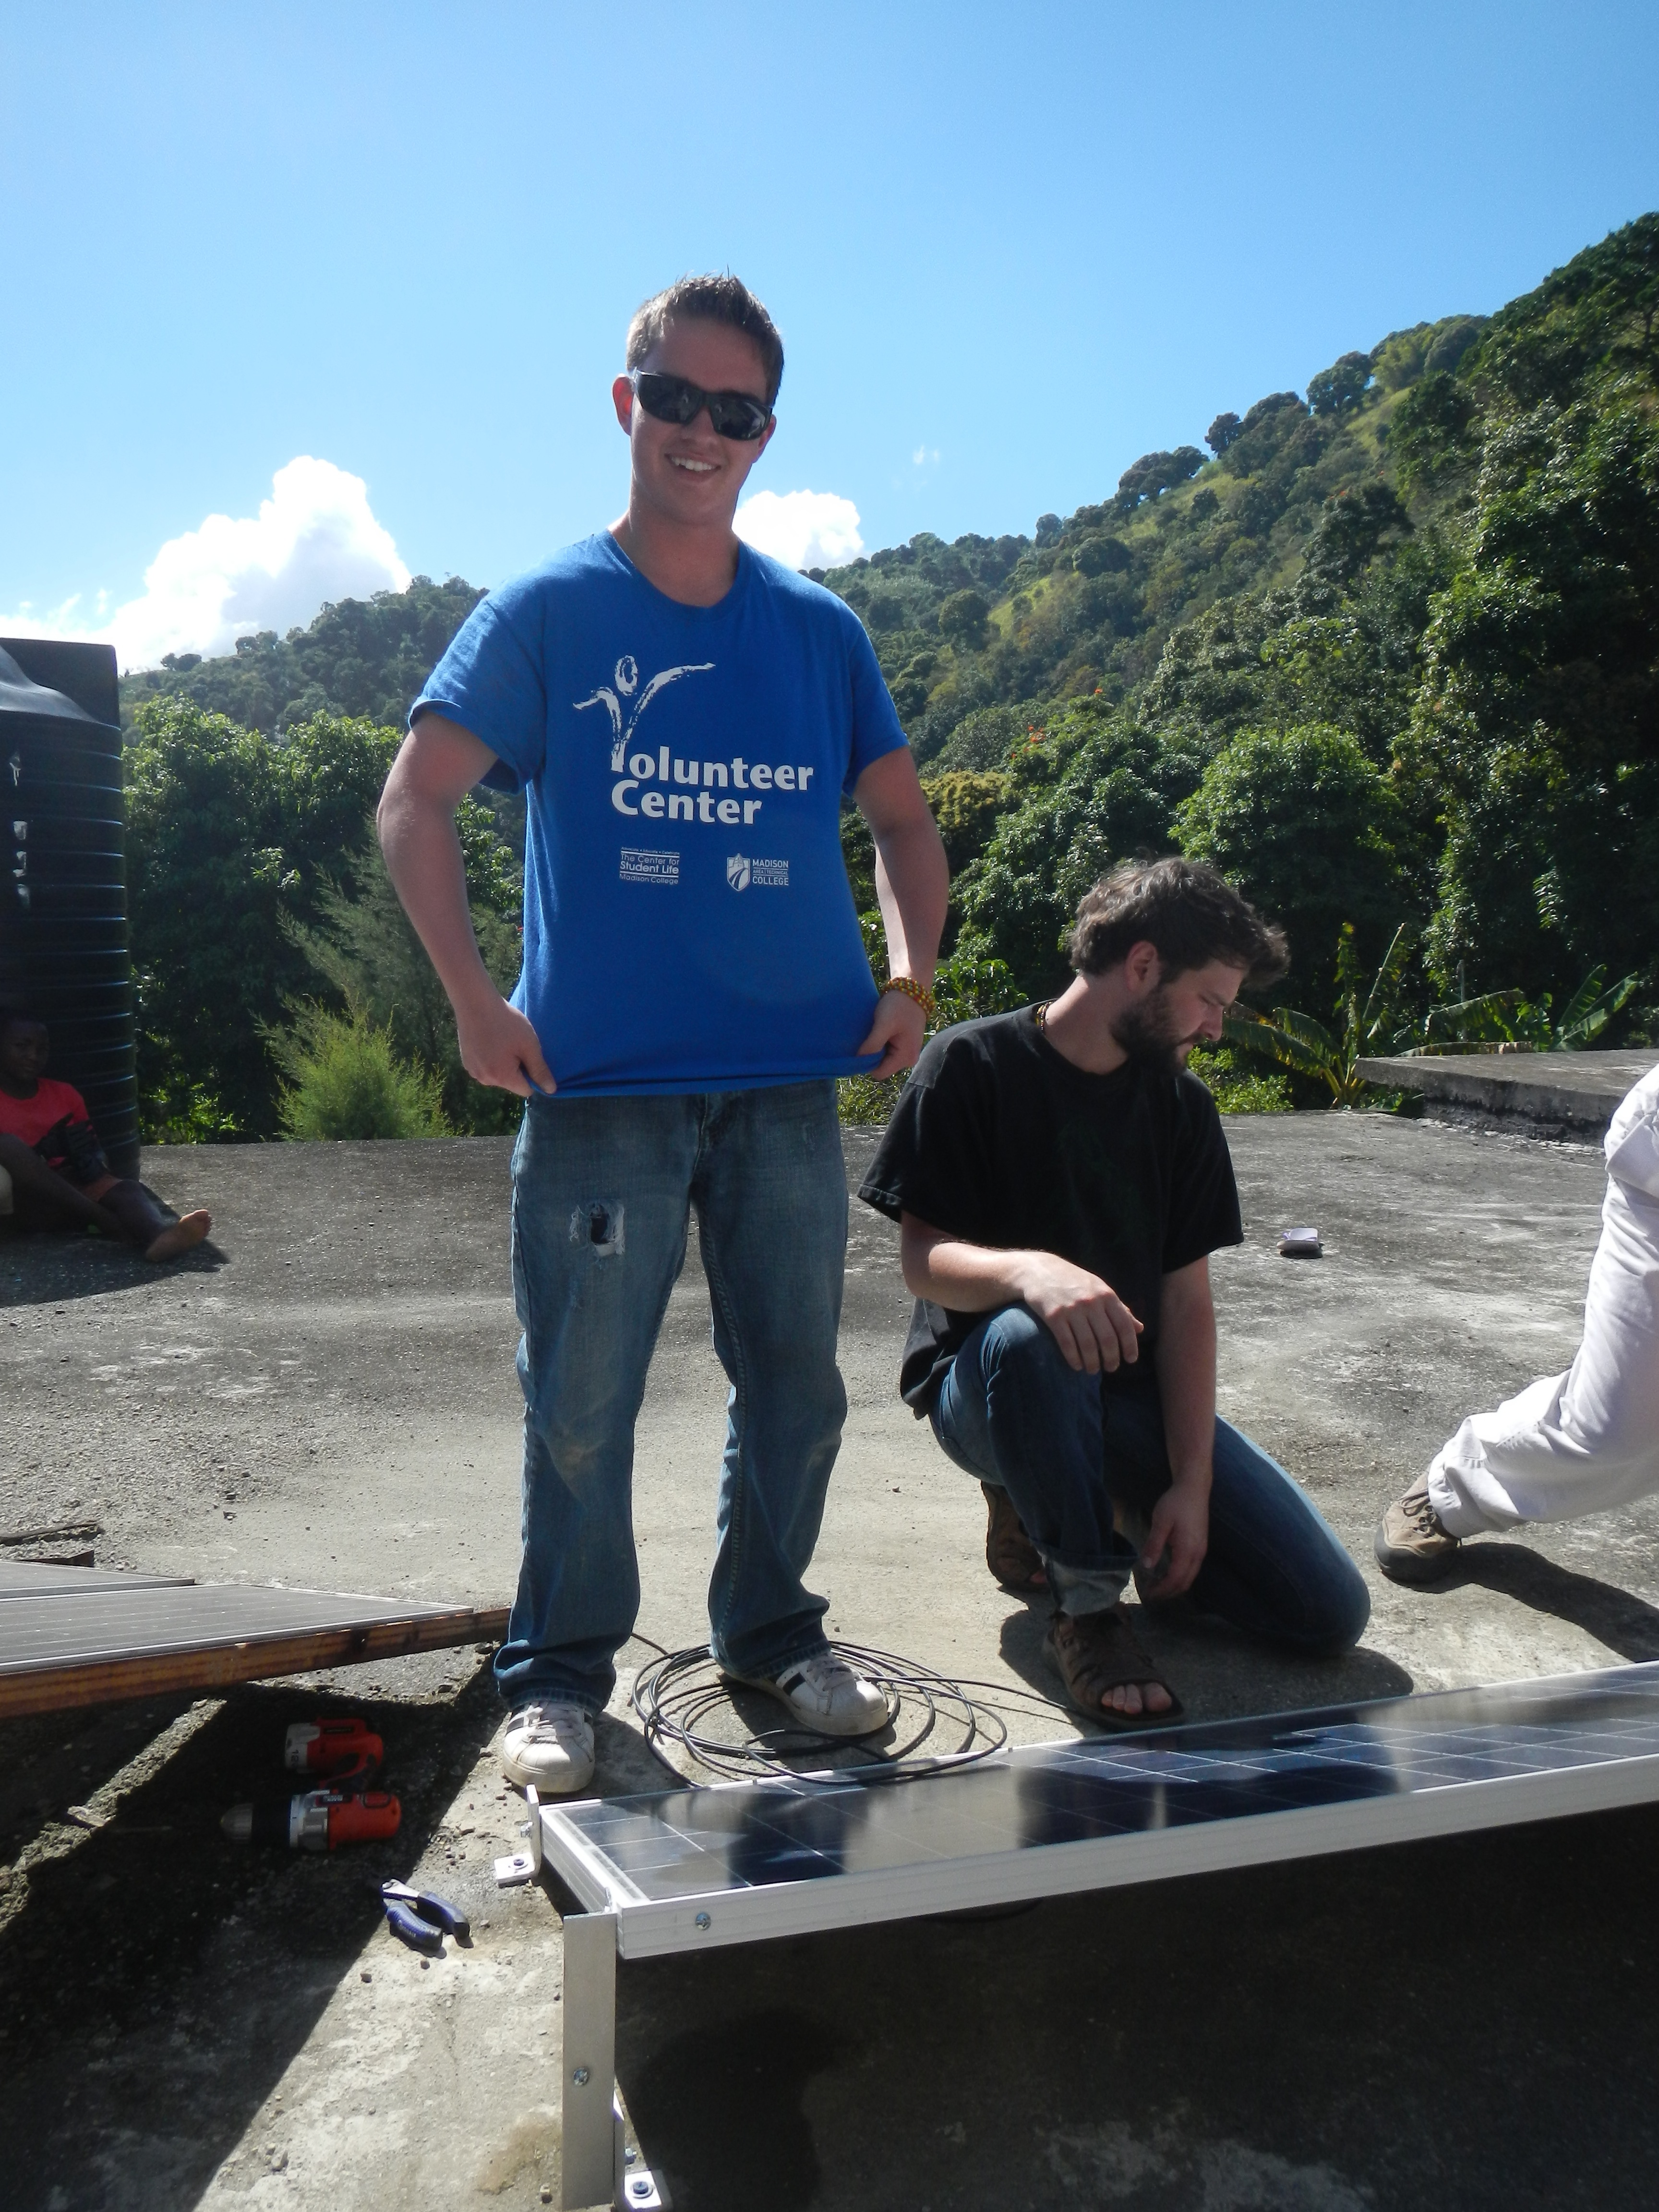
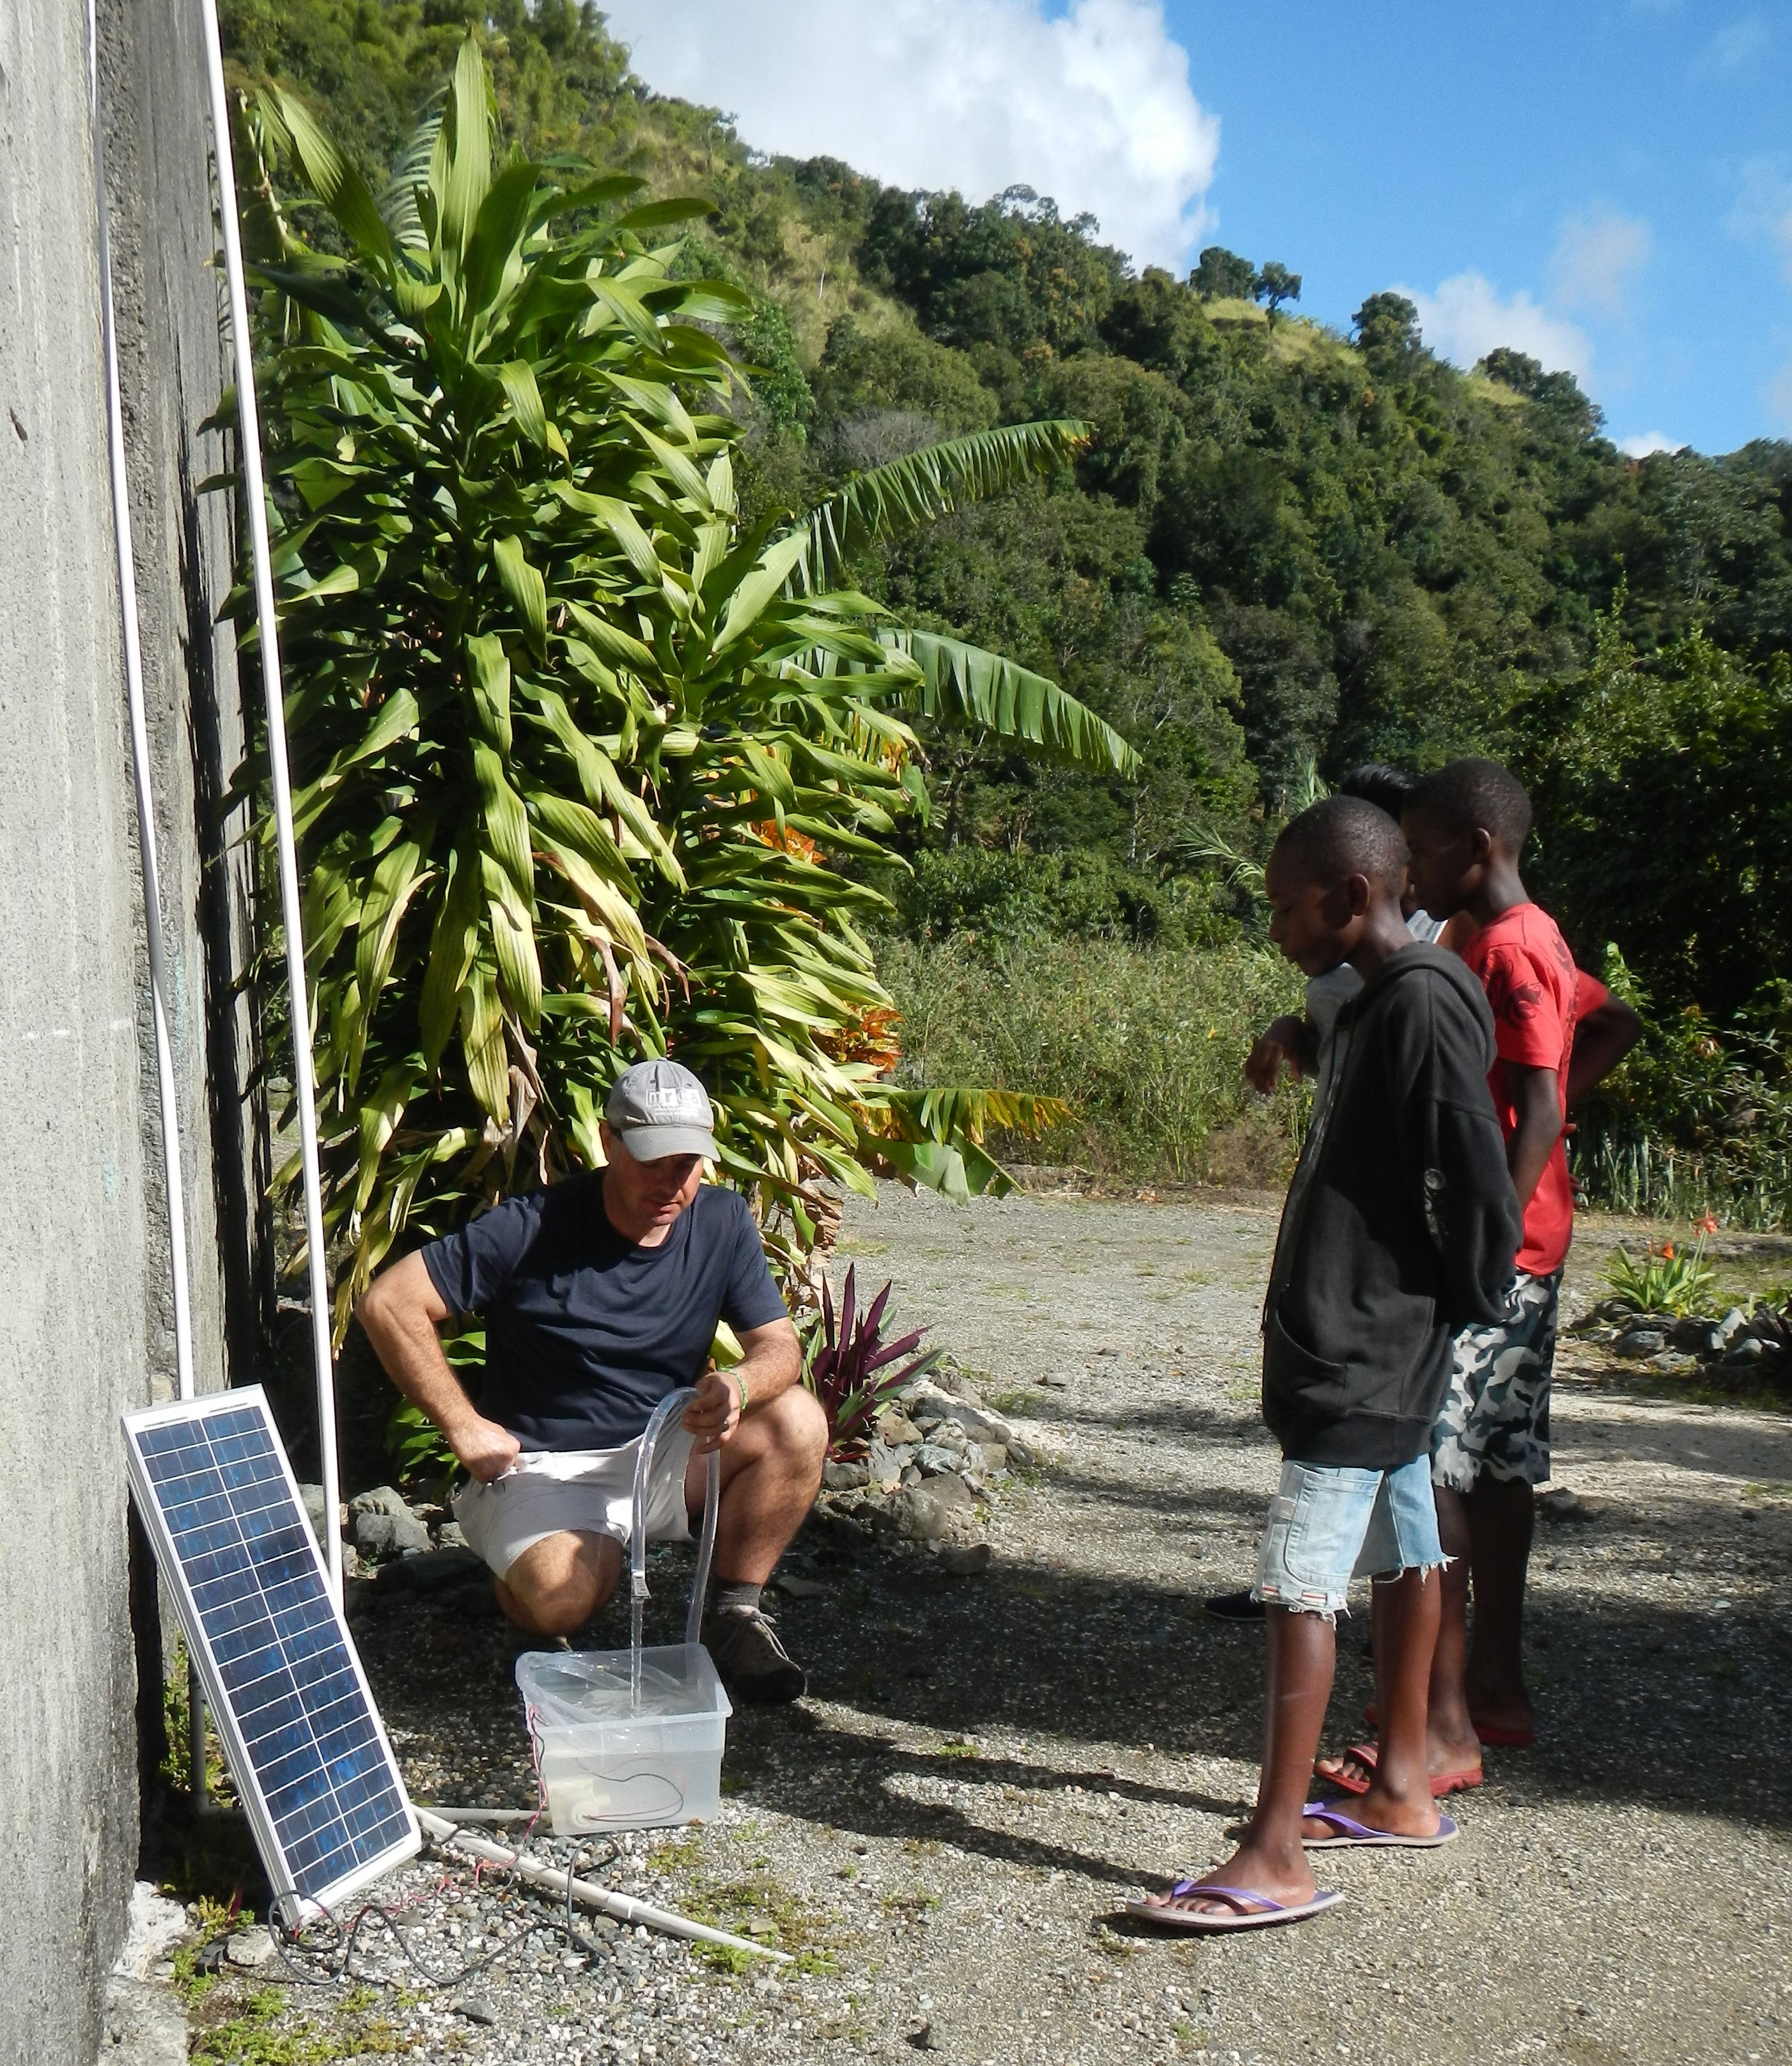
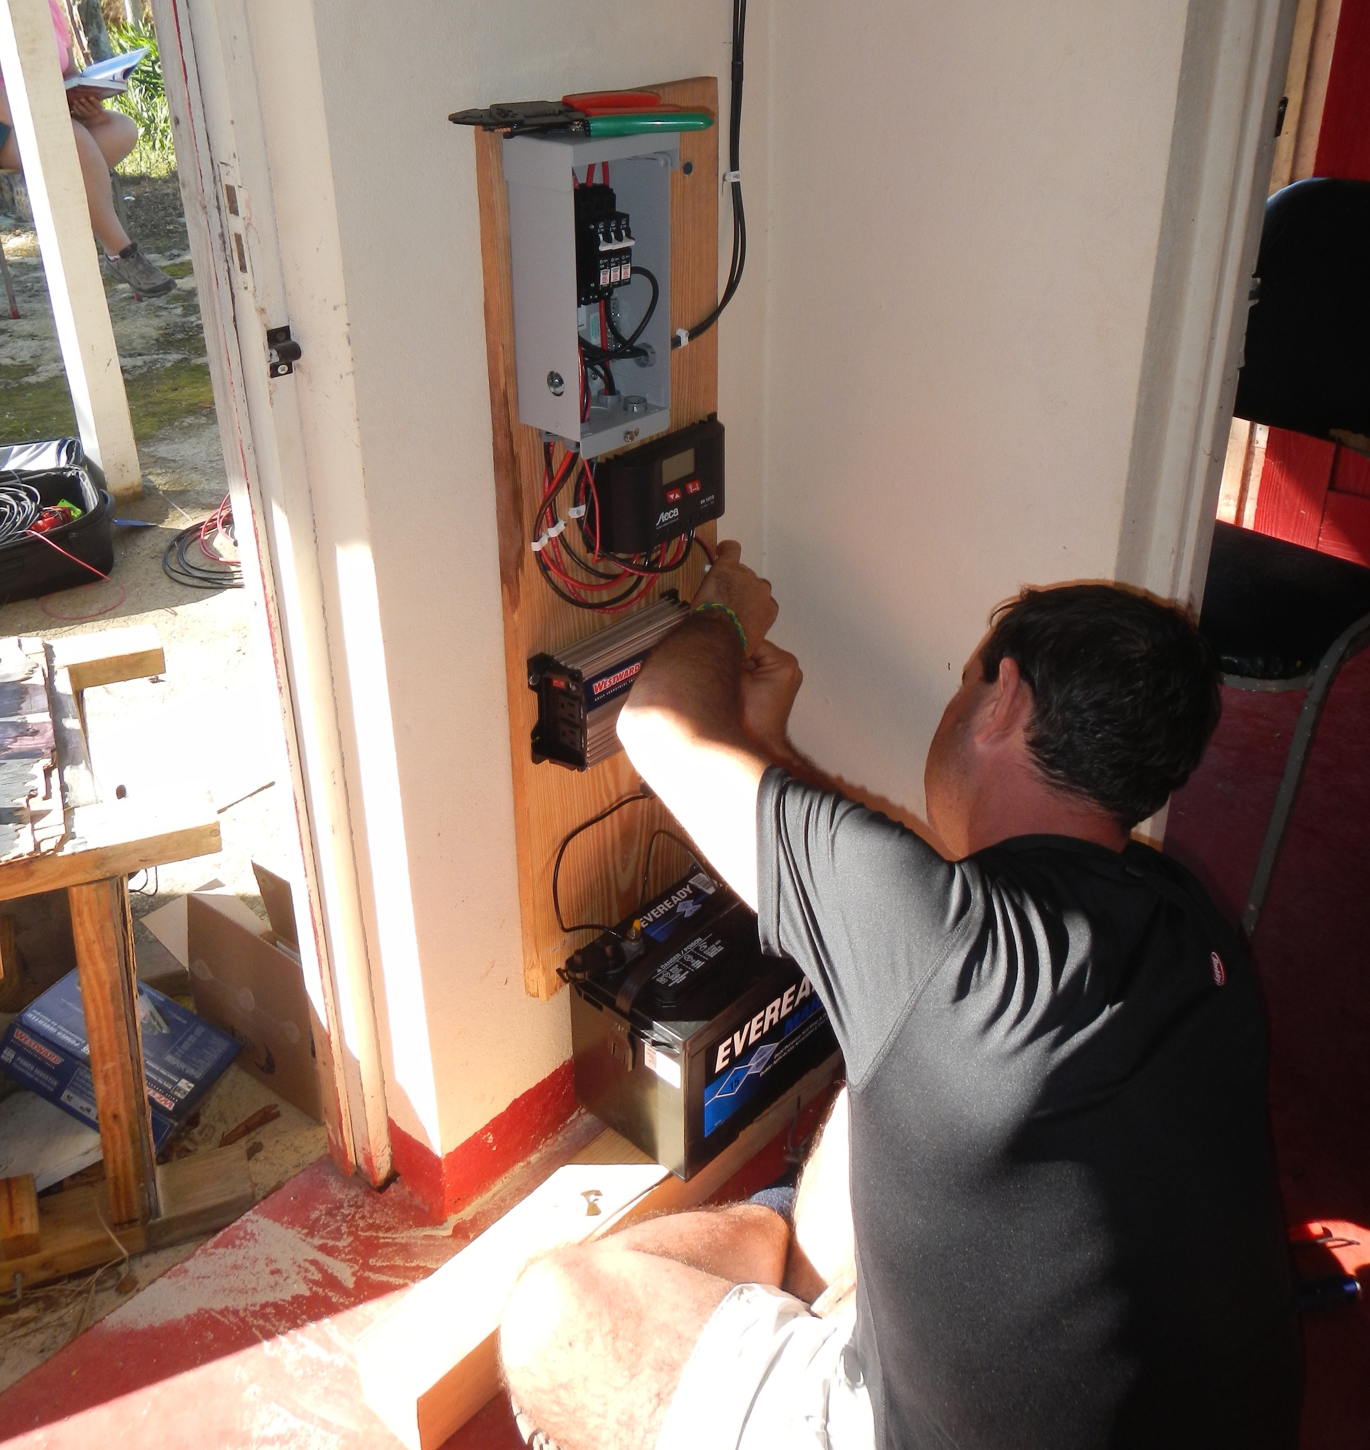
Renewable Energy

Slide 12
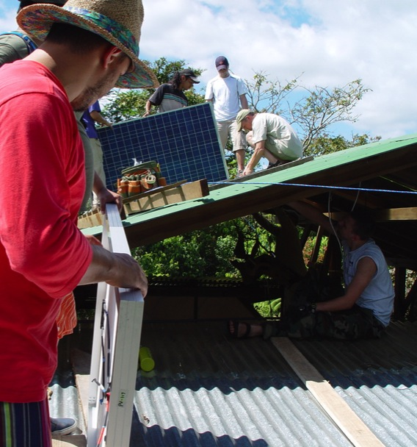
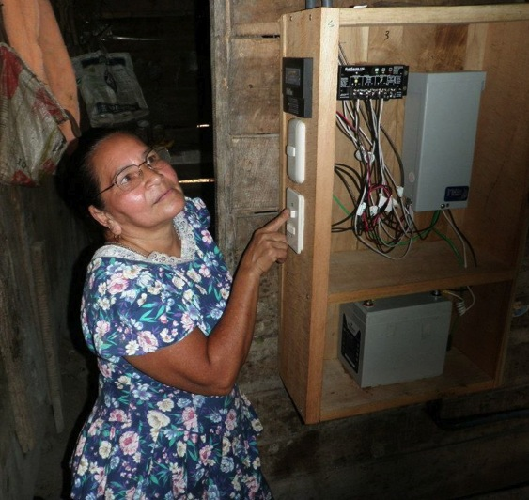
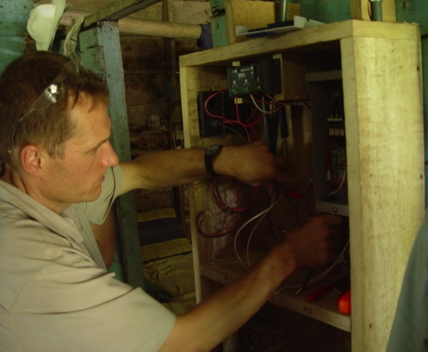
Renewable Energy

Slide 13
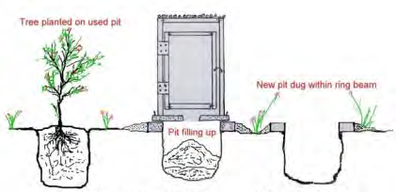
Sustainable Architecture

Slide 14
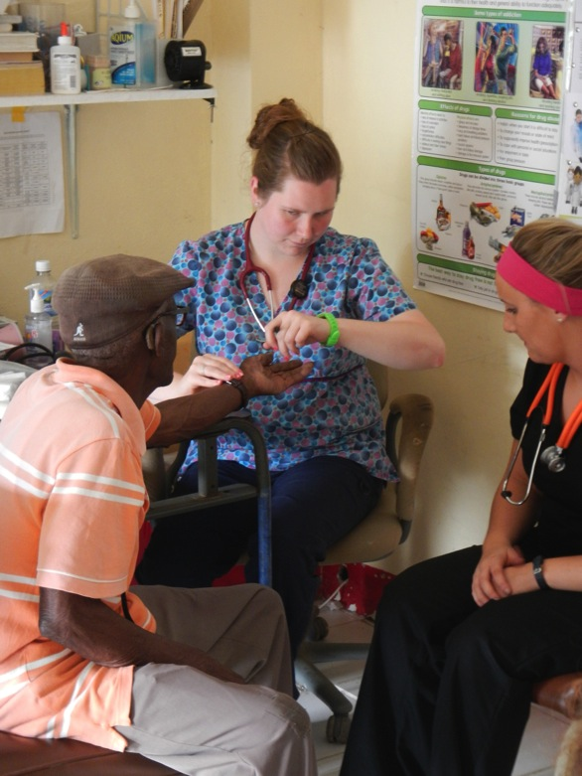
Nursing & Dental

Slide 15
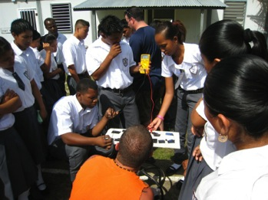
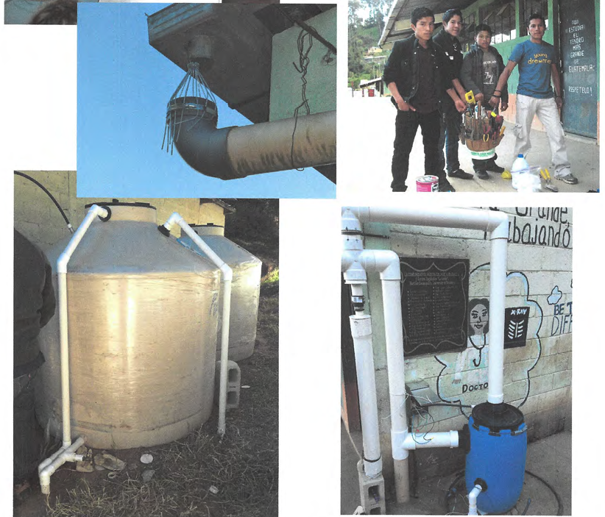
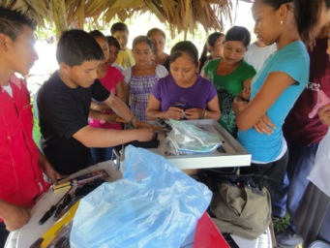
Engineering

Slide 16
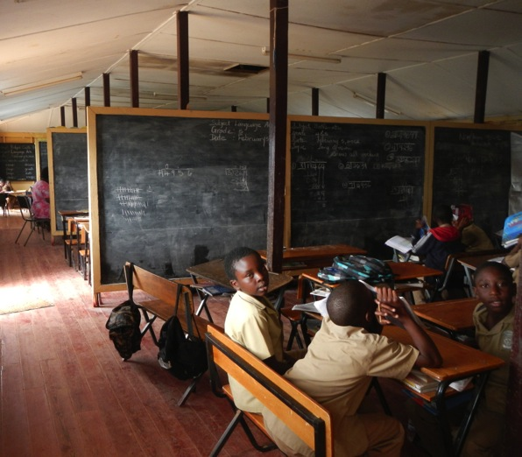
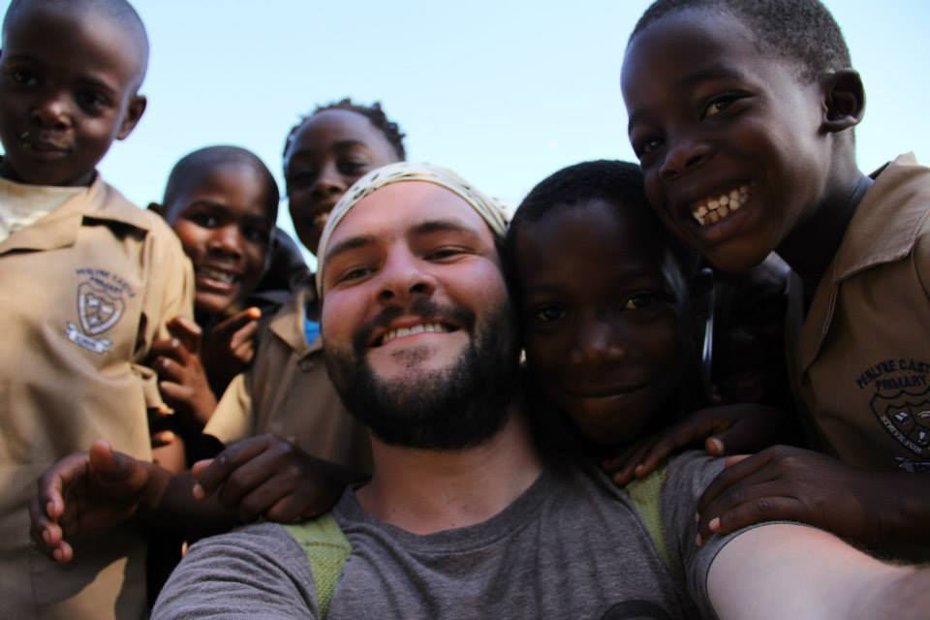
Education

Slide 17
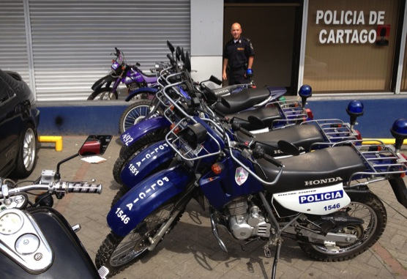
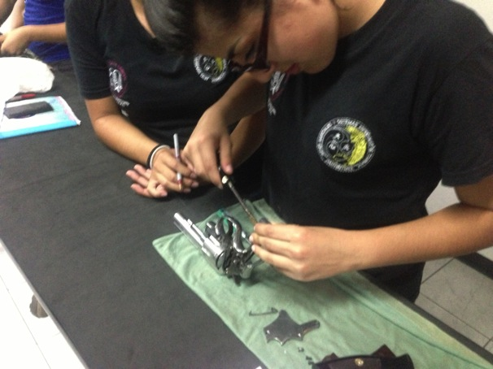
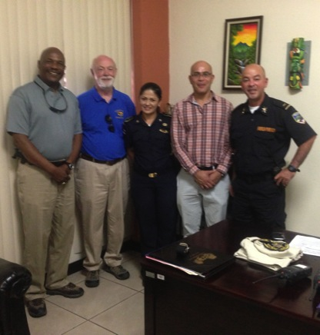
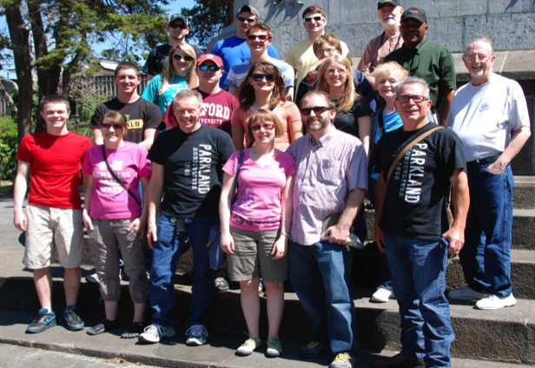
Criminal Justice

Slide 18
Tropical Ecology

Slide 19
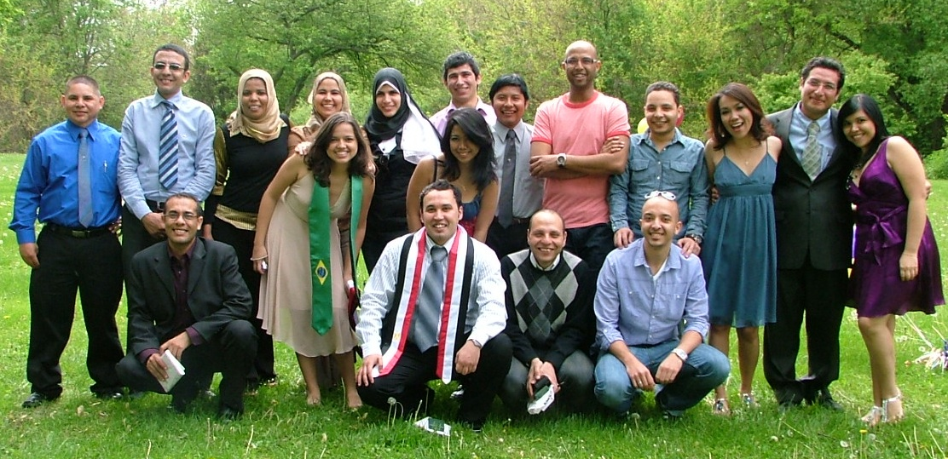
International Students
International students are a critical dimension to campus internationalization and leverages visibility and impact of International Education on the community college campus.

Slide 20
International Student Enrollment Growth
The Center for International Education was created in 2008.

Slide 21
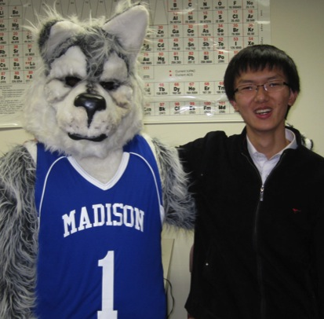
International Student Engagement
Programs and efforts to increase international student engagement on campus include:
Global Showcase
World Student Association
Cultural Connect
Mentor Family Opportunities
Partnerships with other colleges and community organizations

Slide 22
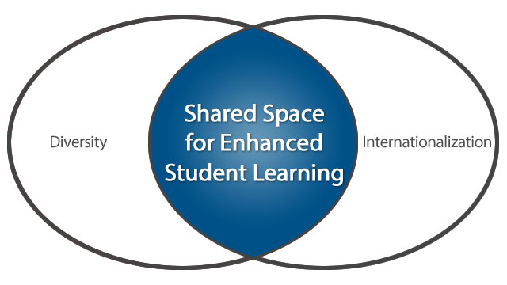
New Directions: Global and Multicultural Center Opening June 2016
Jointly administered by Center for International Education and Student Life
Engage and support diversity on campus
Visible place for student engagement on global and multicultural issues via guest speakers and programs
ACE At Home in the World Toolkit (2013)

Slide 23
Department of Education Title VI Grant 2016
Project Goals:
Internationalize curriculum
Foster an institutional culture of comprehensive internationalization for students and staff
Expand opportunities for Study Abroad
Strengthen partnership with UW-Madison international studies programs

