Slide 1

LEA 101
Establishing (and Maintaining!) an Independent Charter School as Local Education Agency in Wisconsin
Facilitated by
The PEO Charter Schools Team
with Department-wide support
and hosted by WRCCS
July 2024

Slide 2
Morning Agenda
9:00-9:15 – Introductions, Overview
9:15-9:45 – General SPED (Margaret McMurray)
9:45-10:15 – Joint Federal Notifications (Courtney Reed Jenkins)
10:15-10:30 – SNSP (Helen Leong)
10:30-10:40 Break
10:40-11:10 – General Licensing (Julie Hagan)
11:10-11:40 – Educator Effectiveness (Jacob Hollnagel)
11:40-Noon – Accountability (Patrick Chambers)
Noon-1:00 - Lunch

Slide 3
Afternoon Agenda
1:00-1:30 – WISEStaff (Jennifer Janik)
1:30-2:00 – WISE (Adam Mueller)
2:00-2:30 – WRCCS (Sarah Hackett)
2:30-2:40 Break
2:40-3:10 – McKinney-Vento (Clara Pfieffer and/or Kristine Nadolski)
3:10-3:40 – English Learners (Amy Maciolek and Tanya Morin)
3:40-3:50 Break
3:50-4:20 – Title Funding (Brielle Glatzel and/or Josie Smith)
4:20-4:50 – School Financial Services (Matt Baier)
4:50-5:00 – Reminders, Closing (Alexander B. Roberson)

Slide 4
Life as an LEA
An Independent Charter School (ICS) becomes its own LEA (Wis. Stat. 115.775)
All state and federal requirements and obligations of a school district belong to the governing board of the ICS charter school
  e.g., Civil Rights; ADA; IDEA; § 504; ESEA; FERPA; McKinney-Vento

Slide 5
Accountability
a charter school LEADER/OPERATOR is accountable to their GOVERNING BOARD
the GOVERNING BOARD is held accountable by the AUTHORIZER through non-renewal and revocation or required corrective action plans
There may be state and federal consequences for malfeasance, misfeasance, or nonfeasance (e.g., failure to provide a Free and Appropriate Public Education)
There are private rights of actions (e.g., ADA) that permit you to be sued

Slide 6
Disclaimers
This presentation is not all-encompassing or final.
This is a 30,000-foot view. You are still responsible for knowing the “Google Street” view.
The content of this presentation is for informational purposes only and not for the purpose of providing legal advice. You should contact your attorney to obtain legal advice, including compliance with state and federal laws and regulations.

Slide 7
Title Slide
Independent Charter Schools and
Special Education
Margaret McMurray, Special Education Team
July, 2024

Slide 8

Overview
Evaluations
Providing Free Appropriate Public Education (FAPE)
IEP development

Slide 9
Independent Charter Schools and Special Education
Although exempt from many state laws, independent charter schools must comply with federal laws such as the Individuals with Disabilities Education Act (IDEA)

Slide 10
Special Education Enrollment
May not deny admission to students based on disability
May not deny admission to a student with a disability solely because of a need for special education or related services

Slide 11

Evaluation Responsibilities
Accept referrals
Anyone may make a referral
Must be in writing
Must include the name of the child and why the person believes the child has a disability
School staff often assist parents in completing forms

Slide 12
Referral for Evaluation
Individuals required to make referrals
DPI licensed school staff
Physicians, nurses, psychologists, social workers and administrators of social service agencies
Teachers and other professionals must inform parents they are going to make a referral
Anyone else, including parents may make a referral

Slide 13
Evaluation Process and Timelines
Review of existing data by IEP team
Seek parental consent for conducting assessments
Conduct assessments and gather information
Meet to determine eligibility
    60 days from receipt of parental consent

Slide 14
Disability Categories
Autism
Blind and Visually Impaired
Deaf and Hard of Hearing
Deafblind
Emotional Behavioral Disability
Intellectual Disability
Orthopedic Impairment
Other Health Impairment
Significant Developmental Delay
Specific Learning Disability
Speech or Language Impairment
Traumatic Brain Injury

Slide 15

Child with a Disability
Two-part test
First, does the child meet the educational eligibility impairment criteria for one of the disability areas that adversely affects their educational performance
And, as a result of the disability, does the child need special education and related services

Slide 16
Section 504 Eligibility
A person is eligible if they have a physical or mental impairment which substantially limits one or more major life activities, has a record of such impairment, or is regarded as having such impairment
“Major life activities” means function such as caring for one’s self, performing manual tasks, walking, seeing, hearing, speaking, breathing, learning, and working. Not an exhaustive list
Schools may use the same evaluation process as under IDEA.
If eligible, develop a 504 accommodations plan
Notes:
If the child does note meet eligibility requirements, the child may need a 504 plan.

Slide 17
LEA Responsibility
Independent Charter Schools, as an LEA, must ensure the provision of a free appropriate public education (FAPE) to children with disabilities in virtual schools
IEP developed that meets FAPE standard and is implemented

Slide 18
What is FAPE?
FAPE as defined by IDEA means special education and related services that
Are provided at public expense under public supervision and direction,
Meet the standards of the department and Part B of IDEA, and
Are provided in conformity with an IEP

Slide 19

Rowley and Endrew F
Rowley (1982): The IEP must be reasonably calculated to enable the student to receive educational benefit
Endrew F (2017): The IEP must be reasonably calculated to enable a student to make progress appropriate in light of the student’s circumstances
Notes:
These US Supreme Court decisions outline the requirements of an IEP

Slide 20
FAPE
Districts must provide FAPE to each student with a disability by developing a program based on the student’s unique needs that is reasonably calculated to enable the student to make progress appropriate in light of the student’s circumstances, documenting that program in the IEP, and implementing the program articulated in the IEP

Slide 21
Required IEP Team Participants
The student’s parent(s)
At least one regular education teacher of the child
At least one special education teacher of the child
A representative of the local educational agency (often called LEA Rep)
A person able to interpret the instructional implications of evaluation results
Others with knowledge or special expertise about the child
Whenever appropriate, the student (must be invited if purpose is to determine postsecondary goals and transition services)

Slide 22

IEP Contents
Present Levels
Effects of Disability
Disability Related Needs
Goals
Services

Slide 23

Special Education
Special education means specially designed instruction, regardless of where the instruction is conducted, that is provided at no cost to the child or the child’s parents, to meet the unique needs of a child with a disability

Slide 24

Key Concepts
IEPs must be individualized/based on student’s unique needs
Appropriately ambitious in light of the student’s circumstances
Reasonably calculated

Slide 25

IEP Implementation
Schools must have an IEP in place for each student with a disability at the beginning of the school year
IEPs must be implemented as written

Slide 26

Behavior: IDEA Requirements
If the student’s behavior impedes his or her learning, or the learning of others, the IEP team must consider the use of positive behavioral interventions and supports, and other strategies to address the behavior.
Notes:
The IEP team must determine how these supports can be provided in a virtual setting (examples….)

Slide 27
Behavior and FAPE
Failure to address the behavioral needs of a student with a disability can result in both a denial of FAPE and a denial of placement in the least restrictive environment.
Addressing behavioral needs may include developing goals, providing specially designed instruction, related services, et cetera.
Notes:
Patti
Failing to address the behavioral needs of a student can result in both a denial of FAPE to the student and a denial of placement in the least restrictive environment.
In a Dear Colleague letter issued by OSEP in 2016, it was stressed that the consideration of whether a student needs positive behavioral supports and strategies applies regardless of the student’s specific disability, and is a consideration for every IEP team. The letter goes on to state that incidents of misbehavior and classroom disruptions, as well as violations of a code of student conduct, may indicate that the student’s IEP needs to include appropriate positive behavioral supports. This is especially true when there is a pattern. So the letter emphasizes that the behavioral needs of a student must be addressed in the IEP.

Slide 28
Resources
IEP Forms
Forms Guide
Model Policies and Procedures
CCR IEP Framework and Resources

Slide 29
Resources
CESA 1 Special Education Capacity Building Initiative
Supports independent charter schools in compliance, programming (focus on literacy), data collection and reporting, and fiscal management.
Resources include a special education roadmap, planning template, and special education process outline.

Slide 30

Questions?

Slide 31

Joint Federal Notifications
Office of Educational Accountability
Special Education
Title I - Continuous Improvement
2024

Slide 32

Identifications Respond to Needs
 | IDEA | ESSA
Legislation | Individuals with Disabilities Education Act | Every Student Succeeds Act
Goal | Provide students with disabilities a free, appropriate public education | Enhance outcomes for all students
Report Level | Districts | Schools (Does not apply to choice schools)
Identifications | LEA Determinations Meets Requirements Needs Assistance Needs Intervention Needs Substantial Intervention Racial Equity in Special Education Yes No | Schoolwide Comprehensive Support & Improvement (CSI) Student Subgroups Targeted Support & Improvement (TSI) Additional Targeted Support & Improvement (ATSI)

Slide 33
There are 3 ESSA Identifications
least severe
most severe
TSI
ATSI
CSI
Targeted Support & Improvement
Every year
Identifies low performing school student groups
Bottom 10% of overall performance and
bottom 10% of student group
Additional Targeted Support & Improvement
Every 3 years
Identifies lowest-performing school student groups
ATSI schools are TSI schools that fall below the CSI threshold
Comprehensive Support & Improvement
Every 3 years
CSI-Lowest Performance
Bottom 5% of Title I schools ranked by summary score
CSI-Low Graduation Rate
Schools <67% graduation rate

Slide 34
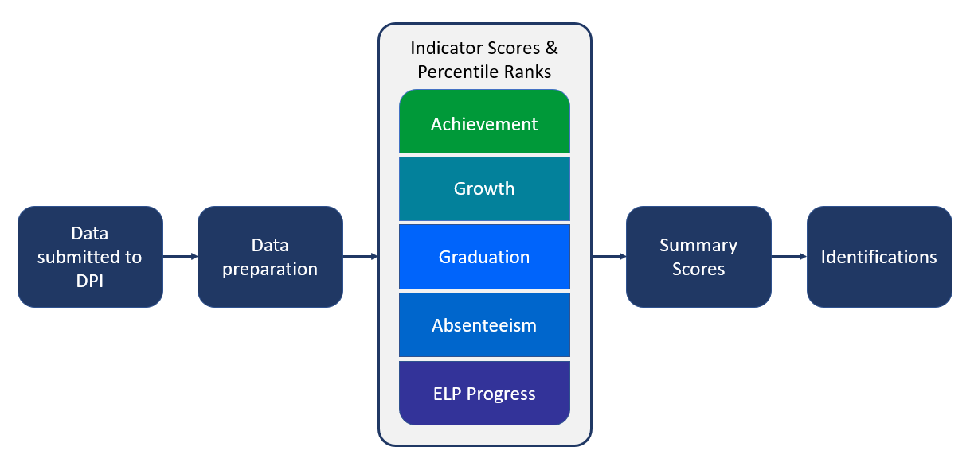
Entering ESSA Identifications

Slide 35
Entering ESSA Identifications
Achievement
3rd-8th and 11th grade assessment results from Forward, ACT, and DLM
Growth
4th-8th grade student growth percentiles (SGPs)
Graduation
4-year and 7-year graduation rates
Absenteeism
Chronic absenteeism rates
ELP Progress
SGPs for English learners

Slide 36
Exiting ESSA Identifications
There are three exit criteria for schools with CSI and ATSI identifications.
TSI identifications do not have an exit process, because the identifications are for one year only.
Exit Criterion | Definition
1 | Not be eligible for identification in the current year
2 | Make sustained and sustainable improvement toward the long-term goals
3 | Demonstrate evidence of systems, structures, and/or procedures that ensure sustained and sustainable high-quality improvement planning and practices are in place

Slide 37

Exiting ESSA Identifications
CSI and ATSI schools are eligible to exit after two years
  Must meet all three exit criteria
  TSI schools do not exit, because TSI identifications are for a single year.
  Exit status is typically confirmed each June after EC3 data is available.
COVID-19 disrupted exit timeframes
  CSI-LP and ATSI schools were not allowed to exit in 2019-20 and 2020-21. CSI-LG schools were eligible to exit.
Consequences for not exiting:
  ATSI-to-CSI conversion (2026-27)
  More rigorous interventions (2024-25)

Slide 38

IDEA LEA Determs with Required Actions
least severe
most severe
Needs Assistance
Needs Intervention
Needs Substantial Intervention
Score of 60-79%
Required actions for this determination begins upon the second consecutive year of the finding.
Score of <60%
Required actions begin immediately, with additional requirements upon three consecutive years of this finding.
Not Score Dependent
Usually the result of incomplete and/or inaccurate reporting which prevents DPI from issuing a determination based on data.

Slide 39
IDEA LEA Determinations
Results | Compliance
Graduation | IDEA Part C to Part B Transitions
Dropouts | Timely Initial Evaluations
Assessment Participation | Post-Secondary Transition Plans
Assessment Proficiency | Corrected Non-Compliance
Placement | Timely and Accurate Data

Slide 40

All LEAs Receive Reports
Release | Date | Reports | Location
Preliminary | February | ESSA Accountability Report IDEA LEA Determinations District Summary Report | SAFE
Final | April | ESSA Accountability Report IDEA LEA Determinations District Summary Report IDEA Racial Equity in Special Education | ESSA Public App and SAFE
*Select ESSA-identified schools also receive ESSA Progress to Exit reports
Key Takeaway:
Every LEA receives a JFN packet so that every LEA has data in support of continuous improvement.

Slide 41
Continuous Improvement Process
ESEA improvement plan for focus and/or priority schools
IDEA improvement plan(s)
Continuous improvement of adult practices to improve student outcomes
School and district improvement plans

Slide 42



Key Take-Aways
December
DATA SNAPSHOT
Ensure accurate data
February
SECURE ACCESS FILE EXCHANGE
Review JFN Packet
Spring
CONTINUOUS IMPROVEMENT
May have required activities

Slide 43
LEA 101 2024
Hold for Helen Leong

Slide 44
Licensing in Charter Schools
Julie Hagen
Education Consultant
July 2024

Slide 45
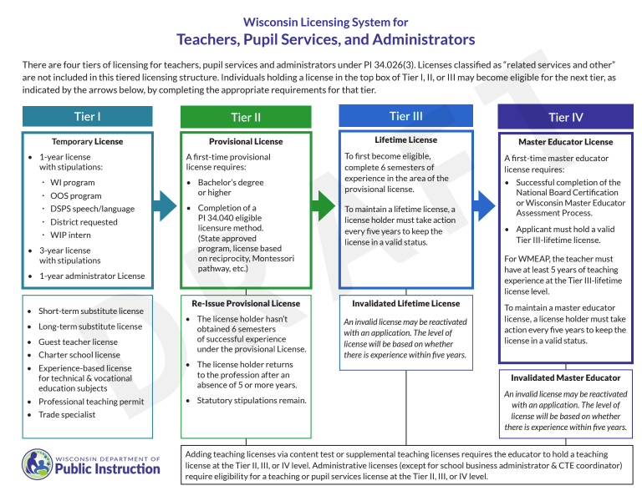
Tiered licensing

Slide 46

Licensing for Teachers
Teachers must hold a license that covers the grades and subjects they are teaching at the Tier I, Tier II (provisional), Tier III (lifetime) or Tier IV (master educator) level.
The tiered licensing system allows teachers to be hired without completing an approved program, but the tier of license will drive eligibility for other licenses.
Charter license requires demonstration of content knowledge.

Slide 47
Charter School License-Demonstrating content knowlege
WI Charter School teaching License requires applicants demonstrate their content knowledge to be eligible for a charter school license. When there is no major or minor on a transcript to demonstrate content knowledge, the following tests are required in the chosen subjects. Special education and supplemental teaching subjects are not issued for charter school license.
Available Charter school teacher licenses | Demonstration of Content knowledge | Passing score
Early childhood (regular education) grades birth-3 | Praxis II Elementary education: content knowledge (test 5018) | 157
Elementary/middle grades K-9 | Praxis II Middle school: content knowledge (test 5146) | 146
Computer science, grades 4-12 | Praxis II Computer science (test 5652) | 149
Math, grades 4-12 | Praxis II Mathematics (test 5165) | 159
Science (2600), grades 4-12 | Major/minor in at least one discrete science area + Praxis II General science: content knowledge (test 5436) | 141
Biology, grades 4-12 | Praxis II Biology (test 5236) | 154
Chemistry, grades 4-12 | Praxis II Chemistry (test 5246) | 146
Physics, grades 4-12 | Praxis II Physics (test 5266) | 145
Earth and space science, grades 4-12 | Praxis II Earth and Space Science (test 5572) | 154
Environmental studies, grades 4-12 | Praxis II Biology (test 5236) | 154
Life and environmental science, grades 4-12 | Praxis II Biology (test 5236) | 154
Social studies (2700), grades 4-12 | Major/minor in at least one discrete social studies area + Praxis II Social Studies: Content knowledge (test 5081) | 153
History, grades 4-12 | Praxis II World and U.S. History: Content Knowledge (test 5941) | 150
Economics, grades 4-12 | Praxis II Economics (test 5911) | 150
Geography, grades 4-12 | Praxis II Geography (test 5921) | 153
Sociology, grades 4-12 | Praxis II Sociology (test 5952) | 154
Political science, grades 4-12 | Praxis II Government/Political Science (test 5931) | 149
Psychology, grades 4-12 | Praxis II Psychology (test 5391) | 154
Language arts (2300), grades 4-12 | Major/minor in at least one discrete language arts area + Praxis II English language arts: Content knowledge (test 5038) | 167
English, grades 4-12 | Praxis II English language arts: Content Knowledge 5038) | 167
Speech communications, grades 4-12 | Praxis II Speech Communication: Content Knowledge (test 5221) | 150
Journalism, grades 4-12 | Praxis II Journalism (test 5224) | 153
Agriculture, grades K-12 | Praxis II Agriculture (test 5701) | 147
Art, grades K-12 | Praxis II Art: Content Knowledge (test 5134) | 158
Business Education, grades K-12 | Praxis II Business Education: Content Knowledge (test 5101) | 154
English as a second language, grades K-12 | Praxis II English to speakers of Other Languages (test 5362) | 149
Family and Consumer Education, grades K-12 | Praxis II Family and Consumer Sciences (test 5122) | 153
Health, grades K-12 | Praxis II Health Education (test 5551) | 151
Marketing, grades K-12 | Praxis II Marketing Education (test 5561) | 153
Music (2500), grades K-12 | Major/minor in at least one discrete music area + Praxis II Music: Content knowledge (test 5113) | 150

Slide 48
Charter School License-Demonstrating content knowlege
To register for the Praxis II: https://www.ets.org/praxis/wi/test-takers/plan-your-test/licensure-requirements.html
To register for the ACTFL OPI and WPT: https://www.languagetesting.com/
To register for the Avant Assessment: https://www.avantassessment.com/languages/hmong
Instrumental music, grades K-12 | Praxis II Music: Content knowledge (test 5113) | 150
Choral music, grades K-12 | Praxis II Music: Content knowledge (test 5113) | 150
General music, grades K-12 | Praxis II Music: Content knowledge (test 5113) | 150
Physical Education, grades K-12 | Praxis II Physical Education: Content knowledge (test 5091) | 150
Technology Education, grades K-12 | Praxis II Technology Education (test 5051) | 159
Theatre, grades K-12 | Praxis II Theatre (test 5641) | 157
Spanish, grades k-12 | ACTFL Oral Proficiency Interview & Writing Proficiency Test - Spanish | Intermediate-High
German, grades K-12 | ACTFL Oral Proficiency Interview & Writing Proficiency Test -German | Intermediate-High
French, grades K-12 | ACTFL Oral Proficiency Interview & Writing Proficiency Test -French | Intermediate-High
Chinese Mandarin, grades K-12 | ACTFL Oral Proficiency Interview & Writing Proficiency Test -Mandarin | Intermediate-High
Hmong | Avant Assessment | 6

Slide 49
Typical Scenarios for teachers
Person with a bachelor’s degree is hired with no license
Licensing solution: Often times teachers are hired under the 1-year license with stipulations for the first year. By the end of the first year, the educator should either complete requirements for the charter school license or have made progress in an approved educator preparation program.
Person with a provisional license in math is hired to teach math and English
Licensing solution: A teacher can work under the 1-year license with stipulations for the first year. By the end of the first year, if this educator can pass a content test, can add another provisional license in English via content test or continue to renew the 1-year license with stipulations by making progress in an approved educator preparation program.

Slide 50

Licensing for Administrators
Tier I license options: Charter School Principal license or 1-year board requested license.
Tier II provisional license: Most principals or other school administrators will need to become eligible for a Tier II-Provisional license by completing a WI approved program or license by reciprocity or the out of state pathway.

Slide 51
Licensing deadlines
Before the start of school year:
  Determine if staff have the appropriate license for their assignments
  For those not appropriately licensed, provide direction and school completed forms, when necessary. (e.g. PI-1624-LWS1 form for 1-year license with stipulations)
During the school year:
  Monitor staff have applied for and have been issued the license(s) needed for their assignments.
  Use the preliminary Licensing Audit conducted in late December – Early January based on the WISEstaff data to assist you ensuring appropriately license staff
  Use the Educator Effectiveness System to support your staff in obtaining licensure.
End of the school year:
  Final licensing audit conducted in mid-June. All staff should be appropriately licensed by this date.

Slide 52
Applicable law & Resources
Requirements for licensure: s.121.02/s.118.40(2r)
Charter school teacher license: s.115.28(7)(g)/s.118.40(2r)(d)1.
Charter school principal: s.115.28(7)(gm)
Virtual charter school requirements: s.118.40 (8)(b)
License via reciprocity: s.118.193
https://dpi.wi.gov/licensing/news

Slide 53
Got Questions?
If you have questions about licensing in general or for a specific person, submit your questions to:
https://dpi.wi.gov/support/contact-us

Slide 54
LEA 101 2024
Hold for Jacob Hollnagel

Slide 55
LEA 101
School & District Report Cards
Office of Educational Accountability
July 19, 2024

Slide 56
School and District Report Cards
All Wisconsin public schools and districts and choice schools receive a report card annually per state statute. This includes charter schools.
Report card score requires two years of at least 20 tested students, who were enrolled for the full academic year.
Schools that do not have enough tested students (including new schools) participate in alternate accountability.

Slide 57
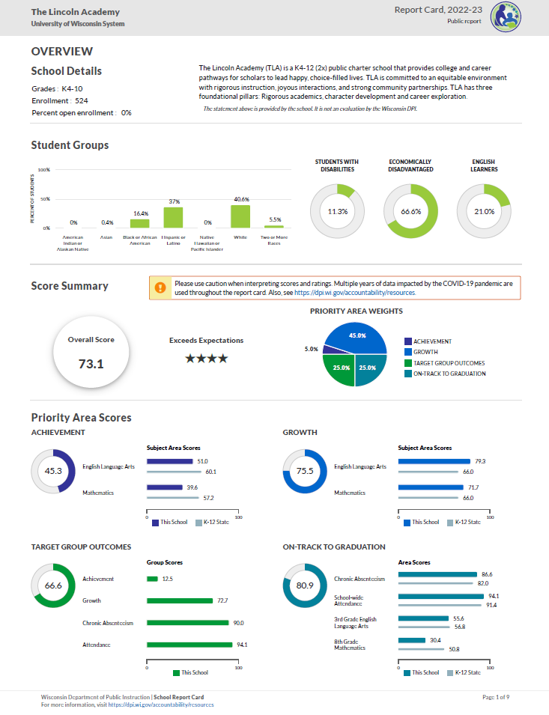
Report Card Overview
Report cards contain the following information:
Overall score and rating
School information
Statement from School (optional)
Four priority areas:
Achievement, Growth, Target Group Outcomes, On-Track to Graduation
For schools with grades 9-12
Course and program data (not on front page)

Slide 58

Report Card Timelines
Two report card releases: Secure and Public
Secure release in Oct
  Via a secure login site (SAFE)
  Non-redacted data--should never be shared.
  Internal review, opportunity to open an inquiry for data corrections
Public release: Nov
  Final release – no more data inquiries
New schools in 2024-25 will receive their first report card(s) in the fall of 2025. Those report cards will be rated using alternate accountability because we will only have one year of data for the school. Their first scored report cards will come in the fall of 2026.

Slide 59
Report Card Resources
Please see our Report Card Resources for resources specific to last year’s report cards and stay tuned to this page for updated resources in the fall.
Here are some other helpful links related to report card requirements and reporting:
Snapshot Preparation
Course and Program Data
Report Card Inquiry Process
Notification Requirements
For questions about report cards, please contact OEA at ReportCardHelp@dpi.wi.gov

Slide 60
Questions?
Viji Somasundaram
Director of Accountability
Sam Bohrod
Assistant Director of Accountability
Patrick Chambers
OEA ​Education Consultant
Data and Policy Communications

Slide 61
LEA 101 Training:
WISEid and WISEstaff Basics
Jennifer Janik
Business Analyst
DPI WISEstaff Development Team

Slide 62
WISEid Topics
WISEid topics covered today:
Purpose of WISEid
Navigating the WISEid application
WISEid basics
Help resources / weekly user group calls

Slide 63
WISEstaff Topics
WISEstaff topics covered today:
Purpose of WISEstaff
Data collected
Who should report data / who gets reported
Data collection timeline
Navigating the WISEstaff application
Basics of data entry
Help resources / weekly user group calls

Slide 64

Purpose of WISEid
WISEid is a secure web application used to maintain basic demographic information about students and staff in schools. WISEid provides identity management across multiple WISE applications through the assignment of a secure, individual identification number.
WISEid can be accessed through WISEhome.
More information on WISEid can be found on the WISEid: Info, Help and FAQ’s page.

Slide 65
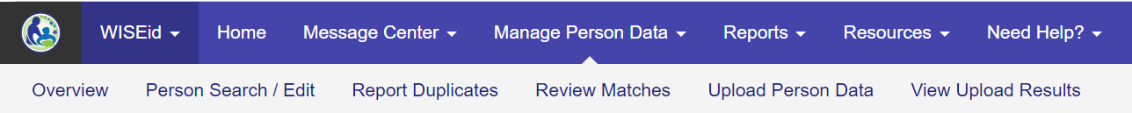
Navigating WISEid
Each menu has an Overview page to summarize menu functions
Message Center: View system notifications, review change requests
Manage Person Data: Access a student or staff record, upload person records, review WISEid matches, report duplicate WISEids
Reports: Student download
Resources: WISEid contacts, provide feedback
Need Help: WISEid user guide, site map, WISEid help

Slide 66
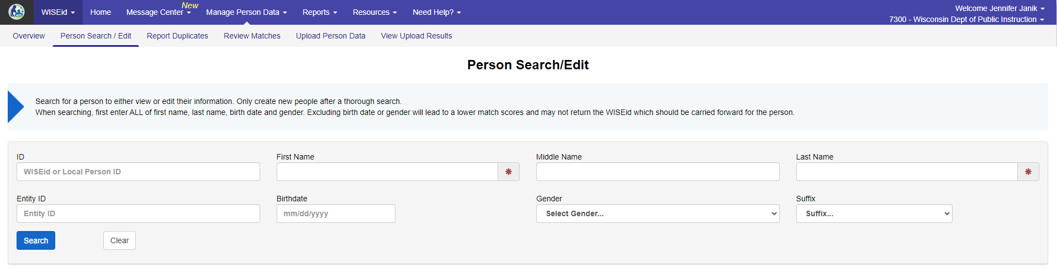
WISEid Basics
Person Search / Person Upload
Search for student or staff by WISEid or name
Create WISEid for new student or staff if not found in search
Upload student or staff person files to keep demographic data current and add Local Person ID if new to your school

Slide 67
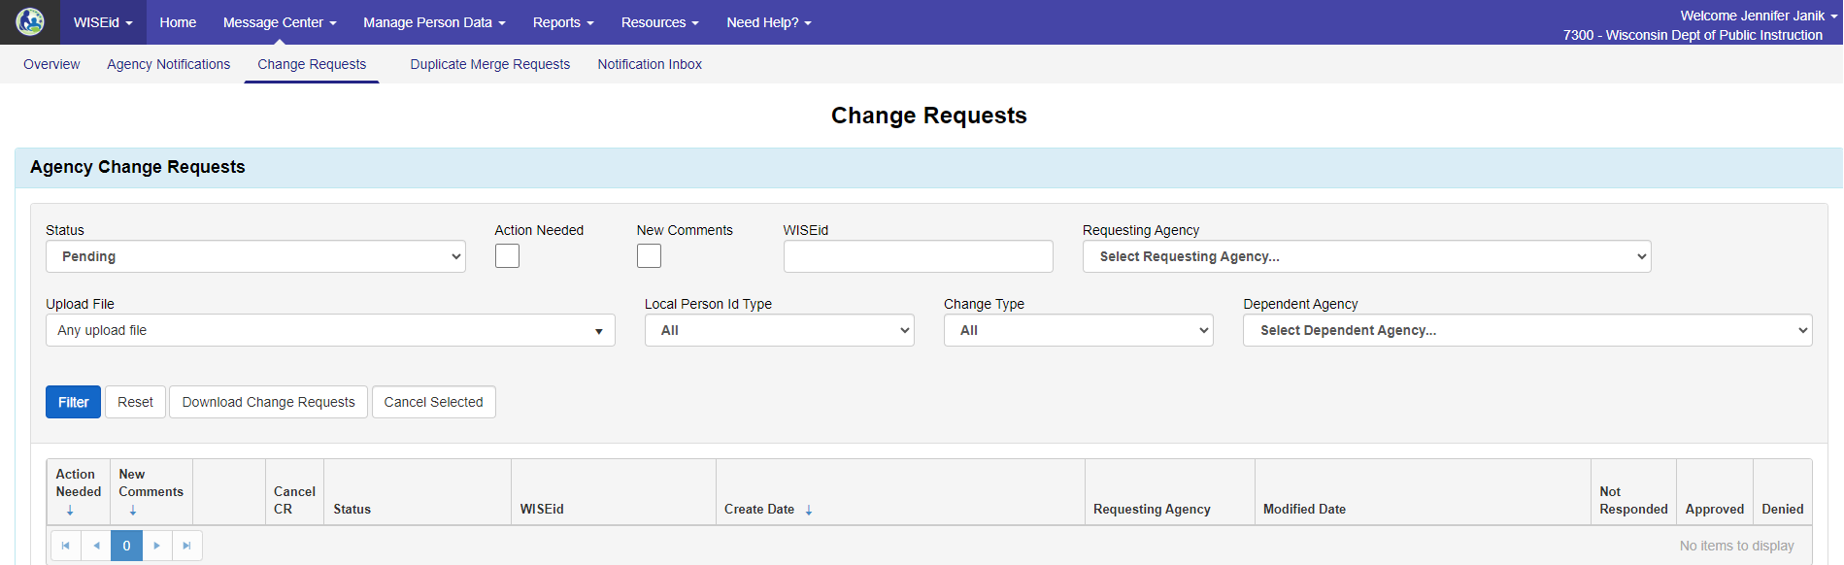
WISEid Basics
Change Requests
Some changes take effect immediately (i.e. last name)
Some changes require DPI approval (i.e. birth date); system creates change request; view and add comments on Change Requests page

Slide 68
Help Resources
DPI Website: http://dpi.wi.gov / Search for: WISEid Help
Join the weekly WISE User Group Calls to hear updates from different teams and ask questions of DPI staff on the call
Join our Microsoft Teams Group to connect with fellow WISE users and receive announcements and notifications from DPI and the WISE community.
Submit a Help Ticket

Slide 69

WISEstaff
WISEstaff

Slide 70
Purpose of WISEstaff
WISEstaff is a secure web application used to maintain required information about school staff members. It stores assignment and salary information for all staff positions within the school, including teachers, paraprofessionals, and principals, as well as support staff such as custodians, bus drivers, and school nurses.
WISEstaff can be accessed through WISEhome.

Slide 71
Purpose of WISEstaff
We collect data for a number of reasons:
State and federal requirements
Conducting staff assignment audits to confirm licensing qualifications
Reporting Special Education staff to secure funding for aid reimbursement
Generation of the Public Staff Reports that are used by members of the education community, researchers, and the public.
Wisconsin School District Performance Report (SDPR)

Slide 72
WISEstaff: Data Collected
WISEstaff facilitates the collection of school staff contract and assignment data.
Contract Data:
Salary, Fringe Benefits
Highest Degree
Years of Experience
Assignment Data:
Position and Area (i.e. Teacher - Elementary Classroom)
FTE
Grades
Position-dependent questions

Slide 73
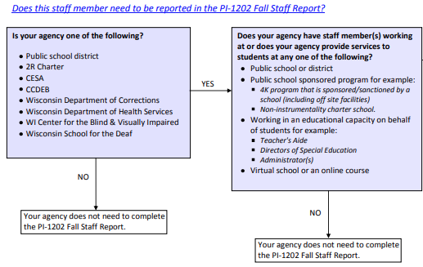
WISEstaff: Who Gets Reported?
WISEstaff is a point in time collection of all staff members in public schools as of the 3rd Friday of September and includes known assignments for the entire regular school year.
dpi.wi.gov / WISEstaff Reporting / Who Should Be Reported?

Slide 74
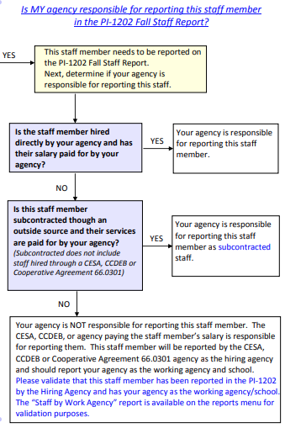
WISEstaff: Who Does Reporting?
Hiring Agency reports staff
If you subcontract staff from a school district or CESA, they report staff they hire
If you subcontract staff from an outside agency, you report staff as subcontracted

Slide 75
WISEstaff: Data Collection Timeline
WISEstaff is NOT a year-round collection, like some other WISE apps.
Each school year has two data collection phases: Preliminary Certification and Final Certification.
Preliminary Certification focuses on collection of licensed assignments to facilitate preliminary educator licensing audit. For the 2024-25 school year:
  Collection opens September 27, 2024
  Deadline is November 12, 2024
  Preliminary audit reports published around end of December

Slide 76
WISEstaff: Data Collection Timeline
Final Certification focuses on corrections to assignments and entry of all other data for final audit and publication of staff data reports. For the 2024-25 school year:
  Except for the day after Preliminary Deadline, WISEstaff remains open for additional data entry and corrections
  Deadline is March 18, 2025
  Public Staff Reports published around end of April
  Final audit reports published around end of June

Slide 77
WISEstaff: Navigation
Each menu has an Overview page to summarize menu functions
Home: Data Quality Dashboard, Staff Collection Checklist
Message Center: View system notifications, review change requests
Person Search: Access a staff record, report duplicate WISEids
Manage Staff Data: Upload contracts and assignments, data validation, certification
Reports: Salary reports, All Staff report, audit results, Staff List
Resources: WISEstaff contacts, Assignment Code List, provide feedback
Need Help: WISEstaff user guide, site map, WISEstaff help, licensing help

Slide 78
Basics of WISEstaff Data Entry
Preliminary Certification Phase
Contact Information
WISEids / Local Person IDs / Entity IDs
Review previous year final audits
Review Assignment Codes (Changes)
Enter Assignment Data, focus on licensed assignments
Review Data Validation
Complete Preliminary Certification
Final Certification Phase
Review Audit Reports
Assignment Corrections
Remaining Assignments
Contracts
Data Quality Review
Complete Final Certification
Review Final Audits

Slide 79
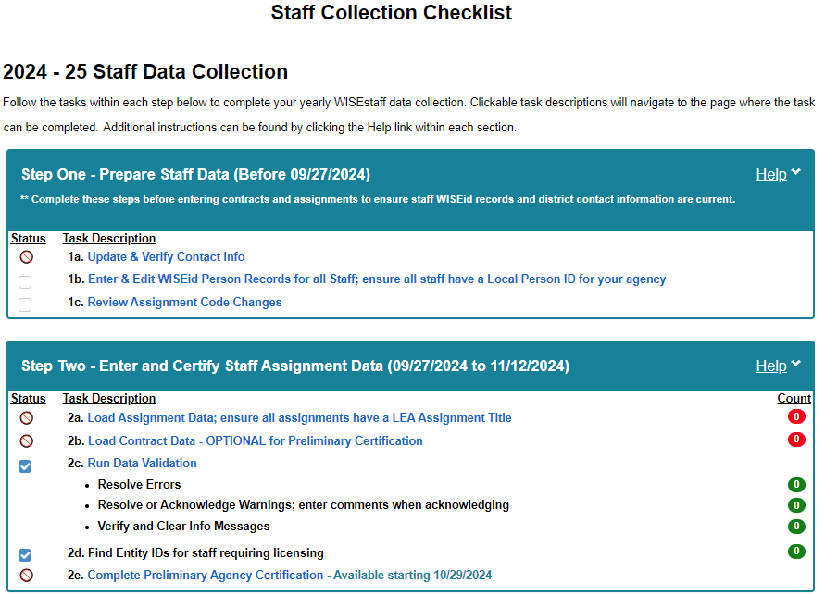
Basics of WISEstaff Data Entry
Staff Collection Checklist
List of preliminary and final certification tasks
Status of each task
Deadlines for tasks

Slide 80
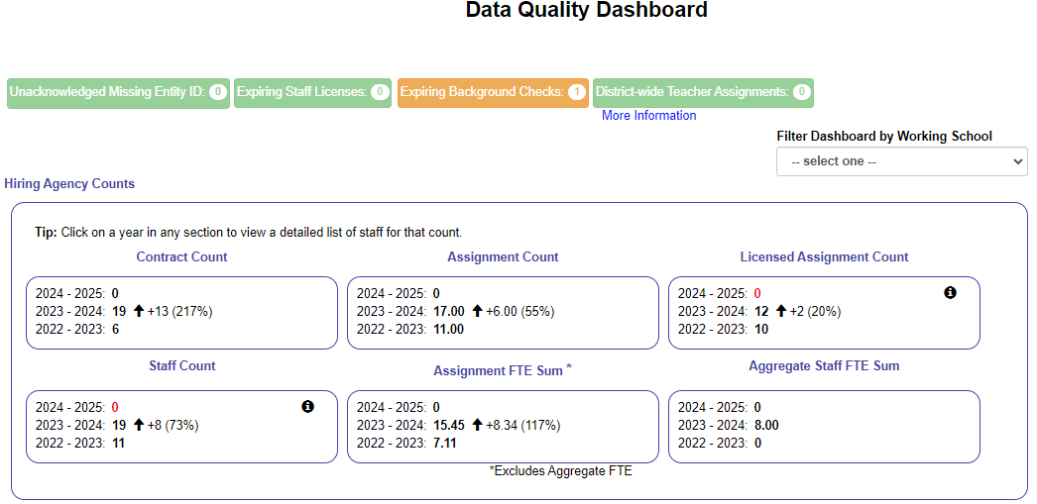
Basics of WISEstaff Data Entry
Data Quality Dashboard
Compares current contracts and assignments to previous years
License and background check alert widgets
Teacher salary alerts

Slide 81
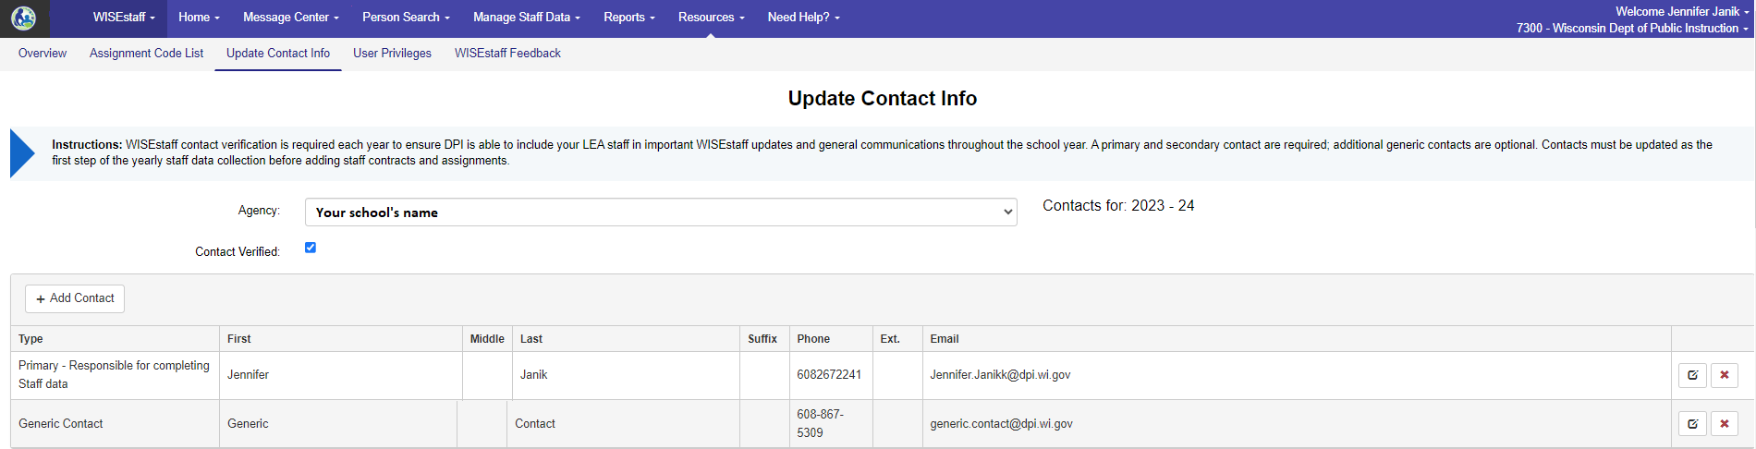
Contact Information
Resources tab → Update Contact Info
It’s important to make sure the contact information at your school is up-to-date throughout the school year.
  * Contacts are used for training opportunities, deadline reminder emails, program updates

Slide 82
Staff IDs: WISEid / Local Person / Entity
WISEid Person Upload
Upload all staff to assign Local Person ID and keep demographic data current
Local Person ID
Generated by your school; attaches staff to your school
Entity ID
Link to DPI license data; required for staff in licensed assignments

Slide 83
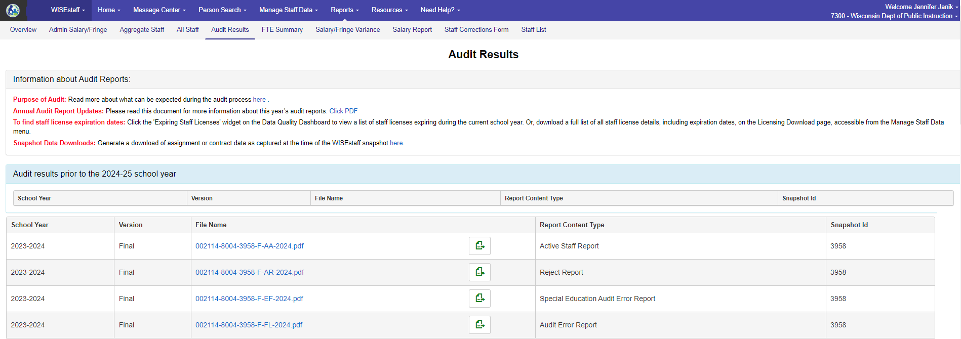
Review Previous Year’s Audits
Reports tab → Audit Results
Review Reject Report and Audit Error Reports before or early in the new school year to identify staff missing Entity IDs or improperly licensed during the previous year

Slide 84
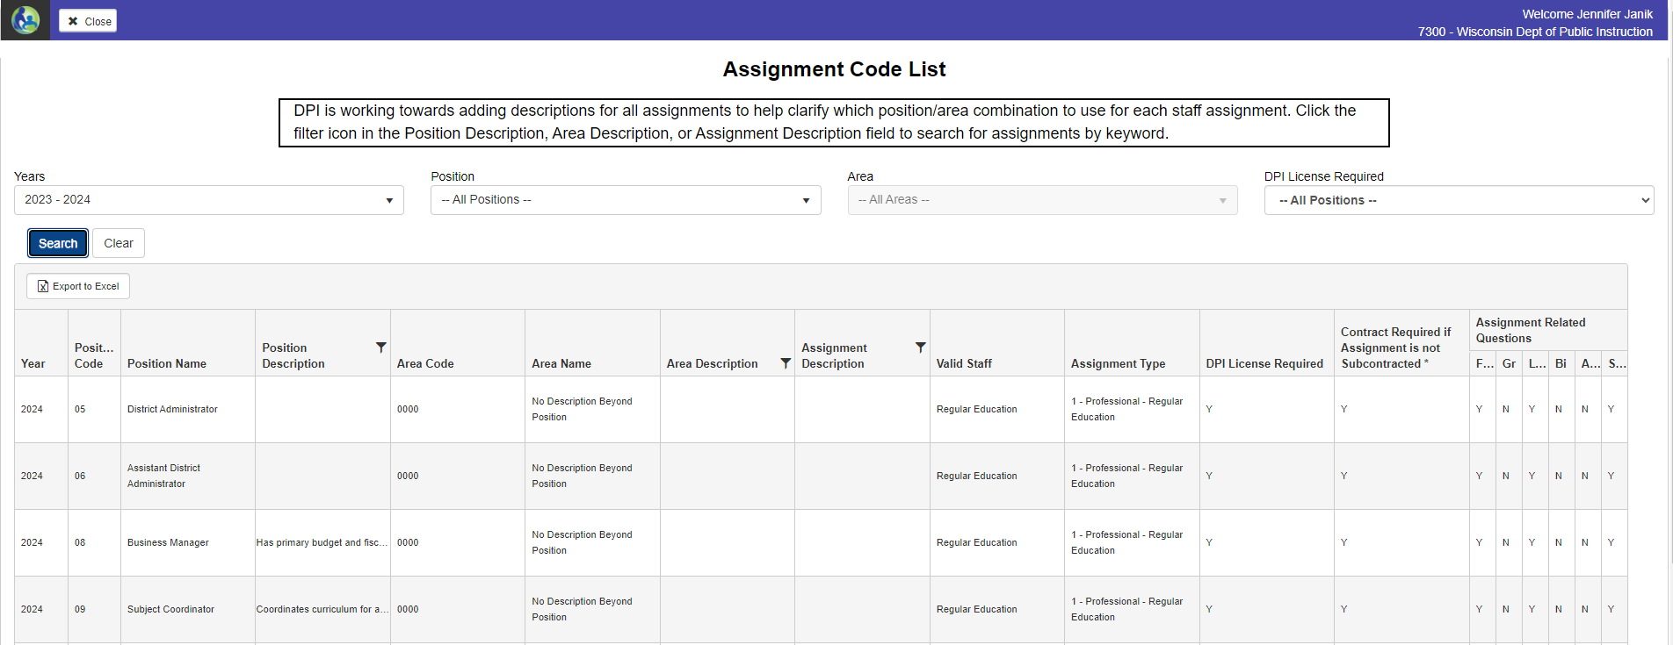
Review Assignment Codes
Resources tab → Assignment Code List
Review which assignments require a DPI license and contract information

Slide 85
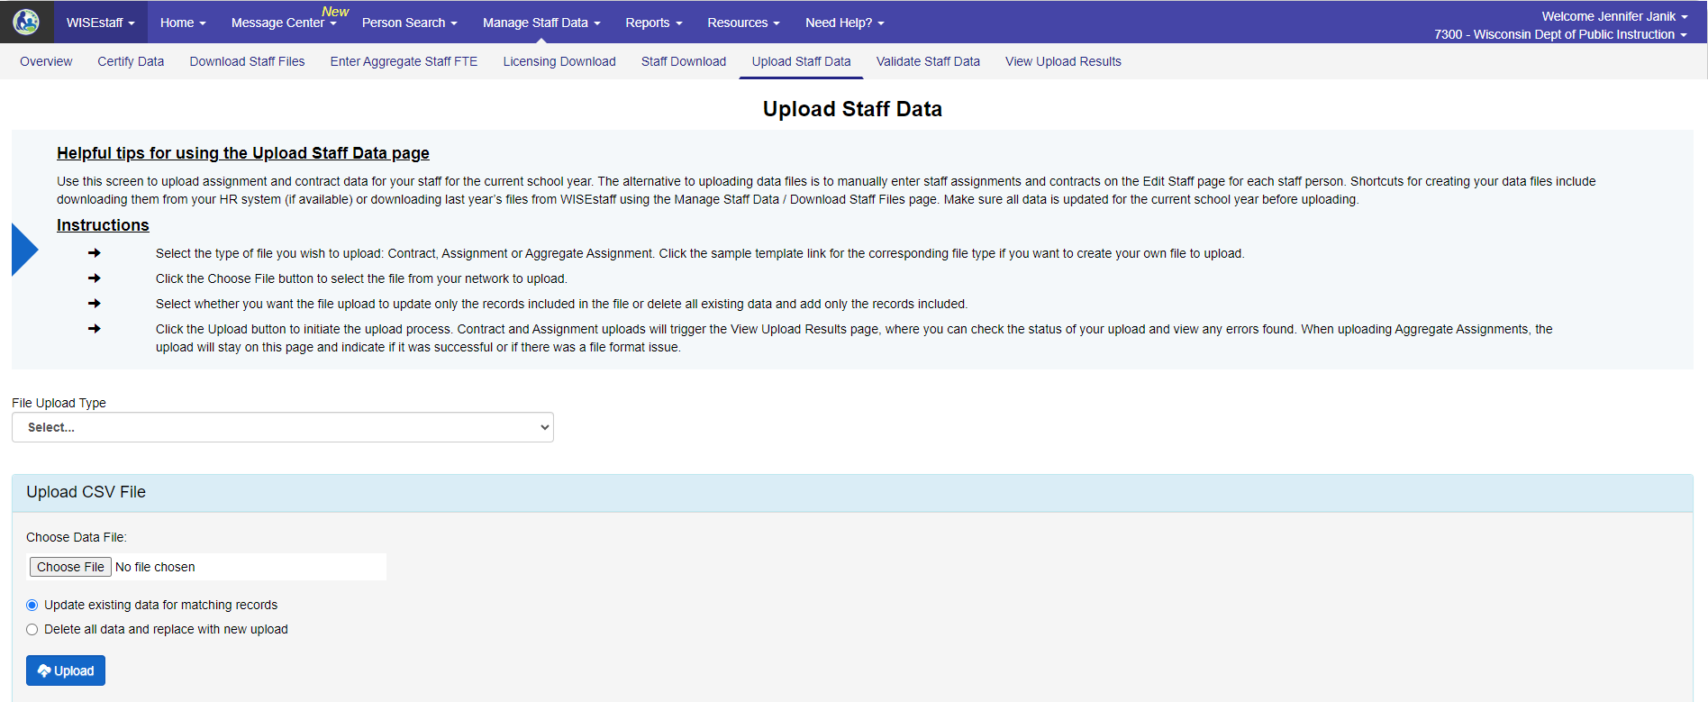
Enter Assignments
Manage Staff Data tab → Upload Staff Data
Upload assignment codes, grades, FTE for all staff working in your school

Slide 86
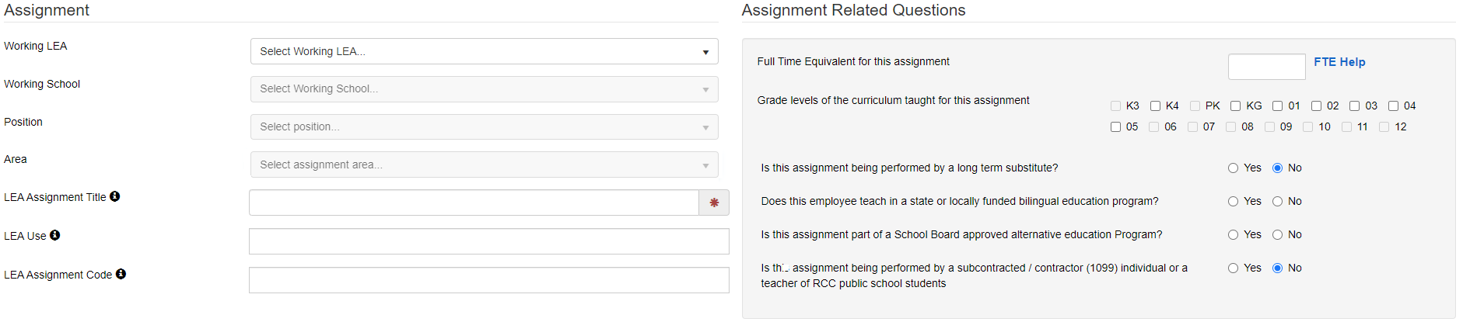
Enter Assignments
Person Search tab → Person Search / Edit → Edit Staff
Manually enter assignment data for each staff person

Slide 87
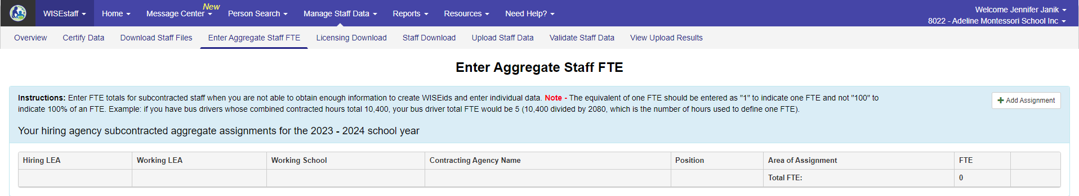
Enter Aggregate Assignments
Manage Staff Data tab → Enter Aggregate Staff FTE
Manually enter aggregate FTE for subcontracted bus drivers, cafeteria workers, maintenance staff

Slide 88
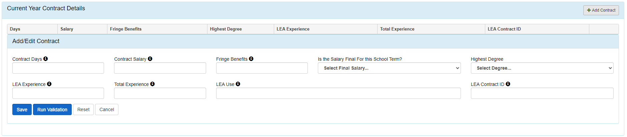
Enter Contract Data
Manage Staff Data tab → Upload Staff Data
Upload contract data (working days, salary and fringe, degree, experience) for staff whose assignment requires contract data (see Assignment Code List)
Person Search tab → Person Search / Edit → Edit Staff
Manually enter contract data for each staff person

Slide 89
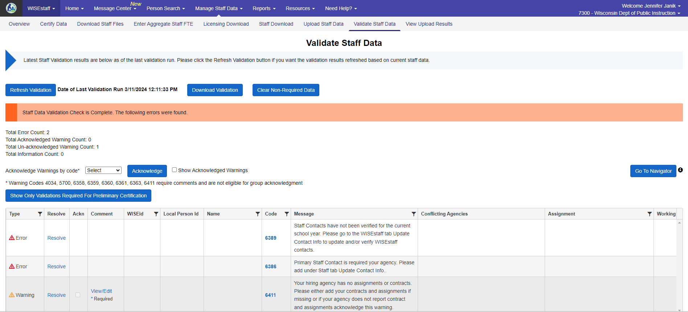
Data Validation
Manage Staff Data tab → Validate Staff Data
WISEstaff runs validations on assignment and contract data to check for missing info and inconsistencies
Three levels: Error, Warning, Informational Message

Slide 90
Data Quality
Reports tab → (Multiple Reports)
Multiple reports are available to review for data quality: Admin Salary/Fringe, Salary/Fringe Variance, All Staff, FTE Summary
Home → Data Quality Dashboard

Slide 91
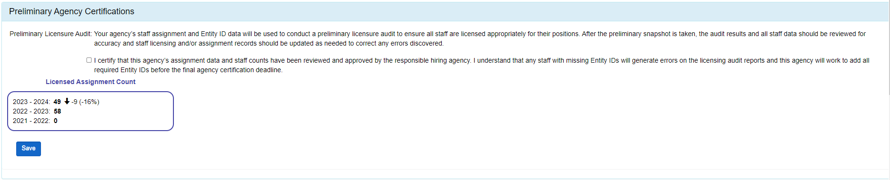
Certification
Manage Staff Data tab → Certify Data
Required before Preliminary Certification Deadline (11/12/2024) and Final Certification Deadline (3/18/2025)
Validation errors must be resolved; warnings must be resolved or acknowledged

Slide 92
Additional Training
CESA WISEstaff Training: This will cover the Staff Collection Checklist and each of the steps involved (slidedeck & video of training included).
WISEstaff Training Videos: Short how to videos.
Mini tutorials for WISEstaff & WISEid: Short how to tutorials.
WISEid E-Learning: WISEid overview, includes quiz and certification.

Slide 93
Helpful Resources & Links
WISEhome
Reporting Information Homepage
WISEstaff Help
Data Elements
Release Notes
WISEdata Events Calendar
Decision Tree Diagram (Who to Report)
Residential Care Centers (RCC) Staff Reporting Guidance
Aggregate FTE examples
FTE Calculation Guidance

Slide 94
Help Resources
DPI Website: http://dpi.wi.gov / Search for:
  * WISEstaff Help
  * WISEstaff Reporting Information
Check WISE Events Calendar for new user trainings
Join the weekly WISEstaff User Group Calls to hear updates from different teams and ask questions of DPI staff on the call
  * Calls will start around the second Tuesday in October
Join our Microsoft Teams Group to connect with fellow WISEstaff users and receive announcements and notifications from DPI and the WISEstaff community.
Submit a Help Ticket

Slide 95
WISEstaff Feedback
Available within the WISEstaff / Resources menu:
Submit feedback directly,
enter a new suggestion, and
vote on suggestions made by other people.
WISEstaff Feedback

Slide 96
Q & A
Questions?
Thank you for attending!

Slide 97
LEA 101 2024
Hold for Adam Mueller

Slide 99
What’s WRCCS?

Slide 100
WRCCS Beliefs and Assumptions
EVERYONE IS DOING THEIR ABSOLUTE BEST with what they have been given.
NO JUDGEMENT today or in the future about what you have done and/or what you are planning on doing to best serve your community.
IMPROVEMENT WILL BE NEEDED as we continue to roll out strategies and systems.
TOGETHER WE ARE STRONGER as we share ideas and support.
CONTROL WHAT WE CAN CONTROL knowing our daily actions will influence positive outcomes.
WE MAY SHARE RESOURCES presented to assist in improving charter schools across the state.
Notes:
We will share resources except if not ready for public.

Slide 101
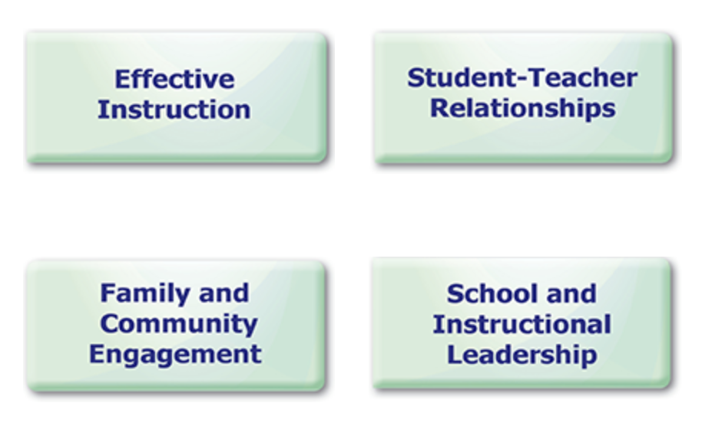
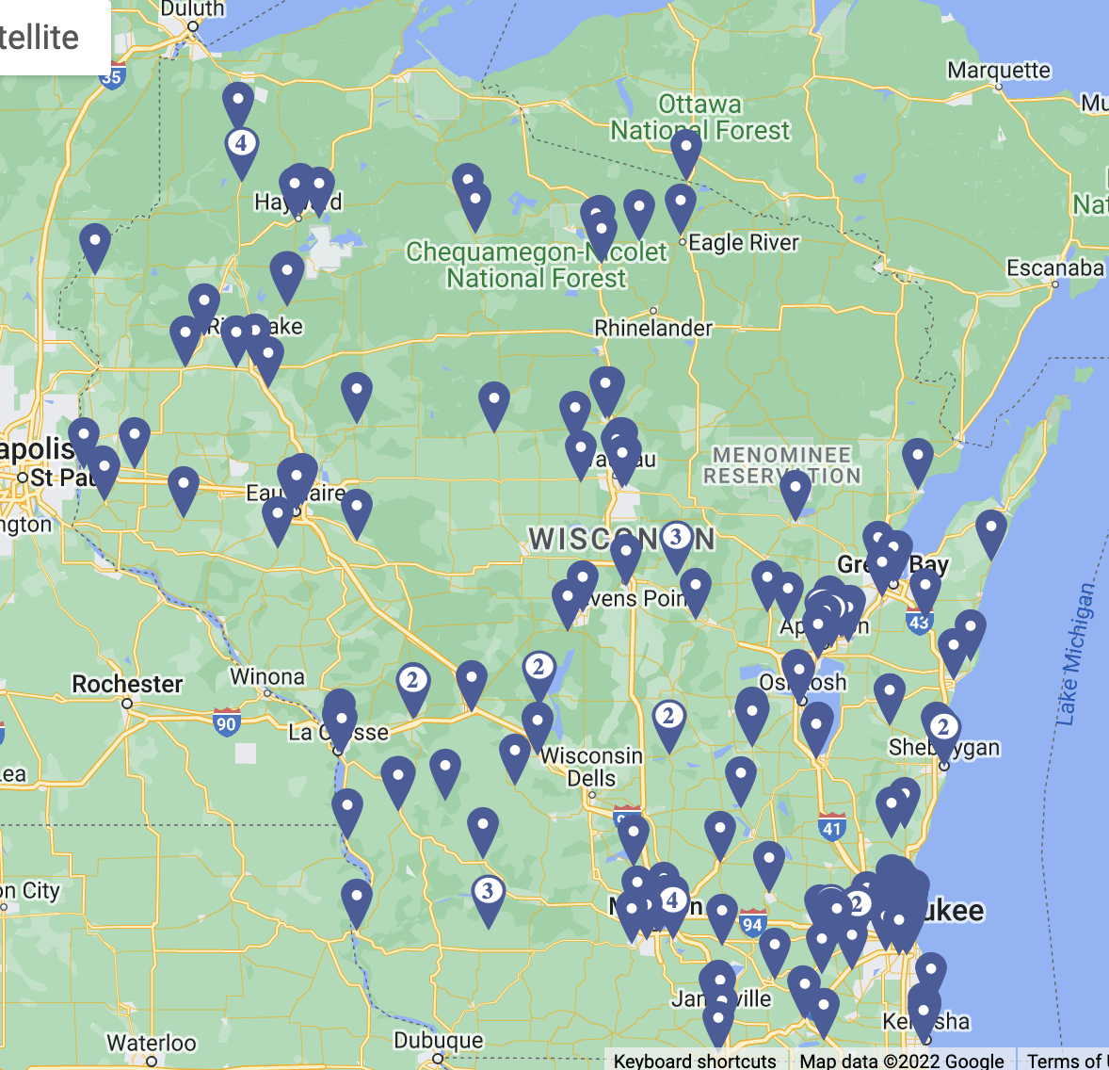
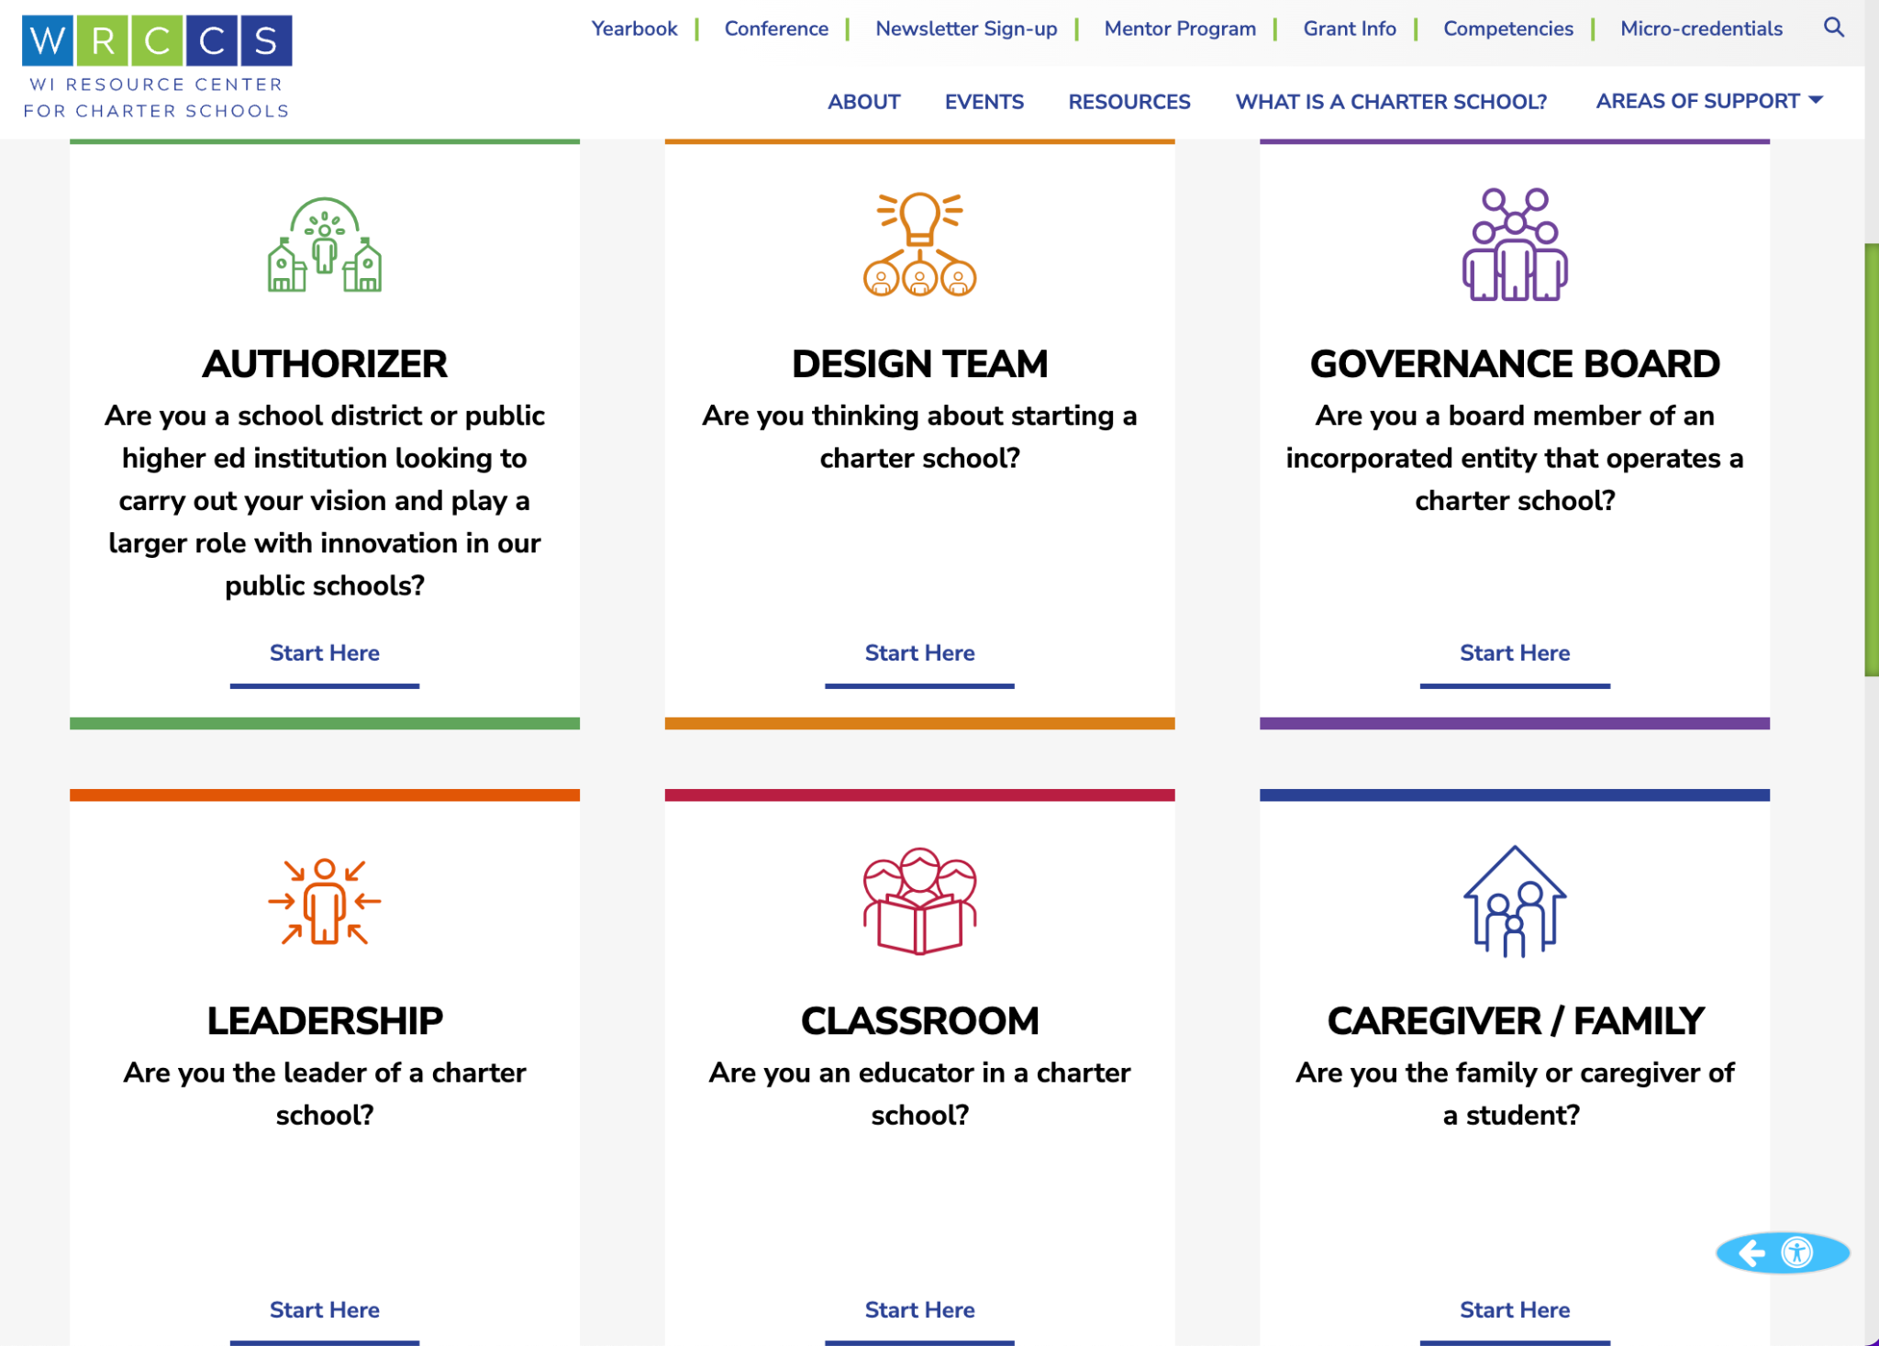
We are here to build charter school capacity in Wisconsin
Work to support specific needs of All schools to meet the needs of all students
Cultivate relationships among schools and facilitate sharing of high quality practices.
Build a warehouse of resources to support the needs and strengths of WI Charters

Slide 102
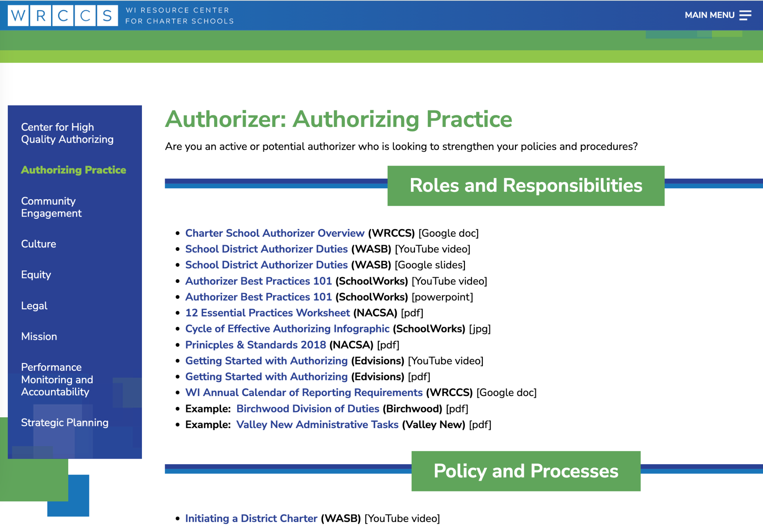

What is WRCCS?
Center for High Quality Authorizing
Charter School Performance Monitoring
Charter School Application Review Process
Purpose, Mission and Vision Development
Meeting Community Needs
Authorizing Best Practices and Legal Responsibilities
Center for High Quality Charter Schools
Governance Board Best Practices and Legal Responsibilities
Charter School Leadership Support
Charter School Classroom Support
Charter School Design Support and Community Needs Analysis

Slide 103

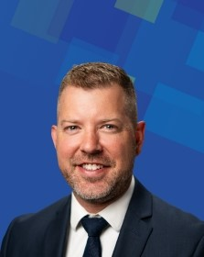
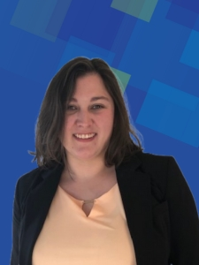








Meet WRCCS!
WRCCS Consultants and Partners
WRCCS Staff at CESA 9
(Plus we collaborate with colleagues within CESA 9)

Slide 104
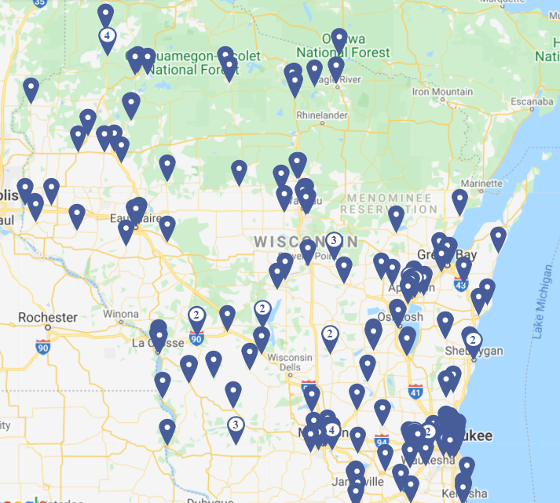
50,000+
Charter School Students
236
Charter Schools
107
Authorizers

Slide 105
WRCCS Professional Development
DPI-funded time for trainings and support for all
authorizers, governance boards, leaders, school staff, and design teams
DPI-funded events (virtual and in person)
DPI-funded resources on website
Individual support via service contracts with authorizers, boards, school teams

Slide 106
Charter School Competencies
Authorizer:
Charter School Performance Monitoring
Charter School Application Review Process
Purpose, Mission and Vision Development
Meeting Community Needs
Legal Responsibilities
Governance Board:
School Leader Evaluation
Governance Practices
Organizational Structures and Procedures
Policy and By-law Development
Self-Assessment
Charter Leadership:
School Culture
Human Resource Management
School Leadership Teams
Staff Evaluation
School Finance
Charter Classroom:
Virtual and Blended Learning Systems
Personalized Learning
School Culture
Designing Learning Targets
Academic Program

Slide 107
How WRCCS supports charter schools and authorizers:
Guide Boards with policies, strategic planning, contracting, and reporting expectations for charters and all schools
Answer questions for Authorizers around the logistics of implementing and overseeing a portfolio of schools with different models
Support School Leaders with understanding the unique charter school leader role, balancing the relationship with a governance board, and developing and maintaining a unique charter school culture.
Provide Curriculum Leaders with innovative learning designs and long term planning
Support Boards and Leaders with synthesis and alignment of practices and articulation of outcomes

Slide 108
Focus on ICSs and LEAs

Slide 109
Celebrate a success or a solution that
your school team or board successfully
implemented in the past year
Notes:
WRCCS Rep - take note of celebration and upload here: https://docs.google.com/spreadsheets/d/1Uy-JhehVpILy3upbFdt2NYUxJbBDQ2P7sJlQw6TDIdQ/edit#gid=1920429508
Chamomile

Slide 110
WRCCS’s most frequent LEA calls for help …
Contracting expert support to fulfill LEA duties (sped, finance, HR, etc.)
Accessing all available funds (and delegating the right expenses)
Student transfer responsibilities (IEPs, records/files, communication with districts, etc.)
Special education and behavior plan obligations
Policies support
Supporting relationship and communication with authorizer

Slide 111
Specific Resources for Independent Charter Schools and LEAs
5-year budgeting sample
Life as an LEA guide
Charter School Policy Manual
Independent 2r Model Contract
Independent 2r Charter School Contract Benchmarks

Slide 112
General Charter Resources
General:
Community Needs Assessment
Finance:
Finding a Vendor Guide for Charter Schools
Expense Decisions for Charter Schools
Charter School Purchasing Guide
Boards:
8 Key Board Responsibilities
General Governance Board Member Job Description
Board Orientation Manual
Annual Legal Checklist
Robert’s Rules of Order Cheat Sheet (from Board Effect)
Cheat Sheet for Taking Minutes (from Board Effect)
Leader:
Performance Measures Guidance (WRCCS) [Google doc]
Charter School Website Requirements (WRCCS) [Google doc]
WI Enrollment and Admissions Guidance (WRCCS) [Google doc]
CESA 1 Roadmap for ICS Special Education Services (CESA 1)

Slide 113
Next steps

Slide 114
ICS and Governance Board Networks
What we’ve discussed so far:
shared services
financial planning and reporting
contracting
compliance reporting
board meeting best practices
Future Discussion Plans:
CESA 1 financial and special education support
purchased services
annual reports
open meeting law
roles and responsibilities
What else can we do to support?
Sign up for the WRCCS email list here!
Sign up for the our monthly network events here! (coming soon)

Slide 115

Tuesday, July 25, 2023
Charter Governance and Authorizer Day
Wednesday, July 26, 2023
Charter Leadership and Classroom Day
Click to register your team!
Notes:
Nick

Slide 116
Please reach out to access personalized support, locate document resources, discuss engaging in PD from WRCCS and our partners, or give us ideas for how we can support you!

Slide 118
Requirements under the McKinney-Vento Homeless Assistance Act:
Supporting Students Experiencing Homelessness
Kristine Nadolski
Clara Pfeiffer
Department of Public Instruction
Notes:
Kristine/Clara - Introduce selves

Slide 119
McKinney-Vento Homeless Assistance Act
Federal Education Law, Reauthorized under ESSA
All LEAs are required to be in compliance
Works hand-in-hand with IDEA, Title I-A and other federal education programs.
Notes:
Kristine
Every Student Succeeds Act (ESSA) amendments to the McKinney-Vento Homeless Assistance Act took effect October 1, 2016
The intent of the McKinney-Vento Act is to remove barriers to students’ educational access and success.

Slide 120
Basic Requirements of McKinney-Vento
All LEAs are required by the McKinney-Vento law to:
Designate a homeless liaison.
Identify and immediately enroll any homeless child or youth (preschool to grade 12).
Continue children or youth in their school of origin.
Inform parents/guardians of the educational rights of their children.
Provide transportation to and from the school of origin.
Ensure no barriers exist (for example, residency requirements, lack of transportation or school fees) for full educational participation.
Develop partnerships with community agencies to identify and assist with basic services for homeless families, children, and youth.
Notes:
Kristine
We want to mention the basic requirements under McKinney-Vento because all districts in the state must be in compliance with the McKinney-Vento Homeless Assistance Act regardless of whether they receive grant funds from DPI.
All districts are required to:

Slide 121
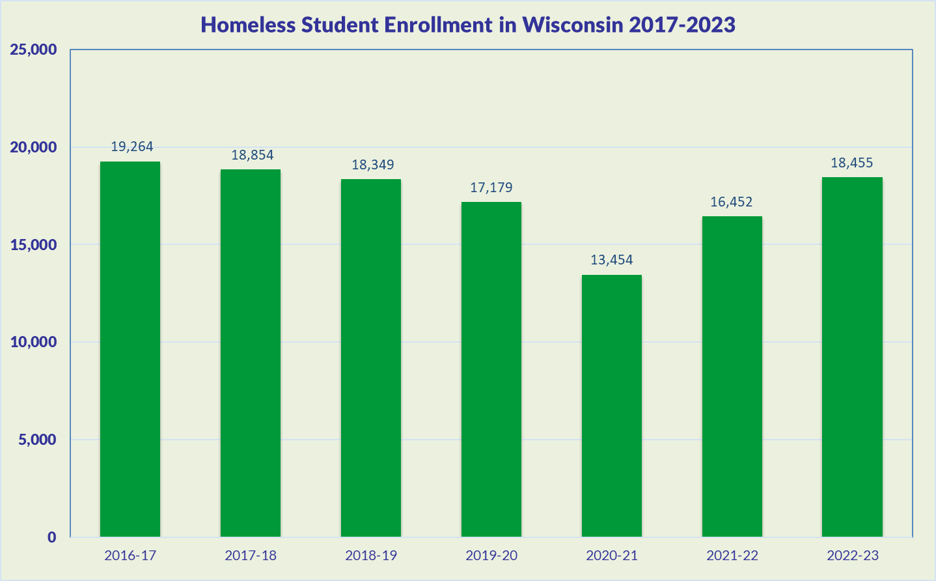
Notes:
Kristine
WI identified 17,179 students in 2019-20 school year - this decrease from previous years can likely be attributed to the difficulty LEAs had with identification of students during virtual learning in COVID.
Otherwise, the state has seen a steady increase over the last 14 years, with around a total of 2-2.5% of the total number of students in WI schools being identified as homeless.

Slide 122
Causes of Homelessness
Lack of affordable housing
Poverty
  Increase in low vs middle wage employment
Health problems
  Lack of health insurance
  Alcohol and other drug abuse (AODA), mental health
Domestic violence
Natural and other disasters (fires, floods, etc.)
Abuse, neglect, family dysfunction
COVID-19
Notes:
Clara

Slide 123
Homelessness Defined
Under the McKinney-Vento Act, homeless children and youth means:
“Children who lack a fixed, regular, and adequate nighttime residence—”
What exactly is a fixed, regular, and adequate nighttime residence?
Notes:
Clara
Children who lack a fixed, regular, and adequate nighttime residence.

Slide 124
Fixed, Regular, and Adequate
Fixed:
-Stationary, permanent, not subject to change
Regular:
-Used on a predictable, routine, consistent basis
-Consider the relative permanence
Adequate:
-Lawfully and reasonably sufficient
-Sufficient for meeting the physical and psychological needs typically met in a home environment
Can the student go to the SAME PLACE (fixed) EVERY NIGHT (regular) to sleep in a SAFE AND SUFFICIENT SPACE (adequate)?
Notes:
Clara

Slide 125
Role of the Homeless Liaison
Every LEA must designate a McKinney-Vento homeless liaison able to carry out the legal duties under the McKinney-Vento Homeless Assistance Act.
Liaisons must ensure that:
Children and youth in homeless situations are identified; enrolled in, and have full opportunity to succeed in school; receive educational services, including preschool; and are referred to healthcare, dental, and mental health services;
Parents and guardians are informed of their rights under McKinney-Vento and can participate in their children’s education;
Public notice of educational rights is posted;
Parents, guardians, and unaccompanied homeless youth are informed of transportation services and assisted with transportation arrangements to the school of origin;
Data are collected and submitted (ex. In the Student Information System);
All LEA staff receive professional development and other support on McKinney-Vento and the unique needs of students experiencing homelessness.
Notes:
Clara
ESSA created new requirements for the capacity, training and duties of LEA McKinney-Vento liaisons.
-There’s recognition that every liaison may not be able to carry out duties.. Now whomever the district designates, there needs to be the ability to carry out duties.
The liaison is ENSURING that these things happen. Not that the liaison is having to do all these duties. Working collaboratively with the district and the community

Slide 126
Role of the Homeless Liaison (continued)
Ensure that:
Disputes regarding eligibility, school selection or enrollment are mediated/resolved;
Unaccompanied youth are enrolled in school and that procedures are implemented to identify and remove barriers that prevent them from receiving credit for full or partial coursework satisfactorily completed at a prior school, in accordance with state, local, and school policies;
Liaisons must participate in professional development and technical assistance as determined appropriate by the state coordinator;
LEAs must develop, review, and revise policies to remove barriers to the identification, enrollment and retention of children and youth in homeless situations, including barriers due to outstanding fees or fines, or absences.
Notes:
Clara
This new requirement ensures that states and school districts remove barriers that prevent young people from getting the credit they need for staying in school and graduating from school.
Liaisons must participate in professional development and technical assistance as determined appropriate by the State Coordinator.
While some states had already provided professional development, such as we have in the form of webinars, not all liaisons were required to participate. Now, as determined by the state coordinator, liaisons will be required to participate.

Slide 127
Role of the Homeless Liaison - Resources
DPI EHCY Role of the Homeless Liaison Webinar
DPI Training Resources: https://dpi.wi.gov/homeless/resources
Liaison Toolkit: https://nche.ed.gov/homeless-liaison-toolkit/
Assessing the Capacity of Liaisons: https://www.schoolhouseconnection.org/wp-content/uploads/2017/10/liaisoncapacityassessmentFINAL.pdf
Notes:
Clara
Resources available for local liaisons

Slide 128
Eligibility
Sharing the housing of others due to loss of housing, economic hardship, or similar reason (sometimes referred to as doubled-up)
Living in motels, hotels, trailer parks, camping grounds due to lack of adequate alternative accommodations
Living in emergency or transitional shelters
Living in a public or private place not designed for ordinary use as a regular sleeping accommodation for humans (cars, parks, bus or train stations, abandoned buildings, substandard housing, etc.).
Children from migratory families who qualify as homeless because they are living in circumstances described above.
Unaccompanied youth living in the above circumstances
Notes:
Kristine

Slide 129
Unaccompanied Homeless Youth
Definition:
Youth who meet the definition of homeless AND are not in the physical custody of a parent or guardian (i.e., youth living with relatives on an emergency basis, youth living with a friend or runaway).
Notes:
Kristine
Build trust! Be patient, and ensure discretion and confidentiality when working with youth.
Many youth become separated from parents due to lack of space in living situations or shelter policies:
Many flee abuse: 20-50 percent sexual; 40-60 percent physical
Many flee family dysfunction: Over 2/3 Hotline callers report at least one parent abuses drugs or alcohol
Roughly 1/3 homeless youth identify as LGBTQ (compared to 3-5 percent of the overall population)
10 percent of currently homeless female teens are pregnant

Slide 130
School of Origin
Each LEA shall, according to each child’s or youth’s best interest:
Continue the student’s education in the school of origin for the duration of homelessness, and until the end of the academic year in which the student becomes permanently housed; OR
Enroll in the resident public school.
  School of origin: school that child or youth attended when permanently housed or last enrolled.
  School of residence: school in the local attendance area where the child or youth is staying.
Notes:
Kristine

Slide 131
School Stability
In determining best interest, the LEA shall:
Presume that keeping the student in the school of origin is in the student’s best interest
  Unless contrary to the request of the parent, guardian, or unaccompanied youth
Consider student-centered factors, including the impact of mobility on achievement, education, health, and safety
Give priority to the parent’s/guardian’s request.
Give priority to the youth’s request (in the case of an unaccompanied youth)
Notes:
Kristine

Slide 132
Transportation
LEAs must provide transportation to and from the school of origin, including until the end of the year when the student obtains permanent housing, at a parent’s or guardian’s request (or at the liaison’s request for unaccompanied youth).
The charter school must provide transportation for a student to remain in the charter school as their school of origin.
Transportation must be provided (if it is a barrier) even if the charter school does not provide transportation for any other students.
Both LEAs (charter school of origin and the resident LEA) must determine how to divide the responsibility and share the cost, or they must share the cost equally.
Notes:
Kristine
Previously districts had the choice to provide transportation until the end of the school year, now all districts must- If it is in the student’s best interest
In the absence of an agreement, two districts must share cost and responsibility equally.
Developing a transportation agreement among districts in the CESA may be a good strategy to prevent disputes about cost
Look at policies to try to eliminate transportation barriers to full participation. This might include extracurricular activities as well.

Slide 133
Immediate Enrollment for Charter Schools
For families and students experiencing homelessness seeking enrollment:
Immediate enrollment is required even if students do not have required documents, such as school records, records of immunization and other required health records, proof of residency, guardianship, or other documents
McKinney-Vento requires immediate enrollment even if students have missed application or enrollment deadlines during any period of homelessness.
  Charter schools do not have to enroll if enrollment is full, but give priority to the student.
  Be flexible on enrolling new students even if it’s past an existing deadline
  Revise enrollment policies if this presents a barrier to families
Notes:
Kristine

Slide 134
Support for Academic Success:
Coordination with Other Laws/Programs
Students eligible under McKinney-Vento are automatically eligible for free school meals.
LEAs must coordinate McKinney-Vento and special education services within the LEA, and with other involved LEAs.
LEAs must coordinate with Title I-A.
  Title I-A Homeless Reservation is required.
Information about a McKinney-Vento student’s living situation is a student education record subject to Family Educational Rights and Privacy Act (FERPA).
Notes:
Clara
FERPA- living situation cannot be disclosed so unless the youth tells you you won’t know housing status

Slide 135
Resources
Wisconsin Department of Public Instruction Education for Homeless Children and Youth: https://dpi.wi.gov/homeless
  McKinney-Vento 101 Module: https://media.dpi.wi.gov/title-i/mckinney-vento/story_html5.html
SchoolHouse Connection
https://www.schoolhouseconnection.org/
National Center for Homeless Education
https://nche.ed.gov/
Notes:
Clara
Website:
Modules
Video
Sample questions document

Slide 136
Questions?
Contacts:
Kristine Nadolski
State Coordinator
kristine.nadolski@dpi.wi.gov
Clara Pfeiffer
Grants Specialist-Advanced
clara.pfeiffer@dpi.wi.gov
Notes:
Clara

Slide 137
LEA 101: English Learners
Amy Maciolek
Tanya Morin
Notes:
Put questions in chat
Will also be time for questions at the end

Slide 138

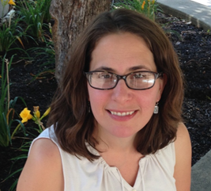

Introductions
Amy Maciolek - ML/Title III
608.266.1570
amy.maciolek@dpi.wi.gov
Tanya Morin- Dual Language/Bilingual-Bicultural
608.267.9393
tanya.morin@dpi.wi.gov
Jesse Roberts - EL Assessment
608.267.5153
jesse.roberts@dpi.wi.gov
Notes:
Tanya/Amy
Who we are
What we do
Mention Jesse as ACCESS testing person

Slide 139
Who is an English Learner?
An English learner (EL) is a student:
aged 3-21;
enrolled or preparing to enroll in an elementary or secondary school
who was not born in the United States or whose native language is a language other than English; and
where difficulties in speaking, reading, writing, or understanding of English may be sufficient to deny them
  the ability to meet the State’s proficient level of achievement on State assessments
  the ability to successfully achieve in classrooms where the language of instruction is English; or
  the opportunity to participate fully in society
Notes:
Tanya
Lot of terms you might hear for students who speak a language other than English at home (ELL, multilingual learner, emerging bilingual, etc.)
Official legal term per Title III/ESEA - EL
Official definition (age, enrolled in school, not born in US or native language is a LOTE, level of English proficiency impacts academic achievement, ability to participate fully in society)
Schools/districts have certain legal responsibilities they must meet when serving these students - which we will review during this presentation

Slide 140
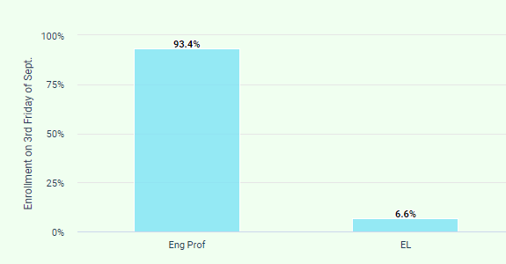

WI Demographics
Number of EL students enrolled in WI public schools in 2023-24 SY: 53,474
Notes:
Tanya
English learners in WI - number, languages, in communities across the state, including larger urban districts, suburban districts, and smaller, rural districts.
Nearly 80% of ELs identify Spanish as their first language.
Top Languages:
Spanish
Hmong
Arabic
Chinese
Somali

Slide 141
EL Acronyms
EL (ELL) English Learner
ML Multilingual learner
BLBC Bilingual- Bicultural
ELP English Language Proficiency
LIEP Language Instruction Educational Program
ACCESS ACCESS for ELLs, annual English Language Proficiency test
HLS Home Language Survey
Screener Initial language proficiency screener used for identification
Exited When an EL reaches native-like proficiency in English and is
no longer served in an language program.
LIEP Crosswalk Document used by DPI outlining language instruction program types
Notes:
Tanya (then pass to Amy for next slide)
Will hear a lot of acronyms/terms related to ELs - some of which will come up during this presentation
ELL - outdated (LEP - state law)
Multilingual learners - asset-based perspectives/highlights the strengths/assets kids bring to the classroom
ELP - official term for language level (levels 1-5, 6, 7)
Will go into more detail on LIEP, ACCESS, HLS, etc. on later slides

Slide 142
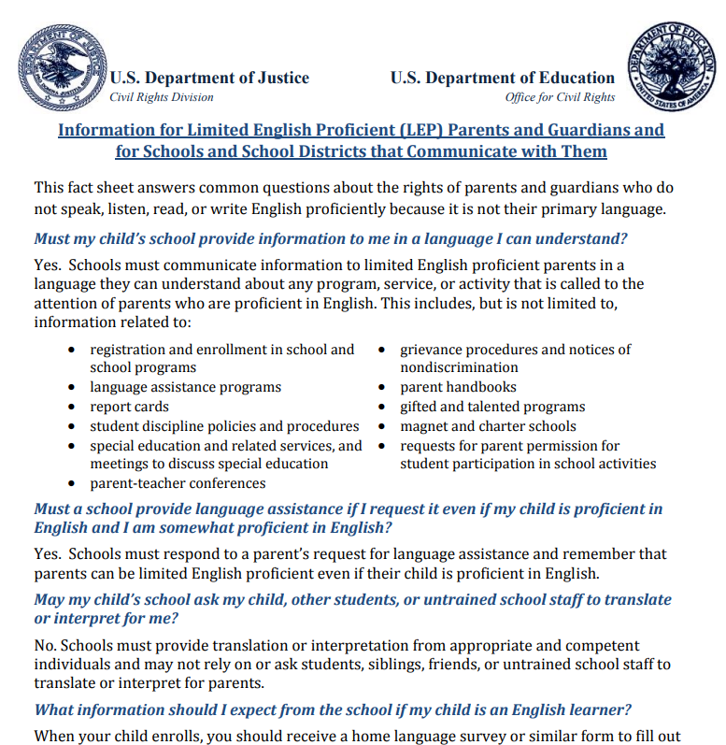
Legal Requirements: Federal
ESEA (Title I, III)
Civil Rights Act of 1964
Equal Education Opportunities Act
Lau vs. Nichols
Castañeda vs. Pickard
See Fact sheets and Chapter 14 of EL Policy Handbook
Notes:
Amy

Slide 143
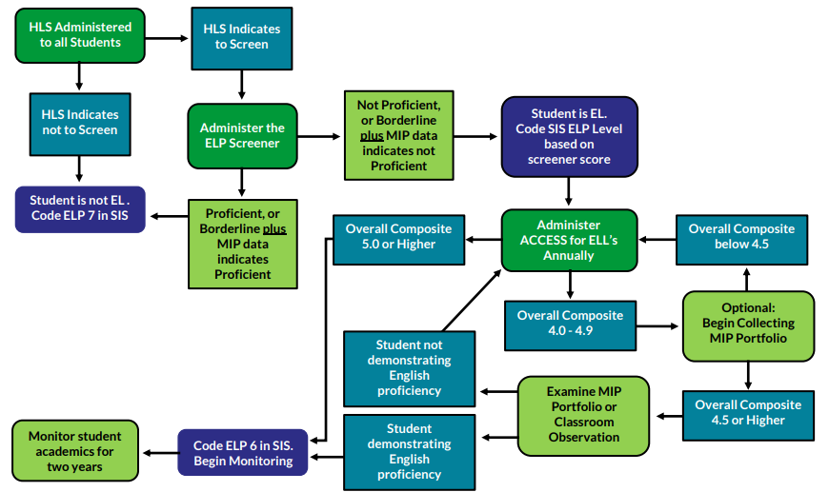
Entrance Procedures
Notes:
Amy
Highlight - translations available on website
Two-step process, Lau plan

Slide 144
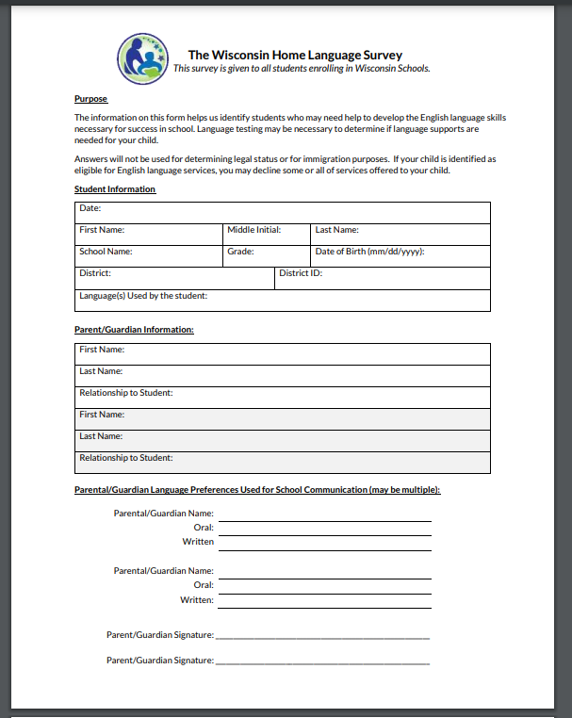
Home Language Survey (HLS)
Purpose:
Use of Language in the home
Identify students (language support)
Language Needs of Caregivers
See EL Policy Handbook chapters 1-3
Notes:
Amy

Slide 145
Effective Programs
LEA/SEA required to ensure districts provide effective programming for ELs
Language assistance programming for EL students must:
  Be educationally sound in theory and effective in practice
  Include sufficient staff and resources.
  Be regularly assessed and continually improved,
Additionally, districts must be able to demonstrate program effectiveness in supporting both:
  Academic content needs of ELs
  EL students’ English language proficiency proficiency growth
See DPI’s EL Policy Handbook Chapter 8 for more information
Notes:
Amy
Program evaluation

Slide 146

Program Models: LIEP Crosswalk
Language Instruction Educational Program (LIEP)
Plan for serving EL students
Variety of models
LIEP Crosswalk
LIEP flowchart
See Chapter 8 of EL Policy Handbook for more details
Notes:
Amy
Chapter 8 of handbook: https://docs.google.com/document/d/1lUN0b-Iam2FLbOd1b2MALAqIagu0qB-oMvbNU-kvS60/edit
Revised crosswalk
Codes for students
Bil/ESL
Flowchart

Slide 147

ACCESS for ELLs
Required to assess English language proficiency (ELP) for all ELs annually, including students whose caregivers have refused services
Must use state-defined ELP assessment
ELP assessment for WI: ACCESS for ELLs
Annual ELP assessment window: December - February.
Check annually with DPI’s Office of Student Assessment for exact dates
See Chapter 5 of EL Policy Handbook for more details
Notes:
Amy
Frequency/timeline
Reporting scores
Exiting based on scores

Slide 148
Exit Procedures
ACCESS Testing
  Composite 5- MUST exit
  Composite 4.5-4.9 (may exit w/MIP)
2 year Monitoring upon exit
See Chapter 6 and Chapter 15 of EL Policy Handbook for more details
Notes:
Amy

Slide 149

Data Reporting
Data Elements*
Immigrant children
Languages spoken
English Language Proficiency Levels
Primary Service: LIEP
* This list is not exhaustive
Notes:
Amy
Immigrant children - beginning of year
LIEP - beginning of year
ACCESS - initial id - beginning of year

Slide 150

English Language Development Standards
State required to adopt English Language Development (ELD) Standards
WI Standards: WIDA English Language Proficiency Standards
Aligned to ACCESS for ELLs
See DPI’s ELD Standards web page for more information
PD available thru WIDA and on DPI’s ELD Standards Professional Learning web page
Notes:
Tanya
Requirement - Comes from Title I of ESEA/ESSA
Adoption - 20-21
WIDA 2020 ELDS Framework/can find on DPI website and WIDA website
21-22 - first year of rollout, 24-25 - Continue building understanding and supporting implementation
Good place to start - Standards 101 module on our ELD standards PD webpage

Slide 151

Professional Learning
CESA EL Networks/Consortia
WIDA training
  Self-paced workshops
  Facilitated workshops
Title III/BLBC Conference:
  October 25, 2024
  Save the Date
Notes:
Tanya
Partner with CESAs to offer EL networks/consortia
WIDA trainings - shared via network meetings, Title III listserv
State-level conference

Slide 152

Resources
DPI’s Bilingual and English Learners webpage
DPI’s EL Policy Handbook
USDE/OELA Family Toolkit
USDE/OELA EL Toolkit
USDE/OELA Newcomer Toolkit
Center for Applied Linguistics
WIDA self-paced workshops
Title III listserv (contact Amy to join)
Notes:
Tanya
Many helpful resources
Encourage you to join the Title III listserv - contact Amy

Slide 153

Questions?

Slide 154
Overview of
Title I, Part A

Slide 155
ESEA and Title I, Part A
Purpose: Provide all children significant opportunity to receive a fair, equitable, and high-quality education, and to close educational achievement gaps.
Title I, Part A funds are targeted to high-poverty LEAs and provide supplementary education to students who are educationally disadvantaged or at risk of failing to meet the state standards.
20 USC 6301
Notes:
The Elementary and Secondary Education Act (ESEA) was first enacted in 1965 with the goal to reduce achievement gaps by providing all children fair and equitable education. ESEA includes numerous programs across a total of ten titles, including Title I. While Title I contains many components, we’re just going to focus on Title I, Part A.
Under the Title I, Part A grant funds are targeted to high-poverty school districts and are used to provide supplementary education to students who are educationally disadvantaged or at risk of failing to meet the state standards.

Slide 156
Allocation of Funds to LEAs
The formula is based on:
  the state’s average per pupil expenditure, and
  the count of children from low-income families
US Census Bureau
Small Area Income and Poverty Estimates (SAIPE) are used to determine poverty.
20 USC 6333
Notes:
The formula to allocate funds to LEAs relies on two primary elements: the state's average per pupil expenditure and the LEA's count of children from low-income families.
For Independent Charter Schools, the allocation is calculated off of poverty counts of students by district, using the resident district’s poverty %.

Slide 157

Grant Period & Carryover Policy
Fiscal Year: July 1 to June 30
Aligns to the state’s fiscal year.
FY25 obligation period begins July 1, 2024 and ends June 30, 2025.
Title I Carryover
An LEA with a Title I-A allocation* of $50,000 or greater may not carry over more than 15% of the total allocation into the next fiscal year unless granted a waiver* from DPI.
  Allocation includes any funds transferred to Title I, Part A.
  The waiver may only be requested once every three years.
20 USC 6339
Notes:
Title I allocations are aligned to our state's fiscal year. This means that a grant's obligation period begins on July 1 and ends on June 30. For FY24, this would be July 1, 2023 through June 30, 2024.
Grant funds not spent within the fiscal year the funds are awarded may be carried over into the next fiscal year. The amount that can be carried over depends on the size of the LEA's allocation.
Districts receiving a Title I allocation less than $50,000 can carry over any remaining funds.
A district with an allocation of $50,000 or greater than $50,000 can only carry over 15% of the total allocation.
It is important to note that carryover is based off the LEA’s Title I-A allocation amount plus an funds transferred from Title II-A and/or TIV-A.

Slide 158
Equitable Participation
ESEA contains provisions that require an LEA to provide equitable services to private school children attending a private school located within the LEA’s boundaries. These provisions, often referred to as equitable participation, are required under each of the Title formula grants.
Since Independent Charter School LEAs do not have geographic boundaries there are no equitable participation requirements for charter-school LEAs.
However, you may notice functionality in WISEgrants that references Private Schools, as this requirement applies to some district LEAs.

Slide 159



Reservations
Reservations
Reservations can be used to provide support to students experiencing homelessness even in non-Title I buildings or students residing in institutions for
Support students experiencing extenuating circumstances who attend non-TI schools with TI funds.
Non-Title I School
Reservations can be a way to effectively support multiple Title I schools with Title I funds.
Title I Schools
Notes:
Reservations can be utilized to provide equitable services by supporting students in non-Title I schools (such as students experiencing homelessness or students in neglected institutions) and as a way to more effectively support multiple TI schools.

Slide 160
Reservations
The LEA may take funds “off the top” of their allocation to support certain initiatives before making per pupil amount allocations at the school level.
Some reservations may be required. Other reservations are optional and at the discretion of the LEA.
20 USC 6313(a)(3)

Slide 161
Required Reservations
Homeless Reservation:
Required for all LEAs.
Used to provide equitable services to students experiencing homelessness at any time during the year.
Family Engagement Reservation:
Required only if the LEA’s allocation is greater than $500,000.
  Must reserve at least 1% of allocation for family engagement activities.
20 USC 6313(c)(3) and 6318(a)(3)

Slide 162
Optional Reservations
Other available reservations include:
  Administration
  Centralized Services
  Professional Development
  Migrant, Delinquent, and Out-of-Home Care (Reservations that support services to eligible students who do not attend Title I schools)
  Preschool
  Financial Incentives (specific for LEAs with TSI and CSI schools)
  Indirect Costs
20 USC 6313
Notes:
Administration for costs associated with services to both public and private school children.
Centralized Services. For example, a district may reserve funds to hire a Title I Reading Coach to work with all the Title I reading teachers across district.
Professional Development that can be divided between multiple Title I schools
To run a TI preschool program.
An LEA may reserve funds to provide services to eligible students who do not attend Title I schools, such as migratory students, students in out-of-home care, or students currently enrolled in delinquent institutions.

Slide 163
Title I School Eligibility
For district LEAs, school building eligibility is determined through ranking based on poverty.
For most Independent Charter School LEAs, which consist of a single school, ranking is considered a formality, and the PPA can be determined by dividing the available funds by the low-income enrollment.
20 USC 6313

Slide 164
Types of Title I Programs
Targeted Assistance
Schoolwide (SWP)
Title I supplemental services are provided to a select group of children.
All staff, students, & resources are part of the Title I schoolwide program.
The SWP is a comprehensive reform strategy designed to upgrade the entire educational program in order to improve the achievement of the lowest achieving students.
Eligible children – children identified with the greatest academic need (failing, or most at risk of failing) the state’s academic achievement standards.
Notes:
There are two kinds of Title I-A programs. Schools may elect to operate as a targeted assistance program or a schoolwide program. This is just a brief overview of the two programs.
Title I Targeted Assistance programs provide services to a select group of children identified as those with the greatest academic need. The purpose of the targeted assistance program is to use Title I funds to improve the academic achievement of those identified Title I students. The goal of the Targeted Assistance program is to improve teaching and learning and to enable those identified students to meet the challenging state performance standards. A Targeted Assistance Program must include effective methods and strategies that rely on scientifically based research; instruction from highly qualified teachers; and parental involvement activities. Targeted Assistance programs may also include resources necessary to provide a well-rounded education.
A schoolwide program uses Title I funds to implement comprehensive strategies to upgrade the educational program in the whole school to increase the academic proficiency all students. Title I schools start as Targeted Assistance programs and must apply to operate their school as a schoolwide program. Once a school is an approved schoolwide program it remains a schoolwide program. The emphasis of a Schoolwide Program is to serve all students by improving structures that support student learning and combining resources to achieve a common goal. Schoolwide programs allow for staff and stakeholders in schools the ability to redesign their programs to meet the needs of all children, so that every student is able to succeed.

Slide 165
Who are “Title I Eligible” Students?
Targeted Assistance
Schoolwide (SWP)
Title I students are identified through a multi-step process.
All students are Title I students.
Schools must first use multiple academic measures to identify eligible students.
Then schools rank students according to academic need.
Schools are not required to rank students for services. The SWP upgrades the educational program for all students while addressing the needs of the lowest achieving students.
Notes:
In a Targeted Assistance program, Title I students are identified through a multi-step process. Schools must first use multiple academic measures to identify eligible students, then rank and serve students according to academic need.
Students do not have to be from low-income families to receive services. While poverty data is used to determine a school’s eligibility for TI funding, poverty data is not used to determine which students to serve. Once the funding reaches the school, children are selected for services solely on the basis of academic need.
*We’ve mentioned how private schools function similarly to a Targeted Assistance program, for “TI Eligiblity” there’s additional considerations for when a private school student is eligible for services beyond the needs assessment; for instance, where the student resides. *Shameless plug for E.P. presentation :)*
In a Schoolwide Program all students are Title I students and are a part of the Title I program.
All staff at the school are also Title I staff. Finally as you might have guessed it, all families are Title I families.
In other words, that comprehensive program should aim to meet the needs of all students, staff, and families!

Slide 166


Allowable Costs & Needs
Targeted Assistance
Schoolwide
Services for the needs of Title I students, parents, and educators.
Strategies identified through the Schoolwide Plan.
Allowable costs must meet the needs identified for the Targeted Assistance program.
Allowable costs must support the comprehensive improvement efforts identified through the Schoolwide Plan.
Notes:
For Title I schools implementing a Targeted Assistance program, the budget item should address the needs of the eligible Title I students, their parents, and their educators.
And, for Title I schools implementing a Schoolwide program, the budget item should support the comprehensive improvement efforts identified in the schoolwide plan, because all students in a schoolwide program are eligible to receive services.

Slide 167
Allowable Costs
Is it allowable?
This is the most common question LEAs ask DPI and the most common question DPI consultants ask each other.
The answer is:
It depends
Notes:
Bri
This is the most common question LEAs ask DPI and the most common question DPI consultants ask each other. “Is it allowable?”
The answer is, “It depends”.

Slide 168
Title I Allowable Costs
Is the proposed budget item addressing the needs of Title I students?
Does the cost adhere to the Uniform Grant Guidance, EDGAR, and the LEA policies?
  Allowable Cost Checklist for Federal Funds
Notes:
So how should an LEA determine if a cost is allowable under Title I?
Each LEA is required to have written procedures to determine allowability of costs and those procedures should include a step for the LEA to ensure that the school received its full share of state and local funds. When that is confirmed, the LEA needs to make sure the proposed budget item is addressing the needs of Title I students.
Additionally, like all budget items charged to any federal grant, the costs must be reasonable and necessary to meet the purpose of Title I.

Slide 169


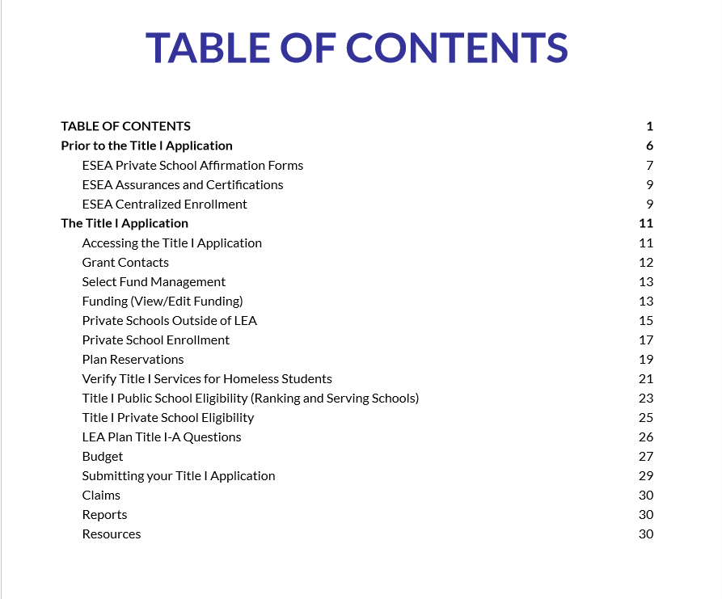
Guide for Completing the Title I, Part A Application in WISEgrants
Title I-A Application Guide

Slide 170
Resources
Contact Information:
Title I Consultant Directory
Title I Shorts - Rank and Serve
Title I Shorts - Per Pupil Amounts
WISEgrants Technical Assistance - Budget Combinations
Guide for Completing the Title I, Part A Application in WISEgrants

Slide 171
WISEdata Finance and Financial Reporting for ICS
Matt Baier
School Financial Services
July 2024

Slide 172
Financial Reporting Development Timeline
ESSA School-Level Reporting
Special Education Annual Report (replace the PI-1505-SE)
Public Financial Dashboard
Transitioning Existing SAFR reports to WiSFiP
Internal Modules for Aid Runs/Revenue Limits/Reporting
On-going Maintenance and Enhancements

Slide 173
School-Level Reporting
School-Level Reporting module transitioned to WiSFiP for 2022-23
The report utilizes your financial data to determine LEA-level vs. school-level (by school) and federal vs. state/local expenditures
LEAs provide data to define Location and Project Codes
Due to some technical obstacles, we did not collect this report from ICS for 2022-23

Slide 174
Special Education Annual Report
Developing the Special Education Annual Report for 2023-24
DPI is auditing, with stakeholder input, the Fund 27 Chart of Accounts as part of the next WUFAR revision
A majority of the functionality needed to transition this report already exists. LEAs are already pushing local Fund 27 accounts to DPI
Creating additional L2 validations in WDF to ensure proper Project Code coding for Fund 27

Slide 175
Special Education Annual Report
Beyond your Fund 27 actual accounts by Project, the report will include:
    Addenda to track SPED grant payments into and out of the LEA
    Validations to ensure school mental health personnel costs meet proration requirements from Act 221
    Reports detailing aid estimates, grant reconciliation, year-to-year comparisons

Slide 176
What is WISEdata Finance?
Vendors pull the current Wisconsin Uniform Financial Accounting Requirements (WUFAR) Chart of Accounts (COA) from DPI
LEA crosswalks ledger to a Local COA in WUFAR and pushes data to WDF
The Local detail COA rolls up to the required DPI COA level
LEA pushes financial data as three sets of data: Local Accounts, Budget Amounts and Actual Amounts

Slide 177
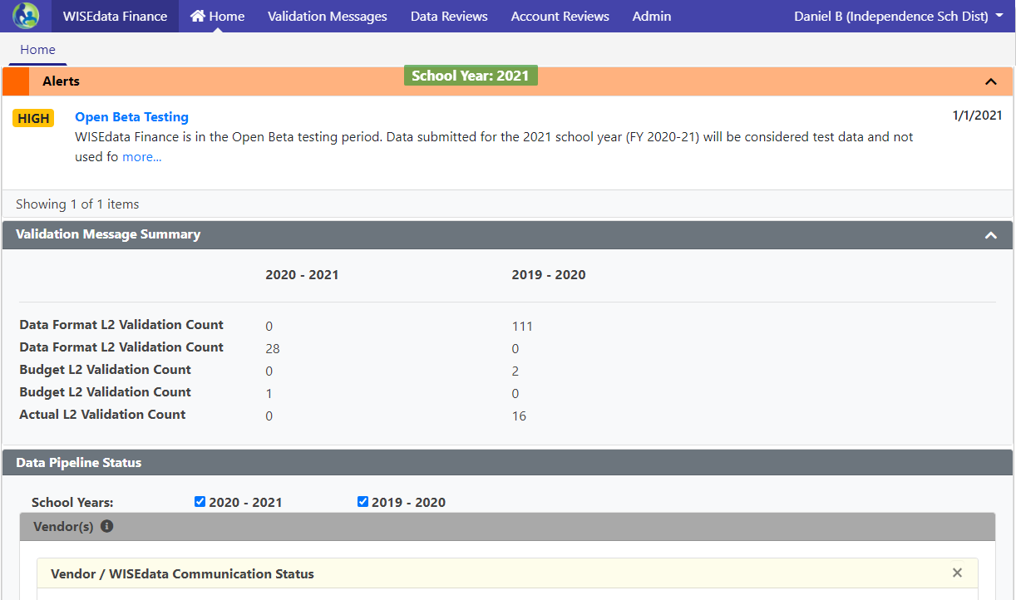
Mindset Shift: WISEdata Finance
Data submissions in WISEdata Finance are point-in-time looks, and it helps to think about data validations more as bringing issues to your attention than giving you a list of errors to clear
“Doing the report”
will mean pushing clean data
Fixing your books and pushing that data to WDF is how you fix your reporting

Slide 178
WISEdata Finance and WUFAR
The Wisconsin Uniform Financial Accounting Requirements.
WUFAR
(pronounced wuh-fer)

Slide 179

What is WUFAR?
A multi-dimensional reporting system that can also be used as an accounting system by the Local Education Agency (LEA).
Not required for accounting, but required for reporting and claims to DPI.
Always used in conjunction with the state Budget and Annual Reports (full and special education), as well as ESSA School-Level Reporting.

Slide 180
Why WUFAR?
DPI needs a uniform system for reporting LEA activity for:
Reporting purposes (both state and federal)
Calculating general and categorical aid
Determining compliance with federal regulations
Comparing activity between LEAs
State budget building
Ensuring compliance with Uniform Grant Guidance requirements to track federal grant expenditures
Notes:
DPI uses WUFAR because every State Education Agency needs a uniform system for reporting both state and federal activity and fiscal reports. It also enables DPI to calculate state-funded general and categorical aids paid to the LEAs. The program teams use it to determine compliance with federal regulations. And lastly, the standardized financial information we receive from the LEAs helps DPI create a state budget and requests for funding from the legislature because we are able to determine local need.

Slide 181
WUFAR is KEY
Simplified and flexible chart of accounts - ensures adherence to state and federal financial reporting requirements, and gives LEAs the ability to segregate and group accounts.
Revisions to WUFAR are done on at least a yearly basis to address needed changes, fix errors, or adhere to requirements under GAAP and GASB.
DPI Chart of Accounts integrated by the vendor. Ensure your local accounts account for changes to WUFAR and the DPI COA so accounts roll up correctly.
Notes:
What are the drivers of the system modernization?
The system has become difficult to manage, utilize outdated or overly-expensive technologies (classic ASP, .NET webforms, and Oracle), and no longer meet DPI IT standards.
School-level reporting: nothing we had could accommodate this. Data was collected through .csv files and the data was not identified by location or school level.
A chart of accounts is an organizational tool.
Not rip and replace, rather custom-configure a system that works with our needs

Slide 182
WUFAR Sequence of Dimensions
This sequence is what you would normally see when looking at an expense report.
Fund
Location
Object or Source
Function
Project
Notes:
There are five components of the WUFAR expenditure account string. ^Fund, ^Location, ^Object of Expense, ^Function, and ^Project. We usually add the word “Code” onto Object and Project – so you will hear someone saying “What is the Object Code?” or “What Project Code should we use?”

Slide 183
WUFAR Account Sequence
A WUFAR account is a sequence of dimensions:
10
E
120
111
122150
141
Fund – Type – Location – Object/Source – Function - Project
Notes:
At the LEA-level, using WUFAR allows for a consistent system and common language around expenditures and revenues. By using WUFAR, LEAs can easily communicate among themselves and work with DPI regarding allowable costs, state aid payments, and audits.

Slide 184
WUFAR is Hierarchical
100000 Instruction
WUFAR dimensions “roll up” from lower detail levels to higher summary levels
A zero means “this includes
anything at a lower level
with a digit here”
120000 Regular Curriculum
122000 English Language
122100 Language Skills
122150 Reading Specialist

Slide 185
Chart of Accounts
Vendors mapped the LEA’s detailed accounts to a general umbrella DPI account - WISEdata Finance displays both the DPI account and the local detailed account.
Local Account | DPI Account | Budget | Actual
27E-100-411-152000-347 | 27E-100-410-152000-000 | $1,500.00 | $1,292.13
27E-100-412-158000-019 | 27E-100-410-158000-000 | $5,000.00 | $2,563.00
By using the “mapping” methodology, DPI no longer has to create hundreds of accounts every time a new grant is created.
By collecting the Local Account, DPI’s program areas have access to the level of detail necessary to determine compliance with Federal grant regulations.

Slide 186
What is a Fund?
Independent fiscal and accounting entity
Requiring its own set of books
In accordance with special regulations, restrictions, and limitations that earmark each fund for a specific activity or for attaining certain objectives
Self-Balancing
  Assets – Liabilities = Fund Balance
  Starting Balance + Revenues – Expenditures = Ending Balance
Self-Contained
  Different funds subject to different legal & program requirements
  Resources move between funds only through specifically defined and allowed fund transfers
Notes:
At the LEA-level, using WUFAR allows for a consistent system and common language around expenditures and revenues. By using WUFAR, LEAs can easily communicate among themselves and work with DPI regarding allowable costs, state aid payments, and audits.

Slide 187
WUFAR Account Format
Fund
Fund 10
Typically used for general education costs funded by a combination of local, state and federal funds.
Day-to-day operations
General Education Instructional staff
General Instructional activities
Pupil Services staff
Pupil Transportation
10
Notes:
The first dimension is “Fund.”
A fund is a fiscal and accounting entity with a self-balancing set of accounts which are segregated for the purpose of carrying out specific activities in accordance with special regulations, restrictions, or limitations. Another way to think of a “fund” is having separate bank accounts for different activities – perhaps a checking account that is established for household costs, another account that has been set up for a personal business, and a third shared account for vacations or gifts. Certain revenues are deposited into each of the accounts and the money drawn out for specific purposes.
For LEAs, the most common account is Fund 10, which covers general education costs funded by a combination of local, state, and federal funds, and accounts for the day-to-day operations of general instruction and services provided to all students.

Slide 188
WUFAR Account Format
Fund
Fund 27
Used to account for the excess cost of providing special education and related services for students with IEPs.
Separated for State Special Education Categorical Aid calculation and IDEA Maintenance of Effort (MOE) calculations.
27
Notes:
Special Education has its own fund, which is 27. Fund 27 is used to account for the excess cost of providing special education and relates services to students with IEPs. It is separated out for calculating state special education categorical aid and IDEA’s maintenance of effort compliance requirement.
If it is a special education expense, it must be accounted for in Fund 27.

Slide 189
WUFAR Account Format
Fund
Fund 50
Student and elderly food services
May carry a positive balance, but not a deficit
  Any year-end deficit is covered with a transfer from Fund 10
50
Notes:
Special Education has its own fund, which is 27. Fund 27 is used to account for the excess cost of providing special education and relates services to students with IEPs. It is separated out for calculating state special education categorical aid and IDEA’s maintenance of effort compliance requirement.
If it is a special education expense, it must be accounted for in Fund 27.

Slide 190
WUFAR Account Format
Fund
Fund 80
Used to account for activities such as adult education, community recreation programs
District may adopt a separate tax levy for this fund
School board must establish a Community Service Fund pursuant to s. 120.13(19)
May not expend monies on ineligible costs as defined by DPI
80

Slide 191
Other Common Funds
Special Revenue (Fund 21)
  Usually for fundraising and private gifts
Debt Service (Funds 38 & 39)
Capital Projects (Funds 41, 46, 49)
  Debt service and capital projects are booked separately from operations
Custodial Fund (Fund 60)
  Held on behalf of student & parent organizations
  Little to no “administrative involvement” by the district

Slide 192
Validations
Two levels of validation rules at work:
L1 validations reject your data before it can be stored in our data warehouse. Validation message are triggered when you push data to DPI. Some examples are rejected accounts, invalid school codes, etc.
L2 validations are run on data saved into the data warehouse (have passed the L1 validations). Examples include: WUFAR mismatches, Amount errors, Project/Program Tag issues
Although validations display in WISEdata Finance, all modifications to the data will happen within your SIS.

Slide 193
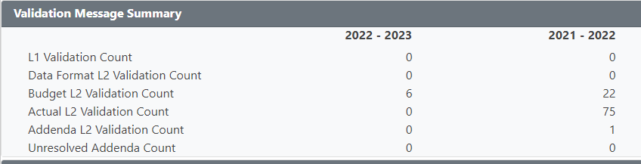
Landing Page - Validation Summary Panel
Panel has been updated to display count summary for
L1 data validations, L2 data and financial validations,
and Addenda by status.

Slide 194
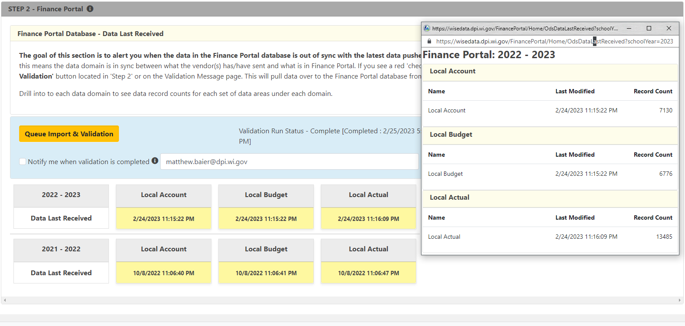
WISE Data API / Finance Portal panels
Notes:
Queue Import & Validation - Manual button to trigger validation run status. Otherwise will run automatically after a set amount of time.
Clicking on yellow panel with timestamp will pop up a window that will display summary information and counts for Local Account, Local Budget, and Local Actual.

Slide 195
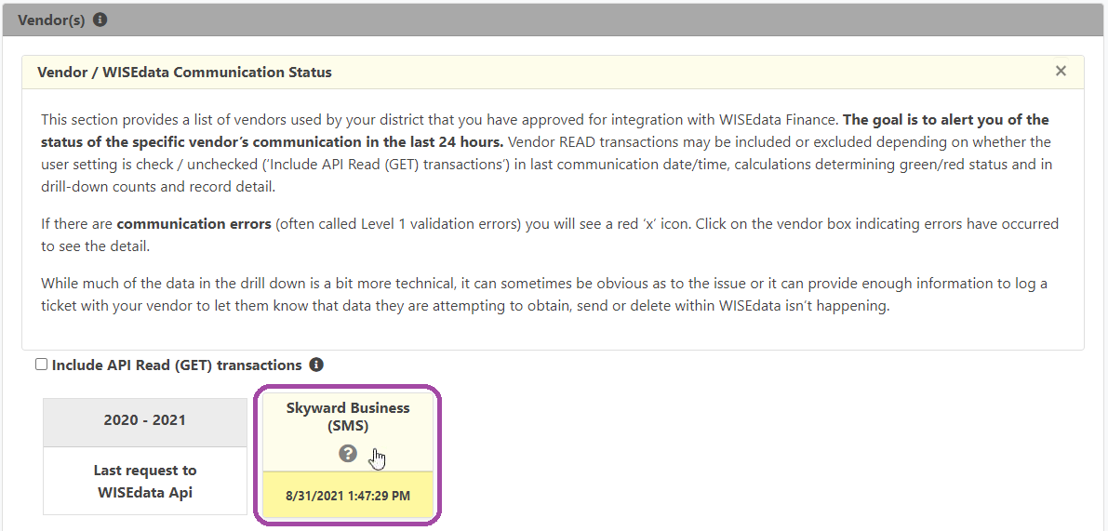
L1 Validations
“How can I see if we have rejected accounts?”
On the WISEdata Finance home screen, scroll down to the panel beneath the Validation Message Summary panel, the “Vendor / WISEdata Communication Status” section. There is a yellow box for each school year that shows when the WISEdata Finance API received the last submission from your vendor.
You can click on the box to get details:
Users are redirected to a screen that
shows summary error and success
counts for Account, Budget, and Actual
records.
Additionally the screen will show a
record of all L1 errors logged in the last
30 days.

Slide 196
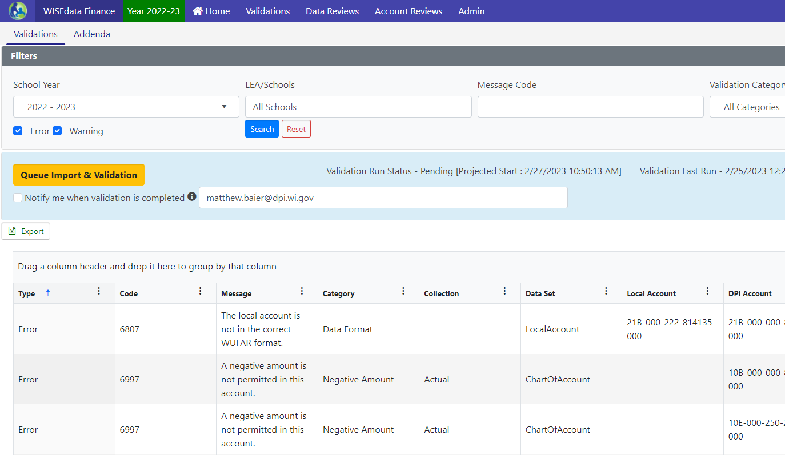
L2 Validations
“How do I see our validations?”
Access through Validations menu > Validations tab
This screen will list all L2 validations (data format and financial) as of the last validation run.

Slide 197
L2 Fiscal Validation Types
Negative Amount
Fund Transfer
On Record
Trial Balance
Notes:
These are laid out in this order for a reason. This is the order I work through them because as some of the negative amount and transfer validations are cleared, your trial balance validations may disappear.
Do a section and reupload to see what validations still remain, the reupload time may save you trying to fix something that is already taken care of.

Slide 198
Validations Updates
Our areas of focus concerning validations in WISEdata Finance:
Updated validations to allow a de minimis amount (less than a dollar) before triggering
Determining timeline for activating budget/actual validations through fiscal year
Building more comprehensive views of L1 validation data
Addiding additional validations as needs identified

Slide 199
Addenda
Reporting addenda to collect additional information based on accounts and amounts triggered within WISEdata Finance.
Required responses collected through WDF and viewable in the Budget and Annual Report in WiSFiP
Building addenda into WDF for Common School Fund / OPEB contributions

Slide 200
Project/Program Tags
Additional data element attached to a local account
Indicates what the account project code is for in the case of a conflict between local and DPI-specified project codes or to indicate non-DPI funding sources (FedDirect, FedOther, WisOther)
Only required if above conditions apply
If using a DPI project code for a non-DPI local purpose, also use LocalUse.
If no conflict then the LocalUse tag is not required for local project codes, although it will not cause any problems if you do so.

Slide 201
Best Practice
Make pushing financial data to
WISEdata Finance
the last step of your
monthly bank reconciliation
Setup a scheduled job to push data if your vendor offers the functionality

Slide 202
WISEgrants and WISEdata Finance
Tracking of federal expenditures and revenue by Project codes aid in ensuring accurate claiming of allowable costs and help streamline program and fiscal monitoring of federal programs.
We are continuing to work on aligning WISEgrants WUFAR accounts to align with WISEdata Finance and the DPI COA.
Federal grants management requires additional levels of details, scrutiny, and compliance which would prevent any ‘full’ automation of grant budgeting and claiming.

Slide 203
Contact Us
For WISEdata Finance questions visit DPI's WISEsupport page to submit a help ticket
https://dpi.wi.gov/wisedata/help/request
General SFS questions: dpifin@dpi.wi.gov
Matt’s Booking page:
https://outlook.office365.com/owa/calendar/MatthewBaier@WIDPIPRD.onmicrosoft.com/bookings/

Slide 204
Closing Thoughts
Alexander B. Roberson

Slide 205
Who are our points of contact?
Everyone at DPI is student-driven and committed to helping you navigate and meet bureaucratic burdens so you can educate kids
Unless you have a designated point of contact on another team (e.g., Program Calendar) contact Alexander B. Roberson first.
You should contact your board attorney, too.
You should always keep your authorizer informed.

Slide 206
How will we know what to do?
Independent Charter Schools Program Calendar
Emails from DPI
Some from PEO, some from other teams
Some emails will go only to the email on the school directory
Payment Letters, Instructions on the website
Visit the ICS webpage first
sometimes other webpages don’t apply to ICS

Slide 207
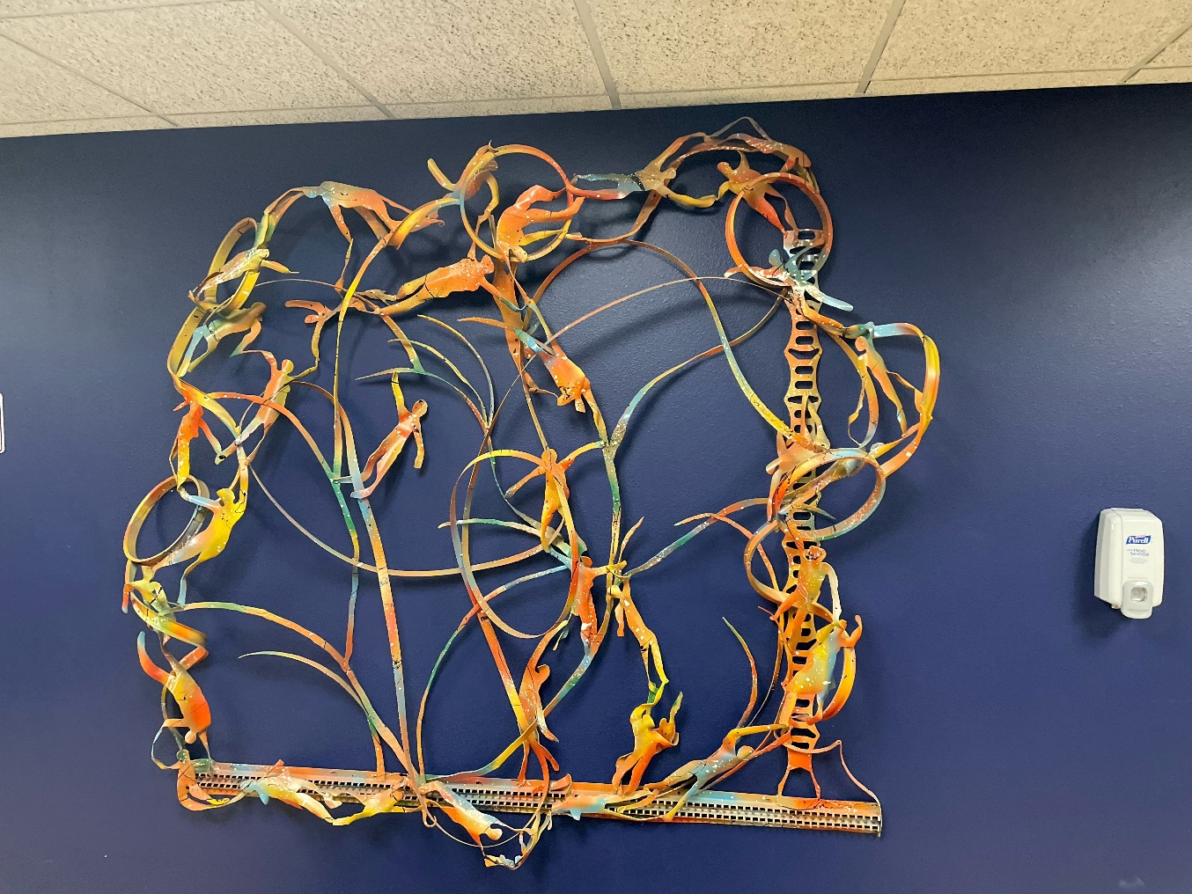
Final Thoughts

Slide 208
Final Thoughts
DPI wants to support in navigating your bureaucratic burdens so you can focus on educating Wisconsin students.
Not trying to play “gotchya!”
Surprises v Bad News
Please keep me informed
I want to see y’all succeed

