Slide 1
Breakfast and Lunch Signage
Feel free to add your school’s mascot, colors, etc., to the signage!
To change the size for printing, click Design >> Slide Size >> Custom Slide Size
Default has been set to 8.5 x 11”
To print, click File >> Print
Type the slide numbers that you want printed
Select “Full Page Slides”
These two lines must be on signage:
Including ½ cup fruit and/or vegetable (if using Offer versus Serve- slides 2 and 3)
This institution is an equal opportunity provider. (on all slides)
Updated 5/2023

Slide 2
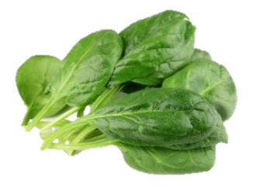
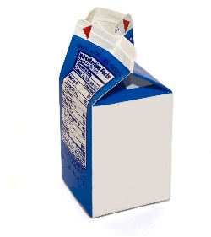
Lunch with OVS
The 5 Food Components for Lunch
Vegetable
Fruit
Grain
Milk
Meat/Meat Alternate
Choose at least 3 components
(including ½ cup fruit and/or vegetable)
For a nutritious meal, choose all 5!
This institution is an equal opportunity provider.
Notes:
Lunch with OVS

Slide 3
Breakfast with OVS
The 3 Food Components for Breakfast
Fruit
Grain
Milk
Choose at least 3 items
(including ½ cup fruit and/or vegetable)
For a nutritious meal, choose all!
This institution is an equal opportunity provider.
Notes:
Breakfast with OVS

Slide 4
Lunch NO OVS
The 5 Food Components for Lunch
Vegetable
Fruit
Grain
Milk
Meat/Meat Alternate
Select all items for a nutritious meal!
This institution is an equal opportunity provider.
Notes:
Lunch NO OVS

Slide 5
Breakfast NO OVS
The 3 Food Components for Breakfast
Fruit
Grain
Milk
Select all items for a nutritious meal!
This institution is an equal opportunity provider.
Notes:
Breakfast NO OVS

