Slide 1
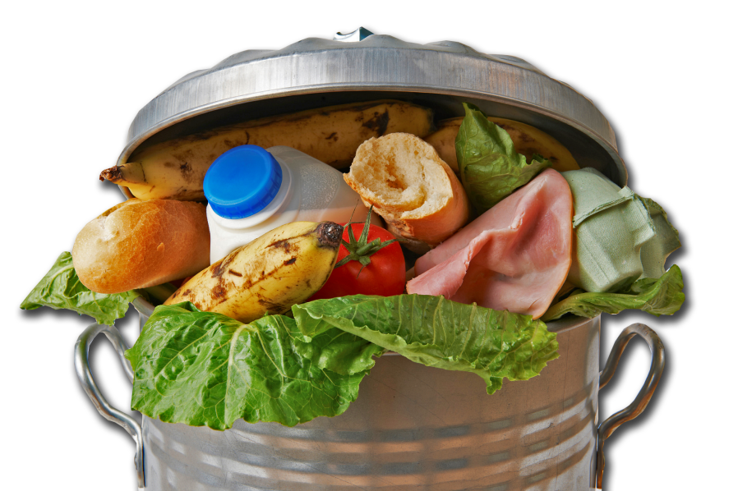
The U.S. Food Waste Challenge
Best Practices for Maximizing
Your Food Resources

Slide 2
U.S. Food Waste Challenge Goals
Disseminate information about best practices to reduce, recover, recycle food waste
Stimulate the development of these practices across the U.S. food chain
Demonstrate commitment to (and successes in) reducing, recovering, recycling food waste

Slide 3
What Schools Can Do
Reduce food waste through improved ordering, preparing, storing procedures
Recover and donate wholesome, uneaten food to feed people in need
Recycle discarded food for other uses (e.g., animal feed, compost, energy generation)

Slide 4
Where Food Loss Can Be Controlled
Purchasing
Receiving
Serving
Storing
Planning
Producing
Active Managerial Control
Food Safety
Monitoring
Training
Supervision
Feedback

Slide 5
USDA Food Waste Infographic
Download it today!
http://www.usda.gov/oce/ foodwaste/resources/ K12_schools.html
Use for educational purposes and to try out new ideas

Slide 6
Additional Resources
Food Recovery Challenge (EPA)
Data management software and technical assistance for schools
Food Donation Program Guidance in Child Nutrition
Statutory authority for food recovery and donation
National Food Service Management Institute
Nationwide training to school nutrition staff and online resources to improve ordering/managing food inventory
Reducing Wasted Food and Packaging (EPA)
A Guide for Food Services and Restaurants
Basics for Handling Food Safely (USDA)

Slide 7
Join the U.S. Food Waste Challenge Simply check the boxes on the Challenge activity form!
What activities will the school undertake in the next year?
Program to reduce the amount of excess food generated in the school
Recover wholesome food from breakfasts and/or lunches to donate to feed people
Recover food waste from breakfasts and/or lunches to feed animals
Recover food waste from breakfasts and/or lunches for composting
Recover food waste from breakfasts and/or lunches for energy generation or other uses
USDA will list your school and activities on its website to help inspire other schools to do their part
Join at: http://www.usda.gov/oce/foodwaste/join.htm

Slide 8
For more information, visit http://www.usda.gov/oce/foodwaste

