Slide 1
School District Audit Conference – DPI Update
Gene Fornecker and Brian Kahl

Slide 2
Agenda
Website Migration
State Single Audit Guidelines Revisions
DPI Appendix
DPI Audit Manual
TEACH
Fund 80 Update
Auditor Workpaper reviews
Auditor Questions
Desk Review Findings
Due Dates
WUFAR updates
Special Education
Open Enrollment
Private School Scholarships
Licensure system update
Reporting Findings
Private School Vouchers
FTE
WUFAR Coding
PI 1563 Reporting

Slide 3
Website Migration
The School Financial Services website, formally located at http://sfs.dpi.wi.gov, was recently migrated to a new home at https://dpi.wi.gov/sfs.
All SFS web page addresses (URLs) have changed because of the migration. This means that all bookmarks previously created no longer work and need to be updated.
A new menu system has been implemented to better organize the site and help customers find content. Simply click a category to open it and find associated subcategories and pages.
A convenient breadcrumb mechanism has also been added to the site so you can tell where you are in the new system and easily click back to related categories.

Slide 4
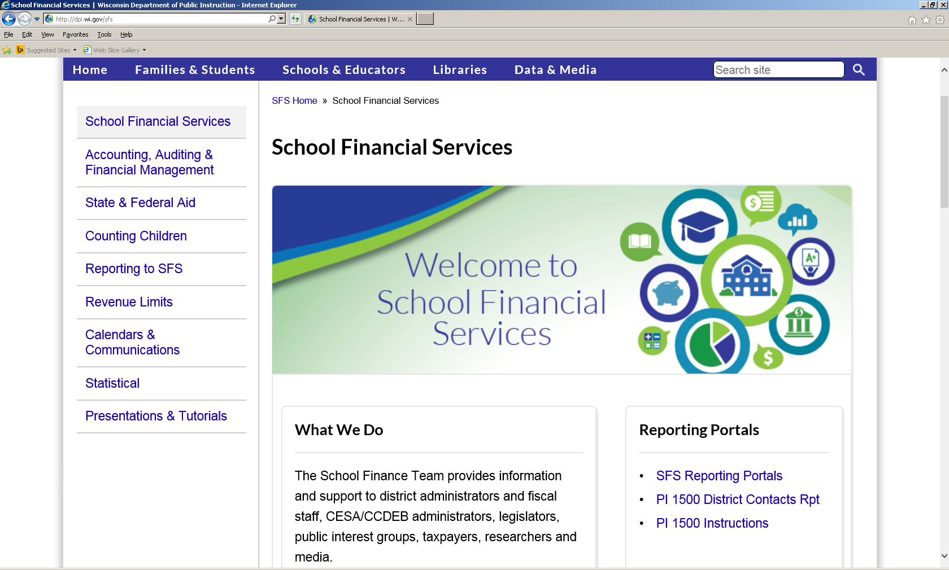

Slide 5
State Single Audit Guidelines

Slide 6
State Single Audit Guidelines
The State Single Audit Guidelines are applicable to an audit if all three conditions are met:
Condition # 1 – The Uniform Guidance applies.
Condition # 2 – The agency received funding from a state department. This funding may be state money or federal pass-through money.
Condition # 3 – The granting agency has not otherwise specified that the Guidelines are not applicable.

Slide 7
State Single Audit Guidelines
Risk-based approach for identifying state major programs (single audits only) –
The auditor shall apply the risk-based approach from the Uniform Guidance to identify which programs will be tested as state major programs, with the following modifications:
Consider prior audit experience with state programs when assessing whether the auditee is a low risk agency for purposes of the percentage-of-coverage rule for state program.

Slide 8
State Single Audit Guidelines
For programs that are state funded, the threshold for Type A programs is $250,000.
For programs that are state funded, the threshold for Type B programs is $62,500.
The granting agency may designate state or federal pass-through programs to be automatically considered to be Type A state programs and these programs are tested as state major unless the auditor assesses them to be low-risk but at least once every three years.

Slide 9
State Single Audit Guidelines
Granting agencies may designate programs to be state major so that these programs are always tested when the auditee has the programs.
Any state funded program that does not exceed $25,000 in expenditures during the audited year need not be included in the testing of major programs.

Slide 10
State Single Audit Guidelines
Auditor workpaper risk assessment documentation should include for each program:
the name of the program
the amounts of expenditures
whether the program is Type A or Type B
the factors considered in the risk assessment
the auditor’s assessment of the risk for each factor
and the overall assessment of risk

Slide 11
State Single Audit Guidelines
Noncompliance that results in likely total questioned costs exceeding $1,000 should always be reported.
Percentage of coverage rule.
The auditor must test major programs that encompass at least 20 percent of total state awards expended for a low-risk auditee.
Otherwise, the auditor must audit major programs that encompass at least 40 percent of total state awards expended.

Slide 12
State Single Audit Guidelines
4.4 Summary Schedule of Prior Audit Findings
The audit reporting package must include a “Summary Schedule of Prior Audit Findings” showing the status of prior audit findings, including findings related to state and federal pass-through programs. This schedule is prepared by the auditee.
If there were no prior audit findings, the auditee should state so in the Schedule.

Slide 13
Uniform Grant Guidance
§200.510 (b) Schedule of expenditures of Federal awards. The auditee must also prepare a schedule of expenditures of Federal awards for the period covered by the auditee's financial statements which must include the total Federal awards expended as determined in accordance with §200.502 Basis for determining Federal awards expended. While not required, the auditee may choose to provide information requested by Federal awarding agencies and pass-through entities to make the schedule easier to use. For example, when a Federal program has multiple Federal award years, the auditee may list the amount of Federal awards expended for each Federal award year separately. At a minimum, the schedule must:

Slide 14
Uniform Grant Guidance
(1) List individual Federal programs by Federal agency. For a cluster of programs, provide the cluster name, list individual Federal programs within the cluster of programs, and provide the applicable Federal agency name. For R&D, total Federal awards expended must be shown either by individual Federal award or by Federal agency and major subdivision within the Federal agency. For example, the National Institutes of Health is a major subdivision in the Department of Health and Human Services.
(2) For Federal awards received as a subrecipient, the name of the pass-through entity and identifying number assigned by the pass-through entity must be included.
(3) Provide total Federal awards expended for each individual Federal program and the CFDA number or other identifying number when the CFDA information is not available. For a cluster of programs also provide the total for the cluster.
(4) Include the total amount provided to subrecipients from each Federal program.
(5) For loan or loan guarantee programs described in §200.502 Basis for determining Federal awards expended, paragraph (b), identify in the notes to the schedule the balances outstanding at the end of the audit period. This is in addition to including the total Federal awards expended for loan or loan guarantee programs in the schedule.
(6) Include notes that describe that significant accounting policies used in preparing the schedule, and note whether or not the auditee elected to use the 10% deminimis cost rate as covered in §200.414 Indirect (F&A) costs.

Slide 15
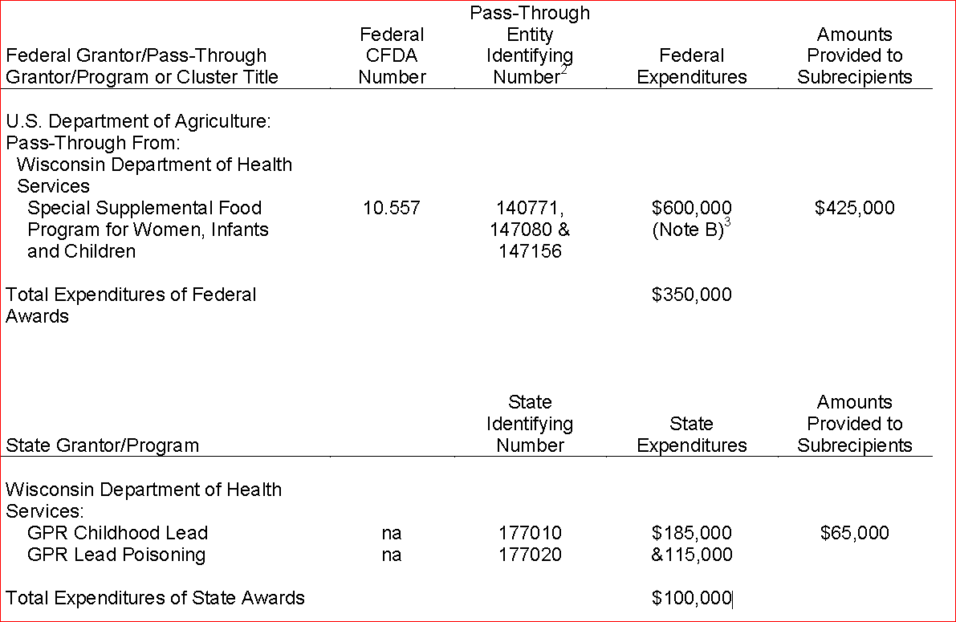
State Single Audit Guidelines

Slide 16
State Single Audit Guidelines
Use the project code as the pass-through identifying number
A list of the project codes that DPI is currently using for the grant funded programs can be found at
https://dpi.wi.gov/sfs/finances/aids-register/aids-register-coding.

Slide 17
State Single Audit Guidelines – DPI Appendix
The following are notable changes made to this appendix in April 2016:
Added clarification regarding the testing of Type A programs with expenditures exceeding $250,000. These programs should be tested at least once every 3 years as a Type A program.
Added section 3.9 which clarifies compliance with state statutes testing
Designated major and designated Type A program compliance supplements are now separate documents that can found on the state single audit guidelines main page
Guidance for auditing programs without a compliance supplement has been updated and revised (new document)

Slide 18
State Single Audit Guidelines – DPI Appendix
The Department of Public Instruction has designated certain programs to be state major programs
General Aids
The Department of Public Instruction has designated two programs to be a Type A programs
Special Education Aid and School Age Parents Aids
Pupil Transportation Aid
See section 3.4 of the Main Document, online at https://doa.wi.gov

Slide 19
State Single Audit Guidelines – DPI Appendix
Compliance with State Statutes
The Department of Public Instruction requires that the compliance with state statutes checklist be completed as part of all audits involving funding from the department.
The completion of the compliance with state statute checklist is required whether or not the auditee has a state single audit required, major programs or Type A programs from the department.
The completion of this checklist will assist auditors in completing the other general requirements in 3.1 to 3.8 of the DPI Appendix.
The compliance with state statutes checklist can be found at https://dpi.wi.gov/sfs/finances/auditors/audit-programs.

Slide 20
 | Budgeted General & Categorical Aids
Categorical Aid Program | FY15 | FY16 | FY17
Special Education | $ 368,939,100 | $ 368,939,100 | $ 368,939,100
Per Pupil Aid*** | $ 126,975,000 | $ 126,842,300 | $ 211,248,200
SAGE | $ 109,184,500 | $ 109,184,500 | $ 109,184,500
Pupil Transportation | $ 23,703,600 | $ 23,954,000 | $ 23,954,000
Sparsity Aid | $ 13,453,300 | $ 17,674,000 | $ 17,674,000
Bilingual-Bicultural | $ 8,589,800 | $ 8,589,800 | $ 8,589,800
Tuition Payments | $ 8,242,900 | $ 8,242,900 | $ 8,242,900
Head Start Supplement | $ 6,264,100 | $ 6,264,100 | $ 6,264,100
Educator Effectiveness | $ 5,746,000 | $ 5,746,000 | $ 5,746,000
High Cost Transportation | $ 5,000,000 | $ 7,500,000 | $ 7,500,000
School Lunch Match | $ 4,218,100 | $ 4,218,100 | $ 4,218,100
Aid for CCDEB's | $ 4,067,300 | $ 4,067,300 | $ 4,067,300
Special Education-High Cost ("Additional") | $ 3,500,000 | $ 3,500,000 | $ 8,500,000
CTE Incentive Grants | $ 3,000,000 | $ - | $ -
School Breakfast Grants | $ 2,510,500 | $ 2,510,500 | $ 2,510,500
TEACH Debt Service | $ 2,052,300 | $ 1,458,400 | $ 1,085,900
Special Education-Supplemental | $ 1,750,000 | $ 1,750,000 | $ 1,750,000
Peer Review & Mentoring | $ 1,606,700 | $ 1,606,700 | $ 1,606,700
4K Start Up Grants | $ 1,350,000 | $ 1,350,000 | $ 1,350,000
School Day Milk | $ 617,100 | $ 617,100 | $ 617,100
Open Enroll Transportation | $ 434,200 | $ 434,200 | $ 434,200
Aid for CESAs | $ 260,600 | $ - | $ -
Gifted and Talented Grants | $ 237,200 | $ 237,200 | $ 237,200
SAGE-Debt Service | $ 133,700 | $ 133,700 | $ 133,700
Supplemental Aid | $ 100,000 | $ 100,000 | $ 100,000
Youth Options Transportation | $ 17,400 | $ 17,400 | $ 17,400
Transition/Incentive Grants | $ - | $ - | $ 100,000
Robotics Competition Grants | $ - | $ - | $ 250,000
Tribal Languages (PR) | $ 222,800 | $ 222,800 | $ 222,800
Aid for AODA (PR) | $ 1,284,700 | $ 1,284,700 | $ 1,284,700
School Library Aids | $ 34,000,000 | $ 36,000,000 | $ 38,000,000
Env Educ, Forestry-UW | $ 200,000 | $ 200,000 | $ -
Env Educ, Env. Assess-UW | $ 130,500 | $ - | $ -
Educ Telecomm Access-DOA | $ 11,105,100 | $ 9,105,100 | $ 10,105,100
Total Categorical Aids | $ 748,896,500 | $ 751,749,900 | $ 843,933,300
General Aids
General Equalization Aids | $ 4,475,960,500 | $ 4,475,960,500 | $ 4,584,098,000
Gen Aids-Hold Harm Sum Suff | $ - | $ - | $ -
High Poverty Aid | $ 16,830,000 | $ 16,830,000 | $ 16,830,000
Total General Aids | $ 4,492,790,500 | $ 4,492,790,500 | $ 4,600,928,000

Slide 21
General Aids
Designated Major Program
Full Audit Program
Districts with more than $25,000 in general aid
Partial Audit Program
Districts with less than $25,000 in general aid
Limited procedures required by DPI
Changes to the 2015-16 Full Audit Program
Energy exemption procedures removed from the General Aids audit program
Fund Balance section of the program moved to the 1506 FB Report

Slide 22
Pupil Transportation Aid
Designated Type A Program
Risk assessment every year
audit if not low risk
Must be audited once every three years if transportation aid is $62,500 or more
$62,500 is the Type B threshold amount (programs below this threshold are considered immaterial)
Full audit program for districts required to have a single audit and greater than $62,500
Partial audit program for districts not required to have a single audit and greater than $62,500

Slide 23
Student Achievement Guarantee in Education (SAGE)
118.43 (9) Sunset. No contract may be entered into or renewed under this section after July 3, 2015.
DPI is prohibited from entering into or renewing five-year SAGE contracts with any school
Current SAGE contracts are valid through the end date listed on the approved contract
2015 Wisconsin Act 53 and Act 71 created the Achievement Gap Reduction Program (AGR) under the new section of Wisconsin Statute 118.44

Slide 24
AGR/SAGE
AGR is replacing the SAGE program
SAGE and AGR will be drawn from the same statewide appropriation
SAGE and AGR will result in the same per pupil allocation
The amount appropriated in the 2015-17 Wisconsin State Budget is $109,184,500

Slide 25
Achievement GAP Reduction (AGR)
The objective of the AGR program is to improve academic performance of low-income pupils in participating schools in grades K-3 through the implementation of one of three strategies or combination of the three strategies.

Slide 26
Achievement GAP Reduction (AGR)
These three strategies are
1)-to provide professional development related to small group instruction and reduce class size to no more than 18:1 or no more than 30:2 in a combined classroom having at least 2 regular classroom teachers
2)-data-driven instructional coaching for teachers
3)-data-informed one-to-one tutoring for students at risk of difficulty with math or reading.

Slide 27
AGR/SAGE
Type A program if over $250,000 in aid received
84 districts received over $250,000 in aid during 2015-16
Total aid received by these 84 districts totaled $91,584,984.51
New audit program for AGR
Types of Services Allowed and Unallowed
Reporting Requirements
Special Tests and Provisions
Type A programs must be tested once every third year

Slide 28
AGR/SAGE
More information on these two programs
See https://dpi.wi.gov/sage for SAGE and AGR information.
Aid amounts by school for 2015-16 can be found at https://dpi.wi.gov/sites/default/files/imce/sage/pdf/2015-16_SAGE_AGR_aid_school.pdf.

Slide 29
Sparsity Aid
2015 ACT 55 eliminates the requirement that at least 20 percent of a district’s pupils be eligible for free and reduced price lunch as a condition of eligibility for this program.
Districts meeting the size and sparsity thresholds will be eligible for aid in the amount of $300 per pupil in FY16 and FY17 provided that there is sufficient funding to avoid proration of aid to school districts.

Slide 30
Per Pupil Aid
Statute Reference
Wisconsin Statute 115.437 Per-Pupil Aid.
Funding
Established in 2011 Wisconsin Act 32 as Per-Pupil Adjustment Aid from a sum-sufficient appropriation under s.20.255 (2) (aq). Renamed to Per-Pupil Aid in 2013 Wisconsin Act 20.
Eligibility
School districts automatically receive this aid
no claim is necessary
there are no eligibility criteria for this aid program
no proration of aid

Slide 31
Per Pupil Aid
Aid Computation
2015 Wisconsin Act 55 the 2015-17 Biennial Budget provides for 2015-16 Per-Pupil Aid in the amount of $150 multiplied by Line 6 Current Year Membership from the district's 2015-16 Revenue Limit worksheet.
In 2016-17 Per-Pupil Aid will be computed as $250 multiplied by the Line 6 Current Year Membership from the district's 2016-17 Revenue limit worksheet.

Slide 32
Per Pupil Aid
Payment Details
Per-Pupil Aid will be paid on the second Monday in July, 2016 and is to be booked as a receivable for 2015-16.
In 2016-17, vouchering will return to the fourth Monday in March and will be considered current-year revenue.
WUFAR Coding
Per-Pupil Aid is coded to Fund 10, Source 619.

Slide 33
Per Pupil Aid
Type A program if the district receives over $250,000 in aid
No audit program for per pupil aid
Suggested Audit Procedure
Recomputation of the aid received
Line 6 multiplied by the Per Pupil Aid amount

Slide 34
TEACH

Slide 35
TEACH Grants
The Wisconsin Department of Administration (DOA) has three TEACH Grants that provide funding to Wisconsin school districts
2016 TEACH $25,000 Competitive Grant
The Wisconsin Department of Administration's TEACH program shall award $25,000 each fiscal year (July 1 to June 30) to consortia of school districts for the purposes of developing and implementing a technology-enhanced high school curriculum.
Information Technology Infrastructure Grants
These grants would be for providing technology infrastructure to improve the capacity of school districts to utilize technology for instruction. The maximum funding allocated each Fiscal Year for years 2015-16 and 2016-17 is $7,500,000 annually.
First grant awards will be in December 2016

Slide 36
TEACH Grants
TEACH Program – Teacher Training Grants for Educational Technology
The Wisconsin Department of Administration (DOA) will be administrating grants under the TEACH program for $1,500,000 annually starting in the 2015-16 fiscal year. These grants will be made available to a consortia of three or more districts for the purpose of training teachers on the use of educational technology.
These TEACH training grants will only be available for districts that have 13 or fewer students per square mile. The following funding will be available: $7,500 for districts with fewer than 750 students; $10 per student for districts with between 750 and 1,500 students; $15,000 for districts with more than 1,500 students.

Slide 37
TEACH Grants
TEACH grant revenues are coded to source 699 per the WUFAR.
Any additional expenditures above those funded by the grant should be shared by the participating districts in the consortium.
Fund 99, Fund 91, or Fund 27 is recommended for Cooperative (consortia) activity. Information on Cooperative funds can be found at https://dpi.wi.gov/sfs/finances/fund-info/package-cooperative-funds.
Please note that the Teacher Training Grants should not be recorded in Fund 23 or Fund 93. Fund 23 and Fund 93 were used to account for programs funded with grants and loans from the TEACH Wisconsin Board that were awarded prior to 2012.

Slide 38
TEACH Grants
No State ID # has been assigned by DOA
Not included in the single audit
More Information can be found at https://teach.wi.gov/pages/home.aspx.
Accounting and Coding information can be found at https://dpi.wi.gov/sfs/finances/wufar/accounting-issues-examples.
DOA contact for TEACH Grants is Matthew Yeakey with an email address of Matthew2.Yeakey@wisconsin.gov

Slide 39
Community Service Fund

Slide 40
Community Service Fund
120.13 (19) Community programs and services. Establish and maintain community education, training, recreational, cultural or athletic programs and services, outside the regular curricular and extracurricular programs for pupils, under such terms and conditions as the school board prescribes. The school board may establish and collect fees to cover all or part of the costs of such programs and services. The school board may not expend moneys on ineligible costs, as defined by the department by rule. Costs associated with such programs and services shall not be included in the school district's shared cost under s. 121.07 (6).

Slide 41
Community Service Fund
Non-controlled Levies
Districts may have "non-controlled" levies including: Referendum-Approved Debt (Fund 39), Community Service (Fund 80), and prior-year levy chargebacks.
The community service fund levy is approved and certified for a specific purpose and can only be used for that purpose.

Slide 42
Community Service Fund
Fund Balances
Restricted
Unspent levy amounts
Committed
Board approved fees
Other revenues committed by the board for Fund 80
Items to Review
Site Repairs (Function 254200)
Building Repairs (Function 254300)
Facilities Acquisition and Remodeling (Function 255000)
Operation Expenditures (Function 253000)
Gas for heat, electricity, water, sewerage

Slide 43
Auditor Workpaper Reviews

Slide 44
Auditor Workpaper Reviews
Criteria: The State Single Audit guidelines require that the auditor use the risk based approach from Circular A-133 to identify which programs will be tested as state major programs. Workpaper documentation should include the name of the program, the amount of expenditures, whether the program is Type A or Type B, the factors considered in the risk assessment, the auditor’s assessment of the risk for each factor, and the overall risk assessment. For a Type A program to be considered low-risk, it shall have been audited as a major program in at least one of the two most recent audit periods.
Comments: The risk assessment required by the State Single Audit guidelines was not included in the audit workpapers for the school districts reviewed. The auditor should document the risk assessment criteria as required. However, the auditor was tracking the history of the testing of the state programs and was testing the Type A programs at least every three years.

Slide 45
Auditor Workpaper Reviews
Criteria: The Wisconsin Department of Public instruction (DPI) has designated Pupil Transportation to be a Type A program. This program must be audited at least once every 3 years. There is an audit program developed by DPI that should be used to audit the Pupil Transportation program.
Comments: The Schedule of Findings and Questioned Costs identified Pupil Transportation as a major program for the School District. The audit program developed by DPI was not used for the district audit and documentation of the audit procedures performed for the pupil transportation program was not found in the workpapers.

Slide 46
Auditor Questions

Slide 47
Auditor Questions
Question: Can the district record the premium received from the issuance of debt in the Capital Projects fund?
Answer: No, Wisconsin State Statutes specifically states that the premium must be recorded in the debt service fund.

Slide 48
Auditor Questions
Wisconsin Statute 67.11 Debt service fund.
67.11(1)(1) Each municipality that issues municipal obligations under this chapter, except obligations issued under s. 67.12 (1), (8) and (8m), shall establish and maintain a debt service fund in accordance with generally accepted accounting principles. The fund may include a separate account for each outstanding municipal obligation issue. Revenues from the following sources shall be recorded to the fund accounts as appropriate:
67.11(1)(a) (a) All moneys accruing to the borrowed money fund prescribed by s. 67.10 (3) which at any stage are not needed and which obviously thereafter cannot be needed for the purpose for which the money was borrowed.
67.11(1)(b) (b) All moneys raised by taxation under s. 67.05 (10) or 67.12 (12) (ee) for the purpose of making principal and interest payments on municipal obligations.
67.11(1)(d) (d) The premium, if any, for which the municipal obligations have been sold above par value and accrued interest.
67.11(1)(e) (e) Such further sums raised by taxation or otherwise, as may be necessary to make all interest and principal payments due in any year. The levying and collection of the taxes or other revenues are authorized; but the governing body may, in its discretion, levy and collect larger sums than the sums so authorized, in order to speed the payment of municipal obligations.

Slide 49
Auditor Questions
Question: Does the district have to allocate investment earnings to Fund 50?
Answer: Yes, Fund 50 should receive a share of the investment earnings per the CFR guidance for the National School Lunch Program Guidance.
7CFR §210.2 Definitions. Revenue, when applied to nonprofit school food service, means all monies received by or accruing to the nonprofit school food service in accordance with the State agency's established accounting system including, but not limited to, children's payments, earnings on investments, other local revenues, State revenues, and Federal cash reimbursements.

Slide 50
Auditor Questions
Question: Does DPI monitor the Title comparability requirement that is included in the Department of Education’s cross-cutting section of the compliance supplement? Do auditors have access to the reports submitted?
Answer: Districts are required to submit the comparability report using the web based application at https://apps4.dpi.wi.gov/TPortal/Pages/SignIn.aspx. The district can print a copy for the auditor.

Slide 51
Title I Comparability Report

Slide 52
Desk Review Findings

Slide 53
Audit issues
Common audit findings:
USDA programs
Student meal prices not increased per PLE requirements
Eligibility for free/reduced prices not correct
IDEA programs
Time and Effort requirements not being met
Educators not holding appropriate licenses

Slide 54
Audit Issues
Pupil Transportation Aid
About 50 districts with findings and many refunds to DPI of overpayments
Students being included in multiple categories
All students being counted
Students included in wrong mileage categories
Students receiving specialized transportation are being included in regular transportation tables
Students included in 0-2 mile category but no Unusually Hazardous Transportation Plan exists

Slide 55
Audit Issues
Common School Fund (library aid)
Aid not being spent within same fiscal year
Unallowed expenditures of aid received (furniture, computer accessories, printers)
https://dpi.wi.gov/common-school-fund
Actuarial Studies not being completed timely resulting in delays in audit completion or modified audit opinions
Bank Account reconciliations not completed

Slide 56
WUFAR

Slide 57
WUFAR Account Changes
Expenditures
Added:
Function 438000, General Voucher Amount—Parental Choice Private School Payments
Object 447 (optional), Service Agreements for Technology Related Hardware
Revenues
Account Title change:
Source 590, Other Payments from Intermediate Users

Slide 58
WUFAR Clarifications
110000 and 120000 Should include the cost of laptops/Chromebooks purchased for individual use
Source 699/799, Other State/Federal Revenues includes payments received from intergovernmental agreements (including those with DPI)

Slide 59
Special Education

Slide 60
Special Needs Scholarship Program
(Special Education Vouchers)
Beginning in 2016-17, allow a child with a disability to attend a participating private school of their choice, if that child has previously been rejected from attending a school in a nonresident school district under the public open enrollment program. State provides a $12,000 voucher to private school.
Funding
DPI:
Pays $12,000 to the private school for each child participating in the program.
Reduces the resident district’s equalization aid amount by a corresponding amount. If insufficient equalization aid, DPI will reduce other state aids received.
Increases a school district’s student membership for revenue limits and general school aid purposes.
School Boards:
Prohibited from “back filling” the aid reduction with property tax levy increase.
Count private school students receiving voucher as part of federal set aside.

Slide 61
Special Education Open Enrollment
Law changed by 2015 Act 55 (the 2015-17 biennial budget)
Changes take effect this fall 2016
Applies to new & continuing students with disabilities in Open Enrollment
Applies to tuition waivers as well
Can only deny for lack of space or program
No more undue financial burden

Slide 62
What is/isn’t a lack of program?
A program relates to type of disability
e.g. Cross-Categorical, EBD
Can deny for lack of program
Related services are not programs
e.g. OT/PT, Speech/Language Therapy, Transportation
Can not deny due to needed related services

Slide 63
Spec Ed Open Enrollment Funding
$12,000 general aid transfer by DPI from resident to nonresident district
Fund 10 expense/revenue
Coded as 10E 435000 382 / 10R 345
Part of June payment reconciliation
Student counted by resident district for state aid & Revenue Limit
Resident district may not use IDEA funds for aid transfer
No Transfer of Service eligibility

Slide 64
Spec Ed Open Enrollment Funding
Nonresident district receives & retains all state special education categorical aids
Nonresident district may use its IDEA funds for open enrolled students
Students in nonresident district’s MOE
Nonresident district assumes nearly all FAPE responsibility
Resident district still represented on the IEP team

Slide 65
DPI Licensure database
The new “ELO”, Educator Licensing Online, system is operational this year and therefore the modified audit procedures applicable last year have been removed from the audit program
https://dpi.wi.gov/tepdl/license-lookup

Slide 67
Due Dates

Slide 68
2016 Report Due Dates
District reports
PI-1505 AC
Due Friday, August 26
Opens July 11
PI-1505 and PI-1505 SE – Both the Full and the Special Education Annual Reports
Due Friday, September 16
Opens July 11
Notes:
Open July 2 –
Allow Auditors time to audit from SAFR
Last year many edits were done late
Goal to have all edits done by July 2
Remember Audited F/S are not due until December 1…any late reports are subject to delay in district receiving aid

Slide 69
2016 Report Due Dates
Auditor reports
Auditor Certification PI-1506 AC
Due Friday, September 9
Opens July 11
Audited Fund Balance PI-1505 FB
Due Friday, September 9
Opens July 11
Special Education No Valid License Worksheet
Due Friday, September 16
Send completed xls document to: dpisfsreports@dpi.wi.gov
Audited Financial Statements
Due December 1, 2016
Notes:
Open July 2 –
Allow Auditors time to audit from SAFR
Last year many edits were done late
Goal to have all edits done by July 2
Remember Audited F/S are not due until December 1…any late reports are subject to delay in district receiving aid

Slide 70
Report Filing
Audit reports for the fiscal year ended June 30, 2016 must be filed to DPI in PDF format by December 1:
dpiauditreports@dpi.wi.gov
Audited financial statements
Management letters, SAS 115 Communications of Internal control matters, and any SAS 114 Communication with Those Charged with Governance
Single Audit reports if issued separately
Data Collection Form (YES! WE WANT IT!)
Notes:
Must have the signature of the firm or CPA
If you or the district are unable to submit reports in pdf give us a call and we will ask that you send to us in paper form and we will scan and save electronically.
2006 year there were 33 reports filed late (after December 1)

Slide 71
Reporting Findings

Slide 72
Audit Manual Update
See Chapter 3 of the Audit Manual
https://dpi.wi.gov/sfs/finances/auditors/audit-manual
Main point of emphasis:
Looking for more specificity in findings
This helps districts develop an appropriate Corrective Action Plan and it helps us form our Management Decisions
Vague findings lead to vague CAP’s
Statistics:
36 Districts with Financial Statement Findings with deficient corrective action plan
Segregation of Duties – 35 districts
Auditors prepare F/S – 8 districts
Material year end adjustments – 1 district

Slide 73
Cash Reconciliations
Condition: A bank reconciliation was not being performed on a monthly basis. Cash receipts were not recorded timely during the fiscal school year.
Example of Corrective Action Plan:
District will provide more oversight.
Does it address the condition that exists? If not, does it provide mitigating controls?
DPI Monitoring:
Will most likely result in the district being placed on monitoring status and could result in district submitting monthly bank recs to DPI before grant claims are approved for payment

Slide 74
Private School Vouchers

Slide 75
Wisconsin Parental Choice Program (WPCP)
Background
State funds provide vouchers to students residing anywhere in the state except Milwaukee and Racine to attend private schools in Wisconsin.
$7.3 million GPR for 1,000 FTE students in 31 private schools in 2014-15.
State payment is $7,214 (grades K-8) and $7,856 (9-12) per FTE in 2015-16.
State payment is $7,323 (grades K-8) and $7,969 (9-12) per FTE in 2016-17.
Student Eligibility
Student must reside in Wisconsin and family income cannot exceed 185% of the federal poverty level ($44,828 for family of four).
Funding
Continuing Students-State GPR funds will directly pay for those students enrolled in the WPCP in 2014-15 and thereafter until they exit the program.
Incoming (new) Students-Each school district with a WPCP student residing in it will pay for new students enrolling in the program in 2015-16 and thereafter through a reduction in their state general aids. School districts fully “count” these students under revenue limits in 2015-16 and thereafter and for state general aid purposes beginning in 2016-17.

Slide 76
Wisconsin Private School Voucher Program Financial Impacts
Beginning in 2015-16, state law directs DPI to include NEW students attending a private school with a state funded voucher for the purpose of: (a) determining a new non-recurring revenue limit exemption (Line 10.H.); (b) reducing a district’s state aids payment in June 2016; and (c) increasing a district’s 2015-16 membership used for state aid purposes in 2016-17.
2015-16 Funding:
Private Schools: State law requires private schools to receive voucher payments ($7,214 for students in grades K-8 and $7,860 for students in grades 9-12) based on current year information. For 2015-16 payments, the 3rd Friday in September 2015 and the 2nd Friday in January 2016 are the student count dates used to calculate the payment for NEW or “incoming” pupils. The voucher schools are paid 1/2 the annual payment based on the 3rd Friday in September student count and 1/2 the annual payment based on the 2nd Friday in January student count. Private schools have annual student membership audits and DPI will adjust the payments based on audited information.

Slide 77
Wisconsin Private School Voucher Program Financial Impacts
2015-16 Funding:
Student Counts: The private school voucher funding mechanism is complicated. DPI will make the membership adjustments and calculate the revenue limit and state aid impacts. Districts do NOT report the private school voucher student counts to DPI. Districts do NOT calculate the financial impacts related to the private school voucher students. DPI will provide both the membership and financial details to the school districts.
Revenue Limits: It is important to note that if a school board chooses to levy less than the private school voucher non-recurring revenue limit authority, the following year’s revenue limit carry-over total will be reduced dollar for dollar. In other words, this new non-recurring revenue limit exemption is treated the same way as other non-recurring revenue limit exemptions if a school board chooses to levy less than the maximum allowed.
State Aid Factors: How the expenditure for the state aid reduction for the private school vouchers impacts a district’s shared costs will depend on how much additional tax is levied per the non-recurring exemption. In addition, DPI will adjust a school district’s 2015-16 aid membership to include the final audited private school voucher students.

Slide 78
Wisconsin Private School Voucher Program Financial Impacts
2015-16 Funding:
Statewide Impacts: $16.1 million estimated state general aid deduction to occur in June 2016. In addition, $21.4 million increased property tax authority granted to school boards. Total estimated tax impact of $37.5 million in 2015-16.
Detail state aid deductions and non-recurring revenue limit authority increases by each of the 142 school districts can be accessed at: https://dpi.wi.gov/sites/default/files/imce/sfs/doc/Voucher_School_Summary_Dec_15_2015.docx
2016-17 Funding:
Each year, starting with the 2015-2016 school year, “incoming voucher students” will increase a school district’s revenue limit calculation equal to the corresponding reduction in the state aid the district will receive. Because each student who qualifies under this program is part of a nonrecurring revenue limit exemption in the current year, the student must qualify again in the coming school years. If that same student qualifies for this program in the future they will be included again in the same manner.

Slide 79
Wisconsin Private School Voucher Program Financial Impacts
2016-17 Funding:
Beginning in 2016-17, state law directs DPI to increase each of the 142 districts’ 2015-16 membership used for state aid purposes by the number of “incoming voucher students”. The addition of an estimated 2,181 FTE private school voucher students to state aid membership will result in a redistribution of the 2016-17 state aids that could impact all school districts.
Other Issues:
If the school district did not receive an equalization aid payment sufficient to cover the voucher aid reduction, the balance would be reduced from other state aid received by the district.
In 2015-16 and 2016-17, the total number of pupils residing in the district who could participate in the choice program from each district is limited to no more than 1% of the district’s prior year membership. Beginning in the 2017-18 school year, the enrollment limit will increase by one percentage point in each year until the enrollment limit reaches 10% of the district’s prior year enrollment. In the year after the limit reaches 10%, no enrollment limit would apply.

Slide 80
Questions?

Slide 81
Thank you!
Gene Fornecker, CPA
608/267-7882
eugene.fornecker@dpi.wi.gov
Brian Kahl, CPA
608/266-3862
brian.kahl@dpi.wi.gov

