Slide 1
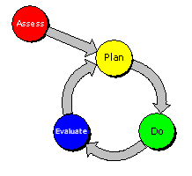
DPI Current Updates, Reminders and Reporting Requirements
School Financial Services Team Panel Discussion
Bruce Anderson, Consultant
Carey Bradley, Consultant
Bob Soldner, Director
Debi Towns, Assistant Director
2016 WASBO Foundation Spring Conference
Kalahari Resort and Conference Center
3:45 - 4:45 pm Thursday, May 26, 2016

Slide 2
General topics to be reviewed:
Year End Reporting Requirements
Fund 80 Eligible Costs and Transfer of Service (TOS) Process
Summer School FTE and Fee Requirements
Changes in Special Education Open Enrollment Funding
Changes in Private School Voucher Reimbursement
New PI-401 form

Slide 3
(Year End) Reporting Requirements

Slide 4
(Year End) Reporting Requirements
Energy efficiency exemption to the revenue limit
Report in the budget publication (for annual budget hearing) on the project savings. (65.90 addendum)
Report utility savings, when known, to DPI in the reporting portal
Savings should be reported so they will be applied to reduce the levy
Long term capital project trust fund (46)
Resolution must be passed before June 30
Funds posted to the bank’s account by July 30
Send proper documentation to DPI to access fund 46 in the Annual Report PI 1505

Slide 5
Fund 80 Eligible Costs and Transfer of Service (TOS) Process
Notes:
These two topics may not impact all school districts currently,
however each may do so in the future
so a basic understanding will be beneficial.

Slide 6
Community Programs and Services Fund 80 Eligible Costs
PI 80.02 Ineligible Costs [four basic defining requirements]
A school board may not expend moneys on ineligible costs for community programs and services. The following are ineligible costs:
[1] Costs for any program or service that is limited to only school district pupils.
[2] Costs for any program or service whose schedule presents a significant barrier for age-appropriate school district residents to participate in the program or service.
[3] Costs that are not the actual, additional cost to operate community programs and services under s. 120.13 (19), Stats.
[4] Costs that would be incurred by the school district if the community programs and services were not provided by the school district.
Notes:
Determining if the program belongs in Fund 80 is not without limitations. A few standard examples are:
Adult Education,
Community recreation programs, such as summer softball/baseball
Day care service
If you are not sure, ASK us!
PI 80 became a permanent rule on May 1, 2015.

Slide 7
Community Programs and Services - CPS Fund 80 Eligible Costs
What does “actual” and “additional” costs mean to a school district?
Every Fund 80 expense is for services provided or materials purchased related to the Community Program or Service.
Payroll for a worker - by the hour or by a limited contract (summer T-ball coach pay for the season.)
Bus contracted to take a group of district residents to a specified site for a special event organized the CPS staff.
Supplies for a program that are clearly restricted to CPS activities. An auditor may ask the district explain how purchased supplies are not being used for PreK-12 programs.
Each Fund 80 expense will need to be documented within the district’s accounting system.
Supporting documentation will be part of the audit process
Notes:
Every district with a Fund 80 will have an annual audit of the expenses. Depending on the process used by the auditor, something was not checked last year could be a question this year or in the future.

Slide 8
Transfer of Service (TOS) Process
The TOS process is based on three basic factors:
The district that assumes this financial responsibility for the program or services from another governmental unit can make a timely Transfer of Service request.
An approved Transfer of Service Request will impact the Revenue Limit calculations for the coming school year and it will be limited to the estimated new costs to the district.
It is important to remember that once a Transfer of Service request has been approved, the Board of Education will make the final decision to increase the local property taxes equal to the approved amount.
Notes:
Each approved TOS provides the school district with the authority to increase the local property taxes.

Slide 9
Transfer of Service (TOS) Process
There are two ways for a district to submit a Transfer of Service request.
The first type and the most common type of TOS request is student based, submitted on-line using the PI-5000 portal and each individual TOS request is entered under one of two reports:
Students with Special Education needs, as determined by the pervious governmental unit, including student coming from a Birth-to-Three program, will be entered under “SPED”.
Students with an Limited-English Proficiency need will be entered under “LEP”.
If a student is identified in both programs they will need to be entered separately in in the SPED and the LEP reports.
The second type of transfer of service request is between the school district and a local municipality, such as city or county. The actual request to DPI, must in a narrative format with both estimated costs and justification for the request.
Notes:
An increase in cost for services is not grounds for a TOS request.

Slide 10
Transfer of Service (TOS) Process
It will be important for the requesting district to remember these three take way points:
Each Transfer of Service request is an estimate of what additional resources the school district will need in the coming school year related to the identified needs.
Any expenses that occurred in the current school will be the responsibility of the school district to cover using their existing resources.
The requesting district must be able to explain how it was determined this individual student came from another governmental unit.
In the fall of 2015, the SFS team did two random samplings of the PI-5000 out of Wisconsin requests and asked the school district to confirm the student came from another governmental unit.
Notes:
Decision Tree for 2016-2017 Revenue Limit Exemption (March 2016)
It is important to walk through the Decision Tree for each student being considered for a Transfer of Service request.
This document can be found by click on the TOS link of the SFS homepage under the Reporting Portals on the right=hand side.

Slide 11
Summer Session Changes, FTE and Fee Requirements

Slide 12
Summer Membership Changes
Specified “on-line” classes for high school credit
Residents Attend Virtually
Count non-residents for membership (if requirements are met)
Requires successful completion
8,100 minutes of instruction are required to earn 1 credit
No longer a limit of 270 minutes per student per day
Year round schools may now claim interim session minutes

Slide 13
Reconcile Fees for Summer Session
Revised PI 1804 work book has a reconciliation worksheet.
Report fees charged and cost of individual items on a per student per course basis.
If you do not track fee waivers, all resident minutes will be reduced for overcharges.
If you collect any fee you are responsible for verifying that it is allowed and actual.
Verify that the amount collected as a fee is the amount spent on the item(s).

Slide 14
Summer Membership – Counting Minutes
Maintain a log and record the actual minutes spent with each student and report those minutes for average daily membership (ADM).
Upon successful completion of certain online courses for students entering grade 7-12, multiply the number of credits earned by 8,100.
Use Days of Membership (enrollment) for each student to calculate Average Daily Membership (ADM) for a course.

Slide 15
ADM: total number of days individual students were enrolled divided by the # of days a course is offered
Courses are held for a specific number of days and minutes per day.
A day of membership is the first day of attendance plus any days where the pupil maintained enrollment.
Student must attend at least one day and maintain enrollment. To maintain enrollment the student is either present or absent with excuse.
For all classes, an accurate record must be kept of attendance, late enrollments, and withdrawals.
The district should have a policy to address notification that a student will not attending for the remainder of the course.

Slide 16
Changes in Special Education Open Enrollment Funding

Slide 17
Special Education Open Enrollment
Law changed by 2015 Act 55 (the 2015-17 biennial budget)
Changes take effect this fall 2016
Applies to new & continuing students with disabilities in Open Enrollment
Applies to tuition waivers as well
Can only deny for lack of space or service
No more undue financial burden

Slide 18
Spec Ed Open Enrollment Funding
$12,000 general aid transfer by DPI from resident to nonresident district
Fund 10 expense/revenue
Coded as 10E 435000 382 / 10R 345
Part of June payment reconciliation
Student counted by resident district for state aid & Revenue Limit
Resident district may not use IDEA funds for aid transfer
No Transfer of Service eligibility

Slide 19
Spec Ed Open Enrollment Funding
Nonresident district receives & retains all state special education categorical aids
Nonresident district may use its IDEA funds for open enrolled students
Students in nonresident district’s MOE
Nonresident district assumes all fiscal responsibility
Resident district still represented on the IEP team

Slide 20
Parental “Choice” Options – 2016-17 http://dpi.wi.gov/sites/default/files/imce/sfs/doc/FY17-ChoiceOptionsFundingTable.docx
Program | 2016-17 FTE Payment Amounts | State/Local Funding Sources | Counted in Resident District’s State Aid | Counted in Resident District’s Revenue Limit | Nonrecurring Revenue Limit Exemption | Increase Levy to Backfill Deduction | Other
Open Enrollment | $6,748 $12,000 SwD | Aid transfer equal to OE payment from resident school district | Yes | Yes | No | No | One year delay for state aids membership and three year phase in for revenue limits.

Slide 21
Changes in Private School Voucher Reimbursement

Slide 22
Wisconsin Parental Choice Program (WPCP)
Background
State funds provide vouchers to students residing anywhere in the state except Milwaukee and Racine to attend private schools in Wisconsin.
$7.3 million GPR for 1,000 FTE students in 31 private schools in 2014-15.
State payment is $7,214 (grades K-8) and $7,856 (9-12) per FTE in 2015-16.
State payment is $7,323 (grades K-8) and $7,969 (9-12) per FTE in 2016-17.
Student Eligibility
Student must reside in Wisconsin and family income cannot exceed 185% of the federal poverty level ($44,828 for family of four).
Funding
Continuing Students-State GPR funds will directly pay for those students enrolled in the WPCP in 2014-15 and thereafter until they exit the program.
Incoming (new) Students-Each school district with a WPCP student residing in it will pay for new students enrolling in the program in 2015-16 and thereafter through a reduction in their state general aids. School districts fully “count” these students under revenue limits in 2015-16 only and for state general aid purposes beginning in 2016-17.

Slide 23
Wisconsin Private School Voucher Program Financial Impacts
2015-16 Funding:
Statewide Impacts: $16.1 million estimated state general aid deduction to occur in June 2016. In addition, $21.4 million increased property tax authority granted to school boards. Total estimated tax impact of $37.5 million in 2015-16.
Detail state aid deductions and non-recurring revenue limit authority increases by each of the 142 school districts can be accessed at: http://dpi.wi.gov/sites/default/files/imce/sfs/doc/Voucher_School_Summary_Dec_15_2015.docx
2016-17 Funding:
Starting with the 2016-2017 school year, “incoming voucher students” will increase a school district’s revenue limit calculation equal to the district’s corresponding reduction in state aids. Because each student who qualifies under this program is part of a nonrecurring revenue limit exemption in the current year, the student must qualify again in the coming school years. If that same student qualifies for this program in the future they will be included again in the same manner.

Slide 24
Wisconsin Private School Voucher Program Financial Impacts
2016-17 Funding:
Beginning in 2016-17, state law directs DPI to increase each of the 142 districts’ 2015-16 membership used for state aid purposes by the number of “incoming voucher students”. The addition of an estimated 2,181 FTE private school voucher students to state aid membership will result in a redistribution of the 2016-17 state aids that could impact all school districts.
Other Issues:
If the school district did not receive an equalization aid payment sufficient to cover the voucher aid reduction, the balance would be reduced from other state aid received by the district.
In 2015-16 and 2016-17, the total number of pupils residing in the district who could participate in the choice program from each district is limited to no more than 1% of the district’s prior year membership. Beginning in the 2017-18 school year, the enrollment limit will increase by one percentage point in each year until the enrollment limit reaches 10% of the district’s prior year enrollment. In the year after the limit reaches 10%, no enrollment limit would apply.

Slide 25
Parental “Choice” Options – 2016-17 http://dpi.wi.gov/sites/default/files/imce/sfs/doc/FY17-ChoiceOptionsFundingTable.docx
Program | 2016-17 FTE Payment Amounts | State/Local Funding Sources | Counted in Resident District’s State Aid | Counted in Resident District’s Revenue Limit | Nonrecurring Revenue Limit Exemption | Increase Levy to Backfill Deduction | Other
MPCP | $7,323 K-8 $7,969 9-12 | 74.4%: GPR 25.6%: MPS state general aid | No | No | No | Yes | MPS Receives High Poverty Aid to reduce levy related to MPCP.
RPCP | $7,323 K-8 $7,969 9-12 | 100% GPR (for students participating prior to 15-16) | No | No | No | No
 |  | Aid transfer equal to voucher payment from Racine (for students first participating in 15-16) | Yes | No | Yes, equal to state aid deduction. | No | One year delay for state aids membership.
WPCP | $7,323 K-8 $7,969 9-12 | 100% GPR (for students participating prior to 15-16) | No | No | No | No
 |  | Aid transfer equal to voucher payment from resident school districts (for students first participating in 15-16) | Yes | No | Yes, equal to state aid deduction. | No | One year delay for state aids membership.

Slide 26
Special Needs Scholarship Program (Special Education Vouchers)
Beginning in 2016-17, allow a child with a disability to attend a participating private school of their choice, if that child has previously been rejected from attending a school in a nonresident school district under the public open enrollment program. State provides a $12,000 voucher to private school.
Funding
DPI:
Pays $12,000 to the private school for each child participating in the program.
Reduces the resident district’s equalization aid amount by a corresponding amount. If insufficient equalization aid, DPI will reduce other state aids received.
Increases a school district’s student membership for revenue limits and general school aid purposes.
School Boards:
Prohibited from “back filling” the aid reduction with property tax levy increase.
No change in IDEA equitable services. District with participating private school includes all students attending the private school.

Slide 27
Parental “Choice” Options – 2016-17 http://dpi.wi.gov/sites/default/files/imce/sfs/doc/FY17-ChoiceOptionsFundingTable.docx
Program | 2016-17 FTE Payment Amounts | State/Local Funding Sources | Counted in Resident District’s State Aid | Counted in Resident District’s Revenue Limit | Nonrecurring Revenue Limit Exemption | Increase Levy to Backfill Deduction | Other
SNSP | $12,000 K-12 | Aid transfer equal to SNSP payment from resident school district | Yes | Yes | No | No | One year delay for state aids membership and three year phase in for revenue limits.

Slide 28
New PI-401 form

Slide 29
Changes in the PI- 401 Form Tax Levy Certification
Beginning in 2016, municipal clerks are required to prepare tax bills highlighting the portion of the tax levy attributed to non-recurring & debt referenda approved after December 31,2014. This information need to be provided to the clerks in the certification process from the school district.
§74.09 (3)(db)
Indicate, in a section of the bill that is separate from the billing information, the total amount of tax levied by a taxing jurisdiction on all property of the taxing jurisdiction and on the property for which the bill is prepared that is the result of a referendum to exceed, on a nonpermanent basis, a school district revenue limit, a technical college district revenue limit, or a county or municipal levy limit and indicate the year in which the authorization to exceed the limit no longer applies. A separate listing is required for each such authorization.

Slide 30
Changes in the PI- 401 Form Tax Levy Certification

Slide 31
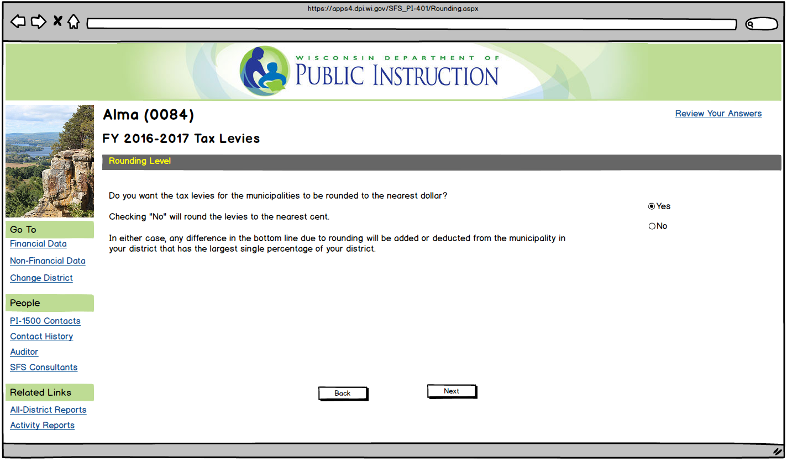

Slide 32
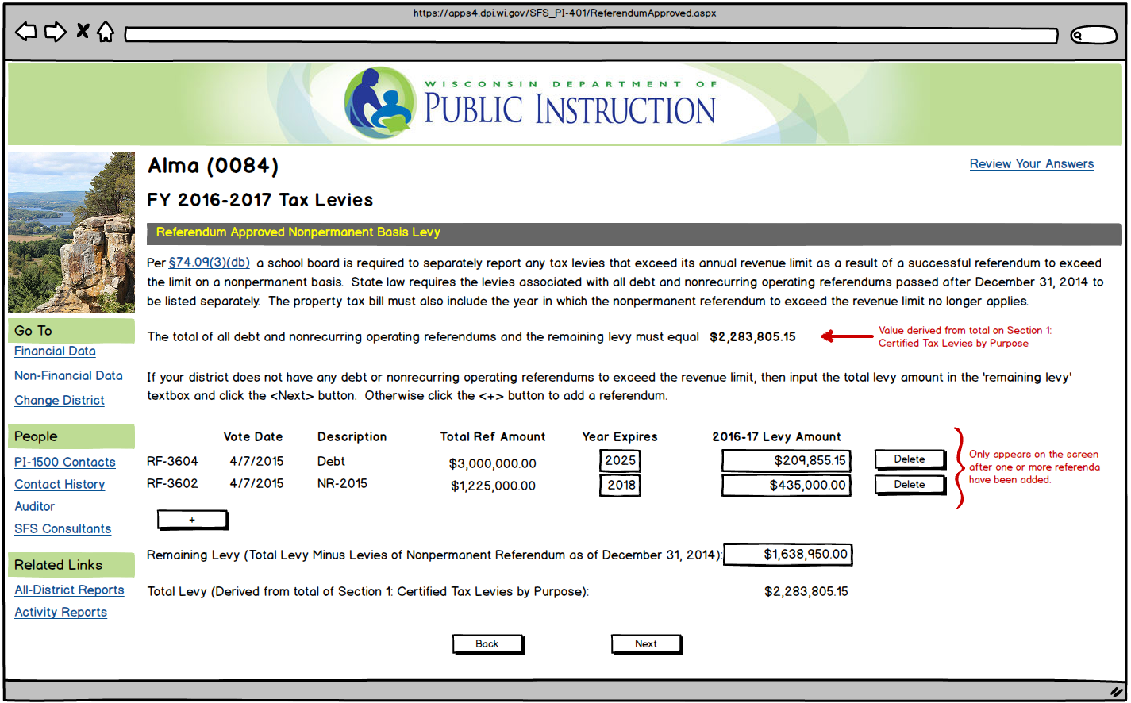

Slide 33
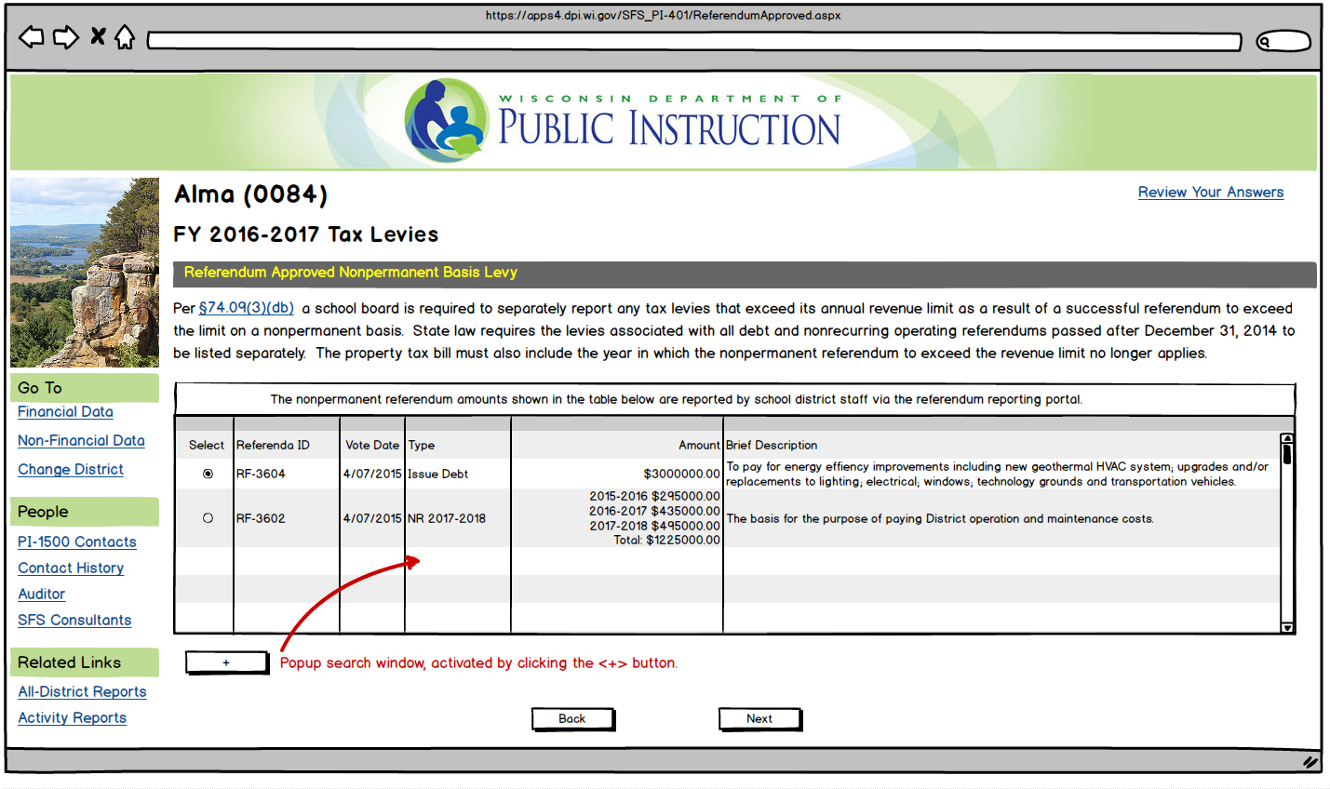

Slide 34
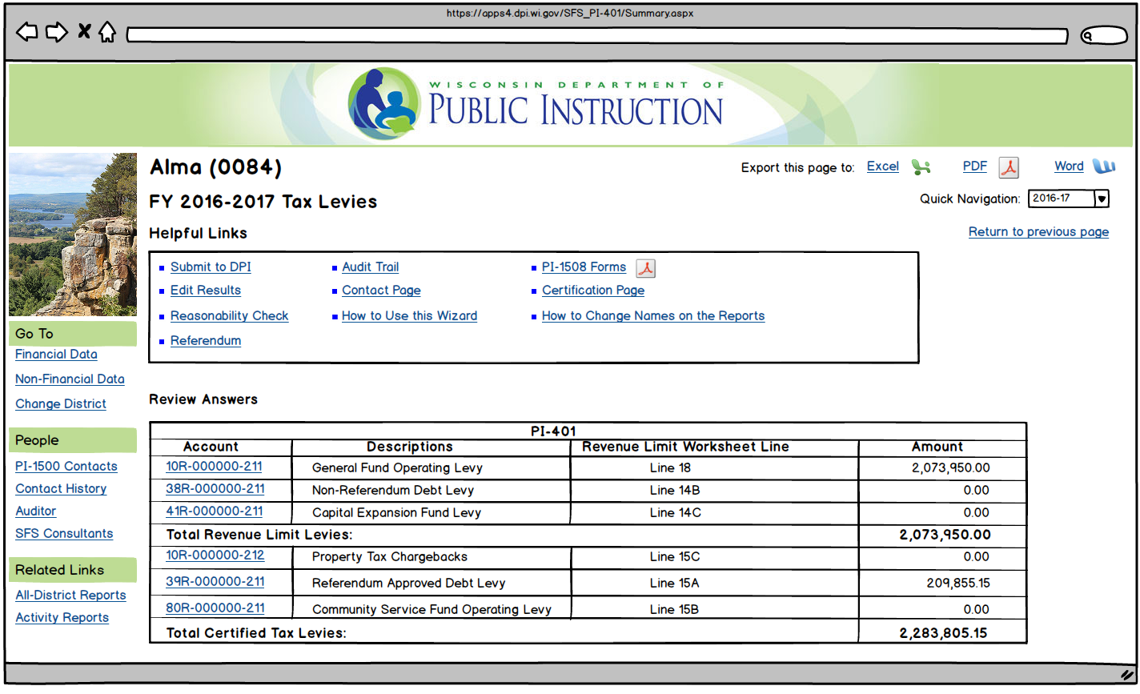

Slide 35
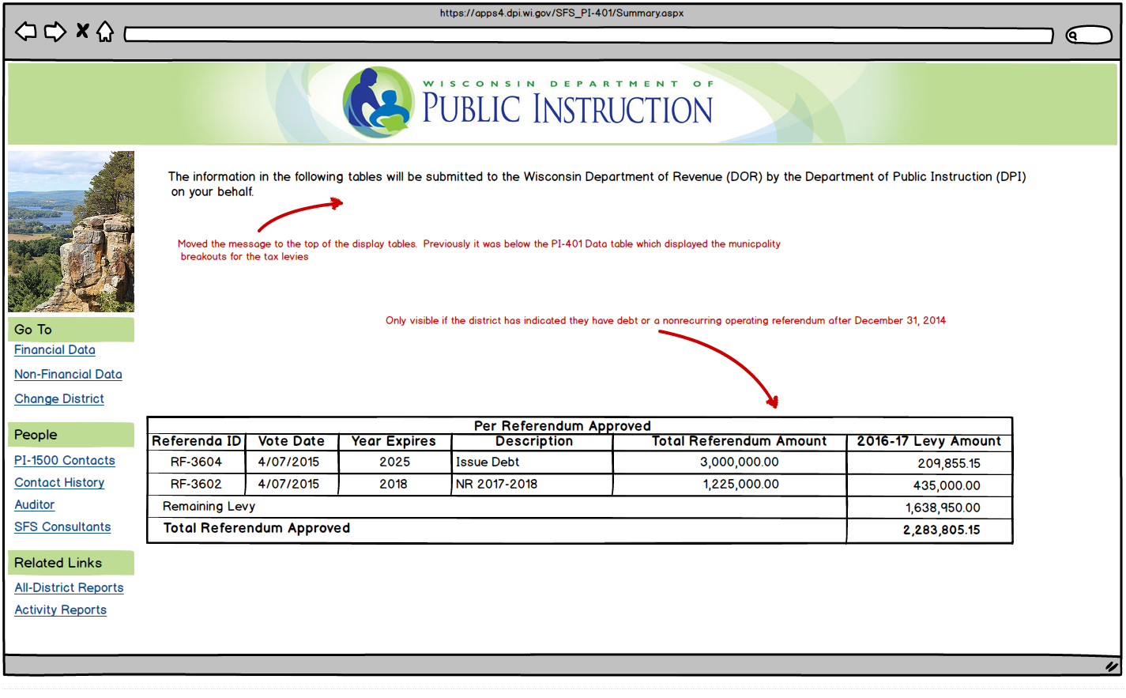
Summary of Total Tax Levy – showing itemization for portion due to non-permanent referenda PLUS remaining levy.

Slide 36
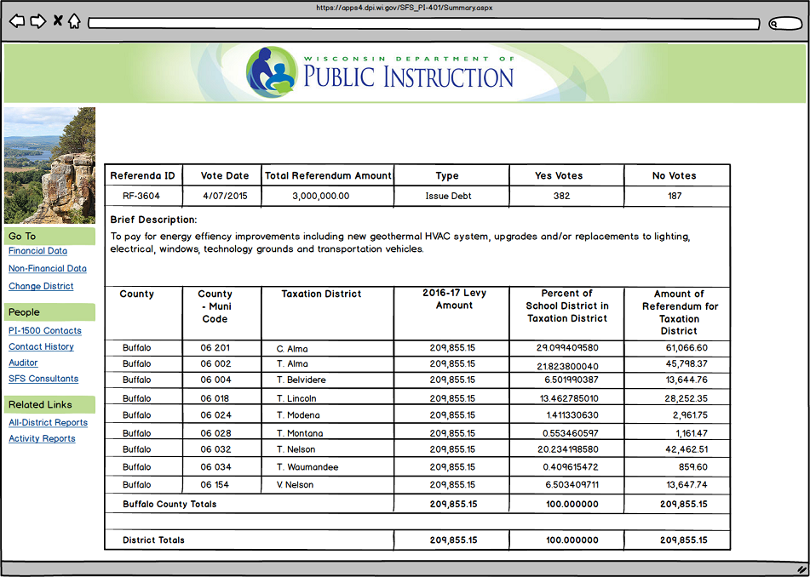
Summary of Appropriation for Ref ID #3604

Slide 37
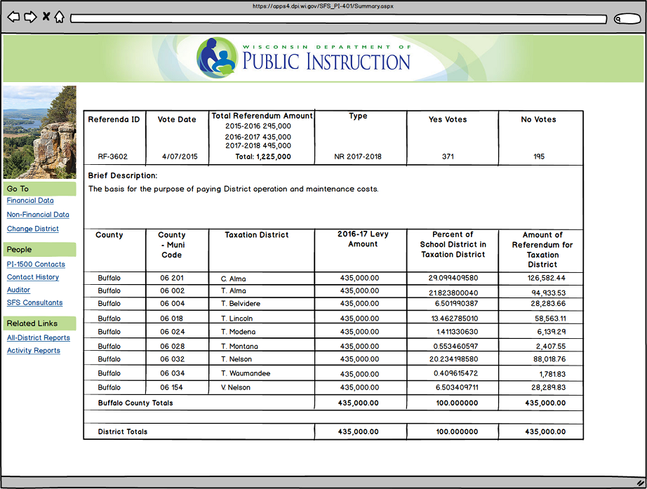
Summary of Appropriation for Ref ID #3602

Slide 38
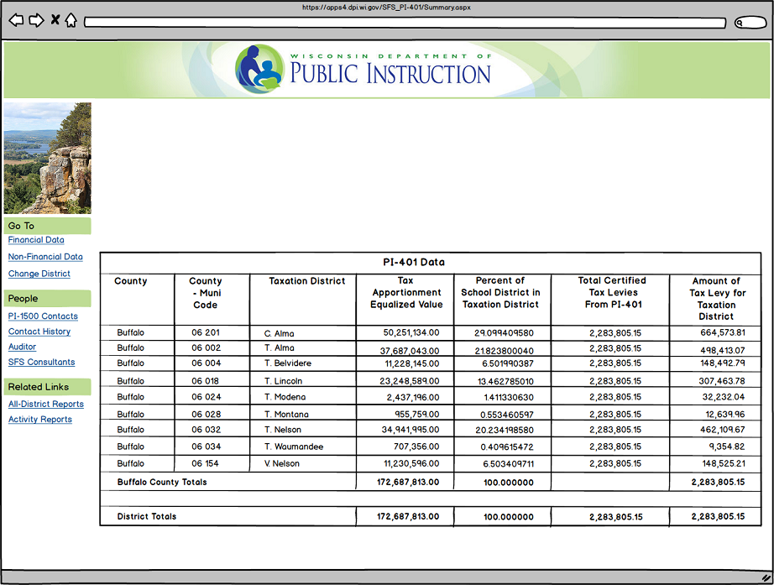
Summary of the Total Tax Appropriation Certification

Slide 39
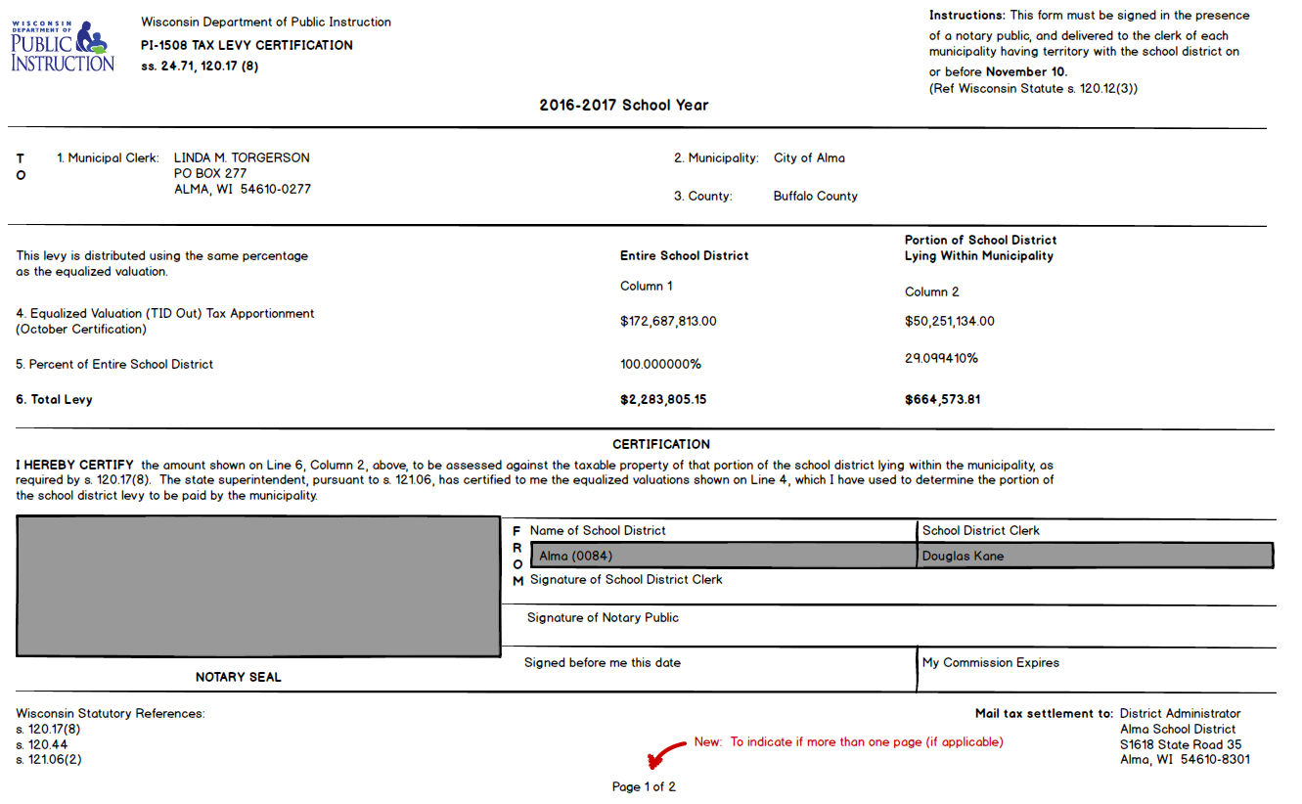

Slide 40
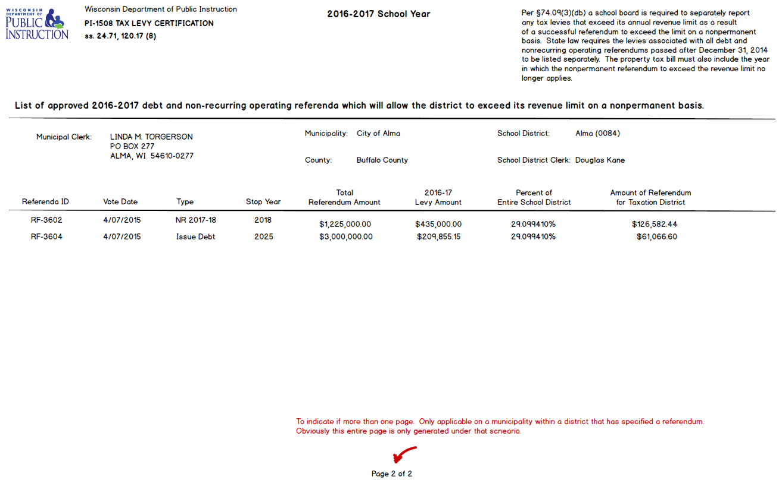

Slide 41
Thanks to WASBO for the opportunity to speak to you today! (all Area Code 608)
Contact Information
Bruce Anderson, Consultant 267-9707
Carey Bradley, Consultant 267-3752
Daniel Bush, Consultant 267-9212
Karen Kucharz Robbe, Consultant 266-3464
Victoria Chung, Accountant 267-9205
Brian Kahl, Auditor 266-3862
Gene Fornecker, Auditor 267-7882
Vacant, Auditor 267-9218
Debi Towns, Assistant Director 267-9209
Bob Soldner, Director 266-6968
School Financial Services http://dpi.wi.gov/sfs

