Slide 1
State Education Convention
20 January 2022
A Deep Dive Into Wisconsin School Finance
Tom Owens
Debby Brunett
Bob Borch
Bob Soldner
January 20, 2022

Slide 2
Agenda
Education Framework
Revenue Limits
Equalization Aid
Fund Balance
Why these topics?
Key to Wisconsin School Finance
2
Notes:
Important to note verbally: As board members, they will not be asked to replicate or recite this information. It is provided to help create a baseline understanding of these complex topics.

Slide 3
Learning Targets
Recall how school finance is structured in Wisconsin and identify why
Explain the difference between revenue limits and state equalization aid and describe the impact on school finance
Recognize the difference between cash and fund balance
3
Notes:
Needs wordsmithing
Important to note verbally: As board members, they will not be asked to replicate or recite this information. It is provided to help create a baseline understanding of these complex topics.

Slide 4
U.S. Constitution on Education –
Education is a State Function
10th Amendment
“…powers not granted to the federal government by the Constitution, nor prohibited to the States, are reserved to the States or the people…”
1791
4

Slide 5
Wisconsin Constitution on Education
Article X, Section 2
“The legislature shall provide by law for the establishment of district schools, which shall be as nearly uniform as practicable; and such schools shall be free and without charge for tuition to all children between the ages of 4 and 20.”
1848
5

Slide 6
Wisconsin Constitution on Education
Article X, Section 4
“Each town and city shall be required to raise by tax, annually, for the support of common schools therein……”
1848
6

Slide 7
Basic Framework - What We Know So Far
State Responsibility
District Schools
As Nearly Uniform as Practicable
Free
Funded by Local Property Tax
7

Slide 8
Modern-Day Wisconsin
In Wisconsin, the primary funding source for public schools is the property tax, but we know that property values across the state are not uniform.
The challenge is defining “uniform as practicable.”
8

Slide 9
Wisconsin Constitution on Education
Article X, Section 2
“The legislature shall provide by law for the establishment of district schools, which shall be as nearly uniform as practicable; and such schools shall be free and without charge for tuition to all children between the ages of 4 and 20.”
A child should not be unfairly disadvantaged
merely by where they live.
9

Slide 10
Constitutional Underpinnings
The State provides financial assistance in the form of Equalization/General Aid to school districts in order to:
  Reduce the reliance upon the local property tax as the sole source of revenue for educational programs.
  Guarantee that a basic educational opportunity is available to all pupils regardless of the local fiscal capacity of the district in which they reside.
10

Slide 11
Revenue Limits
Diving in….
…to districts’ primary revenue calculation
Notes:
Needs wordsmithing

Slide 12
Revenue Limits, State Aids, and Controlled Property Tax Levies
Revenue Limit Levy
“State Aid”
Revenue Limit
Notes:
More money in State Aid (includes General School Aids, High Poverty Aid, State Aid for Exempt Computers and State Aid for Exempt Personal Property) without a corresponding increase to the Revenue Limit won’t result in additional revenue for the district. It just results in property tax relief.
“State Aid” includes General School Aids, High Poverty Aid, State Aid for Exempt Computers and State Aid for Exempt Personal Property. 2021-22 general school aids includes: $4,924.42 million equalization aids; $38.3 million integration (Chapter 220) aids; and $28.05 million special adjustment aids (hold harmless aids).

Slide 13
State Totals - School District Revenues
CONTROLLED
Although the mix of aid and taxes may be different across districts, the Revenue Limit can control 70-90% of the General Fund budget!
13
Notes:
Updated graphic for 2017-18 Comparative Cost
In 1993-94, the State enacted revenue limits to control the revenue a school district can collect from:
General Aid (Equalization Aid, for most districts)
Computer Aid
Aid for Exempt Personal Property
High Poverty Aid
Select Local Levies
General Fund (Fund 10)
Non-Referendum Debt Service (Fund 38)
Capital Projects (Fund 41)
It is not an expenditure control or spending limit.
Examples of what the Revenue Limit does not control (not exhaustive list):
School Fees
Categorical Aids (Per Pupil Aid, Library Aid, Transportation Aid, etc.)
State and Federal Grants
Gate Receipts
Donations
Local Levies
Referendum Debt Service (Fund 39, at times called “Non-Fund 38”)
Community Service Fund (Fund 80)
Prior Year Levy Chargeback for Uncollectible Taxes (Fund 10)

Slide 14
Calculation
Sample Worksheet
Key Information
14

Slide 15
Start With Prior Year Controlled Revenue
Prior Year Revenue Limit Authority (less) non-recurring (one-time) $
15
Notes:
2017-18 Data (Prior Year)
October 15 General Aid Cert (+)
Computer Aid Received (+)
High Poverty Aid (+)
Aid for Exempt Personal Property (+) (will be new in 2019-20 base as 18-19 was first year for the aid payment)
General Fund (Fund 10) Levy (+)
Non-Referendum Debt (Fund 38) Levy (+)
Capital Projects (Fund 41) Levy (+)
Revenue Limit Penalty (-)
Levied Non-Recurring Exemptions (-)
Sum of items above builds the base (starting point) for 2018-19

Slide 16
Membership
Declining Enrollment?
16
Notes:
Membership does not equal students being educated in your buildings.
A 3-year average is used to minimize the financial impact of a sharp incline or decline in membership.
The change in three-year rolling averages (Line 2 vs Line 6) which affects the current year Revenue Limit Authority before exemptions is shown.
The three-year averages also are used in calculating the declining enrollment exemption (Line 10B).

Slide 17
Equalized Property Value
17

Slide 18
Revenue Limit with No Exemptions
18
Notes:
The Prior Year Base Revenue Hold Harmless adjustment was created by the Legislature in 2007.
It is intended to ‘Hold Harmless’ any district calculating a new base that is less than the previous year’s base.
It functions in every way like a non-recurring exemption but appears on Line 7B of the Revenue Limit Worksheet.
Worksheet automatically inserts the loss difference so that the district begins the new year with the same base as prior year.
Currently there are 202 districts which fall into the Hold Harmless provision. Drop from last year as Low Revenue Increase may negate the need for the 7B Hold Harmless.
Oconto Falls for 2018-19 example. Mount Horeb would be an example of Low Revenue ceiling negating the need for Line 7B Hold Harmless.

Slide 19
Per Member Change
The legislature has the authority to set the per member increase. Originally, they based it on the annual percentage change in the consumer price index (CPI) for all urban consumers, US city average. Recent years have been flat dollar amounts, zero, & even reductions.
The per member increase range was as low as -$532.00 in
2011-12 and as high as $274.68 in 2008-09.
For 2015-16, 2016-17, 2017-18, 2018-19, 2021-22, and
2022-23, the legislature has set the increment at $0.00.
19
Notes:
Within this slide, also need to talk about how money has been added to Per Pupil categorical aid ($654 million over the biennium) which is outside the revenue limit.

Slide 20
Low Revenue Ceiling
With specific limitations tied to successful referenda
to exceed revenue limits, 2017 Wisconsin Act 141 and
2019 Wisconsin Act 9 has increased the low revenue
ceiling per member to:
      $9,400 in 2018-19
      $9,700 in 2019-20
      $10,000 in 2020-21 and subsequent years
20
Notes:
Give the basics on the increase, but leave the details out.

Slide 21
Types of Exemptions
Recurring
Non-Recurring
21
Notes:
Recurring Referenda
Requires approval of the voters
Carryover
Eligible prior year unused authority
Other Recurring Exemptions (DPI approves and will populate amounts)
Transfer of Service
Transfer of Territory (rare to get)
Loss of Federal Impact Aid
Requires approval by Electors or Board
Non-Recurring Referendum [Line10 A.]
Energy Efficiency Projects [Line 10 C.]
Auto-determined in Revenue Limit Calculation
Declining Enrollment [Line 10 B.]
Other Non-Recurring Exemptions (DPI determined and populated amounts)
Refunded/Rescinded Taxes [Line 10 D.]
Prior Year Uncounted Open Enrollment Pupils [Line 10 E.]
Reduction for Ineligible Fund 80 Expenditures [Line 10 F.]
Environmental Remediation Exemption [Line 10 G.]
Private School Voucher Aid Deduction [Line 10 H.]
Private School Special Needs Voucher Aid Deduction [Line 10 I.]

Slide 22
Recurring Exemptions
Once a district levies for a Recurring Exemption, that amount stays permanently in the base going forward.
22

Slide 23
Non-Recurring Exemptions
The exemption is only valid for a limited period of time –
usually one Revenue Limit cycle.
23

Slide 24
Impact of Aid Used in the Revenue Limit Calculation
24
Notes:
On October 15 of each year, the DPI provides school districts with certification of their general school aid payment for the current fiscal year.
The calculated Revenue Limit less the General Aid, Computer Aid, Aid for Exempt Personal Property and High Poverty Aid will equal the local revenue limit property tax levy.

Slide 25
Setting the Tax Levy
25
Notes:
The calculated Revenue Limit less the General Aid, Computer Aid, Aid for Exempt Personal Property and High Poverty Aid will equal the local revenue limit property tax levy.
Additional levies (Community Service Fund and Referendum Approved Debt) are also set but outside the revenue limit.
BIG UNDER LEVY

Slide 26
District Specific Revenue Limit Data
Prepopulated and Executable Revenue Limit worksheets
  https://dpi.wi.gov/sfs/limits/worksheets/revenue
Longitudinal data related to Revenue Limits
  https://dpi.wi.gov/sfs/statistical/longitudinal-data/revenue-limit
26

Slide 27
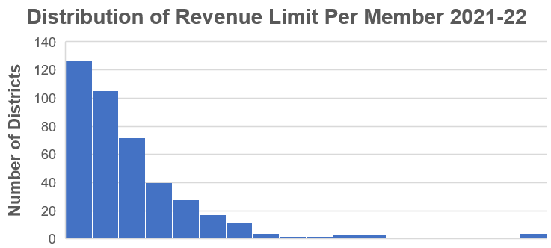
Revenue Limit Per Member with Exemptions
Lowest
$9,773
Highest
$21,628
State Average
$10,711
$10,000
$12,000
$14,000
$16,000
$18,000+
27
Source: Department of Public Instruction
Notes:
2021-22 Revenue Limit Per Member figures which include exemptions
Lowest = Walworth J1@ $9,773
Highest = Gibraltar @ $21,628
Avg $10,711

Slide 28
Basic Revenue Limit Concepts
The Revenue Limit controls income from general state aid and local property tax revenues.
Revenue Limits are calculated by multiplying the Membership * a Per Member dollar amount – and adding on any exemptions.
Most districts are not restrained by their initial calculation but are eligible for various exemptions to increase their Revenue Limit. Exemptions result in additional taxation.
It is very important to know the difference between recurring and
non-recurring exemptions. This is especially true when planning a referendum.
Calculating the property tax levy is a direct result of completing the Revenue Limit calculation.
28

Slide 29
Revenue Limit
Questions?
29

Slide 30
Equalization Aid
Diving in….
…to the general aid portion of Revenue Limits
Revenue Limit
“State Aid”
Revenue Limit Levy
Notes:
“State Aid” includes General School Aids, High Poverty Aid, State Aid for Exempt Computers and State Aid for Exempt Personal Property. 2021-22 general school aids includes: $4,924.42 million equalization aids; $38.3 million integration (Chapter 220) aids; and $28.05 million special adjustment aids (hold harmless aids).

Slide 31
Property Value and Fiscal Capacity
A student should not be unfairly disadvantaged as a result of where he or she lives.
Property Tax Base
This example is for hypothetical purposes only
31
Notes:
The fundamental purpose of the Equalization Aid formula is to “level the playing field” by providing assistance (distributing State general aid) to make up for what districts can’t get from their property tax base.
Equalizes the revenue. Thus, allows the opportunity for similar educational programming.
In general, districts with a higher property tax base receive less aid from the State.
District property value is a key factor.

Slide 32
Formula Equalizes Revenue to Mitigate Differences
Equalization Aid
Property Tax Base
This example is for hypothetical purposes only
32

Slide 33

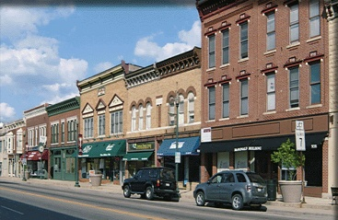



Incorporating the Number of Children to Educate
$1,000,000
$2,000,000
$3,000,000
$4,000,000
$5,000,000
10
10
10
10
10
$100,000
$200,000
$300,000
$400,000
$500,000
The tax base, as a measure of fiscal capacity (wealth), changes after incorporating the number of children to educate.
This example is for hypothetical purposes only
33

Slide 34
Incorporating the Number of Children to Educate
$1,000,000
$2,000,000
$3,000,000
$4,000,000
$5,000,000
10
5
6
10
20
$100,000
$400,000
$500,000
$400,000
$250,000
Notice how the tax base, as a measure of fiscal capacity (wealth), changes after incorporating the number of children to educate.
This example is for hypothetical purposes only
34

Slide 35

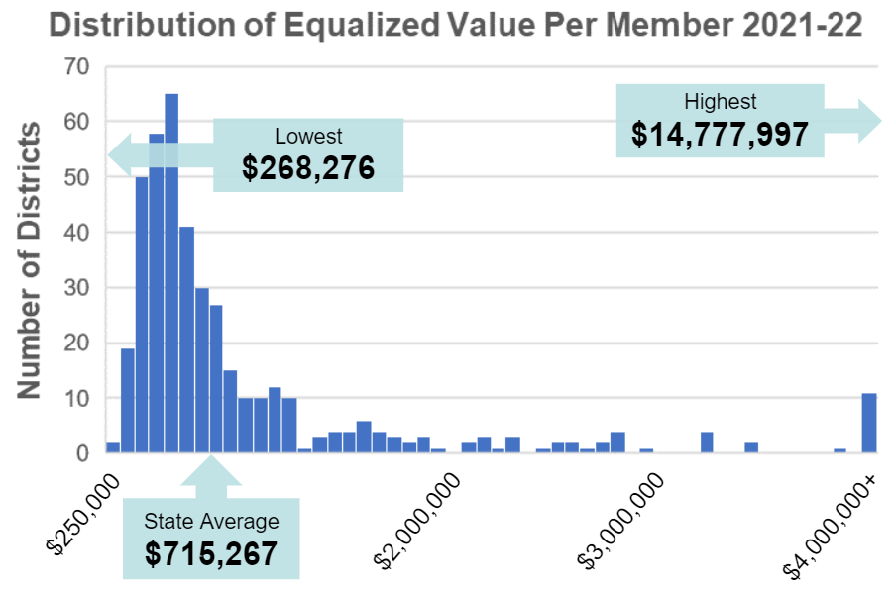
Property Value Per Member
Source: Department of Public Instruction
35
Notes:
2018-19 Property Value and Aid Membership figures for the 2019-20 General Aid Run
Lowest = Beloit $268,276
Highest = North Lakeland $14,777,997
Average $715,267

Slide 36




Key Local Factors
Membership
(Student FTE)
Spending (Shared Costs)
Equalized Property Value
Membership converts variables to per-pupil $s.
36

Slide 37

Factor: Equalized Property Value
Property tax base is used to
determine district wealth and ability to
support district expenditures.
Uses Equalized Valuation or Fair Market Value.
(NOT Assessed Value)
Property values for each district are
certified in May each year
by the WI Department of Revenue
and used in the subsequent year’s aid calculations.
37

Slide 38

Factor: Membership
Who is counted for aid membership?
Generally, residents for which you are financially responsible - i.e. you are paying for the student’s education. Is a “process” to help districts determine who qualifies. Start with who is in your seats on the count date.
Revenue Limit membership is not the same as General Aid membership. State law defines.
38
Notes:
Membership Example – Open Enrollment
1,100 kids counted in your seats on count date
-40 non-resident open enrolled-in kids
+20 resident open enrolled-out kids
1,080 residents you can count for aid (and revenue limit purposes)
Your district will receive Open Enrollment revenue
from the resident districts for the 40 kids attending your district.
Your district will have to pay an Open Enrollment expense to the non-resident districts for your 20 residents attending elsewhere.

Slide 39
Factor: Membership
This example is for hypothetical purposes only
39
September and Summer Membership Included in Revenue Limit 3-Year Average Calculations
Notes:
Aid membership also includes:
- Challenge Academy Students
- Second Chance Partnership Students
- Part-time Attendance F.T.E. of Resident and Non-Resident Private/Home-Schooled Students
- Foster Group Home Students
- Wisconsin Parental Choice Program Students
- Special Needs Scholarship Program Students
- New Independent Charter School Students
See: http://dpi.wi.gov/sfs/children/enrollment/membership-info-reporting

Slide 40
Factor: Membership
This example is for hypothetical purposes only
40
Notes:
To show the differences in membership between Aid and Revenue Limits

Slide 41

Factor: Spending (Shared Cost)
A district gets all types of revenue to fund their educational programs:
Local Property Tax
State Equalization Aid
State Categorical Aid (transportation, library, bilingual aids)
Federal Aid (Title Programs, IDEA)
State Grants
Fees (be careful with what fees you charge)
41

Slide 42
General Fund Shared Cost
This example is for hypothetical purposes only
42

Slide 43

Equalization Aid
State “shares” in district costs funded by state aid and local levy.
$1 in debt service costs is treated the same as $1 in teacher salaries.
Aid is based on a district’s ability to fund expenditures, as measured by its property wealth per member.
Basic premise:
The more property wealth per member a district has, the less equalization aid it will receive…….and vice versa.
43

Slide 44
Equalization Aid
What determines how much aid a district receives?
District Factors
(prior-year data)
equalized property value
membership
spending (shared cost)
State Factors
cost ceilings
guaranteed valuations per member
total state dollars
44
Notes:
There are three district-level factors used in the calculation and three state factors.

Slide 45
Equalization Aid
The aid computation is actually 3 individual computations…….
The results of all 3 are summed to get the district’s total Equalization Aid.

Slide 46
Equalization Aid – District #1
Property Value per Member
Primary Aid
20%
80%
Notes:
State says we will treat the first $1,000 of cost a certain way. Because secondary cost ceiling is $10,800 per member (90% of average shared cost per member), the next $9,800 another way, and anything above this an even different way.
So, state says If you have less than $2M in property value we will share in your first $1,000 in shared cost. How much? Depends on your property value per member.
Our district is $400,000 per member in property value. $400,000 divided by $2,000,000 primary guarantee equals 20%, so district pays 20% of the first $1,000 in costs or $200. State aid will cover 80% or $800.

Slide 47
Sample District #1
(per-member)
TAX BASE
20% x $1,000 | = | $200
STATE AID
80% x $1,000 | = | $800

Slide 48
Equalization Aid – District #2
Property Value per Member
Primary Aid
60%
40%
Notes:
State says we will treat the first $1,000 of cost a certain way. Because secondary cost ceiling is $10,800 per member (90% of average shared cost per member), the next $9,800 another way, and anything above this an even different way.
So, state says If you have less than $2M in property value we will share in your first $1,000 in shared cost. How much? Depends on your property value per member.
Our district is $1,200,000 per member in property value. $1,200,000 divided by $2,000,000 primary guarantee equals 60%, so district pays 60% of the first $1,000 in costs or $600. State aid will cover 40% or $400.

Slide 49
Sample District #2 (Higher Property Value)
(per-member)
TAX BASE
60% x $1,000 | = | $600
STATE AID
40% x $1,000 | = | $400

Slide 50
Equalization Aid – District #1
Tertiary
Aid
50%
50%
Property Value per Member
25%
75%
Secondary Aid
Primary Aid
20%
80%
Notes:
State says we will treat the first $1,000 of cost a certain way. Because secondary cost ceiling is $10,800 per member (90% of average shared cost per member), the next $9,800 another way, and anything above this an even different way.
Tertiary guaranteed property valuation of $800,000 50/50 split

Slide 51
Sample District #1
(per-member)
TAX BASE
20% x $1,000 | = | $200
25% x $9,800 | = | $2,450
50% x $3,700 | = | $1,850
 |  | $4,500
STATE AID
80% x $1,000 | = | $800
75% x $9,800 | = | $7,350
50% x $3,700 | = | $1,850
 |  | $10,000
Total Shared Cost = $7,250,000 (500 members x $14,500)
Tax Base = $4,500 State Aid = $10,000
X 500 membership
Tax Base = $2,250,000 State Aid = $5,000,000
State Aid / Total Shared Cost = 69% aided

Slide 52
Equalization Aid – District #2
Property Value per Member
75%
25%
Secondary Aid
Primary Aid
60%
40%
Notes:
State says we will treat the first $1,000 of cost a certain way. Because secondary cost ceiling is $10,800 per member (90% of average shared cost per member), the next $9,800 another way, and anything above this an even different way.
$1.6 M secondary guarantee
$1.2 M property value/member=75/25 secondary split

Slide 53
Sample District #2 (Higher Property Value)
(per-member)
TAX BASE
60% x $1,000 | = | $600
75% x $9,800 | = | $7,350
STATE AID
40% x $1,000 | = | $400
25% x $9,800 | = | $2,450

Slide 54
Equalization Aid – District #2
Tertiary
Aid
$1.2M / $800,000 = 150%
150%
-50%
Negative Tertiary Aid
Property Value per Member
75%
25%
Secondary Aid
Primary Aid
60%
40%
Notes:
State says we will treat the first $1,000 of cost a certain way. Because secondary cost ceiling is $10,800 per member (90% of average shared cost per member), the next $9,800 another way, and anything above this an even different way.
$800,000 tertiary guarantee→NEGATIVE AID

Slide 55
Sample District #2
(Higher Property Value)
TAX BASE
60% x $1,000 | = | $600
75% x $9,800 | = | $7,350
150% x $3,700 | = | $5,550
 |  | $13,500
STATE AID
40% x $1,000 | = | $400
25% x $9,800 | = | $2,450
-50% x $3,700 | = | -$1,850
 |  | $1,000
Total Shared Cost = $7,250,000 (500 members x $14,500)
Tax Base = $13,500 State Aid = $1,000
X 500 membership
Tax Base = $6,750,000 State Aid = $500,000
State Aid / Total Shared Cost = 6.9% aided

Slide 56
Sample Districts
Per-Member Aid Comparison
#1 STATE AID
$600
$7,350
$1,850
$10,000
1˚
2˚
3˚
Total
#2 STATE AID
$400
$2,450
$-1,850
$1,000
X 500 = $5,000,000
X 500 = $500,000
56

Slide 57
Calculation
Sample Worksheet
Student F.T.E / Shared Cost Data
57

Slide 58
Aid Worksheet
All data is from prior year:
Membership is computed from submitted PI-1563 reports.
(membership reports)

Slide 59
Aid Worksheet
Dollar amounts are from your financial ledger, as verified by your auditor.

Slide 60
Aid Worksheet
All data is from the prior year (2020-21 data is used to calculate 2021-22 aids):
Property value is certified to the DPI by the Department of Revenue.

Slide 61
Equalization Aid Resources on the School Financial Services Website
https://dpi.wi.gov/sfs/aid/general/equalization/overview
“October 15, 2021 Equalization Aid Computation – Percentage Method - Algebraic Format”
“October 15, 2021 Equalization Aid Computation – Percentage Method - Bar Graphs”
SFS Homepage > State and Federal Aid > General Aid> Equalization Aid
http://dpi.wi.gov/sfs/aid/general/equalization/worksheets-general-aid
“2021-2022 October 15 Certification General Aid Worksheet”
SFS Homepage > State and Federal Aid > General Aid> Equalization Aid > General Aid Worksheets
61

Slide 62
Equalization Aid – Where is Your District?
Tertiary
Aid
218
112
Negative Tertiary Aid
Secondary Aid
41
Negative Secondary Aid
Primary Aid
No Equalization Aid
27
23
62
Notes:
2021-22 General School Aids
No equalization aid 23*
Primary only 27
Positive primary and secondary 41
Positive primary, secondary and tertiary 218
Negative tertiary 112
* 5 of these 23 school districts receive $0 General School Aids: Geneva J4, Green Lake, Mercer, North Lakeland, and Washington Island.

Slide 63
Equalization Aid Resources on the School Financial Services Website
https://dpi.wi.gov/sfs/aid/general/equalization/overview
“October 15, 2021 District Formula Position Worksheets”
SFS Homepage > State and Federal Aid > General Aid> Equalization Aid
63

Slide 64
Equalization Aid – What is Happening Over Time?
Tertiary
Aid
State Average Value Per Member
Negative Tertiary Aid
Negative Secondary Aid
Based on $$ in Pot
Secondary Aid
In Statute
Primary Aid
No Equalization Aid
64

Slide 65
Revenue Limits, State Aids, and Controlled Property Tax Levies
Revenue Limit Levy
“State Aid”
Revenue Limit
Notes:
Equalization Aid impacts the tax levy. Changes in one changes the other.
Aid is driven by both local and state factors.
For planning purposes know how changing one of your local factors (spending in most circumstances) could impact your end aid figure.
“State Aid” includes General School Aids, High Poverty Aid, State Aid for Exempt Computers and State Aid for Exempt Personal Property. 2021-22 general school aids includes: $4,924.42 million equalization aids; $38.3 million integration (Chapter 220) aids; and $28.05 million special adjustment aids (hold harmless aids).

Slide 66
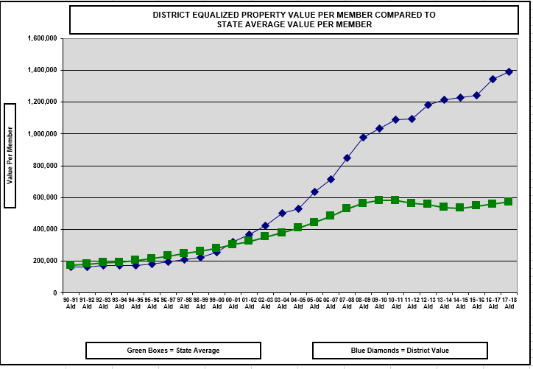
Watch Value Per Member Over Time
1.) Severely Declining Enrollment
2.) Property Value Significantly Increases
66
Notes:
This is what can happen to a district with severe declining enrollment. No one can predict the future, but watching the trendline for your district can be very informative.

Slide 67
Equalization Aid Resources on the School Financial Services Website
http://dpi.wi.gov/sfs/statistical/longitudinal-data/property-valuation
“Longitudinal Equalization Aid Value-Per-Member History”
SFS Homepage > Statistical > Longitudinal Data > Property Valuation
67

Slide 68
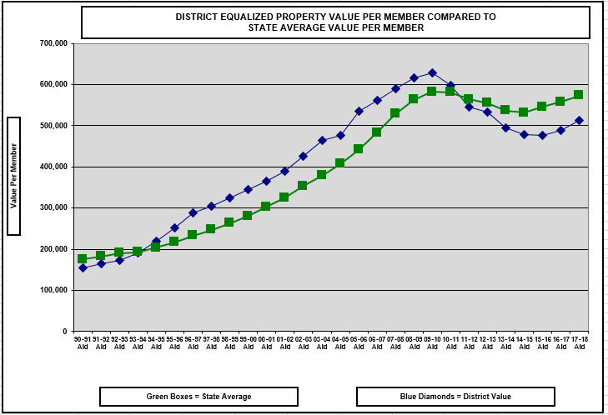
1.) Exploding Enrollment
68

Slide 69
Equalization Aid Resources on the School Financial Services Website
How can I explain changes in my district’s aid?
Multi-Year History on the Website
Longitudinal Excel Spreadsheet
https://dpi.wi.gov/sfs/statistical/longitudinal-data/equalization-aid
A listing of the pertinent Equalization Aid factors that explain what is happening in your district.
69

Slide 70
Basic Equalization Aid Concepts
Aid is inversely related to district property value per member.
One pot of money is split over 421 school districts based on district values, membership, and shared costs. Changes in individual district data affect every other district’s aid.
Depending on district value-per-member, some districts’ aid is increased by increasing expenses, while others’ aid is decreased by increasing expenses.
Know where your district is in the formula and be aware of what is happening to your district over time so you can figure out why your aid has changed AND explain why.
70

Slide 71
Equalization Aids
Questions?
71

Slide 72
Fund Accounting / Fund Balance
Diving in….
…to Wisconsin school district accounting
Notes:
Needs wordsmithing

Slide 73
Fund Accounting
Governments, such as school districts, usually organize their accounting systems on a "fund" basis
A fund is
a separate set of accounting records, segregated for purpose of carrying on an activity
established for accountability purposes to demonstrate that financial resources are being used only for permitted purposes
73

Slide 74
Fund Accounting
Think of a fund as a self-contained box
into which is put everything pertaining to that fund.
74

Slide 75
Fund Accounting
A fund will have "balance sheet" accounts consisting of
  Assets,
  Liabilities, and
  Fund balance,
and a series of
  Revenue and
  Expenditure accounts
General Fund
75

Slide 76
Fund Accounting
WUFAR
Wisconsin’s account coding structure is the
Wisconsin Uniform Financial Accounting Requirements
76

Slide 77
WUFAR Expenditure Account Example
Fund - Location - Object or Source - Function - Program/Project
XX –E or R - XXX - XXX - XXX XXX - XXX
10-E-401-411-122000-000
General Fund-SPASH-General Supply-English-No Project
77

Slide 78
Fund Accounting
WUFAR Funds are
  10 General Fund
  20 Special Project Fund
  21 Special Revenue Trust
  27 Special Education
  30 Debt Service Fund
  38 Non-Referendum 39 Referendum
  40 Capital Projects Fund
  50 Food Service Fund
  60 Agency Fund (Student Activity Funds)
  70 Trust Funds
  80 Community Service Fund
  90 Package & Cooperative Program Fund
78

Slide 79
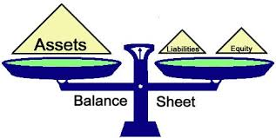
What is Fund Balance?
The difference between assets and liabilities (equity).
79

Slide 80
Examples of Assets and Liabilities
Assets
Cash
Investments
Prepaids
Receivables
  Tax Levy
  Equalization Aid
  $ from other School Districts
Liabilities
Payroll Payables
Payroll liabilities (FICA, WRS, etc.)
Cash flow borrowing
Note: physical assets and liabilities, such as buildings, land and furniture, etc. are not included in fund balance calculation
80

Slide 81
Fund Balance Classifications
DPI Code
Nonspendable Fund Balance 935 000
  Prepaid Expenses & Inventory
Restricted Fund Balance 936 000
  Self-insurance, contracts, debt, legal restrictions
Committed Fund Balance 937 900
  Formal Board action, part of budget, restricted donations.
Assigned Fund Balance 938 900
  Board assigned, capital projects, budgeted
Unassigned Fund Balance 939 900
Reserved: 1-4
Classify in one of five ways:
Unreserved: 5
81
Notes:
Boards should know the district’s fund balance policy and if the Board is meeting its policy. Know your fund balance.
Reserved – can’t be appropriated or spent (such as inventory) or is legally limited to a specific purpose (grants)
Unreserved – can be used for any purpose within the respective fund

Slide 82
DPI coded the Unassigned (Unreserved) Fund Balance into these sub-classifications:
939 100 Revenue Stabilization
  “Rainy Day Funds”
939 200 Working Capital (Cash Flow)
  Used to reduce or eliminate temporary borrowing
939 300 Contingencies
  Circumstances or situations that could result in loss
939 400 Emergencies
  Unplanned, unexpected loss or ‘Acts of God’
939 900 Other
Basically, not identified for any use
None meet Committed or Assigned standards.
82
Notes:
Use these codes locally on a voluntary basis for now.
Someday they may become required and
collected at the state level as part of the Annual and Fall Report; and,
become part of the Annual Audit reporting process.

Slide 83
Fund Balance – Reported as of June 30th
Assets
Liabilities
Fund Balance (Equity)
Fund Balance often changes daily.
  When revenue comes in, a fund balance increases.
  When expenditures are made, a fund balance decreases.
In WI, a public school district’s fiscal year runs from July 1 to June 30. Fund Balance is reported and compared to other years as of June 30th.
83

Slide 84
How does a June 30 fund balance grow or shrink?
Prior Year Ending Fund Balance (Equity)
Current Year Difference Between Revenue and Expense
Ending Fund Balance (Equity)
84

Slide 85

How Large A Fund Balance?
Determination of an appropriate fund balance is strictly a local matter.
The Department of Public Instruction (DPI) makes no recommendation, except that it encourages districts to seek legal counsel should they contemplate budgeting for and/or operating with a negative general fund balance.
This means on an ongoing basis
85

Slide 86
According to DPI, a district with an appropriate fund balance can:
Avoid interest cost and time lost associated with borrowing
Make special purchases or cover unforeseen expenditure needs
Lower debt issuance cost and preserve or enhance its bond rating by demonstrating financial stability
86

Slide 87
What is a Sufficient Fund Balance?
Perhaps the best answer is:
“An amount sufficient to avoid short term borrowing and to realize long-range goals."
Once a cash reserve is spent, it is very difficult to rebuild. We have a responsibility to sustain the academic programs. When it’s gone, it’s gone!! ☹
87

Slide 88
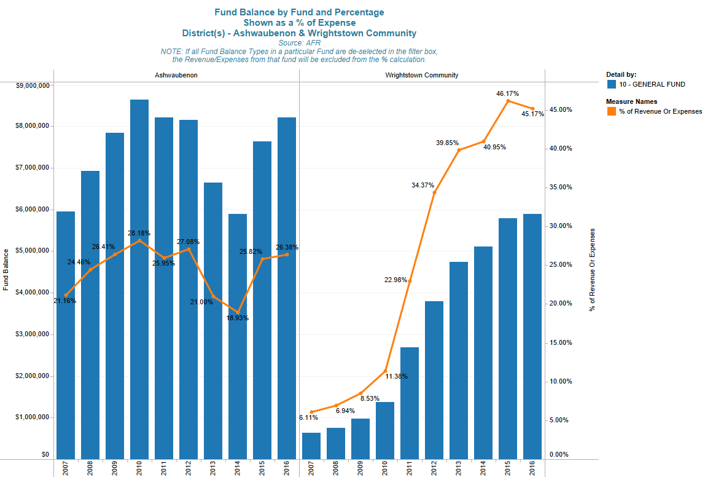
Each district has a unique answer for, “what is an appropriate fund balance.”
88

Slide 89
Have A Fund Balance Policy!
School districts should have a fund balance policy.
  What is your policy?
  Are you following it?
89

Slide 90
A Fund Balance Policy Should
Identify and define fund balance classifications
Identify and define accounting definitions for fund balances
State the General Fund balance level and rationale
  Addresses those issues identified earlier in Determining Sufficient Fund Balance
Address restoration of General Fund Balance
Establish the order of spending when various fund balance funding sources exist (Restricted, Committed, Assigned, and Unassigned)
90

Slide 91

Very Important!
Cash is an asset and therefore is part of the Fund Balance Equation.
However, fund balance does not equal cash.
Let’s talk a little about the cash portion of fund balance…
91

Slide 92
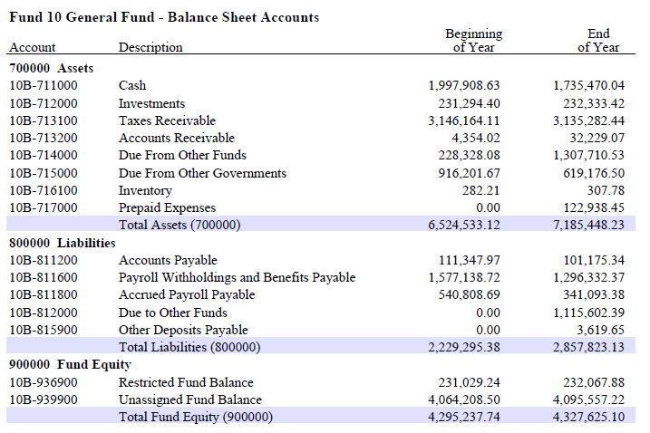
Very Important!
92

Slide 93
How do Districts use the cash portion
of fund balance?
To pay the bills!
93

Slide 94
Typical Change in Monthly Cash Balance
Year1
Year2
Year3
This is a hypothetical example and for illustrative purposes only.
94

Slide 95
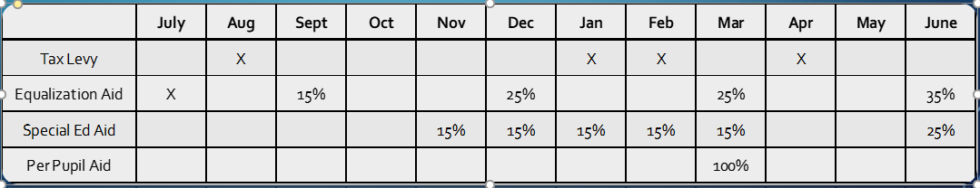
Cash Flow Fluctuations
Expenditures are fairly constant throughout year
Salaries / Fringe are typically 60%-65% of budget
Payroll is typically spread over 21, 24 or 26 pay periods
End-of-year pay adjustments are sometimes needed
Revenues received sporadically throughout the year
Tax Levy is received in the last 6 months of the school year, with the final payment made in August of the next school year.
60% of Equalization Aid is paid over the last 6 months

Slide 96
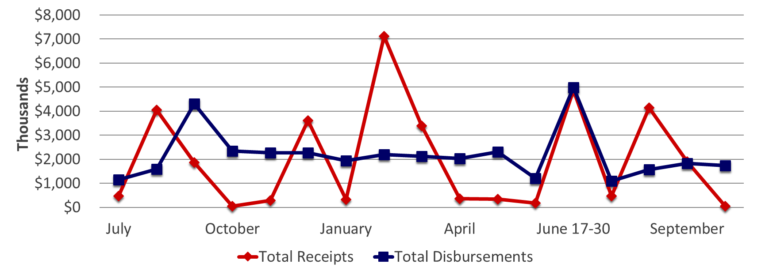
Receipts vs. Disbursements
The hypothetical example is for illustrative purposes only.
96

Slide 97
In Summary
Fund balance is reported as a June 30 snapshot
Cash is an asset but fund balance ≠ cash
The cash portion of fund balance fluctuates greatly throughout the year
Each district has a fund balance level appropriate to them
(there is no one-size-fits-all answer)
The district should have and should be following their fund balance policy
Fund balance = assets – liabilities
Districts’ fund balance levels change daily
97

Slide 98
The School Budget
Understanding important concepts in school budgeting!
98

Slide 99
What is a school budget?
A school budget is the financial outline for addressing how a school district will deliver its educational plan to students in a fiscal year.
The school budget is an estimate and every part that makes up the whole of the budget is subject to known and unknown outside and inside forces.
99

Slide 100
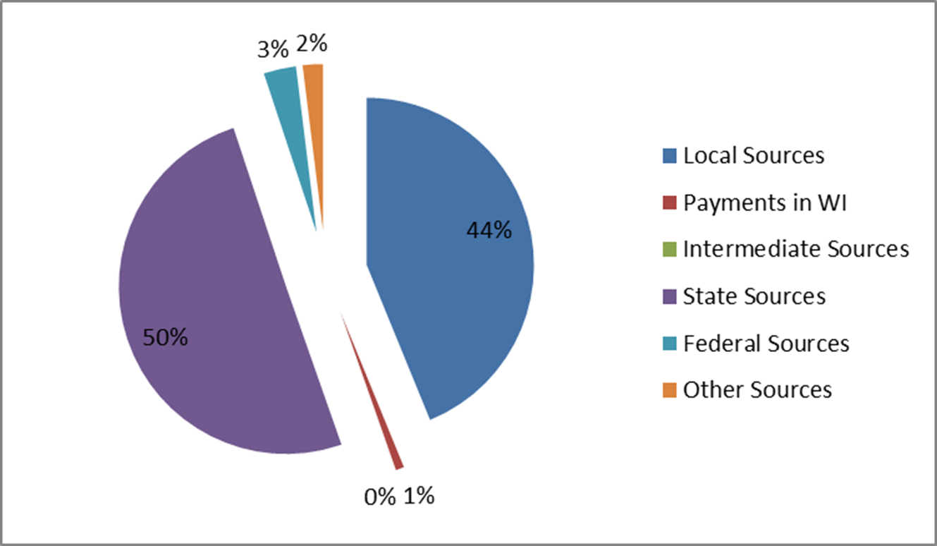
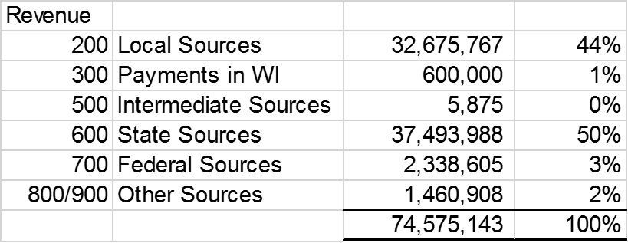
The General Fund –
From where does the money come?
This is a graphic example of Revenue:
100

Slide 101
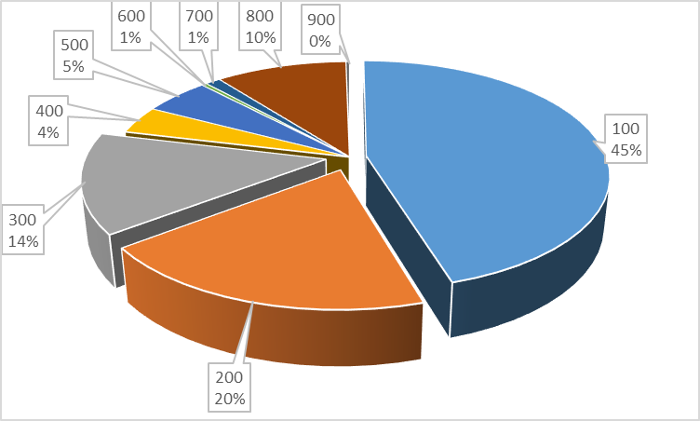
The General Fund –
On What Do We Spend Our Money?
This is a graphic example of Expenditures:
101

Slide 102
Can Wisconsin School Boards Tax Whatever They Want?
No!
The State of Wisconsin imposes strict control over what school boards can levy through revenue limits.
There is an absolute dollar amount determined via a formula that annually generates a limit on a school district's property tax. Failure to levy at that amount will cause some school districts to lose levy authority. Such a loss creates greater budget challenges in delivering the educational plan.
102

Slide 103
School District Finance
Questions?
103

Slide 104




Thank You!
Bob Soldner
Assistant Director
School Financial Services Team
Wisconsin Department of Public Instruction
robert.soldner@dpi.wi.gov
Bob Borch
2r Charter Business Manager
CESA #1
borchb@wi.rr.com
Thomas R. Owens, Ph.D., SFO
Director of Business Services
Stevens Point Area Public School District
towens@pointschools.net
Debby Brunett
School Business Specialist
Baird
Dbrunett@rwbaird.com
104

Slide 105
Important Disclosures
Robert W. Baird & Co. Incorporated is providing this information to you for discussion purposes only. The information does not contemplate or relate to a future issuance of municipal securities. Baird is not recommending that you take any action, and this information is not intended to be regarded as “advice” within the meaning of Section 15B of the Securities Exchange Act of 1934 or the rules thereunder. In providing this information, Baird is not acting as an advisor to you and does not owe you a fiduciary duty pursuant to Section 15B of the Securities Exchange Act of 1934. You should discuss the information contained herein with any and all internal or external advisors and experts you deem appropriate before acting on the information.

