Slide 1
WASBO Fall Conference 7 October 2021
Aids & Revenue Limits: Understanding Your Worksheets
Bob Soldner, Assistant Director
School Financial Services Team
Ben Kopitzke, Finance Consultant School Financial Services Team

Slide 2
Agenda
Introduction
Revenue Limits
Property Tax Levy
State Aids
Questions
Notes:
Build base of knowledge on the calculations/formulas that determine most of your funding.
Understand the relationships between the Revenue Limit and General State Aids.
Identify trends and issues to monitor reviewing these calculations for your district.
Put questions into chat; most first level Qs should be answered; will respond individually afterward if needed
This is the second in a series of presentations the SFS team is participating in

Slide 3
Revenue Limits, School Aids, and Property Tax Levies
Property Tax Levy
State Aid
(General Aid + High Poverty Aid + Computer Aid + Aid for Exempt Personal Property)
Revenue Limit
Notes:
RL: only YOUR district; what neighbor does does not impact your RL
RL are INDIVIDUAL to district—what is happening in YOUR school community
State Aid: $5 billion entirely dependent on everyone else; as others spend more/less, property values change → impacts your district’s share of the allocation; compared to state averages and guarantees set in law. RELATIVE position is important (you have 10% property value increase but everyone else had 15%)
The controllable property tax levy—NOT referenda-approved debt

Slide 4
Revenue Limits
and
Property Tax Levies
Notes:
I suggest we have people bring up their own revenue limit worksheet as you discuss. Also, have them pull up the July 1 general aids sheet.

Slide 5
Revenue Limit History and Overview
Revenue limits:
Implemented in 1993-94.
Designed to restrict the amount of revenue a school district can raise through local property taxes and state general school aids annually on a per pupil basis.
Do not include state categorical aids, federal aids, local receipts, and most debt service tax levies.
Used to increase annually on a per pupil basis; 6 of 8 most recent years is $0.
Calculated based upon a school district’s three-year rolling membership average. Not dependent on changes in other districts.
Allow for multiple adjustments for certain purposes.
Can be exceeded if approved through local referendum.

Slide 6
State Totals - School District Revenues
CONTROLLED
Although the mix of aid and taxes is different across districts, the Revenue Limit can control 70-90% of the General Fund budget!
^ State General Aids includes: equalization aid, special adjustment aid, inter-district & intra-district aids, and high poverty aid (i.e., state aids received under the districts’ revenue limit caps).
* Other Sources includes: state categorical aids, federal aid, and non-property tax local revenue (i.e., revenue received outside of the districts’ revenue limit caps).
Notes:
79% of budget controlled by RL—contingent upon referenda-approved debt
No RAD, RL controls a much larger portion; SWINGS 70 GA/30, others no GA, all on property taxes
In 1993-94, the State enacted revenue limits to control the revenue a school district can collect from:
General Aid (Equalization Aid, for most districts)
Computer Aid
Aid for Exempt Personal Property
High Poverty Aid
Select Local Levies
General Fund (Fund 10)
Non-Referendum Debt Service (Fund 38)
Capital Projects (Fund 41)
It is not an expenditure control or spending limit.
Examples of what the Revenue Limit does not control (not exhaustive list):
School Fees
Categorical Aids (Per Pupil Aid, Special Education, Library Aid, Transportation Aid, etc.)
State and Federal Grants
Gate Receipts
Donations
Local Levies
Referendum Debt Service (Fund 39, at times called “Non-Fund 38”)
Community Service Fund (Fund 80)
Prior Year Levy Chargeback for Uncollectible Taxes (Fund 10)

Slide 7
What is within Revenue Limits?
General Fund (10)
General State Aid
Property Tax Levy
Non-Referendum Debt Service Fund (38)
Property Tax Levy
Capital Projects Fund (41)
Property Tax Levy
Computer Aid
Notes:
In 1993-94, the State enacted revenue limits to control the revenue a school district can collect from:
General Aid (Equalization Aid, for most districts)
Computer Aid
Aid for Exempt Personal Property
High Poverty Aid
Regulates Revenues for Funds 10, 38 and 41
General Fund (Fund 10)
Non-Referendum Debt Service (Fund 38)
Capital Projects (Fund 41)
It is not an expenditure control or spending limit.
Examples of what the Revenue Limit does not control (not exhaustive list):
School Fees
Categorical Aids (Per Pupil Aid, Special Education, Library Aid, Transportation Aid, etc.)
State and Federal Grants
Gate Receipts
Donations
Local Levies
Referendum Debt Service (Fund 39, at times called “Non-Fund 38”)
Community Service Fund (Fund 80)
Prior Year Levy Chargeback for Uncollectible Taxes (Fund 10)

Slide 8
What is outside the Revenue Limit?
Categorical Aids (Special Education, Per Pupil Aid, Library, Transportation, Sparsity, etc.)
State and Federal Grants
Student Fees, Gate Receipts, and Donations
Tax Levy for Referendum Approved Debt Service Fund (39)
Tax Levy for Community Service Fund (80)
Notes:
21% in slide 6

Slide 9
Revenue Limits
Controlled Revenues
State General Aid
Local property taxes (controlled levy)
Department of Revenue Computer Aid
Aid for Exempt Personal Property
Four-Step Process:
Step 1: Build the Base Revenue Per Member
(Worksheet lines 1-3)
Step 2: Calculate New Revenue Per Member
(Worksheet lines 4-7)
Step 3: Determine Allowable Exemptions
(Worksheet lines 8-11)
Step 4: Determine Levy
(Worksheet lines 13-16)
Membership
September Pupil Count FTE
Summer School FTE (40%)
The revenue limit does not include all revenues and it is not a spending limit.
Notes:
Need to know membership (PI-1563), voucher deductions if they have private schools-->confirm if any new residents attending a private school before setting levy
1563 can be adjusted UP OR DOWN-->need to understand impact on RL
RL WILL change with any adjustment-->RL are fluid, allow district to put in different number from their 1563-->penalty if overlevy
3rd Friday and SS counts are now in RL-->focus on data we provide vs what they need to provide
Calculation of RL is a district responsibility→ DPI populates spreadsheets based on info provided by district
Our only responsibility by law is to provide a penalty if they levy too much

Slide 10
Notes:
Don’t get scared. No levy by fund, Energy Efficiency—there is more in the Excel spreadsheet online
This is dropdown, can look at every district; data tab can look at statewide data
Now is the time to review and confirm the current year and look at trends in your district

Slide 11
Revenue Limits-Per Pupil Adjustment History
* Under the 2011-13 budget act, the per pupil adjustment in 2011-12 was set at a 5.5% reduction, The statewide average reduction was $554 per pupil.

Slide 12
Revenue Limits & Budget-Building
Watch Change Across Time – Line 11
Year 1
Year 2
Year 3
Total Revenue Limit with Exemptions
Total Revenue Limit with Exemptions
Total Revenue Limit with Exemptions
Line 11 represents the total amount of resource your district will get from property tax, state general aids, and exempt computer aid.
This will equal about 85-95% of general fund revenues.
For budgeting purposes, it’s very important to compare Line 11 with the previous year’s Line 11. Major decreases in Line 11 from year to year can have serious implications for your budget.
Watch for exemptions!
Notes:
We’ve talked about what happens within the computation in a single year, but you need to also watch what happens from year to year.
Line 11
Keep an eye on membership; membership drives RL (three-year rolling membership_
Base hold harmless and declining enrollment exemptions → temporary help written into RL calculation to give board chance to change: CUT COSTS or go to voters TO EXCEED LIMIT

Slide 13
Know your Exemptions!
Line 8
Line 10
Recurring Exemptions Grow Your Base
Non-Recurring Exemptions One-Time Impacts
This Year
Next Year
This Year
Next Year
Recurring
Base
Non-Recurring
Base
Base
Base
Notes:
Each works differently. Important to know what it does to your base. How they work can determine how the district uses them.
Consider referenda questions and knowing exactly what they will do to the district. Must use your levy authority to build the base
R vs NR; R builds base, NR taken away at end of year when building next year
Recurring has been passing at a higher rate recently; historically had done non-recurring; UNIQUE TO EACH SCHOOL BOARD/COMMUNITY

Slide 14
Revenue Limit Takeaways
The Revenue Limit controls revenue from general state aid (including high poverty aid) and most of your local property tax revenues.
Revenue Limits are calculated by multiplying the three-year rolling membership average times a per member dollar amount – and adding on any exemptions.
Most districts are not restrained by their initial calculation but are eligible for various exemptions to increase their Revenue Limit. Exemptions result in additional taxation authority.
It is very important to know the difference between non-recurring and recurring exemptions. This is especially true when planning a referendum.
Calculating the property tax levy is a direct result of completing the Revenue Limit calculation.

Slide 15
Setting the Levy
Page 2 of the Revenue Limit Worksheet
Notes:
We pull this information based on the information districts report to us
We own the numbers in certain sections.
Four steps all on one page; base revenue down to final tax levy

Slide 16
The Basic Formula
Line 11: Total Revenue Limit
Line 12: State General Aid (4 Categories)
Line 13: Allowable Limited Tax Levy (Funds 10, 38, 41 Levies)
Notes:
Longitudinal data plug, will cover later

Slide 17
Wait! But That’s Not All!
The Line 13 Maximum Levy Amount only applies to three funds.
Fund 10 – General Fund
Fund 38 – Non-Referendum Debt Service
Fund 41 – Capitol Projects Sinking Fund
On Line 14, you allocate your Line 13 amount among these three funds.
Notes:
Levy by Fund

Slide 18
Avoid the Over-Levy
Line 14 CANNOT exceed Line 13.
If it does, the worksheet will let you know.
Notes:
We start updating RL worksheets on a daily or weekly basis as we approach and pass October 15th
Go back and double check the RL worksheets → membership changes, refined voucher deduction, etc.

Slide 19
But There’s More…Potentially
Tax Levies Outside of Revenue Limit
Fund 39 (and other non-Fund 38 funds) – Referendum Approved Debt Service
Amounts added to Line 14 to determine gross total levy
Designed to recover costs related to approved revenues from prior years
Fund 80: Community Service Fund
Property Tax Chargebacks (in Fund 10)
Line 15 allows you to ADD tax levies for these other funds

Slide 20
Gross Total Levy
Line 14: Total Limited Revenue
Line 15: Total Revenue from Other Sources
Line 16: Total Levy from All Sources
Notes:
Do not go to your board with a number that exceeds your limit

Slide 21
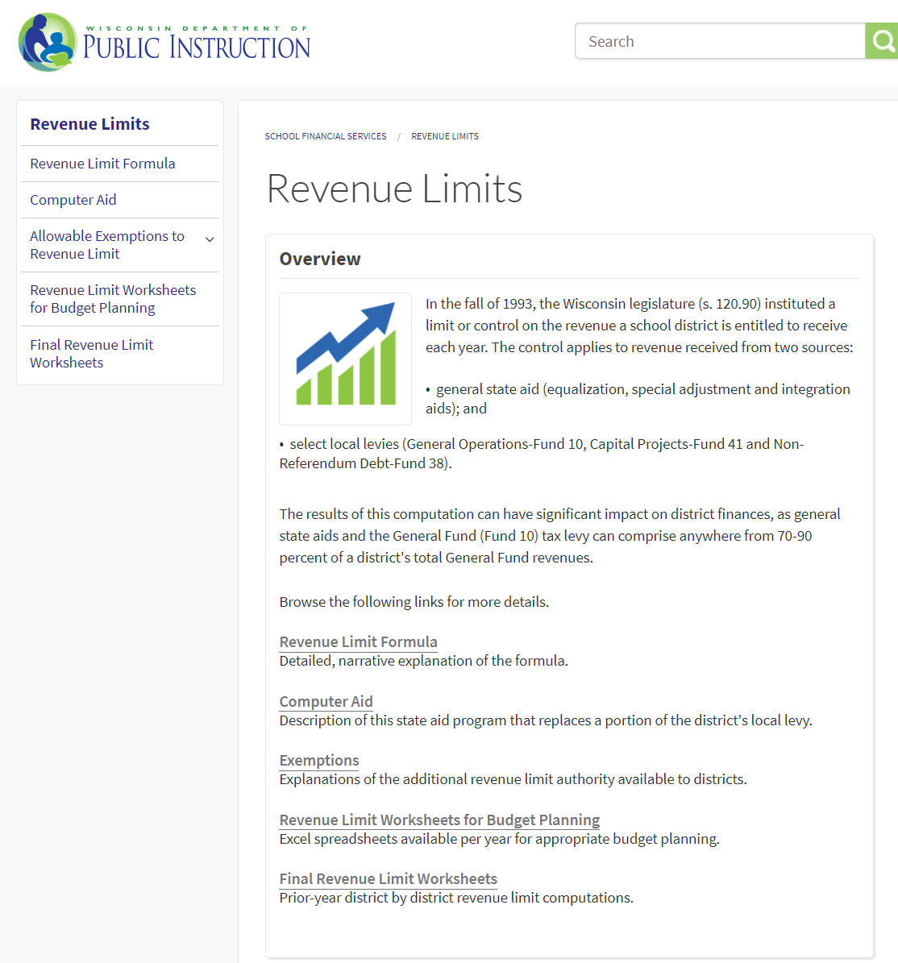
Revenue Limits
How can I predict future limits?
SFS Home (https://dpi.wi.gov/sfs)
Revenue Limits Overview
Revenue Limit Worksheets for Budget Planning
2021-22 Pre-Populated Revenue Limit Worksheet
Notes:
Longitudinal information we will talk about at fall conference; SFS Home, statistical, longitudinal
Don’t recreate the wheel; we have information available

Slide 22
Per Pupil Aid
Categorical Aid – Outside the revenue limit calculation but based on the three-year rolling membership.
Not restricted to a specific purpose. How is your district using the additional resources?
2021-22 and after = $742 per pupil
Notes:
Would take act of legislature to change aid amount: SUM SUFFICIENT, can bank on it

Slide 23
State Aids
Notes:
Which includes equalization aids

Slide 24
State General Aids
The fundamental purpose of the Equalization Aid formula is to “level the playing field” by providing assistance (distributing aid) to poorer districts (those with lower property value) to make up for what they can’t get from their property tax base.
Notes:
One of the strongest K-12 education systems; state provides $5 billion so school boards can provide programs that are nearly equal to more property rich districts while keeping a reasonable tax burden

Slide 25
Basic Equalization Aid Concepts
Aid is inversely related to district property value per member.
One pot of money is split over 421 school districts based on district values, membership, and shared costs. Changes in individual district data can affect every other district’s aid.
Depending on district value-per-member, some districts’ aid is increased by increasing expenses, while others’ aid is decreased by increasing expenses.
Know where your district is in the formula and be aware of what is happening to your district over time so you can figure out why your aid has changed AND explain why.
Notes:
Not just what is happening in YOUR district; changes in you vs changes everywhere else
Know your trends for RL and aids → helps plan referenda

Slide 26
Equalization Aid Factors
District Factors (Prior Year Audited)
Shared cost
Membership (Average of 3rd Friday in Sept FTE + 2nd Friday in January FTE, +100% of Summer FTE, + other adjustments)
Equalized property value
State Factors
Cost ceilings
Guaranteed valuations per member
Amount of funding the State puts into the formula
Notes:
What affects the amount of a district’s Equalization Aid?
Membership is more than 20 kids in first grade classroom looking at the board

Slide 27
2021-22 General Equalization Aid Data (From July 1st Aid Estimate)
2020-21 Property Wealth Data
Most Property Wealthy District
North Lakeland: $14,777,997 per pupil
Equalization aid: $0 per pupil
Least Property Wealthy District*
Beloit: $268,276 per pupil
Equalization aid: $8,188 per pupil
Statewide Average*
$761,609 per pupil
Equalization aid: $6,057 per pupil
2020-21 Shared Cost Data
Highest Overall District
Washington Island: $26,365 per pupil
Lowest Overall District
Stanley-Boyd Area: $10,058 per pupil
Statewide Average
$12,313 per pupil
* Excluding Norris
Notes:
Excluding Norris
Per pupil or per member?
Terms largely interchangeable: student vs member vs pupil
Specific times when you need to calculate MEMBERSHIP
RL membership or state aid membership is common comparison used in WI
CANNOT COMPARE USING TOTALS

Slide 28
How Equalized Aid Works
The aid computation is actually three individual computations…
The results of all three are summed to get the district’s total Equalization Aid.
Primary Tier
Secondary Tier
Tertiary Tier
Notes:
Early 90s was a two-tier formula; added the $1000 primary tier
First $1000 is primary
From 1000 to 90% to avg shared cost is secondary tier
Anything above 90% is tertiary tier
Percentage-based method is in theory how the formula works
Community talk about how formula is broken; “negative aid” makes the formula work.
Broken because only takes property value into consideration; not local wages
Northern WI lake houses: high property values but not commensurate wages

Slide 29
How The Formula Works
Secondary Ceiling
Shared Cost is divided into 3 tiers by the Cost Ceilings
Primary Ceiling
Notes:
$12,313 average; change scale 11081
Primary cost ceiling of $1,000 per member. State aid on these primary shared costs is calculated using the primary guaranteed valuation of $1,930,000 per member.
The secondary tier is for shared costs that exceed $1,000 per member but are less than the secondary cost ceiling. By law, the secondary cost ceiling is set equal to 90% of the prior year statewide shared cost per member. By law, the secondary guarantee is set at the amount that generates equalization aid entitlements that are equal to the total amount of funding available for distribution. The setting of the secondary guarantee depends on the other four formula factors. FLOATING
The tertiary tier is for shared costs above the secondary cost ceiling. State aid on tertiary shared costs is calculated using the tertiary guaranteed valuation. By law, the tertiary guarantee is set equal to the statewide average equalized value per member.

Slide 30
How The Formula Works
A percentage of shared cost aided is calculated for each tier
Your Value per Member
% Aided = 100% –
Guaranteed Value per Member at that tier
Notes:
$12,313 average; change scale
Quick Review from the Fall conference

Slide 31
How The Formula Works
Tertiary Tier
100% – = 6%
$500,000
$715,289
Secondary Tier
100% – = 54%
$500,000
$1,508,774
$5.38 million
Primary Tier
100% – = 74%
$500,000
$1,930,000
Notes:
$12,313 average; change scale 11081
Quick Review from the Fall conference

Slide 32
But What About Negative Aid?
Tertiary Tier
100% – =-32%
$900,000
$715,289
Secondary Tier
100% – = 36%
$900,000
$1,508,774
$2.55 million
Primary Tier
100% – = 64%
$900,000
$1,930,000
Notes:
Change to $12,313 for secondary ceiling; $5,000 increments
Negative aid can eliminate all of your secondary and tertiary aid
Over $1.93 million, get $0 in aid; NOT wiped out by negative aid
Only 5 get no money under general school aids → only get 85% of aid eligibility of prior year

Slide 33
How the Formula “Works in Theory”
Primary Tier & Aid
Secondary Tier & Aid
Tertiary Tier & Aid
100% minus ($1,214,079 / $1,930,000) = 37.1%
Primary Aid: 37.1%* $5,328,000 = $1,976,688
100% minus ($1,214,079 / $1,508,774) = 19.5%
Secondary Aid: 19.5% * $53,636,976 =$10,459,210
100% minus ($1,214,079 / $715,289) = -69.7%
Tertiary Aid: -69.7% * $8,454,029 = -$5,892,458
Notes:
What is E5?

Slide 34
Equalization Aid
How can I find out where my district is in the aid formula?
SFS Home (https://dpi.wi.gov/sfs)
State and Federal Aid
General Aid
Equalization Aid
Percentage Method or Aid Formula Position Excel files
https://dpi.wi.gov/sfs/aid/general/equalization/overview

Slide 35
From Gross Aid Eligibility to Actual Aid Payment (I5)
Reductions/adjustments to general aid eligibility
(Lines H1 & I1 on Aid Certification):
Independent (“2r”) Charter Schools
Effective in 2021-22, Independent (“2r”) Charter Schools are 100% GPR funded. Prior law spread the cost over all districts via an equal % reduction to gross general aid.
Prior Year (“October to June”) adjustment
The difference in general aid amounts calculated between the October 15th aid certification and the final aid run of the prior year (+ or – value).
Private School Vouchers (Statewide, SNSP, Milwaukee & Racine)
Reduction in aid to partially offset the cost of the program.
Notes:
Effective in 21-22, 2r charters use same language that was there; no longer funded with proportional reduction in general aid. Now 100% funded with GPR

Slide 36
Special Adjustment Aid
Provision in law that provides aid after equalization aid is calculated to ensure a district gets at least 85% of their aid eligibility from the previous year.
Many times referred to as hold harmless aid due to the fact it backfills a district to 85% of the previous year
Special Adjustment
Special Adjustment
Year 1
Year 2
Year 3
Notes:
Most call it Hold Harmless
What can happen to a district with severe declining enrollment. Change in formula position.

Slide 37
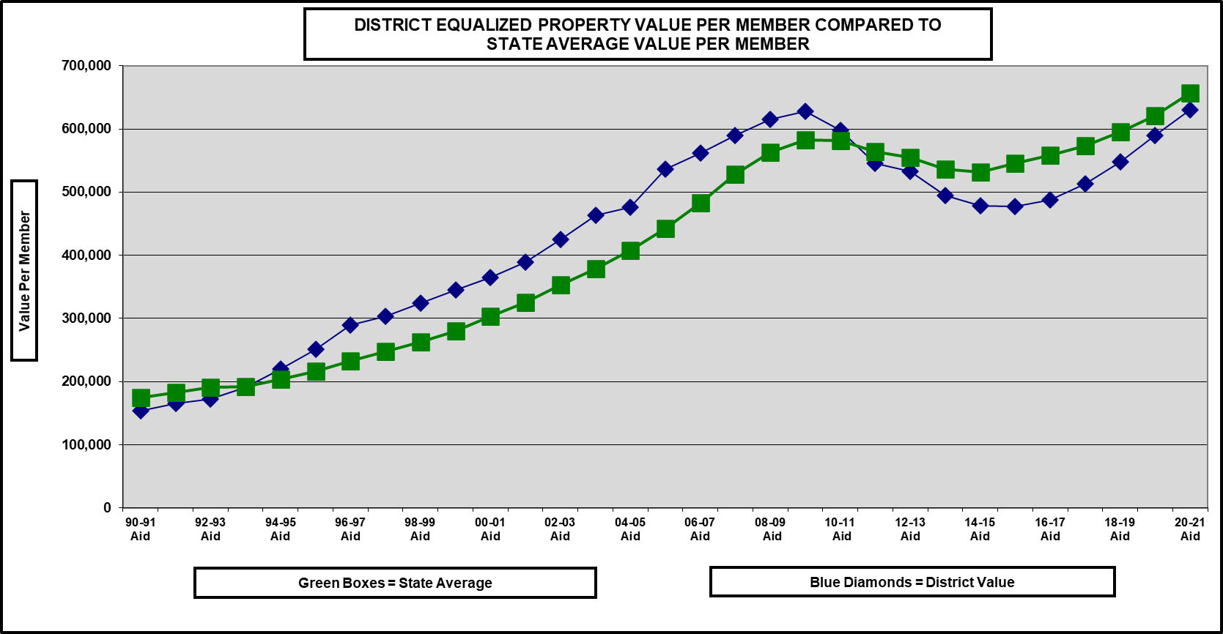
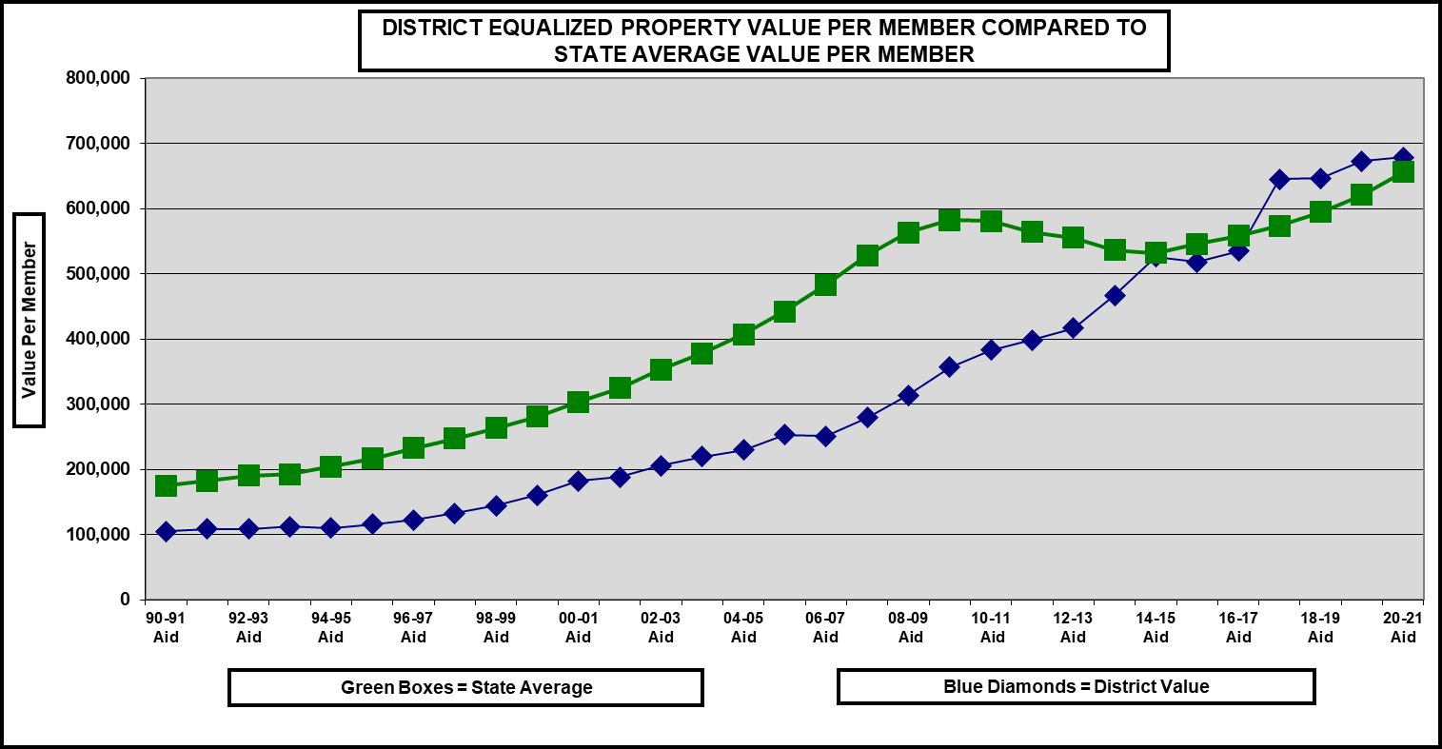
Watch Value Per Member Over Time
Sun Prairie
Blair-Taylor
Notes:
What can happen to a district with severe declining enrollment. Change in formula position.
Sun Prairie also good example; added so many kids moved position in formula

Slide 38
Equalization Aid Recap
One pot of money is split over 421 school districts based on district membership, shared costs and values; changes in individual district data affect every other district’s aid. October 15th!
Aid Membership = Average of 3rd Friday in Sept FTE + 2nd Friday in January FTE, plus 100% of Summer FTE, plus other adjustments This is different from Revenue Limit Membership.
Depending on district value per member, some districts increase their aid by increasing expenses, while others decrease their aid by increasing expenses (negative vs. positive tertiary aid).
Notes:
Numbers come out October 15th. That is your aid eligibility for this school year; slide 39 prior year adjustments, any changes in factors; after October 15th, we will rerun the formula; it shows up as a PRIOR YEAR adjustment in NEXT YEAR’S 22-23 aid
COPY SLIDE 28
Difference between aid eligibility and what you receive listen to Bob 1:20

Slide 39
Equalization Aid Recap
Special Adjustment Aid ensures that districts receive at least 85% of the [gross] general aid eligibility the prior year.
Reductions for the Private Voucher Schools (Statewide, Milwaukee, Racine and Special Needs Scholarship (SNSP)) impact the actual aid received by the district.
Prior year aid adjustments impact the actual aid payment.
Be aware of what is happening to your district over time…
Notes:
How we are incorporating independent charter schools…

Slide 40
Questions?
DPI School Financial Services Team Website: https://dpi.wi.gov/sfs
Dan Bush, Director 608-266-6968
Bob Soldner, Assistant Director 608-267-9124
Ben Kopitzke, Finance Consultant 608-267-9279
Notes:
WASBO year of success; RL, gen aids, build on knowledge shared today
WASDA Getting it Right; two sessions; RL, GA, walk through details

Slide 41
Notes:
Put questions into chat; most first level Qs should be answered
Will respond individually afterward if need be
This is beginning of series of presentation the SFS team is participating in
More detail at the fall conference

Slide 42
Intent
Build base of knowledge on the calculations/formulas that determine most of your funding.
Understand the relationships between the Revenue Limit and General State Aids.
Identify trends and issues to monitor reviewing these calculations for your district.
Notes:
Put questions into chat; most first level Qs should be answered
Will respond individually afterward if need be
This is beginning of series of presentation the SFS team is participating in
More detail at the fall conference

Slide 43
State Aid for Exempt Computer Property
Line 12C
State aid from the Department of Revenue.
Replaces the tax revenue the District would have received if this property was still included on the taxable rolls.
Calculation was changed as part of the 2017-19 Biennial Budget.
Available around October 15th and paid directly by DOR
Notes:
Computer property used to be on first page of RL calculation → moved to line 12C, used to be line 6

Slide 44
We’re Done!
Line 16 is your total all funds levy

Slide 45
Equalization Aid
Sample District Values Per Member
District #1 District #2
Shared Cost $ 12,000 $ 12,000
Equalized Property $200,000 $600,000
Equalization Aid
Primary $ 900 $ 900
Secondary $ 6,000 $ 2,000
Tertiary $ 1,500 $ - 1,500
Total $ 8,400 $ 1,200
70% 10%
Percent of total shared cost – not each additional dollar of cost
Notes:
We are talking about or using value per member here to demonstrate the differences in Districts.
How districts can spend same level with differing property values
Equalization aid fortifies the tax base—fills in the gap

Slide 46
Equalization Aid
POP QUIZ !
What happens when a district’s value per member exceeds the guaranteed value per member?
NEGATIVE AID
116 districts are negatively aided at the tertiary level because their property value per member is greater than the tertiary guarantee.
Notes:
Districts that are in negative aid lose aid dollars as their shared cost increase.
46

