Slide 1
Title Slide
Counting Children:
Third Friday Count;
Summer/Interim Membership
Sue Schnorr - WASBO
Roger Kordus
School Financial Consultant
School Financial Services

Slide 2
PI-1563 Pupil Count and PI-1804
Summer Membership-Things to Know
When are students counted?
Residency – which students are residents?
COVID-19 Regulatory Flexibility Framework
Membership – which residents may be counted?
How are residents counted?
  Early Learners, Kindergarten, Summer Membership
Part-time attendance – how are resident and non-resident students counted?
How is this data reported to DPI?

Slide 3
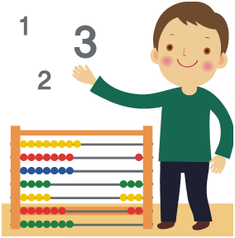
Accurate Pupil Counts provide opportunities to maximize the resources available to support the education of children in your district.
Your role in completing the PI-1563 is important in the lives of children.
3
Notes:
This assignment should be done by the best and brightest staff.

Slide 4
Pupil Count - Words to Know
Full time
Challenge Academy
Pre-School-Special Education
Minutes
Withdrawal
Summer ADM Equivalent
Resident
Age Requirements
Part-time
Pupil
Head Count
Receiving Instruction
4 year old Kindergarten
Enrollment
Thayer
Membership
Open Enrollment
Student
3-year Programs
Hours
Revenue Limit Membership
Attendance
Count Date
Present
Non-Resident
Full Time Equivalency (FTE)
5 year old Kindergarten
Special Education
General Aid Membership
State Schools
Notes:
The “Pupil Count” is a head count only - of those in your schools or your residents.
The “Head Count” count is bodies in your classroom seats.
The “Full Time Equivalency” count is the of students included in the Revenue Limit calculation.
Full Time Equivalency (FTE) is Not head count.
The PI-1563 Pupil Count is a “Head Count” only

Slide 5
Pupil Count Dates for determining Membership Reporting Purposes (PI-1563)
3rd Friday in September (PI-1563)
  Used to determine Revenue Limit, Per Pupil Aid and State Equalization Aid
2nd Friday in January (PI-1563)
  Used to determine state equalization aid
Summer/Interim Membership FTE (W1804)/(PI-1563)
  Included when reporting the September Count
  FTE valued at 100% for Equalization Aid and 40% for Revenue Limit
Challenge Academy (PI-1563 YCA)
  Completed September and March
Notes:
Essentially twice a year. What other purposes are there for counting pupils? JUNE CENSUS (for CSF), OPAL (Open Enrollment application log)

Slide 6

Residency and Membership
Which student FTEs are included in your Revenue Limit and/or Aid Membership?
A key source of guidance is our “Membership Information and Reporting” https://dpi.wi.gov/sfs/children/enrollment/membership-info-reporting webpage.
Notes:
Membership - Resident enrollment adjusted for full time equivalency (FTE)
Under the Guidelines for Counting are 10 links, two critical documents are;
“General Counting Instructions for the PI-1563” and
“PI-1563 Pupil Count Report Workbook Form”

Slide 7
Residents Who May Be Included in Membership (Revenue Limit, Equalization Aid, or Both)
Four (4) Criteria: (For students enrolled in a public school)
  Resident of an eligible age
    A child that lives in the District
    Between the ages of four by September 1 and twenty when enrolling in the regular education program
    Between the ages of three and twenty prior to the first day of class when receiving special education services
  Financial Responsibility
    A child whose instruction is either provided or paid for by the District
Notes:
Are they a resident, eligible age; who is paying for the education (may be offsite), are they present, or meet the “Before and After” Rule.

Slide 8
Residents Who May Be Included in Membership (Revenue Limit, Equalization Aid, or Both)
Four (4) Criteria: (For students enrolled in a public school)
  3. Attending on the Count Date
    A child that is receiving instruction
    A child, did not receive instruction on count date, did receive instruction the before and after rule
4. Certain limited non-residents
    Part-time pupils – Homebased
    Certain Summer Online Course – Open Enrollment
Notes:
Qualifying to be included in the PI-1563 report when absent on the count date should be handled in each site throughout the district.

Slide 9
Determining Who is a Resident
Not defined in statute
Up to the local school district
Case law – Thayer Ruling
  A minor may have, for school purposes, a residence other than that of his parents if the school district was incidental to the child’s reason for living in the district.
Identify where the child lives (address information)
  It is important to keep accurate and up to date enrollment records and address information for all resident children – especially with the level of Open Enrollment activity.
Identify the district where property taxes are paid (municipal clerk records or county data base)
Notes:
So you need to determine if a child is a resident of the district. Number 1, where does the child live
It is very important that every year, the family is asked to complete a registration form that includes their location. This is important for Open Enrolled students as well.

Slide 10
Financial Responsibility
Resident pupils in your seats, taught by your teachers and meeting the age limitations. (Slide #7)
Full-time resident pupils in attendance elsewhere, but your district is paying for their education.
  Open Enrollment
  Tuition Agreements
  Cooperative Programs
  CESA programs
  Tuition Waivers (caution: check the details of the situation)
Notes:
From Slide 8, item #2 Who pays for the child’s education

Slide 11
COVID-19 Regulatory
Flexibility Framework Provisions
Under existing law and DPI guidance, a student may be included in a school district’s September headcount for aid and revenue limit membership purposes if:
The student is enrolled and in attendance on the third Friday in September.
The student is enrolled and in attendance for the school year on any day before the third Friday in September, and any day after that date, with no change in residency or enrollment during that period.
In either case, the student may be counted regardless of the specific setting in which they are receiving instruction.
Notes:
https://dpi.wi.gov/sites/default/files/imce/administrators/e-mail/08_24_20_Regulatory_Flex_Framework.pdf SLIDE #61 has this link.
If a student was absent on the count day due to an excused absence; this is how they could be counted.
How might this playout in September of 2020.
The Key will be in can the district document the student’s attendance?
See the “Attendance” information provided in the PDF dated 08-24-2020.

Slide 12
COVID-19 Regulatory
Flexibility Framework Provisions
If a district implements policies on how teachers will take and record attendance in their student information system (SIS) for in-person, virtual, or blended instruction, then it should conduct its third Friday count process as usual.
Otherwise, the district will need to define its attendance policies for the instructional settings that may be in use this year, and then determine alternative method(s) for documenting attendance used in the third Friday membership count.
Districts selected for membership audits, as required by law, will need to make their attendance policies and documentation used for their headcounts available to auditors, but DPI is not prescribing that policies or documentation must be in any particular format.
Notes:
https://dpi.wi.gov/sites/default/files/imce/administrators/e-mail/08_24_20_Regulatory_Flex_Framework.pdf

Slide 13
Counting 3 Year-Old Students Attending
Programs in Your District
When a school district provides educational services to resident children who are 3 years old as of September 1st or reach the age of 3 years old during the current school year, if the individual program allows. That child can be counted in the PI-1563 report in one program only, the choices are:
Preschool-Special Education – Included in count
Title One Funded Preschool - Not included in count
School-Operated Head Start – Not included in count
3 Year-Old Programs – these non-special education students will not be included in the pupil count and not impact the district’s revenue limit calculations and related aid calculations. However, costs in Fund 10 associated with 3-Year-Old Programs will reduce the district’s shared cost in the General Equalization aid calculation.
https://dpi.wi.gov/sfs/children/enrollment/pi-1563-program-def#YO%20Add
Notes:
These programs must operated out of Fund 10 (General Fund), Fund 27 (Special Education), Fund 29 (Head Start for some districts) not Fund 80 (Community Service)

Slide 14
Counting Non-residents When Completing the PI-1563
Completing the PI 1563 is a process, not just a matter of counting residents, it also includes non-resident students attending your schools
  You include non-resident students in seats in your district
  Subtract non-residents in those seats
  Adjust for Part-time students
  The non-resident students will not be in adjusted head count used to calculate the district’s membership FTEs.
Notes:
If the goal is to report residents, why do I have to count non-residents? This is a process that accounts for students in your building and district residents. All number you need to know, membership and open enrollment. Cost and revenue.

Slide 15
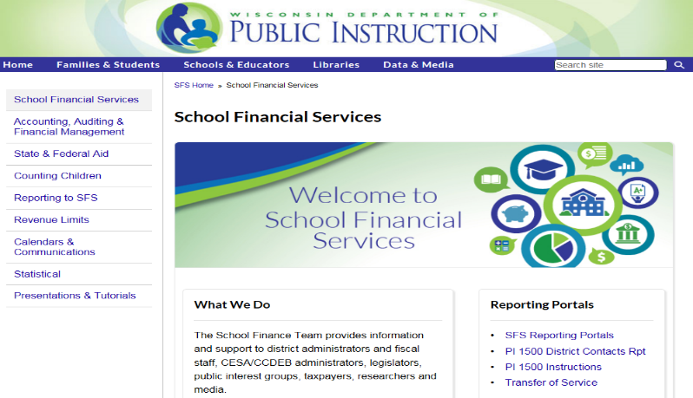
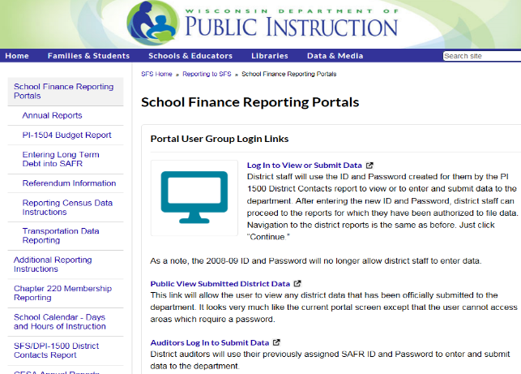
September Pupil Count
Start by clicking on the “SFS Reporting Portals”
Login from here. Do not bookmark any portal pages beyond this one.

Slide 16
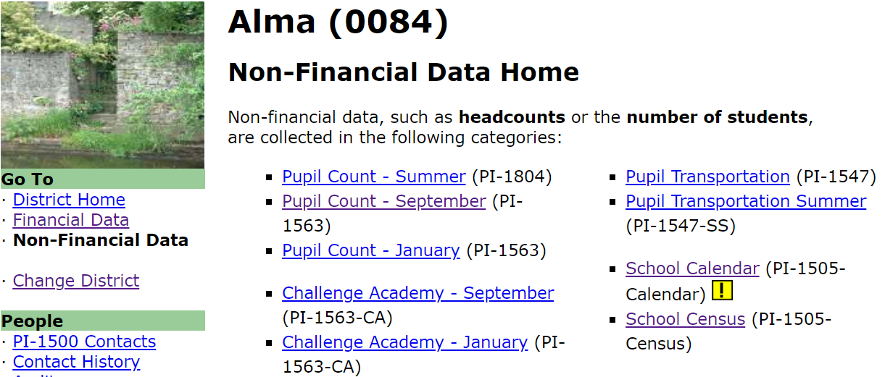
School Finance Reporting Portal
Under “Non-Financial Data Home” you will find a link to the “Pupil Count September” portal.

Slide 17
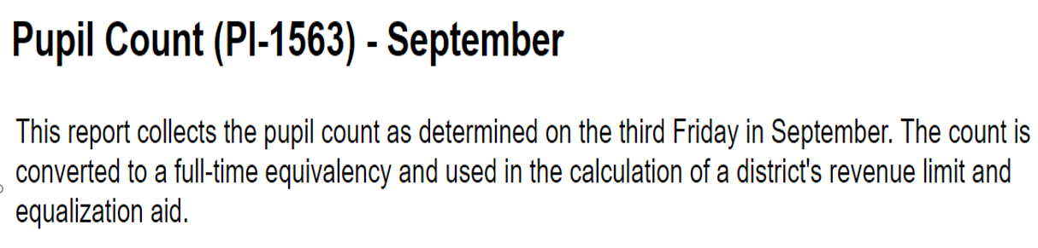
This is first page inside the PI-1563 portal, and it will provide the user with updated general information that needs to be reviewed and considered before this report is completed.

Slide 18
5 Steps where data is entered in the PI-1563 portal
Step 1: Head Count – (Record all Resident and Non-Resident students to whom the district is directly providing educational services)
Step 2: Non-Resident Reductions- (Record students in your seats that are residents of another district)
Step 3: Resident Reductions- (Record resident students who are included in the head count but are not eligible to be counted full-time for state aid purposes)
Step 4: Resident Additions – (Record residents students your district is financially responsible for that attend another school)
Step 5: Part time Home-Schooled (Record Non-Resident Home-Schooled students attending your school)
Notes:
These five steps are to be completed by your district before submitting the PI-1563 pupil count report.

Slide 19
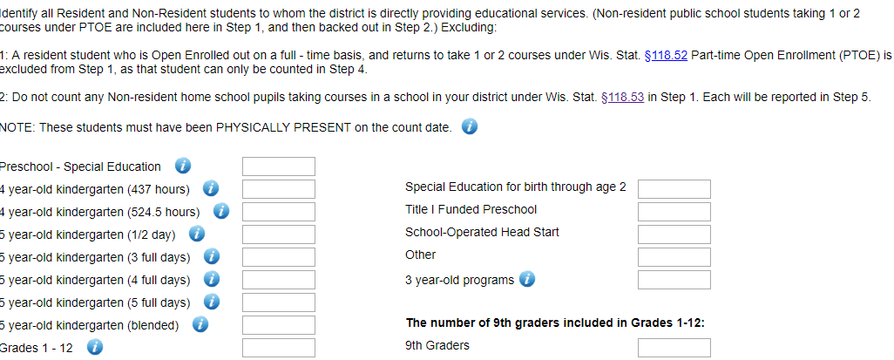
PI-1563 Pupil Count Process, Step 1.1 Physically Present and Step 1.2 Absentees (same as shown below)
The SFS team will be continue to collect the counting of 9th graders for the "Personal Electronic Computing Devices Grant” as required by Wis. Stat. 115.438(4)(a)1.
Step 1 – Head Count - Identify all Resident and Non-Resident students to whom the district is directly providing educational services.
Notes:
Present and absent, absent should meet the before and after rule. This is children in your seats, they may or may not be residents of your district.
Counting students in non-special education 3-year old programs: Wisc. Stat. 121.004(7)(d) A pupil enrolled in a preschool program under subch. V of ch. 115 [CHILDREN WITH DISABILITIES​] who is 3 years of age or older shall be counted as one-half pupil.​
In the fall of 2019 all school districts will still need to record the number of 9 grade students in the PI-1563-September report. Wisconsin statute 115.438(4)(a)1, speaks to the responsibility of each school district to provide the number of 9 grade students to DPI through the end of this grant program in 2022-23. This data must be reported even though the 2019 Act 9, the Personal Electronic Computing Devices Grant is no longer funded, effective with the 2019-20 school year.

Slide 20
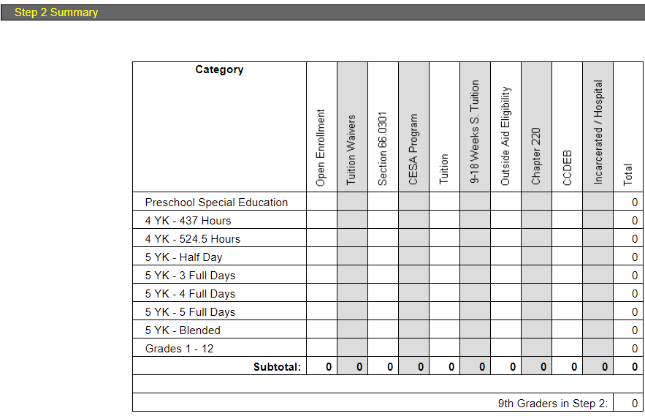
PI-1563 Pupil Count Process
Step 2 – Non-Resident Reductions- (Students in your seats that are residents of another district)
Notes:
Those in attendance in your district that you may not include in the final “Head Count as they are non-residents attending under: OE; Tuition Waiver; 66.03 Coop; CESA Program; Tuition; 9-18 Weeks S. Tuition; Outside Age Eligibility; Chapter 220: CCDEB; Incarcerated / Hospital

Slide 21
PI-1563 Pupil Count Process -
Part-time Resident (Step 3 –Reductions)
Resident student - less than Full-Time Enrollment attends:
any grade in a public school in the district under s. 118.53 is eligible for state aid up to a maximum of two courses per pupil per semester.
high school in the district under s. 118.145(4) is eligible for state aid up to a maximum of two courses per pupil per semester.
the district less than full-time as defined by s. 118.15(1). Private school students who attend grades other than high school are included in this area.
Student attends another district through Open Enrollment, but returns to resident district for up to two classes under s. 118.25 – were not to be counted in Step 1 as they will be added in Step 4.
See https://dpi.wi.gov/sfs/children/enrollment/pi-1563-program-def#NR%20Reduct
Notes:
This is where a resident student included in Step 1, the Head Count, is adjusted for as they are attending only part time.
Homeschool part-time resident can be in any grade.
Non-public school students residents can only be attending high school classes.

Slide 22
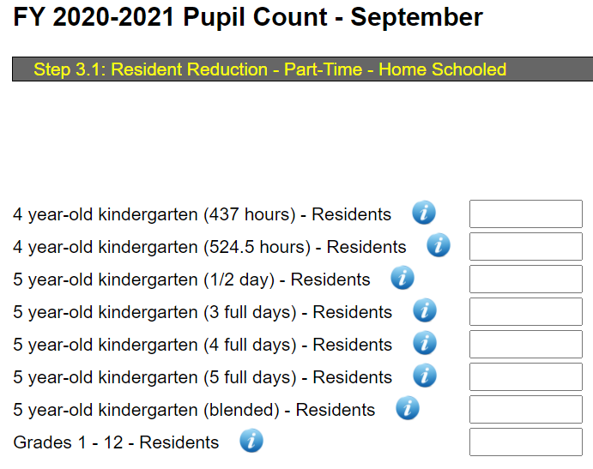
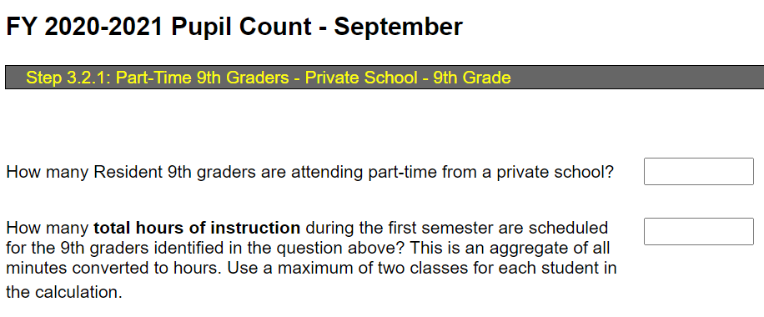
PI-1563 Pupil Count Process -
Part-time Resident (Step 3 –Reductions)
When entering Part-Time – Private School students, a different screen will be provided for 9th, 10th, 11th and 12th grades.
The more students in the 1st box, the higher the value needed in the 2nd box.
After this screen, for each grade, a follow up screen will need to be completed, with same basic questions seen for the 9th graders shown to the right.
Notes:
This screen will could need to be completed twice; for Home Schooled students and/or for Private School students, if your district based on where the students get their primary educational services from.

Slide 23
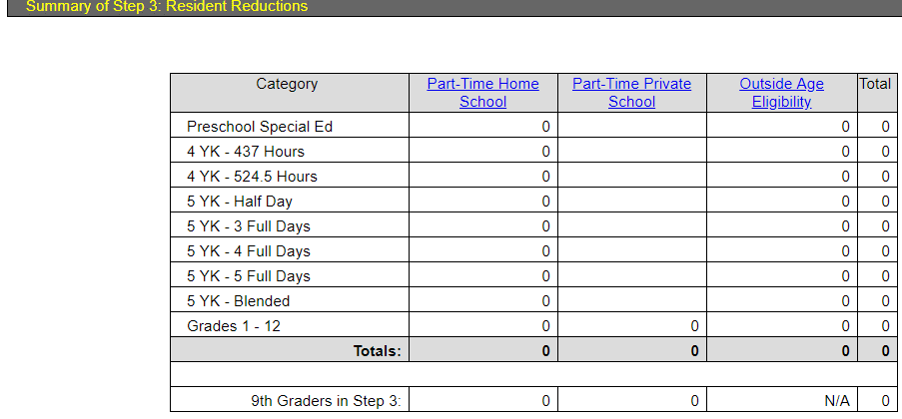
PI-1563 Pupil Count Process
Step 3 – Resident Reductions- (Resident students who are included in the head count but are not eligible to be counted full-time for state aid purposes)
Notes:
Adjusts data to account for part-time residents and remove those outside the age eligibility.

Slide 24
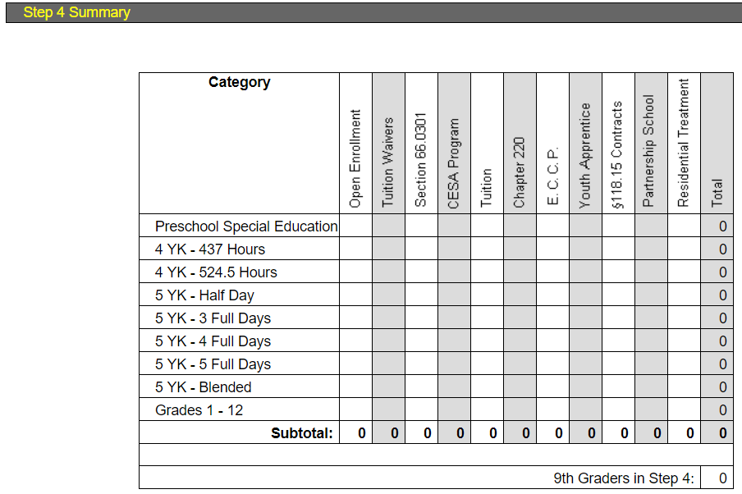
PI-1563 Pupil Count Process
Step 4 – Resident Additions – (Residents your district is financially responsible for that attend another school)
Notes:
These are your resident students attending elsewhere and you have financial responsibility.

Slide 25
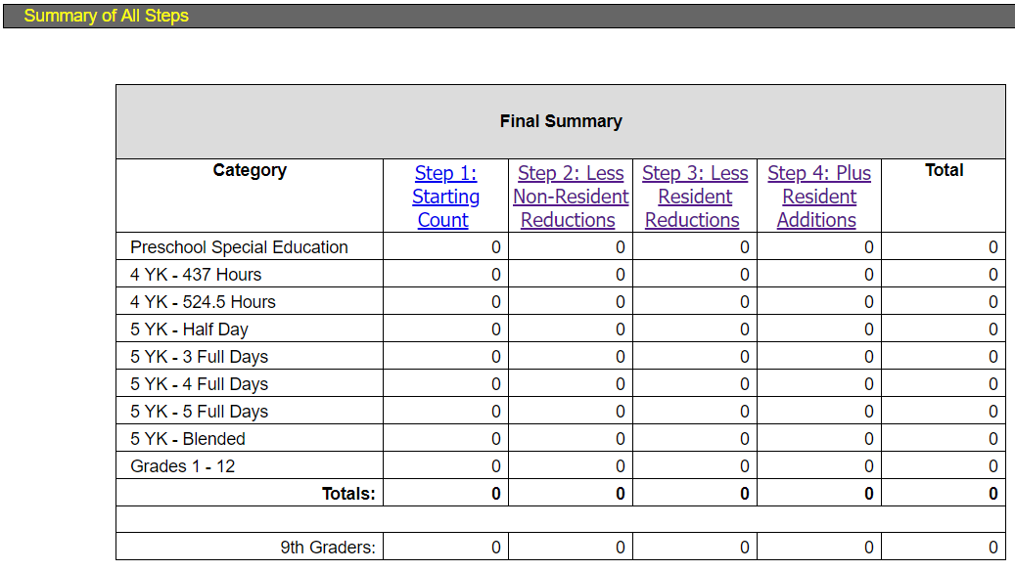
PI-1563 Pupil Count Process
Final Summary – Review Data
Provides a Summary of Pupils by Steps 1 - 4
Notes:
NOTE: this Final Summary does not include any students in Step 5, as they are not a part of Revenue Limit FTE count, they will be automatically include in calculating the district’s General Aid.

Slide 26
PI-1563 Pupil Count Process -
(Step 5, Non-Resident Additions)
Part Time Home-Schooled, Non-Resident Pupils
A school district can count, for General Aid (but not Revenue Limit) purposes, a non-resident, home-school pupil (but not a non-resident private-, parochial- or tribal-school pupil) taking courses in the district under §118.53, in an amount equal to 0.25 FTE per course, up to two courses per semester (i.e., district could count a maximum of 0.50 FTE per non-resident, home-school pupil). [see §121.004(7)(em)]
Part time Home-Schooled, Non-Resident Pupils are collected in Step 5 of the PI-1563 wizard.
Notes:
One of the rare instances you can count non-residents for membership purposes. Part-time only. .25 FTE Per Course for aid purposes, not revenue limit.

Slide 27
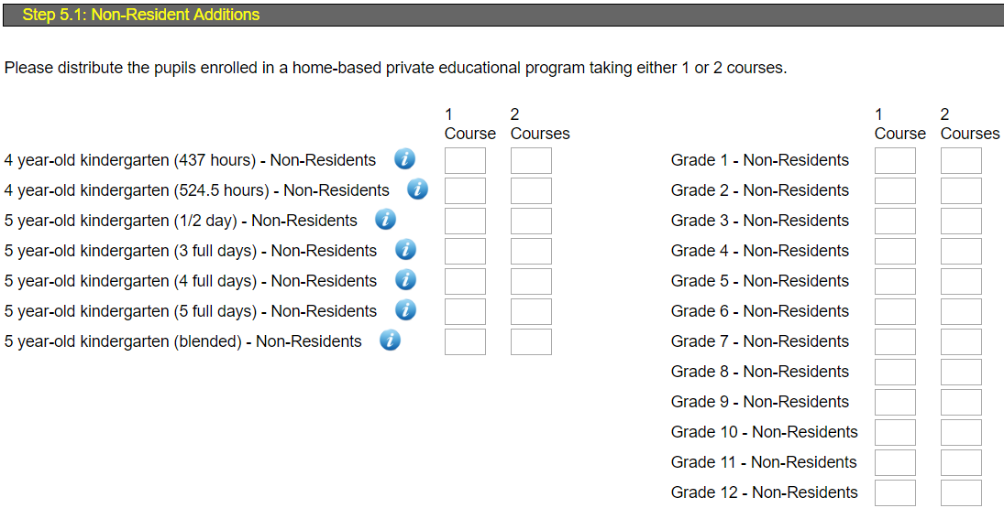
PI-1563 Pupil Count Process -
(Step 5, Non-Resident Additions)
Notes:
One of the rare instances you can count non-residents for membership purposes. Part-time only. .25 FTE Per Course for aid purposes, not revenue limit.

Slide 28
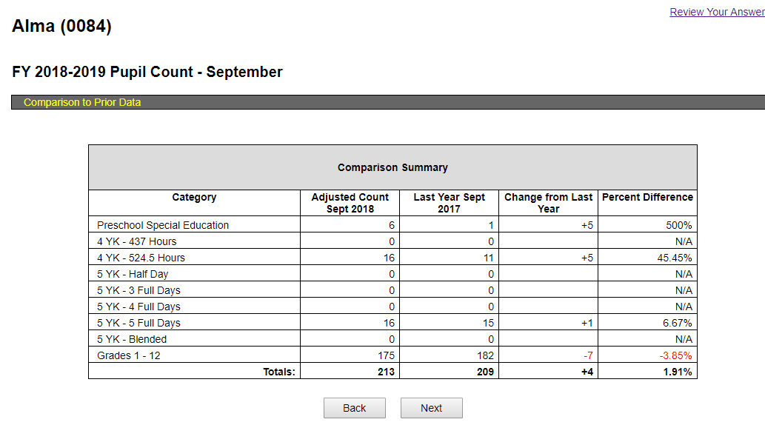
PI-1563 Pupil Count Process
Review Resident Student Count Data
Compare Current Year Data to Prior Year Data
Notes:
Step 6, review data, from slide #19. Review your answers takes you to a screen you can use to move around in the program. This screen compares current year’s data to the previous year’s data.

Slide 29
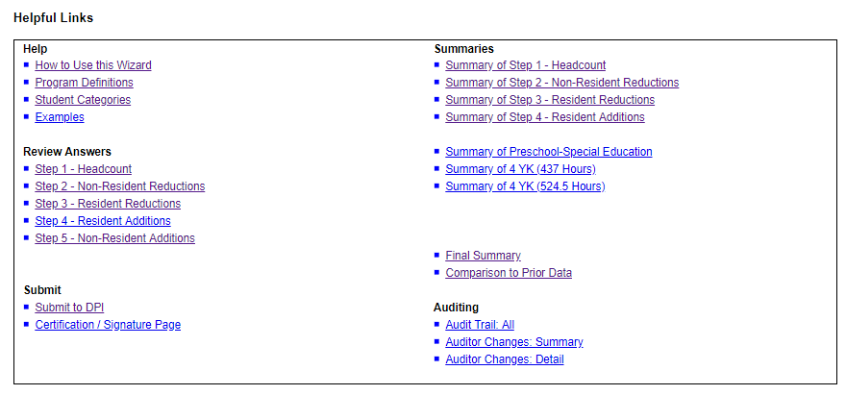
Review Your Answers
Links on this screen help you move around in the PI-1563 to review the data (Step 6) and Locating Help Information

Slide 30
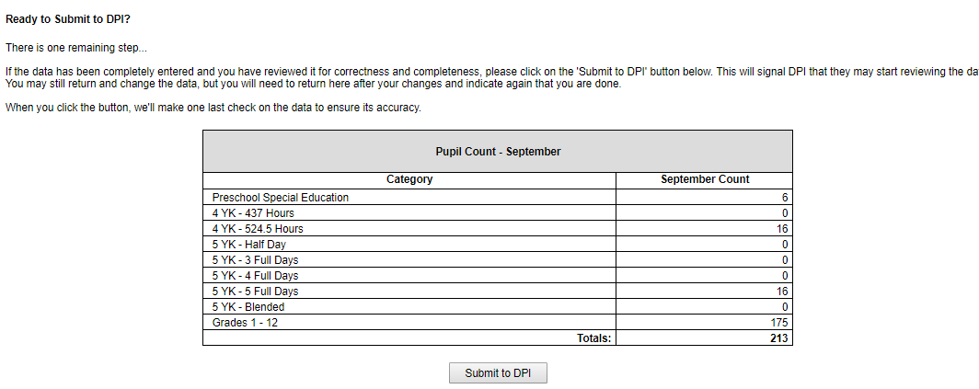
PI-1563 Pupil Count Process
(Adjusted) HEAD COUNT
Step 7 –Submit Completed Report
Notes:
September Count by Category is used to calculate FTE

Slide 31
Full Time Equivalency (FTE)
FTE - The result of a computation that divides the amount of time for a less than full - time activity by the amount of time normally required in a corresponding full - time activity.
Membership - Resident enrollment adjusted for full time equivalency (FTE) as noted in the following groups:
  Pre - School - Special Education =.5 FTE
  4 - Year Old Kindergarten = .5 or.6 FTE
  5 - Year Old Kindergarten = .5 – 1 FTE
  Summer ADM Equivalent = FTE Calculated by taking the total minutes of instruction divided by 48,600.
Notes:
You first do a head count. That data is then turned into FTE. Special education beyond “preschool” could count for 1 FTE if the IEP has a modified day.
Full Time Equivalency (FTE) – Not head count”

Slide 32
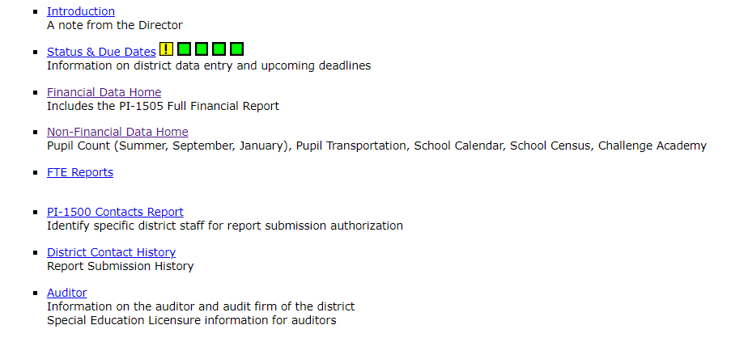
Online FTE Reports
Shows the resident adjusted FTE that will be used for for Membership

Slide 33
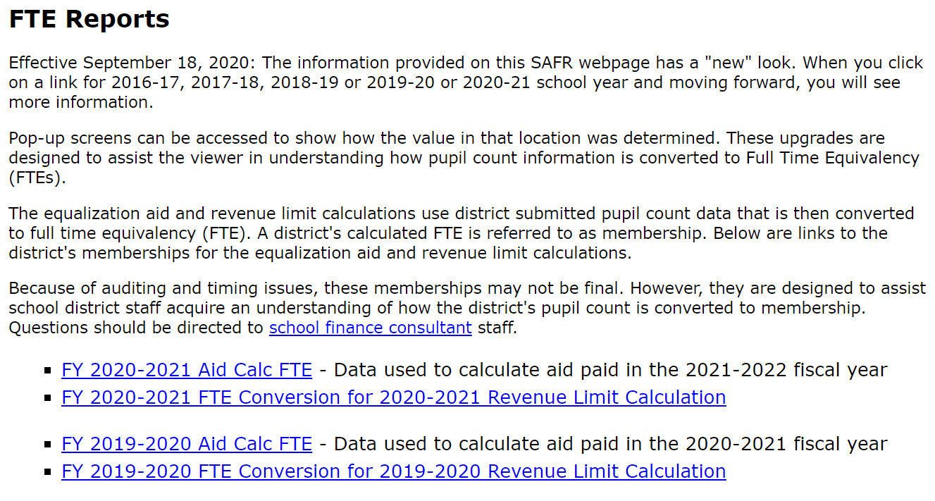
Online FTE Reports
Shows the FTE that will be used for Revenue Limit Membership and Equalization Membership purposes
Notes:
The links of this webpage will be updated when the PI-1563 portal is open to the district.

Slide 34
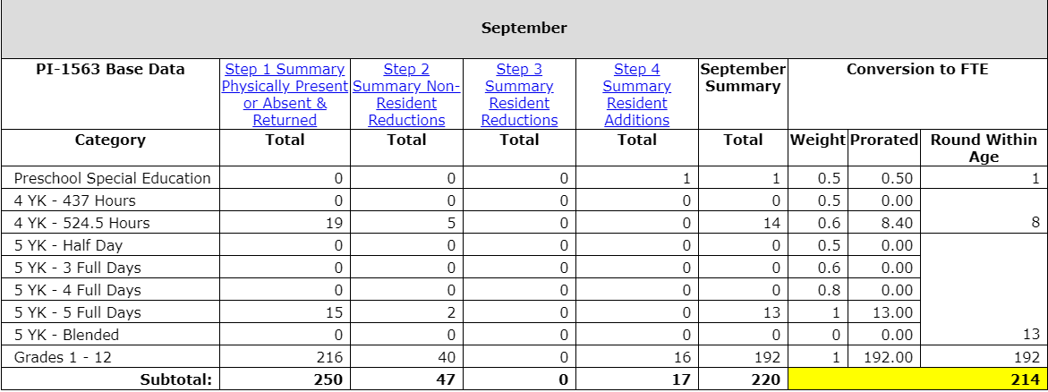
Full Time Equivalency (FTE)
When you click on the highlighted value, within the FTE portal, a popup screen will provided a breakdown of that total.
Notes:
Resident head count is 220. FTE is 217.
The “Head Count” count is bodies in your classroom seats.
The “Full Time Equivalency” count is the of students included in the district’s financial calculation.
Full Time Equivalency (FTE) – Not head count.

Slide 35
FTE for Revenue Limit Purposes
FTE generated from the PI-1563 pupil count report from September Count only.
FTE generated from the September Challenge Academy Report.
40% of FTE identified in the Summer/ Interim Membership FTE report.

Slide 36
FTE for Equalization Aid that will be used for the following school year
FTE generated from the PI-1563 pupil count report from September & January pupil count reports.
FTE generated from the September & January Challenge Academy Reports.
100% of the FTE identified in the Summer Membership FTE report.
Adjustment for Part-time Private or Home-based Students.(Step 3)
Adjustment for Part-time Private non-resident Students.(Step 5)
Adjustment for certain foster/group home students.
Adjustment for Private School Voucher students.
Notes:
You first do a head count. That data is then turned into FTE. (NOTE) Special education beyond “preschool” could count for 1 FTE if the IEP has a modified day.

Slide 37
Summer Membership Reporting
Fees
Fees
Fees
Complete The Excel Workbook
Report Totals Using On-line Reporting
Fees
Fees

Slide 38
Summer Membership Reporting-W1804
Summer and Interim Sessions start and end during break periods outside of the school year
  (for membership purposes only, not the fiscal year)
An Excel worksheet (PI-1804/PI-1804-1805) is available to calculate minutes used for your Summer FTE.
The data on the 1804 W2 Summary Sheet of the Excel worksheet is reported to DPI on-line at the conclusion of summer school and is due in September.
Keep the complete Excel workbook for your auditor to review the information used to calculate your summer school FTE.
Notes:
Always keep any and all supporting data regarding what was submitted in any pupil count portal.

Slide 39
Summer School Reporting-W1804
The data on the 1804 W2 Summary Sheet of the Excel worksheet is reported to DPI on-line at the conclusion of summer school and is due October 1, 2021.
The summer school report is one of the few reports that asks you to calculate the FTE count as opposed to a head count.
Keep the Excel spreadsheet, as your auditor will review the information used to calculate your summer membership FTE and fee reconciliation.
Milwaukee and the suburban districts use a special workbook (W1804-1805) that counts ITP students (Chapter 220)

Slide 40
Summer and Interim Session Fees
Fees for the resident student or parent may be charged for individual use supplies (towels, gym clothes, band instruments, notebooks, pencils), textbooks, or similar items (workbooks) if the district claims the members for State General Aid under ss. 121.14.
Fees may be charged for social, recreational, or extracurricular summer classes and programs which are neither credited toward graduation nor eligible for State General Aid [s. 118.04(4)].
https://dpi.wi.gov/sfs/finances/budgeting/school-fees

Slide 41
Summer and interim Session Fees
  The fee must fund an item that is legally permitted and actually purchased for summer school use
  The fee may not be used to subsidize the cost of any other classes, students or administration
  The fee must be based upon the actual cost of the applicable item(s) the student received
  If your district is required to have a membership audit, the auditor will also review your summer school FTE and any associated summer school fees

Slide 42

Membership Audits
Who, What, When
Notes:
Audits. Financial every year. Do you know what auditors do? Confirm data reported to the DPI is accurate and collected correctly (according to statute; the “rules”).

Slide 43
District Selection Process
The state superintendent is required annually to select at least 25 percent of school districts to have membership audits.
  Random Selection
    From a "four-year cycle" pool
    From an "annual selection" pool
  District audited in the prior year having a net error rate in excess of 1% from the reported membership, for either count date.
  Pupil Count report was not received on time.
Districts announced in February and due May 1st
Notes:
DPI is required by to law select districts for audit. You should plan on having an audit at least every three years, and more often if your auditor finds errors

Slide 44
Reconciliation Worksheet
RECONCILIATION OF SEPTEMBER COUNT TO JANUARY COUNT
All districts are required to explain (reconcile) membership changes that occur between the September and January counts.
The process involves identifying and documenting the specific membership additions and subtractions that have happened in each category (ex. 4YK - 524.5 hours) between the 2 count dates.
The completed reconciliation is to be kept on file at the district office and available for DPI and your independent auditor upon request.
Supporting documentation should also be kept on file and available upon request.
Notes:
We reviewed the September count in the reporting portal. There is a similar process for the January count. You are required to reconcile these counts and keep documentation on file. This is a document auditors will request to check for compliance.

Slide 45
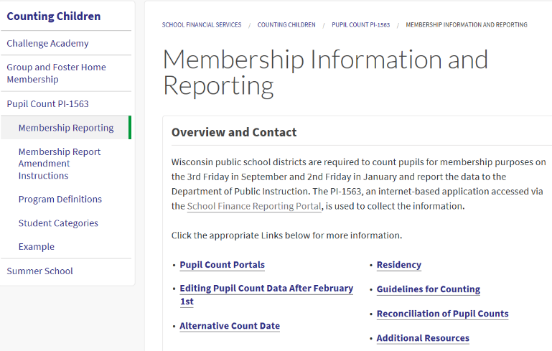
Reconciliation Worksheet
All districts are required to explain (reconcile) membership changes that occur between the September and January counts.

Slide 46
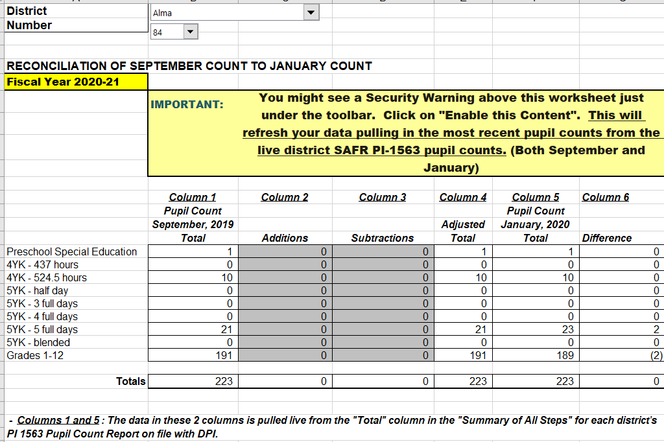
Reconciliation Worksheet
Notes:
Worksheet that has you identify September counts, identify changes, to get to the number of students in January.

Slide 47
Summer Membership - Audit
Review of Fees for summer school are part of this auditing process.
  Review DPI Guidance on this issue.
  Review proposed fees to make sure they are appropriate.
  At the close of the summer class, complete the fee reconciliation in the PI 1804 - You may need to refund the overcharge.
  Invoices used to confirm actual cost of eligible supplies and support the amount of the fee.
  To avoid the consequences of overcharging, adequate refunds must be made before the October 1st.
Enrollment and Withdrawal Records (ADM)
Attendance Records (ADM)
Course Descriptions
Board Policy Regarding Attendance and Enrollment Status
Notes:
Be ready and be thorough.
Average Daily Membership (ADM)

Slide 48

Heads Up !
Things to know about . . .
Things to watch for when . . .

Slide 49
Non-Public Part-time Attendance
Home-based Private Education
§118.53
§ 121.004(7)(em)
Non-Parochial, Parochial, Tribal § 118.145(4)
§121.004(7)(e)
Grades 9-12
Residents Only
Up to 2 Courses Per Semester
Can Count - FTE Computed on Hours Attended
Resident
Non-Resident
Any Grade (K-12)
Up to 2 Courses Per Semester
Can Count - FTE Computed on Hours Attended
Any Grade (K-12)
Up to 2 Courses Per Semester
Can Count - .25 FTE for Each Course, .50 FTE Max
---> Only for General Aid Purposes, NOT Revenue Limit <---
Notes:
5 clicks
A slide worth saving

Slide 50
Early Learners; Preschool, 4K
New 4K programs need to be approved by DPI.
4-Year-Old Kindergarten must be universal and open to all age eligible children in the district.
Pupil must be at least 4 years old by Sept 1st.
Preschool and Special Education
  If pupils are enrolled in both 4K and Preschool Special Education, count in 4K. Do not count in more than one category/program.
Notes:
This slide speaks to every enrollment for 4K students.

Slide 51
Membership and 3, 4, and 5-Year Olds
Takeaways
Have to be public school students in order to count for membership.
Non-Special Education 3-Year Olds participating in district programs are counted separately in PI-1563 Step 1.1 and Step 1.2. from Special Education 3-Year Olds students you serve
Count children in the program they are attending.

Slide 52
Membership and 3 Year Olds
Please see the session handout provided in these links:
Student Membership three, four or five year-olds
https://dpi.wi.gov/sites/default/files/imce/sfs/xls/Revised-Student-Membership-3-4_or-5-Year-Olds5.xlsx
This document will be a good recourse when working with determining the assignment of students being served under the age of six.

Slide 53
Special Education
Begins at age three.
For three- and four-year-old children not in a 4k program, count as .50 FTE regardless of the special education program time in attendance.
  Speech and Language
  Early Childhood (Pre-School)
  Other Services
Students who turned 20, prior to the first day of class, may enroll any time during the year.
Notes:
If the student is receiving educational instruction from a non-public school and receiving related services from your district, that student cannot be included in the PI-1563, but should be included in the October 1st “Child Find” (a Special Education report).

Slide 54
Counting Students Who Are 20 and 21 Years Old
If a special education student is 20 prior to the first day of classes according to the school calendar, the student can enroll any time during the year, even after turning 21, and the district must provide services and can count the student.
If a regular education student is 20 when he/she enrolls and receives instruction, the district must provide services and can count the student. If a student turns 21 prior to enrolling and receiving instruction, the district is not required to provide services and cannot count the student. If a student enrolls prior to turning 21, but turns 21 before attending classes, the district is not required to provide services and the student cannot be counted.
Notes:
We have touched on this in a couple of ways. Information on the website, membership. https://dpi.wi.gov/sites/default/files/imce/sfs/pdf/Counting-Students-Who-Are-20-and-21-Years-Old_2019.pdf

Slide 55
Part-time Attendance and FTE
Residents attending Private School
  Calculated based on hours
Residents - Home Based
  Calculated based on hours
Non-Residents Home Based
  .25 FTE per Course
Follow the directions/steps as given in the report process or reporting form

Slide 56
Counting Part-time Pupils
District of attendance may count non-resident, home-based pupils enrolled part-time
Different method to count resident vs. non-resident part-time pupils
Pupil comes from:
RESIDENT
NON-RESIDENT
Home School
[All grades]
# PT Pupil Hours / FT Hours for Grade = FTE
0.25 FTE per course (max of 2 courses)
Private School
[Grade 9-12]
# PT Pupil Hours / FT Hours for Grade = FTE
Cannot be counted
Notes:
Helpful graphic

Slide 57
Challenge Academy
Separate report used to account for cadets.
National Guard determines residency.
Both fall and spring reports must be completed.
If student is in the Fall CA count, do not count in PI-1563
By answering questions regarding the regular pupil count data, the Spring report will determine how to count the pupil.

Slide 58
Other
Tuition Waivers
  These situations involve children moving out/in of a district mid-year. Sometimes, you still can count a pupil in the year they have moved out of your district….and, sometimes you can’t count a new pupil that recently moved in.

Slide 59
DPI School Financial Service Team
General Contact Information:
Website https://dpi.wi.gov/sfs
SFS Team Staff Directory
https://dpi.wi.gov/sfs/communications/staff-directory
(608) 267-9114 (phone)
dpifin@dpi.wi.gov (email)
DPI COVID-19 Resource

