Slide 1
AN INTRODUCTION TO OPEB:
GASB 74 and 45, Fund 73, Act 99 WASBO Spring Conference 2017
Gene Fornecker,
School Financial Services Auditor
May 12, 2017

Slide 2
What is OPEB?
Other Postemployment Benefits (OPEB) are post employment benefits earned by employees during their career that they receive after they are no longer active employees.
Insurance benefits
Health
Health Reimbursement Accounts (HRA)
Dental
Vision
Life Insurance
Disability
Long term care
Does NOT include WRS retirement plans, pension plans, stipends or compensated absences

Slide 3
Why is OPEB Important?
In 2004 the Governmental Accounting Standards Board issued Statement 45 (GASB 45) to provide more complete and reliable financial reporting of OPEB.
Applies to all districts
School districts (and other government bodies) are required to determine their OPEB liability and report this in their financial statements.
Does NOT require the funding of future payments.

Slide 4
GASB 45
For OPEB, all districts must have new valuation studies completed
Every 2 years if 200+ members for OPEB only
Every 3 years if less than 200 members for OPEB only
Every 2 years for pension plans and supplemental pension-type stipends
Significant changes to employee benefits should result in a new actuarial study even if before the next scheduled study.
Plan members are those active employees eligible to receive those future benefits, terminated employees who have accumulated the benefits but are not yet receiving them, and retired employees (or their beneficiaries) currently receiving benefits.
Reevaluation of the benefits of having Fund 73 Trust should be made.

Slide 5
What method should you use to determine the OPEB liability?
Actuary Study
Required for plans with >100 plan members
Required for pension plans (non-OPEB) regardless of the number of plan members
Alternative Method
Allowable for plans with <100 plan members
DPI doesn’t have guidance on this
Check GASB Statement 45, paragraphs 33-35
Check with your actuary or auditor

Slide 6
Actuarial Studies
Actuarial firms listed on the DPI website on the bottom of the Benefit Trust Fund page or directly at http://dpi.wi.gov/sfs/finances/fund-info/employee-benefit-trust-fund
These are not DPI recommendations
Ask for AND check references!
Talk to other districts or your auditors
DON’T wait until the last minute to hire an actuary
10 firms for 424 districts + CESAs
PLUS they do this for townships, villages, cities, and counties

Slide 7
Key Terms in the Study
Actuarial Accrued Liability (AAL)/Total OPEB Liability
The value of benefits for all periods prior to the current fiscal year.
This value is accrued, and the benefits are earned, during the employment period.
Normal Cost (NC)/Service Cost (SC)
The value of benefits earned in the current year.
Unfunded Actuarial Accrued Liability (UAAL)/Net OPEB Liability
The difference between the AAL or Total OPEB liability and the value of assets dedicated to the liability (PFNP).
Plan Fiduciary Net Position (PFNP)
Value of trust assets as of the valuation date

Slide 8
Key Terms in the Study
Annual Required Contribution (ARC)/Actuarially Determined Contribution
The employer’s contribution to offset the liability
Equals NC/SC + one year amortized value of the UAAL (Amortized Accrued Liability).
The annual amount a district is required to record as their liability on the financials.
Not actually the amount a district is required to contribute in a given year, but the amount needed in that year to fully fund the liability over the period of amortization.

Slide 9
Key Terms in the Study
Implicit Rate Subsidy (IRS)
What is it?
When retirees and active employees are on the same health insurance plan, generally the premiums are higher than if the active employees had their own plan. The difference between what the active employees pay with the retirees on their plan and what they would pay on a plan with just active employees is the Implicit Rate Subsidy.

Slide 10
GASB Statements 74 and 45
GASB 74: Rules for accounting of the trust fund. Compliance is
Only required if have established a trust fund
Therefore, NOT required of all districts
GASB 74 has replaced GASB 43 FYE 6/30/17
GASB 45: Rules governing the determination of OPEB liability, establishing a Plan, identifying the ARC, etc.
Compliance IS required of all districts

Slide 11
GASB 45
What does it mean for the district? - All Districts
Need to be sure they have a current valuation that can be used in the filing of the audited financial statements
How will they address the OPEB liability?
Fund a Trust or Pay As You Go
Change benefits offered
May want to start checking NOW to see if your districts are up to date on their valuations
What does it mean for the auditor?
Without a current valuation, the auditor issues a modified opinion
Key items from the study are included in the district’s financial statements

Slide 12
Paying For Those Future Obligations
Option 1
Districts that do NOT set aside funds, fund their obligation on a “Pay As You Go” basis.
Example, the retiree insurance premium is paid out of fund 10, function 292000, object 290 during the period in which they are retired and receive that benefit

Slide 13
Paying For Those Future Obligations
Option 2
Districts may choose to set aside funds for the future payments towards the OPEB liability while employees are active.
This is governed by GASB 74
REQUIRES establishing a segregated trust fund.
WUFAR Fund 73
District holds the assets as trustee.
These assets no longer belong to the district.
Just over 180 districts + 6 CESAs have OPEB trust

Slide 14
What is Fund 73
Option 2 - A trust fund established specifically to account for post employment benefits
Segregated fund to account for resources held in trust for post employment benefits
Established if the district creates a formal and legal trust, in accordance with
State statutes
Federal laws
IRS guidelines

Slide 15
Considerations of whether to establish a trust?
Trust
Assurance funds will be available
Contribution reduces financial statement liability
Effect on bond rating
Retiree benefits paid from trust
Pay as you go
No assurance funds will be available
“Pay as you go” reduces financial statement liability
Effect on bond rating
Retiree benefits paid from operating funds

Slide 16
Considerations of whether to establish a trust?
Trust
GASB 74 and 45 reporting in financial statements
Segregation of assets
Assets invested under WI Stat. §881.01
Reporting at annual meeting
Pay as you go
GASB 45 reporting in financial statements
No segregation of assets
Assets invested under WI Stat. §66.0603

Slide 17
Considerations of whether to establish a trust?
Trust
Aid eligibility
General aid
not exceeding unfunded liability plus normal cost
Categorical aid
not exceeding ARC
Federal and State grants
not exceeding ARC
Pay as you go
Aid eligibility
General aid
“pay as you go”
Categorical aid
not eligible
Federal and State grants
not eligible

Slide 18
What are DPI requirements when setting up a trust?
E-Mail to DPI
Actuary study or acceptable cost method calculation
Employee benefit trust agreement
Legal opinion
Board approval
https://dpi.wi.gov/sfs/finances/fund-info/employee-benefit-trust-fund

Slide 19
What investment opportunities are available to the trust?
2005 Wisconsin ACT 99
Funds held in trust to provide for post-employment health care benefits may be invested in the same manner as is authorized for investments under §881.01, “Uniform prudent investor act”.
Enacted into law January 4, 2006

Slide 20
What investment opportunities are available to the trust?
2005 Wisconsin ACT 99
Applicable to benefits defined under GASB 45 statement only
Exception: school district operating under Wis.Stats. 119 (MPS)
Trustee must comply with prudent investor rule
School district may delegate investment authority over funds to investment manager

Slide 21
What investment opportunities are available to the trust?
2005 Wisconsin ACT 99
District obligated to develop trust investment policies and monitor investments on a regular basis
Overall investment strategy
Identify risk and return objectives
Investment policy in writing highly recommended
Protects district and trustees

Slide 22
What investment opportunities are available to the trust?
2005 Wisconsin ACT 99
Additional reporting at annual meeting or public budget hearing
Applies to ALL districts with Fund 73
Reporting required:
Amount in trust
Investment return earned since last annual meeting
Total of disbursements made since last annual meeting
Name of investment manager if investment authority has been delegated

Slide 23
What’s ALL in Fund 73?
OPEB - Valued in actuarial study
Wide variety of benefits included
Supplemental Stipend Type Pension - Valued in study
Traditional Pension - Separate valuation (only a few districts have this, similar to WRS)
Fully funded HRAs
Active employee current use
Active employee for use during retirement
TSAs
Prefunded Termination Benefits

Slide 24
Accounting For Fund 73 - OPEB
District contributions to Trust
Retiree contribution to Trust (if applicable)
Payments to vendors for retirement benefits
Implicit Rate Subsidy Payback
ALL SEPARATE CASH TRANSACTIONS!!
Cash MUST move in full
No netting
No book entries

Slide 25
Accounting Related to Fund 73
District contributions to Trust
Expensed to district Funds (10, 27, 50, 80…)
Object Code 218 (Contribution to Employee Benefit Trust)
Allocated across funds and functions of active employee plan members
By FTE or salaries
Fund 73 OPEB Revenue Code 951
CASH MUST BE TRANSFERRED TO TRUST BY JULY 30.
District Funds Object 218 = Fund 73 Source 951

Slide 26
Accounting For Fund 73 - OPEB
Retiree contributions to Trust
Deposited to Fund 73 trust
Revenue Source 952
If the district can’t directly deposit into the trust, when received, instead of a Fund 10 revenue, district should set up a Due to Fund 73 account (Function 812000).
This is not district revenue and should never be coded to a revenue account.

Slide 27
Accounting For Fund 73 - OPEB
Payment of Retiree Benefits from the Trust
Paid directly to Vendor
73E-420000-991
District pays with Trust Reimbursing
District (Fund 10) pays vendor and charges to 714000 - Due From Fund 73
NEVER AN EXPENDITURE TO DISTRICT
Trust Records a Due to Fund 10
Debit 73E-420000-991
Credit 73B-812000
Actual Cash, IN FULL, must be transited to district.

Slide 28
Accounting For Fund 73 - OPEB
Implicit Rate Subsidy Payback
Implicit Rate Subsidy Payback is an expenditure of the trust (retiree benefit) if retirees are on the district’s health insurance plan, UNLESS
Self-funded and trust pays actual medical costs
ETF State Group Health Plan - Community Rated
Plan premiums rated separately for retirees
Immaterial as determined by actuary

Slide 29
Accounting For Fund 73 - OPEB
Implicit Rate Subsidy Payback
Implicit rate subsidy payback is paid to the district from the trust and reduces the healthcare costs of active employee plan members with health insurance.
MUST BE ALLOCATED to employee fund, function and project
Even if no contribution that year, implicit rate subsidy payback applies.
Implicit rate subsidy payback calculation includes any amounts paid directly from retiree to insurance company.
Do not use amount from study, must be applied to actual health and long term care insurance costs of retirees on the plan.

Slide 30
Sample of Activity - Exhibit A
Sample of Activity - Exhibit B

Slide 31
Accounting For Fund 73 - OPEB
Implicit Rate Subsidy Payback
Expenditure from the Trust to the District
Debit 73E-420000-994
Credit 73B-711000
Receipt of Implicit Rate Subsidy Payback from the Trust
Debit xxB-711000
Credit xxE-xxxxxx-241
Fund 73 trust must pay the district IN CASH and IN FULL for the Implicit Rate Subsidy Payback.

Slide 32
Accounting For Fund 73 - OPEB
Sample of Activity
Spreadsheet on the Benefit Trust Fund page
Multiple tabs to guide you through the transactions
Fund 73 - Account Descriptions and OPEB Sample Entries
Employee Benefit Fund Requirements
Compliance guidance – Start here if you are new
https://dpi.wi.gov/sfs/finances/fund-info/employee-benefit-trust-fund

Slide 33
How DPI requirements are audited
Annual Report edits
Amount of contribution from the district equals the revenue into the trust.
Check: Total of object 218’s (all funds) equal to Contribution in fund 73, source 951+ 953
If there are any costs coded to Fund 27, Object 218, project 011, did they meet one of the 3 criteria for state categorical aid (unless 1st year of the trust)?
1) Contribution = ARC
2) Contribution (73R 951) is 5% greater than the expenditures out of the trust for OPEB (73E, Objects 991 and 994)
3) Same as number 2 but looking at 3 years
If it did not meet one of the criteria, not eligible for special education categorical aid and it will need to be moved to project 019.

Slide 34
How DPI requirements are audited
Manual Report edits
If a district has a trust, are they using it?
Check: If beginning Fund Balance, are there expenditures?
Is the implicit rate subsidy payback being done?
Check #1 - Auditor should check
Check #2: DPI will see if a district is using the new Object 994 for the Implicit Rate Subsidy Payback or will ask a question during the manual review.

Slide 35
How DPI requirements are audited
Manual edits continued:
Did the contribution exceed the ARC?
Check: Is there at least the amount in excess of the ARC in Function 292000, Object 218?
Excess not eligible for categorical aid
If a new study is due, does DPI have a copy?
Audit program
Contribution required to be physically made within thirty days of June 30th
Was activity budgeted for?

Slide 36
HRA differences
HRA/HSA document lists all scenarios for HRA payments to Trust under Payroll And Benefits
Prefunded for active employee retirement
Current active employee use
Current retiree use
https://dpi.wi.gov/sfs/finances/wufar/accounting-issues-examples
HRA is valued in actuarial study - prefunded for retirement
Accounting follows traditional OPEB
At retirement, district will put $1,000 into an HRA for each year worked, but does not put the full $1,000 into the trust every year. Unfunded liability exists. Also could fund, but not allocated under employee’s name in HRA account.

Slide 37
HRA differences
HRA is fully funded when earned - prefunded each year, in full, for retirement
MUST GO INTO IRREVOCABLE ACCOUNT
District puts away $1,000 in each year an employee works for use at retirement. The full $1,000 is funded every year and is allocated and held in the HRA account in the employee’s name.
Obligation is fully funded and will not be valued in the actuarial study.
Allocated to employee fund, function and project!!!!
Earnings belong to trust - can pay fees or be allocated to employee accounts

Slide 38
Changing Benefits - Considerations
Elimination of other post employment benefits for some or all current employees
Districts cannot eliminate post employments benefits to retirees. That obligation remains.
What happens to OPEB trust assets if no future liability exists?
Consult the trust document for any language addressing this situation
Consult with legal counsel and/or your actuary
Notify DPI

Slide 39
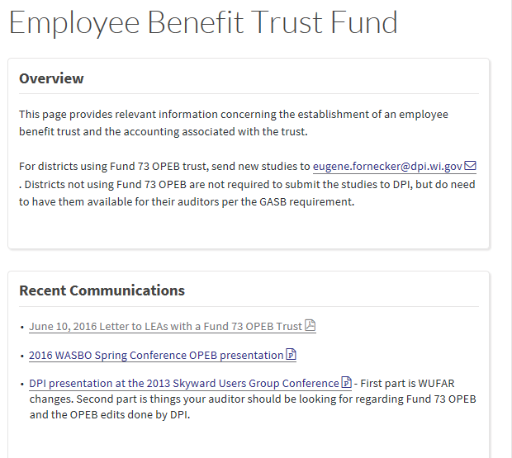
http://dpi.wi.gov/sfs/finances/fund-info/employee-benefit-trust-fund

Slide 40
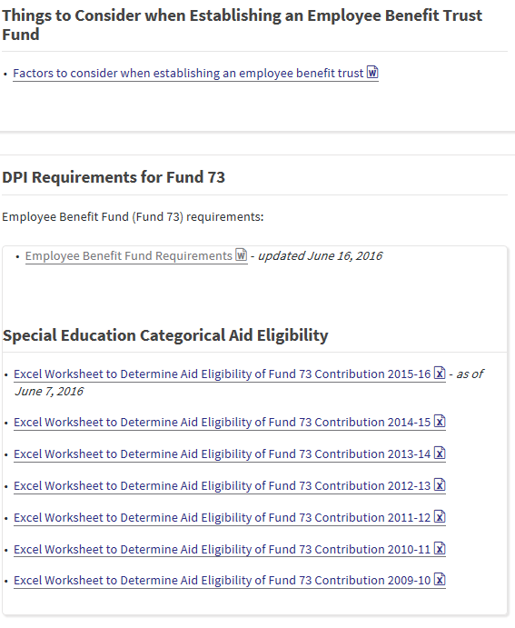

Slide 41
Gasb 74 and 75
GASB 74: Replaces GASB 43, effective for fiscal years beginning after June 15, 2016. Requires more extensive note disclosures and RSI related to measurement of OPEB liabilities for trust assets including annual money-weighted rates of return on plan investments.
GASB 75: Replaces GASB 45, effective for fiscal years beginning after June 15, 2017. Requires governments to report a liability on the face of the financial statements for the OPEB they provide. (unfunded liability presently disclosed in footnotes)
Requires use of entry age normal cost method to determine liability
The new standards are designed to be consistent with GASB 67 and 68 related to pensions

Slide 42
QUESTIONS? Contact: Gene Fornecker School Finance Auditor 608-267-7882 Eugene.Fornecker@dpi.wi.gov

