Slide 1
GETTING IT RIGHT:
FROM THE BUDGET TO THE LEVY
…AND BEYOND…
OCTOBER 19, 2020
VIRTUAL presentation
Bruce Anderson
Roger Kordus
School Financial Services, DPI

Slide 2
Today’s Goals
For you to be able to:
Accurately prepare (and be able to explain) your district’s 2020-21 Revenue Limit
Understand your October 15 Aid Certification
Understand how the Revenue Limit information fits into your 2020-21 budget
Compute your final Fall, 2020 levy
Complete your PI-401 (tax documents)
Finalize your 2020-21 budget
Learn a few other things about school finance

Slide 3
Agenda
8:30 AM WASDA Introduction
SFS Introduction/Preparation/Handouts slides 1-16
Revenue Limit – Lines 1-7 (Steps 1 ) Slides 17-40 (includes Membership)
9:20 AM
Work Break Slide 41, opportunity to respond to your questions
9:50 AM
Revenue Limit – Lines 8-16 (Steps 2, 3 & 4) slides 42 to 80
Consequences of Underlevying
10:40 AM
Work Break Slide 81, opportunity to respond to your questions
11:10 AM
Levy Process slides 82-116
Equalization Aid, Other Odds and Ends
12:00 PM
Bruce and Roger will remain available to assist any of the participants

Slide 4
Supporting documents (you were to bring today)
Your district's 2019-2020 final revenue limit worksheet* https://dpi.wi.gov/sites/default/files/imce/sfs/xls/revlim20_prepop_may26_final.xlsx
“Your district’s 2020-2021 most recent revenue limit worksheet” spreadsheet found at https://dpi.wi.gov/sfs/limits/worksheets/revenue
“Your District-Specific Equalization Aid Formula Components Longitudinal” spreadsheet found at https://dpi.wi.gov/sites/default/files/imce/sfs/xls/longitudinal_eq_1011_2021July.xlsx
Your district's Oct. 15th Certification of 2020-2021 General Aid from DPI* https://dpi.wi.gov/sfs/aid/general/equalization/worksheets-general-aid#2019-2021
Your district's September membership count, including 2020 summer school* (See the FTE report in SAFR)
Your district's 2020 Equalized Values received October 1 from Department of Revenue*
Blank Tax Levy Worksheet (printed by participant)
Notes:
The information on this page was sent to WASDA on 10-07-2020

Slide 5
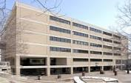
DPI Finance Team….How Can We Help You?
The budget and most finance-related processes rely a great deal on the exchange of information between the district and the Department of Public Instruction (DPI) throughout the year.
The School Finance Team at DPI provides an extensive finance website, resource materials, and phone consultation to assist districts.
Information
Data
Support
Notes:
Under the “Budget Development and Planning” link on the SFS homepage, we have put out numerous “longitudinal” Excel graphs/spreadsheets displaying data from Comparative Cost, Equalization Aid, Revenue Limit, District Value and how it related to the aid computation.

Slide 6
DPI Finance Team….How We Can Help You
Become familiar with our website at:
Don’t hesitate to call or e-mail one of us for answers or guidance! See “SFS Team Staff Directory”
https://dpi.wi.gov/sfs/communications/staff-directory
Our Team provides information via our School Finance Bulletins, this is a new presentation format.
We recommend you subscribe – by clicking on “School Finance Bulletins” on the right side of our website, under “Latest Information”.
https://dpi.wi.gov/sfs

Slide 7
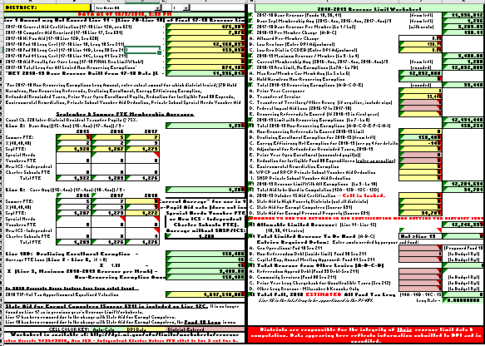
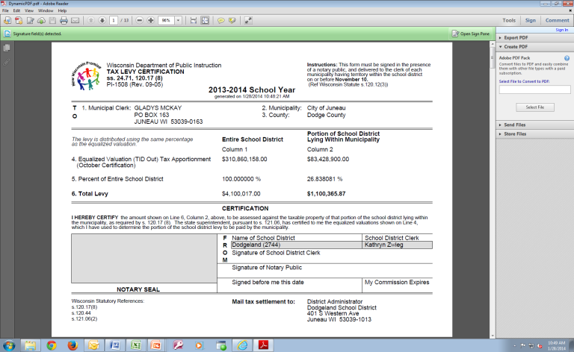
Budget/Revenue Limit Roadmap
(January)
Revenue Limit Calculation
Summer Count,
3rd Friday Sept Count,
Oct 1 Tax Values,
October 15 Aid Cert.
Certify Levies via
PI-401 (in portal) Late Oct
Preliminary Budget?
Annual Meeting?
Original
Budget
Budget Planning Papers
(basis for full budget)
Send tax bills.
PI-1508
Early Nov
Budget Adjustments to BOE
Budget Report PI-1504 (Early Dec)
Notes:
This slide lays out the “Big Picture” of the budgeting cycle.
Districts initially update their enrollment projections in December and complete a “first look” at the new-year revenue limit computation. This computation is not static – it needs to be updated by the district as new/revised information is received.
To get an accurate budget assessment, once the initial revenue limit has been completed, there are 3 crucial numbers created by the rl calculation that must be incorporated in the budget development papers – General Aid Estimate, Fund 10 Levy, and Computer Aid.
The budget development papers are nothing more than enumerating all known revenues and expenditures for the coming year. So, the district needs to examine all revenues and expenditures and adjust as necessary. The goal is to get to the bottom line early in the budgeting cycle. This structural deficit will determine what cuts have to be made.
Adjustments to the revenue limit may happen throughout the timeframe from January to the 3rd Friday, when things start to solidify. In a short 3 weeks from the 3rd Friday in September to the October 15 aid certification, districts get all the information they need to set their levies.
Once October 15 arrives, districts can adjust their budgets, set their levies, and fill out/send their tax bills.

Slide 8
REVENUE LIMITS

Slide 9
Revenue Limits
Limitation imposed by State Law in the Fall of 1993 on the revenues that public school districts in Wisconsin can raise from local Property Taxes* & State General Aid.
……each district has their own computation……
……not an expenditure control……
A district’s Revenue Limit will determine approximately 80-90 % of a school district’s General Fund Revenue Budget.
* General Fund (10), Non-Referendum Debt Service (38), Capital Projects Funds (41)

Slide 10
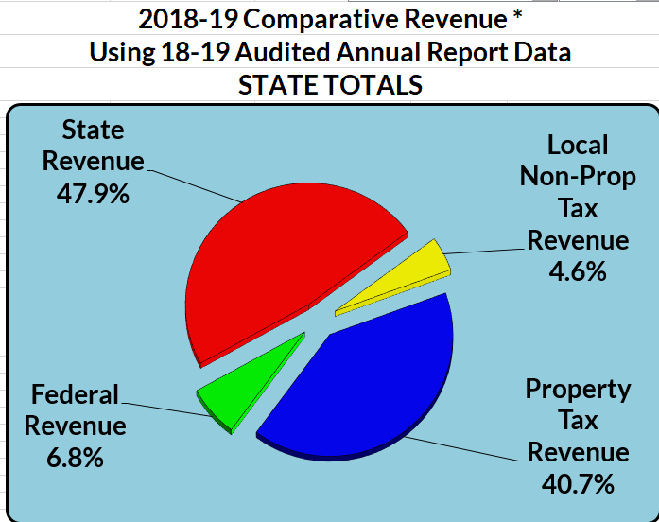
Comparative Revenue Under the Limits in 2018-19
Statewide Data
General Fund
Notes:
The most resent statewide data is from 2018-2019 school year. https://dpi.wi.gov/sfs/statistical/cost-revenue/comparative-revenue-member
The Revenue Limit does not control the following revenues:
Categorical Aids (Library Aid, Transportation Aid, High Cost Transportation Aid, etc.)
State and Federal Grants
School Fees, Gate Receipts
Donations
Referendum Debt (Fund 39)
Community Service Fund (Fund 80) Levies

Slide 11
Non-Revenue-Limit Revenues & Expenditures
2020-2021
WUFAR
Personnel Costing
?
State
Categorical
Aid
?
Utilities & Other Expenses
?
State & Federal Grants
Individual Building Budgets
?
?
Summer School Budget

Slide 12
Revenue Limits
The Revenue Limit controls the following revenues:
General Aid - Equalization Aid (for most districts), Chapter 220 Programs, and Special Adjustment Aids
High Poverty Aid [12.B.]
Computer Aid (vouchered by the Department of Revenue in July) [12.C.]
State Aid for Exempt Personal Property (vouchered by the Department of Revenue in May) [12.D.]
General Fund (Fund 10), Non-Referendum Debt (Fund 38) & Capital Projects (Fund 41) Levies [14. A. B. C.]

Slide 13
Revenue Limits
The Revenue Limit does not control the following revenues:
Per-Pupil Aid is increasing to $742 in 2020-21 (no increase)
School Fees
Categorical Aids (Library, Transportation, Sparsity, AGR/SAGE, etc.)
State and Federal Grants
Gate Receipts/ Donations
Referendum-Approved Debt (Fund 39) & Community Service Fund (Fund 80) Levies

Slide 14
Revenue Limit Computation
Each new-year Revenue Limit computation builds on the previous-year’s fiscal activity.
Incorporates what your student counts are doing.
Gives you the total resources you can collect from the tax levy and state funding (slide #12).
District will need this data for budgeting purposes.
In the first year of the state budgeting process, a district may need to start estimating revenue limit revenues early and often throughout the budget process.
Notes:
Remember 2021-2022 will be impacted by the state budgeting process.

Slide 15
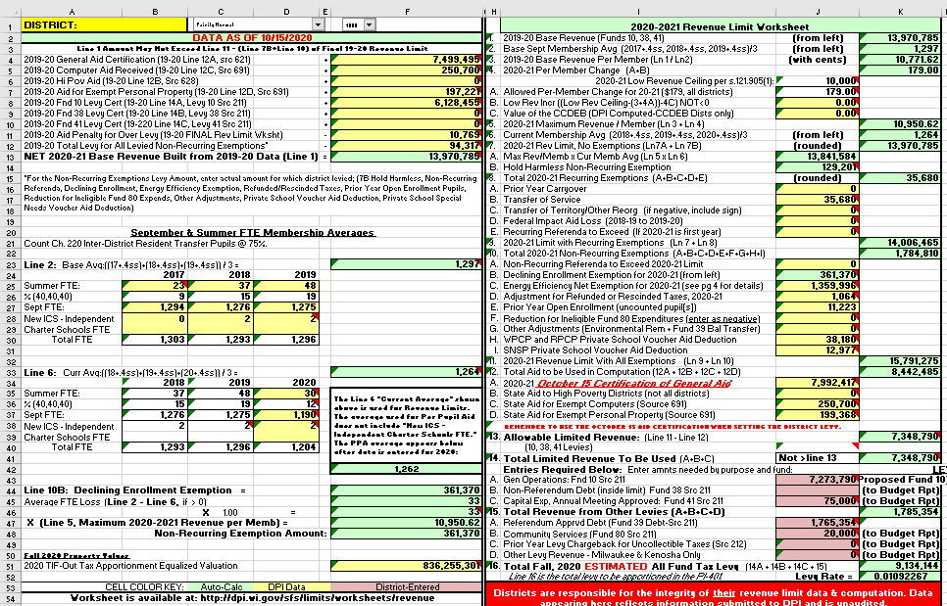
Revenue Limit Important Data Pieces
Property Values
(Oct 1)
Membership (Counting Students)
?
Other Levies
Recurring Exemptions
(???)
?
?
Chargeback Levy
Non-Recurring Exemptions
(???)
Debt Levies
Equalization Aid
(Oct 15)
High Poverty Aid
?
?

Slide 16
Revenue Limits
We’ll walk through a SAMPLE 2020-21revenue limit calculation worksheet, explaining line-by-line and giving you some time to work on your district’s numbers….
….please ask questions as we go.
This year, as this is a virtual presentation, you can send us questions using the Chat feature. The presenter or another SFS Team member may respond to your question.
Notes:
The information on this spreadsheet will be similar to a school district, yet modified to demonstrate key concepts.
Cody L will be talking about this process at the beginning of the presentation.

Slide 17
A 4-Step Process
Revenue Limit
Step 1: Build the Base Revenue Per Member.
(Worksheet lines 1-3)
Step 2: Calculate a New Revenue Per Member.
(prior to exemptions)
(Worksheet lines 4-7)
Step 3: Determine Allowable Exemptions. (Worksheet lines 8-11)

Slide 18
Revenue Limit
Step 4: Determine Levy Amounts.
Controlled Amounts
Levies for Funds 10, 38, 41
(Worksheet lines 12-14)
Non-Controlled Amounts
Levies for Funds 39 & 80 and Prior-Year Chargeback
(Worksheet line 15)

Slide 19
Revenue Limit Worksheet
(Located in at the bottom of the left page)
Green cells are formula cells and will auto calculate the amount for that cell based on the values entered in other cells.
Yellow cells pull data on file with DPI and loaded on the “Data” tab of the worksheet.
Pink cells require district entry.
Note: as DPI receives additional data and loads into the spreadsheet, we will change the pink cells to yellow cells.

Slide 20
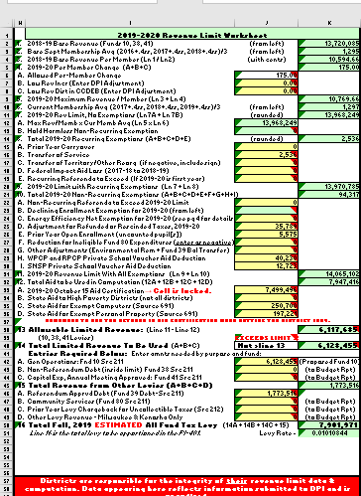
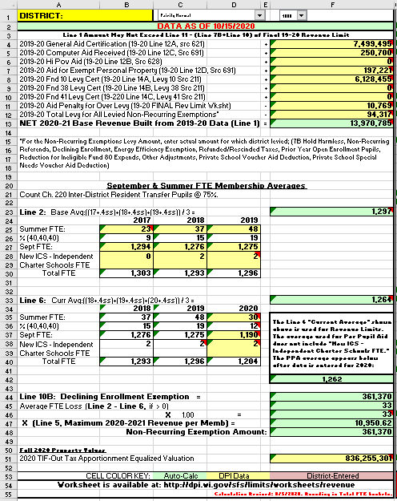
Step 1: Build the Base Revenue Line 1
Cell “10-F” comes from page 3 of 2019-20 R.L. wkst Cell ”17-O”.
Note the pupil counts.
Cell “ 4l-F” comes from page 3 of 2019-20 R.L. wkst Cell +42-O”,
Notes:
Here is how the LEFT side feeds data to the Right side.
(Excel line numbers)
<click> Line 1 – Base Revenues (12A)
<click> Line 2 – Computer Aid Received (12C)
<click> Line 8 – Levy Certification (14A)
<click> Line 11 – Aid Penalty for Over levy last year ( page 3 of last year’s RLW)
<click> Line 12 – Aid for Exempt Computers ( page 3 of last year’s RLW)

Slide 21
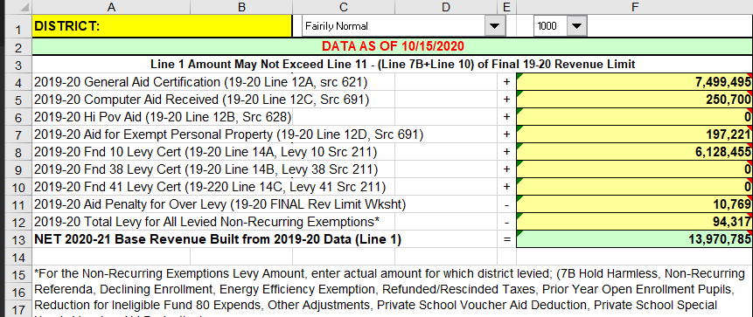
Step 1: Build the Base Revenue - Line 1
Notes:
The amount generated on Line 1 on the left hand side of the revenue limit worksheet is transferred to Line 1 on the right

Slide 22
Step 1: Build the Base Revenue - Line 2

Slide 23
MEMBERSHIP
(Kid count drives the Revenue Limit.
It’s that important.)

Slide 24
Let’s Talk a Bit About Membership…
Your district membership is used in both of your district Revenue Limit and Equalization Aid computations.
3 Questions for Guidance
Who can you count for membership?
Who is a resident and enrolled?
Who is incurring the cost for the education?
Notes:
To be included in the pupil count as a resident, the pupil must be currently enrolled and attending to receive instruction.

Slide 25
Membership
Who can you count for membership?
Generally, residents for which you are financially responsible - i.e. you are incurring the cost for the student’s education.
Start with who is in your seats on the count date.
Subtract non-residents being educated in your seats.
Subtract residents that may not be counted for levy purposes.
Add residents who are elsewhere (and for which you are financially responsible).
Watch for the “before and after” rule:
(Count the student if he/she was present for instruction during the school year, at least one day before the count date and at least one day after, and didn’t change residency during the period of absence.)

Slide 26
Membership
Who is a Resident?
Not defined by statute. Residency is determined
by the local district. (Look at your BOE policy.)
1.) Is the child living in the district with his/her parents?
2.) What about other situations?
– there is case law - i.e. - Thayer Ruling
A minor may have, for school purposes, a residence other than that of his parents. In this specific case, the school district was incidental to the child’s reason for living in the district.
Use common sense…WHY are they there?
Communicate with other district.

Slide 27
Membership
Who is incurring the cost for the education?
Pupil is in your seats, taught by your teachers.
Full-time resident pupils in attendance elsewhere, but your district is paying for their education.
Open Enrollment (your residents going elsewhere)
Tuition Agreements
CESA Programs
Tuition Waivers (Be careful with this one. These situations involve kids moving out/in of a district mid-year. Sometimes, you still can count a kid in the year that they have moved out of your district….and, sometimes you can’t count a new kid that has recently moved into your district. Please call us if you have a student in this situation.)
Notes:
Tuition Waiver can take place in two ways
First year, student just moved.
Additional year, student moved last school year.
“Myvote.wi.gov” is a website your district can confirm in which district the student/family.

Slide 28
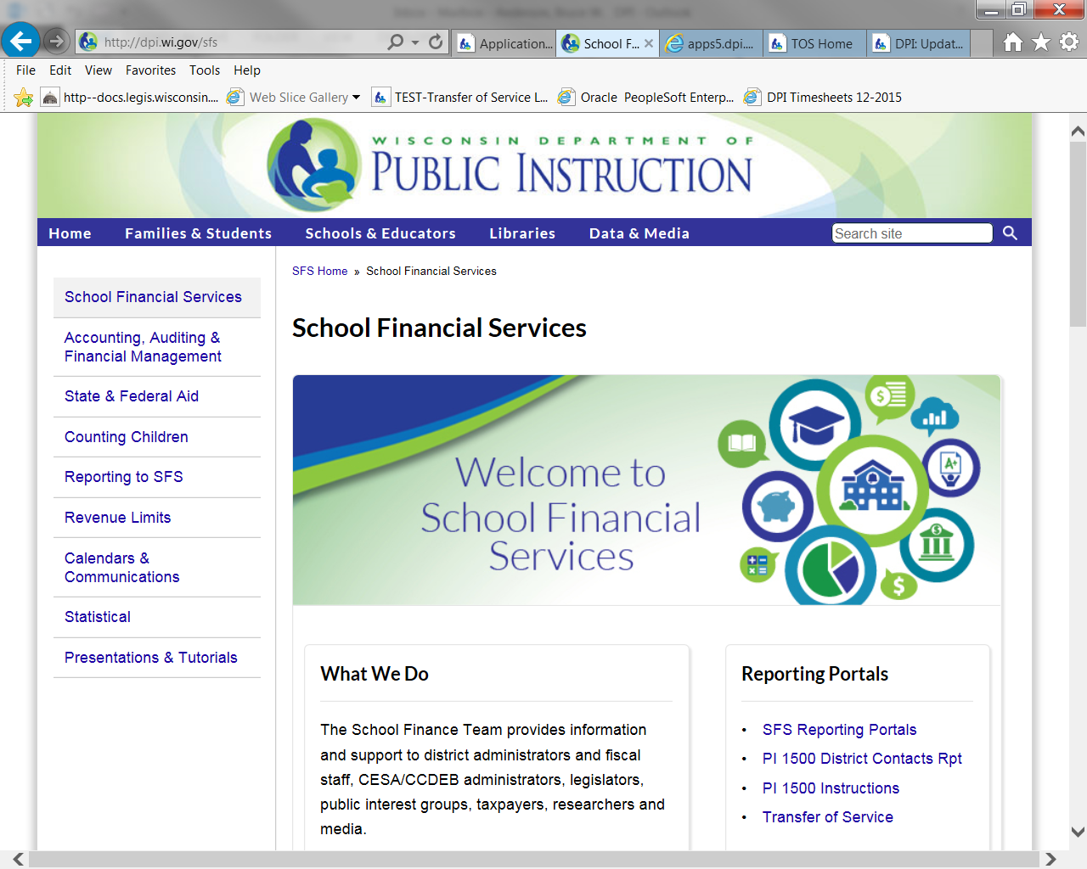
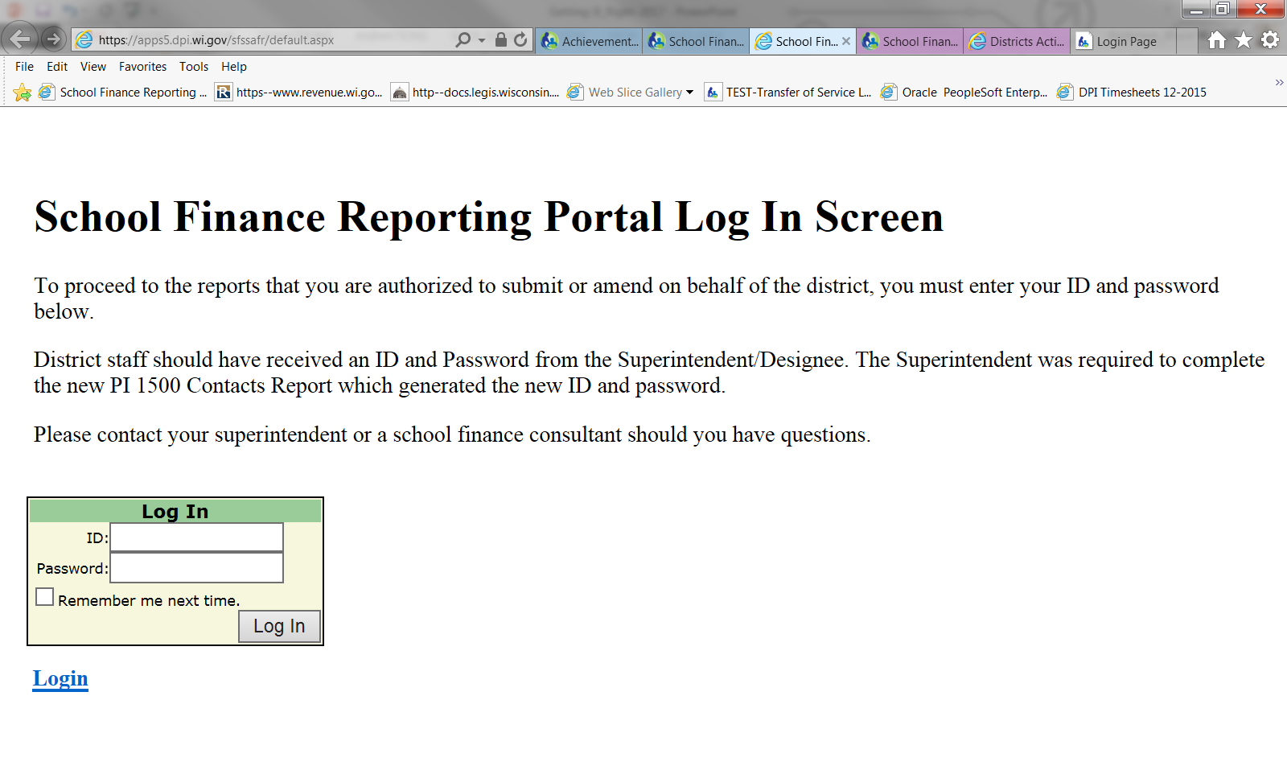
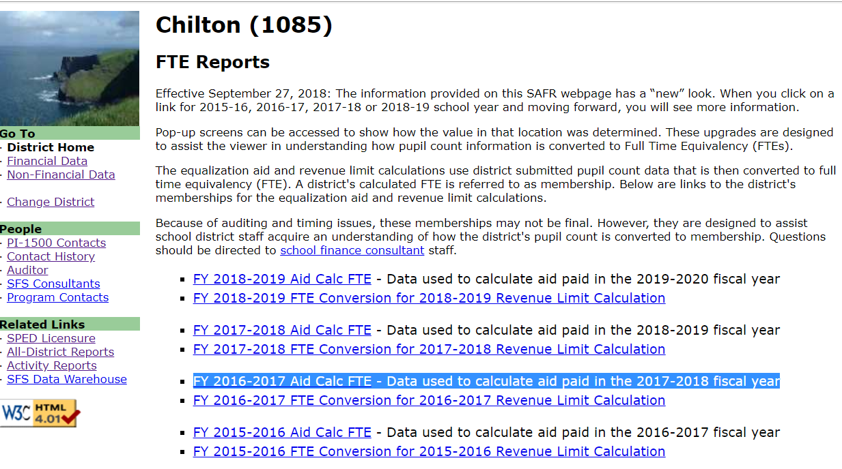
SAFR Membership Reports
Found on the SFS website at:
SFS Homepage>School Finance Reporting Portal>Log In>District Home>FTE Reports

Slide 29
September 2020 and Summer/Interim 2020 Membership SAFR Membership Report

Slide 30
September 2018 & Summer/Interim 2018 Membership SAFR Membership Report

Slide 31
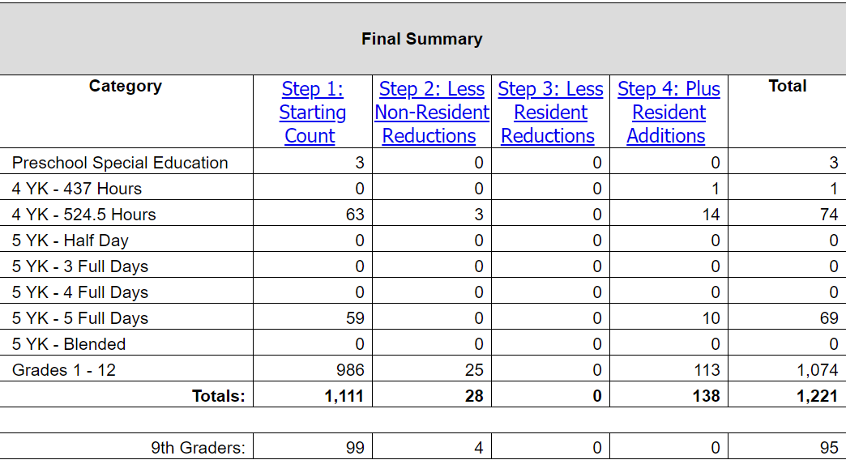
Straight Pupil Count (NOT used for much!) Need to convert to FTE!
Numbers need
to be converted
into an FTE!
Still needed:
9th grade count for the fall of 2020 “Personal Electronic Computing Device Grant process.”
SAFR/Non-Financial Data Home/
Membership Report/Final Summary

Slide 32
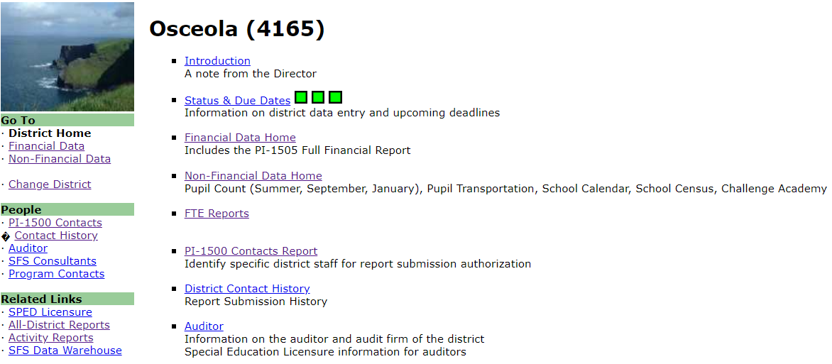
Revenue Limit Membership SAFR Membership Report

Slide 33
Pupil FTE data (used in the Revenue Limit!)
SAFR/FTE Reports/ FY 2020-21 FTE Conversion for Revenue Limit Calculation
(includes Challenge Academy students)

Slide 34
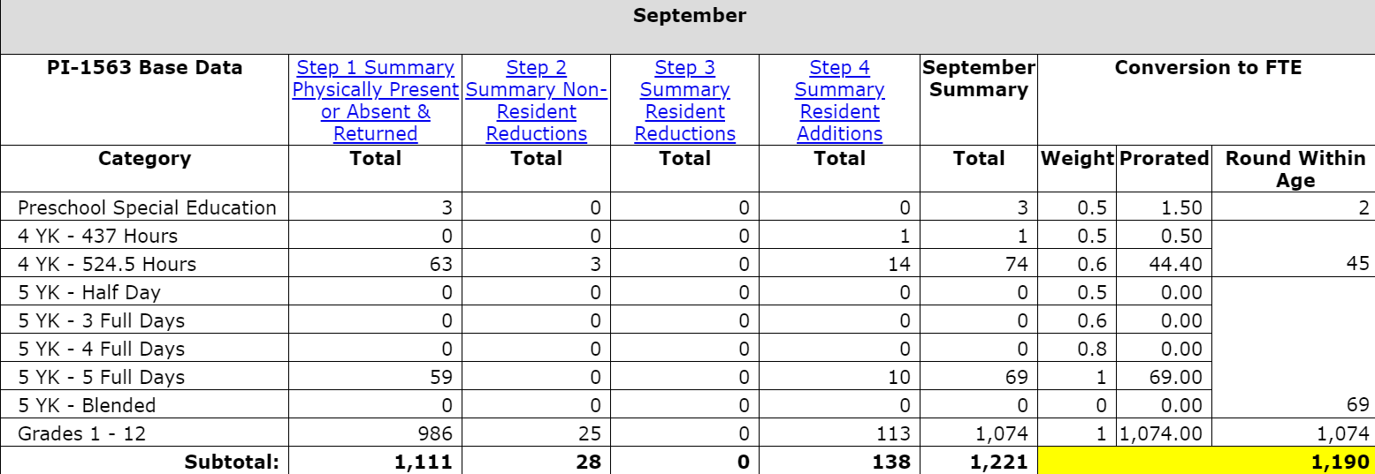
Pupil FTE Conversion (used in the Revenue Limit!)
SAFR/FTE Reports/ FY 2020-21 FTE Conversion for Revenue Limit Calculation
(includes Challenge Academy students)
Notes:
When you click on the blue colored number as seen in the previous slide (33), it will provide a chart of how the end value was calculated. This is a good item to share with your Board members.

Slide 35
FTE Membership
Both the Summer School/Interim FTE Membership and the 3rd Friday in September Pupil Count (PI-1563) are used in the Revenue Limit computation.
Each Interim session that ends after September 1st of a given school year will not be included in the Revenue Limit calculations until the following school year.
Remember: Where the student is educated is not necessarily important. Who is paying for the education is the critical detail.

Slide 36
Pupil Count Resources
http://dpi.wi.gov/sfs/children/enrollment/overview
The web address for everything “Membership.”
General Count Instructions for the PI-1563 Workbook
PI-1563 Pupil Count Workbook Form for Draft Use
http://dpi.wi.gov/sfs/children/enrollment/membership-info-reporting
Excel File: “Converting Count to FTE”

Slide 37
Enrollment Projections
Enrollment drives everything!
Find a reliable method to project your district’s enrollment.
You’ll need estimates of the upcoming Summer and 3rd Friday in September before you begin next year’s budget development process.

Slide 38
Step 1: Build the Base Revenue Line 2
Add the 3 previous year’s FTEs and divide by 3. This shows up in Line 2 on the second page of the worksheet.

Slide 39
Step 1: Summary
Lines 1-3
Base Revenue Per Member
(second page of worksheet)

Slide 40
Step 2: Calculate a New Revenue per Member
Line 4A
Line 4A: Each year, under current law, each district’s per member revenue limit may change.
Historically was an inflationary increase.
Recently has been fixed dollar amounts.
In 2019-20, line 4A = $175.00.
For 2020-21 the increase on Line 4A = $179.00
Notes:
*For the 2011-12 year, all districts had their base revenue limit per member reduced by 5.5%.

Slide 41
WORKING BREAK

Slide 42
Step 2: Calculate a New Revenue per Member
Lines 4B & 4C
With specific limitations tied to successful referenda to exceed revenue limits, the 2019 Wisconsin Act 19 has most districts with an increase in the low revenue ceiling per member to:
$9,700 in 2019-20
$10,000 in 2020-2021

Slide 43
Step 2: Calculate a New Revenue per Member Line 5
Line 5 is the sum of Lines 3 and 4 (auto-calculates).
*
**
* If your district received an additional increase to reach the 10,000 minimal revenue/member.
Notes:
A few districts will have a value 4.B.on the 2020-21 low Revenue Increase as they have passed the delay of an increase due to a failed referendum.

Slide 44
Step 2: Calculate a New Revenue per Member Line 6
The 2020 membership data comes from the FTE portal that was available when the data was uploaded, per time stamp.
The date on the Revenue Limit worksheet is very important (in Red). The SFS Team will update on a regular basis (usually daily) from now until November 6, 2020.
Notes:
If your district made changes to your pupil count data for 2012 after October 11, the FTE we have pre-populated in the revenue limit worksheet will not include those changes. The district will have to make the changes on its own.

Slide 45
Step 2: Calculate a New Revenue per Member Line 6
Current three year average membership = September (Third Friday) counts + 40% of Summer School FTE For 2020-21, use years 2018, 2019, and 2020.
Notes:
If your district made changes to your pupil count data for 2020 after October 15, the FTE we have pre-populated in the revenue limit worksheet will not include those changes. The district will have to make the changes on its own.

Slide 46
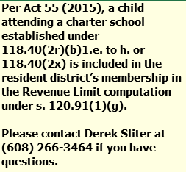
New ICS - Independent Charter Schools FTE
Residents of your school district’s area that are attending a Independent Charter School (ICS) authorized by the UW System Office of Educational Opportunity in 2020-21.
On lines/column 38 D and 39 D ( one joint cell) DPI will enter any of your students in this program.
To the right is the comment
for this location.
In June the public school districts aid will receive an aid deduction of $9,165 per new ICS FTE

Slide 47
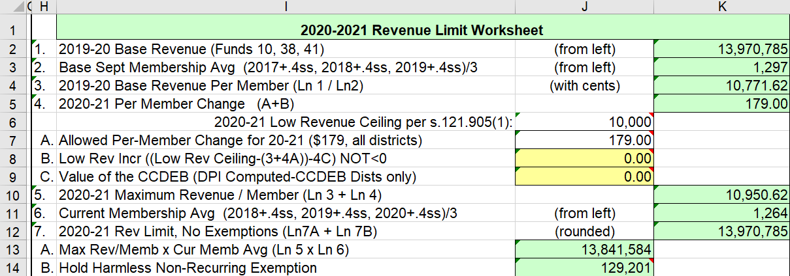
Step 2: Calculate a New Revenue per Member Line 7
In 2020-2021 – if a district’s 2019-2020 Base Revenue Per Member (line 3) was less than $10,000 and adjustment can be found on line 4 B, that is in addition to Per-Member Change.
Notes:
Same as in Slide 43 A few districts will have a value 4.B.on the 2020-21 low Revenue Increase as they have passed the delay of an increase due to a failed referendum.

Slide 48
Step 2: Summary
Lines 1-7

Slide 49
Step 3: Determine Allowable Exemptions Lines 8-11
Exemptions to the Revenue Limit allow districts to levy additional amounts up and above the amount generated by the computation up to this point.
Line 8 tracks Recurring Exemptions.
Line 10 tracks Non-Recurring Exemptions.
It’s important to understand the distinction between the two.

Slide 50
Step 3: Determine Allowable Exemptions Line 8
Recurring Exemptions (Lines 8A-E) are base-building – that is, if the district taxes for any of this additional authority, the levy amount is automatically included in the succeeding year’s base.

Slide 51
Step 3: Determine Allowable Exemptions Line 8
Line 8A – Prior Year Carryover – unused levy authority from prior year allowed to be used in current year. (DPI provides)
Line 8B – Transfer of Service - a school district which assumes responsibility for a program or service from another governmental unit may request and be granted an exemption to the district revenue limit equal to the increased cost due to that program or service. (special education or ESL services)
Line 8E – Recurring Referenda to Exceed – referenda amount (normally, if 2020-21 is the first year). Call DPI if you have questions.

Slide 52
Step 3: Determine Allowable Exemptions Line 10
Non-Recurring Exemptions (Lines 10A-I) are not base-building – that is, if a district taxes for any of these exemptions, the amount is not included in the succeeding year’s base.
Notes:
Adjustments for private school voucher students were provided by DPI on Monday, October 15, 2020. This non-recurring exemption (Line 10H) and Private school Special Needs Voucher Aid deduction is also an non-recurring exemption (Line 10I) reflects the maximum state aid deduction as a result of the voucher payments from resident districts ($8,046 per K-8 & $8,692 per 9-12 FTE student and $12,723 for Special Needs under current law). Essentially, this exemption and transfer would have zero impact on the district’s annual budget. State aids is reduced and the school board is granted authority to increase property taxes to replace the loss of state school aids. The private school students in the voucher programs ARE NOT counted in the district’s membership report (PI 1563). DPI provides the private school student counts for purposes of the following year’s Equalization Aid calculation.

Slide 53
Know the Difference !
Recurring Exemptions – Rolling forward in Your Base
This Year
Next Year
Recurring
Base
Line 8
Base
Non-Recurring Exemptions – One Year Only
This Year
Next Year
Non-Recurring
Base
Base
Line 10
Notes:
Each works differently. Important to know what it does to your base. How they work can determine how the district uses them.

Slide 54
Non-Recurring Exemptions
The exemption is only valid for a limited period of time – usually one Revenue Limit cycle.
2018-19 Revenue Limit
2019-20 Revenue Limit
Hold Harmless (Line 7B)
Declining Enrollment
Energy Efficiency
Adjustment for new
Choice Students
Aid
+
Levy
Allowed Per-Member
Change $175
Base
Base
Base Will Include Only
Levied
Recurring Authority
from the Prior Year
15

Slide 55
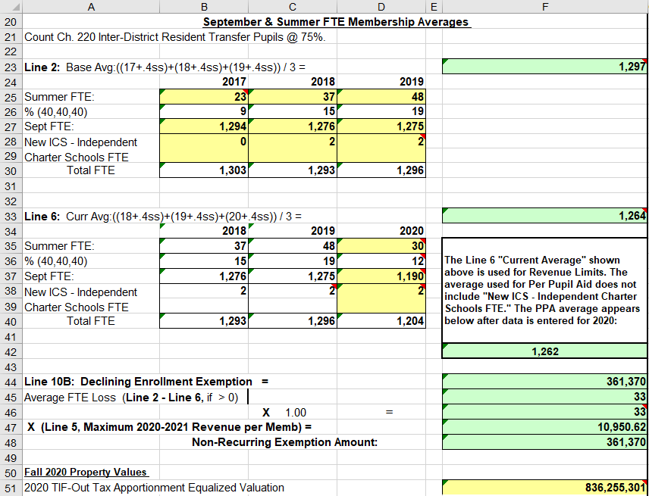
Step 3: Determine Allowable Exemptions Line 10
Line 10A – Non-Recurring Referenda – district has a successful referenda. Use the amount for 19-20.
Line 10B – Declining Enrollment
Page 2
Page 1
Line 10B (right side), Declining Enrollment Exemption, will auto-fill based on the Summer and September membership numbers entered on the left side of the worksheet.

Slide 56
Step 3: Determine Allowable Exemptions Line 10
Line 10C – Energy Efficiency – exemption to fund a project to implement energy efficiency measures or to purchase energy efficiency products. See DPI Rule and info at: http://dpi.wi.gov/sfs/limits/exemptions/overview
Districts are no longer able to pass/amend resolutions after December 31, 2017
Multi-year reconciliation is located on page 4 of the worksheet.

Slide 57
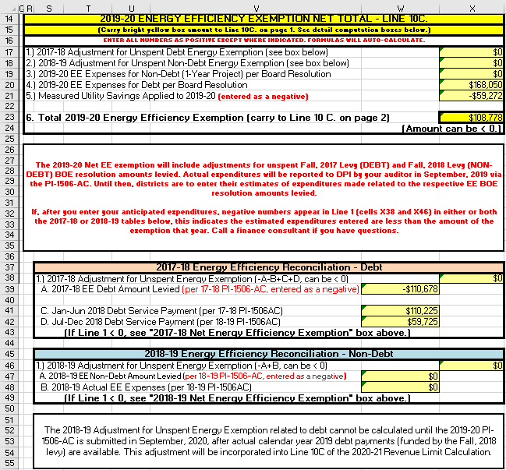
Step 3: Determine Allowable Exemptions Line 10C Energy Efficiency

Slide 58
Step 3: Determine Allowable Exemptions Line 10
Line 10D – Adjustment for Rescinded Taxes – exemption to recover the funds refunded to a taxpayer whose property value had subsequently been reduced by a court action and/or a reviewing authority (Letter from DOR is the basis for amount). DOR provides amounts.
Line 10E - Prior Year Open Enrollment (uncounted pupils) – exemption to compensate for not counting Open Enrollment pupils from the prior year.
Line 10F – Reduction for Ineligible Fund 80 Expenditures – http://dpi.wi.gov/sfs/finances/fund-info/community-service/overview
10H – WPCP and RPCP Private School Voucher Aid Deduction – allows a district to levy for the aid deduction related to this new program.
10I – SNSP Private School Voucher Aid Deduction– allows a district to levy for the aid deduction related to this new program.
Remember, any unused Non-Recurring authority is not eligible for carryover in the next year – districts have one, and only one, opportunity to use Non-Recurring exemptions.

Slide 59
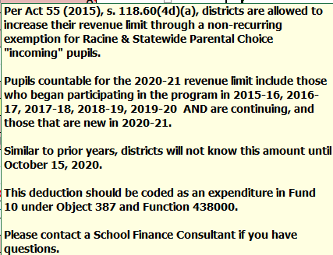
Step 3: Determine Allowable Exemptions Line 10
10H – Adjustment for New Statewide Choice Pupils – allows a district to levy for the aid deduction related to this new program.
WUFAR Code: Debit: Fund 10, Function 438000, Object 387

Slide 60
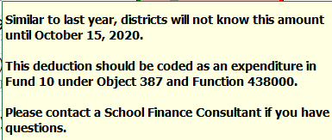
Step 3: Determine Allowable Exemptions Line 10
Line 10.I, SNSP Private School Voucher Aid Deduction

Slide 61
Step 3: Determine Allowable Exemptions Lines 8-11
Line 11 2019-20 Revenue Limit With All Exemptions (Ln 9 + Ln 10).
This is the total revenue your district can receive from the combination of property tax from Funds 10, 38, and 41, State General Aid (Equalization, Special Adjustment, and Integration Aids), High Poverty Aid, and State Computer Aid.

Slide 62
Revenue Limits & Budget-Building
Watch Change Across Time – Line 11
Year 1
Year 2
Year 3
Total Revenue Limit with Exemptions
Total Revenue Limit with Exemptions
Total Revenue Limit with Exemptions
Line 11 represents the total amount of resource your district will get from property tax, state general aids, and exempt computer aid. This will equal about 85-95% of general fund revenues.
For budgeting purposes, it’s very important to compare your new Line 11 with the previous year’s Line 11. Major decreases in Line 11 from year to year can have serious implications for your budget.
Notes:
We’ve talked about what happens within the computation in a single year, but you need to also watch what happened from year to year.
Line 11

Slide 63
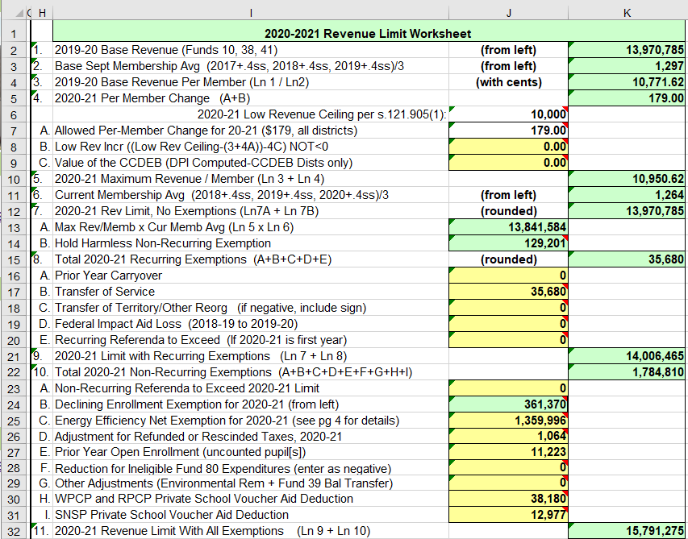
Fly-Over Review of Lines 1 – 11

Slide 64
Step 4: Determine Levy
Controlled Amounts - Lines 12-14
General State Aid (12A) High Poverty Aid (12B)
Computer Aid (12C)
Aid for Exempt Personal Property (12D)
Fund 10, General Fund Levy (14A)
Fund 38, Non-Referendum Debt Levy (14B)
Fund 41, Capital Projects Levy (14C)
Non-Controlled Amounts - Line 15
Fund 39 [non-Fund 38], Referendum Debt Levy (15A)
Fund 80, Community Service Fund (15B)
Fund 10, Src 212, Property Tax Chargebacks (15C)

Slide 65
Aid Certification - Line 12
12A. General Aid (October 15 Cert.)
12B. State Aid to High Poverty Districts (not all districts)
12C. State Aid for Exempt Computers
12D. State Aid for Exempt Personal Property (new in 2018-19)
Line 13 must now be divided between the Fund 10 levy, the Fund 38 levy and the Fund 41 levy
Notes:
Computer aid moved from Line 17 in the 2017-18 Revenue Limit to Line 12C in the 2018-19 calculation. State law changed how this was calculated and we no longer need to base it on the amount being levied so we simplified the worksheet. One of the few opportunities we ever get to do that, so we took it.

Slide 66
Controlled Amounts Line 14
October 15 Aid Certification, High Poverty Aid, Computer Aid, and Aid for Exempt Personal Property reduce what you can levy.
Line 11 – Total Resources from Property Tax and General Aid
Line 13
Allowable
Limited
Levy Revenue
Fund 10 Levy
Fund 38 Levy
Fund 41 Levy

Slide 67
Strategy - Line 14
If 14 is > 13:
First, type in the amounts you intend to levy for Funds 38 and 41 (lines 14B & 14C).
Then, subtract (14B+14C) from line 13. Enter into line 14A.
By doing this, you have levied to your maximum. Note that districts may choose to levy less than the maximum.
Remember: Line 14 cannot exceed Line 13 ! If it does, you will receive a message in red that you have exceeded the limit and should reduce something in Lines 14A, B, or C to avoid overlevying.

Slide 68
Non-Controlled Amounts Line 15
Enter anticipated levy amounts
into Lines 15 A, B, & C.
Notice Line 15 D is for Milwaukee and Kenosha only.

Slide 69
TIF-Out Apportionment Equalized Valuation
Before October 15th, you will need to enter the “2020 TIF-Out Tax Apportionment Equalized Valuation” in the cell to the right of the title on page 1 of the worksheet.
(The Department of Revenue certified the 2020 Property Values on October 1, 2020.)
This value is use to calculate the “Levy Rate”, on the last line on page 2.

Slide 70
Total All Fund Levy - Line 16
Line 16 is the sum of all levies from all funds (line 14 & line 15).
Line 16 is the levy to be apportioned to municipalities and must equal the total amounts on the PI-401.

Slide 71
Just a Reminder!
Districts are responsible for the integrity of the revenue limit data & computation. Data appearing here reflects information submitted to DPI and is unaudited.
The Revenue Limit worksheets posted to the DPI Website are pre-populated with the most recent data available to DPI from district reports (e.g., membership, referenda results).
In other words … the worksheets are not “real time” – watch for the “Revised on” date at the top of the worksheet.

Slide 72
Takeaway:
Be aware of the type of exemptions in your computation and the effect of under levying.

Slide 73
HOW DOES UNDERLEVYING AFFECT ME?

Slide 74
Revenue Limit Exemptions
Recurring Exemptions(Line 8)
Prior-Year Carryover
Transfer of Service
Transfer of Territory
Federal Impact Aid Loss
Recurring Referenda to Exceed (if year 1 of authority)
Non-Recurring Exemptions
Line 7B - Hold Harmless Non-Recurring Exemption
10.A - Non-Recurring Referenda to Exceed 2019-20 Limit
10.B - Declining Enrollment Exemption for 2019-20 (from left)
10.C - Energy Efficiency Exemption
10.D - Adjustment for Refunded/Rescinded Taxes
10.E - Prior Year Open Enrollment
10.F - Ineligible Fund 80 Expenses
10.G - Environmental Remediation Exemption
10.H - WPCP and RPCP Voucher Deduct
10.I - SNSP Voucher Deduct

Slide 75
#1 - Recurring Exemptions, Levied to Max
(District with a 500 members)
2018-19
2019-20
Allowed Per-Member
Change $175
Recurring Referendum
Prior Year Aid
plus
Levies
(no backouts)
Transfer of Service
Base
Base
Aid
+
Levy
$10,087,500
$10,000,000
This district used all of its authority and has no carryover for 2019-20, Line 8A.
Notes:
It should be a verbal notation that the $175 per member change in 2019-20 versus $0 in 2018-19 can cause the base to increase for 2020-21.
Stress that once the Recurring Exemptions are levied, they become part of the base in the next year and moving forward so they won’t show up again as exemptions.
2018-19 Info:
Base of $7.0 million
TOS of $200K
Recurring Referendum of $2.8M, first year, then this amount is built into the base.
Total Authority of $10.0M
Aid/Levy of $10.0M
2019-20 Info:
Base in 2019-20
$10.0M of levied Base/Recurring exemptions in 2018-19
$87,500 of Per Member Authority (500*$175)
Non-Base info
Carryover Authority on Line 8A = $0

Slide 76
#2 - Recurring Exemptions, Underlevy
(District with a 500 members)
2018-19
2019-20
$200,000 carryover
$9,887,500
$10,000,000
Allowed Per-Member
Change $175
Recurring Referendum
Prior Year Aid
plus
Levies
(no backouts)
Transfer of Service
Base
Aid
+
Levy
Base
Underlevied by $200,000
This district has a $200,000 carryover for 2019-20, Line 8A.
Notes:
2018-19 Info:
Base of $7.0 million
TOS of $200K
Recurring Referendum of $2.8M
Total Authority of $10.0M
District’s board chooses to under levy by $200,000 in 2018-19. Aid/Levy of $9.8M. This amount will be carried over to 2019-20 since there are no other non-recurring items to consider.
2019-20 Info:
Base calculation
$9.8M of levied Base/Recurring exemptions in 2018-19
$87,500 of Per Member Authority (500*$175)
Non-Base info
District will also receive a $200K Recurring Exemption on Line 8A in 2019-20 for unused Base/Recurring authority from 2018-19

Slide 77
#3 - Non-Recurring Exemptions, Levied to Max
(District with a 500 members)
2018-19
2019-20
$9,100,000
$9,237,500
Decl Enroll - $100,000
Allowed Per-Member
Change $175
Base
Prior Year Aid
plus
Levies
Aid
+
Levy
Base
In this district, in 2019-20, the Allowed Per-Member change will cover $89,500 of the Decl Enroll amount in 2018-19 and the base will be down by $10,500
Notes:
2018-19 Info:
Base of $7.0 million
Recurring Referendum of $2M
Non-recurring exemption (declining enrollment) of $100K
Total Authority of $9.1M
Total aid/levy of $9.1M
2019-20 Info:
Base calculation
$9.0M of levied Base/Recurring exemptions in 2018-19
$150,000 Declining Enrollment from 2018-19
Equals $9,150,000 Base for 2019-20
Add $87,500 of Per Member Authority (500*$175)
Total Authority of $9,237,500M
Non-Base info
Carryover Authority on Line 8A = $0

Slide 78
#4 – Non-recurring Exemption, Recurring, and Underlevy
(District with a 500 members)
2018-19
2019-20
$7,587,500
$7,536,000
Allowed Per-Member
Change $175
Declining Enrollment-$46,000
Transfer of Service
Prior Year Aid
plus
Levies
Low Revenue Increase
Base
Aid
+
Levy
Base
Underlevied by $10,000
This district will have no carryover authority to 2019-20 in Line 8A. (as the Underlevied amount did not role forward)
Notes:
2018-19 Info:
Base of $7.0 million
Transfer of Service $250K
Low Revenue $250K
Non-recurring exemption of $46K
Total Authority of $7,546,000
Aid/Levy of $7,536,000 – under levy of $10,000
2019-20 Info:
Base calculation
$7.5M of levied Base/Recurring exemptions in 2018-19
$87,500 of Per Member Authority (500*$175)
Base = $7,500,000 + $87,500 = $7,587,500
Non-Base info
Carryover Authority on Line 8A = $0
The under levy from 2018-19 cannot roll forward due to the under levy being less than the Non-Recurring (one-time) exemption of $46K. Non-recurring exemptions are one-time authority the board can chose to levy for the current year only. Each year non-recurring exemptions are re-calculated to see if the district qualifies based on the criteria set in statutes for each of the types of non-recurring exemptions.

Slide 79
#5 - Non-recurring Exemption, Other Recurring, Underlevy
(District with a 500 members)
2018-19
2019-20
$8,990,000
$10,000 carryover (not included)
$9,077,500
Declining Enrollment-$46,000
Allowed Per-Member
Change $175
Transfer of Service
Operating Referenda
Prior Year Aid
plus
Levies
(no backout)
Base
Aid
+
Levy
Base
Underlevied by $56,000
This district will have $10,000 in
carryover authority in Line 8A.
Notes:
2018-19 Info:
Base of $7.0 million
Transfer of Service $250K
Recurring Referenda $1.75M
Non-recurring exemption of $46K
Total Authority of $9,046,000
Aid/Levy of $8,990,000 – under levy of $56,000
2019-20 Info:
Base calculation
$8,990,000 of levied Base/Recurring exemptions in 2018-19
$87,500 of Per Member Authority (500*$175)
Base = $8,990,000 + $87,500 = $9,077,500
Non-Base info
Carryover Authority on Line 8A = $10,000
Only $10,000 of the under levy from 2018-19 rolls forward as $46,000 of the $56,000 total under levy related to Non-recurring exemptions which are one-time authority. Under levies are first applied to one-time authority and then anything that exceeds the total non-recurring exemption amounts for that year are able to be carried forward and added to the next year’s calculation as carryover authority.

Slide 80
#6 –Hold Harmless (non-recurring), Nonrecurring Exemption, Recurring, & Underlevy
(District with a 500 members)
2018-19
2019-20
$7,240,000
$10,000 carryover (not included yet)
$10,000
$7,327,500
Decl Enroll - $200,000
Allowed Per-Member
Change $175
Hold Harmless(Ln7) - $40,000
Ref - $250,000
Prior Year Aid
+
Levies
Base
Aid
+
Levy
Base
Underlevied by $250,000
Notes:
2018-19 Info:
Base of $7.0 million
Recurring Referenda $250K
Non-recurring exemptions – total of $240,000
Declining Enrollment of $200,000
Hold Harmless of $40,000
Total Authority of $7,490,000
Aid/Levy of $7,240,000 – under levy of $250,000
2019-20 Info:
Base calculation
$7,240,000 of levied Base/Recurring exemptions in 2018-19
$89,500 of Per Member Authority (500*$175)
Base = $7,240,000 + $87,500 = $7,327,500
Non-Base info
Carryover Authority on Line 8A = $41,248
Only $10,000 of the under levy from 2018-19 rolls forward as $240,000 of the $250,000 total under levy related to Non-recurring exemptions which are one-time authority. Under levies are first applied to one-time authority and then anything that exceeds the total non-recurring exemption amounts for that year are able to be carried forward and added to the next year’s calculation as carryover authority.

Slide 81
WORKING BREAK

Slide 82
You Are Ready to Set the Levy When…
…you’ve finished your revenue limit calculation, which incorporates:
Third Friday in September and Summer 2020 Counts
October 1 Property Tax Values
October 15 General Aid Certification

Slide 83
Levy Certification – Sample District
Line 14A | Fund 10 | = | $7,273,790
Line 14B | Fund 38 | = | $0
Line 14C | Fund 41 | = | $75,000
Line 15A | Fund 39 | = | $1,765,354
Line 15B | Fund 80 | = | $20,000
Line 15C | Chargeback | = | $0
Line 16 | Total All-Fund Levy |  | $9,134,144
Notes:
Update on Monday

Slide 84
Levy Certification
On or before November 1, 2020, your school board needs to vote on the district property tax levy for 2020-21.
After the levies have been set, district staff will use an internet-based report (PI-401) to certify the district’s levy to municipalities and to report the data to both DPI and the Department of Revenue. This report is due on November 6th, five days after the Nov. 1 deadline for school boards to set their levies.

Slide 85
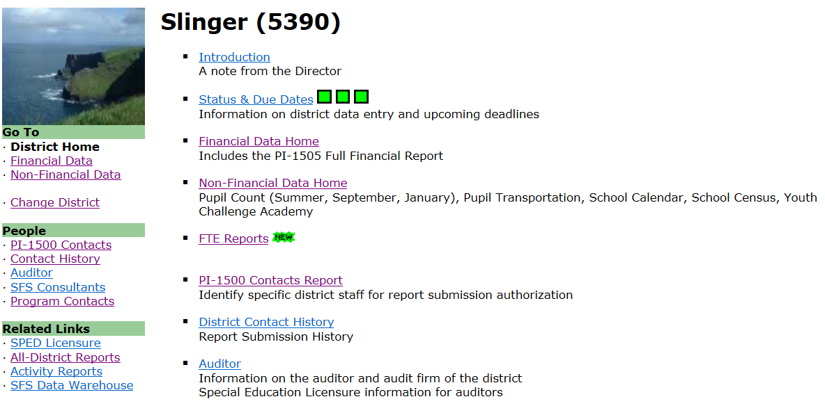
Levy Certification (PI-401)
SAFR/Financial Data Home/Tax Levies/2018-19

Slide 86
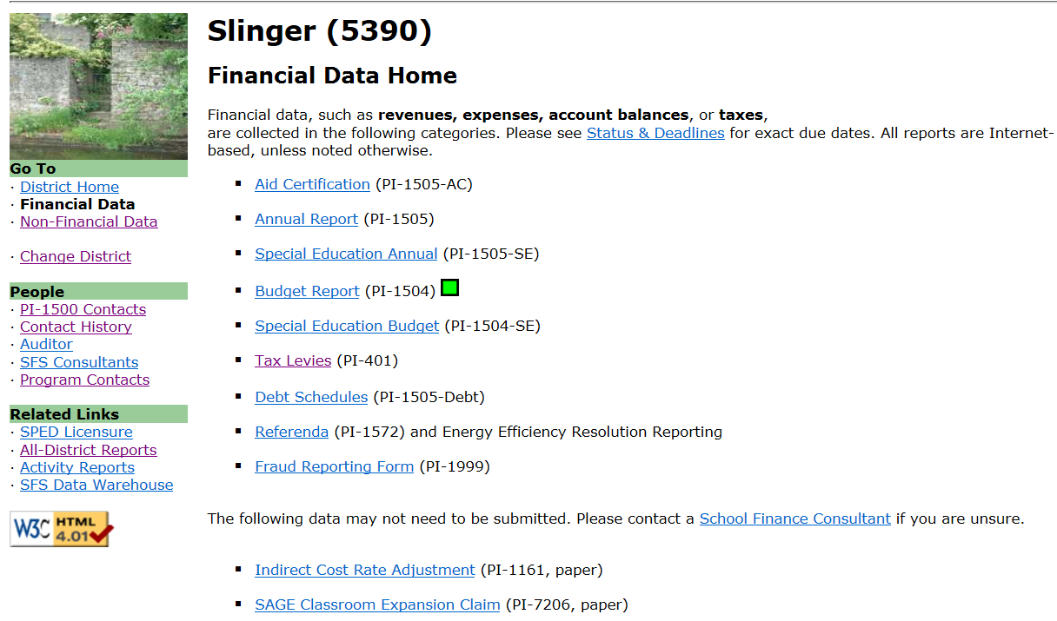
Levy Certification (PI-401)

Slide 87
Levy Certification – Enter Info
Does this match Line 16 on your revenue limit worksheet?????? It should.
This screenshot and the data shown are to be an example only.
Notes:
Data from fall of 2019

Slide 88
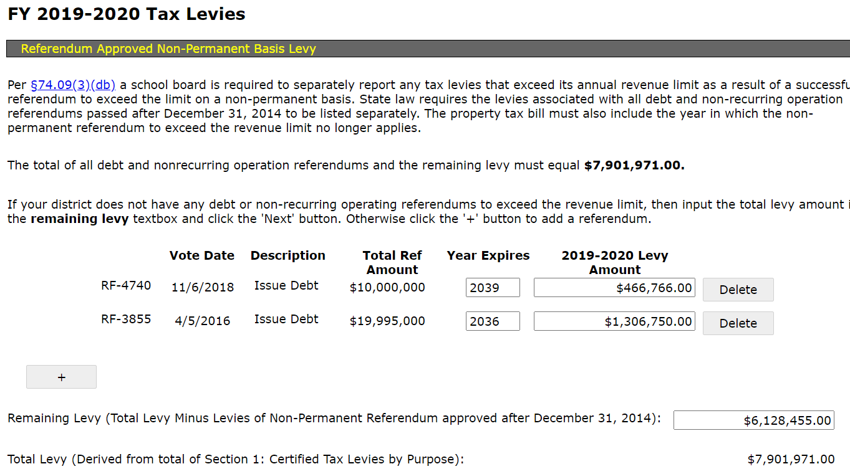
Levy Certification – Enter Info (non-permanent referendum)
This screenshot and the data shown are to be an example only.

Slide 89
Levy Certification – Enter Info (non-permanent referendum)
This screenshot and the data shown are to be an example only.

Slide 90
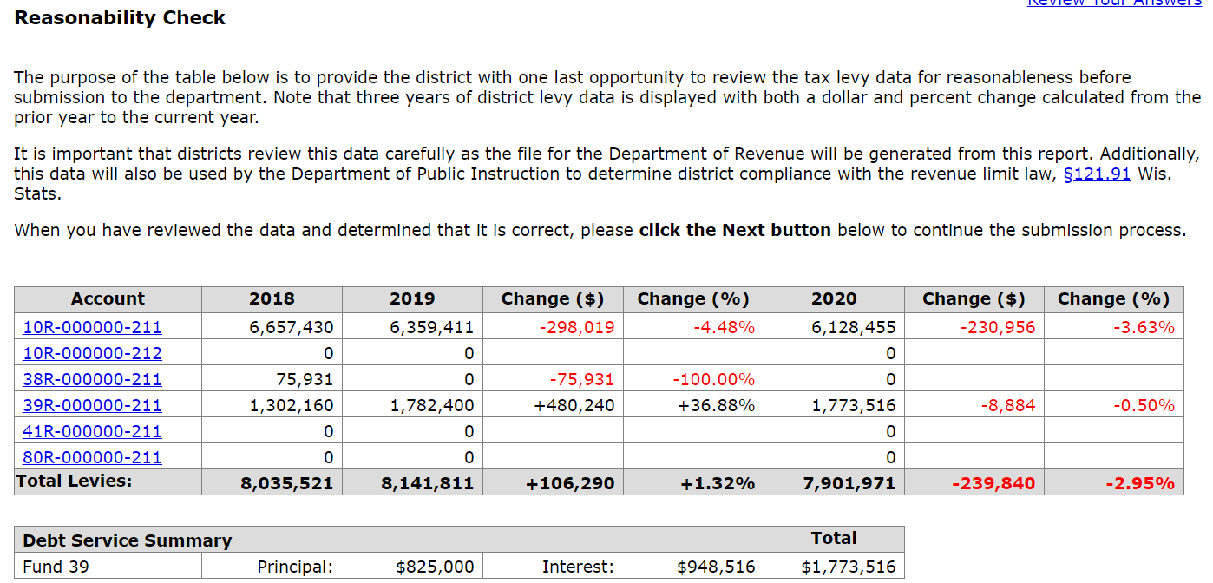
Levy Certification – Reasonability Check
This screenshot and the data shown are to be an example only.
Notes:
Do on Monday

Slide 91
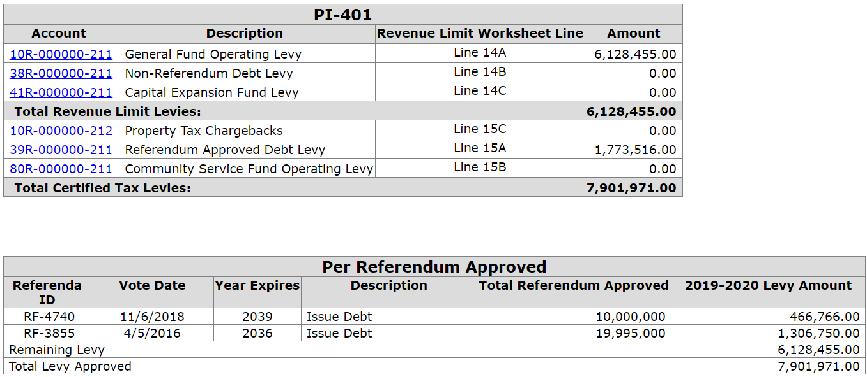
Levy Certification – Enter Info (non-permanent referendum)
39R is one payment for two referenda approved on the same date, the district must divide the payment between the two questions.
This screenshot and the data shown are to be an example only.

Slide 92
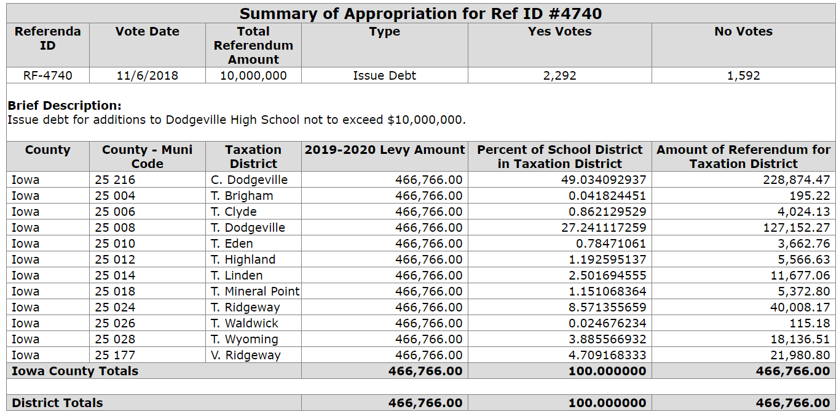
Levy Certification – Enter Info ((non-permanent referendum)
This screenshot and the data shown are to be an example only.

Slide 93
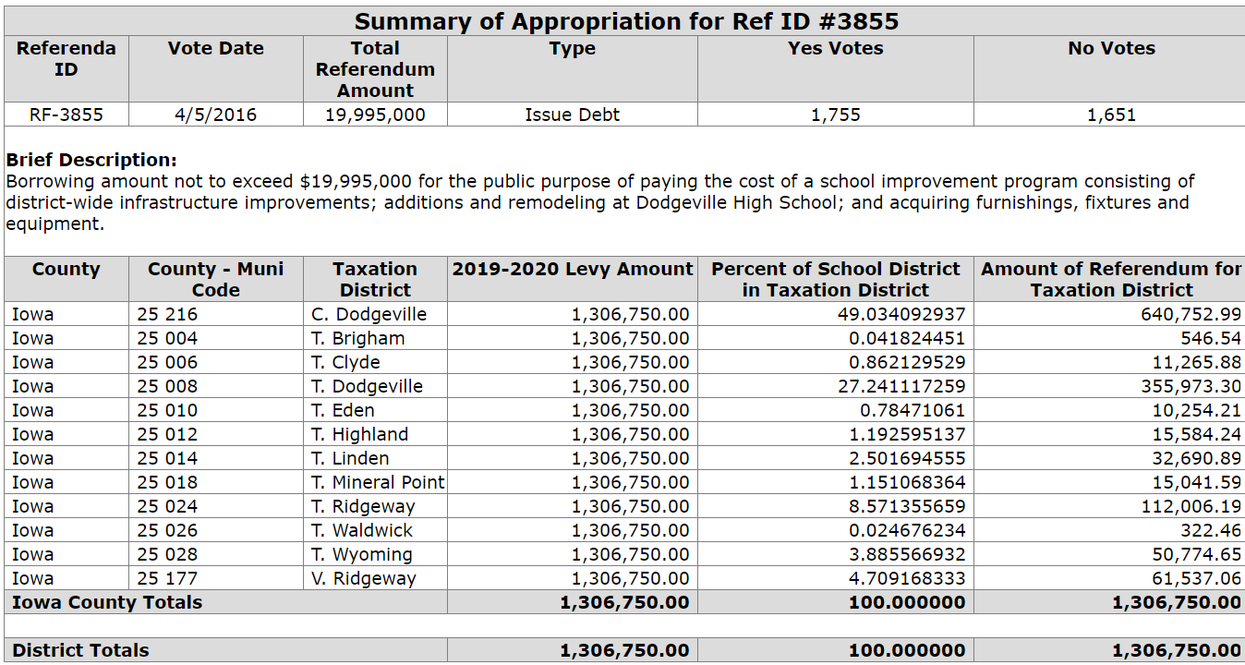
Levy Certification – Enter Info (non-permanent referendum)
This screenshot and the data shown are to be an example only.

Slide 94
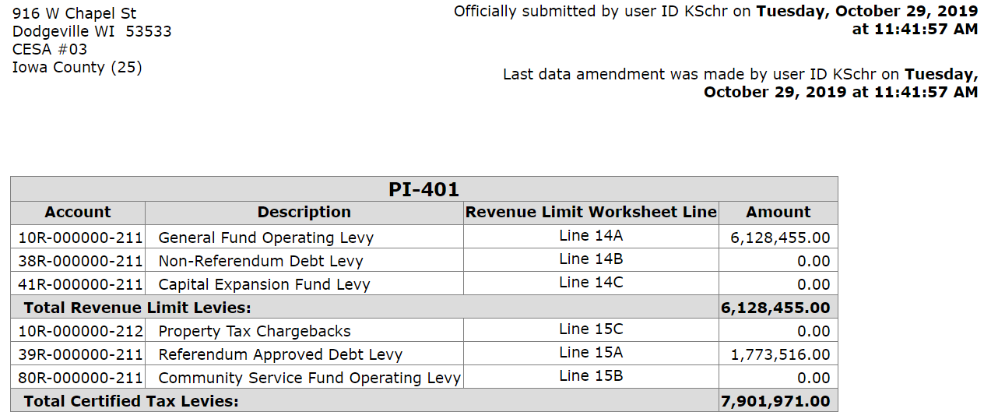
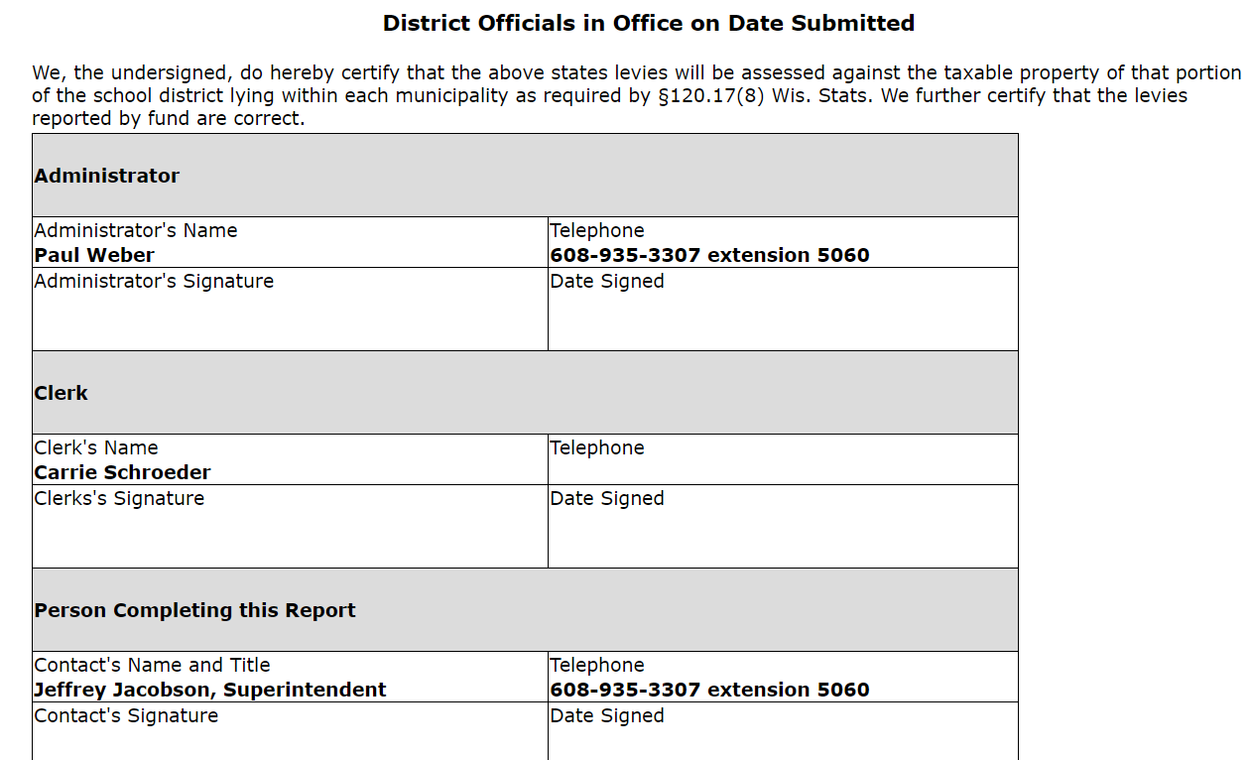
Levy Certification – District Officials Signatures
This screenshot and the data shown are to be an example only.

Slide 95
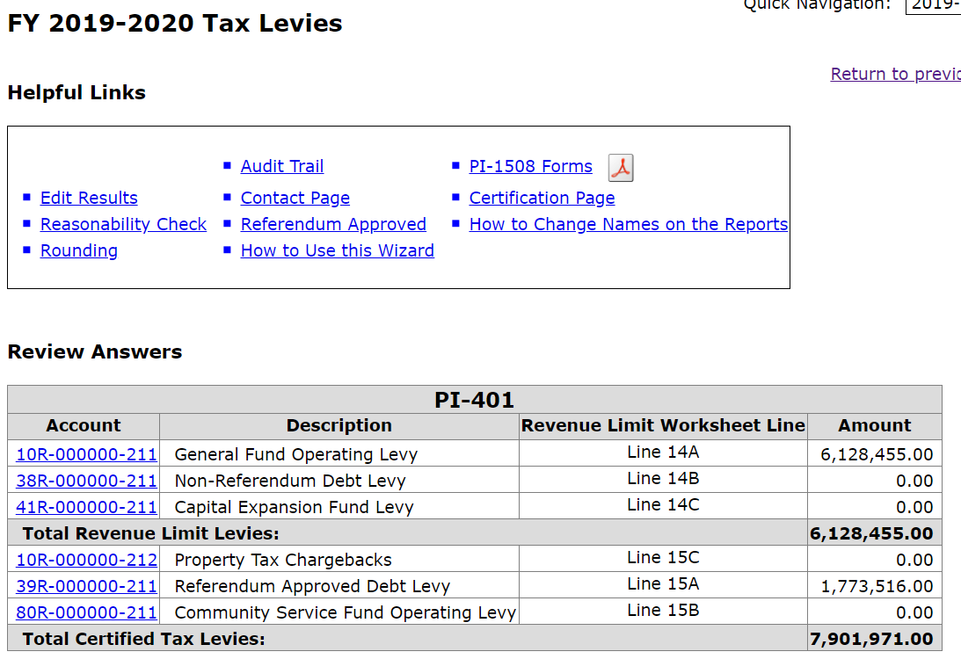
Levy Certification – Print Tax Bills

Slide 96
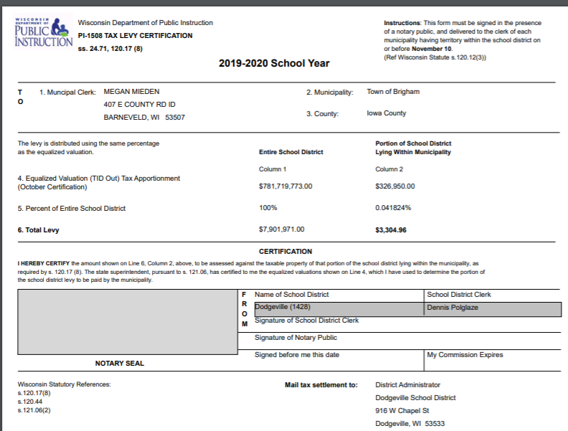
Levy Certification – Tax Bills (Page 1)
This screenshot and the data shown are to be an example only.

Slide 97
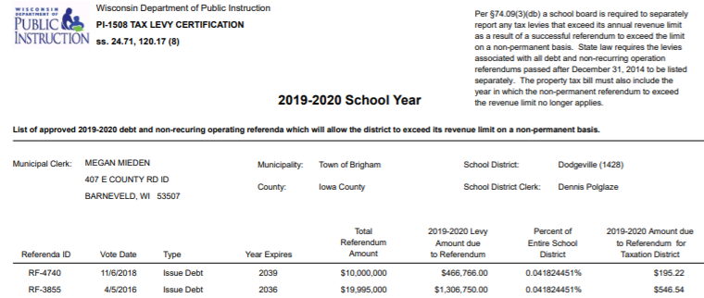
Levy Certification – Tax Bills with non-permanent referendum data (Page 2)
This screenshot and the data shown are to be an example only.

Slide 98
Levy Certification
Congratulations! You are done!
The information you have provided will be submitted to the Wisconsin Department of Revenue (DOR) by the Department of Public instruction on your behalf. Your district no longer needs to send a paper report to DOR.
Gather the appropriate signatures on the tax bills and certification page, mail your tax bills, and take the afternoon off!

Slide 99
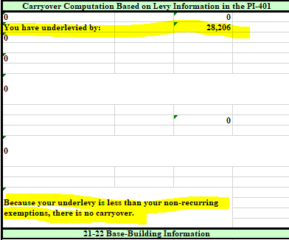
DPI Reconciliation
DPI will run programs in the background and manually populate the tax amounts from the district’s PI-401, once it is submitted. If a district underlevies or over levies, it will be indicated on the bottom half. In this case, the district levied to its maximum.

Slide 100
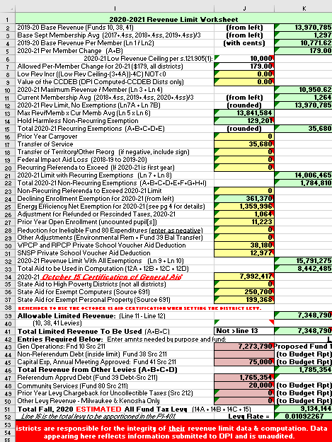
Budget Building
Budget Planning Papers Not yet updated
Revenue Limit Calculation
Notes:
This slide lays out the “Big Picture” of the budgeting cycle.
Districts initially update their enrollment projections in December and complete a “first look” at the new-year revenue limit computation. This computation is not static – it needs to be updated by the district as new/revised information is received.
To get an accurate budget assessment, once the initial revenue limit has been completed, there are 3 crucial numbers created by the rl calculation that must be incorporated in the budget development papers – General Aid Estimate, Fund 10 Levy, and Computer Aid.
The budget development papers are nothing more than enumerating all known revenues and expenditures for the coming year. So, the district needs to examine all revenues and expenditures and adjust as necessary. The goal is to get to the bottom line early in the budgeting cycle. This structural deficit will determine what cuts have to be made.
Adjustments to the revenue limit may happen throughout the timeframe from January to the 3rd Friday, when things start to solidify. In a short 3 weeks from the 3rd Friday in September to the October 15 aid certification, districts get all the information they need to set their levies.
Once October 15 arrives, districts can adjust their budgets, set their levies, and fill out/send their tax bills.

Slide 101
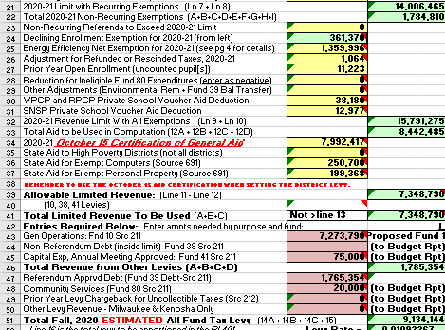
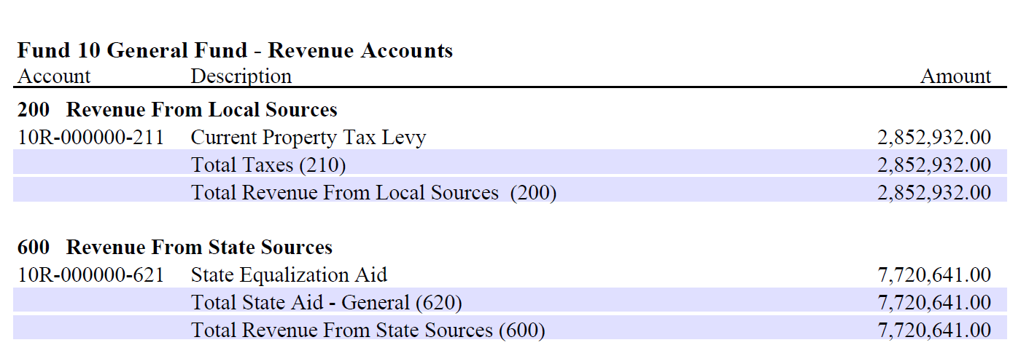
Levy Certification and the Budget Report
Lines 12 A,B,C&D, 14 A,B&C, and 15 A-D need to be transferred to the budget report.

Slide 102
Tie It All Together
What’s tied together? The levies on the following should all be the same:
Revenue Limit Worksheet
DPI PI-401
PI-1508 (Tax Bills)
2019-20 DPI Budget Report

Slide 103
Budget/Revenue Limit Roadmap
(January)
Revenue Limit Calculation
Summer 2017 Count, 3rd Friday Sept Count,
Oct 1 Tax Values,
October 15 Aid Cert.
Certify Levies via
PI-401 (in portal) Late Oct
Preliminary Budget?
Annual Meeting?
Original
Budget
Budget Planning Papers
(basis for full budget)
Send tax bills.
PI-1508
Early Nov
Budget Adjustments to BOE
Budget Report PI-1504 (Early Dec)
Notes:
This slide lays out the “Big Picture” of the budgeting cycle.
Districts initially update their enrollment projections in December and complete a “first look” at the new-year revenue limit computation. This computation is not static – it needs to be updated by the district as new/revised information is received.
To get an accurate budget assessment, once the initial revenue limit has been completed, there are 3 crucial numbers created by the rl calculation that must be incorporated in the budget development papers – General Aid Estimate, Fund 10 Levy, and Computer Aid.
The budget development papers are nothing more than enumerating all known revenues and expenditures for the coming year. So, the district needs to examine all revenues and expenditures and adjust as necessary. The goal is to get to the bottom line early in the budgeting cycle. This structural deficit will determine what cuts have to be made.
Adjustments to the revenue limit may happen throughout the timeframe from January to the 3rd Friday, when things start to solidify. In a short 3 weeks from the 3rd Friday in September to the October 15 aid certification, districts get all the information they need to set their levies.
Once October 15 arrives, districts can adjust their budgets, set their levies, and fill out/send their tax bills.

Slide 104
Tie It All Together
Once you submit the levy reports to DOR and DPI, and the budget report to DPI, the process is completed …..
…..until next year……

Slide 105
Board Responsibilities
Adopt the Budget
Approve an Appropriate Tax Levy (by November 1st)

Slide 106
Important Dates
On or before November 10th – last day to certify levy to municipalities
The PI-401 Report is due to DPI on November 7th (so we can have time to remind districts of November 10th Certification deadline). If you have a referendum on the 6th, submit as soon as possible.
December 1st– Special Ed Budget Due to DPI (PI-1504 SE)
December 1st - Budget Report due (PI-1504)

Slide 107
EQUALIZATION AID – EXPLAINING THE CHANGES FROM YEAR TO YEAR

Slide 108
Basic Equalization Aid Concepts
Aid is inversely related to district property value per member.
One pot of money is split over 422 school districts based on district values, membership, and shared costs. Changes in individual district data affect every other district’s aid.
Value-per-member is crucial to explaining aid.
Depending on district value-per-member, some districts’ aid is increased by increasing expenses, while others’ aid is decreased by increasing expenses.
Know where your district is in the formula and be aware of what is happening to your district over time so you can figure out why your aid has changed AND explain why.

Slide 109
Equalization Aid
Property Value per Member
Tertiary Aid
Negative Tertiary Aid
50%
50%
25%
75%
Secondary Aid
10%
90%
Primary Aid
Notes:
State says we will treat the first $1000 of cost a certain way. The next $7000 another way, and anything above this an even different way.
So, state says If you have $2M in property value we will share in your cost. How much?
Our district is $200K
Get out of the presentation so we can talk about various districts.

Slide 110
Equalization Aid Across Time
See Statistical > Longitudinal Data from the SFS Homepage.
What districts did individually and collectively (cost, value, and kids) in the 2018-19 fiscal year determines how everything shakes out in the 2019-20 aid year.

Slide 111
Equalization Aid Across Time
http://dpi.wi.gov/sfs/statistical/longitudinal-data/longitudinal-data
“Multi-Year Longitudinal Analysis of General and Equalization Aid Formula Components”
Location: SFS Homepage > Statistical > Longitudinal Data > Equalization Aid

Slide 112
Takeaway:
Know where you are in the formula
(positively-aided or negatively-aided).
Watch where you are as a % of the state average for the critical variables of
1.) value-per-member and
2.) shared cost-per-member.
This can explain why your aid changed the way it did.

Slide 113
OTHER ODDS AND ENDS

Slide 114
Referenda & Debt
Remember to follow referendum guidelines on our website - http://dpi.wi.gov/sfs/reporting/safr/referendum/overview and consult with district’s bond counsel to ensure compliance with all statutory requirements.
Debt schedules must be updated with any new or refinancing information.
Budget Report edits will expect your budget entries to tie out to your debt schedules.

Slide 115
A Special Note About the Long Term Debt Levies
The Fall 2019 levies (Funds 38 & 39) should be enough to cover your debt payments due in the Spring of 2020 and Fall of 2020. (calendar year)
The 2019-20 Budget Report should reflect total amount of the levy revenue in 38 or 39 source 211, but only the payments you will make in the Fall of 2019 and Spring of 2020. (fiscal year)

Slide 116
Or call:
Questions?
Visit our web site: ttp://dpi.wi.gov/sfs/index.html
Email: dpifin@dpi.wi.gov
Phone: (608) 267-9114
Web: dpi.wi.gov/sfs
Team Directory: dpi.wi.gov/sfs/communications/staff-directory
Bruce Anderson, Consultant 608-267-9707
Roger Kordus, Consultant 608-267-3752

