Slide 1
WASDA - GETTING IT RIGHT
FROM THE BUDGET TO THE
LEVY
… AND BEYOND …
School Financial Services Team
October 17 and 18, 2022

Slide 2
Today’s Goals
For you to be able to:
Accurately prepare (and be able to explain) your district’s Revenue Limit
Understand your October 15 Aid Certification
Understand how the Revenue Limit information fits into your fiscal year budget
Compute your final Fall levy
Complete your PI-401 (tax documents)
Finalize your fiscal year budget
Learn a few other things about school finance

Slide 3


Agenda
WASDA Introduction
SFS Introduction
Membership
Revenue Limit
Consequences of Under Levying
Levy Process
Equalization Aid
Referenda

Slide 4
Documents to reference
Your district’s fiscal years final revenue limit worksheet can be found at Revenue Limit Worksheets
Your District-Specific Equalization Aid Formula Components Longitudinal” spreadsheet found at Longitudinal Equalization-aid
Your district's Oct. 15th Certification of General Aid from DPI Equalization Aid
Your district's September membership count, including summer school in the DPI SFS Reporting Portal, under non-financial data
Your district’s current year Equalized Values received October 1 from Department of Revenue*

Slide 5


DPI Finance Team….How Can We Help You?
The budget and most finance-related processes rely a great deal on the exchange of information between the district and the Department of Public Instruction (DPI) throughout the year.
School Finance Team at DPI provides an extensive finance website, resource materials, and phone consultation to assist districts
Information
Data
Support

Slide 6

DPI Finance Team….How We Can Help You
Become familiar with our website at:
  School Financial Services
  School Financial Services Staff Contacts
  Don’t hesitate to call or e-mail one of us for answers or guidance! See “SFS Team Staff Directory”
  We recommend you subscribe – by clicking on “School Finance Bulletins” on the right side of our website, under “Latest Information”.

Slide 7
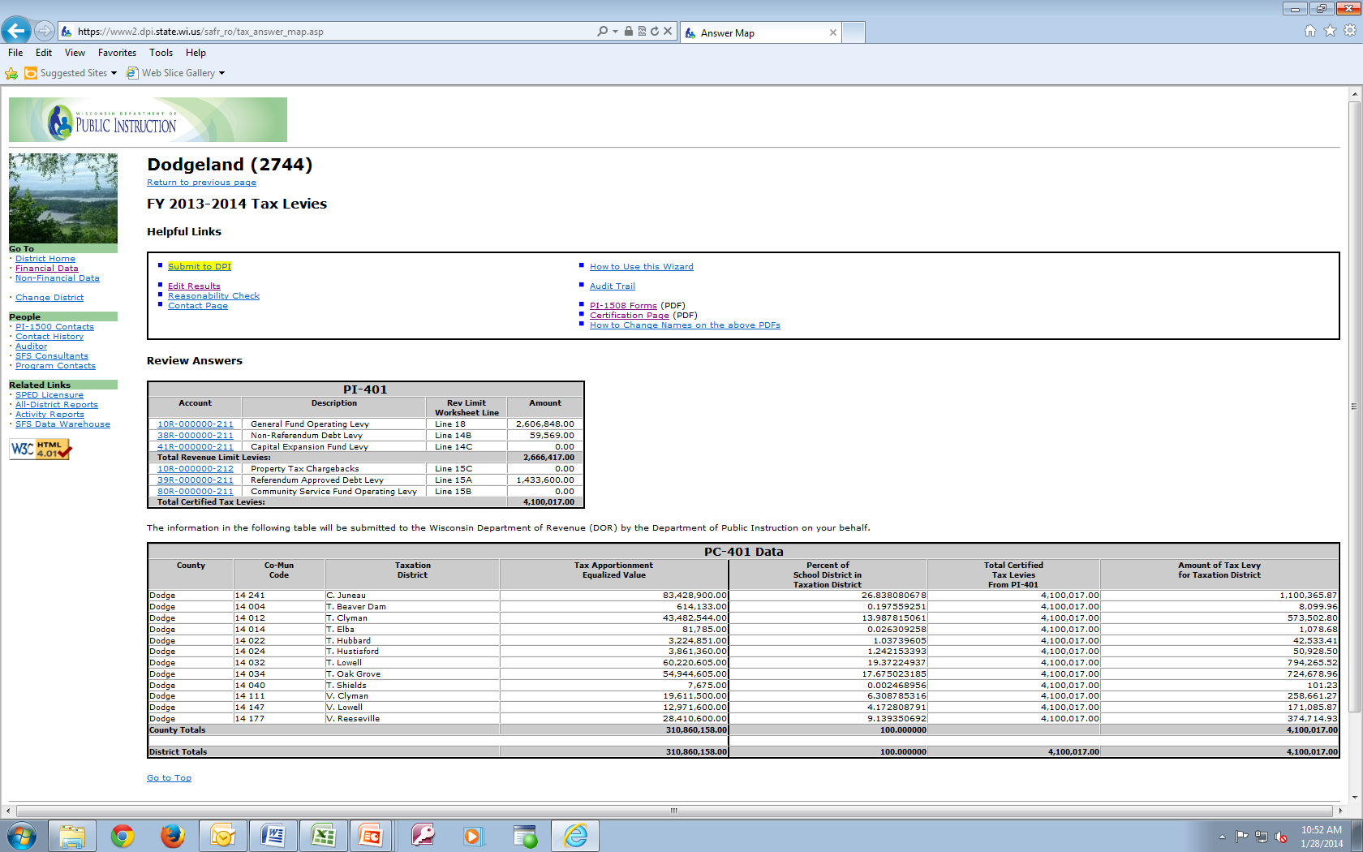
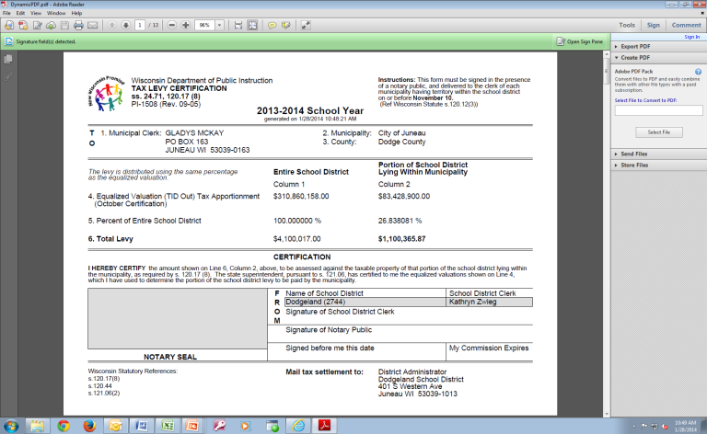
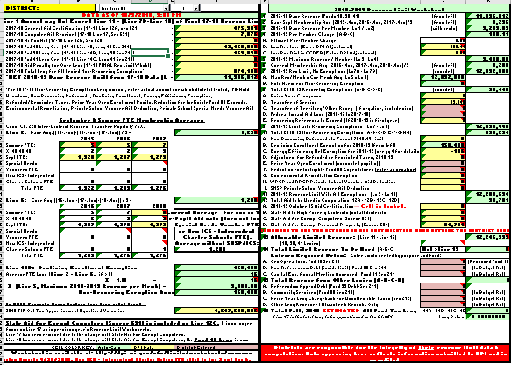
Budget/Revenue Limit Roadmap
WISEdata & WiSFiP
Certify Levies via
PI-401 (in portal) Late Oct
Summer Count,
3rd Friday Sept Count,
Oct 1 Tax Values,
October 15 Aid Cert.
Original
Budget
Revenue Limit Calculation
Send tax bills.
PI-1508
Early Nov
Budget Adjustments to BOE

Slide 8

REVENUE LIMITS

Slide 9
Revenue Limits
Limitation imposed by State Law in the Fall of 1993 on the revenues that public school districts in Wisconsin can raise from local Property Taxes & State General Aid.
……each district has their own computation……
……not an expenditure control……
A district’s Revenue Limit will determine approximately
80-90 % of a school district’s General Fund Revenue Budget.
General Fund (10), Non-Referendum Debt Service (38), Capital Projects Funds (41)

Slide 10
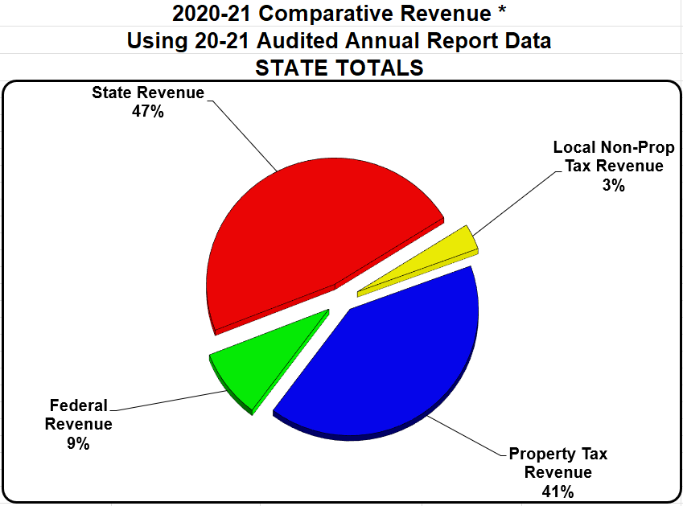
Comparative Revenue Under the Limits
Statewide Data
General Fund
Notes:
41% local property tax revenue
47% state aid
9% federal aid
3% local non-property tax revenue

Slide 11
Revenue Limits
The Revenue Limit controls the following revenues:
  General Aid - Equalization Aid (for most districts), Chapter 220 Programs, and Special Adjustment Aids [12A]
  High Poverty Aid [12B]
  Computer Aid (vouchered by the Department of Revenue in July) [12C]
  State Aid for Exempt Personal Property (vouchered by the Department of Revenue in May) [12D]
  General Fund (Fund 10), Non-Referendum Debt (Fund 38) & Capital Projects (Fund 41) Levies [14ABC]

Slide 12
Revenue Limits – Revenues Outside
The Revenue Limit does not control the following revenues:
  Per-Pupil Aid $742 for 2021-22 and thereafter per statute
  School Fees
  Categorical Aids (Per-Pupil Aid, Special Educ, Library, Transportation, Sparsity, AGR/SAGE, etc.)
  State and Federal Grants
  Gate Receipts/ Donations
  Referendum-Approved Debt (Fund 39) & Community Service Fund (Fund 80) Levies

Slide 13
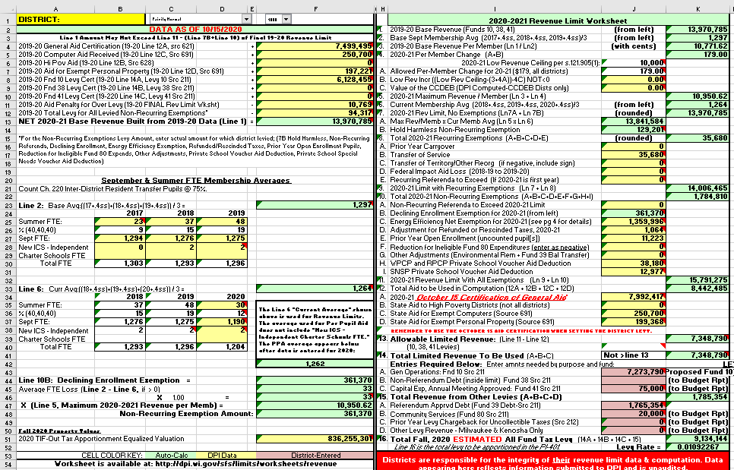
Revenue Limit Important Data Pieces
Membership (Counting Students)
Property Values
(Oct 1)
Recurring Exemptions
Other Levies
Non-Recurring Exemptions
Equalization Aid
(Oct 15)
Chargeback Levy
High Poverty Aid
Debt Levies

Slide 14

Revenue Limits
We’ll walk through a sample revenue limit calculation worksheet, explaining line-by-line and giving you some time to work on your district’s numbers….
….please ask questions as we go.

Slide 15
Quiz Time!
Name 3 revenues at your district that the Revenue Limit formula controls
Name 3 revenues that the Revenue Limit formula does not control

Slide 16
Revenue Limit
Step 1: Build the Base Revenue Per Member.
    (Lines 1-3)
Step 2: Calculate a New Revenue Per Member.
  (prior to exemptions)
  (Lines 4-7)
Step 3: Determine Allowable Exemptions. (Lines 8-11)

Slide 17
Revenue Limit
Step 4: Determine Levy Amounts.
Controlled Amounts
Levies for Funds 10, 38, 41
(Worksheet lines 12-14)
Non-Controlled Amounts
Levies for Funds 39 & 80 and Prior-Year Chargeback
(Worksheet line 15)

Slide 18
Revenue Limit Worksheet
(Located in at the bottom of the left page)
Green cells are formula cells and will auto calculate the amount for that cell based on the values entered in other cells.
Yellow cells pull data on file with DPI and loaded on the “Data” tab of the worksheet.
Pink cells require district entry.
  Note: as DPI receives additional data and loads into the spreadsheet, we will change the pink cells to yellow cells.

Slide 19
Step 1: Build the Base Revenue Line 1
Aid Penalty comes from page 3 RLW
Total levied NRE comes from page
3 RLW

Slide 20
Step 1: Build the Base Revenue - Line 1
Notes:
Updated twice a day→ always grab most recent version

Slide 21

MEMBERSHIP
Membership directly impacts the Revenue Limit.

Slide 22
Let’s Talk a Bit About Membership…
Your district membership is used in both of your district Revenue Limit and Equalization Aid computations.
3 Questions for Guidance
  Who can you count for membership?
  Who is a resident and enrolled?
  Who is incurring the cost for the education?

Slide 23
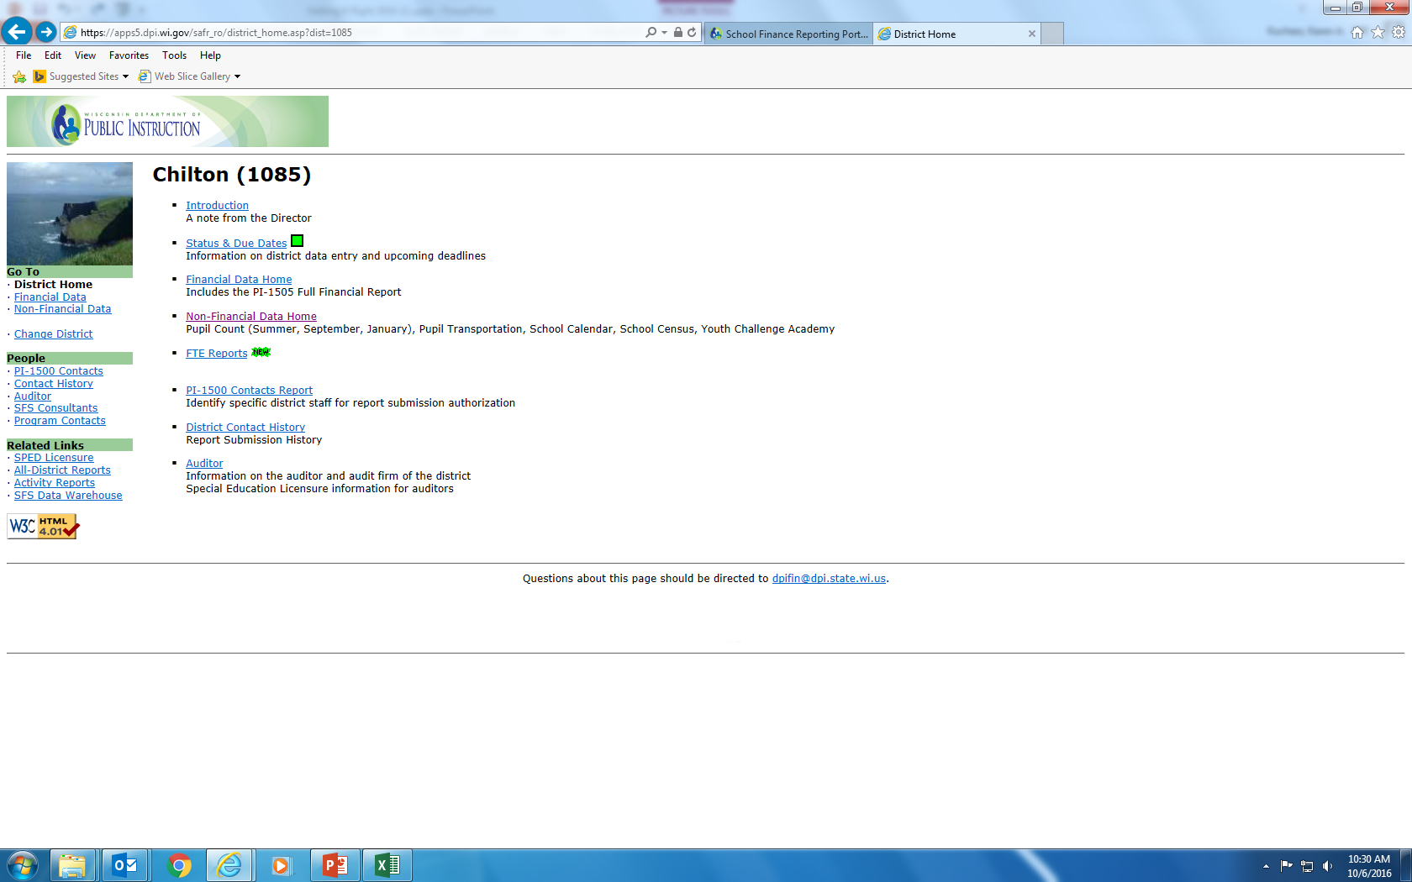
Membership Reporting Portals
SAFR Membership Report

Slide 24
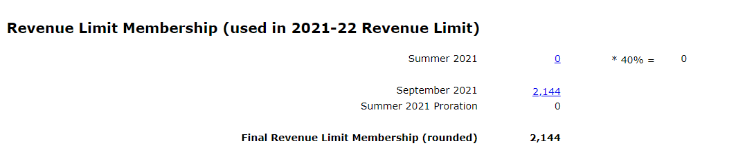
Pupil FTE data
(used in the Revenue Limit!)
FY 2021-22 FTE Conversion for Revenue Limit Calculation
includes Challenge Academy students and
Independent Charter Schools (ICS) New Authorizers FTE

Slide 25
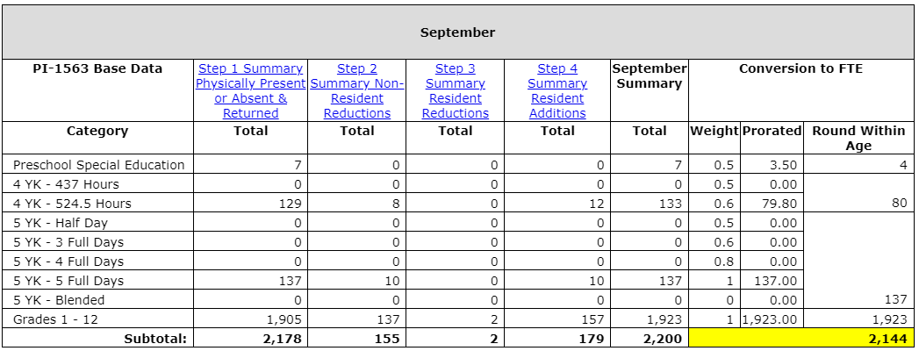
Pupil FTE Conversion
(used in the Revenue Limit!)
FTE Conversion for Revenue Limit Calculation
includes Challenge Academy students and
Independent Charter Schools (ICS) New Authorizers FTE

Slide 26
Pupil Count - Words to Know
Full time
Challenge Academy
Pre-School-Special Education
Minutes
Withdrawal
Summer ADM Equivalent
Resident
Age Requirements
Part-time
Pupil
Head Count
Receiving Instruction
4-year-old Kindergarten
Enrollment
Thayer
Membership
Open Enrollment
Student
3-year Programs
Hours of Instruction
Revenue Limit Membership
Attendance
Count Date
Present
Non-Resident
Full Time Equivalency (FTE)
5-year-old Kindergarten
State Schools
Special Education
General Aid Membership
Notes:
The “Pupil Count” is a head count only - of those in your schools or your residents.
The “Head Count” count is bodies in your classroom seats.
The “Full Time Equivalency” count is the of students included in the Revenue Limit calculation.
Full Time Equivalency (FTE) is Not head count.
The PI-1563 Pupil Count is a “Head Count” only

Slide 27

Which terms are you most familiar with, least familiar with?
Turn and talk with your colleagues at your table
This Photo by Unknown Author is licensed under CC BY-NC-ND

Slide 28
Pupil Count Resources
School Financial Services Web pages for everything concerning “membership.”
Pupil Count - PI-1563
  General Count Instructions for the PI-1563 Workbook
  PI-1563 Pupil Count Workbook Form for Draft Use
  Membership Information and Reporting
  Excel worksheet for converting the count to FTE can be found under additional resources

Slide 29
Back to the Revenue Limit Formula
Step 1: Build the Base Revenue - Line 2

Slide 30
Step 1: Summary Lines 1-4
Base Revenue Per Member
(second page of worksheet)

Slide 31
Step 2: Calculate a New Revenue
per Member - Line 4A
Line 4A: Each year, under current law, each district’s per member revenue limit may change.
Historically was an inflationary increase.
Recently $0 (6 of 8 years)
For 2021-22 the increase on Line 4A is $0
For 2022-23 the increase on Line 4A is $0
Next biennial budget is in progress…

Slide 32

Step 2: Calculate a New Revenue Per Member
Lines 4B & 4C
Pending specific limitations tied to unsuccessful referenda to exceed revenue limits, districts have a Low Revenue Ceiling of $10,000
The LRC might change with the next biennial budget.
Per s. 121.905(1), the Low Revenue Ceiling to be used in a district's "low revenue" computation (provided here for reference) can vary from district to district depending on the results of referenda. Please consult this statute and the district's specific referenda results to explain the number seen here.

Slide 33
Step 2: Calculate New Revenue
per Member - Line 5
Line 5 is the sum of Lines 3 and 4 (auto-calculates)

Slide 34
Step 2: Calculate a New Revenue
Per Member - Line 6
Current three-year average membership = September (Third Friday) FTE + 40% of Summer School FTE + New ICS FTE

Slide 35
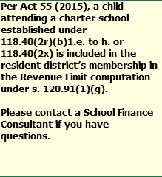
New ICS - Independent Charter Schools FTE
Residents of your school district that are attending an Independent Charter School (ICS) authorized by “new” authorizers (i.e., UW System or certain tribal colleges).
  On Lines 2 and 6 under “New ICS” DPI will enter your resident students.
  To the right is the comment from the RLW
  In June, the school district aid will receive an aid deduction to pay for the new ICS.

Slide 36
Step 2: Calculate a New Revenue
Limit - Line 7
Notes:
Hold Harmless: Line 7 cannot be less than line 1→ NON-RECURRING
Additional Low Revenue authority automatically increases the district's per member revenue limit amount. Eligible districts need not do anything special to receive this increase - if the district is eligible an amount will be populated in the cell by DPI

Slide 37
Step 3: Increase Your Revenues→ Determine Allowable Exemptions - Lines 8-11
Exemptions to the Revenue Limit allow districts to levy additional amounts above the amount generated by the computation up to this point.
Line 8 tracks Recurring Exemptions.
Line 10 tracks Non-Recurring Exemptions.
Know the difference!

Slide 38
Step 3: Determine Allowable Exemptions
Recurring - Line 8
Recurring Exemptions (Lines 8A-E) are base-building; if the district taxes for any of this additional authority, the levy amount is automatically included in the succeeding year’s base.

Slide 39
Step 3: Determine Allowable Exemptions
Line 8
Line 8A – Prior Year Carryover – unused levy authority from prior year allowed to be used in current year. (DPI provides)
Line 8B – Transfer of Service - a school district which assumes responsibility for a program or service from another governmental unit may request and be granted an exemption to the district revenue limit equal to the increased cost due to that program or service. (special education or ESL services)
Line 8E – Recurring Referenda to Exceed – referenda amount (normally, if 2022-23 is the first year). Call DPI if you have questions.

Slide 40
Step 3: Increase Your Revenues - Determine Allowable Exemptions
Non-Recurring - Line 10
Non-Recurring Exemptions (Lines 10A-I) are not base-building; if a district taxes for any of these exemptions, the amount is not included in the succeeding year’s base.

Slide 41
Know the Difference !
Recurring Exemptions – Rolling forward in Your Base
This Year
Next Year
Recurring
Line 8
Base
Non-Recurring Exemptions – One Year Only
This Year
Next Year
Non-Recurring
Line 10
Base
Base

Slide 42
Non-Recurring Exemptions
The exemption is only valid for a limited period of time – usually one Revenue Limit cycle.
Prior Year Revenue Limit
Current Year Revenue Limit
Hold Harmless (Line 7B)
Declining Enrollment
Energy Efficiency
Aid
+
Levy
Adjustment for new
Choice Students
Base
Base Will Include Only
Levied
Recurring Authority
from the Prior Year

Slide 43
Step 3: Determine Allowable Exemptions
Non-Recurring - Line 10
Line 10A – Non-Recurring Referenda – district has a successful referenda.
Line 10B – Declining Enrollment Line
Line 10B (right side), Declining Enrollment Exemption, will auto-fill based on the Summer and September membership numbers entered on the left side of the worksheet
minus
Page 1
Page 2

Slide 44
Step 3: Determine Allowable Exemptions
Non-Recurring - Line 10
Line 10C – Energy Efficiency – exemption to fund a project to implement energy efficiency measures or to purchase energy efficiency products. See DPI Rule and information at: Exemptions
    Districts are no longer able to pass/amend resolutions after December 31, 2017.
    Multi-year reconciliation is located on page 4 of the worksheet.

Slide 45
Step 3: Determine Allowable Exemptions
Line 10C Energy Efficiency

Slide 46
Step 3: Determine Allowable Exemptions
Line 10
Line 10D – Adjustment for Rescinded Taxes – exemption to recover the funds refunded to a taxpayer whose property value had subsequently been reduced by a court action and/or a reviewing authority (Letter from DOR is the basis for amount). DOR provides amounts.
Line 10E - Prior Year Open Enrollment (uncounted pupils) – exemption to compensate for not counting Open Enrollment pupils from the prior year.
Line 10F – Reduction for Ineligible Fund 80 Expenditures – Fund 80 Community Service Overview
10H – WPCP and RPCP Private School Voucher Aid Deduction – allows a district to levy for the aid deduction related to these private school programs.
10I – SNSP Private School Voucher Aid Deduction– allows a district to levy for the aid deduction related to this special needs scholarship program for private schools.
Remember, any unused Non-Recurring authority is not eligible for carryover in the next year – districts have one, and only one, opportunity to use Non-Recurring exemptions

Slide 47
Line 10D vs Line 15C
Line 10D: Adjustment for Refunded or Rescinded Taxes
Property taxpayer contests assessment and value of property is reduced
Districts allowed to increase RL by the amount refunded as a result of a
valuation re-determination under s. 74.41
DOR computes amounts each fall and sends letters in mid-November; DPI
pre-populates this field based on certified amounts provided by DOR
Statutes do not permit RL exemption for any other kind of chargeback
Line 15C: Prior Year Levy Chargeback for Uncollectible Taxes
Municipality unable to collect full amount from property taxpayer after full
levied amount provided to district
Municipality asks the district to return the uncollectible amount under s. 74.42
District recovers the amount returned to municipality through an outside of
the RL “chargeback levy” instead of an adjustment

Slide 48
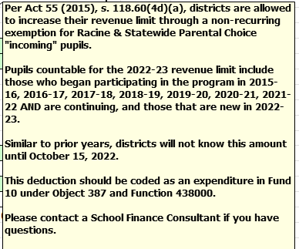
Step 3: Determine Allowable Exemptions
Non-Recurring - Line 10
10H – Adjustment for private school voucher students – allows a district to levy for the aid deduction related to these programs.

Slide 49
Step 3: Determine Allowable Exemptions
Non-Recurring - Line 10
Line 10.I., SNSP Private School Voucher Aid Deduction
Per Act 36 (2017), s. 115.7915, districts are allowed to increase their revenue limit through a non-recurring exemption for Special Needs Scholarship Program pupils.
Districts did not know these amounts until DPI releases the October 15th aid certification.

Slide 50
Step 3: Determine Allowable Exemptions
Lines 8-11
Line 11 Revenue Limit With All Exemptions (Ln 9 + Ln 10).
This is the total revenue your district can receive from the combination of property tax from Funds 10, 38, and 41, State General Aid (Equalization, Special Adjustment, and Integration Aids), High Poverty Aid, and State Computer Aid.

Slide 51
Revenue Limits & Budget-Building
Watch Change Across Time – Line 11
Year 1
Year 2
Year 3
Total Revenue Limit with Exemptions
Total Revenue Limit with Exemptions
Total Revenue Limit with Exemptions
Line 11 represents the total amount of resource your district will get from property tax, state general aids, and exempt computer aid. This will equal about 80-90% of general fund revenues.
For budgeting purposes, it’s very important to compare your new Line 11 with the previous year’s Line 11. Major decreases in Line 11 from year to year can have serious implications for your budget.

Slide 52
Quiz Time!
Name three recurring exemptions in the revenue limit formula.
Name three non-recurring exemptions in the revenue limit formula.

Slide 53
Fly-Over Review of Lines 1 – 11

Slide 54
Step 4: Determine Levy
Controlled Amounts - Lines 12-14
  General State Aid (12A) High Poverty Aid (12B)
  Computer Aid (12C) Aid for Exempt Personal Property (12D)
Fund 10, General Fund Levy (14A)
Fund 38, Non-Referendum Debt Levy (14B)
Fund 41, Capital Projects Levy (14C)
Non-Controlled Amounts - Line 15
Fund 39 [non-Fund 38], Referendum Debt Levy (15A)
Fund 80, Community Service Fund (15B)
Fund 10, Property Tax Chargebacks (15C)

Slide 55
Aid Certification - Line 12
12A. General Aid (October 15 Cert.)
12B. State Aid to High Poverty Districts (not all districts)
12C. State Aid for Exempt Computers
12D. State Aid for Exempt Personal Property
Line 13 must now be divided between the Fund 10 levy, the Fund 38 levy and the Fund 41 levy

Slide 56
Controlled Amounts
Line 14
Line 11 – Total Resources from Property Tax and General Aid
October 15 Aid Certification, High Poverty Aid, Computer Aid, and Aid for Exempt Personal Property reduce what you can levy.
Line 13
Allowable
Limited
Levy Revenue
Fund 10 Levy
Fund 38 Levy
Fund 41 Levy

Slide 57
Strategy - Line 14
First, type in the amounts you intend to levy for Funds 38 and 41
(lines 14B & 14C).
Then, subtract (14B+14C) from line 13. Enter into line 14A.
By doing this, you have levied to your maximum.
Note that districts may choose to levy less than the maximum.
Remember: Line 14 cannot exceed Line 13 ! If it does, you will receive
a message in red that you have exceeded the limit and should reduce something in Lines 14A, B, or C to avoid over levying.

Slide 58
Non-Controlled Amounts
Line 15
Enter anticipated levy amounts
into Lines 15 A, B, & C.
Notice Line 15 D is for Milwaukee and Kenosha only

Slide 59
TIF-Out Apportionment Equalized Valuation
Before October 15th, you will need to enter the
“2022 TIF-Out Tax Apportionment Equalized Valuation”
The Department of Revenue certified the 2022 Property Values on October 1, 2022.
This value is used to calculate the Levy Rate

Slide 60
Total All Fund Levy - Line 16
Line 16 is the sum of all levies from all funds (line 14 & line 15).
Line 16 is the levy to be apportioned to municipalities and must equal the total amounts on the PI-401.

Slide 61
Just a Reminder!
Districts are responsible for the integrity of the revenue limit data & computation. Data appearing here reflects information submitted to DPI and is unaudited.
The Revenue Limit worksheets posted to the DPI Website are pre-populated with the most recent data available to DPI from district reports (e.g., membership, referenda results).
In other words, … the worksheets are not “real time” – watch for the “Revised on” date at the top of the worksheet.

Slide 62

Exemptions
Be aware of the type of exemptions in your computation and the effect of under levying.

Slide 63

School Board Sets the Levy
HOW DOES UNDERLEVYING AFFECT ME?
Notes:
In 2021-22, nine school districts had prior year revenue limit carry-over of $10,001,914. Only 0.001% of total 2020-21 Line 11 $9,424,763,001. Almost all school boards levy their maximum revenue limit authority.

Slide 64
Revenue Limit Exemptions
Recurring Exemptions (Line 8)
Prior-Year Carryover
Transfer of Service
Transfer of Territory
Federal Impact Aid Loss
Recurring Referenda
to Exceed
(if year 1 of authority)
Non-Recurring Exemptions (Lines 7B &10)
Line 7B - Hold Harmless Non-Recurring Exemption
10A - Non-Recurring Referenda to Exceed 2022-23 Limit
10B - Declining Enrollment Exemption for 2022-23
10C - Energy Efficiency Exemption
10D - Adjustment for Refunded or Rescinded Taxes
10E - Prior Year Open Enrollment (uncounted pupils)
10F – Reduction for Ineligible Fund 80 Expenditures
10G – Other Adjustments (Fund 39 Balance Transfer)
10H - WPCP and RPCP Private School Voucher Deduct
10I - SNSP Private School Voucher Deduction

Slide 65
#1 - Recurring Exemptions, Levied to Max
Prior year
Current year
Recurring Referendum
Prior Year Aid
plus
Levies
(no backouts)
Aid
+
Levy
Transfer of Service
Base
$10,000,000
$10,000,000
This district used all of its authority and has no carryover for current year, Line 8A.
No additional Per-Member
Revenue limit

Slide 66
#2 - Recurring Exemptions, Underlevy
Prior year
Current year
$200,000 carryover
$10,000,000
$9,887,500
Recurring Referendum
Prior Year Aid
plus
Levies
(no backouts)
Transfer of Service
Base
Aid
+
Levy
Base
Underlevied by $200,000
This district has a $200,000 carryover for current year, Line 8A.
No additional Per-Member
Revenue limit

Slide 67
#3 – Non-recurring Exemption, Recurring, and Underlevy
Prior year
Current year
$7,536,000
$7,480,000
No additional Per-Member
Revenue limit
Declining Enrollment-$46,000
Transfer of Service
Prior Year Aid
plus
Levies
Low Revenue Increase
Base
Aid
+
Levy
Base
This district will have no carryover authority to current year in Line 8A (as the $10,000 Under levied amount did not roll forward)
Under levied by $10,000

Slide 68
#4 - Non-recurring Exemption, Other Recurring, Underlevy
Prior year
Current year
$8,990,000
Declining Enrollment-$46,000
No additional Per-Member
Revenue limit
Transfer of Service
Operating Referenda
Prior Year Aid
plus
Levies
(no backout)
Base
Aid
+
Levy
Base
Underlevied by $56,000
This district will have $10,000 in
carryover authority in Line 8A.

Slide 69
You Are Ready to Set the Levy When…
…you’ve finished your revenue limit calculation, which incorporates:
Third Friday in September and Summer Counts
October 1 Property Tax Values
October 15 General Aid Certification

Slide 70
Levy Certification
On or before November 1, your school board needs to vote on the district property tax levy for the current fiscal year.
After the levies have been set, district staff will use an internet-based report (PI-401) to certify the district’s levy to municipalities and to report the data to both DPI and the Department of Revenue.
This report is due on November 4th.

Slide 71
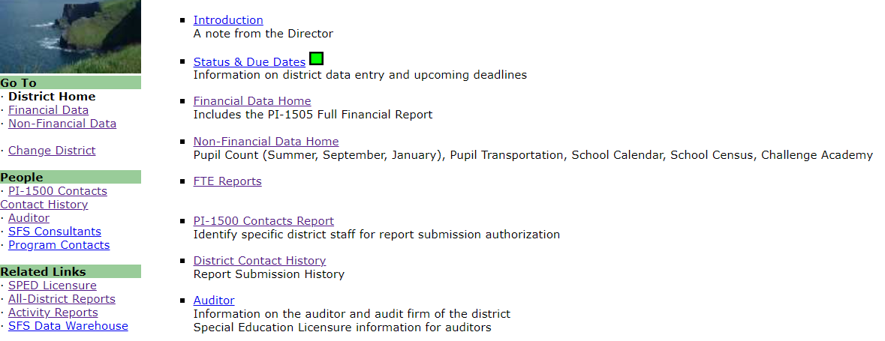
Levy Certification (PI-401)

Slide 72
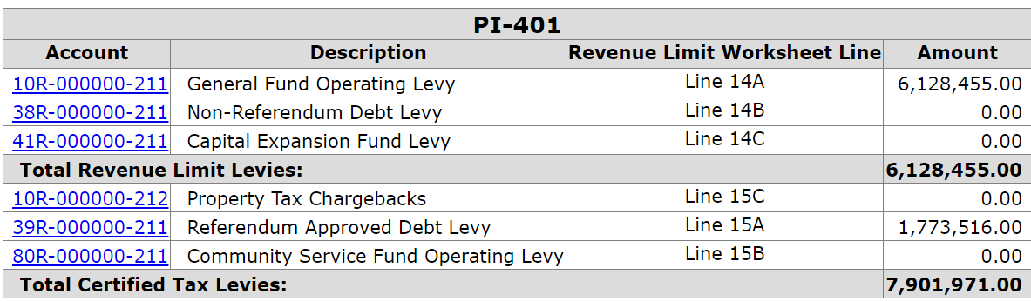
Levy Certification – Enter Info
Check to verify the data matches your revenue limit worksheet.

Slide 73
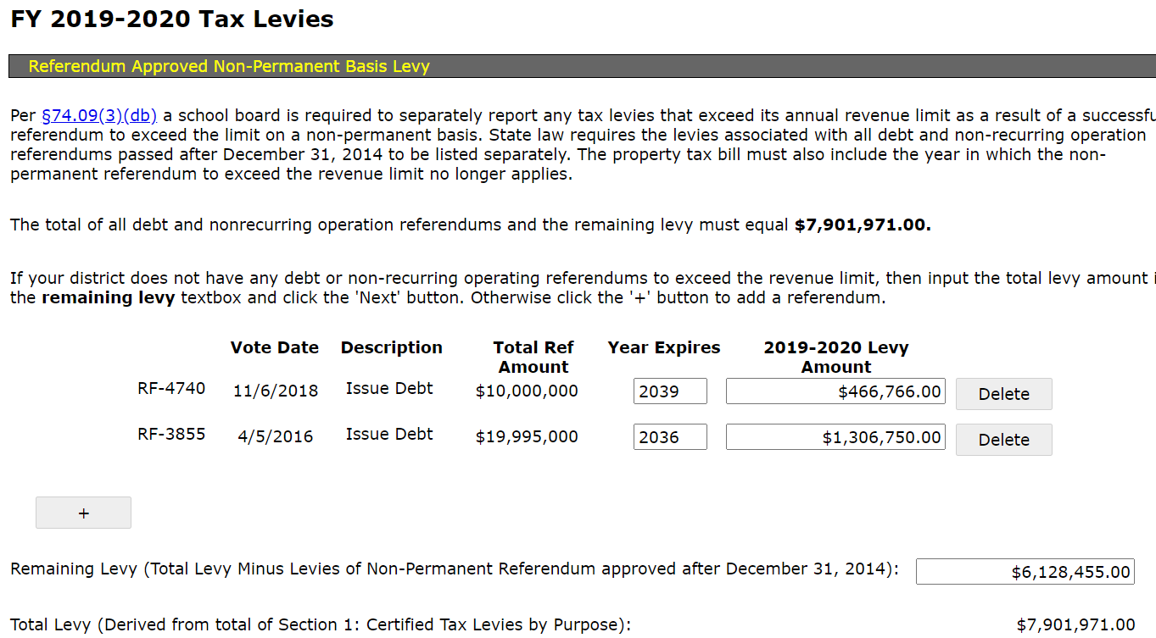
Levy Certification – Enter Info (non-permanent referendum)

Slide 74
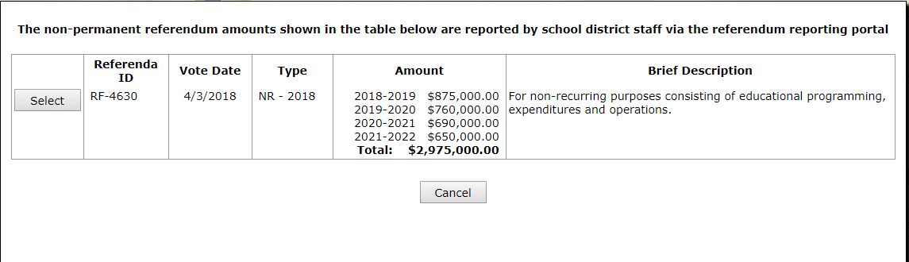
Levy Certification – Enter Info (non-permanent referendum)

Slide 75
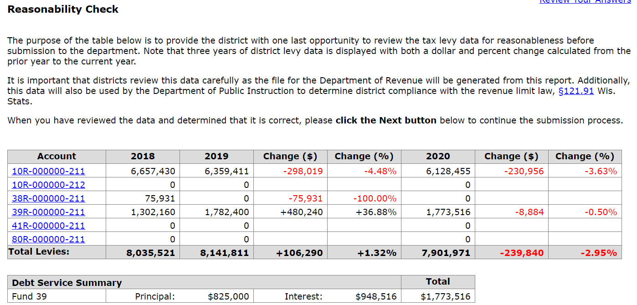
Levy Certification – Reasonability Check

Slide 76
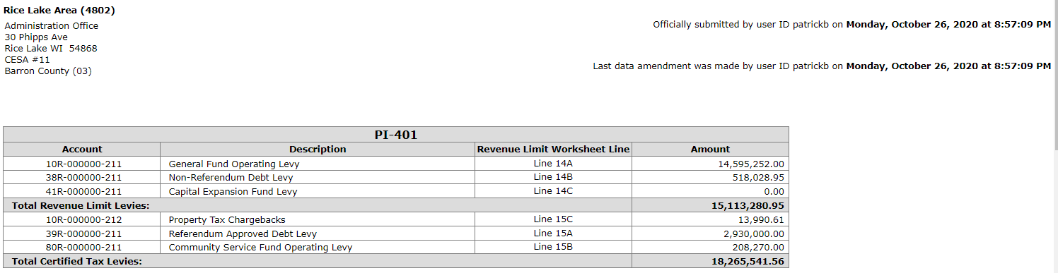
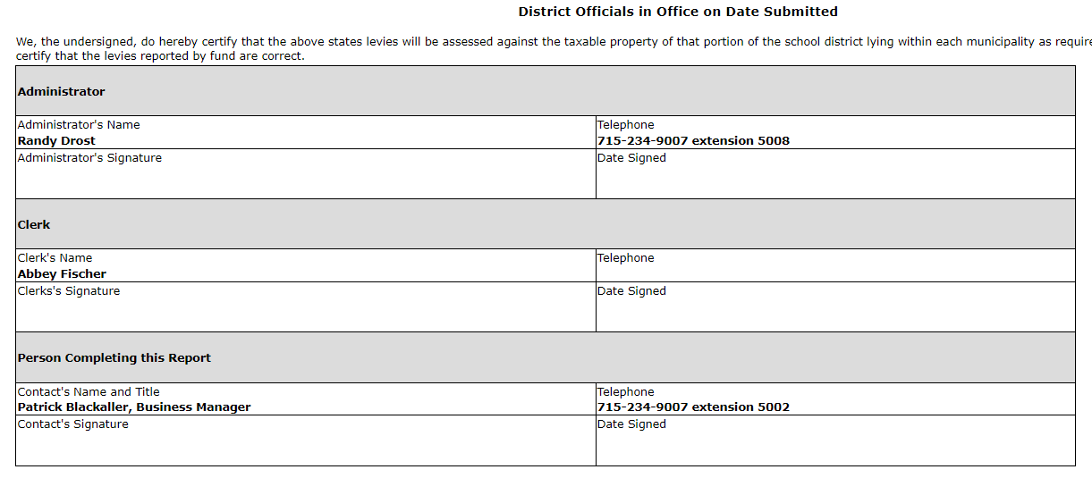
Levy
Certification –
District Officials Signatures

Slide 77
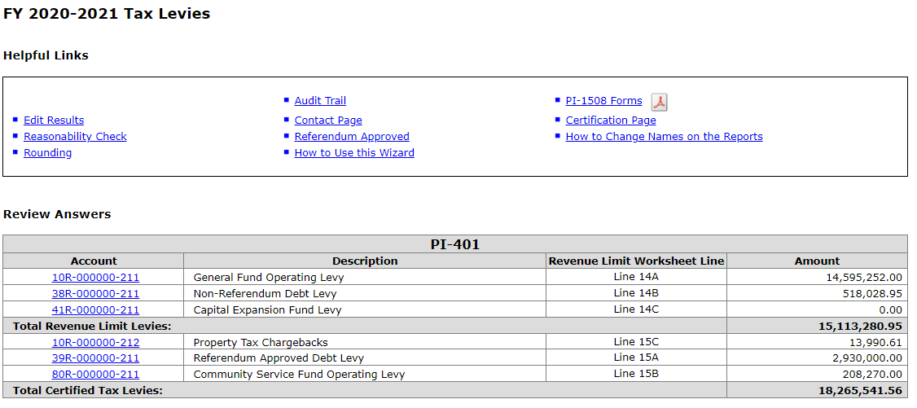
Levy Certification – Print Tax Bills

Slide 78
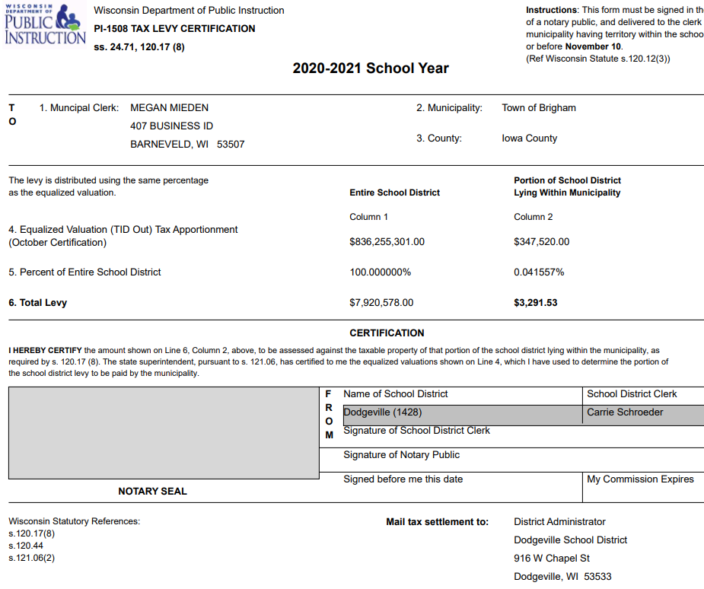
Levy Certification – Tax Bills (Page 1)

Slide 79
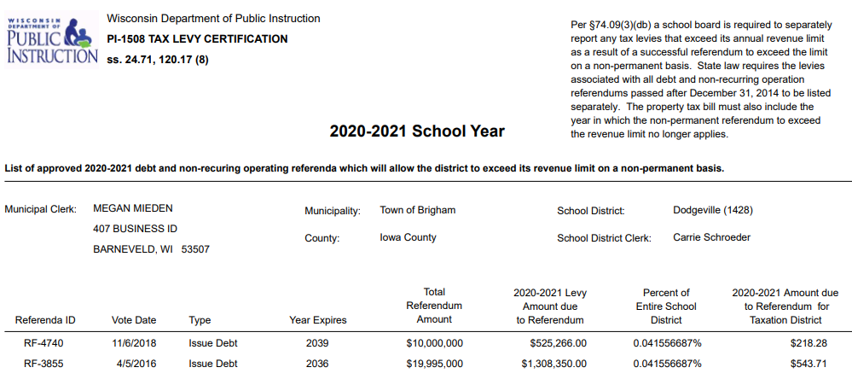
Levy Certification – Tax Bills with non-permanent referendum data (Page 2)

Slide 80
Levy Certification
The information you have provided will be submitted to the Wisconsin Department of Revenue (DOR) by the Department of Public instruction on your behalf.
Gather the appropriate signatures on the tax bills and certification page mail or deliver your school districts PI-1508 certification documents to each municipal clerk in your district.

Slide 81
DPI Reconciliation
DPI will run programs in the background and manually populate the tax amounts from the district’s PI-401, once it is submitted. If a district unde- levies or overlevies, it will be indicated here.
In this case, the district underlevied significantly.

Slide 82
Tie It All Together
What’s tied together? The levies on the following should all be the same:
  Revenue Limit Worksheet
  DPI PI-401
  PI-1508 (Tax Bills)
  DPI Budget Report
  Once you submit the levy reports to DOR and DPI, and the budget report to DPI, this process is complete for the fiscal year.

Slide 83
Board Responsibilities
  Adopt the Budget
  Approve an Appropriate Tax Levy (by November 1st)

Slide 84
Timeline
    October 14: Oct. 15th General Aid Certification released (this year)
    November 1: Deadline for school boards to approve levies
    November 4: Deadline to submit PI-401
    November 10: Deadline for district clerks to inform municipal
    clerks of their share of the tax levy

Slide 85
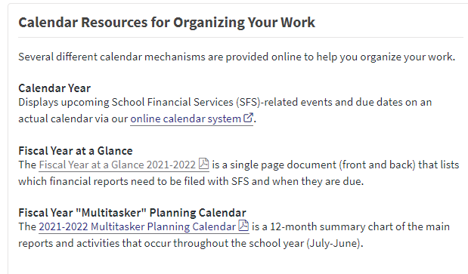
Important Dates
DPI SFS Calendar for reporting

Slide 86
General School Aids
EQUALIZATION AID – EXPLAINING THE CHANGES FROM YEAR TO YEAR

Slide 87
Basic Equalization Aid Concepts
  Aid is inversely related to district property value per member.
  One pot of money is split over 421 school districts based on district values, membership, and shared costs. Changes in individual district data affect every other district’s aid.
  Value-per-member is crucial to explaining aid.
  Depending on district value-per-member, some districts’ aid is increased by increasing expenses, while others’ aid is decreased by increasing expenses.
  Know where your district is in the formula and be aware of what is happening to your district over time so you can figure out why your
  aid has changed and explain why.

Slide 88
Equalization Aid
Tertiary
Aid
50%
Negative Tertiary Aid
50%
Property Value per Member
25%
75%
Secondary Aid
Primary Aid
20%
80%
Notes:
State says we will treat the first $1000 of cost a certain way. The next $9800 another way, and anything above this an even different way.
Primary cost ceiling of $1,000 per member. State aid on these primary shared costs is calculated using the primary guaranteed valuation of $1,930,000 per member.
The secondary tier is for shared costs that exceed $1,000 per member but are less than the secondary cost ceiling. By law, the secondary cost ceiling is set equal to 90% of the prior year statewide shared cost per member. By law, the secondary guarantee is set at the amount that generates equalization aid entitlements that are equal to the total amount of funding available for distribution. The setting of the secondary guarantee depends on the other four formula factors. FLOATING
The tertiary tier is for shared costs above the secondary cost ceiling. State aid on tertiary shared costs is calculated using the tertiary guaranteed valuation. By law, the tertiary guarantee is set equal to the statewide average equalized value per member.
So, state says If you have $2M in property value we will share in your cost. How much?
Our district is $400K PVM
Get out of the presentation so we can talk about various districts.

Slide 89
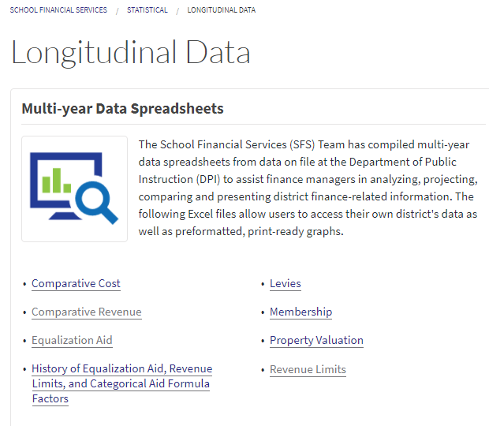
Equalization Aid Across Time
DPI SFS Team's Longitudinal Data
Notes:
Comparative Cost
Comparative Revenue
Equalization Aid
History of Equalization Aid, Revenue Limits, and Categorical Aid Formula Factors
Levies
Membership
Property Valuation
Revenue Limits

Slide 90
Equalization Aid Across Time
Know where you are in the formula
(positively-aided or negatively-aided).
Watch where you are as a % of the state average for the critical variables of
1.) value-per-member and
2.) shared cost-per-member.
This can explain why your aid changed the way it did.

Slide 91
Referenda & Debt
  Follow DPI SFS Team’s referendum guidelines on our website - Referendum
  Consult with your district’s bond counsel to ensure compliance with all statutory requirements.
Debt schedules must be updated with any new or refinancing information.
Budget Report edits will expect your budget entries to tie out to your debt schedules.

Slide 92
Questions?
Visit our web site:
DPI SFS Team's Web Page
SFS Team's Staff Contacts
Email: dpifin@dpi.wi.gov
Phone: (608) 267-9114

Slide 93
Addendum

Slide 94
Membership
Who can you count for membership?
Generally, residents for which you are financially responsible - i.e., you are incurring the cost for the student’s education.
Start with who is in your seats on the count date.
Subtract non-residents being educated in your seats.
Subtract residents that may not be counted for levy purposes.
Add residents who are elsewhere (and for which you are financially responsible).
Watch for the “before and after” rule:
      (Count the student if she/he was present for instruction during the school year, at least one day before the count date and at least one day after, and didn’t change residency during the period of absence or enroll/attend a private school or homeschool.)

Slide 95
Membership
Who is a Resident?
Not defined by statute. Residency is determined
by the local district. (Look at your school board policy.)
1.) Is the child living in the district with his/her parents?
2.) What about other situations?
– There is case law – the Thayer Ruling
A minor may have, for school purposes, a residence other than that of his parents. In this specific case, the school district was incidental to the child’s reason for living in the district.
Why are students attending your district?

Slide 96
Membership
Who is incurring the cost for the education?
  Pupil is in your seats, taught by your teachers.
  Full-time resident pupils in attendance elsewhere, but your district is paying for their education.
    Open Enrollment (your residents going elsewhere)
    Tuition Agreements
    CESA Programs
    Tuition Waivers (Be careful with this one. These situations involve kids moving out/in of a district mid-year. Sometimes, you still can count a kid in the year that they have moved out of your district….and, sometimes you can’t count a new kid that has recently moved into your district. Please call us if you have a student in this situation.)

Slide 97
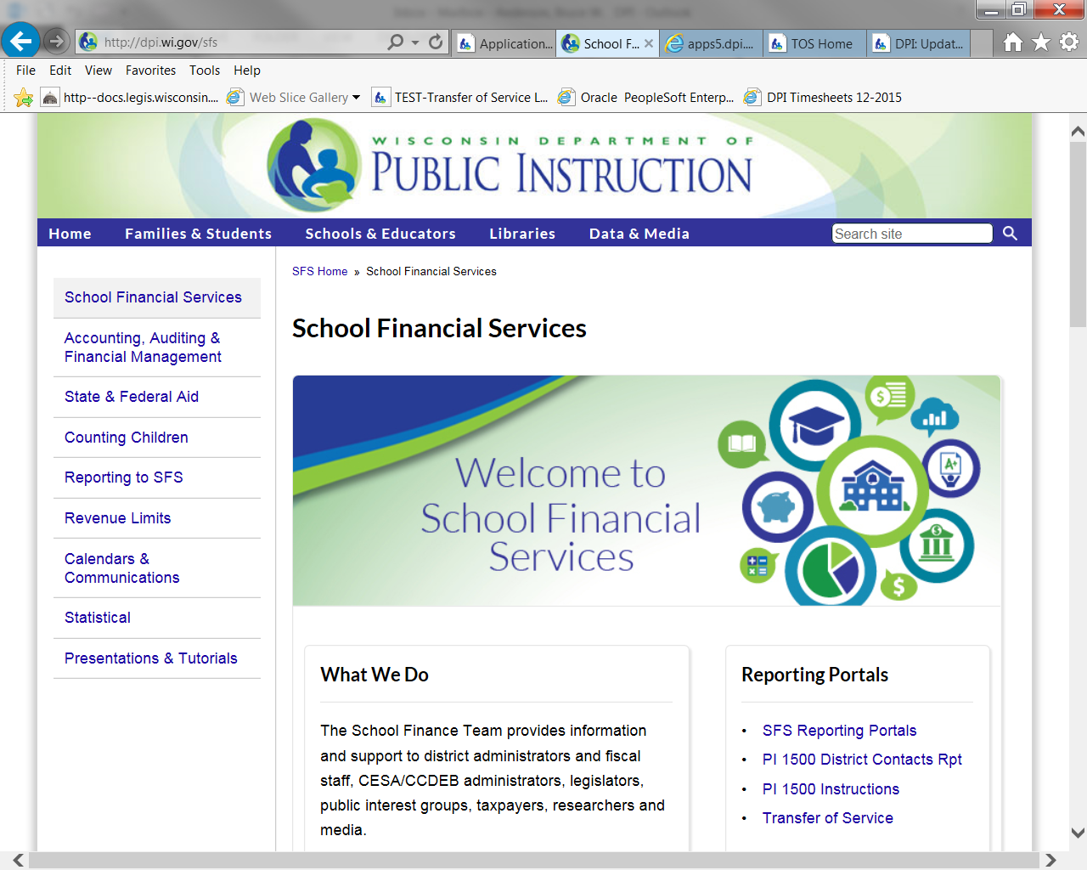
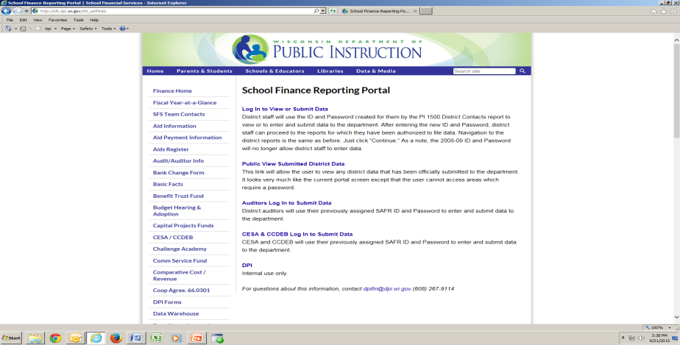
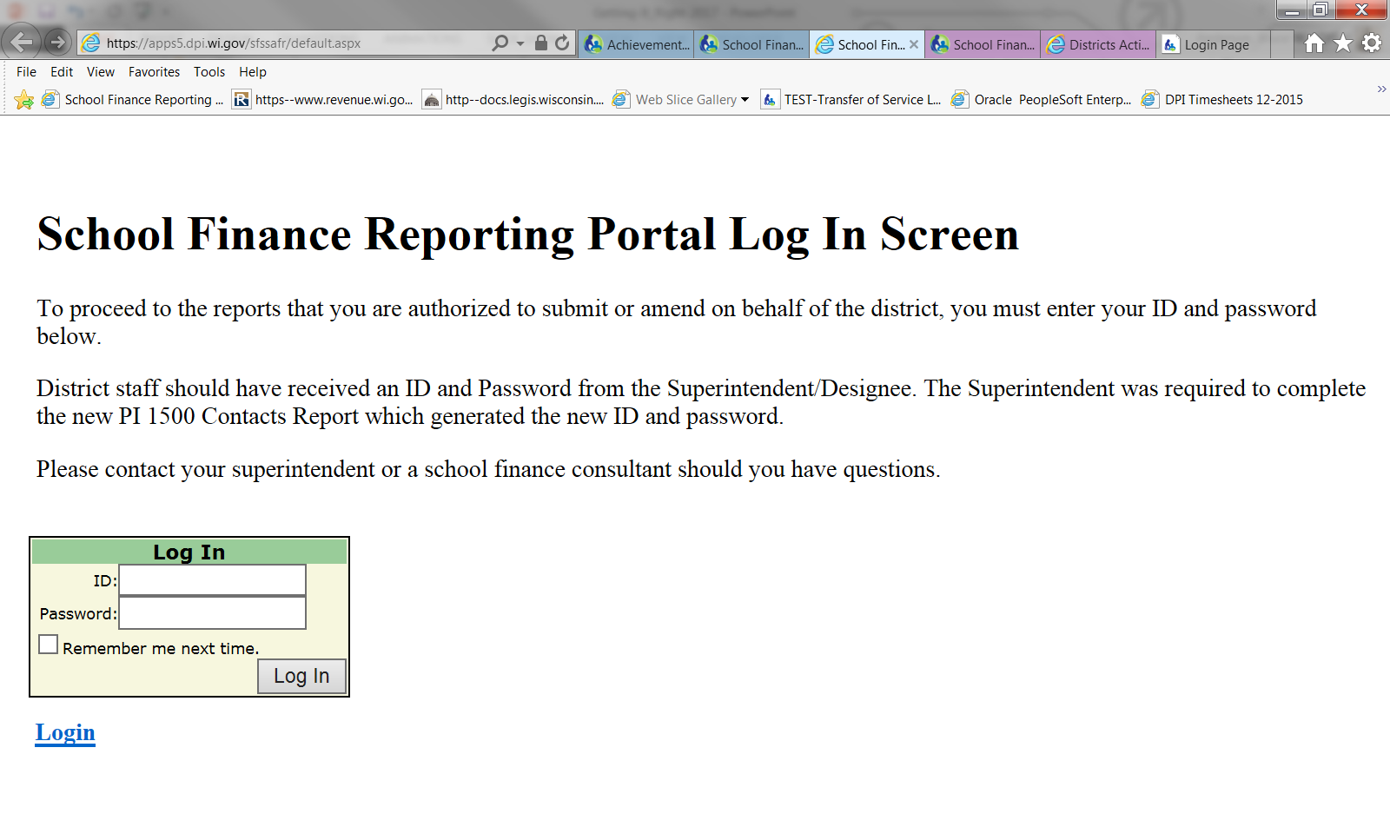
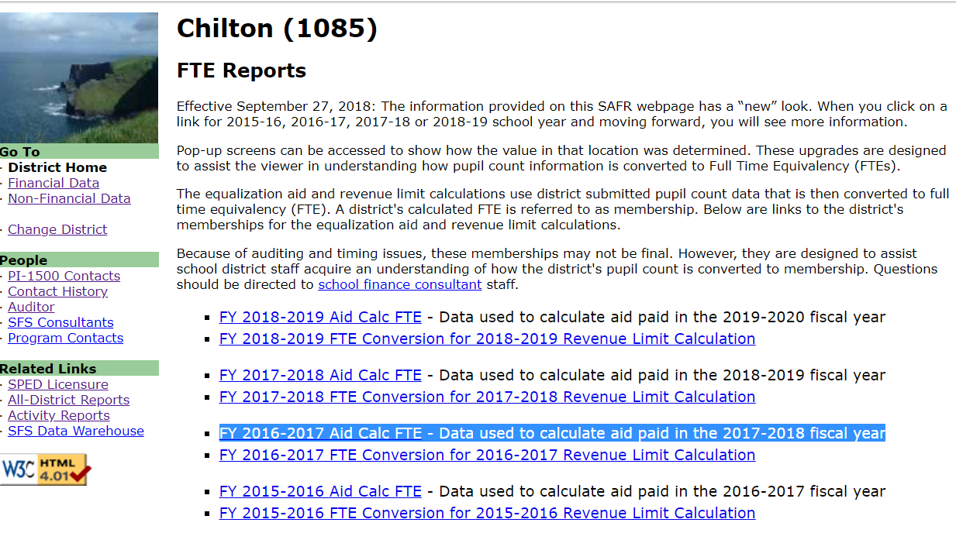
SAFR Membership Reports
Found on the SFS website at:
SFS Homepage>School Finance Reporting Portal>Log In>District Home>FTE Reports

Slide 98
Membership Reporting Portals
SAFR Membership Report

Slide 99
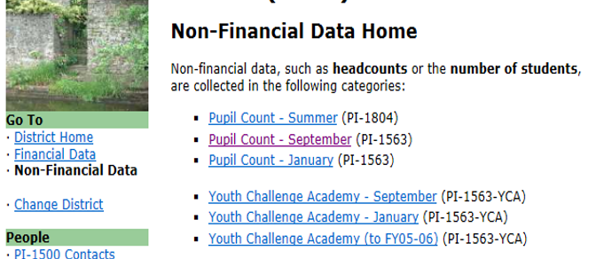
Membership Reporting Portals
SAFR Membership Report

Slide 100
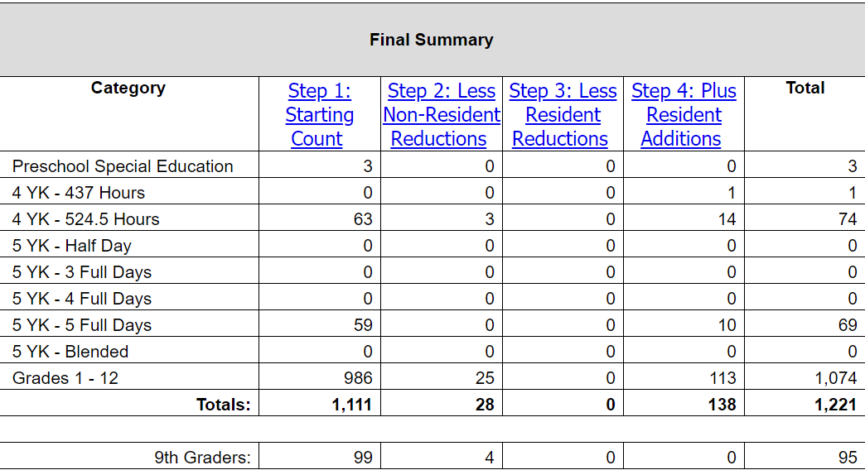
Straight Pupil Count (NOT used for much!)
Need to convert to Full Time Equivalency (FTE)!
Numbers need
to be converted
into an FTE!
Still needed:
9th grade count for the fall of 2021 “Personal Electronic Computing Device Grant process.”

Slide 101
Full Time Equivalency (FTE) Membership
Both the Summer School/Interim FTE Membership and the 3rd Friday in September Pupil Count (PI-1563) are used in the Revenue Limit computation.
Each Interim session that ends after September 1st of a given school year will not be included in the Revenue Limit calculations until the following school year.
Remember: Where the student is educated is not necessarily important. Who is paying for the education is an important factor to determine if the student can be included in the counting process.

Slide 102

Student Enrollment Projections
Enrollment drives everything!
Find a reliable method to project your district’s enrollment.
You’ll need estimates of the upcoming Summer and 3rd Friday in September before you begin next year’s budget development process.

Slide 103
Revenue Limit Formula
  Each new-year Revenue Limit computation builds on the previous-year’s fiscal activity.
  Incorporates what your student counts are doing.
  Gives you the total resources you can collect from the tax levy and state funding.
  District will need this data for budgeting purposes.
  In the first year of the state budgeting process, a district may need to start estimating revenue limit revenues early and often throughout the budget process.

Slide 104
Levy Certification – Sample District
Line 14A | Fund 10 | = | $7,273,790
Line 14B | Fund 38 | = | $0
Line 14C | Fund 41 | = | $75,000
Line 15A | Fund 39 | = | $1,765,354
Line 15B | Fund 80 | = | $20,000
Line 15C | Chargeback | = | $0
Line 16 | Total All-Fund Levy |  | $9,134,144

Slide 105
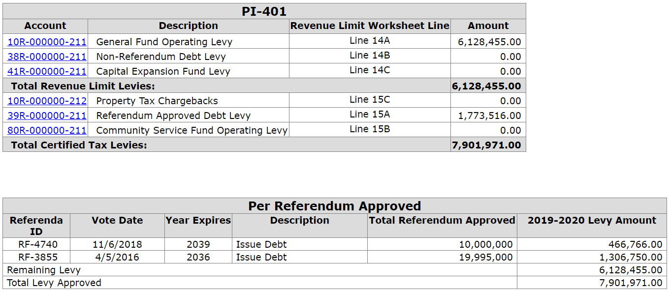
Levy Certification – Enter Info (non-permanent referendum)
39R is one payment for two referenda approved on the same date, the district must divide the payment between the two questions.

Slide 106
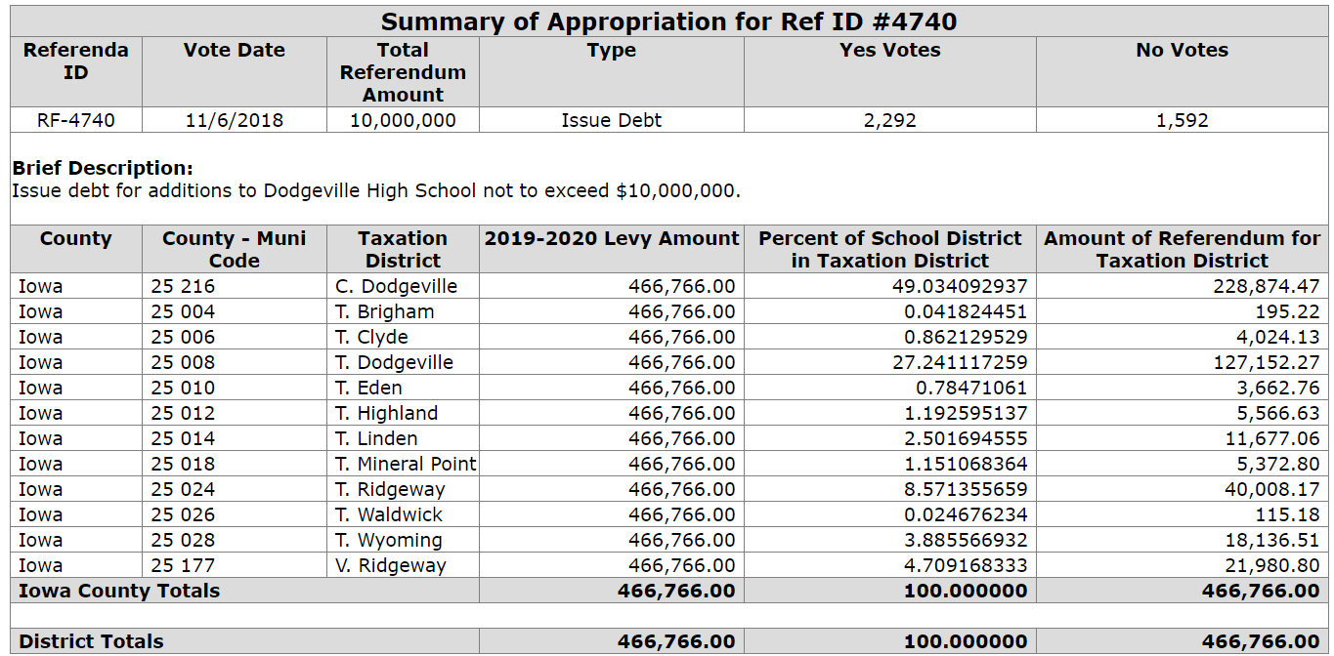
Levy Certification – Enter Info
(non-permanent referendum)

Slide 107
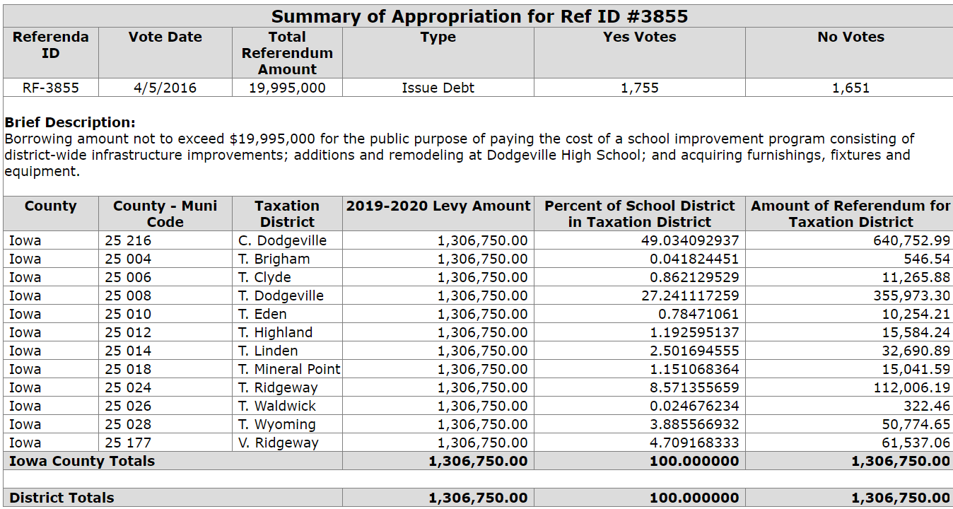
Levy Certification – Enter Info
(non-permanent referendum)

