Slide 1

Text Slide Master
WASBO New School Administrator & Support Staff Conference
7 September 2022
Tax Levy Adoption
Bob Soldner, Assistant Director
School Financial Services Team
Ben Kopitzke, Finance Consultant
School Financial Services Team

Slide 2
Recap
Property Tax Levy
State Aid
(General + High Poverty + Computer + Exempt Personal Property)
Revenue Limit
Notes:
Any lingering questions about revenue limits?
RL: only YOUR district; what neighbor spends does not impact your RL
RL are INDIVIDUAL to district—what is happening in YOUR school community
State Aid: $5.2 billion entirely dependent on everyone else; as others spend more/less, property values change → impacts your district’s share of the allocation; compared to state averages and guarantees set in law. RELATIVE position is important (you have 10% property value increase but everyone else had 15%)
The controllable property tax levy—NOT referenda-approved debt

Slide 3
Recap
The amounts on Line 15 are added to Line 14 to determine the gross total levy on Line 16.
Notes:
Do not go to your board with a number that exceeds your limit
Bottom line covered in next presentation

Slide 4
Discussion
Discuss at your table:
What does ‘levy to the max’ mean to you?
Why might your school board not levy to the max?
Notes:
VIP REMINDER: Debt Service is levied on a calendar year basis and paid on a fiscal year basis

Slide 5
Recap
Divided by this
This
Yields your
levy rate
Notes:
Managing rate vs levy; tradition of school board
RL: only YOUR district; what neighbor spends does not impact your RL
RL are INDIVIDUAL to district—what is happening in YOUR school community
State Aid: $5.2 billion entirely dependent on everyone else; as others spend more/less, property values change → impacts your district’s share of the allocation; compared to state averages and guarantees set in law. RELATIVE position is important (you have 10% property value increase but everyone else had 15%)
The controllable property tax levy—NOT referenda-approved debt

Slide 6
Discussion
Discuss at your table:
Does your school board care more about mill rate or total levy?
What actions did district staff take in the past to implement the wishes of the school board?
Notes:
VIP REMINDER: Debt Service is levied on a calendar year basis and paid on a fiscal year basis

Slide 7
Overview: Budget Adoption and Tax Levy
Adopt a budget at a school board
meeting and set the tax levy
Step #5
Step #4
The electors at the annual meeting vote a tax
(Common School Districts only)
Hold a public hearing, at which time residents of the district
have an opportunity to comment on the proposed budget
Step #3
Publish a class 1 notice in the newspaper
Step #2
Step #1
Create a proposed budget that identifies expected revenues,
expenditures and fund balances for the upcoming/current year
Notes:
Steps in process – labeling
Common School District
Unified districts do not have an annual meeting, only a hearing

Slide 8
2022-23 Budget
Prepare for Hearing and Adoption
Update revenue estimates
Revenue Limit (“controlled”) revenues/levy
General Aid (Equalization, Ch. 220, Special Adjustment
Computer and High Poverty Aid
Tax Levies (for Funds 10, 38 [CY], and 41)
GENERAL AIDS
PROPERTY TAXES
Notes:
Largest source of revenues
Driven by membership – declining enrollment impact – shrinking base
Worksheets are available to run revenue limit calculation – verify what DPI has on file
Important to understand what is populating and yet to come- estimates
October 15th aid certification based on PI-1506AC

Slide 9
2022-23 Budget
Prepare for Hearing and Adoption
Update revenue estimates
Non-controlled tax levies—Referendum Debt
Service Fund 39 & Community Service Fund 80
State Categorical Aids (review prior year reports
and aids register)
Open Enrollment revenue (monitor net gain/loss)
Grants (federal, state, or other)
Local Revenues (interest, fees, gate receipts)
FEES
REF. DEBT
GRANTS
CATEGORICAL AIDS
Notes:
VIP REMINDER: Debt Service is levied on a calendar year basis and paid on a fiscal year basis

Slide 10
Discussion
Discuss at your table:
What were your district’s biggest changes in revenue from last year to this year?
How will these changes impact your levy?
Notes:
VIP REMINDER: Debt Service is levied on a calendar year basis and paid on a fiscal year basis

Slide 11
Budget Adoption
The school board shall adopt a budget at a school board meeting after the public hearing and no later than the meeting in which the tax levy is set.
This is sometimes referred to as the “original” budget.
  Deadline November 1st
Step #5
Adopt a budget at a school board meeting and set the tax levy
Notes:
District can accept & spend money before the budget is finalized.

Slide 12
Tax Levies
On or before November 1, every public school board must approve the levy amounts necessary to:
Operate and maintain district schools (§120.12(3))
Meet any irrepealable tax obligations (§120.12(4))
Tax Levy Certification (to Municipalities) by November 10th (§120.12(3))
Step #5
Adopt a budget at a school board meeting and set the tax levy

Slide 13
Tax Levies
Common School Districts: The school board is not required to adopt the same levy as the Annual Meeting, but they should be able to explain any differences.
Unified Districts: The board sets the levy following the Budget Hearing.
Step #5
Adopt a budget at a school board meeting and set the tax levy

Slide 14
Tax Levies by Fund
INSIDE THE LIMIT | OUTSIDE THE LIMIT
Fund 10 – General Fund | Fund 39 – Referendum Debt Service Fund
Fund 38 – Non-Referendum Debt Service Fund | Fund 80 – Community Service Fund
Fund 41 – Capital Expansion Fund | Tax Chargebacks (Fund 10)
Notes:
Ben through here

Slide 15
Discussion
Discuss at your table:
What funds does your school board use today?
Why? Could others also be used?
Notes:
VIP REMINDER: Debt Service is levied on a calendar year basis and paid on a fiscal year basis

Slide 16
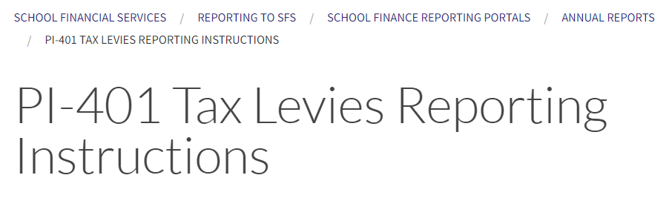
Reporting of Tax Levies
https://dpi.wi.gov/sfs/reporting/safr/annual/pi-401-instructions
Notes:
Report is in SAFR under Financial Reports
DPI will collect Tax levy information for the Department of Revenue
The application will generate PI-1508 forms to send to the Municipalities
May be completed before Board action/meeting so you will be able to get signatures at the meeting

Slide 17
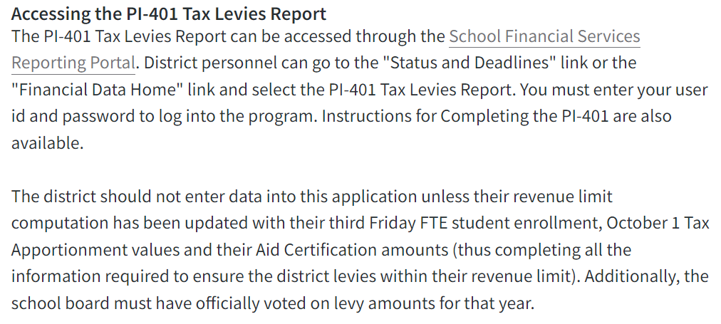

Reporting of Tax Levies
https://dpi.wi.gov/sfs/reporting/safr/annual/pi-401-instructions
Notes:
Link→public portal→choose district→Financial Data Home→Tax Levies PI-401→2021-2022
Report is in SAFR under Financial Reports
DPI will collect Tax levy information for the Department of Revenue
The application will generate PI-1508 forms to send to the Municipalities
May be completed before Board action/meeting so you will be able to get signatures at the meeting

Slide 18
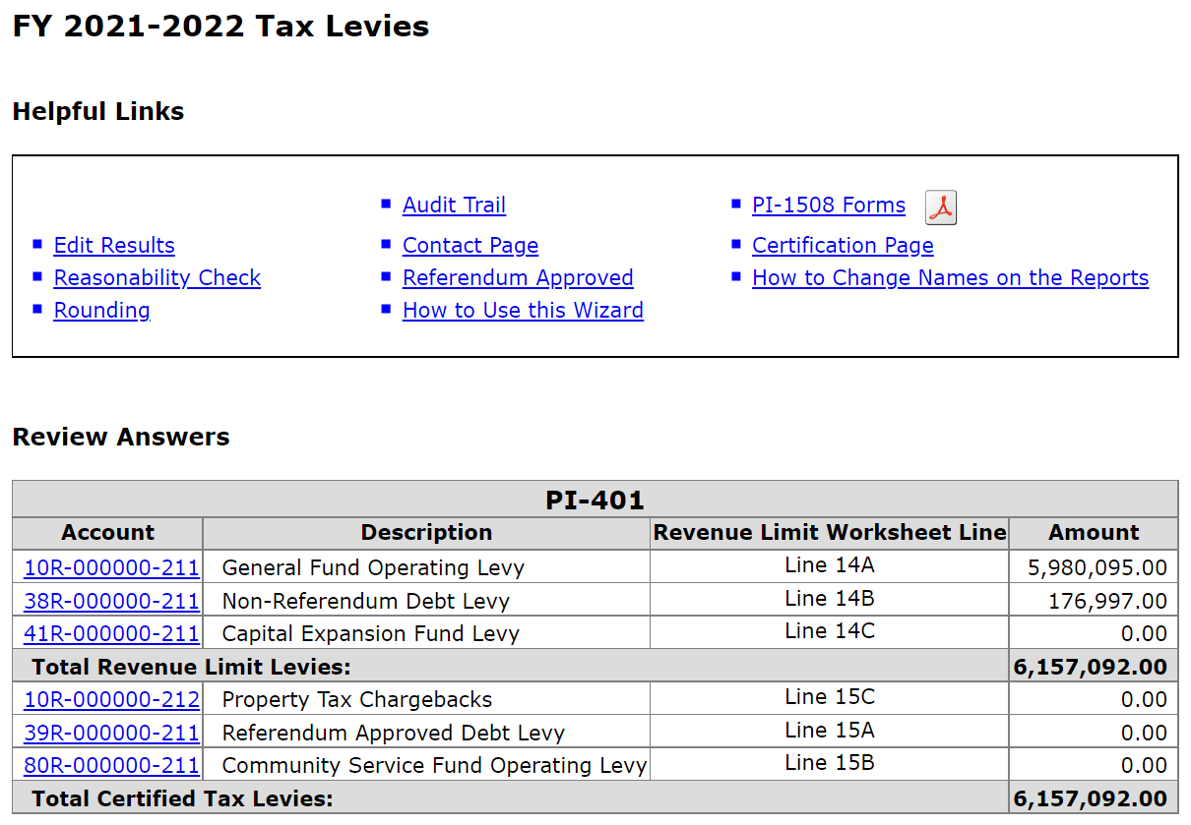
Tax Levies by Fund
Notes:
Report is in SAFR under Financial Reports
DPI will collect Tax levy information for the Department of Revenue
The application will generate PI-1508 forms to send to the Municipalities
May be completed before Board action/meeting so you will be able to get signatures at the meeting

Slide 19
Tax Levy Helpful Hints
Figure out your Fund 38 and Fund 41 levies before Fund 10
Levy non-referendum debt service directly into Fund 38
Adopt separate Fund 38 and Fund 39 debt levies
Notes:
Newbies & veterans alike have made the mistake of levying Fund 10 up to their limit, and then also levying Fund 38, which results in their districts levying over the Revenue Limit and getting penalized the following year.
Some districts levy into Fund 10 and then transfer the cost of their Fund 38 debt service – this is allowed but not recommended.
We’ve seen districts adopt a single “debt service levy” and then misallocate it between Fund 38 and Fund 39.

Slide 20
Tax Levy Helpful Hints
Budget is school year, but debt service is calendar year
  This year’s levy is part of the 2022-23 budget
  The levy pays for your March 2023 & September 2023 debt service payments
  Money for the September 2023 payment is part of 2022-23 year-end fund balance
Notes:
This drives everyone crazy and is an easy thing to goof up.

Slide 21
Tax Levy Helpful Hints
ASK FOR HELP
  Your first tax levy can be scary…
  But there are resources for help
  Your neighbors had their own first tax levies and most are glad to help if you reach out
  Call the SFS Team if you still aren’t sure about something…better to fix it on the front end!

Slide 22
Tax Levy Apportionment
The PI-401 will divide (apportion) your levy among the local municipal levies based on equalized values from Department of Revenue

Slide 23
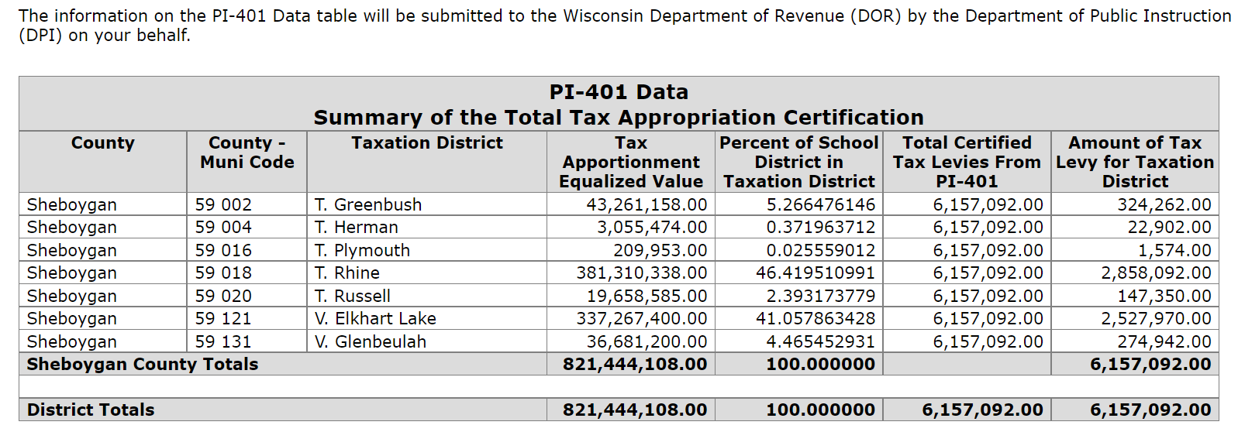
Tax Levy Apportionment
Notes:
DPI will submit your completed data to the Department of Revenue after November 10th

Slide 24
Tax Levy Apportionment
The application will create
PI-1508 forms for you to certify levy amounts to municipalities
Double-check your math!
Notes:
Contact us ASAP if you believe there are problems with how the PI-401 is apportioning your taxes and generating PI-1508 forms.

Slide 25
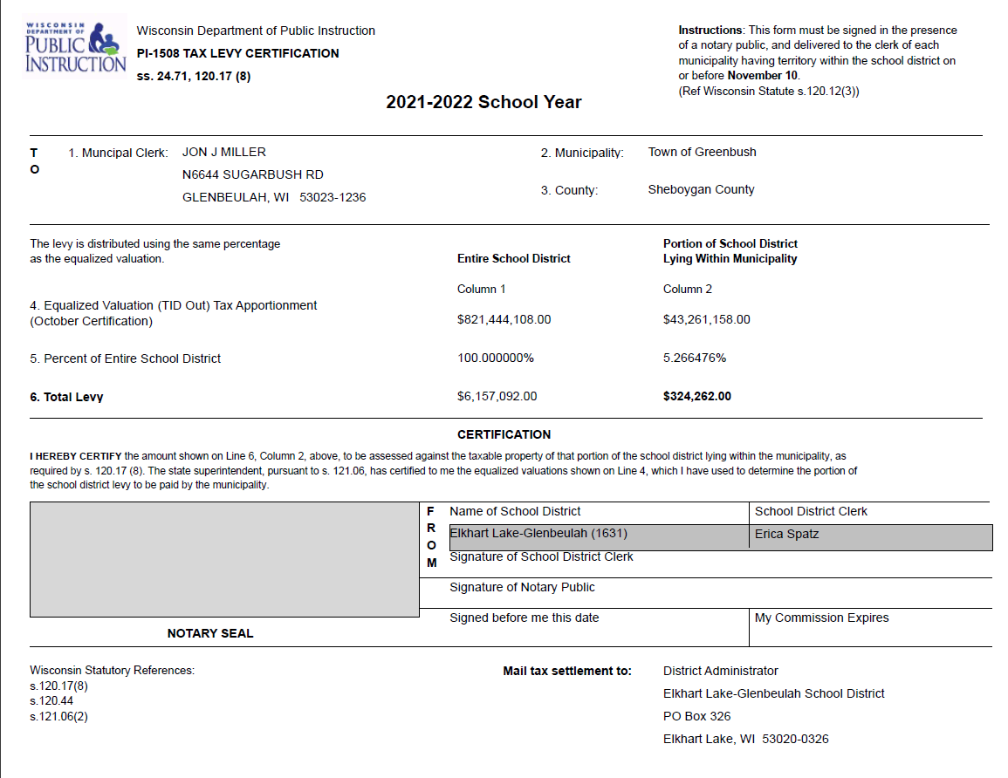
Tax Levy Apportionment
Notes:
New form coming in WISFIP; same functionality as 401 and 1508 but updated
Report in in SAFR under Financial Reports
The PI-401 SAFR application will generate PI-1508 forms to send to the Municipalities by November 10th (received)
May be completed before Board action/meeting so you will be able to get signatures at the meeting

Slide 26
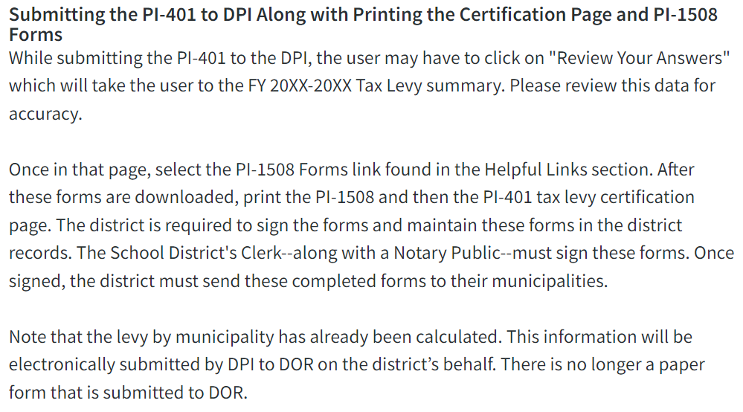
Submitting Tax Levies
https://dpi.wi.gov/sfs/reporting/safr/annual/pi-401-instructions
Notes:
Report is in SAFR under Financial Reports
DPI will collect Tax levy information for the Department of Revenue
The application will generate PI-1508 forms to send to the Municipalities
May be completed before Board action/meeting so you will be able to get signatures at the meeting

Slide 27
Questions?
DPI School Financial Services Team
Website: https://dpi.wi.gov/sfs
Mark Elworthy, Director 608-266-9534
Bob Soldner, Assistant Director 608-267-9124
Ben Kopitzke, Finance Consultant 608-267-9279

