Slide 1
Introduction to WUFAR Wisconsin Uniform Financial Accounting Requirements
Matt Baier, Fiscal Data Coordinator
James Rhinerson, School Finance Auditor
School Financial Services Team
September 6, 2023
Notes:
Introductions
Survey group experience

Slide 2
What is WUFAR?
A multi-dimensional reporting system that can also be used as an accounting system by the Local Education Agency (LEA).
Not required for accounting, but required for reporting and claims to DPI.
Always used in conjunction with the state Budget and Annual Reports (full and special education), as well as ESSA School-Level Reporting.
Notes:
Jim

Slide 3
Why WUFAR?
DPI needs a uniform system for reporting LEA activity for:
Reporting purposes (both state and federal)
Calculating general and categorical aid
Determining compliance with federal regulations
Comparing activity between LEAs
State budget building
Ensuring compliance with Uniform Grant Guidance requirements to track federal grant expenditures
Notes:
Jim
DPI uses WUFAR because every State Education Agency needs a uniform system for reporting both state and federal activity and fiscal reports. It also enables DPI to calculate state-funded general and categorical aids paid to the LEAs. The program teams use it to determine compliance with federal regulations. And lastly, the standardized financial information we receive from the LEAs helps DPI create a state budget and requests for funding from the legislature because we are able to determine local need.

Slide 4
Why WUFAR?
LEAs need a consistent system and common language for:
Purchasing and expenditures
Planning, creating, and monitoring local budgets and expenses
Budget development and decision-making authority
Local budget accountability
Notes:
At the LEA-level, using WUFAR allows for a consistent system and common language around expenditures and revenues. By using WUFAR, LEAs can easily communicate among themselves and work with DPI regarding allowable costs, state aid payments, and audits.

Slide 5
Why WUFAR?
Wisconsin Statutes, s. 115.28(13) Uniform financial fund accounting.
[The state superintendent shall] prescribe a uniform financial fund accounting system, applicable to all school districts and county children with disabilities education boards, which provides for the recording of all financial transactions inherent in the management of schools and county children with disabilities education board programs and the administration of the state's school aid programs.
Notes:
At the LEA-level, using WUFAR allows for a consistent system and common language around expenditures and revenues. By using WUFAR, LEAs can easily communicate among themselves and work with DPI regarding allowable costs, state aid payments, and audits.

Slide 6
Why WUFAR?
Wisconsin Statutes, s. 115.30(1) …School district officers and employees shall maintain a uniform recording of accounting as prescribed by the department and make such reports to the department as will enable it to distribute state school fund appropriations and state educational appropriations to the schools and persons entitled thereto...
Notes:
Jim
At the LEA-level, using WUFAR allows for a consistent system and common language around expenditures and revenues. By using WUFAR, LEAs can easily communicate among themselves and work with DPI regarding allowable costs, state aid payments, and audits.

Slide 7
GAAP & GASB
WUFAR meets requirements under Generally Accepted Accounting Principles (GAAP) and Governmental Accounting Standards Board (GASB) which apply to all state and local governments.
Changes to GAAP and GASB are one of the primary reasons DPI makes revisions to WUFAR on a periodic basis.
Notes:
Jim

Slide 8
WUFAR Sequence of Dimensions
This sequence is what you would normally see when looking at an expense report.
Fund
Location
Object or Source
Function
Project
Notes:
Matt
There are five components of the WUFAR expenditure account string. ^Fund, ^Location, ^Object of Expense, ^Function, and ^Project. We usually add the word “Code” onto Object and Project – so you will hear someone saying “What is the Object Code?” or “What Project Code should we use?”

Slide 9
WUFAR Account Sequence
A WUFAR account is a sequence of dimensions:
10
E
120
111
122150
141
Fund – Type – Location – Object/Source – Function - Project
Notes:
Matt
At the LEA-level, using WUFAR allows for a consistent system and common language around expenditures and revenues. By using WUFAR, LEAs can easily communicate among themselves and work with DPI regarding allowable costs, state aid payments, and audits.

Slide 10
WUFAR is Hierarchical
100000 Instruction
WUFAR dimensions “roll up” from lower detail levels to higher summary levels
A zero means “this includes anything at a lower level with a digit here”
120000 Regular Curriculum
122000 English Language
122100 Language Skills
122150 Reading Specialist
Notes:
Matt

Slide 11
WUFAR is Hierarchical
DPI only defines dimensions to a certain level
100000 and 120000 are required functions for reporting to DPI
122000 and 122100 are optional DPI-defined functions for local use
122150 is a locally created function for an even greater level of detail
100000 Instruction
120000 Regular Curriculum
122000 English Language
122100 Language Skills
122150 Reading Specialist
Notes:
Matt

Slide 12
WUFAR Account Sequence
Fund
10
E
120
111
122150
141
Which accounting entity is it part of?
10 = General Fund
Notes:
Jim

Slide 13
What is a Fund?
Independent fiscal and accounting entity
Requiring its own set of books
In accordance with special regulations, restrictions, and limitations that earmark each fund for a specific activity or for attaining certain objectives
Self-Balancing
Assets – Liabilities = Fund Balance
Starting Balance + Revenues – Expenditures = Ending Balance
Self-Contained
Different funds subject to different legal & program requirements
Resources move between funds only through specifically defined and allowed fund transfers
Notes:
Jim
At the LEA-level, using WUFAR allows for a consistent system and common language around expenditures and revenues. By using WUFAR, LEAs can easily communicate among themselves and work with DPI regarding allowable costs, state aid payments, and audits.

Slide 14
WUFAR Account Format
Fund
Fund 10
Typically used for general education costs funded by a combination of local, state and federal funds.
Day-to-day operations
General Education Instructional staff
General Instructional activities
Pupil Services staff
Pupil Transportation
10
Notes:
Jim
The first dimension is “Fund.”
A fund is a fiscal and accounting entity with a self-balancing set of accounts which are segregated for the purpose of carrying out specific activities in accordance with special regulations, restrictions, or limitations. Another way to think of a “fund” is having separate bank accounts for different activities – perhaps a checking account that is established for household costs, another account that has been set up for a personal business, and a third shared account for vacations or gifts. Certain revenues are deposited into each of the accounts and the money drawn out for specific purposes.
For LEAs, the most common account is Fund 10, which covers general education costs funded by a combination of local, state, and federal funds, and accounts for the day-to-day operations of general instruction and services provided to all students.

Slide 15
WUFAR Account Format
Fund
Fund 27
Used to account for the excess cost of providing special education and related services for students with IEPs.
Separated for State Special Education Categorical Aid calculation and IDEA Maintenance of Effort (MOE) calculations.
27
Notes:
Jim
Special Education has its own fund, which is 27. Fund 27 is used to account for the excess cost of providing special education and relates services to students with IEPs. It is separated out for calculating state special education categorical aid and IDEA’s maintenance of effort compliance requirement.
If it is a special education expense, it must be accounted for in Fund 27.

Slide 16
WUFAR Account Format
Fund
Fund 50
Student and elderly food services
May carry a positive balance, but not a deficit
Any year-end deficit is covered with a transfer from Fund 10
50
Notes:
Jim
Special Education has its own fund, which is 27. Fund 27 is used to account for the excess cost of providing special education and relates services to students with IEPs. It is separated out for calculating state special education categorical aid and IDEA’s maintenance of effort compliance requirement.
If it is a special education expense, it must be accounted for in Fund 27.

Slide 17
WUFAR Account Format
Fund
Fund 80
Used to account for activities such as adult education, community recreation programs
District may adopt a separate tax levy for this fund
School board must establish a Community Service Fund pursuant to s. 120.13(19)
May not expend monies on ineligible costs as defined by DPI
80
Notes:
Jim

Slide 18
Other Common Funds
Special Revenue (Fund 21)
Usually for fundraising and private gifts
Debt Service (Funds 38 & 39)
Capital Projects (Funds 41, 46, 49)
Debt service and capital projects are booked separately from operations
Custodial Fund (Fund 60)
Held on behalf of student & parent organizations
Little to no “administrative involvement” by the district
Notes:
Jim

Slide 19
Special Funds
Other Special Projects (Fund 29)
Private Trust Fund (Fund 72)
Employee Trust Fund (Fund 73)
Cooperative Programs (Fund 99)
Notes:
Jim

Slide 20
WUFAR Account Sequence
Type
10
E
120
111
122150
141
What sort of account is it?
E = Expenditure
Notes:
Matt

Slide 21
Account Types
DPI defines three types of accounts:
E xpenditure
R evenue
B alance Sheet
Notes:
Matt

Slide 22
Account Types
Most LEAs add detail for account statement types:
Balance Sheet
A sset
L iability
e Q uity
Operating Statement
E xpenditure
R evenue
Notes:
Matt

Slide 23
WUFAR Account Format
Fund
Location
Location
Where?
DPI generally has not collected in the past.
Can be used for internal tracking by the LEA, including school level reporting.
10 - 27
123

Slide 24
WUFAR Account Sequence
Location
10
E
120
111
122150
141
Where is this activity located?
120 = Shady Meadow Elementary*
* Local account detail
Notes:
Matt

Slide 25
WUFAR Account Format
Fund
Location
Source
Source
Where
Source identifies revenues and other sources of funds according to their origins.
Used exclusively with Revenues
10
000
619
Notes:
Matt

Slide 26
WUFAR Account Format
Fund
Location
Object
Object
What or Who
Object identifies the type of cost by category, such as salaries, materials, supplies, or contracted services.
What you are buying, or
Who you are buying it from
10 - 27
123
300
Notes:
Matt
The Object is the next number in this sequence. This code identifies the different types of expenses. What is being paid for, or in the case of purchasing a service, the type of entity providing the service. For example, library books are labeled with an object 432. Capital Equipment is tied to object 550. Services purchased from a CESA are coded to 386.
Think of the WUFAR string as going from general to detailed. The Fund is the broadest piece, followed by the Object, which identifies if the cost is salaries, or a purchased service, a non-capital object, or capital expense.

Slide 27
WUFAR Account Sequence
Object/Source
10
E
120
111
122150
141
Expense Object: What is being paid for?
111 = Certified Staff Salary*
* Local account detail
Notes:
Matt

Slide 28
Types of Objects
Salaries & Benefits (100 / 200 Objects)
Purchased Services (300 Objects)
Non-Capital Objects (400 Objects)
Capital Objects (500 Objects)
Insurance (700 Objects)
Other Objects (900 Objects)
Notes:
Matt
The Object is always a three-digit code hierarchical classification, similar to the Dewey Decimal system. On the largest level, it is broken into categories that are indicated by the first digit of the code. DPI uses the categories as distinct budget sections within WISEgrants.
The 400 object series encompasses all items considered non-capital objects. Object 410 is the general bucket of “supplies” with the more detailed object 411 representing General Supplies, 415 identifies food, 417 is specifically for paper and so on.
A zero in any position of a WUFAR code number represents a total of other more detailed account codes. For example, 411 and 415 roll up to 410, and 410 and 430 roll up to 400. Although this roll up exists, LEAs should always use the more detailed level available.

Slide 29
WUFAR Account Format
Fund
Location
Object
Function
Function
Why?
For what area or purpose?
100 000-level functions are instructional.
200 000-level functions are support services.
10 - 27
123
300
110 000
-
158 000
Notes:
Jim

Slide 30
WUFAR Account Sequence
Function
10
E
120
111
122150
141
What is the purpose?
122150 = Reading*
* Local account detail
Notes:
Jim

Slide 31
Types of Functions
Instruction – 100 000
110 000 - Undifferentiated Curriculum
120 000 - Regular Curriculum
130 000 - Vocational Curriculum
140 000 - Physical Curriculum
150 000 - Special Education Curriculum
160 000 - Co-curricular Activities
170 000 - Other Special Needs
Notes:
Jim
This slide lists some the instructional functions. The highest level are tied to categories of curriculum. Notice how each one begins with the number “1.”

Slide 32
Types of Functions
Support Services – 200 000
210 000 - Pupil Services
220 000 - Instructional Staff Services
230 000 - General Administration
240 000 - School Building Administration
250 000 - Business Administration
260 000 - Central Services
270 000 - Insurance and Judgements
Notes:
Jim
This slide lists some the support functions. Notice how each one begins with the number “2.” Within federal grants, the most commonly used support functions will be under Pupil Services and Instructional Staff Services.

Slide 33
Example: Instructional Function Detail
110 000 - Undifferentiated Curriculum: Teaches two or more curricular areas to the same group of students
Language arts / social studies program
First grade teacher
Notes:
Jim
110 000 is Undifferentiated Curriculum, which is used when it applies to the teaching of two or more curricular areas to the same group of students in the same location.
This generally covers the primary grades, where instructors teach multiple subjects to the same group of students.

Slide 34
Example: Instructional Function Detail
120 000 - Regular Curriculum: Teaches one curricular area
122 000 – English Language
124 000 – Mathematics
124 100 – Algebra
124 300 – Calculus
124 600 – Geometry
Notes:
Jim
Regular curriculum is coded to 120 000 series and applies to the teaching of a specific curricular area.

Slide 35
Example: Instructional Function Detail
150 000 – Special Education Curriculum
152 000 – Early Childhood
156 000 – Physical / Sensory
156 100 – Deaf & Hard of Hearing
156 200 - Homebound
156 600 – Speech / Language
156 700 – Visually Impaired
158 000 – Cross Categorical - SE
159 000 – Other Special Curriculum
159 100 – Special Education Program Aide
159 200 – Special Education Short Term Subs
159 300 – Special Education Specialty Teachers
Notes:
Jim
The special education program uses the greatest variety of functions. Many of the staff accounted for under these functions are required to have related and specific DPI licenses tied to that area. The detail of these functions are used when determining allowable costs under the IDEA grant and state special education categorical aid.

Slide 36
Types of Functions
Non-Program Transactions – 400 000s
431 000 - General Education Contracted Instruction
436 000 - Special Education Contracted Instruction
Instructional functions (100 000 series) become 400 000 functions when the instruction is purchased.
156 700 for Visual Impairment Teacher Salary / Benefits
436 000 for Contracted Visual Impairment Instruction
Notes:
Jim
There are also functions coded to the 400 000 series, which indicate non-program transactions, such as transfers to another fund within the LEA. But this series also includes payment for instructional services provided by another entity, which are coded under 436000-Special Education Contracted Instruction and 431000-General Contracted Instruction.
I want to spend a moment on this slide because this is a very common function used in special education. LEAs often purchase special education instruction from CESAs, other LEAs, or private vendors. When this occurs, the ^original instructional function is converted to a 436 000. It does not matter the detail of the original 150 000 series function, each one becomes a 436 000 when it is purchased from another entity.
^For example, if the LEA employs a Visual Impairment Teacher, the function used is 156 700. If the LEA instead purchases Visual Impairment instruction from a CESA, ^that same function is moved from a salaries and benefits object to a purchased service as a 436 0000.

Slide 37
Example: Support Services Function Detail
210 000 – Pupil Services
211 000 – Direction of Pupil Services
212 X00 – Social Work
213 X00 – Guidance
214 X00 – Health
215 X00 – Psychological Services
218 000 – Therapy
218 100 – Occupational Therapy
218 200 – Physical Therapy
220 000 – Instructional Staff Services
221 000 – Improvement of Instruction
221 300 – Instructional Staff Training
223 000 – Supervision & Coordination
223 3X0 – SPED Supervision and Coordination
223 900 – Other Instructional Staff Supervision and Coordination
256 000 – Pupil Transportation
260 000 – Central Services
264 400 – Non-Instructional Staff Training
Notes:
Jim
This slide lists the commonly used support service functions related to pupil services, special education related services, and instructional staff services. A common grant expense is professional development or training, which is also included in the support services series as a 221300 for instructional staff and a 264 400 for non-instructional staff.

Slide 38
WUFAR Account Format
Fund
Location
Object
Function
Project
10 - 27
123
300
110 000
-
158 000
141
-
341
Project
How is it paid for?
Project is designed to identify a funding source.
Notes:
Matt

Slide 39
WUFAR Account Sequence
Project
10
E
120
111
122150
141
Which special program or project is it part of?
141 = Title I
Notes:
Matt

Slide 40
Project Codes
Grants and programs managed by DPI get their own project codes
Payments on the Aids Register show the project code
Aids Register WUFAR Codes - https://apps6.dpi.wi.gov/AID/WufarReport
Notes:
Matt
Project codes play a critical role in compliance with Federal grants. The Federal Uniform Grant Guidance requires subrecipients of federal funds to track all grant-funded expenditures separate from their general operating costs. Using DPI-assigned project codes ensures that the LEA is meeting this requirement and can easily produce reports demonstrating that the funds were used only for allowable costs under the federal program.
In addition, tagging each expenditure with the appropriate project code may be necessary to meet many federal fiscal requirements, such as maintenance of effort.

Slide 41
Fund 10 Project Codes
ESEA | IDEA | CARES
141 – Title I-A | 341 – IDEA Coordinated Early Intervening (CEIS) | 160 – Elementary and Secondary Emergency Relief Fund (ESSER)
365 – Title II-A
391 – Title III-A | 341 – IDEA Comprehensive CEIS (CCEIS)
381 – Title IV-A
 |  | 162 – Governor’s Emergency Education Relief Fund (GEER)
360 – Wisconsin Charter Schools Program | 341 – IDEA Title I Schoolwide Set-Aside
400 – Carl D. Perkins CTE
Notes:
Matt
Here are common project codes tied to Federal grants. If the purpose of the grant activity is to support general education, the expense belongs in Fund 10. Although IDEA funding is generally used to offset the cost of providing special education instruction and related services, when the funds are repurposed to support all students under coordinated early intervening services or to support a school’s Title I schoolwide program, the expenditure will be recorded in Fund 10. However, it will always keep the project code of the IDEA grant to identify how the expenditure was paid.

Slide 42
Fund 27 Project Codes
Local | Federal
011 – State Special Education Categorical Aid | 341 – IDEA Flow-through
 | 347 – IDEA Preschool
019 – Non-aidable Special Education Cost | 160 - ESSER
 | 162 - GEER
ALL special education expenditures must have a project code.
Notes:
Matt
Every expenditure coded to fund 27 requires a three-digit project code that is not 000.
Special education costs that are eligible for state special education categorical aid reimbursement are tagged with a project code of 011. In Wisconsin, special education staff (including some categories of contracted staff) and specialized transportation costs are eligible for state special education categorical aid. The LEA covers costs using local funds during the year the expense occurs and in the following fiscal year receives a certain percentage of state aid from DPI.
Special education costs that are not eligible for state special education categorical aid, such as supplies, curriculum or private placement tuition for a student, are tagged with a project code of 019. The LEA pays for the costs using local funds and does not receive any state or federal aid for the expenditure.
Expenditures an LEA charges to the IDEA grant are tagged with a project code of 341 for costs reimbursed with IDEA flow-through funds or a project code of 347 for costs reimbursed with IDEA preschool funds.

Slide 43
Project Codes
Project codes are used to identify expenditures funded by a particular program or grant
10
E
120
111
122150
141
141 = Title I
The default project for local, non-specific costs is 000
10
E
120
111
122150
000
Notes:
Matt

Slide 44
Local Project Codes
LEAs can use their own codes for specific projects or programs (e.g. referendum construction, non-DPI grants)
900s are reserved for local projects
Notes:
Matt

Slide 45
WUFAR Account Sequence
What does this account mean?
10
E
120
111
122150
141
Salary expenditures for a regular education Title I reading specialist at Shady Meadow Elementary School
Notes:
Jim

Slide 46
Expenditure vs. Revenue Accounts
One dimension varies depending on the account type:
10
E
120
111
122100
141
With an expenditure account this is an Object, what is being paid for.
Notes:
Jim

Slide 47
Expenditure vs. Revenue Accounts
One dimension varies depending on the account type:
10
R
000
621
000000
000
With a revenue account this is a Source, where money is coming from and what it’s used for.
Source 621 = State Equalization Aid
Notes:
Jim

Slide 48
Revenue Account Detail
10
R
000
621
000000
000
Note that this revenue account does not have a location, function, or project.
DPI does not collect these for most revenues.
Notes:
Jim

Slide 49
Revenue Account Detail
DPI specifies revenue functions only for fund transfers:
27
R
000
110
411000
000
Operating transfer
from the General Fund
to the Special Education Fund
Notes:
Jim

Slide 50
Revenue Account Detail
An LEA may add detail to provide more information:
10
R
000
271
000000
000
Source 271 is used for Co-Curricular Admissions.
Notes:
Jim

Slide 51
Revenue Account Detail
An LEA may add detail to provide more information:
10
R
400
271
000000
000
Source 271 is used for Co-Curricular Admissions.
An LEA using location 400 for its high school might want to track admissions by sport…
Notes:
Jim

Slide 52
Revenue Account Detail
An LEA may add detail to provide more information:
10
R
400
271
162120
000
…so they choose to use the detail function they have defined for Girls Basketball, 162120, to code those admissions
Notes:
Jim

Slide 53
Balance Sheet Accounts
Balance sheet accounts use three dimensions:
80
A
711000
Fund
Type
Function
Notes:
Jim

Slide 54
Balance Sheet Accounts
What does this account mean?
80
A
711000
Community Service Fund cash (asset).
Notes:
Jim

Slide 55
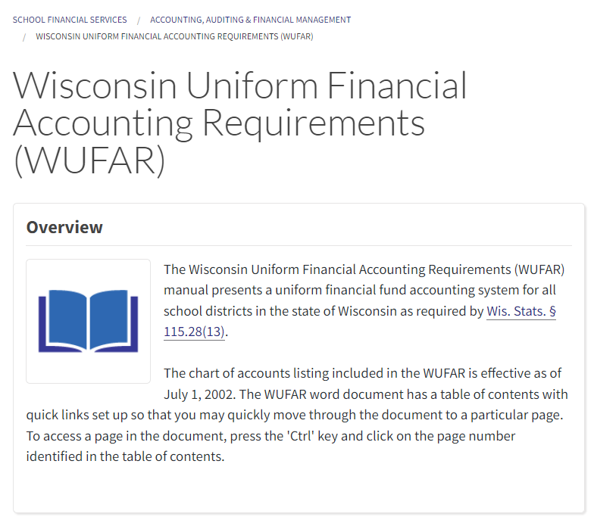
WUFAR
Find it on the DPI School Financial Services webpage: dpi.wi.gov/sfs/finances/wufar/overview
WUFAR resources updated at least yearly, including the manual, summary of revisions, and account matrices
Will transition to Online WUFAR module in WiSFiP
Notes:
Matt

Slide 56
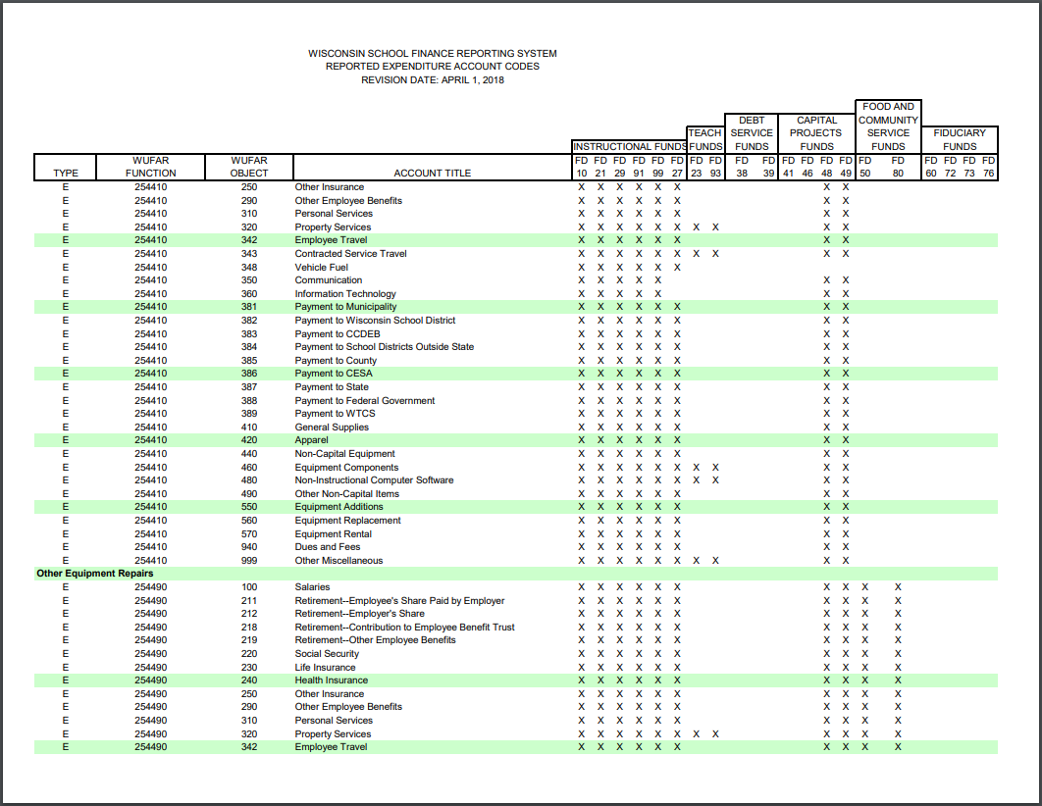
Account Matrices
Supplemental charts showing allowed account combinations
Allowed combinations officially defined in the written account dimension descriptions
Notes:
Matt

Slide 57
High-level WUFAR: Sources
Source | Label | Examples (not a complete list)
100 | Transfers | Transfers of money from one fund to another
200 | Local Sources | Taxes, fees, donations, sales, interest & investment proceeds
300 | Inter-District Payments (WI) | Service payments & aid transits from another WI district
400 | Inter-District Payments (OOS) | Service payments from districts outside the state
500 | Intermediate Sources | Service payments & aid transits from CESAs & counties
600 | State Sources | State aids and grants
700 | Federal Sources | Federal aids and grants
800 | Other Financing Sources | Debt proceeds, sales of real estate & capital equipment
900 | Other Revenues | Cash balance adjustments, refunds, trust contributions
Notes:
Matt

Slide 58
High-level WUFAR: Balance Sheet
Function | Label | Examples (not a complete list)
810000 | Current Liabilities | What you owe
811000 | Payables | Accounts payable, accrued payroll & benefits
812000 | Due to Other Funds | Fund transfers pending
813000 | Due to Other Governments | Payments due to other districts, CESA, etc.
814000 | Due to Student Organizations | Money held for student clubs & activities
815000 | Deposits Payable | Self-funded insurance, HRAs
816000 | Deferred Revenues | Items recorded as revenues in the future
817000 | Health Benefit Claims Payable | Unpaid claims for self-funded benefits
818000 | Due to Parent Organizations | PTO
819000 | Other Fund Liabilities | Anything else
Notes:
Matt

Slide 59
High-level WUFAR: Balance Sheet
Function | Label | Examples (not a complete list)
930000 | Fund Balance | Surplus in fund at year end
935000 | Non-Spendable | Non-cash assets, donor restricted funds
936000 | Restricted | Restricted by laws or creditors
937000 | Committed | Held for specific purpose by formal Board action
938000 | Assigned | Intended to be used for specific purpose
939000 | Unassigned | Anything not in other fund balance categories
Notes:
Matt

Slide 60
High-level WUFAR: Balance Sheet
Optional fund balance accounts for local use
Function | Label | Examples (not a complete list)
939000 | Unassigned | Anything not in other fund balance categories
939100 | Revenue Stabilization | “Rainy Day” fund
939200 | Working Capital Needs | Cash flow
939300 | Contingencies | Pending litigation, environmental remediation
939400 | Emergencies | Disasters, “acts of God”
939900 | Other Unassigned | Anything else
Notes:
Matt

Slide 61
SFS Contacts
Matt Baier, Fiscal Data Coordinator matthew.baier@dpi.wi.gov, 608-266-1863
Olivia Bernitt, School Finance Auditor olivia.bernitt@dpi.wi.gov, 608-267-2137
James Rhinerson, School Finance Auditor
james.rhinerson@dpi.wi.gov, 608-266-7692
SFS Team Contact dpifin@dpi.wi.gov, 608-267-9114
Notes:
Matt

