Slide 1
PI-1505 DPI Annual Report Processing 101 (How to Survive the Annual Report)
Olivia Bernitt, School Finance Auditor
Mark Elworthy, Director School Financial Services Team
Matt Baier, Fiscal Data Analyst
WASBO New Administrators and Support Staff Conference September 7, 2023

Slide 2
Vocabulary
Grant Receivables
Ledger
PI 401
Beginning Balance
Reconciliation
SAFR
EOY Adjusting Entries
Debits = Credits
Aids Register Amount
WUFAR Matrix
Rejected Account
Edits
Due from
Due to
Cents vs No Cents
DPI On the Record
Debt Tables
Tax Levy
Trial Balance
Inter-fund Transfer
Fund Equity Accounts
08B Long-term Debt Obligations

Slide 3
[We Hope You Started] Early
Start preparing for the DPI Annual Report at least 2-3 weeks BEFORE the due date of September 22!
Give yourself PLENTY of uninterrupted time since you are new to the process
Make sure your WDF/WiSFiP login works

Slide 4
Annual Report Process
1. Finalize Your Books
2. Push Your Data
4. Certify Your Report
3. Resolve Validations and Complete Addenda

Slide 5
Finalize Your Books
Transactions complete and booked through June 30
Purchase orders liquidated
Invoices paid and check runs completed
Grant claims completed
Payables and receivables, end-of-year adjustments posted

Slide 6
Finalize Your Books
Funds are balanced
Debits equal credits
Inter-fund transfers are complete
Transfers from Fund 10 to:
Have a zero balance in Fund 27
Cover any deficit in Funds 38 or 50
Pay your share of a Fund 99 co-op, if you have one

Slide 7
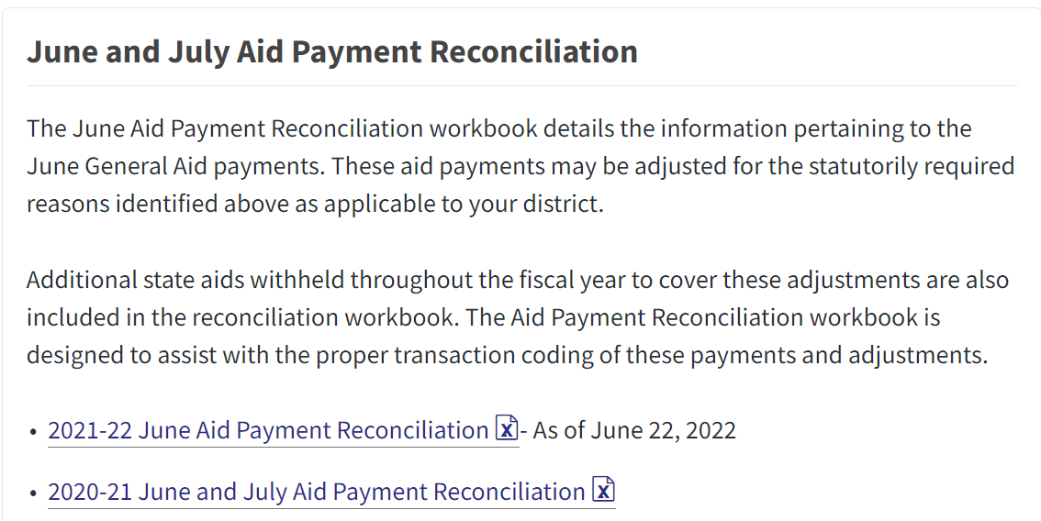
DPI June Payment Adjustments

Slide 8
Annual Report & Your Audit
Ideal: Your audit is complete before you begin working on the Annual Report
If you have to start your Annual Report while your auditor is still working…
New - Make sure to update your books and push the data to your Annual Report as your auditor sends you corrections!

Slide 9
Review and Know Your Data
Total Revenues and Expenditures for All Funds
All Balance Sheet Beginning and Ending Balances
Have a copy of the district’s prior year SAFR Annual Report for reference (last year to use SAFR as primary source)

Slide 10
Review and Know Your Data
Does Fund 27 balance? (assets=liabilities)
Do you have any negative amounts?
Do you have amounts in inactive accounts?

Slide 11
Rejected Accounts
Why was the account code rejected?
Rejected Object/Source
Rejected Function
Rejected Fund/Object/Source/Function combinations

Slide 12
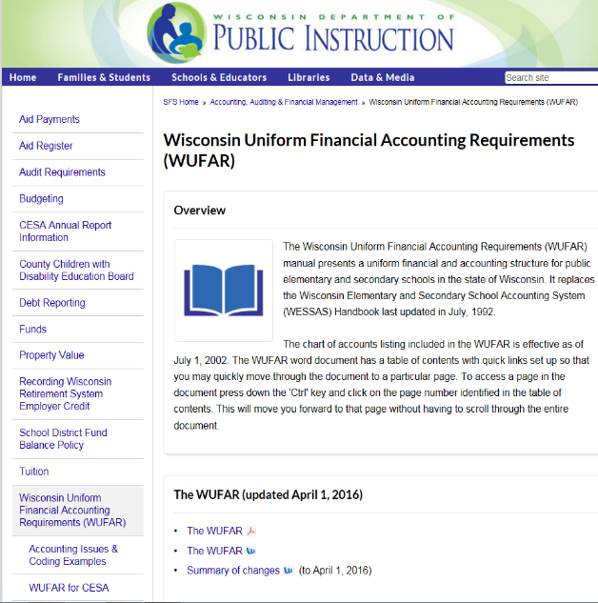
Rejected Account Resources
Review WUFAR Updates
Once a year
Use WUFAR matrices to find “allowable” accounts.

Slide 13
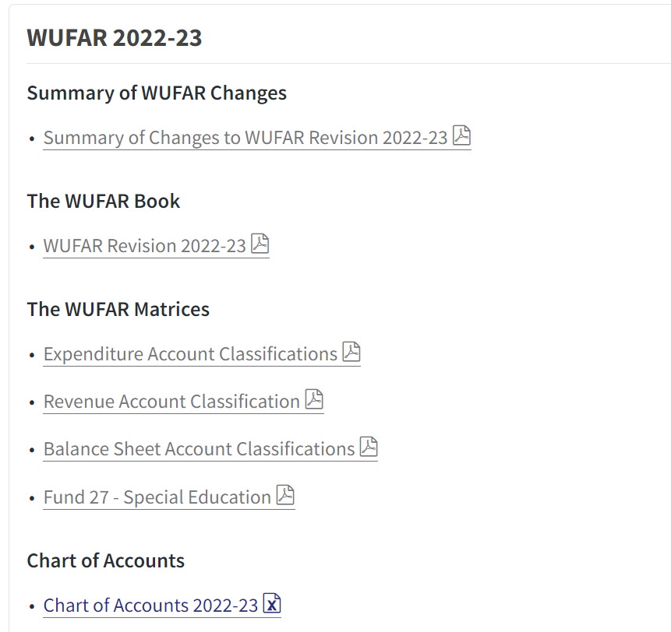
WUFAR Matrix (Chart)
Shows required reporting codes

Slide 14
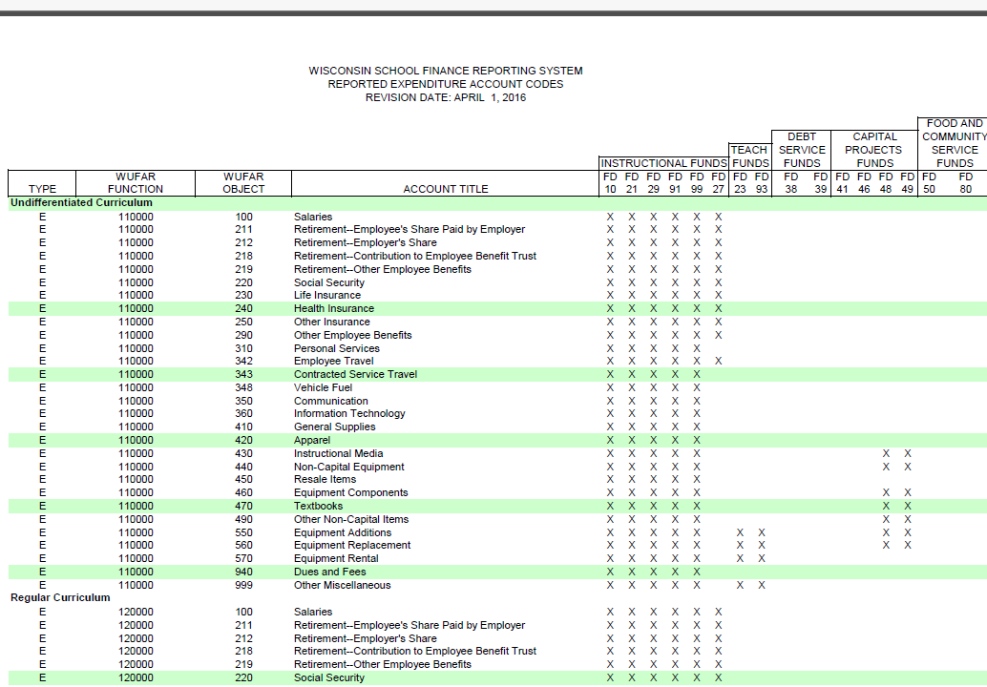
Fund
Note # of places (up to four)
Function
Object

Slide 15
Rejected Account Example
Local Account used by district
10 E 800 217 110000 000
Is the fund valid?
Is the object valid?
Is the function valid?
Is the combination valid?

Slide 16
10 E 800 217 110000 000

Slide 17
Rejected Account Example
Local Account used by district
10 E 800 230 220000 000
Is the fund valid?
Is the object valid?
Is the function valid?
Is the combination valid?

Slide 18
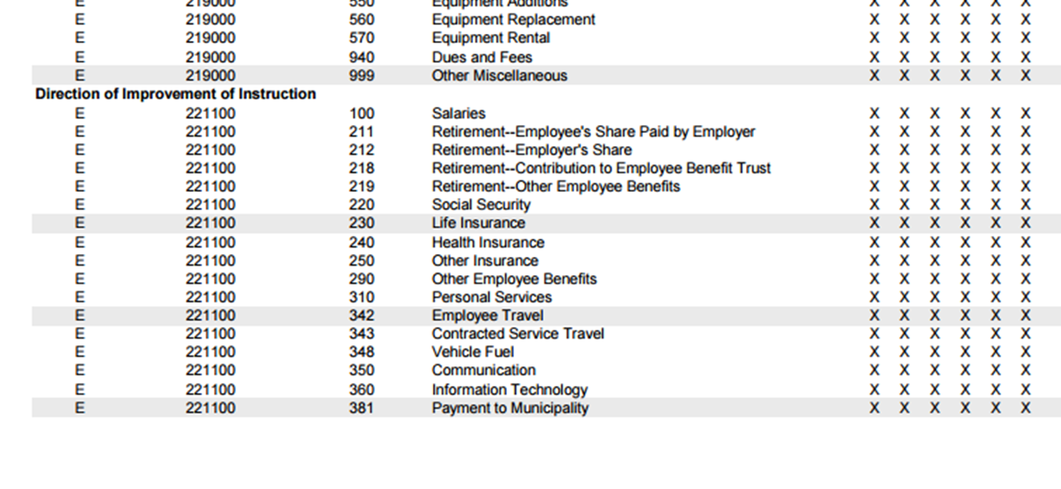
10 E 800 240 220000 000
10 E 800 230 220000 000

Slide 19
Rejected Account Example
Local Account used by district
10 E 800 341 110000 000
Is the fund valid?
Is the object valid?
Is the function valid?
Is the combination valid?

Slide 20
10 E 800 240 220000 000
10 E 800 341 110000 000
341 PUPIL TRAVEL
Used with all functions and sub-functions in the 256 700 series.
The cost of contracted pupil transportation between home and school, for field trips, spectator buses, extra curricular activities. Include transportation cost for students between school sites.

Slide 21
DPI Amount
Certified Amount Errors, Tax Levy Errors, and Amounts “On Record” are all taken from either:
1. Information you have already reported to us via another report
2. Information we have provided via Aids Register, June Aid Payment Journal Entries, etc.

Slide 22
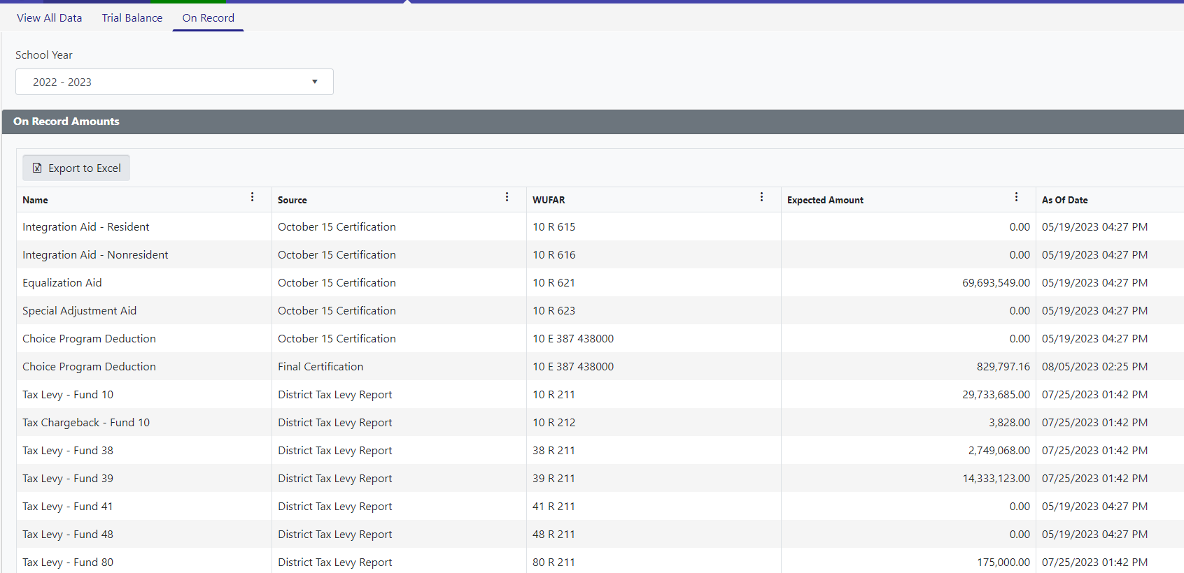
“On Record”

Slide 23
“On Record”

Slide 24
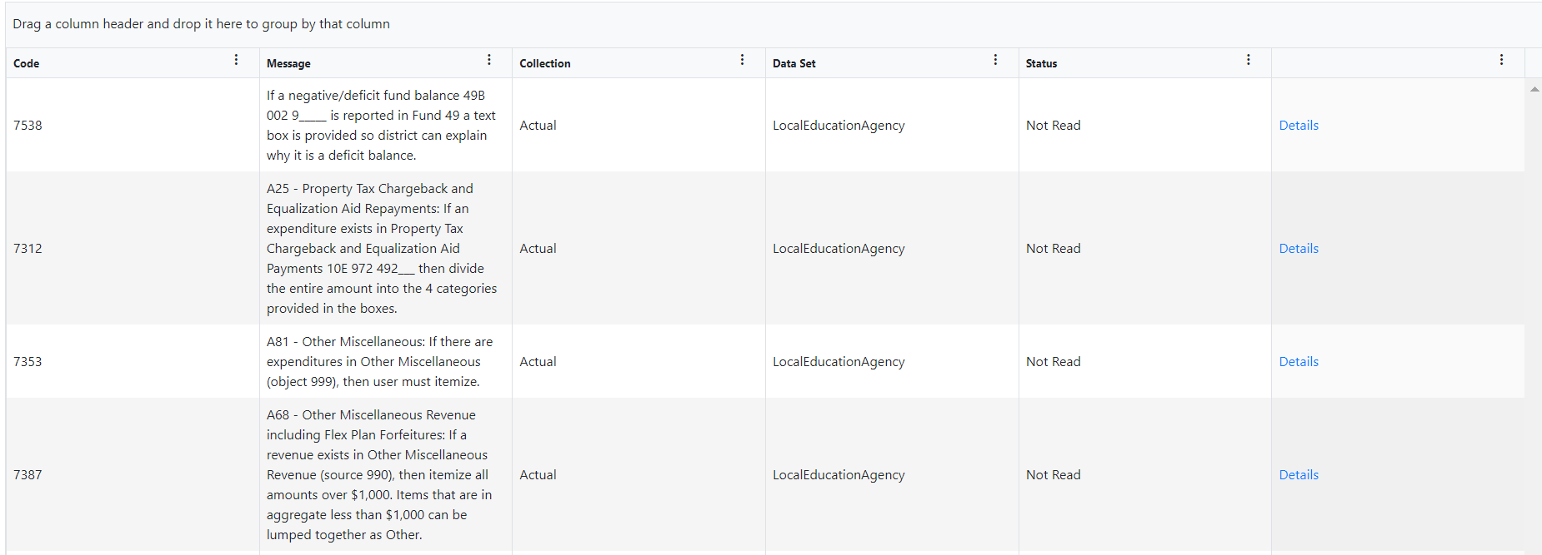
Complete Addenda

Slide 25
Complete Addenda

Slide 26
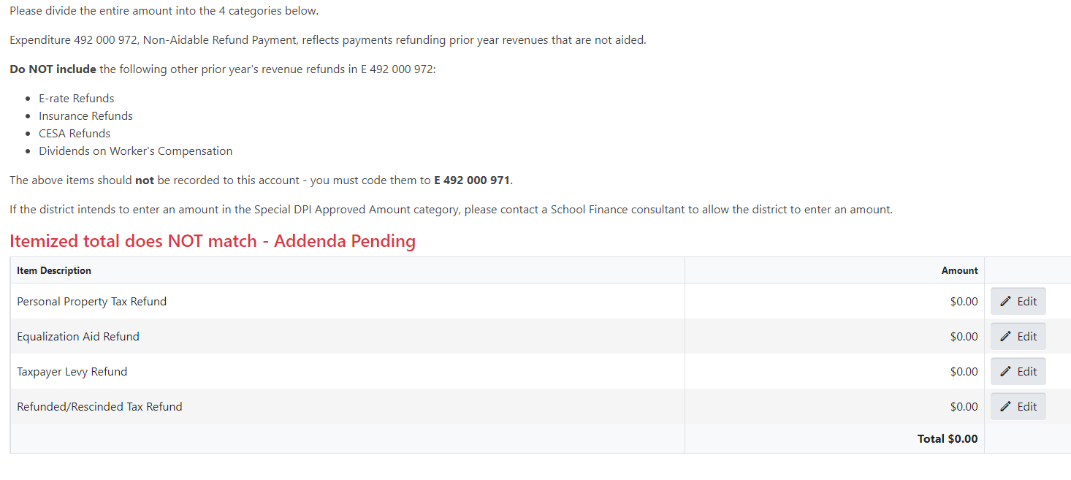
Complete Addenda

Slide 27
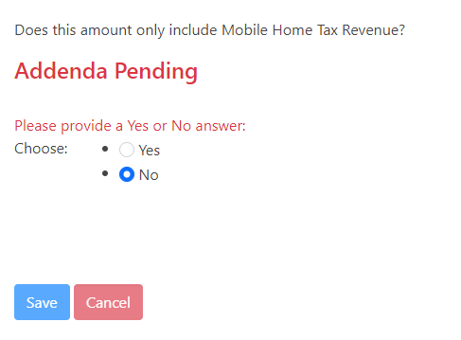
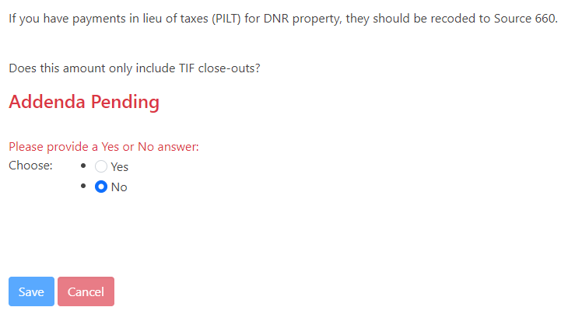
Complete Addenda

Slide 28
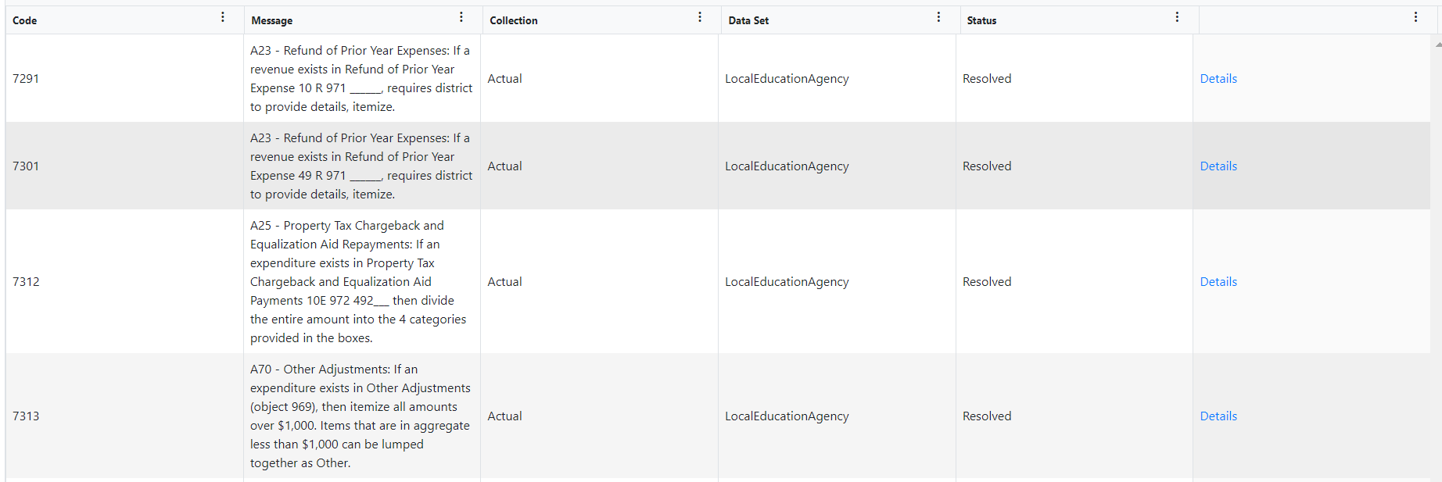
Complete Addenda

Slide 29
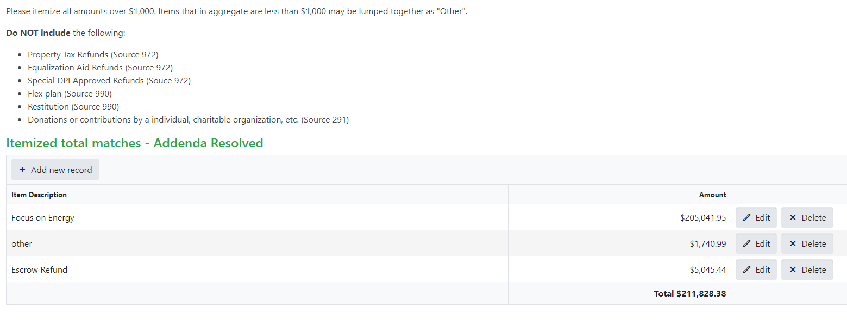
Complete Addenda

Slide 30
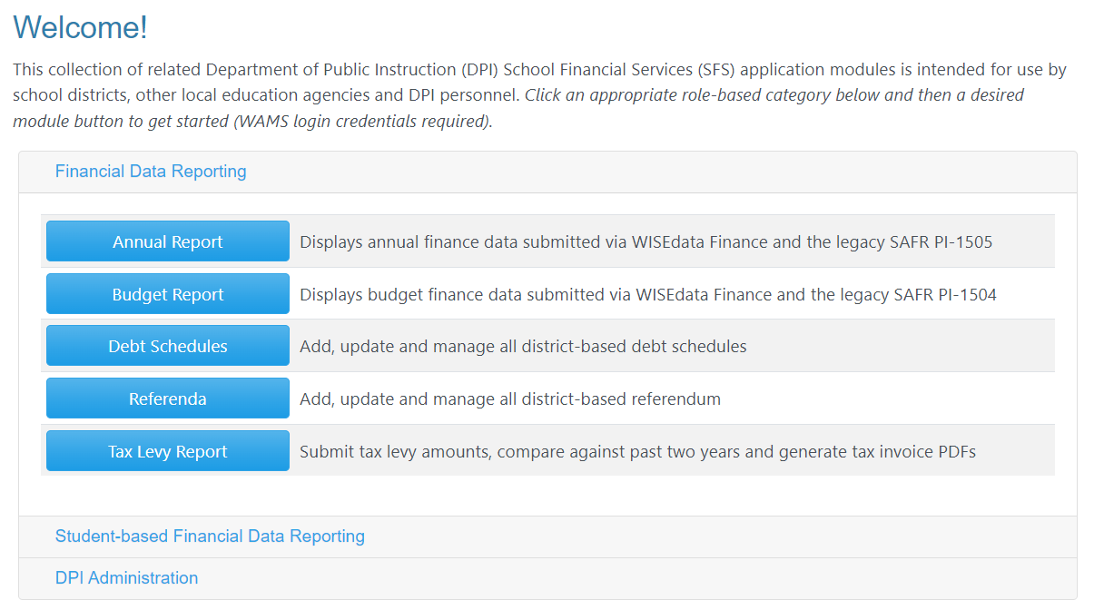
Annual Report Views in WiSFiP

Slide 31
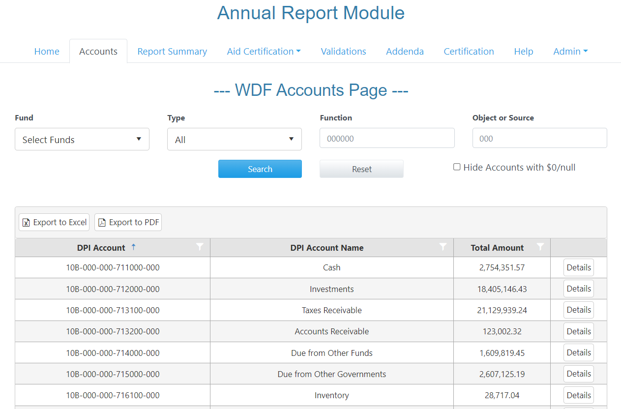
Annual Report Views in WiSFiP

Slide 32
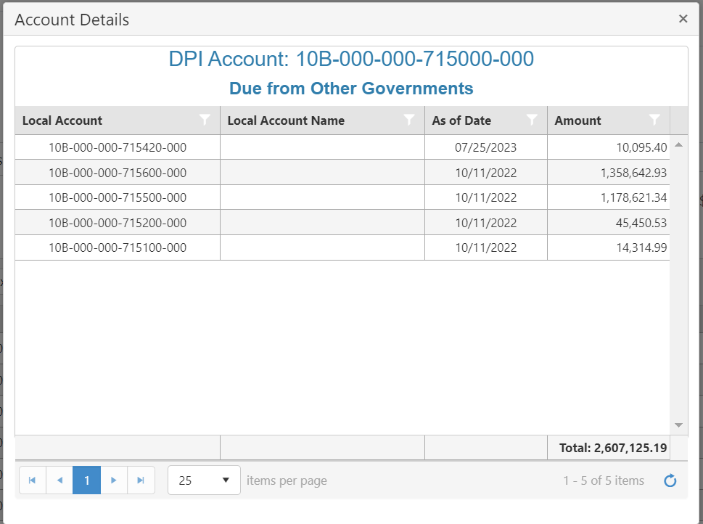
Annual Report Views in WiSFiP

Slide 33
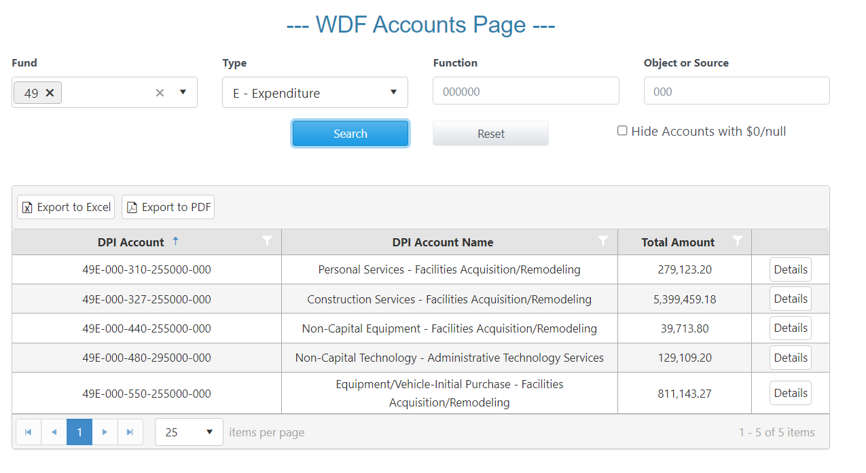
Annual Report Views in WiSFiP

Slide 34
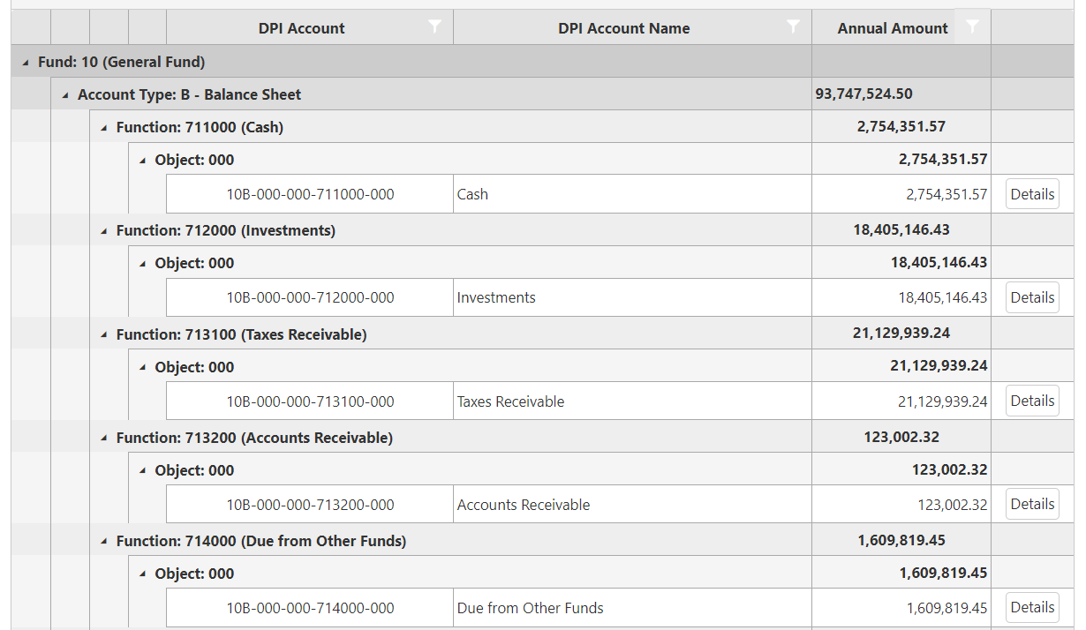
Report Summary Page

Slide 35
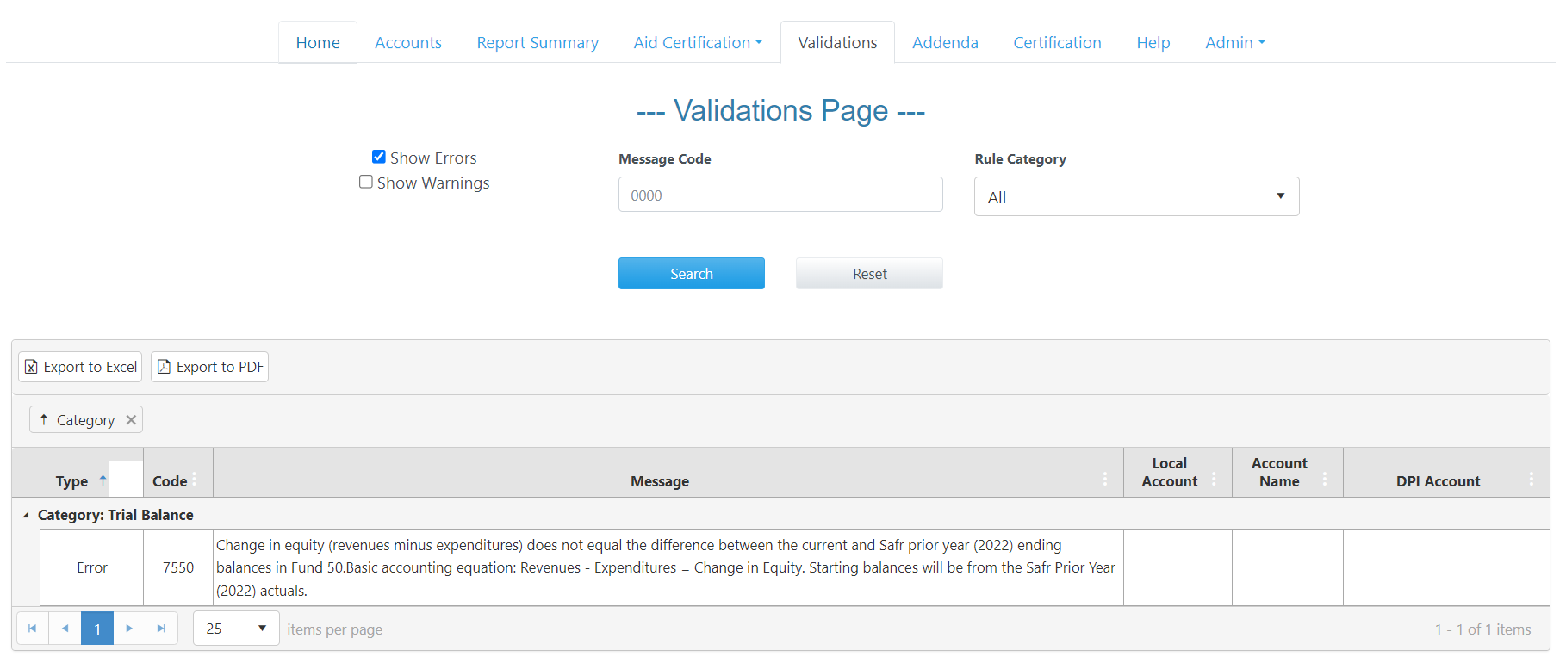
Annual Report Views in WiSFiP

Slide 36
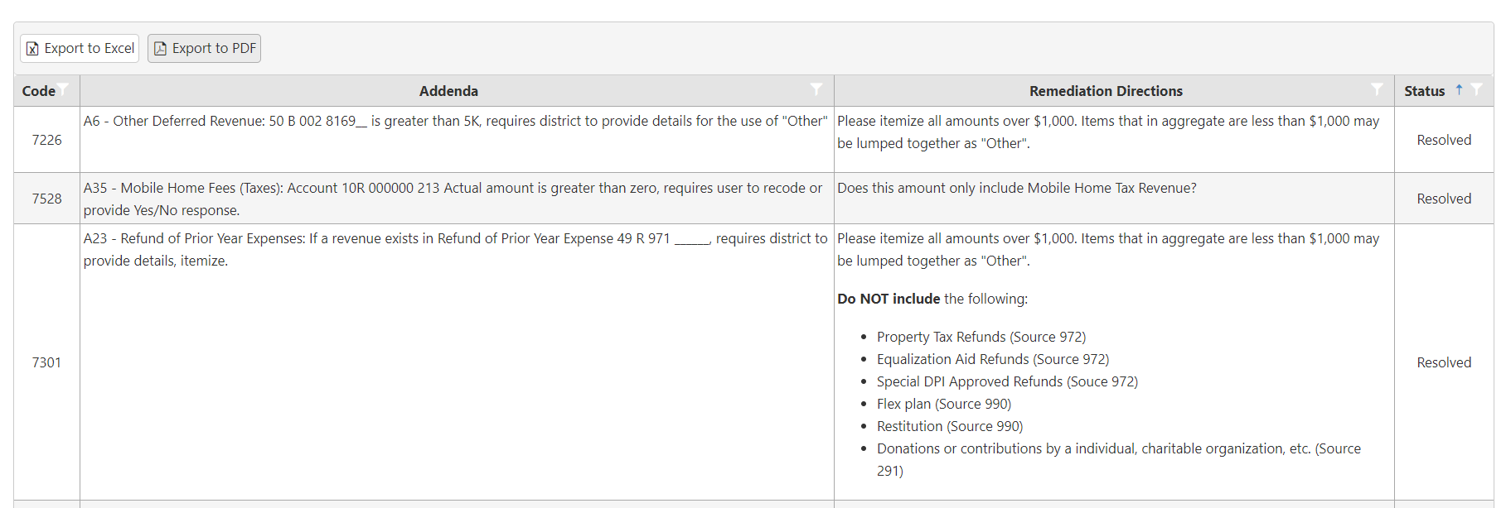
Annual Report Views in WiSFiP

Slide 37
Annual Report Views in WiSFiP

Slide 38
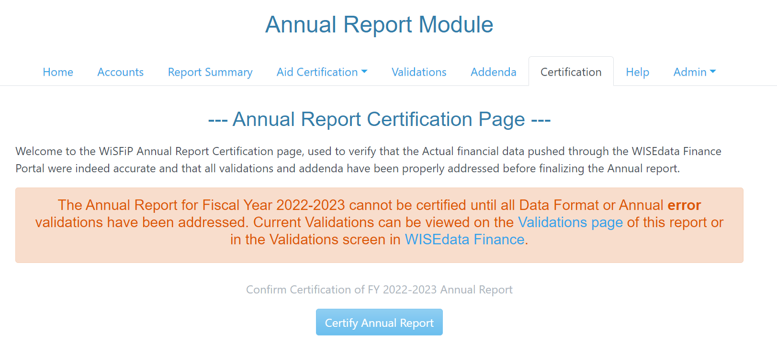
Annual Report Views in WiSFiP

Slide 39
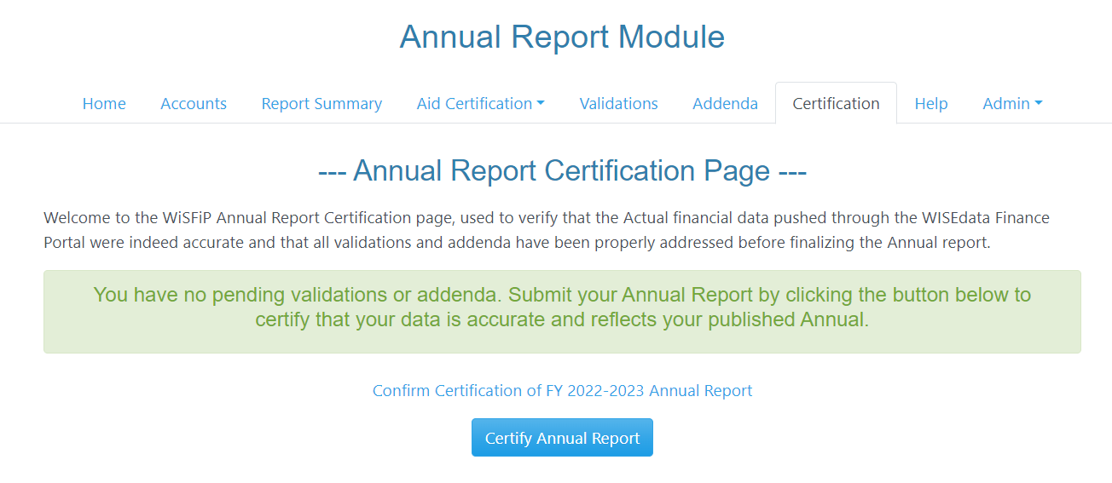
Annual Report Views in WiSFiP

Slide 40
Resources
WUFAR webpage
WISEdata Finance/WiSFiP webpage
WISEdata Finance/WiSFiP Podcast
Sign up for the podcast and find past presentations online!

Slide 41
Contacting the SFS Team
Email: dpifin@dpi.wi.gov
Phone: (608) 267-9114
Web: dpi.wi.gov/sfs
Team Directory: dpi.wi.gov/sfs/communications/staff-directory

