Slide 1
West Allis - West Milwaukee School District
Petition to Detach Response
May 7, 2024
Dr. Tarrynce Robinson - Superintendent
Aaron Norris - Assistant Superintendent

Slide 2
Agenda
Historical Background
What is the request and who are the petitioners?
Wisconsin State Legislature Criteria for Detachment
Criteria (#1) Geographical location and topographical features that affect travel time for students
Criteria (#2) The educational needs of all of the children residing in the affected school district
Criteria (#3) Programming at schools and the results
Criteria (#4) Testimony/Written Statements filed out by residents
Criteria (#5) The estimated fiscal effect of the proposed reorganization on the affected school district
Criteria (#6) Noncontiguous
Criteria (#7) The socioeconomic level and racial composition of the pupils who reside are at risk
Criteria (#8) Results of any referendum
Criteria (#9) Any/Other Appropriate Factors
Summary
Conclusion/Recommendations

Slide 3
Historical Background
1947 Milwaukee County School Committee formed to consider school district consolidations in and around Milwaukee County
January 19, 1954 West Allis Common Council annexed territory from the Town of Greenfield which included the School District of Parkway and Johnson
January 25, 1954 The City of West Allis annexed from the Town of Wauwatosa the territory of the Lafollette and Lane School Districts.
“On March 17, 1954, the Milwaukee County Committee received a petition signed by 154 residents of the New Berlin portion of the Parkway School District. It requested that the portion of New Berlin that was known as Parkway No G-6 District be permitted to continue in the West Allis system.” (100 Years of the West West Allis and West Milwaukee Schools. Pages 66-70)

Slide 4
Historical Background
“West Allis officials voiced opposition to including the position of New Berlin, Waukesha County in the West Allis School System.”
“After much discussion, the County School Committee took action. A motion was made to consolidate… and Joint School District No. 6 of the Town of Greenfield in Milwaukee County and the Town of New Berlin in Waukesha county (Parkway District) with the School District of the city of West Allis.”
(100 Years of the West West Allis and West Milwaukee Schools. Pages 66-70) (HERE)
(October, 1985 letter and enclosures from State Superintendent Herbert J. Grover to West Allis School District, District Administrator, Sam Castagna) (HERE)

Slide 5
What is the request made by the petitioner?
Alter the boundaries for a small territory of New Berlin households located within the West Allis – West Milwaukee (WAWM) School District and allow the New Berlin students living within this small territory to attend the adjoining New Berlin School District.
Original request and petition (HERE)
Petitioners presentation to the West Allis - West Milwaukee School Board (HERE)

Slide 6
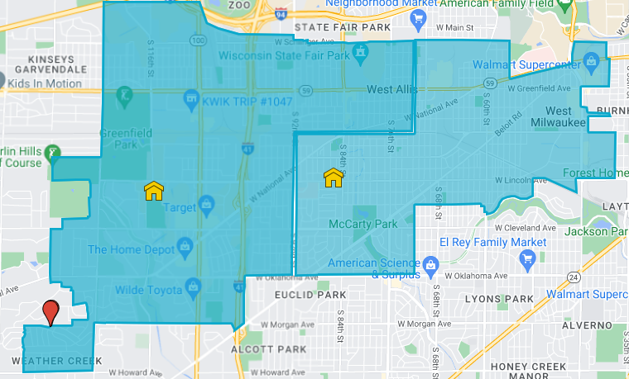
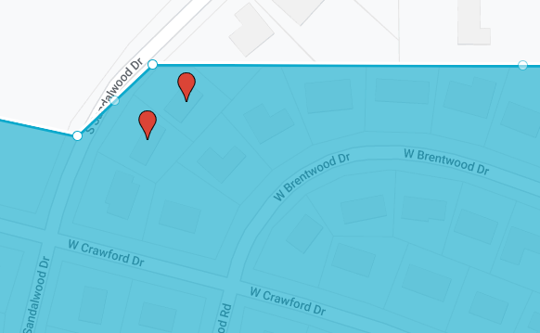
What is the Location of the Parcels?

Slide 7
Who are the petitioners?
The petitioner’s presentation indicated:
2 homeowners in New Berlin neighborhoods:
Our analysis indicates that the request received by the WAWM School District includes:
3 total signatures and the petitioner
3 resident signatures (multiple signatures per household)
All 3 residents are confirmed within the WAWM School District
0 students

Slide 8
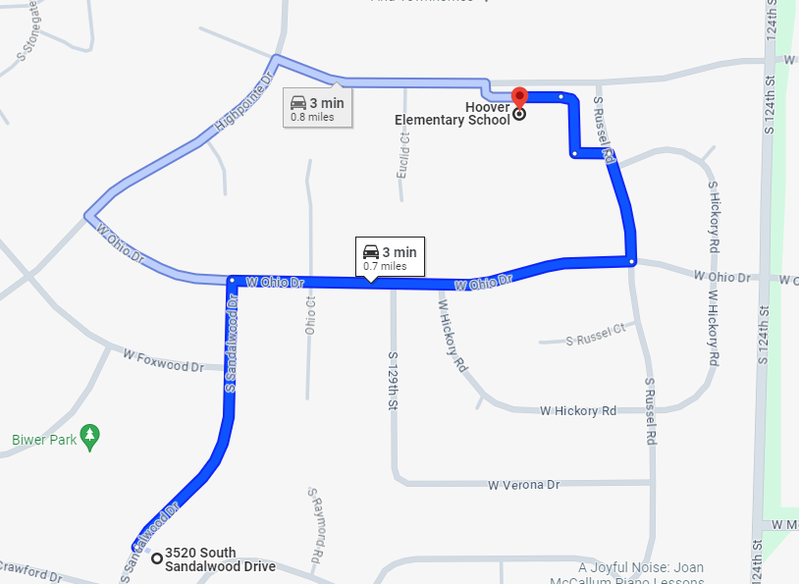
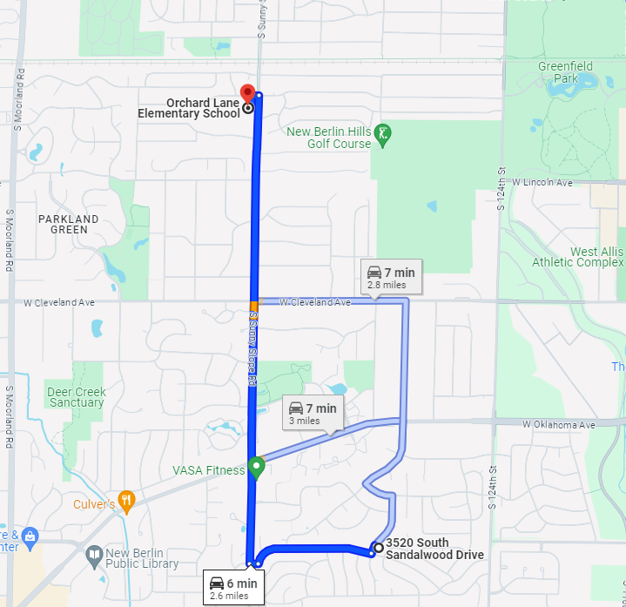
Wisconsin State Legislature Criteria (#1)
The geographical and topographical characteristics of the affected school districts, including the estimated travel time to and from school for pupils in the school districts.

Slide 9
Wisconsin State Legislature Criteria (#1)
Distance to neighborhood WAWM Schools from 3510 S. Sandalwood Dr:
Hoover Elementary: .7 Miles
Frank Lloyd Wright Intermediate: 3.0 Miles
Nathan Hale High School: 2.4 Miles
Distance to neighborhood New Berlin Schools from 3510 S. Sandalwood Dr:
Orchard Lane Elementary: 2.6 Miles
Eisenhower Middle School: 1.9 Miles
Eisenhower High School: 1.9 Miles

Slide 10
Wisconsin State Legislature Criteria (#1)
Annual Miles Traveled to School
Elementary Annual Travel | West Allis (171 Days) | New Berlin (176 Days)
 | 119.7 miles | 457.6 miles
Middle School Annual Travel | West Allis (174 Days) | New Berlin (176 Days)
 | 522 miles | 334.4 miles
High School Annual Travel | West Allis (174 Days) | New Berlin (176 Days)
 | 417.6 miles | 334.4 miles

Slide 11
Wisconsin State Legislature Criteria (#1)
School Career Miles Traveled to School
Elementary Annual Travel | West Allis (6 years) | New Berlin (7 years)
 | 718.2 miles | 3,203.2 miles
Middle School Annual Travel | West Allis (3 years) | New Berlin (2 years)
 | 1,556 miles | 668.8 miles
High School Annual Travel | West Allis (4 years) | New Berlin (4 years)
 | 1,670.4 miles | 1,337.6 miles
School Career Miles Traveled | 3,944.6 miles | 5,209.6 miles

Slide 12
Wisconsin State Legislature Criteria (#2)
The educational needs of all of the children residing in the affected school districts, the educational programs currently offered by each affected school district and the ability and commitment of each school district to meet those needs and continue to offer those educational programs.

Slide 13
Wisconsin State Legislature Criteria (#2)
On February 12, the petitioners argued that due to academic test scores the West Allis-West Milwaukee School District is not adequately servicing students who live in New Berlin and attend the WAWM School District.
This snapshot they provided shows a large difference between the two school districts but this picture is largely incomplete.
What the petitioners really are alleging is that students who live in New Berlin but attend WAWM School District aren’t provided as quality of an education as a student who attends the New Berlin school district when comparing academic outcomes.
But when they showed data to prove their case, they presented information that compared the entire WAWM School District to the New Berlin School District….this is not an accurate representation
For the purposes of our presentation, we would like to show you the following comparison:
How students who live in New Berlin but attend WAWM score on state assessments
VS
How students who attend New Berlin score on the same state assessments.

Slide 14
Wisconsin State Legislature Criteria (#2)
Math Forward Exam Comparison 2022-2023
3rd - 5th Grade
School | % Below Basic | % Basic | % Proficient / Advanced
Hoover | 38.9% | 27.5% | 33%
New Berlin Students at Hoover | 29% | 32.3% | 38.7%
Orchard Lane, New Berlin School District | 12.7% | 27% | 60.2%

Slide 15
Wisconsin State Legislature Criteria (#2)
Math Forward Exam Comparison 2022-2023
6th - 8th Grade
School | % Below Basic | % Basic | % Proficient / Advanced
FLW | 43.9% | 34.6 | 20.7%
New Berlin Students at Lane | 40.6% | 37.5% | 21.9%
Orchard Lane 6th Grade, New Berlin West 7th & 8th Grade | 13.7 | 26% | 58.5%

Slide 16
Wisconsin State Legislature Criteria (#2)
ELA Forward Exam Comparison 2022-2023
3rd - 5th Grade
School | % Below Basic | % Basic | % Proficient / Advanced
New Berlin Students at Hoover | 28.1% | 12.5% | 59.4%
Orchard Lane, New Berlin School District | 18% | 31.8% | 50.2%

Slide 17
Wisconsin State Legislature Criteria (#2)
ELA ACT Aspire Comparison 2022-2023
9th - 10th Grade (Current 10th - 11th Grade)
School | % Below Basic | % Basic | % Proficient / Advanced
New Berlin Students at Nathan Hale | 7.9 | 39.5% | 52.6%
New Berlin West High | 13.4% | 30.6% | 53.3%

Slide 18
Wisconsin State Legislature Criteria (#2)
Math ACT Aspire Comparison 2022-2023
9th - 10th Grade (Current 10th - 11th Grade)
School | % Below Basic | % Basic | % Proficient / Advanced
New Berlin Students at Nathan Hale | 28.9% | 26.3% | 44.7%
New Berlin West High | 14.6% | 29.3% | 53.7%
Notes:
When you see numbers that do not add up to 100%, it is because of non-test students who opted out or never completed makeup tests

Slide 19
Wisconsin State Legislature Criteria (#2)
ELA Forward Exam Comparison 2022-2023
6th - 8th Grade
School | % Below Basic | % Basic | % Proficient / Advanced
New Berlin Students at Lane | 18.8% | 37.5% | 43.8%
Orchard Lane 6th Grade, New Berlin West 7th & 8th Grade | 10.2% | 33.8% | 54.7%

Slide 20
Wisconsin State Legislature Criteria (#2)
The petitioners would like to look at the whole district and use this as their comparison measure, but the reality is by doing this it doesn’t take into account other factors such as socioeconomic status, disability status, and ethnicity.
A good example of this is below.
Students in the WAWM School District are over 4.5 times more likely to be living in poverty than someone in New Berlin.
Students who live in New Berlin but attend WAWM are 2 times more likely to be living in poverty than someone in New Berlin
Economically Disadvantaged Percentage
 | WAWM School District | New Berlin Students Attending WAWM | New Berlin School District
2022 - 2023 | 63.7% | 27.3% | 14.2%
2016 - 2017 | 56.2% | 37.6% | 11.6%

Slide 21
Wisconsin State Legislature Criteria (#2)
Here are the Facts:
Academically, students who live in New Berlin but attend the WAWM school district score just as well on state standardized tests.
When you compare the entire school district, New Berlin scores better than the WAWM school district but that doesn’t take into account other factors such as socioeconomics, as well as psychological and physical components.
Students who attend WAWM School District are 4.5 times more likely to be from a home of poverty than students who attend the School District of New Berlin.

Slide 22
Wisconsin State Legislature Criteria (#3)
If territory is proposed to be detached from one school district and attached to an adjoining school district, whether the proposed detachment will have any adverse effect on the program currently offered by the school district from which the territory is proposed to be detached, including both curricular and extracurricular aspects of that program.

Slide 23
Wisconsin State Legislature Criteria (#3)
A snowball effect is defined as: “a situation in which something increases in size or importance at a faster and faster rate”
The petitioners argued that since there only 2 properties that their detachment would have no adverse impact on WAWM School District programming.
In reality, nothing is further from the truth.
The petitioners said that they only pursued this detachment due to a previously approved petition in 2022 in which 160 properties were detached. Estimated property value of the detachment was over $40M which resulted in the WAWM School District losing over $480,000 in property tax revenue.
Now this petition is another 2 properties both of which have 0 school aged children.
The properties have a taxable value at $586,000.
Through the snowball effect this (if approved) would be now 162 total properties totaling $40.5M.
The petitioners would argue that the snowball effect isn’t real, but when you take into consideration that they themselves pursued this because of the prior petition and the total lost value in property / revenue it is clear that petition requests like this DO have an adverse effect on our school district property value and revenue which impacts our staff and students.

Slide 24
Wisconsin State Legislature Criteria (#3 & 8)
WAWM Compared to New Berlin Class Size Targets
WAWM
New Berlin
Grade | Planned Class Max | Fill to | 92% of Class Max | Planned Stud/Sec
4K | 20 | 92% | 18.4 | 18
KG | 22 | 92% | 20.24 | 20
1 | 24 | 92% | 22.08 | 22
2 | 24 | 92% | 22.08 | 22
3 | 24 | 92% | 22.08 | 22
4 | 27 | 92% | 24.84 | 25
5 | 27 | 92% | 24.84 | 25
Average | 24 |  |  | 22.0
Grade | Planned Class Max | Fill to | 92% of Class Max | Optimal Stud/Sec
4K | 26 | 90% | 23.4 | 23
KG | 26 | 90% | 23.4 | 20
1 | 26 | 90% | 23.4 | 22
2 | 26 | 90% | 23.4 | 22
3 | 30 | 90% | 27 | 22
4 | 30 | 90% | 27 | 25
5 | 30 | 90% | 27 | 25
Average | 28 |  |  | 22.7

Slide 25
Wisconsin State Legislature Criteria (#4)
The testimony of and written statements filed by the residents of the affected school districts.

Slide 26
Wisconsin State Legislature Criteria (#4)
The petitioners cited statements from themselves as they relate to the following:
Concerns about overall test scores as they compare to the New Berlin School District
History of poorly managed resources
Proposed referendum which will increase property taxes
Territories residing in Waukesha County not Milwaukee County

Slide 27
Wisconsin State Legislature Criteria (#4)
Testimonial 1: Student Test Scores
This area of concern was addressed during Criteria #2.
As we stated, students who reside in New Berlin but attend the WAWM School District score just as high on state standardized tests as students who live and attend the New Berlin School District.

Slide 28
Wisconsin State Legislature Criteria (#4)
Testimonial 2: WAWM Financial History
The petitioners stated that the WAWM School District has a bad history with it’s finance’s. As you can see we are in a better financial position than the New Berlin School District.
 | West Allis-West Milwaukee June 30, 2023 | New Berlin June 30, 2022
General Fund Balance | $ 35,334,402 | $ 14,444,736
Debt Service Balance | $ 199,879 | $ 153,860
Other Governmental Funds Balance (restricted to 27, 46/49, 50, 80) | $ 30,948,405 | $ 5,184,018
Total Fund Balance | $ 66,482,686 | $ 19,782,614
% of General Fund v. Expenditures | 33.50% | 24.98%
Credit Rating | Aa2 (Moody’s) | Aa2 (Moody’s)

Slide 29
Wisconsin State Legislature Criteria (#4)
Testimonial 3: Upcoming WAWM Proposed Referendum & Tax Impact
Over the past 5 years, the New Berlin School District and the WAWM School District have asked voters to approve the same number of referendums. Both were denied by their respective communities.
Tax Impact
In 2022-23, 160 properties were detached from WAWM To New Berlin.
This totaled nearly $40M of total equalized property value that resulted in an estimated revenue loss of $484,000.
 | Equalized Property Value of NB in WAWM | NB Percent of WAWM Tax Levy | Mill Rate West Allis-West Milw. | Mill Rate New Berlin
2022-23 | $ 424,433,481 | 6.945 % | $ 6.55 | $ 6.89
2023-24 | $ 385,108,728 | 5.849 % | $ 6.69 | $ 5.87

Slide 30
Wisconsin State Legislature Criteria (#4)
Final Testimonial: The petitioners argued that since their property resides in Waukesha County and the West Allis-West Milwaukee School District is in Milwaukee County that this is suitable enough evidence for their properties to be detached.
The Facts: There are around 100 school districts in the State of Wisconsin where they serve multiple counties. The petitioners experience is shared with thousands of residences all across the State.

Slide 31
Districts in Multiple Counties (Page 1)
The following School District span multiple counties.
School District | County 1 | County 2 | County 3
Union Grove | Kenosha | Racine
Muskego-Norway | Waukesha | Racine
Oconomowoc | Waukesha | Jefferson | Dodge
Kewaskum | Washington | Fond du Lac | Sheboygan
Random Lake | Ozaukee | Sheboygan
Campbellsport | Fond du Lac | Sheboygan
Lomira | Dodge | Fond du Lac
Notes:
https://wi-dpi.maps.arcgis.com/apps/webappviewer/index.html?id=24d718b4d3674e7eb8d7230359a5b73c

Slide 32
Districts in Multiple Counties (Page 2)
School District | County 1 | County 2 | County 3
Lodi | Columbia | Dane
DeForest | Columbia | Dane
Sauk Prairie | Sauk | Columbia | Dane
Portage | Columbia | Marquette
Ripon | Green Lake | Fond du Lac | Winnebago
New Holstein | Fond du Lac | Sheboygan | Calumet
Berlin | Green Lake | Waushara | Winnebago

Slide 33
Districts in Multiple Counties (Page 3)
School District | County 1 | County 2 | County 3
Watertown | Jefferson | Dodge
Waterloo | Dodge | Dane | Jefferson
Whitewater | Walworth | Jefferson | Rock
Waupun | Dodge | Fond du Lac
Randolph | Columbia | Dodge
Columbus | Columbia | Dane | Dodge
Palmyra-Eagle | Jefferson | Walworth | Waukesha
*** There are over 75 more school districts in multiple counties. ***

Slide 34
Wisconsin State Legislature Criteria (#5)
The estimated fiscal effect of the proposed reorganization on the affected school districts, including the effect of the apportionment of assets and liabilities.

Slide 35
Wisconsin State Legislature Criteria (#5)
Average Property Values x Municipality
** The West Allis - West Milwaukee School District is made up of 4 municipalities:
West Allis, West Milwaukee, Greenfield and New Berlin.
It is important to note the massive differences in average property values between the 4 municipalities.
 | Average Home Value | Total EPV | % of EPV
West Allis | $ 240,500 | $ 5,654,653,400 | 85.88%
West Milwaukee | $ 178,000 | $ 469,718,300 | 7.13%
Greenfield | $ 259,500 | $ 75,022,522 | 1.14%
New Berlin | $ 385,000 | $ 385,108,728 | 5.85%
Notes:
Averages came from redfin.com (median sale prices)
867 total parcels in New Berlin

Slide 36
Wisconsin State Legislature Criteria (#5)
Based on 2023-24 data provided by Redfin.
2 Petitioner Property Values
Property 1:
Estimated Property Value = $409,655
Property 2:
Estimated Property Value = $438,256
160 Properties Detached in 2023
On July 1, 2023; 160 properties were detached from WAWM to New Berlin. Below is the average home values of the properties now that they are in the New Berlin School District.
$619,000 (based on actual home sales)

Slide 37
Wisconsin State Legislature Criteria (#5)
Over the past 2 years, look at what petition’s like this have done to our local tax base.
Mill Rate - WAWM
2022-23 Mill Rate: $6.55
2023-24 Mill Rate: $6.69
1.64% increase
2022 Petition = $42,000,0000 total EPV
2023 Petition = $585,0000 total EPV
Mill Rate - New Berlin
2022-23 Mill Rate: $6.89
2023-24 Mill Rate $5.87
14.8% decrease due to estimated
$42M increase in property value
Should petitions like this continue, we would stand to lose over $385 million in total property value. Similar to what happened in 2022, this burden would fall on our families who have the least amount of financial resources.

Slide 38
Wisconsin State Legislature Criteria (#5)
A snowball effect is defined as: “a situation in which something increases in size or importance at a faster and faster rate”
The petitioners argued that since there only 2 properties that their detachment would have no adverse impact on WAWM School District finances.
In reality, nothing is further from the truth.
The petitioners said that they only pursued this detachment due to a previously approved petition in 2022 in which 160 properties were detached. Estimated property value of the detachment was over $40M which resulted in the WAWM School District losing over $480,000 revenue.
Now this petition is another 2 properties both of which have 0 school aged children.
The properties have a taxable value at $586,000.
Through the snowball effect this (if approved) would be now 162 total properties totaling $40.5M.
The petitioners would argue that the snowball effect isn’t real, but when you take into consideration that they themselves pursued this because the last petition was approved through the DPI appeal process and the total lost value in property / revenue it is clear that petition requests like this DO have an adverse effect on our school district property value and revenue which impacts our staff and students.

Slide 39
Wisconsin State Legislature Criteria (#6)
Whether the proposed reorganization will make any part of a school district's territory noncontiguous.
contiguous
adjective
con·​tig·​u·​ous kən-ˈti-gyə-wəs -gyü-əs1
: being in actual contact : touching along a boundary or at a point
noncontiguous
adjective
non·​con·​tig·​u·​ous ˌnän-kən-ˈti-gyə-wəs -gyü-əs
especially : not adjoining along a boundary or consisting of parts that adjoin
Merriam Webster (HERE)

Slide 40
Wisconsin State Legislature Criteria (#6)
Map of Petition Area

Slide 41
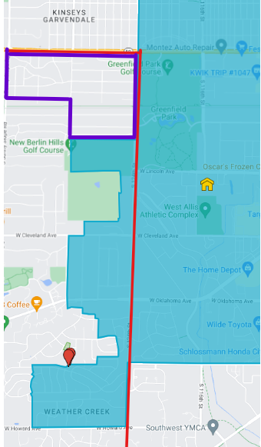
Wisconsin State Legislature Criteria (#6)
City of New Berlin Boundary
Elmbrook School District boundary within New Berlin
Area of Petitioners
City Of New Berlin Boundary

Slide 42
Wisconsin State Legislature Criteria (#7)
The socioeconomic level and racial composition of the pupils who reside or will reside in territory proposed to be detached from one school district and attached to an adjoining school district or in a school district proposed to be dissolved; the proportion of the pupils who reside in such territory who are children at risk, as defined under s.118.153 (1)(a); and the effect that the pupils described in this paragraph will have on the present and future socioeconomic level and racial composition of the affected school districts and on the proportion of the affected school districts' enrollments that will be children at risk.

Slide 43
Wisconsin State Legislature Criteria (#7)
A snowball effect is defined as: “a situation in which something increases in size or importance at a faster and faster rate”
The petitioners argued that since there only 2 properties that their detachment would have no adverse impact on the socioeconomic and racial composition within the WAWM School District.
In reality, nothing is further from the truth.
The petitioners said that they only pursued this detachment due to a previously approved petition in 2022 in which 160 properties were detached.
Now this petition is another 2 properties.
The petitioners would argue that the snowball effect isn’t real. But when you take into consideration that they only pursued this due to the previous petition and accompany this with current socioeconomic and racial demographics.
It is clear that petition requests like this will adversely impact the socioeconomic and racial demographics in the WAWM School District. What this means…..should this petition pass and the snowball effect continues, New Berlin School District will have more students who are White and from economically advantage backgrounds.

Slide 44
Wisconsin State Legislature Criteria (#7)
Economically Disadvantaged Comparison
Category | Economically Disadvantaged | Percent
New Berlin Students attending WAWM | 62/179 | 34.6%
2022-2023 District Economically Disadvantaged Comparison
West Allis - West Milwaukee | New Berlin
63.7% | 14.2%
Data pulled from the 22-23 DPI District Report Card

Slide 45
Wisconsin State Legislature Criteria (#7)
Comparison of Racial Demographics (2022-2023)
Category | % White | % Black | % Asian | % Hispanic | % Two or More Races | % Other
New Berlin Students attending WAWM | 63% | 11.3% | 4.5% | 12.5% | 8.5% | .2%
WAWM School District | 44.8% | 11.7% | 2.8% | 30.4% | 9.4% | .9%
New Berlin School District | 78.1% | 1.1% | 7.6% | 9% | 3.9% | .3%

Slide 46
Wisconsin State Legislature Criteria (#7)
Students with Disabilities Comparison
Category | Number of Special Education Students | Percentage of Special Education Students
New Berlin Students attending WAWM | 27 /179 | 15.1%
2022-2023 Students with Disabilities Comparison
West Allis - West Milwaukee | New Berlin
15.8% | 10%
Data pulled from the 22-23 DPI District Report Card

Slide 47
Wisconsin State Legislature Criteria (#7)
Summary of Criteria 7
Factor | West Allis - West Milwaukee | New Berlin Students Attending WAWM | New Berlin
Racial Composition (Percent of White Students) | 44.8% | 63% | 78.1%
Economic Disadvantaged | 63.7% | 34.6% | 14.2%
Students with Disabilities | 15.8% | 15.1% | 10%

Slide 48
Wisconsin State Legislature Criteria (#8)
Results of any referendum
Over the past 5 years, the New Berlin School District and the WAWM School District have asked voters to approve the same number of referendums. Both were denied by their respective communities.
2019 New Berlin SD asked a operating question for $5 million…which failed. Adversely they continued to defer maintenance and long-range planning. Funding of planned technology, equipment and safety upgrades, as well as curriculum and instruction resources, remained on hold. Additional staff reductions were made, causing increased class sizes and the elimination of some programs and services were also made..
Additionally, there is discussion of the consolidating schools in New Berlin.
Meanwhile, we have maintained our class size targets, maintained programming and balanced this with managed investments in capital improvement projects. This is reflected in stark differences in our financial position.

Slide 49
Wisconsin State Legislature Criteria (#8)
WAWM Compared to New Berlin Class Size Targets
WAWM
New Berlin (slide 16)
Grade | Planned Class Max | Fill to | 92% of Class Max | Planned Stud/Sec
4K | 20 | 92% | 18.4 | 18
KG | 22 | 92% | 20.24 | 20
1 | 24 | 92% | 22.08 | 22
2 | 24 | 92% | 22.08 | 22
3 | 24 | 92% | 22.08 | 22
4 | 27 | 92% | 24.84 | 25
5 | 27 | 92% | 24.84 | 25
Average | 24 |  |  | 22.0
Grade | Planned Class Max | Fill to | 92% of Class Max | Optimal Stud/Sec
4K | 26 | 90% | 23.4 | 23
KG | 26 | 90% | 23.4 | 20
1 | 26 | 90% | 23.4 | 22
2 | 26 | 90% | 23.4 | 22
3 | 30 | 90% | 27 | 22
4 | 30 | 90% | 27 | 25
5 | 30 | 90% | 27 | 25
Average | 28 |  |  | 22.7

Slide 50
Wisconsin State Legislature Criteria (#9)
Other appropriate factors.
Financial State: Fund Balance & Credit Rating Comparison
Property Values in New Berlin vs. West Allis & West Milwaukee
Snowball effect on Past and Future Petitions
Open Enrollment as an Option
Function of Wis Statute 117.13
Why Submit Petition with no Students

Slide 51
Wisconsin State Legislature Criteria (#9)
Fund Balance & Credit Rating Comparison
 | West Allis-West Milwaukee June 30, 2023 | New Berlin June 30, 2022
General Fund Balance | $ 35,334,402 | $ 14,444,736
Debt Service Balance | $ 199,879 | $ 153,860
Other Governmental Funds Balance (restricted to 27, 46/49, 50, 80) | $ 30,948,405 | $ 5,184,018
Total Fund Balance | $ 66,482,686 | $ 19,782,614
% of General Fund v. Expenditures | 33.50% | 24.98%
Credit Rating | Aa2 (Moody’s) | Aa2 (Moody’s)
Notes:
WAWM Credit Rating - (West Allis-West Milwaukee School District, Wisconsin; General Obligation - Standard and Poors Rating Action October 2020
These Credit Ratings are comparable although from different rating agencies

Slide 52
Wisconsin State Legislature Criteria (#9)
Snowball Effect
Should this petition be approved and the snowball effect continue to happen. The WAWM School District would have significant impacts on the future of our school district.
Total Revenue loss of $2,088,481 per year
177 number of current resident members attending our schools =
$11,403 * 177 = $2,018,331 (Revenue)
50 current New Berlin resident members open enroll out of WAWM School District
Net Revenue = ($11,403* 50) - ($10,000 * 50) = $70,150
$385,108,728 in total property value
** By losing resident students, revenue and property value this would impact taxpayers

Slide 53
Wisconsin State Legislature Criteria (#9)
Open Enrollment and other School Choice Options
The State Legislature has systems in place for students to attend area non-resident schools districts, which include the following:
Open Enrollment
WPCP & MPCP (Wisconsin/Milwaukee Parental Choice Program) - - Voucher Program
Home-schooling
Open enrollment is the main option for families seeking to choice their child from one public school district to another.
This exists as a mechanism for families looking to enroll in an area non-resident district.

Slide 54
Wisconsin State Legislature Criteria (#9)
Open Enrollment
 | # of new open enrollment seats - New Berlin School District Approved by Year | # of New Berlin Students applying who live in WAWM School District by Year | # of WAWM School District students living in New Berlin who are open enrolled to New Berlin School District by Year
2019-20 | 0 | 7 | 1
2020-21 | 30 | 16 | 7
2021-22 | 0 | 7 | 10
2022-23 | 0 | 30 | 13
2023-24 | 0 | 2 | 10

Slide 55
Wisconsin State Legislature Criteria (#9)
Function of the State Law
The Wisconsin Statute 117.13 states: “This applies to the detachment of territory from one school district and its attachment to an adjoining school district”
Furthermore, this statute gives DPI the authority to oversee this as the State agency over Education.
That said, why would 2 property owners both with no kids file a petition under Wisconsin Statute 117.13 which is designed specifically for school districts and overseen by DPI.

Slide 56
Wisconsin State Legislature Criteria (#5)
Property Values of Petition Area vs. New Berlin School District
2 Petitioner Property Values
3510 S. Sandalwood Drive
Estimated Property Value = $409,655
3520 S. Sandalwood Drive
Estimated Property Value = $438,256
160 Properties Detached in 2023
On July 1, 2023; 160 properties were detached from WAWM to New Berlin. Below is the average home values of the properties now that they are in the New Berlin School District.
$619,000 (based on actual home sales)

Slide 57
Summary of Significant Considerations
The petitioners provided compelling yet incomplete evidence in support of their petition to detach a small territory from the West Allis - West Milwaukee School District and attach it to the New Berlin School District. The West Allis - West Milwaukee School District analysis demonstrates the following:
Travel distances in terms of annual miles and school career miles are longer for West Allis - West Milwaukee students in New Berlin if they were to attend New Berlin schools.
There are no material differences between the academic outcomes of students who attend New Berlin School District vs. students who live in New Berlin and attend WAWM.
Allowing this petition would have significant future implications for educational programming (snowball effect) for the students and families in the WAWM School District. The petitioners themselves said in their presentation that they only are asking today due to a prior approved petition.
There are over 100 school districts that span multiple counties in Wisconsin. This is not a suitable reason to allow any residence to detach.
Class sizes have not increased and programs have not been cut as a result of the failed referendum in the West Allis - West Milwaukee School district and in fact, New Berlin due to a failed referendum has cut programming and increased class size.
Both petitioners do not have children and stand to gain financially from their property being detached from WAWM and adjoined to the New Berlin School District.
Financially, it would also decrease the taxes that petitioners pay and increase the taxes for community members with much less means within our the WAWM School District.

Slide 58
Summary of Analysis tied to Statutory Criteria
Criteria | Supports Approval | Supports Denial | Indifferent
1. Location and travel time |  | X
2. Educational needs |  | X
3. Programming |  | X
4. Testimony and statements |  |  | X
5. Fiscal impact |  | X
6. Noncontiguous | X
7. Socioeconomic and racial composition |  | X
8. Results of referendum |  | X
9. Other factors |  | X

Slide 59
Recommendation
Uphold the decision made by the WAWM School Board denying the petition to detach from the School District of West Allis-West Milwaukee to the New Berlin School District, for the reasons presented today.

Slide 60
Questions

