Slide 1

Petition to Detach from WAWM School District
Presented by New Berlin Residents
Tuesday May 7, 2024

Slide 2
Criteria for School District Reorganizations under Wis. Stat. 117.15
(1) The geographical and topographical characteristics of the affected school districts, including the estimated travel time to and from school for pupils in the school districts.
(2) The educational needs of all the children residing in the affected school districts, the educational programs currently offered by each affected school district and the ability and commitment of each school district to meet those needs and continue to offer those educational programs.
(2m) If territory is proposed to be detached from one school district and attached to an adjoining school district or proposed to be included in a new school district under S.117.105, whether the proposed detachment will have any adverse effect on the program currently offered by the school district from which the territory is proposed to be detached, including both curricular and extracurricular aspects of that program
(3) The testimony of and written statements filed by the residents of the affected school districts
(4) The estimated fiscal effect of the proposed reorganization on the affected school districts, including the effect of the apportionment of assets and liabilities.

Slide 3
Statutory Factors to Consider for School District Reorganization under Wis. Stat. 117.15 (cont.)
(5) Whether the proposed reorganization will make any part of a school district's territory noncontiguous.
(6) The socioeconomic level and racial composition of the pupils who reside or will reside in territory proposed to be detached from one school district and attached to an adjoining school district, in territory proposed to be included in a new school district under S.117.105 or in school districts proposed to be consolidated or in a school district proposed to be dissolved; the proportion of the pupils who reside in such territory who are children at risk, as defined under S.118.153(1) (a); and the effect that the pupils described in this paragraph will have on the present and future socioeconomic level and racial composition of the affected school districts and on the proportion of the affected school districts' enrollments that will be children at risk
(7) The results of any referendum held under S.117.10

Slide 4
Factor 1 – Estimated Travel Time
Morning Time Study: Overall slightly higher mileage but shorter travel time to New Berlin Schools than WAWM Schools (Time:6.5 min vs. 6.83 min; Mileage: 2.25 miles vs. 2.07 miles)

Slide 5
Factor 1 – Estimated Travel Time
Afternoon Time Study: Overall equal mileage and shorter travel time to New Berlin Schools than WAWM Schools (Time:6 min vs. 7 min; Mileage: 2.20 for both districts)
Recent reorganization includes properties adjacent to WAWM Hoover Elementary

Slide 6
Factor 2
The educational needs of all children residing in the affected school districts, the educational programs currently offered by each affected school district, and the ability and commitment of each school district to meet those needs and continue to offer those educational programs.

Slide 7
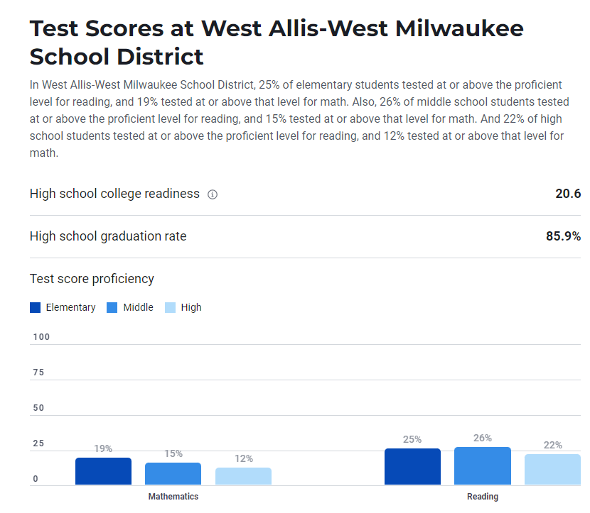
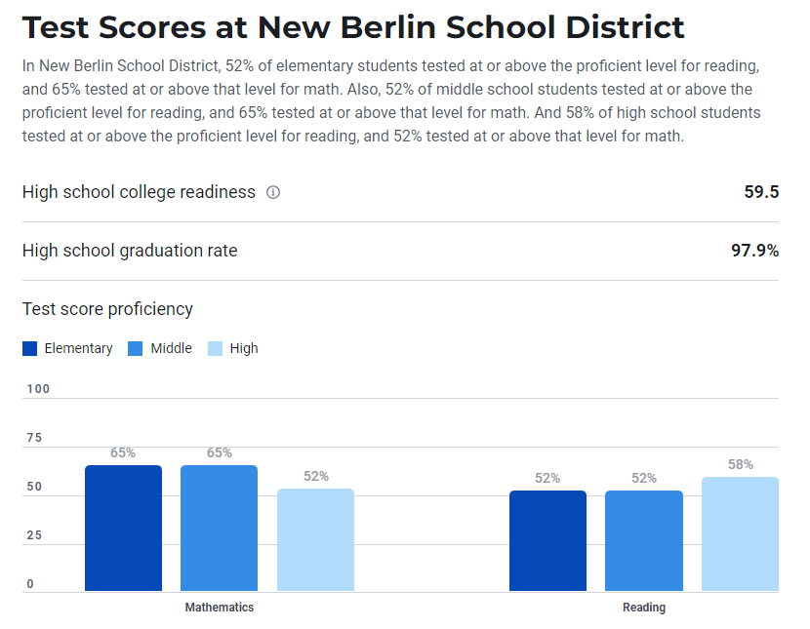
Overall Test Scores per US News & World Report

Slide 8
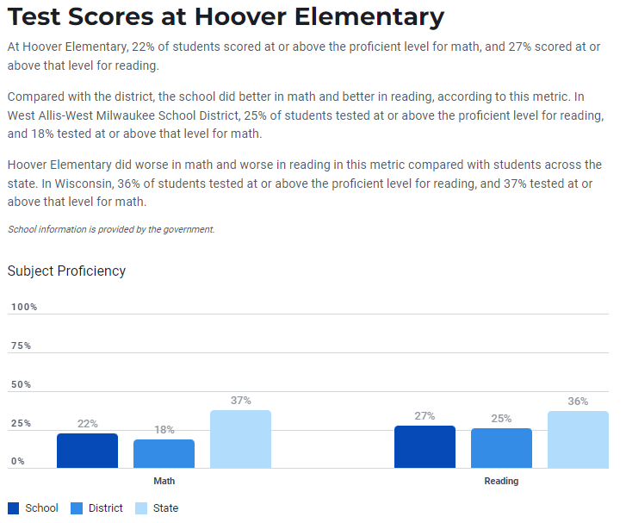
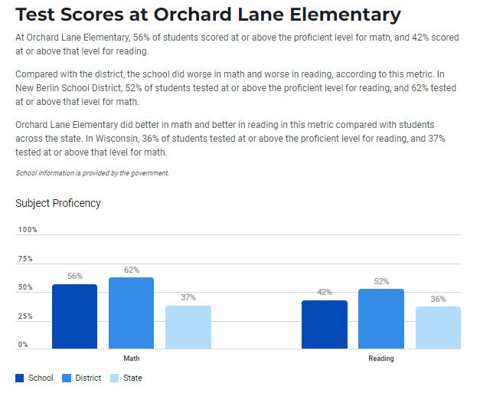
Elementary School Comparison (Score Card Not Available)

Slide 9
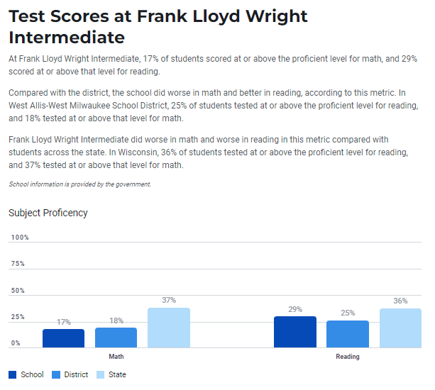
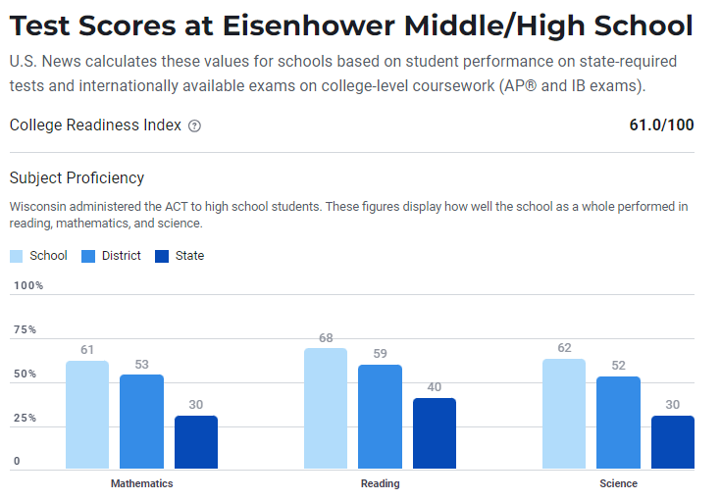
Middle School Comparison

Slide 10
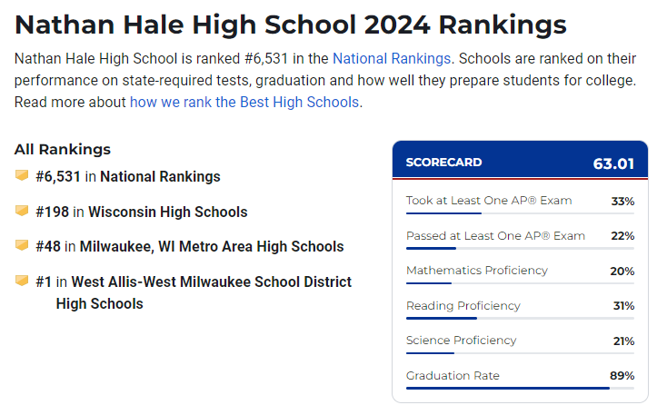
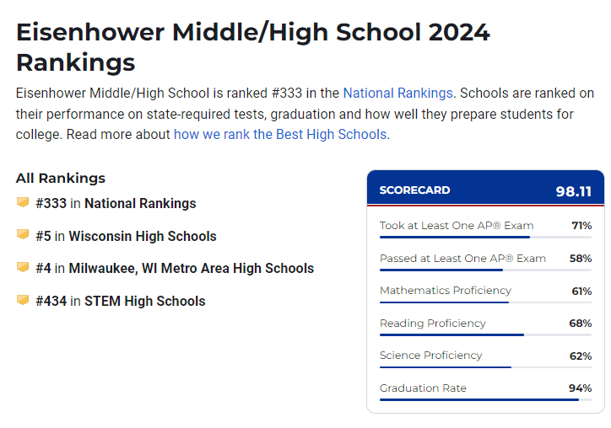
High School Score Card Comparison

Slide 11

Program Offerings
New Berlin school district has a well known STEM (science, technology, engineering, and math program). They were ranked a #302 out of the top 5,000 schools in the country.
  WAWM didn’t make the list. Per www.wawmsd.org, “There is a growing demand for skilled trades and professionals in manufacturing, engineering and design in our region. Our goal is to integrate more STEM (Science, Technology, Engineering and Math) education into our traditional technical education program. However, the current layout of our classrooms limits the ability to incorporate technology and equipment to provide hands-on learning opportunities.”

Slide 12
Program Offerings Continued
WAWM recently sent out a survey for proposed referendums. They have an expected deficit of $4M annually and are looking at cutting costs. Some items they are considering cutting include the following:
  Reducing middle/high school course offerings including electives, advanced placement and career preparation
  Reducing elementary school specials such as art, music, physical education, library, life skills, and STEM
  Reduce middle/high school athletics and fine arts offerings such as sports, music and drama
  Delay curriculum updates such as textbooks, classroom materials, and online resources
  Reduce student support services such as academic support, mental health, and student counseling

Slide 13
Factor 3: Testimonials
100% of the owners and/or electors in the territories desired to be detached signed the petition
Concerns about WAWM School District include the following:
  Schools in WAWM are not as highly rated as schools in ew Berlin
  Poorly managed resources at WAWM School District
    West Allis district delays end-of-year payments for teachers (jsonline.com)
    https://www.jsonline.com/story/news/education/2017/02/25/west-allis-school-district-turns-taxpayers-after-blowing-through-175-million-reserves/97647200/
    Local school district loses $843,000 to scammers (tmj4.com)
  Proposed referendum that will increase property taxes
  Expected budget shortfalls of nearly $4M annually over the next 5 years
  The territories are in Waukesha County not Milwaukee County

Slide 14
Factor 4
The estimated fiscal effect of the proposed reorganization on the affected school districts, including the effect of the apportionment of assets and liabilities.
  No impact to state aid as there are no school age children residing at either address
  The detachment of two homes from WAWM has little effect on the Mill rate for WAWM residents and property owners as WAWM is the 2nd largest school district in Milwaukee County and the 11th largest in the state.
  Our combined property values total $586,100 per the New Berlin municipal clerk. The 2023-2024 Mill Rate is 6.69 for WAWM and 5.87 for New Berlin.
    Our detachment would result in an increase in revenue of $3,440.41 to New Berlin and a decrease in revenue to WAWM of $3,921.01.
  Per June 30, 2022 audited financial statements, total WAWM property tax revenue was $40,287,000. A reduction of $3,921 per year would be 0.0097% of total property tax revenue.
  Per June 30, 2022 audited financial statements, total WAWM revenues were $139,999,000. Our combined contribution of $3,921 accounted for 0.0028% of the total.

Slide 15
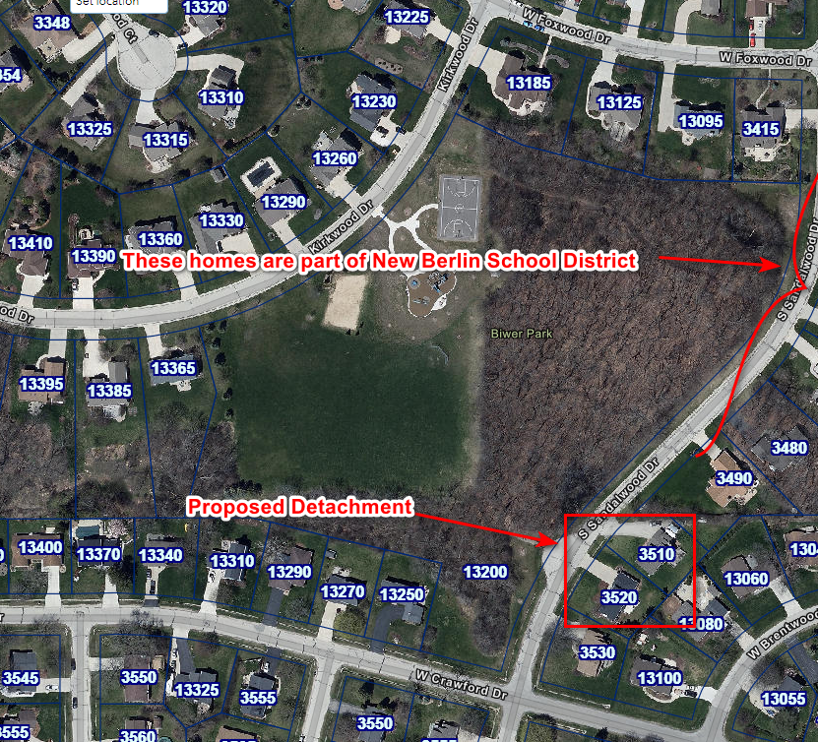
Factor 5
Whether the proposed reorganization will make any part of a school district's territory noncontiguous:
The territory is contiguous to New Berlin

Slide 16
Factor 6
The socioeconomic level and racial composition of the pupils who reside or will reside in territory proposed to be detached from one school district and attached to an adjoining school district, in territory proposed to be included in a new school district under s. 117.105 or in school districts proposed to be consolidated or in a school district proposed to be dissolved; the proportion of the pupils who reside in such territory who are children at risk, as defined under s. 118.153(1) (a); and the effect that the pupils described in this paragraph will have on the present and future socioeconomic level and racial composition of the affected school districts and on the proportion of the affected school districts' enrollments that will be children at risk.
  There will be negligible impact on the socioeconomic level and racial composition as there are currently no school aged children residing at either address petitioning to be detached

Slide 17
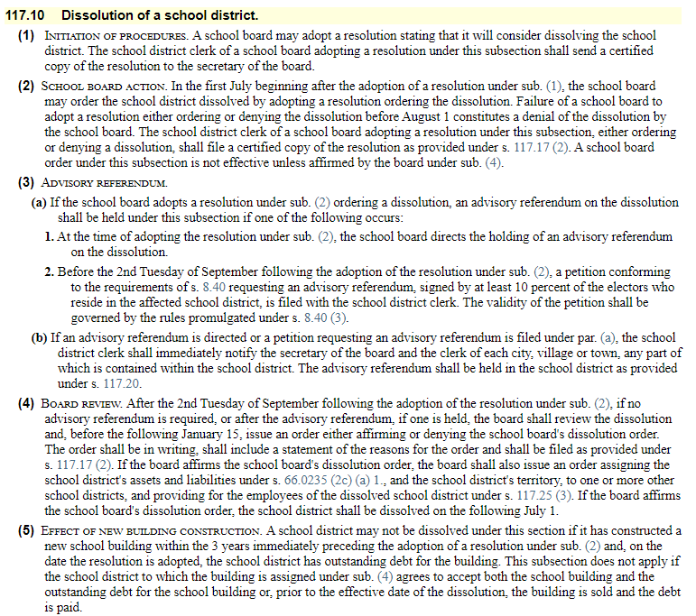
Factor 7
The results of any referendum held under S. 117.10
  Not aware of any resolution to dissolve the school district

Slide 18

Summary

Slide 19
Recommendation
Support the petitioning New Berlin residents to detach from the School District of West Allis-West Milwaukee and join the New Berlin School District, which already voted in favor of their initial petition.

Slide 20
Questions?

