Slide 1
Impact of Private School Vouchers and Public Charters on Wisconsin Public Schools
Dan Bush Director, School Financial Services Team Wisconsin Department of Public Instruction
January 23, 2020

Slide 2
Revenue Limits, State Aids, and Controlled Property Tax Levies
Revenue Limit
Controlled
Property Tax Levies
State Aid
(General Aid + High Poverty Aid + Computer Aid + Aid for Exempt Personal Property)
Revenue Limit
Notes:
More money in General Aid without a corresponding increase to the Revenue Limit won’t result in additional revenue for the district. It just results in property tax relief.

Slide 3
Revenue Limit Overview
In 1993-94, the State enacted revenue limits to control the majority of revenues a school district can receive. Today, the limits include:
State General Aids
High Poverty Aid
Computer Aid
Aid for Exempt Personal Property
Local Property Taxes (vast majority)
Notes:
General Aid (Equalization Aid, for most districts)
Computer Aid
Select Local Levies – Controlled:
General Fund (Fund 10)
Non-Referendum Debt Service (Fund 38)
Capital Projects (Fund 41)
It is not an expenditure control or spending limit.

Slide 4
State Totals - School District Revenues
CONTROLLED
Although the mix of aid and taxes may be different across districts, the Revenue Limit can control 70-90% of the General Fund budget!
Notes:
Updated graphic for 2016-17 Comparative Revenues
In 1993-94, the State enacted revenue limits to control the revenue a school district can collect from:
General Aid (Equalization Aid, for most districts)
Computer Aid
Aid for Exempt Personal Property
High Poverty Aid
Select Local Levies
General Fund (Fund 10)
Non-Referendum Debt Service (Fund 38)
Capital Projects (Fund 41)
It is not an expenditure control or spending limit.
Examples of what the Revenue Limit does not control (not exhaustive list):
School Fees
Categorical Aids (Per Pupil Aid, Library Aid, Transportation Aid, etc.)
State and Federal Grants
Gate Receipts
Donations
Local Levies
Referendum Debt Service (Fund 39, at times called “Non-Fund 38”)
Community Service Fund (Fund 80)
Prior Year Levy Chargeback for Uncollectible Taxes (Fund 10)

Slide 5
Revenue Limit Overview
Think of Revenue Limits as a Pie
The Limit itself is the outer crust – this defines the size of the pie.
There are two fillings: state aids and local taxes.
As one increases, the other decreases.

Slide 6
Revenue Limit Pie
The amount of “filling” from state sources is determined by the state general school aids formula.
The amount of “filling” from local taxes is based on the space available in the crust of the pie (district specific revenue limit calculation) and whether the Board wants to fill the pie (how much to raise in taxes).

Slide 7
Revenue Limits
Controlled (Capped) Revenues does not include other revenues such as:
Categorical Aids:
Per Pupil Aid ($630 in 2019-20, $742 in 2020-21 & 2021-22)
Special Education Aid
Transportation aid
State and Federal Grants
School Fees
Open Enrollment Tuition Revenue
These revenues are in addition to the controlled revenues under the revenue limit.

Slide 8
Revenue Limit Factors
Critical factors in the revenue limit calculation include:
Base Revenue (Prior Year Revenue Limit)
Membership (Full Time Equivalent Number of Students)
Allowable Annual Change Per Member
Allowable Exemptions to the Limit

Slide 9
Revenue Limit Membership
Membership =/= Students in Seats
Includes residents attending School Board authorized charter schools (type of public school)
Includes resident Open Enrollment (OE) students attending elsewhere
Includes resident students attending New/Other independent charter schools
2018-19 first year with two schools authorized by UW System Office of Educational Opportunity.
Pro-rates for part-time students, such as four year-old Kindergarten

Slide 10
Revenue Limit Membership
2017-18 | 2018-19 | 2019-20
Membership | Membership | Membership
Sept 2015
Sept 2016 | Sept 2016
Sept 2017 | Sept 2017 | Sept 2017
 | Sept 2018 | Sept 2018
 |  | Sept 2019
Notice how an on-going membership change must be in place for 3 years before the full impact is realized in the revenue limit membership calculation.
Notes:
Revenue Limit Membership is calculated on a three year average.
A three year average is used to minimize the financial impact of a sharp increase or decrease in membership (FTE students).
2018-19 Revenue Limit Membership =
(Sept 2016 + Sept 2017 + Sept 2018) / 3

Slide 11
Revenue Limit Calculation
Membership
Maximum Revenue / Member
Revenue Limit with No Exemptions
If Membership or the Maximum Revenue per Member increase, the “Pie Crust” (district specific revenue limit calculation) will get bigger.
Notes:
11

Slide 12
Allowable Exemptions to the Limit
What are the most common Exemptions to expand the pie crust (district specific revenue limit calculation)?
Non-Recurring Exemptions (one time annual)
Make this year’s pie crust bigger
Declining Enrollment
“Hold Harmless”
Energy Efficiency
Non-Recurring Referendum
Recurring Exemptions (ongoing permanent)
Makes this + future years’ pie crusts larger
Transfer of Service
Recurring Referendum
12
Notes:
12

Slide 13
Allowable Exemptions to the Limit
Exemptions for Private School Vouchers
Non-Recurring Exemptions
Beginning in 2015-16, adjustment for incoming private school regular education voucher (WPCP/RPCP) students:
In 2018-19, the authority to increase property taxes is equal to the state aid deduction used to pay the private school voucher amounts ($7,754 per K-8 and $8,400 per 9-12 FTE resident student) for the Wisconsin and Racine Parental Choice Programs (WPCP and RPCP).
Beginning in 2017-18, adjustment for incoming private school special needs scholarship program (SNSP) voucher students:
In 2018-19, the authority to increase property taxes is equal to the state aid deduction used to pay the private school voucher amounts ($12,431 per FTE resident student) for the SNSP.
Revenue limit exemption (equal to the state aid deduction for these voucher programs) calculated by DPI and shared on October 15.
Notes:
13

Slide 14
Top Ten State General Fund Programs and % Share of State’s 2019-21 General Fund Budget
Category % of State Budget
1. K-12 General and Categorical School Aids 32.5%
Medical Assistance 17.8%
State Correctional Operations 6.3%
4. University of Wisconsin System 6.0%
5. School Levy/First Dollar Tax Credits 5.8%
Shared Revenues 4.5%
Technical College System Aids 2.8%
State Debt Obligation Bonds 2.1%
Private Choice/Voucher Programs 1.9%
Community and Juvenile Correctional Services 1.6%
All Other State Funding 18.7%
Source: Legislative Fiscal Bureau (2019-21 Biennial Budget Summary-Table 11)
Notes:
The 9 largest programs make up ≈ 80% of state spending.

Slide 15
State Aids -- Equalization Aid Formula
General school aids primarily composed of Equalization Aids, which is a cost-sharing formula
that incorporates:
Spending = Shared Costs
Number of Students to Educate = Members
Property Value
All Prior-Year Data
(2018-19 data is used for 2019-20 aid)

Slide 16
General School Aids Overview
General School Aids contains three different components:
Equalization Aids
Integration (Chapter 220) Aids
Special Adjustment (85% Hold Harmless) Aids
General equalization aids are received within school district revenue limits, thus increases or decreases in such state aids directly affect school district property tax levies.
General equalization aids may be used by school districts for any purpose.
Changes in any one school district’s “factors” (membership, costs, property value) affect the distribution of general equalization aid in most other school districts.

Slide 17
2019-20 General School Aid Deductions
Program | Impact | Amount (In Millions)
Independent Charter Schools - Legacy | 416 Districts* | $75.4
Independent Charter Schools – New Authorizers | 13 Districts | $2.7
Milwaukee Parental Choice (Vouchers) | Milwaukee | $36.8
Wisconsin Parental Choice (Vouchers) | 256 Districts | $73.2
Racine Parental Choice (Vouchers) | Racine | $22.3
Special Needs Scholarship (Vouchers) | 84 Districts | $13.0
Total |  | $223.4
* Five districts receive no state general aid.
$4,656 million in general school aids. $193 million is 4.2% of total general school aids.

Slide 18
General Fund Shared Cost
Expenditures that are funded by State General Aid and Local Property Tax
Notes:
State shares in costs funded by local property tax and state general aid.

Slide 19
State Aids Membership – Step 1
Average of
3rd Friday in September – FTE Residents
2nd Friday in January – FTE Residents
FTE = full-time equivalent
2 halftime (.5) kindergarten students = 1 FTE
+ Summer/Interim Courses FTE Residents
Summer/Interim = 48,600 minutes of instruction = 1 FTE
All Prior-Year Data
(2018-19 data is used for 2019-20 aid)
Notes:
You have probably heard lots about this – student counts and membership.
Maybe you have not seen FTE (full-time equivalent).
Half-time k program, it would take 2 (two) K students to make 1 full-time student. All state aid computations use this converted number – a fulltime equivalent.
Summer school membership is not based on the number of students in summer school, but the number of hours spent in instructional classes.
So, how does this all work?

Slide 20
State Aids Membership – Step 2
Also Includes:
Wisconsin Private School Voucher Students
Racine Private School Voucher Students
Special Needs Scholarship Program (Voucher) Students
New Independent Charter Schools (ICSP)
Challenge Academy Students
Second Chance Partnership Students
Part-time Attendance F.T.E. of Resident and Non-Resident Private/Home-Schooled Students
Foster Group Home Students
See:
http://dpi.wi.gov/sfs/children/enrollment/membership-info-reporting
Notes:
20

Slide 21
Private School Voucher (Choice) Programs
In 2019-20, four separate private school voucher programs exist:
Milwaukee Parental Choice Program
Racine Parental Choice Program
Wisconsin Parental Choice Program
Special Needs Scholarship Program
A summary table including the:
participating private schools;
number of participating students (enrollment and FTE) by program by school;
estimated total annual payment received by the private school;
total number of students receiving a state funded voucher (the four programs combined) and the percentage of total private school student enrollment
https://dpi.wi.gov/sites/default/files/imce/sms/Choice/Data_and_Reports/ 2019-20/2019-20_summary_mpcp_wpcp_rpcp_snsp.pdf

Slide 22
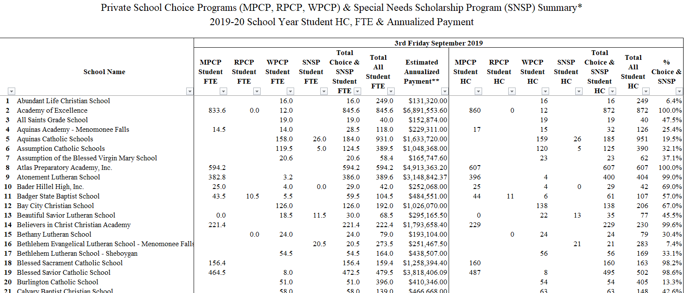
Private School Voucher (Choice) Programs
Go To: https://dpi.wi.gov/sms
Private School Choice Programs
Private School Choice Programs: Data and Reports
Once on the page go to the Section “School Enrollment and Estimated Payment (MPCP, RPCP, WPCP & SNSP)”
Select 2019-20 PDF or Excel

Slide 23
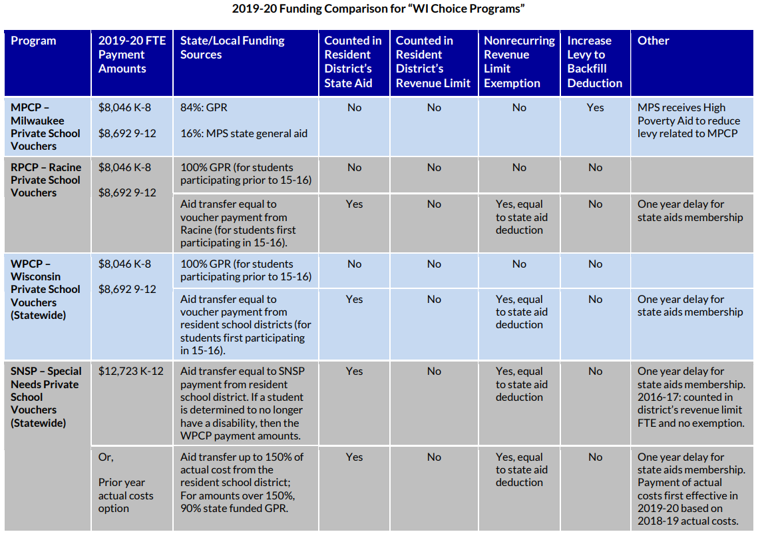
Parental “Choice” Options – 2019-20 https://dpi.wi.gov/sites/default/files/imce/sfs/pdf/FY20-ChoiceOptionsFundingTable.pdf

Slide 24
Private Choice Programs and Per Student Payments
These three private school choice programs:
Milwaukee Parental Choice Program (MPCP)-enacted in 1990-91
Racine Parental Choice Program (RPCP)-enacted in 2011-12
Wisconsin Parental Choice Program (WPCP)-enacted in 2013-14
Each program is funded on a current year basis with sum sufficient funds.
2019-20 Per FTE Student Payments:
Grades K-8 $8,046
Grades 9-12 $8,692

Slide 25
Milwaukee Parental Choice Program (MPCP)
Fiscal Year | Number of MPCP Schools | Full-Time Equivalent (FTE) Students | MPCP FTE Student Payment | MPCP Total State Aid Payments/ Program Cost
1990-91 | 6 | 300 | $2,446 | $733,800
1998-99 | 83 | 5,761 | $4,894 | $28,194,300
2008-09 | 123 | 19,428 | $6,607 | $127,061,900
2010-11 | 100 | 20,256 | $6,442 | $129,183,100
2017-18 | 125 | 27,670 | $7,530/$8,176 | $213,300,000
2018-19 | 129 | 28,100 | $7,754/$8,400 | $221,800,000
2019-20 (estimated) | 130 | 28,147 | $8,046/$8,692 | $230,100,000

Slide 26
MPCP: State/Local Funding
In 2019-20, the state directly pays 84% of the cost of the MPCP while Milwaukee Public Schools (MPS) pays 16% of the cost ($36.8 million this year) through a reduction in its state general school aids.
MPS can increase its property tax levy to replace this state general aid reduction under its revenue limit; however, MPS cannot count choice students in its membership for state general aid purposes and does not receive a revenue limit adjustment for each MPCP student.
Under current law, the state General Purpose Revenue (GPR) share increases by 3.2% annually through 2023-24 and MPS’ share decreases by the same figure each year until the MPCP is entirely GPR state-funded in 2024-25.
MPS also receives $5 million in High Poverty Aid in 2019-20 to reduce its property tax levy related to the MPCP.

Slide 27
Racine Parental Choice Program (RPCP) History
Fiscal Year | Number of RPCP Schools | Total Full-Time Equivalent (FTE) Students | RPCP FTE Student Payment | RPCP Total State Aid Payments/ Program Cost
2011-12 | 8 | 219 | $6,442 | $1,408,200
2012-13 | 11 | 485 | $6,442 | $3,125,300
2013-14 | 13 | 1,169 | $6,442 | $7,529,400
2014-15 | 15 | 1,659 | $7,210/$7,856 | $12,154,300
2015-16 | 19 | 2,057 | $7,214/$7,860 | $15,089,900
2016-17 | 19 | 2,420 | $7,323/$7,969 | $18,022,900
2017-18 | 23 | 2,852 | $7,530/$8,176 | $21,876,300
2018-19 | 26 | 3,240 | $7,754/$8,400 | $26,600,000
2019-20 (estimated) | 27 | 3,558 | $8,046/$8,692 | $29,200,000

Slide 28
Wisconsin Parental Choice Program (WPCP)
Fiscal Year | Number of WPCP Schools | Total Full-Time Equivalent (FTE) Students | WPCP FTE Student Payment | WPCP Total State Aid Payments/ Program Cost
2013-14 | 25 | 498 | $6,442 | $3,212,300
2014-15 | 31 | 994 | $7,210/$7,856 | $7,345,200
2015-16 | 82 | 2,483 | $7,214/$7,860 | $18,369,200
2016-17 | 121 | 2,978 | $7,323/$7,969 | $22,382,500
2017-18 | 153 | 4,359 | $7,530/$8,176 | $33,612,100
2018-19 | 213 | 6,880 | $7,754/$8,400 | $54,600,000
2019-20 (estimated) | 254 | 9,419 | $8,046/$8,692 | $77,300,000

Slide 29
RPCP/WPCP: State/Local Funding
1. Students enrolled in the RPCP/WPCP prior to 2015-16:
Vouchers paid with state GPR funding until student exits program.
Students are not counted in a district’s membership for state general aid or revenue limit purposes.
2. Students enrolling in the RPCP/WPCP in 2015-16 or thereafter:
State General Aids
Resident district pays for RPCP/WPCP students through a reduction in its state general aids.
RPCP/WPCP students are counted in their resident district’s membership for state general aid purposes in the following year.
In 2015-16 and 2016-17, the total number of pupils residing in the district who could participate in the choice program from each district was limited to no more than 1% of the district’s prior year membership.

Slide 30
RPCP/WPCP: State/Local Funding
Students enrolling in the RPCP/WPCP in 2015-16 or thereafter (continued):
State General Aids
Beginning in the 2017-18 school year, the enrollment limit will increase by one percentage point in each year until the enrollment limit reaches 10% of the district’s prior year enrollment (2025-26). Beginning in 2026-27, no enrollment limit would apply.
Revenue Limits
Resident districts receive a revenue limit adjustment equal to the per student choice payment, allowing them to replace the state general aid reduction through increased property taxes if the resident school board chooses to do so.

Slide 31
RPCP State/Local Funding History
Fiscal Year | RPCP FTE Students | RPCP Direct State GPR Funding | State General Aid Deduction/Local Property Taxpayer Funding
2011-12 | 219 | $1,408,200 | $0
2012-13 | 485 | $3,125,300 | $0
2013-14 | 1,169 | $7,529,400 | $0
2014-15 | 1,659 | $12,154,300 | $0
2015-16 | 2,057 | $10,925,100 | $4,164,500
2016-17 | 2,420 | $9,482,900 | $8,540,000
2017-18 | 2,852 | $8,252,000 | $13,624,000
2018-19 | 3,240 | $7,319,000 | $18,296,000
2019-20 (estimated) | 3,558 | $6,867,200 | $22,332,800

Slide 32
WPCP State/Local Funding History
Fiscal Year | WPCP FTE Students | # of School Districts with WPCP Student | WPCP Direct State GPR Funding | State General Aid Deduction/Local Property Taxpayer Funding
2013-14 | 498 | N/A | $3,212,300 | $0
2014-15 | 994 | N/A | $7,345,200 | $0
2015-16 | 2,483 | 141 | $6,535,900 | $11,833,200
2016-17 | 2,978 | 182 | $5,837,000 | $16,545,400
2017-18 | 4,359 | 225 | $5,120,000 | $28,492,000
2018-19 | 6,880 | 256 | $4,649,000 | $49,972,000
2019-20 (estimated) | 9,419 | 275 | $4,067,300 | $73,232,700

Slide 33
Choice Program Expansion 2012-13 through 2018-19 (animation slide)

Slide 34
Private (and Private Choice) Schools: State Categorical Aids
All private schools in Wisconsin are eligible for the following state categorical aid programs:
School lunch aid;
School breakfast aid;
School day milk aid; and
Robotics league participation grants.
Private schools participating in one of the state’s choice programs are also eligible for some additional state categorical aid programs:
School performance improvement grants (new in 2018-19); and
School mental health aid (new in 2018-19).

Slide 35
Special Needs Scholarship Program (SNSP)
The SNSP is funded on a current year basis with sum sufficient funds.
SNSP Per FTE Student Payments:
2019-20 $12,723
State General Aids
Resident district pays for SNSP students through a reduction in its state general aids.
SNSP students are counted in their resident district’s membership for state general aid purposes in the following year.
Revenue Limits
Resident districts receive a revenue limit exemption/adjustment equal to the per student payment allowing the school board to replace the state aid deduction through increased property taxes.
In 2016-17 only: Counted in district’s revenue limit FTE and no exemption.

Slide 36
SNSP State/Local Funding History
Fiscal Year | # of SNSP Private Schools | Full-Time Equivalent (FTE) Students | # of Districts with SNSP Student | SNSP Direct State GPR Funding | State General Aid Deduction/ Local Property Taxpayer Funding
2016-17 | 26 | 215 | 22 | 0 | $2,579,000
2017-18 | 28 | 244 | 25 | 0 | $2,962,000
2018-19 | 76 | 676 | 84 | 0 | $8,352,000
2019-20 (estimated) | 97 | 1,033 | 113 | 0 | $13,029,000

Slide 37
Parental “Choice” Options – 2019-20 https://dpi.wi.gov/sites/default/files/imce/sfs/pdf/FY20-ChoiceOptionsFundingTable.pdf

Slide 38
Independent Charter School Program (ICSP) Authorizers
Charter Authorizer | School Location | Pupil Residency | Number of Charter Schools
Legacy Authorizers
City of Milwaukee | Statewide | Statewide | Unlimited
UW-Milwaukee | Statewide | Statewide | Unlimited
UW-Parkside | Statewide | Statewide | Unlimited
MATC | Statewide | Statewide | Unlimited
New Authorizers (2015 Act 55 and 2017 Act 59)
Any Technical College District Board (other than MATC) | Statewide | Statewide | Unlimited
Waukesha County Executive | Waukesha County | Statewide | Unlimited
College of Menominee Nation | Statewide | Statewide | No more than 6 schools between these two authorizers
Lac Courte Orielles Ojibwa Community College | Statewide | Statewide
Office of Educational Opportunity (UW System) (Recovery Charter School Authorizer) | Statewide | Statewide | Unlimited
Any UW System Chancellor (other than UW-Milwaukee and Parkside) | Statewide | Statewide | Unlimited

Slide 39
Legacy and New ICSP: State/Local Funding
The ICSP is funded on a current year basis with sum sufficient funds.
Per FTE Student Payments: $8,911 in 2019-20.
1. Students currently attending legacy independent charter schools (ICS):
All districts have their state general aid proportionally reduced (1.5% in 2018-19) to pay for legacy independent charter school program (ICSP) students.
School boards have the option to increase their property tax levy under their revenue limit to replace the state general aid reduction.
Legacy ICSP students not included in revenue limits or general aids membership.
2. Students attending ICS authorized by new/other authorizers (New in 2018-19, two charter schools in operation):
State General Aids
Resident district pays for students through a reduction in its state general aids.
Students are counted in resident district’s membership for state general aid purposes in the following year.
Revenue Limits
Resident district counts New ICSP students in its three-year rolling membership average.

Slide 40
ICSP: Other Funding/Categorical Aids
Unlike private schools, charter schools may not charge tuition.
Independent charter schools are treated as Local Educational Agencies (LEAs) for state/federal reporting requirements and directly receive federal aid (IDEA, Title I, etc.) as applicable.
Independent charter schools are eligible for some state categorical aid programs:
Special education aid;
School lunch aid;
Pupil transportation aid;
Special education transition incentive grants;
Robotic league participation grants;
School performance improvement grants (new in 2018-19);
School mental health aid (new in 2018-19);
Community & school mental health collaboration grants (new in 2018-19); and
Special education transition readiness grants (new in 2018-19).

Slide 41
ICSP State/Local Funding History - Legacy
Fiscal Year | Number of ICSP Schools | ICSP Full-Time Equivalent (FTE) Students | ICSP FTE Payment | ICSP Direct State GPR Funding | State Aid Deduction/ Local Property Taxpayer Funding
1998-99 | 3 | 55 | $6,062 | 0 | $333,400
2016-17 | 22 | 7,526 | $8,188 | 0 | $61,622,900
2017-18 | 23 | 7,813 | $8,395 | 0 | $65,590,100
2018-19 | 26 | 8,520 | $8,619 | 0 | $71,500,000
2019-20 (estimated) | 23 | 8,458 | $8,911 | 0 | $75,400,000

Slide 42
ICSP State/Local Funding History
New Authorizers
Fiscal Year | Number of ICSP Schools | ICSP Full-Time Equivalent (FTE) Students | # of Districts with Students | ICSP Direct State GPR Funding | State Aid Deduction/Local Property Taxpayer Funding
2018-19 | 2 | 253 | 16 | 0 | $2,176,300
2019-20 (estimated) | 2 | 299 | 13 | 0 | $2,667,100

Slide 43
Private School Choice/Voucher Summary
Racine and Wisconsin Parental Choice Programs (RPCP/WPCP)
For choice students enrolled in the RPCP/WPCP PRIOR to 2015-16:
These choice students are paid directly with state General Purpose Revenue (GPR) funds until the student exits the RPCP/WPCP. The State directly pays 100% of the costs of these vouchers.
There is no reduction from a school district’s state general aids for these students.
These choice students are not counted in a school district’s membership for state general aid or revenue limit purposes.

Slide 44
Private School Choice/Voucher Summary
Racine and Wisconsin Parental Choice Programs (RPCP/WPCP)
For choice/voucher students enrolled in the RPCP/WPCP in 2015-16 or thereafter, State General Aids Impacts:
The choice student’s resident district pays their voucher through a reduction in its state general aids.
If a district does not receive enough state general aid to cover this reduction, the balance is taken from other state aids (e.g., Per Pupil Aid) received.
In the following year, these choice students are counted in their resident district’s membership for state general aids.
A district may recoup some state general aid depending on its “position” in the state general aid formula, but is very unlikely to fully recover its prior year state aid reduction.

Slide 45
Private School Voucher Summary
Racine and Wisconsin Parental Choice Programs (RPCP/WPCP)
For choice students enrolled in the RPCP/WPCP in 2015-16 or thereafter,
Revenue Limits Impacts:
These choice students are not counted in the revenue limit membership
The choice student’s resident district receives a non-recurring revenue limit adjustment equal to the per FTE choice payment in the current year, allowing a school board to replace the state aid reduction through increased property taxes.
If a school board chooses to levy less than the private school voucher non-recurring revenue limit exemption, the following year’s revenue limit carry-over total will be reduced dollar for dollar. In other words, this new non-recurring revenue limit exemption is treated the same way as other non-recurring revenue limit exemptions if a school board chooses to levy less than the maximum allowed.

Slide 46
Private School Voucher Takeaways
School District Budgets – Current Year (Year 1)
For choice students enrolled in the RPCP/WPCP in 2015-16 or thereafter, the school board must choose one of the following three options (or a combination):
Increase property taxes to replace the loss of state school aids in order to maintain existing student educational programs.
Use fund balance or some other source of revenues to replace the loss of state school aids to maintain current programs.
Reduce current district expenditures equal to the state aids deduction.

Slide 47
Private School Voucher Takeaways
School District Budgets – Following Year (Year 2)
For choice students enrolled in the RPCP/WPCP in 2015-16 or thereafter,
These choice students are counted in their resident district’s membership for state general aid purposes in the following year’s state aid calculation. Not counted for revenue limits.
A district may recoup some state general aid depending on its “position” in the state general aid formula, but is very unlikely to fully recover its prior year state aid reduction.

Slide 48
Private School Voucher Takeaways
Wisconsin and Racine Parental Choice Programs:
Adding private school voucher students to the general aid membership changes one of the factors used to determine state equalization aids. This results in a redistribution of the existing level of general school aids. The impacts are:
If one district receives additional school aids, other district(s) receive less school aids.
Revenue Limits – State Aids = Property Taxes
The effect is as though the choice/voucher expansion is funded statewide with property taxes.

Slide 49
Contact and Questions ?
Daniel Bush
Director
School Financial Services Team
608-266-6968
daniel.bush@dpi.wi.gov
Visit our web site at:
https://dpi.wi.gov/sfs/finances/private-school-vouchers

