Slide 1
State Education Convention
January 19, 2023
A Deep Dive Into Wisconsin School Finance
Tom Owens
Debby Brunett
Bob Borch
Bob Soldner

Slide 2
Agenda
Education Framework
Revenue Limits
Equalization Aid
Fund Balance
Why these topics?
Key to Wisconsin School Finance
2
Notes:
Important to note verbally: As board members, they will not be asked to replicate or recite this information. It is provided to help create a baseline understanding of these complex topics.

Slide 3
Learning Targets
Recall how school finance is structured in Wisconsin and identify why
Explain the difference between revenue limits and state equalization aid and describe the impact on school finance
Recognize the difference between cash and fund balance
3
Notes:
Needs wordsmithing
Important to note verbally: As board members, they will not be asked to replicate or recite this information. It is provided to help create a baseline understanding of these complex topics.

Slide 4
U.S. Constitution on Education –
Education is a State Function
10th Amendment
“…powers not granted to the federal government by the Constitution, nor prohibited to the States, are reserved to the States or the people…”
1791
4

Slide 5
Wisconsin Constitution on Education
Article X, Section 2
“The legislature shall provide by law for the establishment of district schools, which shall be as nearly uniform as practicable; and such schools shall be free and without charge for tuition to all children between the ages of 4 and 20.”
1848
5

Slide 6
Wisconsin Constitution on Education
Article X, Section 4
“Each town and city shall be required to raise by tax, annually, for the support of common schools therein……”
1848
6

Slide 7
Basic Framework - What We Know So Far
State Responsibility
District Schools
As Nearly Uniform as Practicable
Free
Funded by Local Property Tax
7

Slide 8
Modern-Day Wisconsin
In Wisconsin, the primary funding source for public schools is the property tax, but we know that property values across the state are not uniform.
The challenge is defining “uniform as practicable.”
8

Slide 9
Wisconsin Constitution on Education
Article X, Section 2
“The legislature shall provide by law for the establishment of district schools, which shall be as nearly uniform as practicable; and such schools shall be free and without charge for tuition to all children between the ages of 4 and 20.”
A child should not be unfairly disadvantaged
merely by where they live.
9

Slide 10
Constitutional Underpinnings
The State provides financial assistance in the form of Equalization/General Aid to school districts in order to:
  Reduce the reliance upon the local property tax as the sole source of revenue for educational programs.
  Guarantee that a basic educational opportunity is available to all pupils regardless of the local fiscal capacity of the district in which they reside.
10

Slide 11
Revenue Limits
Diving in….
…to districts’ primary revenue calculation
Notes:
Needs wordsmithing

Slide 12
Revenue Limits, State Aids, and Controlled Property Tax Levies
Revenue Limit Levy
“State Aid”
(General + High Poverty + Computer + Exempt Personal Property)
Revenue Limit
Notes:
More money in State Aid without a corresponding increase to the Revenue Limit won’t result in additional revenue for the district. It just results in property tax relief.
“State Aid” includes:
General School Aids (Equalization Aids, Chapter 220 Integration Aids, and Special Adjustment (Hold Harmless Aids);
High Poverty Aid;
State Aid for Exempt Computers; and
State Aid for Exempt Personal Property.
2022-23 general school aids includes: $5,141.7 million equalization aids; $37.2 million integration (Chapter 220) aids; and $22.7 million special adjustment aids (hold harmless aids).

Slide 13
What is Important to School Board Members
What is the “Revenue Limit” and why is it important?
What causes it to increase and/or decrease?
How is the formula impacted by one-time or permanent increases – including operational referendums
Why districts must plan both short and long-term

Slide 14
Revenue Limit History
Established in 1993
Goal was to create levy controls for WI school districts
Created a calculation to determine the amount of revenue a district could generate through the sources of state general aid and the local tax levy
Provided operational referendums if calculation provided insufficient funds

Slide 15
Revenue Limit Levy Controls
Source: Department of Public Instruction; sample school district shown

Slide 16
Importance of Revenue Limit Revenue
CONTROLLED
Although the mix of aid and taxes is different across districts, the Revenue Limit can control 70-90% of the General Fund revenue budget!
^ State General Aids includes: equalization aid, special adjustment aid, inter-district & intra-district
aids, and high poverty aid (i.e., state aids received under the districts’ revenue limit caps).
* Other Sources include: state categorical aids, federal aid, and non-property tax local revenue
(i.e., revenue received outside of the districts’ revenue limit caps).
Notes:
In 1993-94, the State enacted revenue limits to control the revenue a school district can collect from:
General Aid (Equalization Aid, for most districts)
Computer Aid
Aid for Exempt Personal Property
High Poverty Aid
Select Local Levies
General Fund (Fund 10)
Non-Referendum Debt Service (Fund 38)
Capital Projects (Fund 41)
It is not an expenditure control or spending limit.
Examples of what the Revenue Limit does not control (not exhaustive list):
School Fees
Categorical Aids (Per Pupil Aid, Special Education, Library Aid, Transportation Aid, etc.)
State and Federal Grants
Gate Receipts
Donations
Local Levies
Referendum Debt Service (Fund 39, at times called “Non-Fund 38”)
Community Service Fund (Fund 80)
Prior Year Levy Chargeback for Uncollectible Taxes (Fund 10)

Slide 17
Calculation
Sample Worksheet
Note: Fiscal Year begins July 1st; RLWS final figures received October 15th
Key Information
17

Slide 18

Revenue Limit Formula
Resident Membership (FTE)
$ per member
On-going and one-time exemptions
Revenue Limit Authority
Three-Year Average
September Full Time Equivalency (FTE)
40% Summer School
New Independent Charter School

Slide 19
Revenue Limit Formula
Resident Membership (FTE)
$ per member
On-going and one-time exemptions
Revenue Limit Authority
Amounts differ between school districts
“Low Revenue Ceiling” creates minimum
Legislature determines state-wide per-member annual adjustments
“Recurring” (On-going) exemptions create district-specific increases

Slide 20
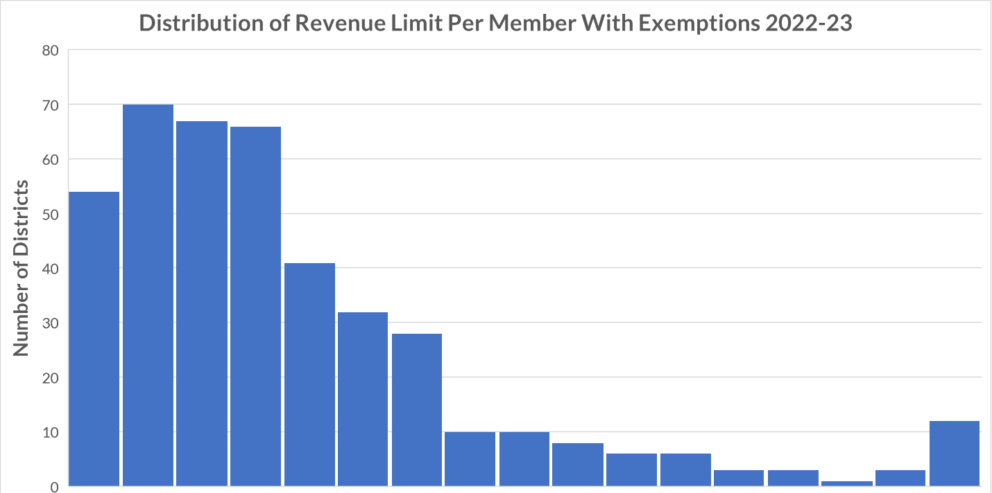
Revenue Limit Per Member with Exemptions
Lowest
$10,006
Highest
$26,356
State Average
$11,888
$10,000 | $12,000 | $14,000 | $16,000 | $18,000+
20
Notes:
2022-23 Revenue Limit Per Member figures which include exemptions
Average = $11,888
Lowest = Blair-Taylor $10,006
Highest = Washington $26,356
Ratio = 2.63 to 1

Slide 21

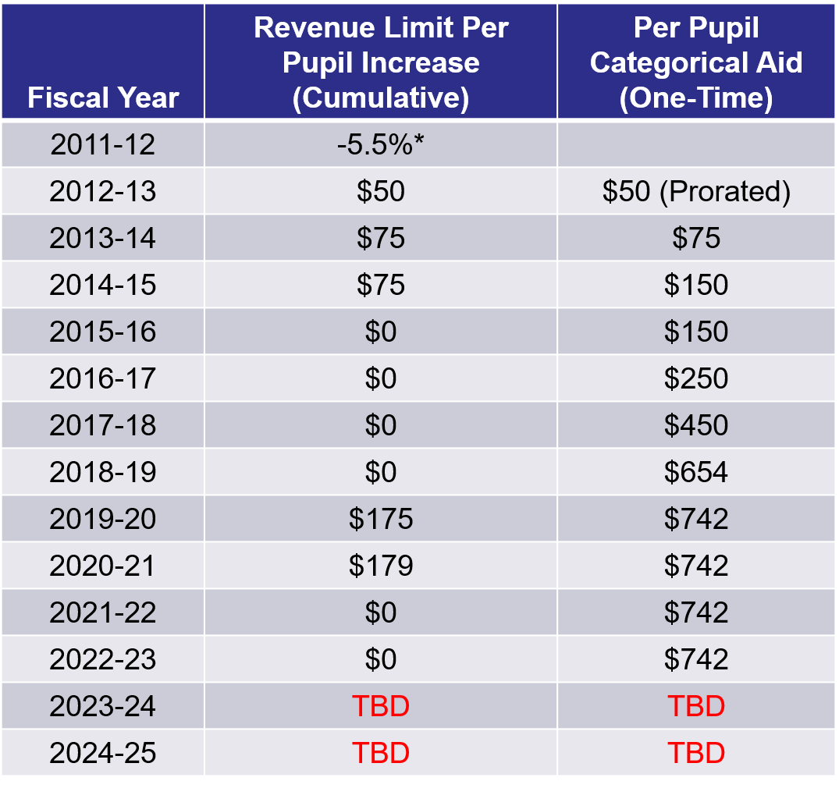
Per Member Change
Notes:
Legislature determines the per member increase. Originally, based it on the annual percentage change in the consumer price index (CPI) for all urban consumers, US city average. Recent years have been flat dollar amounts, zero, & even reductions.
The per member increase range was as low as -$554.00 in
2011-12 and as high as $274.68 in 2008-09.
For 2015-16, 2016-17, 2017-18, 2018-19, 2021-22, and
2022-23, the legislature set the increment at $0.00.
Within this slide, also need to talk about how money has been added to Per Pupil categorical aid ($654 million over the biennium) which is outside the revenue limit.
ONLY Decrease in Per member: Under the 2011-13 budget act, the per pupil adjustment in 2011-12 was set at a 5.5% reduction. The statewide average reduction was $554 per pupil.

Slide 22
Test For Understanding
Resident Membership (FTE)
$ per pupil
What is this sample district’s “Base”
Revenue Limit Trend?
What if a district, instead, had increasing FTE?

Slide 23
Exemptions
Resident Membership (FTE)
$ per member
On-going and one-time exemptions
Revenue Limit Authority
District – specific “exemptions”
Some auto-calculate; others based on district reports or data
Recurring and Non-Recurring have differing long-term impacts

Slide 24
Recurring Exemptions
Once a district levies for a Recurring Exemption, that amount stays permanently in the base going forward.
24

Slide 25
Non-Recurring Exemptions
The exemption is only valid for a limited period of time –
usually one Revenue Limit cycle.
25

Slide 26
Types of Exemptions
Recurring
Prior Year Carryover
Transfer of Service
Recurring Referenda to Exceed
Transfer of Territory/Other Reorg and Federal Impact Aid Loss
Non-Recurring
Hold Harmless
Declining Enrollment Exemption
Non-Recurring Referenda to Exceed
Energy Efficiency Net Exemption
Prior Year Open Enrollment
WPCP, RPCP Private School Voucher and Special Needs Scholarship Program Deductions
Adjustment for Refunded or Rescinded Taxes, Fund 39 residual balance transfer, and Ineligible Fund 80 expenditures
26
Notes:
Recurring Referenda
Requires approval of the voters
Carryover
Eligible prior year unused authority
Other Recurring Exemptions (DPI approves and will populate amounts)
Transfer of Service
Transfer of Territory (rare to get)
Loss of Federal Impact Aid
Requires approval by Electors or Board
Non-Recurring Referendum [Line10 A.]
Energy Efficiency Projects [Line 10 C.]
Auto-determined in Revenue Limit Calculation
Declining Enrollment [Line 10 B.]
Other Non-Recurring Exemptions (DPI determined and populated amounts)
Refunded/Rescinded Taxes [Line 10 D.]
Prior Year Uncounted Open Enrollment Pupils [Line 10 E.]
Reduction for Ineligible Fund 80 Expenditures [Line 10 F.]
Environmental Remediation Exemption [Line 10 G.]
Private School Voucher Aid Deduction [Line 10 H.]
Private School Special Needs Voucher Aid Deduction [Line 10 I.]

Slide 27
“Base Revenue Limit” and Exemptions
Ave FTE * Max. Rev. / Member = majority of districts’ RL authority
Recurring exemptions, once levied, increase districts’ base
Non-recurring exemptions are received in the current year
27

Slide 28
Total Revenue Limit Authority
Resident Membership (FTE)
$ per member
On-going and one-time exemptions
Revenue Limit Authority
The “How Much” revenue a district can receive through the sources of General Aid and the Local Tax Levy

Slide 29
Revenue Limit, Equalization Aid, and Controlled Property Tax Levy
Revenue Limit Levy
EqualizationAid
Revenue Limit
Notes:
More money in State Aid without a corresponding increase to the Revenue Limit won’t result in additional revenue for the district. It just results in property tax relief.
“State Aid” includes:
General School Aids (Equalization Aids, Chapter 220 Integration Aids, and Special Adjustment (Hold Harmless Aids);
High Poverty Aid;
State Aid for Exempt Computers; and
State Aid for Exempt Personal Property.
2022-23 general school aids includes: $5,141.7 million equalization aids; $37.2 million integration (Chapter 220) aids; and $22.7 million special adjustment aids (hold harmless aids).

Slide 30
School Tax Levy Composition
Total School-Based Tax Levy
Revenue Limit Tax Levy
(Funds 10, 38 and/or 41)
Referendum Approved Debt Levy
(Fund 39)
Community Service Tax Levy
(Fund 80)
Prior Year Levy Chargeback
and Other

Slide 31
Basic Revenue Limit Concepts
The Revenue Limit controls revenues from general state aids and local property taxes.
Revenue Limit can control 70-90% of the General Fund revenue budget.
Revenue Limits are calculated by multiplying the Average Membership * a Per Member dollar amount and adding any exemptions.
It is very important to know the difference between recurring and
non-recurring exemptions. This is especially true when planning a referendum.
Calculating the property tax levy is a direct result of completing the Revenue Limit worksheet.
31

Slide 32
District Specific Revenue Limit Data
Prepopulated and Executable Revenue Limit worksheets
  https://dpi.wi.gov/sfs/limits/worksheets/revenue
Longitudinal data related to Revenue Limits
  https://dpi.wi.gov/sfs/statistical/longitudinal-data/revenue-limit
32

Slide 33
Revenue Limit
Questions?
33

Slide 34
Equalization Aid
Diving in….
…to the general aid portion of Revenue Limits
Revenue Limit
“State Aid”
Revenue Limit Levy
Notes:
More money in State Aid without a corresponding increase to the Revenue Limit won’t result in additional revenue for the district. It just results in property tax relief.
“State Aid” includes:
General School Aids (Equalization Aids, Chapter 220 Integration Aids, and Special Adjustment (Hold Harmless Aids);
High Poverty Aid;
State Aid for Exempt Computers; and
State Aid for Exempt Personal Property.
2022-23 general school aids includes: $5,141.7 million equalization aids; $37.2 million integration (Chapter 220) aids; and $22.7 million special adjustment aids (hold harmless aids).

Slide 35
Property Value and Fiscal Capacity
A student should not be unfairly disadvantaged as a result of where he or she lives.
Property Tax Base
This example is for hypothetical purposes only
35
Notes:
The fundamental purpose of the Equalization Aid formula is to “level the playing field” by providing assistance (distributing State general aid) to make up for what districts can’t get from their property tax base.
Equalizes the revenue. Thus, allows the opportunity for similar educational programming.
In general, districts with a higher property tax base receive less aid from the State.
District property value is a key factor.

Slide 36
Formula Equalizes Revenue to Mitigate Differences
Equalization Aid
Property Tax Base
This example is for hypothetical purposes only
36

Slide 37





Incorporating the Number of Children to Educate
$1,000,000
$2,000,000
$3,000,000
$4,000,000
$5,000,000
10
10
10
10
10
$100,000
$200,000
$300,000
$400,000
$500,000
The tax base, as a measure of fiscal capacity (wealth), changes after incorporating the number of children to educate.
This example is for hypothetical purposes only
37

Slide 38
Incorporating the Number of Children to Educate
$1,000,000
$2,000,000
$3,000,000
$4,000,000
$5,000,000
10
5
6
10
20
$100,000
$400,000
$500,000
$400,000
$250,000
Notice how the tax base, as a measure of fiscal capacity (wealth), changes after incorporating the number of children to educate.
This example is for hypothetical purposes only
38

Slide 39

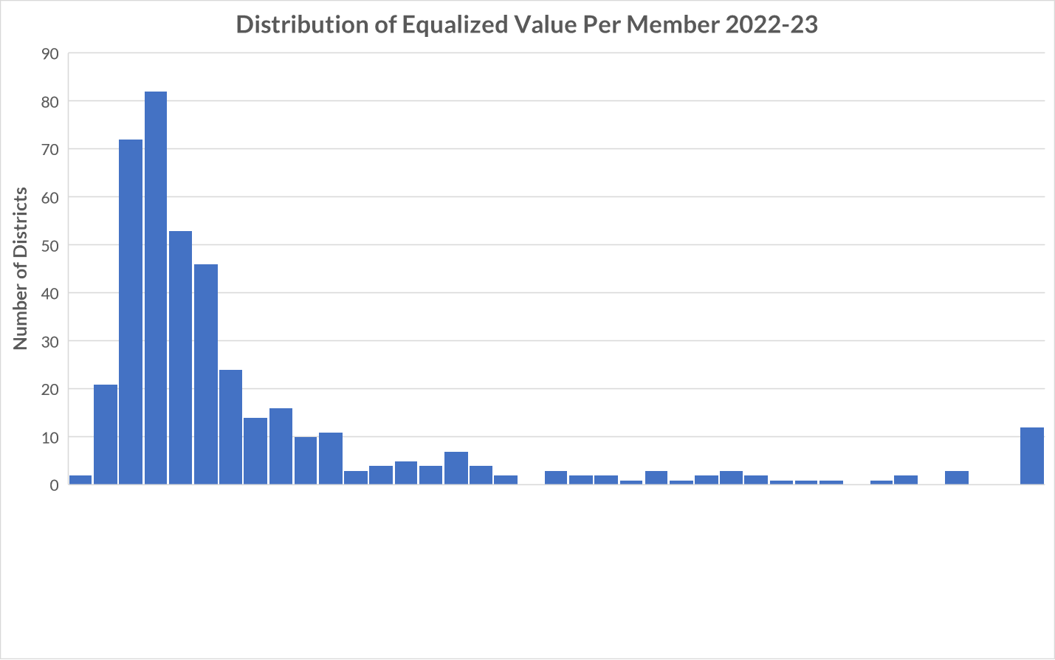
Property Value Per Member
Lowest
$282,065
Highest
$16,646,813
State Average
$754,823
$250,000
$2,000,000
$4,000,000+
$3,000,000
Source: Department of Public Instruction
39
Notes:
For 2022-23 General Aid, Prior Year (PY) data from 2021-22, excluding Norris
Low – Abbotsford $282,065
High – North Lakeland $16,646,813
Ratio: 59 to 1

Slide 40




Key Local Factors
Membership
(Student FTE)
Spending (Shared Costs)
Equalized Property Value
Membership converts variables to per-pupil $s.
40

Slide 41

Factor: Equalized Property Value
Property tax base is used to
determine district wealth and ability to
support district expenditures.
Uses Equalized Valuation or Fair Market Value.
(NOT Assessed Value)
Property values for each district are
certified in May each year
by the WI Department of Revenue
and used in the subsequent year’s aid calculations.
41

Slide 42

Factor: Membership
Who is counted for aid membership?
Generally, residents for which you are financially responsible - i.e. you are paying for the student’s education. Is a “process” to help districts determine who qualifies. Start with who is in your seats on the count date.
Revenue Limit membership is not the same as General Aid membership. State law defines.
42
Notes:
Membership Example – Open Enrollment
1,100 kids counted in your seats on count date
-40 non-resident open enrolled-in kids
+20 resident open enrolled-out kids
1,080 residents you can count for aid (and revenue limit purposes)
Your district will receive Open Enrollment revenue
from the resident districts for the 40 kids attending your district.
Your district will have to pay an Open Enrollment expense to the non-resident districts for your 20 residents attending elsewhere.

Slide 43
Factor: Membership
This example is for hypothetical purposes only
43
September and Summer Membership Included in Revenue Limit 3-Year Average Calculations
Notes:
Aid membership also includes:
- Challenge Academy Students
- Second Chance Partnership Students
- Part-time Attendance F.T.E. of Resident and Non-Resident Private/Home-Schooled Students
- Foster Group Home Students
- Wisconsin Parental Choice Program Students
- Special Needs Scholarship Program Students
- New Independent Charter School Students
See: http://dpi.wi.gov/sfs/children/enrollment/membership-info-reporting

Slide 44
Factor: Membership
This example is for hypothetical purposes only
44
Notes:
To show the differences in membership between Aid and Revenue Limits

Slide 45

Factor: Spending (Shared Cost)
A district gets all types of revenue to fund their educational programs:
Local Property Tax
State Equalization Aid
State Categorical Aid (transportation, library, bilingual aids)
Federal Aid (Title Programs, IDEA)
State Grants
Fees (be careful with what fees you charge)
45

Slide 46
General Fund Shared Cost
This example is for hypothetical purposes only
46
Notes:
^ State General Aids includes: equalization aid, special adjustment aid, inter-district & intra-district
aids, and high poverty aid (i.e., state aids received under the districts’ revenue limit caps.
* Other Sources includes: state categorical aids, federal aid, and non-property tax local revenue
(i.e., revenue received outside of the districts’ revenue limit caps).

Slide 47
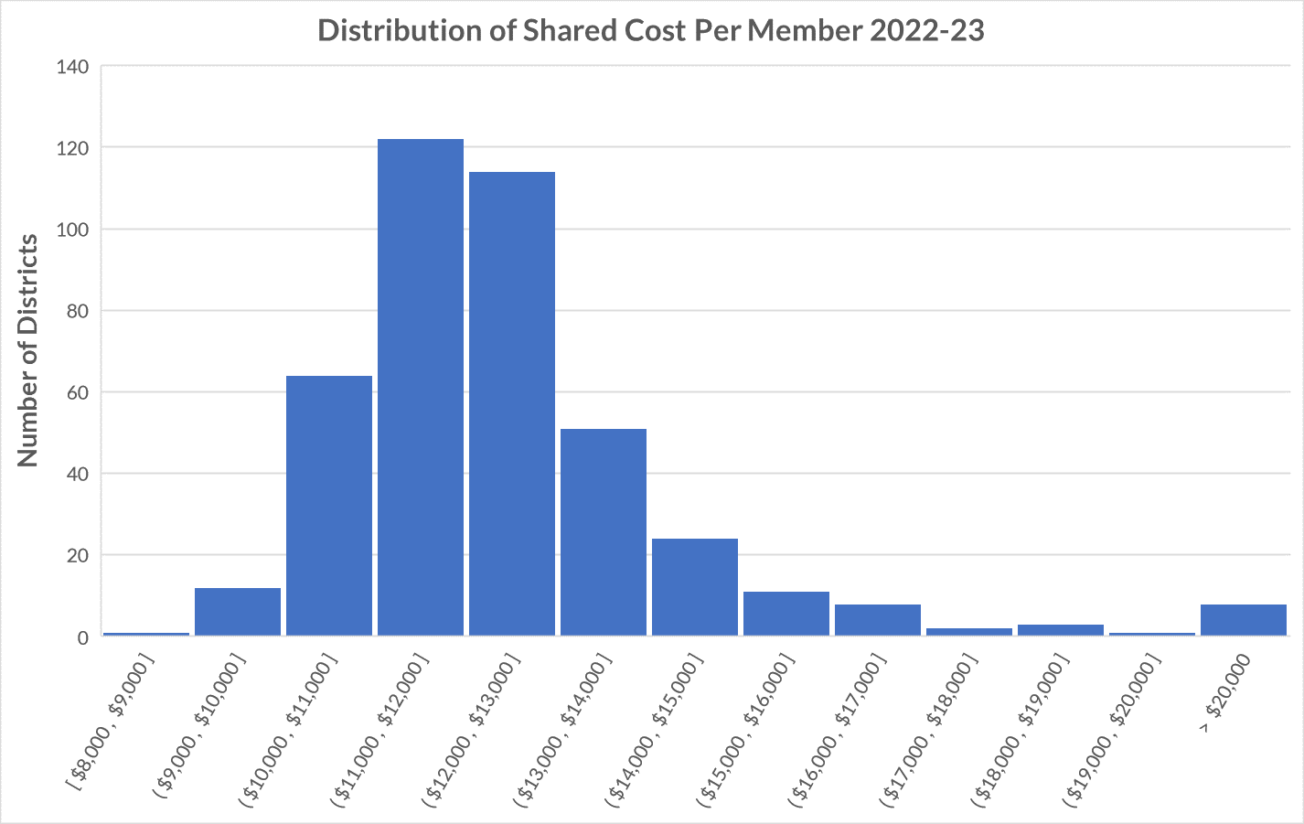
Lowest
$8,466
Highest
$25,286
State Average
$12,049
Notes:
For 2022-23 General Aid, Prior year (PY) 2021-22 data
Low – Cornell $8,466
High – Washington Island $25,286
Ratio: 2.99 to 1

Slide 48

Equalization Aid
State “shares” in district costs funded by state aid and local levy.
$1 in debt service costs is treated the same as $1 in teacher salaries.
Aid is based on a district’s ability to fund expenditures, as measured by its property wealth per member.
Basic premise:
The more property wealth per member a district has, the less equalization aid it will receive…….and vice versa.
48

Slide 49
Equalization Aid
What determines how much aid a district receives?
District Factors
(prior-year data)
equalized property value
membership
spending (shared cost)
State Factors
cost ceilings
guaranteed valuations per member
total state dollars
49
Notes:
There are three district-level factors used in the calculation and three state factors.

Slide 50
Equalization Aid
The Equalization Aid computation is actually three individual computations…….
The results of all three (primary, secondary and tertiary) are summed to get the district’s total Equalization Aid.

Slide 51
Equalization Aid – District #1
Property Value per Member
Primary Aid
20%
80%
Notes:
State says we will treat the first $1,000 of cost a certain way. Because secondary cost ceiling is $10,800 per member (90% of average shared cost per member), the next $9,800 another way, and anything above this an even different way.
So, state says If you have less than $2M in property value we will share in your first $1,000 in shared cost. How much? Depends on your property value per member.
Our district is $400,000 per member in property value. $400,000 divided by $2,000,000 primary guarantee equals 20%, so district pays 20% of the first $1,000 in costs or $200. State aid will cover 80% or $800.

Slide 52
Sample District #1
(per-member)
TAX BASE
20% x $1,000 | = | $200
STATE AID
80% x $1,000 | = | $800
Notes:
From Percent Aid https://dpi.wi.gov/sfs/aid/general/equalization/overview

Slide 53
Equalization Aid – District #2
Property Value per Member
Primary Aid
60%
40%
Notes:
State says we will treat the first $1,000 of cost a certain way. Because secondary cost ceiling is $10,800 per member (90% of average shared cost per member), the next $9,800 another way, and anything above this an even different way.
So, state says If you have less than $2M in property value we will share in your first $1,000 in shared cost. How much? Depends on your property value per member.
Our district is $1,200,000 per member in property value. $1,200,000 divided by $2,000,000 primary guarantee equals 60%, so district pays 60% of the first $1,000 in costs or $600. State aid will cover 40% or $400.

Slide 54
Sample District #2 (Higher Property Value)
TAX BASE
60% x $1,000 | = | $600
STATE AID
40% x $1,000 | = | $400
Notes:
$1.2M/m vs $400,000/m property value

Slide 55
Equalization Aid – District #1
Tertiary
Aid
50%
50%
Property Value per Member
25%
75%
Secondary Aid
Primary Aid
20%
80%
Notes:
State says we will treat the first $1,000 of cost a certain way. Because secondary cost ceiling is $10,800 per member (90% of average shared cost per member), the next $9,800 another way, and anything above this an even different way.
Tertiary guaranteed property valuation of $800,000 50/50 split

Slide 56
Sample District #1
(per-member)
TAX BASE
20% × $1,000 | = | $200
25% × $9,800 | = | $2,450
50% × $3,700 | = | $1,850
 |  | $4,500
STATE AID
80% × $1,000 | = | $800
75% × $9,800 | = | $7,350
50% × $3,700 | = | $1,850
 |  | $10,000
Total Shared Cost = $7,250,000 (500 members × $14,500)
Tax Base = $4,500 State Aid = $10,000
× 500 membership
Tax Base = $2,250,000 State Aid = $5,000,000
State Aid / Total Shared Cost = 69% aided

Slide 57
Equalization Aid – District #2
Property Value per Member
75%
25%
Secondary Aid
Primary Aid
60%
40%
Notes:
State says we will treat the first $1,000 of cost a certain way. Because secondary cost ceiling is $10,800 per member (90% of average shared cost per member), the next $9,800 another way, and anything above this an even different way.
$1.6 M secondary guarantee
$1.2 M property value/member=75/25 secondary split

Slide 58
Sample District #2
(Higher Property Value, per-member)
TAX BASE
60% × $1,000 | = | $600
75% × $9,800 | = | $7,350
STATE AID
40% × $1,000 | = | $400
25% × $9,800 | = | $2,450

Slide 59
Equalization Aid – District #2
Tertiary
Aid
$1.2M / $800,000 = 150%
150%
-50%
Negative Tertiary Aid
Property Value per Member
75%
25%
Secondary Aid
Primary Aid
60%
40%
Notes:
State says we will treat the first $1,000 of cost a certain way. Because secondary cost ceiling is $10,800 per member (90% of average shared cost per member), the next $9,800 another way, and anything above this an even different way.
$800,000 tertiary guarantee→NEGATIVE AID

Slide 60
Sample District #2
(Higher Property Value)
TAX BASE
60% × $1,000 | = | $600
75% × $9,800 | = | $7,350
150% × $3,700 | = | $5,550
 |  | $13,500
STATE AID
40% × $1,000 | = | $400
25% × $9,800 | = | $2,450
-50% × $3,700 | = | -$1,850
 |  | $1,000
Total Shared Cost = $7,250,000 (500 members × $14,500)
Tax Base = $13,500 State Aid = $1,000
× 500 membership
Tax Base = $6,750,000 State Aid = $500,000
State Aid / Total Shared Cost = 6.9% aided

Slide 61
Sample Districts
Per-Member Aid Comparison
#1 STATE AID
$600
$7,350
$1,850
$10,000
1˚
2˚
3˚
Total
#2 STATE AID
$400
$2,450
-$1,850
$1,000
× 500 = $5,000,000
× 500 = $500,000
61

Slide 62
Calculation
Sample Worksheet
Student FTE / Shared Cost Data
62

Slide 63
Aid Worksheet
All data is from prior year:
Membership is computed from submitted PI-1563 (membership) reports.

Slide 64
Aid Worksheet
Dollar amounts are from your financial ledger, as verified by your auditor.

Slide 65
Aid Worksheet
All data is from the prior year (2021-22 data is used to calculate 2022-23 aids):
Property value is certified to the DPI by the Department of Revenue.

Slide 66
Equalization Aid Resources on the School Financial Services Website
https://dpi.wi.gov/sfs/aid/general/equalization/overview
“October 15, 2022 Equalization Aid Computation – Percentage Method - Algebraic Format”
“October 15, 2022 Equalization Aid Computation – Percentage Method - Bar Graphs”
SFS Homepage > State and Federal Aid > General Aid> Equalization Aid
http://dpi.wi.gov/sfs/aid/general/equalization/worksheets-general-aid
“20212-2023 October 15 Certification General Aid Worksheet”
SFS Homepage > State and Federal Aid > General Aid> Equalization Aid > General Aid Worksheets
66

Slide 67
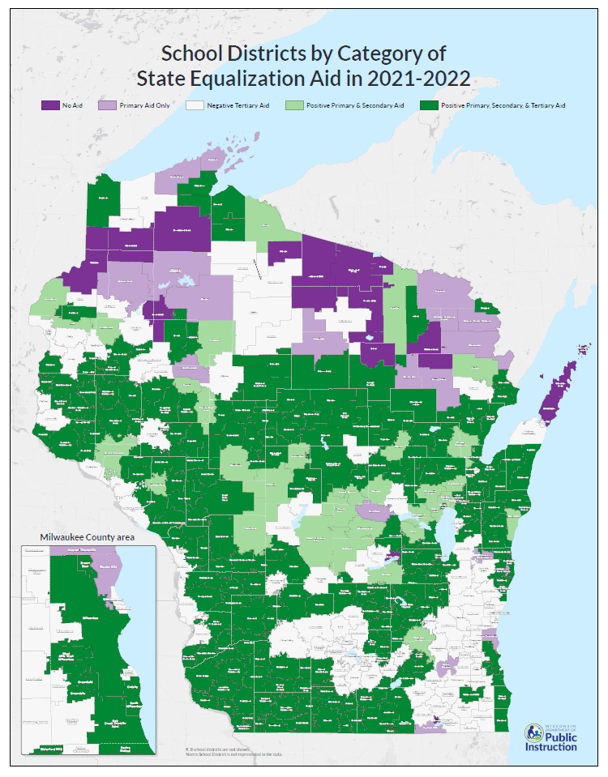
https://dpi.wi.gov/sfs/statistical/finance-maps/overview
Notes:
https://dpi.wi.gov/sfs/statistical/finance-maps/overview
Final 2021-22 General School Aids
No equalization aid 23*
Primary only 27
Positive primary and secondary 40
Positive primary, secondary and tertiary 220
Negative tertiary 111
*6 of these 23 school districts receive $0 General School Aids: Geneva J4, Green Lake, Mercer, North Lakeland, Washington Island, and Northwood.

Slide 68
Equalization Aid – Where is Your District?
Tertiary
Aid
220
111
Negative Tertiary Aid
Secondary Aid
40
Negative Secondary Aid
Primary Aid
No Equalization Aid
27
23
68
Notes:
Final 2021-22 General School Aids
No equalization aid 23*
Primary only 27
Positive primary and secondary 40
Positive primary, secondary and tertiary 220
Negative tertiary 111
* 6 of these 23 school districts receive $0 General School Aids: Geneva J4, Green Lake, Mercer, North Lakeland, Washington Island, and Northwood.

Slide 69
Equalization Aid Resources on the School Financial Services Website
https://dpi.wi.gov/sfs/aid/general/equalization/overview
“October 15, 2022 District Formula Position Worksheets”
SFS Homepage > State and Federal Aid > General Aid> Equalization Aid
69

Slide 70
Equalization Aid – What is Happening Over Time?
Tertiary
Aid
State Average Value Per Member
Negative Tertiary Aid
Negative Secondary Aid
Based on $$ in Pot
Secondary Aid
In Statute
Primary Aid
No Equalization Aid
70

Slide 71
Revenue Limits, State Aids, and Controlled Property Tax Levies
Revenue Limit Levy
“State Aid”
Revenue Limit
Notes:
Equalization Aid impacts the tax levy. More money in State Aid without a corresponding increase to the Revenue Limit won’t result in additional revenue for the district. It just results in property tax relief.
Aid is driven by both local and state factors.
For planning purposes know how changing one of your local factors (spending in most circumstances) could impact your general school aids.
“State Aid” includes:
General School Aids (Equalization Aids, Chapter 220 Integration Aids, and Special Adjustment (Hold Harmless Aids);
High Poverty Aid;
State Aid for Exempt Computers; and
State Aid for Exempt Personal Property.
2022-23 general school aids includes: $5,141.7 million equalization aids; $37.2 million integration (Chapter 220) aids; and $22.7 million special adjustment aids (hold harmless aids).

Slide 72
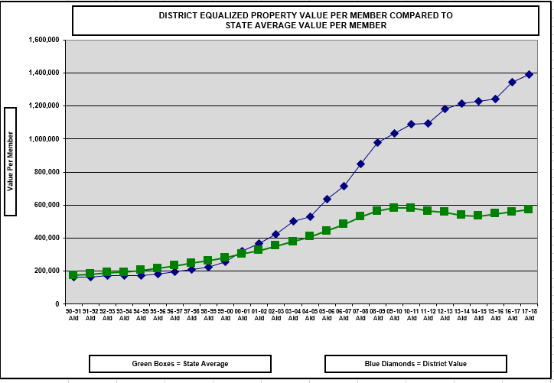
Watch Value Per Member Over Time
1.) Severely Declining Enrollment
2.) Property Value Significantly Increases
72
Notes:
This is what can happen to a district with severe declining enrollment. No one can predict the future, but watching the trendline for your district can be very informative.

Slide 73
Equalization Aid Resources on the School Financial Services Website
http://dpi.wi.gov/sfs/statistical/longitudinal-data/property-valuation
“Longitudinal Equalization Aid Value-Per-Member History”
SFS Homepage > Statistical > Longitudinal Data > Property Valuation
73

Slide 74
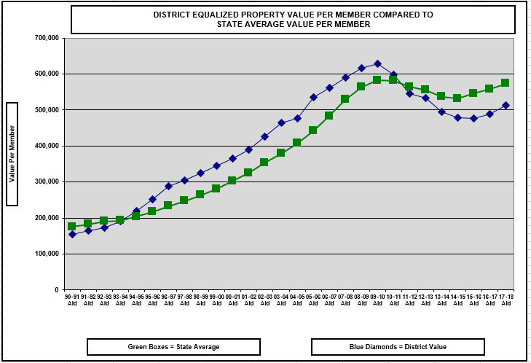
1.) Exploding Enrollment
74

Slide 75
Equalization Aid Resources on the School Financial Services Website
How can I explain changes in my district’s aid?
Multi-Year History on the Website
Longitudinal Excel Spreadsheet
https://dpi.wi.gov/sfs/statistical/longitudinal-data/equalization-aid
A listing of the pertinent Equalization Aid factors that explain what is happening in your district.
75

Slide 76
Basic Equalization Aid Concepts
Equalization Aid is property tax relief under revenue limits.
Aid is inversely related to district property value per member.
One pot of money is split over 421 school districts based on district values, membership, and shared costs.
Depending on district value-per-member, some districts’ aid is increased by increasing expenses, while others’ aid is decreased by increasing expenses.
Know where your district is in the formula and understand why your equalization aid changes.
76

Slide 77
Equalization Aids
Questions?
77

Slide 78
Fund Accounting / Fund Balance
Diving in….
…to Wisconsin school district accounting
Notes:
Needs wordsmithing

Slide 79
Fund Accounting
Governments, such as school districts, usually organize their accounting systems on a "fund" basis
A fund is
a separate set of accounting records, segregated for purpose of carrying on an activity
established for accountability purposes to demonstrate that financial resources are being used only for permitted purposes
79

Slide 80
Fund Accounting
Think of a fund as a self-contained box
into which is put everything pertaining to that fund.
80

Slide 81
Fund Accounting
A fund will have "balance sheet" accounts consisting of
  Assets,
  Liabilities, and
  Fund balance,
and a series of
  Revenue and
  Expenditure accounts
General Fund
81

Slide 82
Fund Accounting
WUFAR
Wisconsin’s account coding structure is the
Wisconsin Uniform Financial Accounting Requirements
82

Slide 83
WUFAR Expenditure Account Example
A WUFAR account is a sequence of dimensions:
10
E
120
111
122150
141
Fund – Type – Location – Object/Source – Function - Project
83

Slide 84
WUFAR Expenditure Account Example
What does this account mean?
10
E
120
111
122150
141
Salary expenditures for a regular education Title I
reading specialist at Shady Meadow Elementary School

Slide 85
Fund Accounting
WUFAR Funds are
  10 General Fund
  20 Special Project Fund
  21 Special Revenue Trust
  27 Special Education
  30 Debt Service Fund
  38 Non-Referendum 39 Referendum
  40 Capital Projects Fund
  50 Food Service Fund
  60 CUSTODIAL FUND
  70 Trust Funds
  80 Community Service Fund
  90 Package & Cooperative
  Program Fund
85

Slide 86
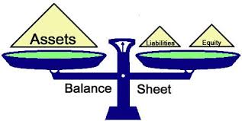
What is Fund Balance?
The difference between assets and liabilities (equity).
86

Slide 87
Examples of Assets and Liabilities
Assets
Cash
Investments
Prepaids
Receivables
  Tax Levy
  Equalization Aid
  $ from other School Districts
Liabilities
Payroll Payables
Payroll liabilities (FICA, WRS, etc.)
Cash flow borrowing
Note: physical assets and liabilities, such as buildings, land and furniture, etc. are not included in fund balance calculation
87

Slide 88
Fund Balance Classifications
DPI Code
Nonspendable Fund Balance 935 000
  Prepaid Expenses & Inventory
Restricted Fund Balance 936 000
  Self-insurance, contracts, debt, legal restrictions
Committed Fund Balance 937 900
  Formal Board action, part of budget, restricted donations.
Assigned Fund Balance 938 900
  Board assigned, capital projects, budgeted
Unassigned Fund Balance 939 900
Reserved: 1-4
Classify in one of five ways:
Unreserved: 5
88
Notes:
Boards should know the district’s fund balance policy and if the Board is meeting its policy. Know your fund balance.
Reserved – can’t be appropriated or spent (such as inventory) or is legally limited to a specific purpose (grants)
Unreserved – can be used for any purpose within the respective fund

Slide 89
DPI Coded the Unassigned (Unreserved) Fund Balance into these Sub-Classifications:
939 100 Revenue Stabilization
  “Rainy Day Funds”
939 200 Working Capital (Cash Flow)
  Used to reduce or eliminate temporary borrowing
939 300 Contingencies
  Circumstances or situations that could result in loss
939 400 Emergencies
  Unplanned, unexpected loss or ‘Acts of God’
939 900 Other
Basically, not identified for any use
None meet Committed or Assigned standards.
89
Notes:
Use these codes locally on a voluntary basis for now.
Someday they may become required and
collected at the state level as part of the Annual and Fall Report; and,
become part of the Annual Audit reporting process.

Slide 90
Fund Balance – Reported as of June 30th
Assets
Liabilities
Fund Balance (Equity)
Fund Balance often changes daily.
  When revenue comes in, a fund balance increases.
  When expenditures are made, a fund balance decreases.
In WI, a public school district’s fiscal year runs from July 1 to June 30. Fund Balance is reported and compared to other years as of June 30th.
90

Slide 91
How does a June 30 fund balance grow or shrink?
Prior Year Ending Fund Balance (Equity)
Current Year Difference Between Revenue and Expense
Ending Fund Balance (Equity)
91

Slide 92

How Large A Fund Balance?
Determination of an appropriate fund balance is strictly a local matter.
The Department of Public Instruction (DPI) makes no recommendation, except that it encourages districts to seek legal counsel should they contemplate budgeting for and/or operating with a negative general fund balance.
This means on an ongoing basis
92

Slide 93
According to DPI, a district with an appropriate fund balance can:
Avoid interest cost and time lost associated with borrowing
Make special purchases or cover unforeseen expenditure needs
Lower debt issuance cost and preserve or enhance its bond rating by demonstrating financial stability
93

Slide 94
What is a Sufficient Fund Balance?
Perhaps the best answer is:
“An amount sufficient to avoid short-term borrowing and to realize long-range goals."
Once a cash reserve is spent, it is very difficult to rebuild. We have a responsibility to sustain the academic programs. When it’s gone, it’s gone!! ☹
94

Slide 95
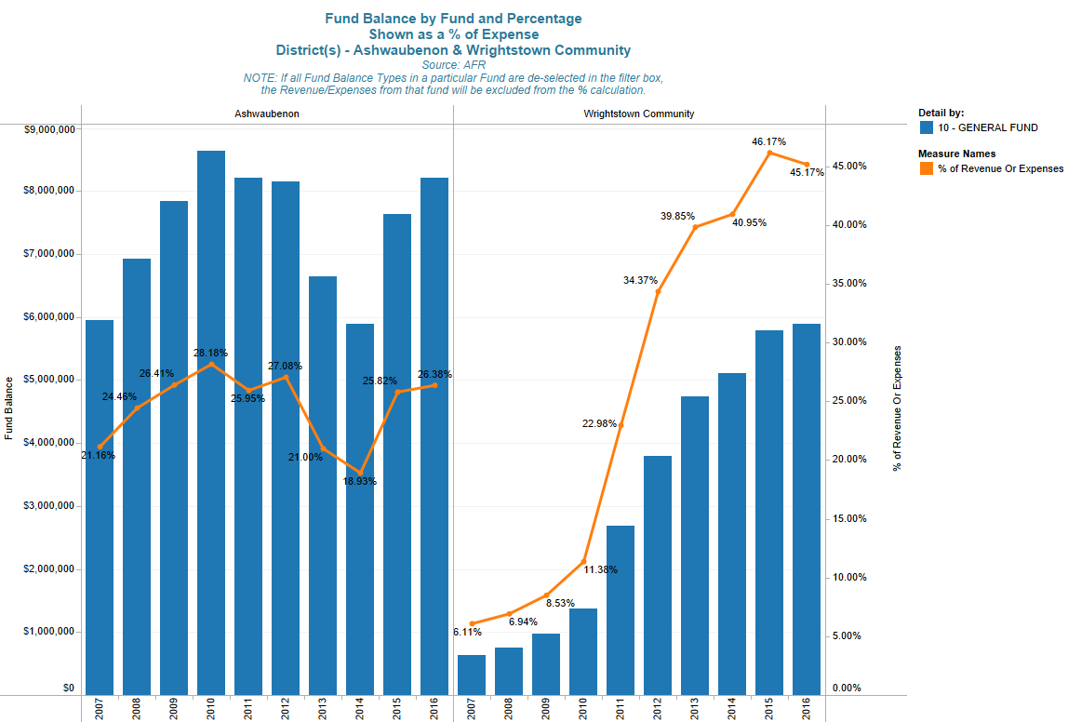
Each district has a unique answer for, “what is an appropriate fund balance.”
95

Slide 96
Have A Fund Balance Policy!
School districts should have a fund balance policy.
  What is your policy?
  Are you following it?
96

Slide 97
A Fund Balance Policy Should
Identify and define fund balance classifications
Identify and define accounting definitions for fund balances
State the General Fund balance level and rationale
  Addresses those issues identified earlier in Determining Sufficient Fund Balance
Address restoration of General Fund Balance
Establish the order of spending when various fund balance funding sources exist (Restricted, Committed, Assigned, and Unassigned)
97

Slide 98

Very Important!
Cash is an asset and therefore is part of the Fund Balance Equation.
However, fund balance does not equal cash.
Let’s talk a little about the cash portion of fund balance…
98

Slide 99
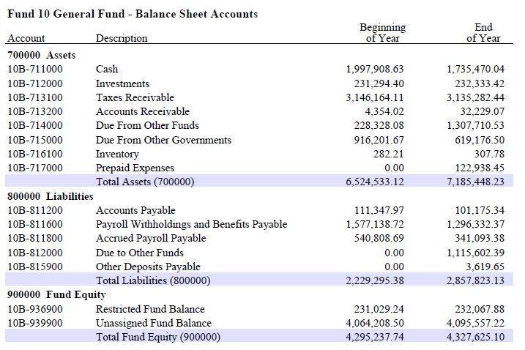
Very Important!
99

Slide 100
How do Districts use the cash portion
of fund balance?
To pay the bills!
100

Slide 101
Typical Change in Monthly Cash Balance
Year1
Year2
Year3
This is a hypothetical example and for illustrative purposes only.
101

Slide 102
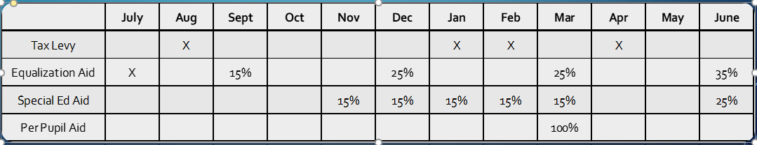
Cash Flow Fluctuations
Expenditures are fairly constant throughout year
Salaries / Fringe are typically 60%-65% of budget
Payroll is typically spread over 21, 24 or 26 pay periods
End-of-year pay adjustments are sometimes needed
Revenues received sporadically throughout the year
Tax Levy is received in the last 6 months of the school year, with the final payment made in August of the next school year.
60% of Equalization Aid is paid over the last 6 months

Slide 103
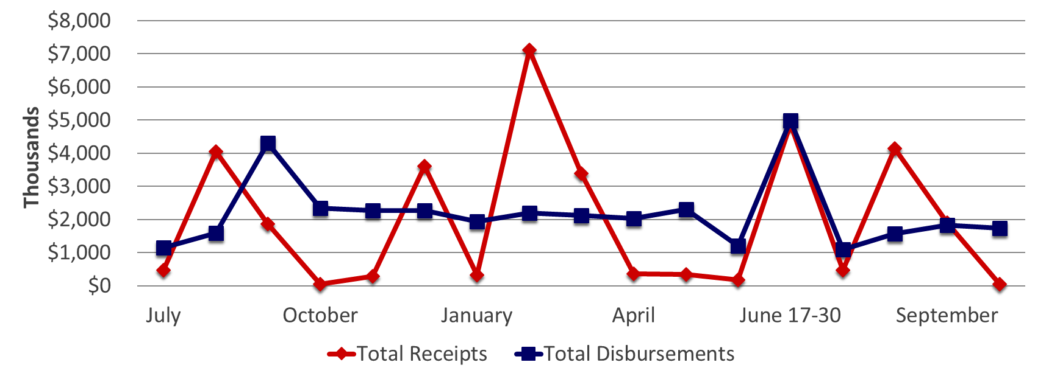
Receipts vs. Disbursements
The hypothetical example is for illustrative purposes only.
103

Slide 104
In Summary
Fund balance is reported as a June 30 snapshot
Cash is an asset but fund balance ≠ cash
The cash portion of fund balance fluctuates greatly throughout the year
Each district has a fund balance level appropriate to them
(there is no one-size-fits-all answer)
The district should have and should be following their fund balance policy
Fund balance = assets – liabilities
Districts’ fund balance levels change daily
104

Slide 105
The School Budget
Understanding important concepts in school budgeting!
105

Slide 106
What is a school budget?
A school budget is the financial outline for addressing how a school district will deliver its educational plan to students in a fiscal year.
The school budget is an estimate and every part that makes up the whole of the budget is subject to known and unknown outside and inside forces.
106

Slide 107
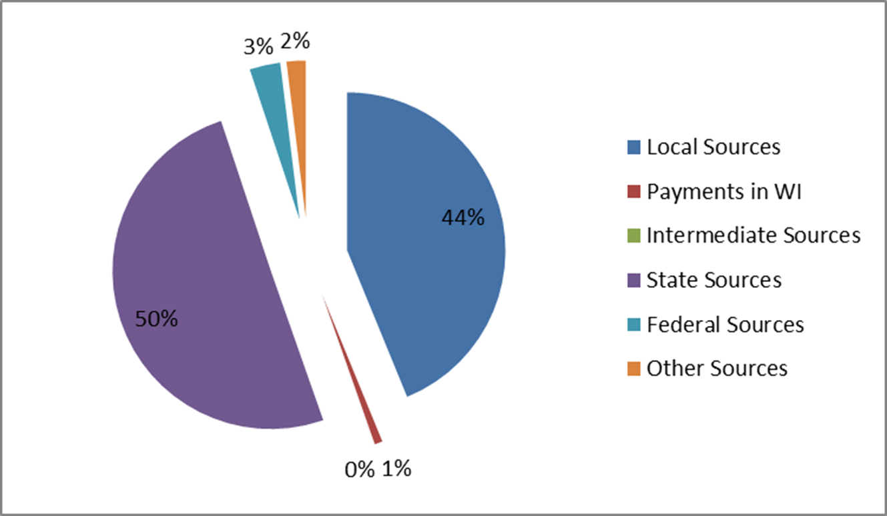
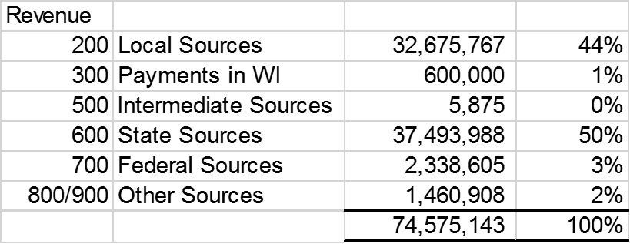
The General Fund –
From where does the money come?
This is a graphic example of Revenue:
107

Slide 108
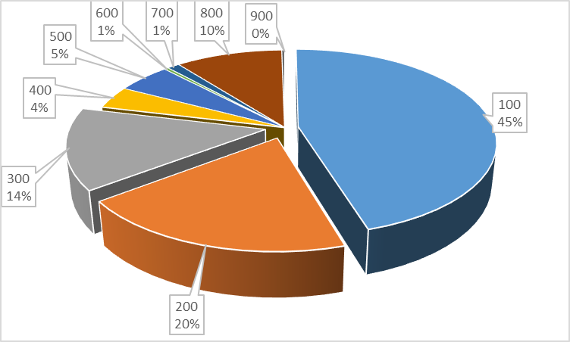
The General Fund –
On What Do We Spend Our Money?
This is a graphic example of Expenditures:
108

Slide 109
Can Wisconsin School Boards Tax Whatever They Want?
No!
The State of Wisconsin imposes strict control over what school boards can levy through revenue limits.
There is an absolute dollar amount determined via a formula that annually generates a limit on a school district's property tax. Failure to levy at that amount will cause some school districts to lose levy authority. Such a loss creates greater budget challenges in delivering the educational plan.
109

Slide 110
School District Finance
Questions?
110

Slide 111




Thank You!
Bob Soldner
Assistant Director
School Financial Services Team
Wisconsin Department of Public Instruction
robert.soldner@dpi.wi.gov
Bob Borch
2r Charter Business Manager
CESA #1
borchb@wi.rr.com
Thomas R. Owens, Ph.D., SFO
Director of Business Services
Stevens Point Area Public School District
towens@pointschools.net
Debby Brunett
School Business Specialist
Baird
Dbrunett@rwbaird.com
111

Slide 112
Important Disclosures
Robert W. Baird & Co. Incorporated is providing this information to you for discussion purposes only. The information does not contemplate or relate to a future issuance of municipal securities. Baird is not recommending that you take any action, and this information is not intended to be regarded as “advice” within the meaning of Section 15B of the Securities Exchange Act of 1934 or the rules thereunder. In providing this information, Baird is not acting as an advisor to you and does not owe you a fiduciary duty pursuant to Section 15B of the Securities Exchange Act of 1934. You should discuss the information contained herein with any and all internal or external advisors and experts you deem appropriate before acting on the information.

