Slide 1
State Education Convention
January 18, 2024
A Deep Dive Into Wisconsin School Finance
Tom Owens
Debby Brunett
Todd Gray
Jennifer Buros
Mark Elworthy

Slide 2
Agenda
Education Framework
Revenue Limits
Equalization Aid
Fund Balance
Emerging Topics
Why these topics?
Key to Wisconsin School Finance
2
Notes:
Important to note verbally: As board members, they will not be asked to replicate or recite this information. It is provided to help create a baseline understanding of these complex topics.

Slide 3
Learning Targets
Recall how school finance is structured in Wisconsin and identify why
Explain the difference between revenue limits and state equalization aid and describe the impact on school finance
Recognize the difference between cash and fund balance
3
Notes:
Needs wordsmithing
Important to note verbally: As board members, they will not be asked to replicate or recite this information. It is provided to help create a baseline understanding of these complex topics.

Slide 4
U.S. Constitution on Education –
Education is a State Function
10th Amendment
“…powers not granted to the federal government by the Constitution, nor prohibited to the States, are reserved to the States or the people…”
1791
4

Slide 5
Wisconsin Constitution on Education
Article X, Section 3
“The legislature shall provide by law for the establishment of district schools, which shall be as nearly uniform as practicable; and such schools shall be free and without charge for tuition to all children between the ages of 4 and 20.”
1848
5

Slide 6
Wisconsin Constitution on Education
Article X, Section 4
“Each town and city shall be required to raise by tax, annually, for the support of common schools therein……”
1848
6

Slide 7
Basic Framework - What We Know So Far
State Responsibility
District Schools
As Nearly Uniform as Practicable
Free
Funded by Local Property Tax
7

Slide 8
Modern-Day Wisconsin
In Wisconsin, the primary funding source for public schools is the property tax, but we know that property values across the state are not uniform.
The challenge is defining “uniform as practicable.”
8

Slide 9
Wisconsin Constitution on Education
Article X, Section 2
“The legislature shall provide by law for the establishment of district schools, which shall be as nearly uniform as practicable; and such schools shall be free and without charge for tuition to all children between the ages of 4 and 20.”
A child should not be unfairly disadvantaged
merely by where they live.
9

Slide 10
Constitutional Underpinnings
The State provides financial assistance in the form of Equalization/General Aid to school districts in order to:
  Reduce the reliance upon the local property tax as the sole source of revenue for educational programs.
  Guarantee that a basic educational opportunity is available to all pupils regardless of the local fiscal capacity of the district in which they reside.
10

Slide 11
Revenue Limits
Diving in….
…to districts’ primary revenue calculation
Notes:
Needs wordsmithing

Slide 12
Revenue Limits, State Aids, and Controlled Property Tax Levies
Revenue Limit Levy
“State Aid”
(General + Computer Exempt + Personal Property)
Revenue Limit
Notes:
More money in State Aid without a corresponding increase to the Revenue Limit won’t result in additional revenue for the district. It just results in property tax relief.
“State Aid” includes:
General School Aids (Equalization Aids, Chapter 220 Integration Aids, and Special Adjustment (Hold Harmless Aids);
High Poverty Aid;
State Aid for Exempt Computers; and
State Aid for Exempt Personal Property.
2022-23 general school aids includes: $5,141.7 million equalization aids; $37.2 million integration (Chapter 220) aids; and $22.7 million special adjustment aids (hold harmless aids).

Slide 13
Importance of Revenue Limit Revenue
CONTROLLED
Although the mix of aid and taxes is different across districts, the Revenue Limit can control 70-90% of the General Fund revenue budget!
^ State General Aids includes: equalization aid, special adjustment aid, inter-district & intra-district
aids, computer exempt and personal property aids (i.e., state aids received under the districts’ revenue limit).
* Other Sources include: state categorical aids, federal aid, and non-property tax local revenue
(i.e., revenue received outside of the districts’ revenue limit).
13
Notes:
In 1993-94, the State enacted revenue limits to control the revenue a school district can collect from:
General Aid (Equalization Aid, for most districts)
Computer Aid
Aid for Exempt Personal Property
High Poverty Aid
Select Local Levies
General Fund (Fund 10)
Non-Referendum Debt Service (Fund 38)
Capital Projects (Fund 41)
It is not an expenditure control or spending limit.
Examples of what the Revenue Limit does not control (not exhaustive list):
School Fees
Categorical Aids (Per Pupil Aid, Special Education, Library Aid, Transportation Aid, etc.)
State and Federal Grants
Gate Receipts
Donations
Local Levies
Referendum Debt Service (Fund 39, at times called “Non-Fund 38”)
Community Service Fund (Fund 80)
Prior Year Levy Chargeback for Uncollectible Taxes (Fund 10)

Slide 14
Revenue Limit History
Established in 1993
Goal was to create levy controls for WI school districts
Created a calculation to determine the revenue a district could generate through state general aid and the local tax levy
Provided operational referendums if needed
14

Slide 15
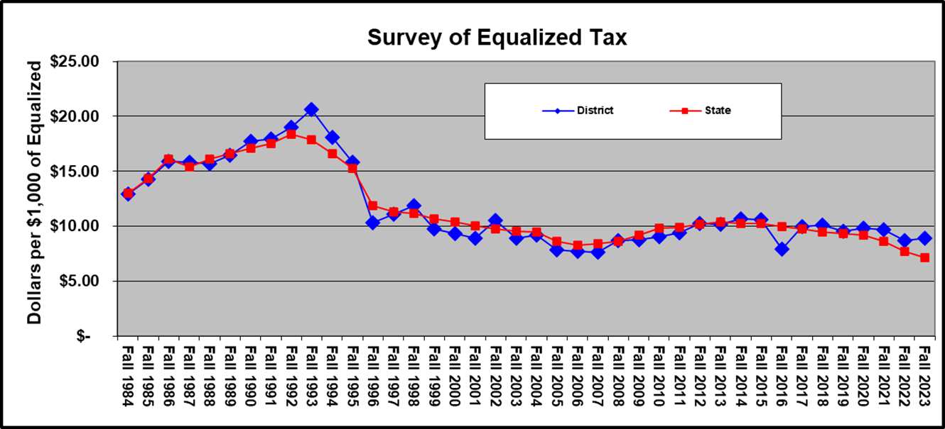
Revenue Limit Levy Controls
Source: Department of Public Instruction; sample school district shown
15

Slide 16
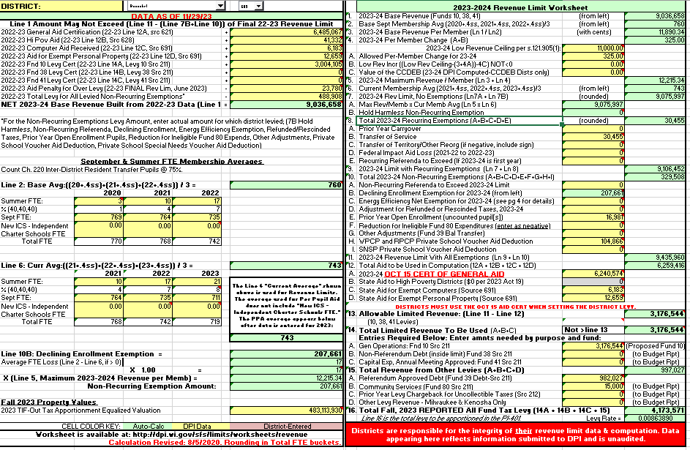
Calculation
Sample Worksheet
Note: Fiscal Year begins July 1st; RLWS final figures received October 15th
Key Information
16

Slide 17

Revenue Limit Formula Membership
Resident Membership (FTE)
$ per member
On-going and one-time exemptions
Revenue Limit Authority
Three-Year Average
September Full Time Equivalency (FTE)
40% Summer School
Independent Charter School
17

Slide 18
Revenue Limit Formula
September Full-Time Equivalency (FTE) = Resident students prorated for part-time attendance
Summer School = Total Summer School Minutes / 48,600
New ICS Students: revenue limit revenue may not be ≥ payment $
Head Count
OE IN
OE Out
Resident Student Count
Resident Student Count
FTE Equivalent (i.e., 0.5 or 0.6)
Resident FTE
Resident Student Count
18

Slide 19
Revenue Limit Formula
Resident Membership (FTE)
$ per member
On-going and one-time exemptions
Revenue Limit Authority
Amounts differ between school districts
“Low Revenue Ceiling” creates minimum
Legislature determines state-wide per-member annual adjustments
“Recurring” (On-going) exemptions create district-specific increases
19

Slide 20
Revenue Limit
Per Pupil Adjustment (Cumulative) and LRC
Year | Adjustment | Low Rev Ceiling
2011-12 | -5.5%* | $9,000
2012-13 | $50 | $9,000
2013-14 | $75 | $9,100
2014-15 | $75 | $9,100
2015-16 | $0 | $9,100
2016-17 | $0 | $9,100
2017-18 | $0 | $9,100
2018-19 | $0 | $9,400
2019-20 | $175 | $9,700
2020-21 | $179 | $10,000
2021-22 | $0 | $10,000
2022-23 | $0 | $10,000
2023-24 | $325 | $11,000
2024-25 | $325 | $11,000
20
Source: Department of Public Instruction
Notes:
Legislature determines the per member increase. Originally, based it on the annual percentage change in the consumer price index (CPI) for all urban consumers, US city average. Recent years have been flat dollar amounts, zero, & even reductions.
The per member increase range was as low as -$554.00 in
2011-12 and as high as $274.68 in 2008-09.
For 2015-16, 2016-17, 2017-18, 2018-19, 2021-22, and
2022-23, the legislature set the increment at $0.00.
Within this slide, also need to talk about how money has been added to Per Pupil categorical aid ($654 million over the biennium) which is outside the revenue limit.
ONLY Decrease in Per member: Under the 2011-13 budget act, the per pupil adjustment in 2011-12 was set at a 5.5% reduction. The statewide average reduction was $554 per pupil.

Slide 21
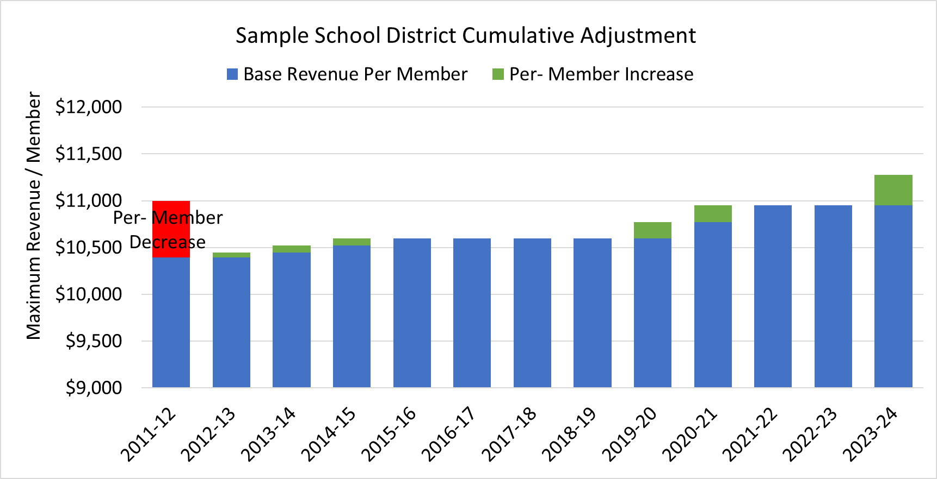
Revenue Limit
Per Pupil Adjustment (Cumulative) Example
21
Source: Department of Public Instruction
Notes:
Legislature determines the per member increase. Originally, based it on the annual percentage change in the consumer price index (CPI) for all urban consumers, US city average. Recent years have been flat dollar amounts, zero, & even reductions.
The per member increase range was as low as -$554.00 in
2011-12 and as high as $274.68 in 2008-09.
For 2015-16, 2016-17, 2017-18, 2018-19, 2021-22, and
2022-23, the legislature set the increment at $0.00.
Within this slide, also need to talk about how money has been added to Per Pupil categorical aid ($654 million over the biennium) which is outside the revenue limit.
ONLY Decrease in Per member: Under the 2011-13 budget act, the per pupil adjustment in 2011-12 was set at a 5.5% reduction. The statewide average reduction was $554 per pupil.

Slide 22
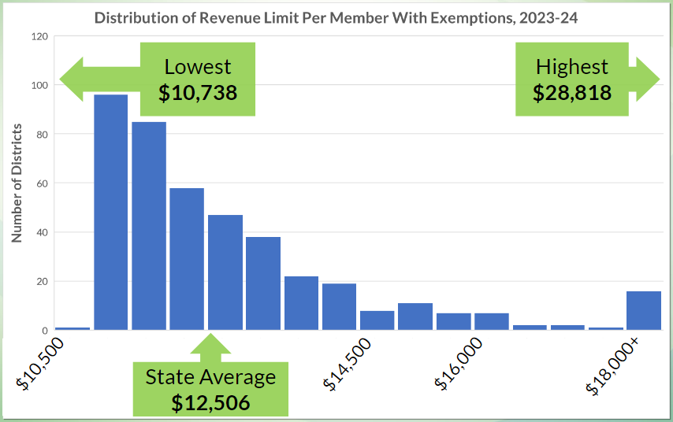
Revenue Limit Per Member with Exemptions
$12,506 average is $618 increase over 2022-23 average of $11,888
Source: Department of Public Instruction
22
Notes:
Legislature determines the per member increase. Originally, based it on the annual percentage change in the consumer price index (CPI) for all urban consumers, US city average. Recent years have been flat dollar amounts, zero, & even reductions.
The per member increase range was as low as -$554.00 in
2011-12 and as high as $274.68 in 2008-09.
For 2015-16, 2016-17, 2017-18, 2018-19, 2021-22, and
2022-23, the legislature set the increment at $0.00.
Within this slide, also need to talk about how money has been added to Per Pupil categorical aid ($654 million over the biennium) which is outside the revenue limit.
ONLY Decrease in Per member: Under the 2011-13 budget act, the per pupil adjustment in 2011-12 was set at a 5.5% reduction. The statewide average reduction was $554 per pupil.

Slide 23
Exemptions
Resident Membership (FTE)
$ per member
On-going and one-time exemptions
Revenue Limit Authority
District – specific “exemptions”
Some auto-calculate; others based on district reports or data
Recurring and Non-Recurring have differing long-term impacts
23

Slide 24
Recurring Exemptions
Once levied, Recurring Exemptions remain in the base going forward.
24

Slide 25
Non-Recurring Exemptions
Non-Recurring Exemptions are only valid for a limited time, usually one Revenue Limit cycle.
25

Slide 26
Types of Exemptions
 | Recurring | Non-Recurring
Auto-calculates | Prior Year Carryover | Hold Harmless Declining Enrollment Exemption
Populates if applicable | Transfer of Service Transfer of Territory (rare to get) Federal Impact Aid Loss | Refunded/Rescinded Taxes Prior Year Uncounted Open Enrollment Ineligible Fund 80 Expenditures Environmental Remediation Exemption Private School Voucher and Special Needs Aid Deduction
Requires board approval |  | Energy Efficiency Exemption (1,000- year moratorium on new approvals)
Requires voter approval | Recurring Referenda | Non-Recurring Referenda
26

Slide 27
Types Of Exemptions
Declining Enrollment (FTE)
  In 2023-24, > 60% of districts experienced declining 3-year average FTE
  Example:
Transfer of Service
  The transfer of service exemption §121.91(4)(a)(3) Wis. Stats. Provides that a school district which assumes responsibility for a program or service from another governmental unit may request and may be granted an exemption to the district revenue limit equal to the increased cost due to that program or service.
2020-21 | 2021-22 | 2022-23 | 2023-24
770 | 768 | 742 | 719
 |  | 760 | 743
27

Slide 28
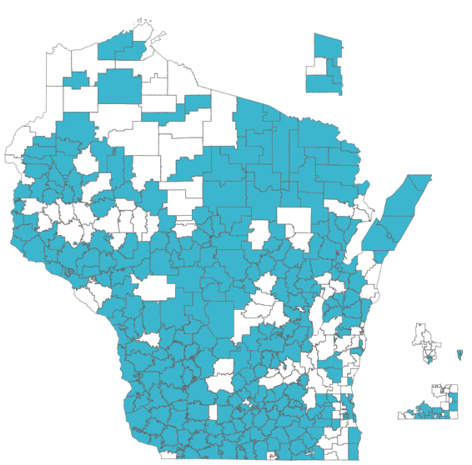
Types Of Exemptions
Recurring and Non-Recurring Referenda (more in other WASB sessions)
Districts that have at least 10% of their base revenue limit supplemented by non-recurring operating referendum
Districts who have passed an Operational Referendum Question since 1992
Source: Department of Public Instruction
28

Slide 29
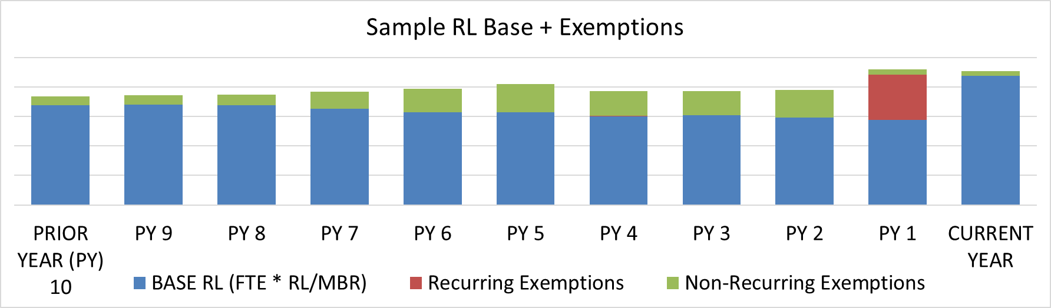
“Base Revenue Limit” and Exemptions
Ave FTE * Max. Rev. / Member = majority of districts’ RL authority
Recurring exemptions, once levied, increase districts’ base
Non-recurring exemptions are received in the current year
29

Slide 30
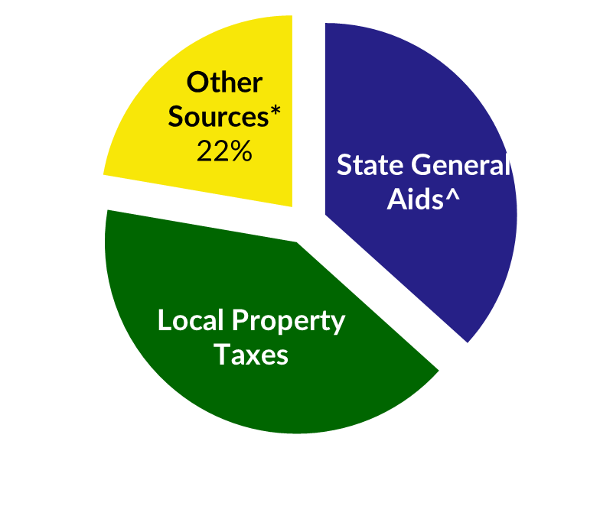
Total Revenue Limit Authority
Resident Membership (FTE)
$ per member
On-going and one-time exemptions
Revenue Limit Authority
The “How Much” revenue a district can receive through
the sources of General Aid and the Local Tax Levy
30

Slide 31
Revenue Limits, State Aids, and Controlled Property Tax Levies
Revenue Limit Levy
“State Aid”
(General + Computer Exempt + Personal Property)
Revenue Limit
Notes:
More money in State Aid without a corresponding increase to the Revenue Limit won’t result in additional revenue for the district. It just results in property tax relief.
“State Aid” includes:
General School Aids (Equalization Aids, Chapter 220 Integration Aids, and Special Adjustment (Hold Harmless Aids);
High Poverty Aid;
State Aid for Exempt Computers; and
State Aid for Exempt Personal Property.
2022-23 general school aids includes: $5,141.7 million equalization aids; $37.2 million integration (Chapter 220) aids; and $22.7 million special adjustment aids (hold harmless aids).

Slide 32
Revenue Limit Levies
Fund 41 Capital projects fund
Fund 38 Non-Referendum-Approved Debt
Fund 10 General Fund
Typically a change in a Fund 41 or Fund 38 levy does not impact the total levy, instead it distributes more or less to Fund 10
Revenue Limit Levy
Fund 10
Fund 38
Fund 41

Slide 33
Total School Tax Levy Composition
Fund 39 Levy
Referendum debt initiated via voter approval
Levy = at minimum, amount to make annual payment
Fund 80 levy
Board approved
Based on programming and need
Total School-Based Tax Levy
Revenue Limit Levy
(Funds 10, 38 and/or 41)
Referendum Approved Debt Levy
(Fund 39)
Community Service Tax Levy
(Fund 80)
Prior Year Levy Chargeback
and Other

Slide 34
Mill Rate
Total School Levy
Equalized TID Out Value
(a.k.a EQ or Fair Market Value)
1,000
Mill Rate
(per $1,000 EQ Value)
Example:
  $2,557,794 / $410,416,166 * 1,000 = $6.23
  $623 on $100,000 home (school portion only)

Slide 35
Basic Revenue Limit Concepts
The Revenue Limit controls revenues from general state aids and local property taxes.
Revenue Limit can control 70-90% of the General Fund revenue budget.
Revenue Limits are calculated by multiplying the Average Membership * a Per Member dollar amount and adding any exemptions.
It is important to know the difference between recurring and
non-recurring exemptions.
Calculating the total school levy is a direct result of completing the Revenue Limit worksheet.
35

Slide 36
District Specific Revenue Limit Data
Prepopulated and Executable Revenue Limit worksheets
  https://dpi.wi.gov/sfs/limits/worksheets/revenue
Longitudinal data related to Revenue Limits
  https://dpi.wi.gov/sfs/statistical/longitudinal-data/revenue-limit
36

Slide 37
Revenue Limit
Questions?
37

Slide 38
Equalization Aid
Diving in….
…to the general aid portion of Revenue Limits
Revenue Limit
“State Aid”
Revenue Limit Levy
Notes:
More money in State Aid without a corresponding increase to the Revenue Limit won’t result in additional revenue for the district. It just results in property tax relief.
“State Aid” includes:
General School Aids (Equalization Aids, Chapter 220 Integration Aids, and Special Adjustment (Hold Harmless Aids);
High Poverty Aid;
State Aid for Exempt Computers; and
State Aid for Exempt Personal Property.
2022-23 general school aids includes: $5,141.7 million equalization aids; $37.2 million integration (Chapter 220) aids; and $22.7 million special adjustment aids (hold harmless aids).

Slide 39
Property Value and Fiscal Capacity
A student should not be unfairly disadvantaged as a result of where he or she lives.
Property Tax Base
This example is for hypothetical purposes only
39
Notes:
The fundamental purpose of the Equalization Aid formula is to “level the playing field” by providing assistance (distributing State general aid) to make up for what districts can’t get from their property tax base.
Equalizes the revenue. Thus, allows the opportunity for similar educational programming.
In general, districts with a higher property tax base receive less aid from the State.
District property value is a key factor.

Slide 40
Formula Equalizes Revenue to Mitigate Differences
Equalization Aid
Property Tax Base
40
This example is for hypothetical purposes only

Slide 41

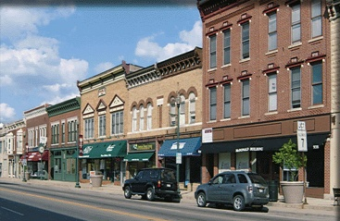



Incorporating the Number of Children to Educate
$1,000,000
$2,000,000
$3,000,000
$4,000,000
$5,000,000
10
10
10
10
10
$100,000
$200,000
$300,000
$400,000
$500,000
The tax base, as a measure of fiscal capacity (wealth), changes after incorporating the number of children to educate.
41
This example is for hypothetical purposes only

Slide 42
Incorporating the Number of Children to Educate
$1,000,000
$2,000,000
$3,000,000
$4,000,000
$5,000,000
10
5
6
10
20
$100,000
$400,000
$500,000
$400,000
$250,000
Notice how the tax base, as a measure of fiscal capacity (wealth), changes after incorporating the number of children to educate.
42
This example is for hypothetical purposes only

Slide 43

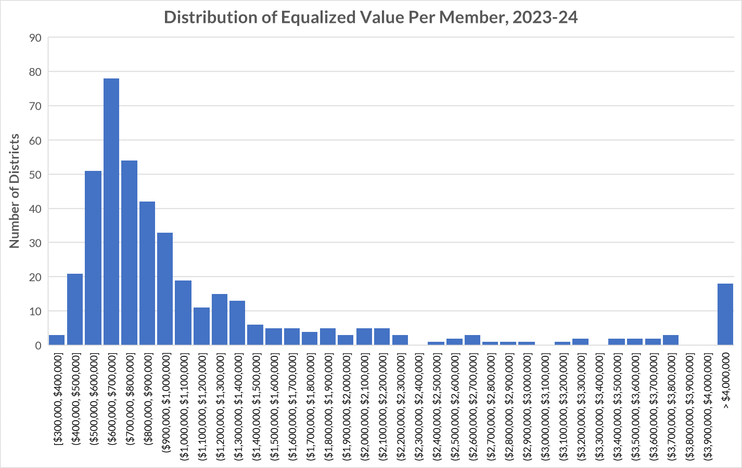
Property Value Per Member
Lowest
$308,910
Highest
$17,506,625
State Average
$861,627
$300,000
$2,000,000
$4,000,000+
$3,000,000
43
Source: Department of Public Instruction
Notes:
For 2023-24 General Aid, Prior Year (PY) data from 2022-23, excluding Norris
Low – Abbotsford $308,910 High – North Lakeland $17,506,625 Ratio: 56.67 to 1
Average $861,627 Median $816,871

Slide 44




Key Local Factors
Equalized Property Value
Membership
(Student FTE)
Membership converts variables to per-pupil $s.
Spending (Shared Costs)
44

Slide 45

Factor: Equalized Property Value
Property tax base is used to
determine district wealth and ability to
support district expenditures.
Uses Equalized Valuation or Fair Market Value.
(NOT Assessed Value)
Property values for each district are
certified in May each year
by the WI Department of Revenue
and used in the subsequent year’s aid calculations.
45

Slide 46

Factor: Membership
Who is counted for aid membership?
Generally, residents for which you are financially responsible - i.e. you are paying for the student’s education. Is a “process” to help districts determine who qualifies. Start with who is in your seats on the count date.
Revenue Limit membership is not the same as General Aid membership. State law defines.
46
Notes:
Membership Example – Open Enrollment
1,100 kids counted in your seats on count date
-40 non-resident open enrolled-in kids
+20 resident open enrolled-out kids
1,080 residents you can count for aid (and revenue limit purposes)
Your district will receive Open Enrollment revenue
from the resident districts for the 40 kids attending your district.
Your district will have to pay an Open Enrollment expense to the non-resident districts for your 20 residents attending elsewhere.

Slide 47
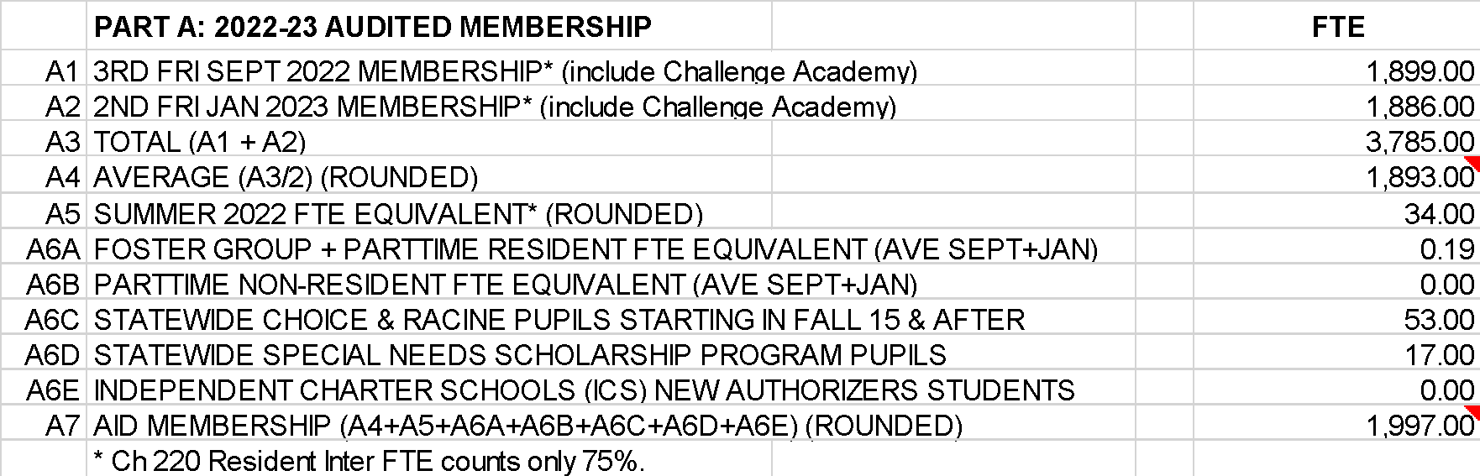
Factor: Membership
This example is for hypothetical purposes only
47
September and Summer Membership Included in Revenue Limit 3-Year Average Calculations
Notes:
Aid membership also includes:
- Challenge Academy Students
- Second Chance Partnership Students
- Part-time Attendance F.T.E. of Resident and Non-Resident Private/Home-Schooled Students
- Foster Group Home Students
- Wisconsin Parental Choice Program Students
- Special Needs Scholarship Program Students
- New Independent Charter School Students
See: http://dpi.wi.gov/sfs/children/enrollment/membership-info-reporting

Slide 48
Factor: Membership
This example is for hypothetical purposes only
48
Notes:
To show the differences in membership between Aid and Revenue Limits

Slide 49

Factor: Spending (Shared Cost)
A district gets all types of revenue to fund their educational programs:
Local Property Tax
State Equalization Aid
State Categorical Aid (transportation, library, bilingual aids)
Federal Aid (Title Programs, IDEA)
State Grants
Fees (be careful with what fees you charge)
49

Slide 50
General Fund Shared Cost
This example is for hypothetical purposes only
50
Notes:
^ State General Aids includes: equalization aid, special adjustment aid, inter-district & intra-district
aids, and high poverty aid (i.e., state aids received under the districts’ revenue limit caps.
* Other Sources includes: state categorical aids, federal aid, and non-property tax local revenue
(i.e., revenue received outside of the districts’ revenue limit caps).

Slide 51
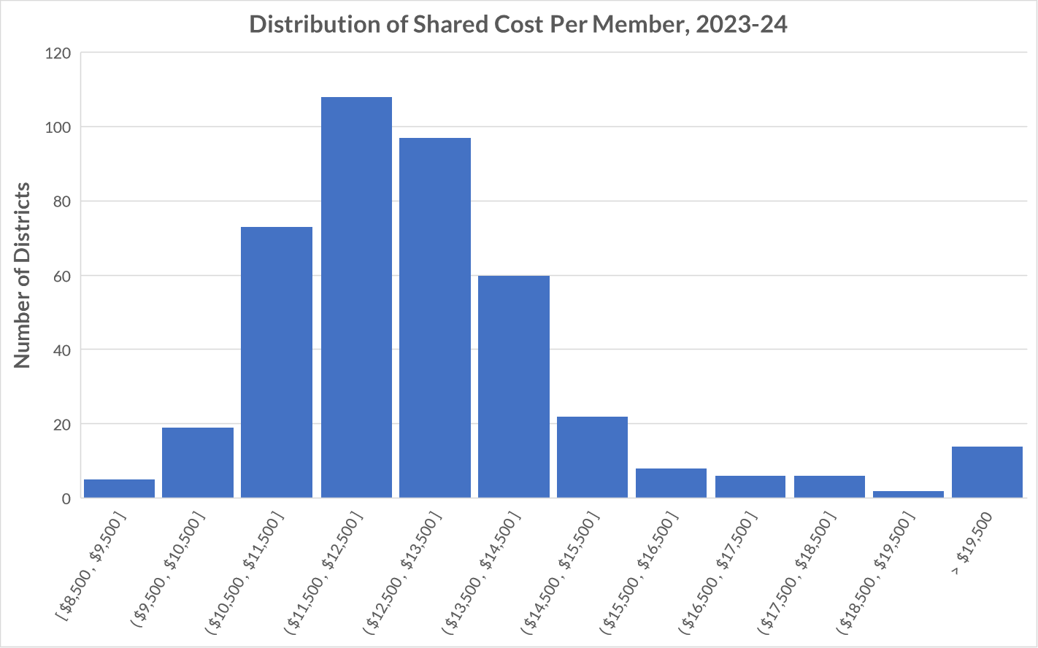
Shared Cost Per Member
Lowest
$8,548
Highest
$26,106
State Average
$12,438
$8,500
$10,500
$15,000
$19,500+
$17,500
51
Source: Department of Public Instruction
Notes:
For 2023-24 General Aid, Prior Year (PY) data from 2022-23, excluding Norris
Low – Menominee Indian $8,548 High – Washintgon $26,106 Ratio: 3.05 to 1
Average $12,438 Median $12,546

Slide 52

Equalization Aid
State “shares” in district costs funded by state aid and local levy.
$1 in debt service costs is treated the same as $1 in teacher salaries.
Aid is based on a district’s ability to fund expenditures, as measured by its property wealth per member.
Basic premise:
The more property wealth per member a district has, the less equalization aid it will receive…….and vice versa.
52

Slide 53
Equalization Aid
What determines how much aid a district receives?
District Factors
(prior-year data)
State Factors
  equalized property value
  membership
  spending (shared cost)
  cost ceilings
  guaranteed valuations per member
  total state dollars
53
Notes:
There are three district-level factors used in the calculation and three state factors.

Slide 54
Equalization Aid
The Equalization Aid computation is actually three individual computations…….
The results of all three (primary, secondary and tertiary) are summed to get the district’s total Equalization Aid.

Slide 55
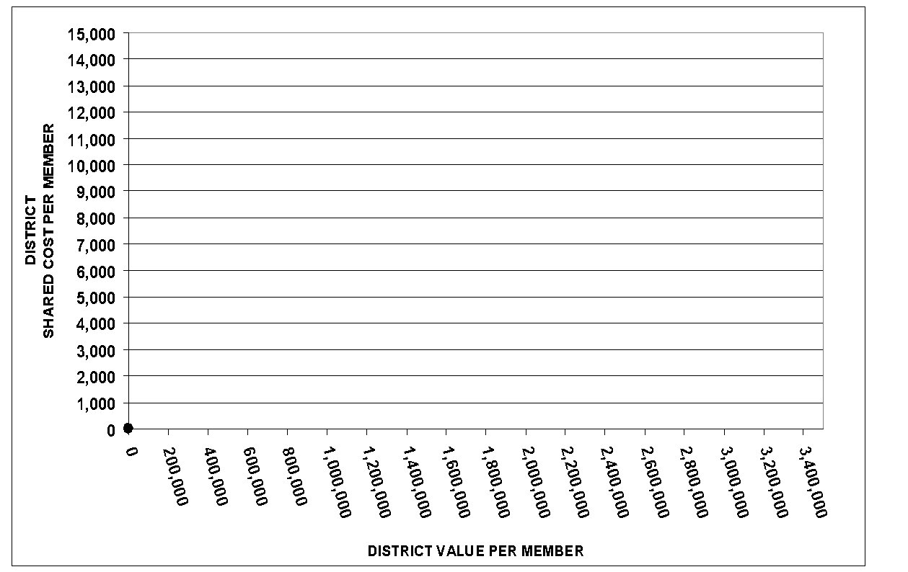
Equalization Aid – Where is Your District?
Tertiary
Aid
199
110
Negative Tertiary Aid
Secondary Aid
65
Negative Secondary Aid
Primary Aid
No Equalization Aid
20
27
55
Notes:
2022-23 General School Aids (421 School Districts)
No equalization aid 27* (PY 23)
Primary only 20 (PY 27)
Positive primary and secondary 65 (PY 41)
Positive primary, secondary and tertiary 199 (PY 218)
Negative tertiary 110 (PY 112)
* 6 of these 27 school districts receive $0 General School Aids: Geneva J4, Green Lake, Mercer, North Lakeland, Northwood, and Washington Island.

Slide 56
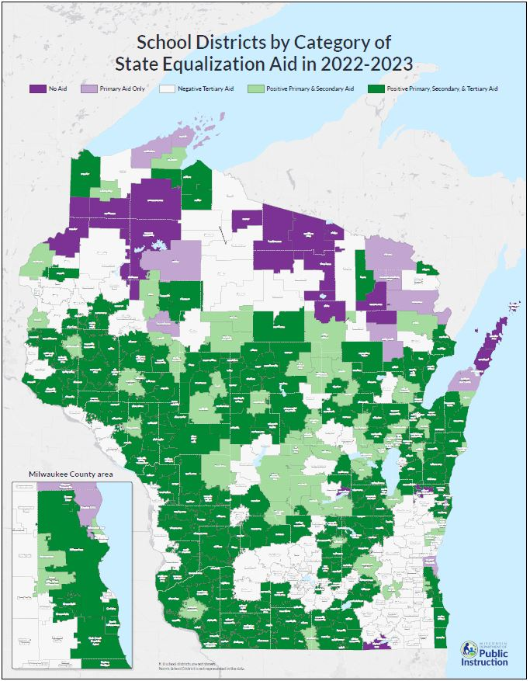
School Finance Maps
https://dpi.wi.gov/sfs/statistical/finance-maps/overview
Notes:
https://dpi.wi.gov/sfs/statistical/finance-maps/overview
2022-23 General School Aids (421 School Districts)
No equalization aid 27* (PY 23)
Primary only 20 (PY 27)
Positive primary and secondary 65 (PY 41)
Positive primary, secondary and tertiary 199 (PY 218)
Negative tertiary 110 (PY 112)
* 6 of these 27 school districts receive $0 General School Aids: Geneva J4, Green Lake, Mercer, North Lakeland, Northwood, and Washington Island.

Slide 57
Equalization Aid Resources on the School Financial Services Website
October 15, 2023 Equalization Aid Computation – Percentage Method - Algebraic Format
October 15, 2023 Equalization Aid Computation – Percentage Method - Bar Graphs
SFS Homepage > State and Federal Aid > General Aid> Equalization Aid
https://dpi.wi.gov/sfs/aid/general/equalization/overview
2023-2024 October 15 Certification General Aid Worksheet
SFS Homepage > State and Federal Aid > General Aid> Equalization Aid > General Aid Worksheets
http://dpi.wi.gov/sfs/aid/general/equalization/worksheets-general-aid
57

Slide 58
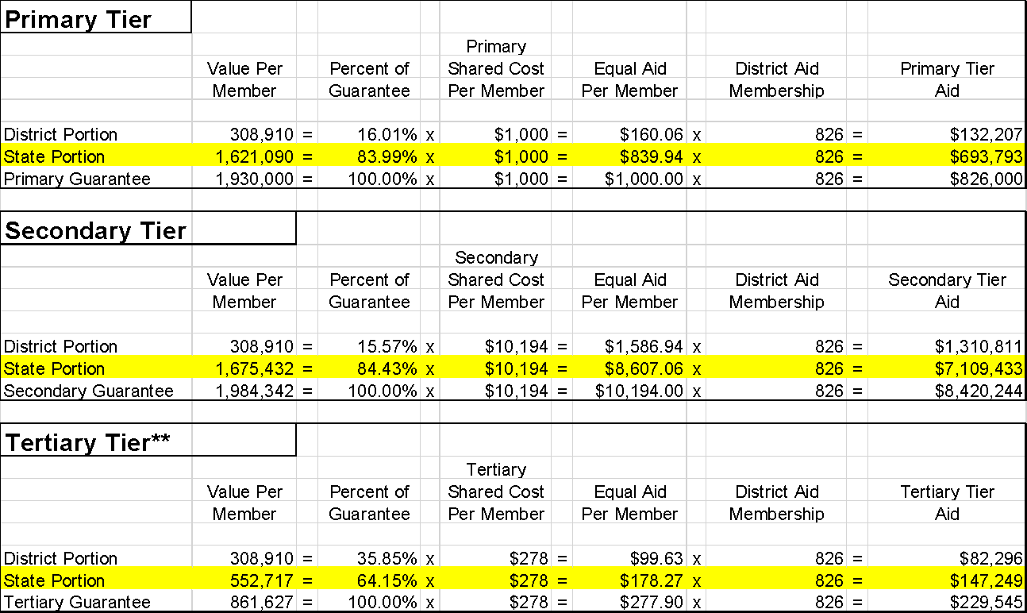
October 15th Equalization Aid – Algebraic
Notes:
** Negative aid is generated when a district's value per member exceeds the state guarantee at any tier. So, if the district's value per member is 125% of the Tertiary Guarantee, every dollar of tertiary cost in the formula would cost the taxpayers $1.25.
Total Equalization Aid for This District:** $7,950,475
(Sum of the "State Portion" amount at each level.)
(Certain exceptions apply for certain districts generating negative aid amounts.)
Total Shared Cost for This District: $9,475,789
(Sum of the per-member cost at each level, multiplied by membership.)
Aid Percentage for This District: 83.9%
(Equalization Aid ÷ Shared Cost)
* Aid amounts and shared cost calculated here may differ slightly from the amount shown on the October 15 certification (seems to be exacerbated the larger the district). The "percentage" method of calculating Equalization Aid is not the official method prescribed in statute; however, this exercise/calculation can be a valuable tool in gaining a conceptual understanding about how the formula works.
** The Milwaukee Parental Choice Program and the Milwaukee [Independent] Charter School Programs are funded through lapses from the general school aid appropriation. All districts' official October 15 Aid Certification worksheets will show a "below-the-line" reduction on their worksheets as part of the Independent Charter Program lapse (MPS will show an additional reduction for the Milwaukee Parental Choice Program). Aid numbers appearing on this sheet DO NOT include those reductions, as this tool is meant to show the intricacies of the tiers in the formula; that is, the amounts in this worksheet reflect gross equalization aid eligibility.

Slide 59
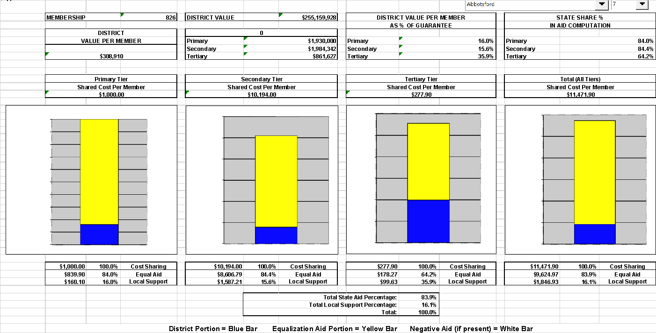
October 15th Equalization Aid – Bar Graph

Slide 60
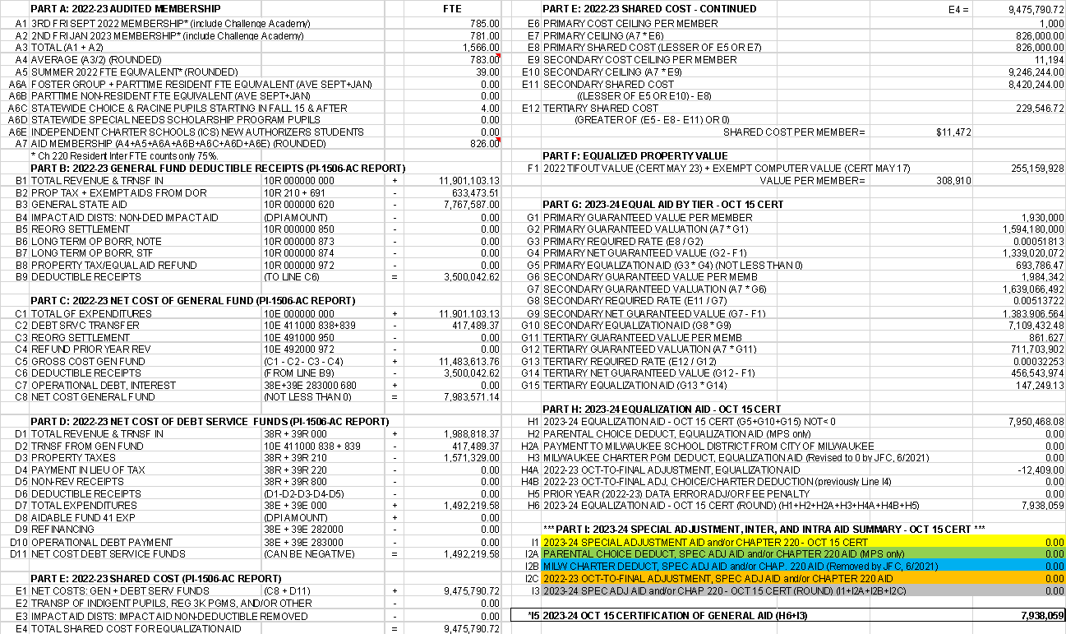
October 15th General Aid Certification Worksheets
60

Slide 61
Equalization Aid – What is Happening Over Time?
State Average Value Per Member
Tertiary
Aid
Negative Tertiary Aid
Negative Secondary Aid
Based on $$ in Pot
Secondary Aid
In Statute
Primary Aid
No Equalization Aid
61
Notes:
2022-23 General School Aids (421 School Districts)
No equalization aid 27* (PY 23)
Primary only 20 (PY 27)
Positive primary and secondary 65 (PY 41)
Positive primary, secondary and tertiary 199 (PY 218)
Negative tertiary 110 (PY 112)
* 6 of these 27 school districts receive $0 General School Aids: Geneva J4, Green Lake, Mercer, North Lakeland, Northwood, and Washington Island.

Slide 62
Revenue Limits, State Aids, and Controlled Property Tax Levies
Revenue Limit
“State Aid”
Revenue Limit Levy
Notes:
Equalization Aid impacts the tax levy. More money in State Aid without a corresponding increase to the Revenue Limit won’t result in additional revenue for the district. It just results in property tax relief.
Aid is driven by both local and state factors.
For planning purposes know how changing one of your local factors (spending in most circumstances) could impact your general school aids.
“State Aid” includes:
General School Aids (Equalization Aids, Chapter 220 Integration Aids, and Special Adjustment (Hold Harmless Aids);
High Poverty Aid;
State Aid for Exempt Computers; and
State Aid for Exempt Personal Property.
2022-23 general school aids includes: $5,141.7 million equalization aids; $37.2 million integration (Chapter 220) aids; and $22.7 million special adjustment aids (hold harmless aids).

Slide 63
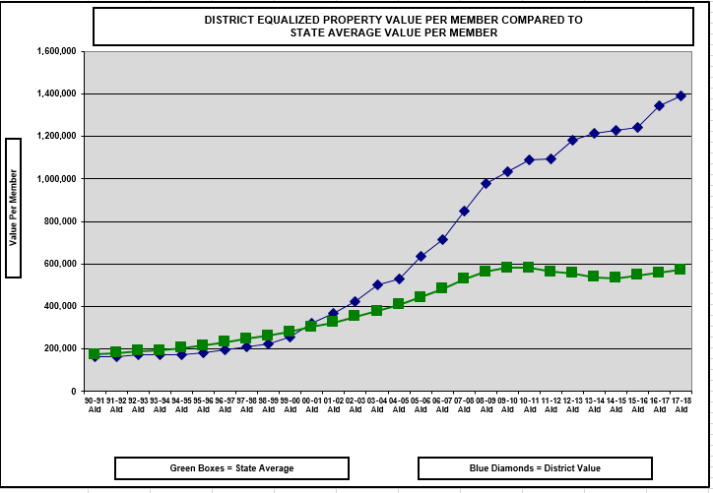
Watch Value Per Member Over Time
1.) Significant Declining Enrollment
2.) Property Value Significantly Increases
63
Notes:
This is what can happen to a district with severe declining enrollment. No one can predict the future, but watching the trendline for your district can be very informative.

Slide 64
Equalization Aid Resources on the School Financial Services Website
“Longitudinal Equalization Aid Value-Per-Member History”
SFS Homepage > Statistical > Longitudinal Data > Property Valuation
http://dpi.wi.gov/sfs/statistical/longitudinal-data/property-valuation
64

Slide 65
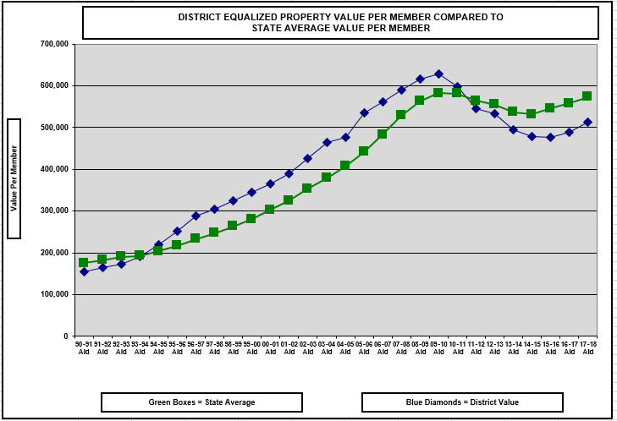
Watch Value Per Member Over Time
1.) Significant Enrollment Increase
65

Slide 66
Equalization Aid Resources on the School Financial Services Website
How can I explain changes in my district’s aid?
Multi-Year History on the Website
Longitudinal Excel Spreadsheet
https://dpi.wi.gov/sfs/statistical/longitudinal-data/equalization-aid
A listing of the pertinent Equalization Aid factors that explain what is happening in your district.
66

Slide 67
Basic Equalization Aid Concepts
Equalization Aid is property tax relief under revenue limits.
Aid is inversely related to district property value per member.
One pot of money is split over 421 school districts based on district values, membership, and shared costs.
Depending on district value-per-member, some districts’ aid is increased by increasing expenses, while others’ aid is decreased by increasing expenses.
Know where your district is in the formula and understand why your equalization aid changes.
67

Slide 68
Equalization Aids
Questions?
68

Slide 69
Fund Accounting / Fund Balance
Diving in….
…to Wisconsin school district accounting
Notes:
Needs wordsmithing

Slide 70
Fund Accounting
Governments, such as school districts, usually organize their accounting systems on a "fund" basis
A fund is
a separate set of accounting records, segregated for purpose of carrying on an activity
established for accountability purposes to demonstrate that financial resources are being used only for permitted purposes
70

Slide 71

Fund Accounting
Think of a fund as a self-contained box
into which is put everything pertaining to that fund.
71

Slide 72

Fund Accounting
A fund will have "balance sheet" accounts consisting of
  Assets,
  Liabilities, and
  Fund balance,
and a series of
  Revenue and
  Expenditure accounts
General Fund
72

Slide 73
Fund Accounting
WUFAR
Wisconsin’s account coding structure is the
Wisconsin Uniform Financial Accounting Requirements
73

Slide 74
WUFAR Expenditure Account Example
A WUFAR account is a sequence of dimensions:
10
E
120
111
122150
141
Fund – Type – Location – Object/Source – Function - Project
74

Slide 75
WUFAR Expenditure Account Example
What does this account mean?
10
E
120
111
122150
141
Salary expenditures for a regular education Title I
reading specialist at Shady Meadow Elementary School
75

Slide 76
Fund Accounting
WUFAR FUNDS ARE
  10 GENERAL FUND
  20 SPECIAL PROJECT FUND
  21 SPECIAL REVENUE TRUST
  27 SPECIAL EDUCATION
  30 DEBT SERVICE FUND
  38 NON-REFERENDUM 39 REFERENDUM
  40 CAPITAL PROJECTS FUND
  50 FOOD SERVICE FUND
  60 CUSTODIAL FUND
  70 TRUST FUNDS
  80 COMMUNITY SERVICE FUND
  90 PACKAGE & COOPERATIVE
  PROGRAM FUND
76

Slide 77

What is Fund Balance?
The difference between assets and liabilities (equity).
77

Slide 78
Examples of Assets and Liabilities
Assets
Cash
Investments
Prepaids
Receivables
  Tax Levy
  Equalization Aid
  $ from other School Districts
Liabilities
Payroll Payables
Payroll liabilities (FICA, WRS, etc.)
Cash flow borrowing
Note: physical assets and liabilities, such as buildings, land and furniture, etc. are not included in fund balance calculation
78

Slide 79
Fund Balance Classifications
DPI Code
Reserved: 1-4
Nonspendable Fund Balance 935 000
  Prepaid Expenses & Inventory
Restricted Fund Balance 936 000
  Self-insurance, contracts, debt, legal restrictions
Committed Fund Balance 937 000
  Formal Board action, part of budget, restricted donations.
Assigned Fund Balance 938 000
  Board assigned, capital projects, budgeted
Unassigned Fund Balance 939 000
Classify in one of five ways:
Unreserved: 5
79
Notes:
Boards should know the district’s fund balance policy and if the Board is meeting its policy. Know your fund balance.
Reserved – can’t be appropriated or spent (such as inventory) or is legally limited to a specific purpose (grants)
Unreserved – can be used for any purpose within the respective fund

Slide 80
DPI Coded the Unassigned (Unreserved) Fund Balance into these Sub-Classifications:
939 100 Revenue Stabilization
  “Rainy Day Funds”
939 200 Working Capital (Cash Flow)
  Used to reduce or eliminate temporary borrowing
939 300 Contingencies
  Circumstances or situations that could result in loss
939 400 Emergencies
  Unplanned, unexpected loss or ‘Acts of God’
939 900 Other
Basically, not identified for any use
None meet Committed or Assigned standards.
80
Notes:
Use these codes locally on a voluntary basis for now.
Someday they may become required and
collected at the state level as part of the Annual and Fall Report; and,
become part of the Annual Audit reporting process.

Slide 81
Fund Balance – Reported as of June 30th
Assets
Fund Balance often changes daily.
  When revenue comes in, a fund balance increases.
  When expenditures are made, a fund balance decreases.
In WI, a public school district’s fiscal year runs from July 1 to June 30. Fund Balance is reported and compared to other years as of June 30th.
Liabilities
Fund Balance (Equity)
81

Slide 82
How does a June 30 fund balance grow or shrink?
Prior Year Ending Fund Balance (Equity)
Current Year Difference Between Revenue and Expense
Ending Fund Balance (Equity)
82

Slide 83

How Large A Fund Balance?
Determination of an appropriate fund balance is strictly a local matter.
The Department of Public Instruction (DPI) makes no recommendation, except that it encourages districts to seek legal counsel should they contemplate budgeting for and/or operating with a negative general fund balance.
This means on an ongoing basis
83

Slide 84
According to DPI, a district with an appropriate fund balance can:
Avoid interest cost and time lost associated with borrowing
Make special purchases or cover unforeseen expenditure needs
Lower debt issuance cost and preserve or enhance its bond rating by demonstrating financial stability
84

Slide 85
What is a Sufficient Fund Balance?
Perhaps the best answer is:
“An amount sufficient to avoid short-term borrowing and to realize long-range goals."
Once a cash reserve is spent, it is very difficult to rebuild. We have a responsibility to sustain the academic programs. When it’s gone, it’s gone!! ☹
85

Slide 86
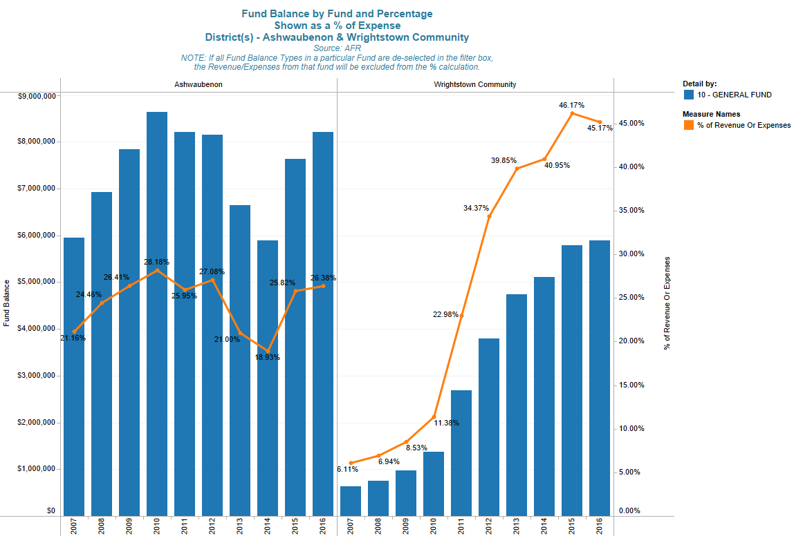
Each district has a unique answer for, “what is an appropriate fund balance.”
86

Slide 87
Have A Fund Balance Policy!
School districts should have a fund balance policy.
  What is your policy?
  Are you following it?
87

Slide 88
A Fund Balance Policy Should
Identify and define fund balance classifications
Identify and define accounting definitions for fund balances
State the General Fund balance level and rationale
  Addresses those issues identified earlier in Determining Sufficient Fund Balance
Address restoration of General Fund Balance
Establish the order of spending when various fund balance funding sources exist (Restricted, Committed, Assigned, and Unassigned)
88

Slide 89

Very Important!
Cash is an asset and therefore is part of the Fund Balance Equation.
However, fund balance does not equal cash.
Let’s talk a little about the cash portion of fund balance…
89

Slide 90
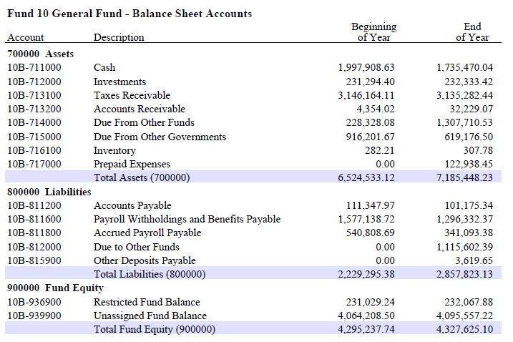
Very Important!
90

Slide 91
How do Districts use the cash portion
of fund balance?
To pay the bills!
91

Slide 92
Typical Change in Monthly Cash Balance
Year1
Year2
Year3
This is a hypothetical example and for illustrative purposes only.
92

Slide 93
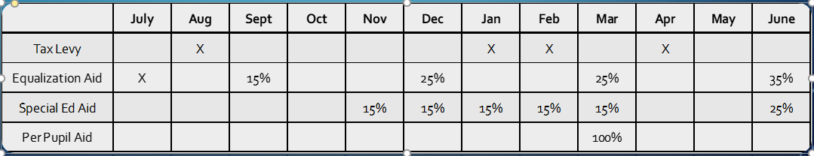
Cash Flow Fluctuations
Expenditures are fairly constant throughout year
  Salaries / Fringe are typically 60%-65% of budget
  Payroll is typically spread over 21, 24 or 26 pay periods
  End-of-year pay adjustments are sometimes needed
Revenues received sporadically throughout the year
  Tax Levy is received in the last 6 months of the school year, with the final payment made in August of the next school year.
  60% of Equalization Aid is paid over the last 6 months
93

Slide 94
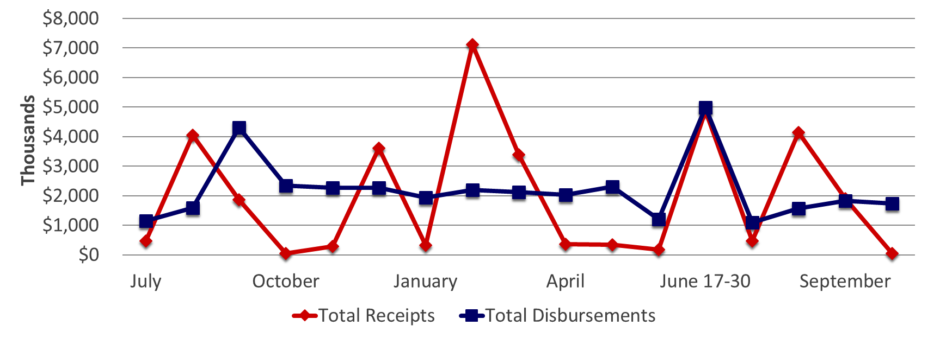
Receipts vs. Disbursements
The hypothetical example is for illustrative purposes only.
94

Slide 95
In Summary
Fund balance = assets – liabilities
Districts’ fund balance levels change daily
Fund balance is reported as a June 30 snapshot
Cash is an asset but fund balance ≠ cash
The cash portion of fund balance fluctuates greatly throughout the year
Each district has a fund balance level appropriate to them
(there is no one-size-fits-all answer)
The district should have and should be following their fund balance policy
95

Slide 96
The School Budget
Understanding important concepts in school budgeting!
96

Slide 97
What is a school budget?
A school budget is the financial outline for addressing how a school district will deliver its educational plan to students in a fiscal year.
The school budget is an estimate and every part that makes up the whole of the budget is subject to known and unknown outside and inside forces.
97

Slide 98
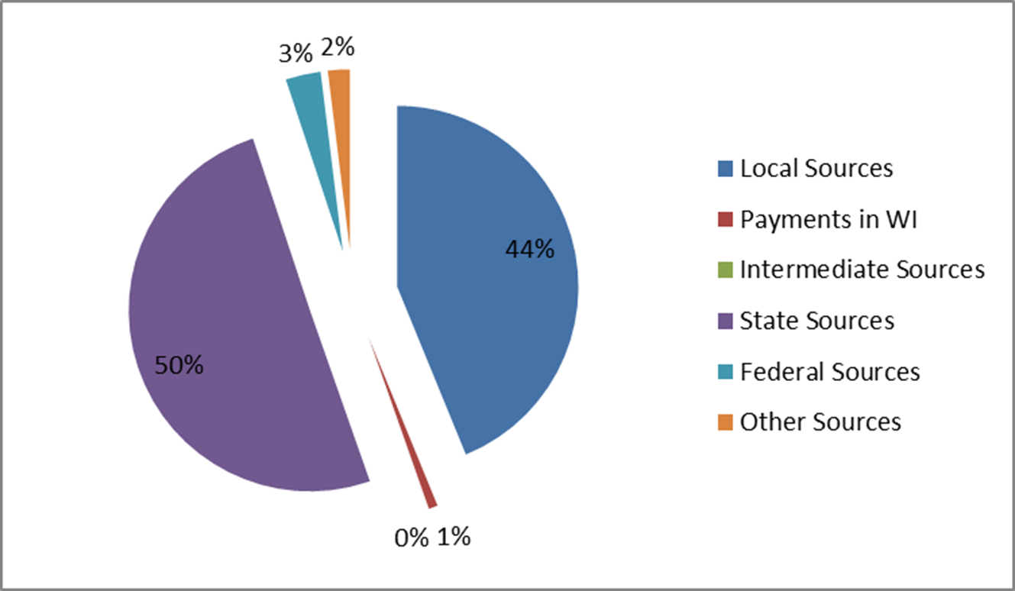
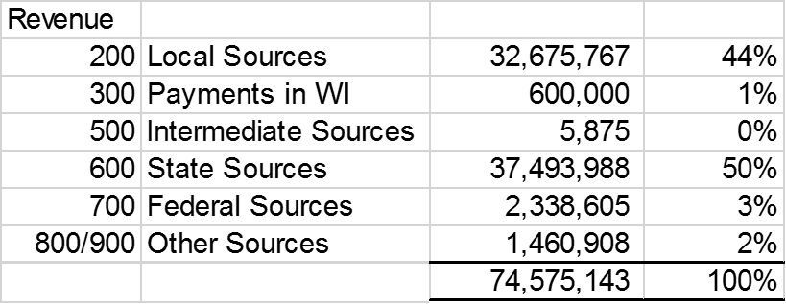
The General Fund –
From where does the money come?
This is a graphic example of Revenue:
98

Slide 99
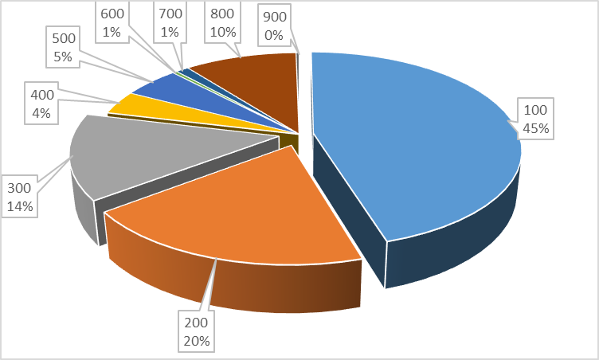
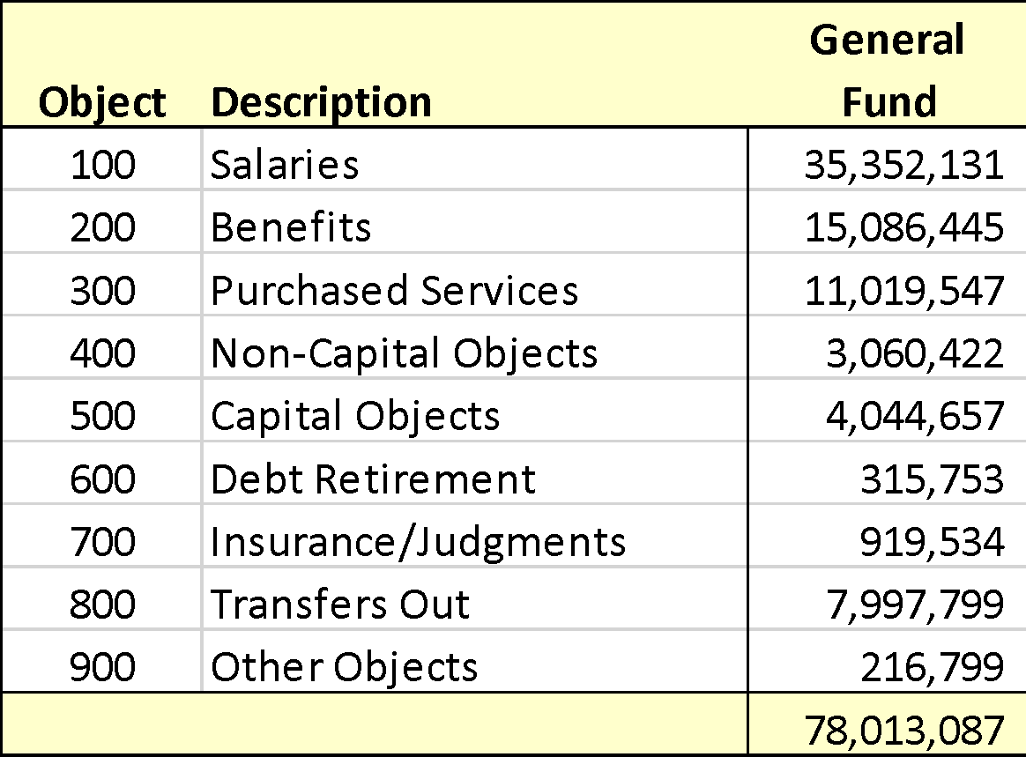
The General Fund –
On What Do We Spend Our Money?
This is a graphic example of Expenditures:
99

Slide 100
Can Wisconsin School Boards Tax Whatever They Want?
No!
The State of Wisconsin imposes strict control over what school boards can levy through revenue limits.
There is an absolute dollar amount determined via a formula that annually generates a limit on a school district's property tax. Failure to levy at that amount will cause some school districts to lose levy authority. Such a loss creates greater budget challenges in delivering the educational plan.
100

Slide 101

Emerging Topics
Vouchers
School Levy Tax Credit

Slide 102
Private School Choice/Voucher Summary
Revenue Limit Impact
For choice students enrolled in the RPCP/WPCP since 2015-16 and SNSP students since 2017-18, the Revenue Limit Impacts:
Private school Choice students are not counted in a district’s revenue limit membership
The Choice students’ resident district receives a non-recurring revenue limit adjustment equal to the per FTE choice payment in the current year allowing a school board to replace the state aid reduction through increased property taxes
If a school board chooses to levy less than the private school voucher non-recurring revenue limit exemption, the following year’s revenue limit carry-over total will be reduced dollar for dollar

Slide 103
School Board Options and Impacts
School District Budgets - Current Year (Year 1)
For choice students enrolled in the RPCP/WPCP since 2015-16 and SNSP students since 2017-18, the school board must choose on the following three options (or a combination):
Increase property taxes to replace the loss of state school aids in order to maintain existing student educational programs
Use fund balance or some other source of revenues to replace the loss of state school aids to maintain current student programs
Reduce current district expenditures equal to the state aids deduction

Slide 104
School Levy Property Tax Credit
FY2024 - credit amount paid to municipalities increased from $940,000,000 to $1,195,000,000
FY2025 - credit amount paid to municipalities will increase from $1,195,000,000 to $1,275,000000
  A portion of the school levy tax credit is paid the first Monday in May
  The remaining portion is paid in July

Slide 105
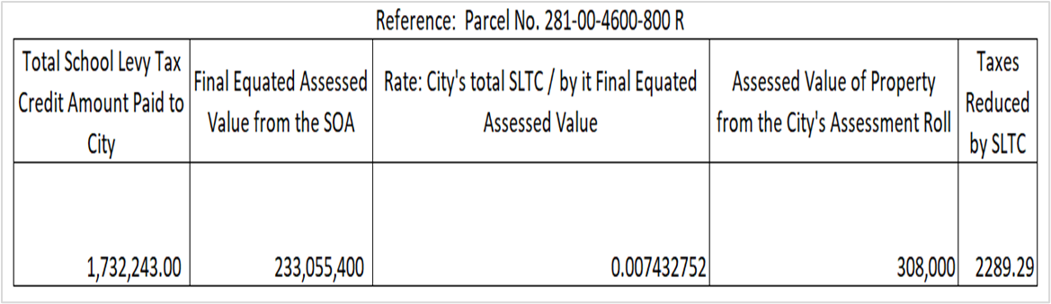
School Levy Property Tax Credit
School levy tax credit calculation
Notes:
●School levy tax credit is calculated by dividing the total school levy tax credit amount paid to the municipality by the final equated assessed value of the municipality. This rate is then multiplied by the property's assessed value to arrive at the parcels SLTC applied to the tax bill.

Slide 106
School District Finance
Questions?
106

Slide 107




Thank You!
Todd Gray, Ph.D., CPA
Budget Analytics, Inc.
Business Advisor, Palmyra-Eagle Area S.D.
tgrayphdcpa@gmail.com
Jennifer Buros
Assistant Director
School Financial Services Team
Wisconsin Department of Public Instruction
Jennifer.buros@dpi.wi.gov
Thomas R. Owens, Ph.D., SFO
Director of Business Services
Stevens Point Area Public School District
towens@pointschools.net
Mark Elworthy
Director
School Financial Services Team
Wisconsin Department of Public Instruction
mark.elworthy@dpi.wi.gov
Debby Brunett
Director
Baird
Dbrunett@rwbaird.com
107

Slide 108
Important Disclosures
Robert W. Baird & Co. Incorporated is providing this information to you for discussion purposes only. The information does not contemplate or relate to a future issuance of municipal securities. Baird is not recommending that you take any action, and this information is not intended to be regarded as “advice” within the meaning of Section 15B of the Securities Exchange Act of 1934 or the rules thereunder. In providing this information, Baird is not acting as an advisor to you and does not owe you a fiduciary duty pursuant to Section 15B of the Securities Exchange Act of 1934. You should discuss the information contained herein with any and all internal or external advisors and experts you deem appropriate before acting on the information.

