Slide 1
Equalized Values
and School District Apportionment
WI Dept of Revenue | State and Local Finance Division
Wisconsin State Education Convention| January 17, 2024

Slide 2
January 1
Property assessment
June
SOA and MAR to DOR
August
Equalized values to munis and counties
October 1 Equalized values to DPI, schools
November
DPI sends school
levies to DOR
November 20
DOR issues credit notices to munis
December 1
Deadline to send levy info to munis clerks
December 8
Deadline for tax roll delivery to treasurers
Third Monday in December
Mail tax bills

Slide 3
Equalized Values
and School District Apportionment
WI Dept of Revenue | State and Local Finance Division
Wisconsin State Education Convention| January 17, 2024

Slide 4
Presenters
Gary Martell
  Property Assessment Supervisor, Equalization Bureau
  State and Local Finance Division
Debra Werner
  Auditor, Local Government Services
  State and Local Finance Division
Lynn Oldenburg
  Auditor, Local Government Services
  State and Local Finance Division

Slide 5
Agenda
Equalized values
  Definition
  Purpose | Process
  Calendar
School district apportionment
  Purpose | Process
School district levy uses
Presentation evaluation survey
Notes:
Make sure to take the evaluation survey at the end…there is a link and a QR code

Slide 6
Assessed Values

Slide 7

Assessed Values
Assessed values are determined by the local assessor as of January 1 each year
Assessments are typically determined using mass appraisal techniques
Assessed values are not required to be at market value
An assessor completes one of two types of assessments each year
  Maintenance
  Revaluation

Slide 8
Maintenance Assessments
Changes are limited to updates for physical changes to a property, change in taxable status, or updated information about a property
  Example: A detached two-stall garage was built in August 2023
  The January 1, 2024, assessment includes the value of the new garage
Any changes to assessments should reflect a value that is in line with the assessments of other properties

Slide 9
Revaluation Assessments
Assessor estimates market value for each property
Assessments are based on:
  Recent sales
  Income generating potential of the real estate (not the business)
  Cost to build new, less depreciation for age and condition
Assessed values are not adopted as equalized values
  Equalized values are determined independently by DOR

Slide 10
Equalized Values

Slide 11

Equalized Values – Definition
Estimate of total taxable value of all real and personal property in each taxation district as of January 1
  Excludes exempt property (personal property exempt starting in 2024)
  Agricultural land (class 4) – use value vs. market value
  Undeveloped land (class 5) – 50% of market value
  Agricultural forest (class 5M) – 50% of market value
August 1 – DOR issues preliminary values
August 15 – DOR issues certified values
Notes:
What are Equalized Values? Let's go over the definition…
Unlike Assessed Values, Eq Values must be determined every year
Prior year corrections for personal property assessments can still be applied in 2024 and 2025

Slide 12
Equalized Values – Purpose
Provide uniform basis to administer property tax system for levy purposes
  Fairness and equity between municipalities
Municipal boundary ≠ school, county, tech college boundaries
Equalized values do not extend to individual properties
  Individual parcel/property tax fairness dependent on municipal assessment roll

Slide 13
Equalized Values – Uses
Apportionment of property tax levy
  Counties
  School districts
  Technical colleges
  State reforestation
Allocation of state aids
Debt limit calculation

Slide 14
Equalized Values – Uses
Municipal assessment compliance – sec. 70.05 Wis. Stats.
Equating manufacturing property assessments
Levy limit calculations – net new construction

Slide 15
Equalized Values – Process
Prior year corrections
Economic adjustments (market value changes)
Municipal Assessment Report (MAR)
  New construction
  Demolitions
  Annexations
  Exemptions

Slide 16
Equalized Values – Process
Manufacturing property
Statement of Changes in Equalized Values Report
  revenue.wi.gov/Pages/Report/soc-eqv.aspx
  Compares previous year’s values to current year
  Details changes and includes prior year corrections

Slide 17
Equalized Values – Process
Prior Year Corrections
DOR uses assessor data submitted by the second Monday in June to calculate equalized values certified on August 15
Information provided after second Monday in June becomes a correction to
next year’s equalized value

Slide 18
Equalized Values – Process
Prior Year Corrections – Three-Step Process
Step 1 – Correction
  Equalized values carried forward each year
  Apply correction amount to calculate next year's starting value
Step 2 – Compensation
  Apply correction amount a second time to compensate for over- or under-valuation in previous year
  This is a one-year adjustment, removed in the following year
Step 3 – Removal of compensation
  The compensation amount is removed

Slide 19
Equalized Values – Process
Prior Year Corrections – Example for City of Badger
Estimated MAR submitted in June 2023
Final MAR submitted in September 2023
Difference between the two reports – additional $1,000,000 in residential new construction reported at a ratio of 100% on the final MAR
August 15, 2023 – certified equalized value was $80,000,000 but should have been $81,000,000

Slide 20
Equalized Values – Process
Prior Year Corrections – Example for City of Badger
Correction process for 2024 and 2025 equalized values
  Step 1 – 2024 correction amount – add $1,000,000
  Step 2 – 2024 compensation – add $1,000,000
  Step 3 – 2025 removal of compensation – remove $1,000,000

Slide 21
Equalized Values – Process
Economics
DOR annual review of real estate sales
  Assessor determines which sales are useable market sales and useable for DOR's ratio study
Sales and assessments are analyzed and used to measure average change in market value by property class
  Residential, commercial, other (ag farm site) property classes use a statistical projection to determine the percent change
  Undeveloped, ag forest, forest, other classes use large-acre sales analysis to determine average per acre selling price

Slide 22
Equalized Values – Process
Municipal Assessment Report (MAR)
Municipal assessor submits annually to DOR – includes changes in assessed values as of January 1
  New construction – includes remodeling and partial construction
  Demolition
  Classification shifts
  Annexations

Slide 23
Equalized Values – Process
Manufacturing Values
Manufacturing full value assessments – real estate
Total full value of manufacturing class added to equalized value of
non-manufacturing property

Slide 24
Assessed Value vs. Equalized Value
 | Equalized Value | Assessed Value
Valuation date | January 1 | January 1
Updated Annually | Yes | No
Applies to individual properties | No | Yes
Uses | Apportionment of tax levy Allocation of state aids Debt limit calculation Municipal Compliance Equating of manufacturing assessments Levy limit calculations | Determines amount of tax levy covered by the property

Slide 25
Equalized Values – Calendar
January 1
Statutory assessment date
February/March
Assessors provide sale validation and assessment data for sales included in DOR's ratio study used for economics
April 22 – Fourth Monday of April
First date to hold municipal board of review (BOR)

Slide 26
Equalized Values – Calendar
On-going
Individual property owners appeal BOR decisions – sec. 70.85 Wis. Stats.
June 10 – Second Monday of June
Municipal Assessment Report (MAR) due
  Includes Tax Incremental District assessment data
  Information used for 2024 equalized values, tax incremental district values and net new construction
  Changes reported on amended MAR filed after June 10, 2024, become a correction applied to 2025 equalized value

Slide 27
Equalized Values – Calendar
August 1
DOR releases preliminary equalized values for review
August 7
Deadline to report potential errors to DOR
  Errors – clerical, arithmetic, transpositional, or similar error representing over or under-valuation of property
  Must be equal or greater than 2% of equalized value – if less than 2%, correction applied to 2025 value

Slide 28
Equalized Values – Calendar
August 15
DOR releases certified equalized values
October 15
Deadline for municipality to appeal equalized values – sec. 70.64, Wis. Stats.
November 1
DOR sends preliminary assessment compliance notices to municipalities
December 2
DOR sends letter to municipal clerk if final MAR has not been filed

Slide 29
Accurate Equalized Values
Communication
  Municipal assessors need to keep in contact with the Equalization District Office
  Review and comment on DOR preliminary values
    Sales information – mid-March
    Equalized values – August 1
Timely and accurate filings with DOR
  Sales information – Late February
  Municipal Assessment Report – second Monday in June

Slide 30
January 1
Property assessment
June
SOA and MAR to DOR
August
Equalized values to munis and counties
October 1 Equalized values to DPI, schools
November
DPI sends school
levies to DOR
November 20
DOR issues credit notices to munis
December 1
Deadline to send levy info to munis clerks
December 8
Deadline for tax roll delivery to treasurers
Third Monday in December
Mail tax bills

Slide 31
School District Apportionment

Slide 32
Local Government Services Role
Certification of school district equalized values for:
  Fall School District Apportionment
  School Certificates of Equalized Values
  Spring School Aids

Slide 33
Local Government Services Role
Fall School District Apportionment
  Annually by October 1
  Values to DPI and published on our website
  Used for levy apportionment

Slide 34
Local Government Services Role
School Certificates of Equalized Values
  Annually by October 1
  Certificates published on DOR website
  Used for borrowing

Slide 35
Local Government Services Role
Spring School Aids
  Annually by May 1
  Values to DPI for your aid calculations
Notes:
Each spring, we recalculate the distribution of the prior fall values for purposes of certifying equalized values that are used for school aid calculations.
We complete this by May 1, then hand off the values to DPI

Slide 36
Apportionment
Defined as "divide and allocate"
Think percent to total – what percent of the school district's value lies within each municipality?
Property tax levies are apportioned based on what percent of the school district's total equalized value less TID value increment lies within each town, village, and city within its boundary

Slide 37
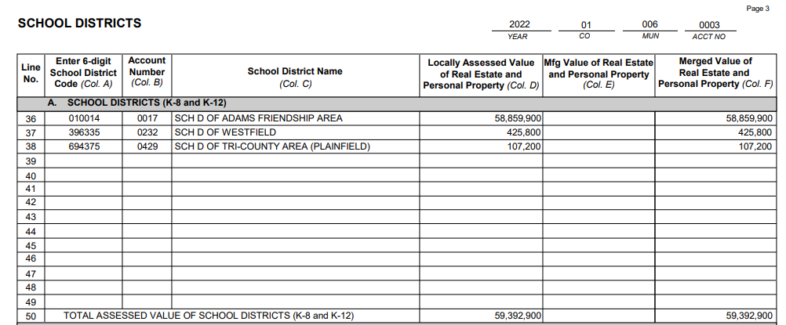
School District Calculation
What percent of the school district's total assessed value lies within each municipality?
  As reported on the Statement of Assessment (SOA)

Slide 38
School District Calculation
Use current year SOA to allocate the equalized value of non-manufacturing property to the school district pieces within the town, village or city
Use prior year percentages if current year SOA is not available
Add DOR-assessed manufacturing equalized (full) value
Subtract the equalized TID value increment

Slide 39
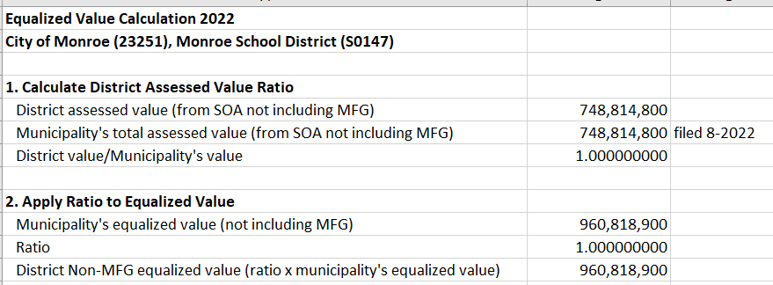
School District Calculation

Slide 40
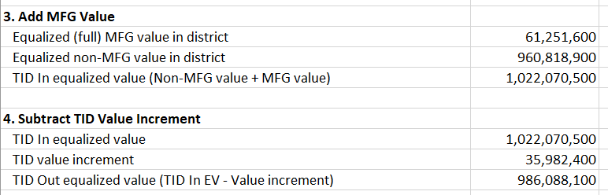
School District Calculation

Slide 41
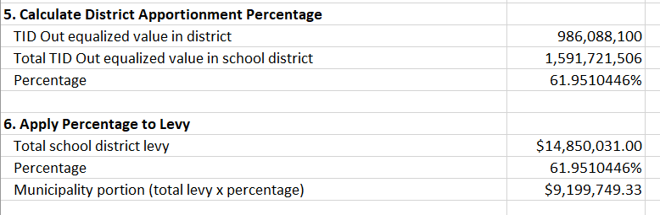
School District Calculation

Slide 42
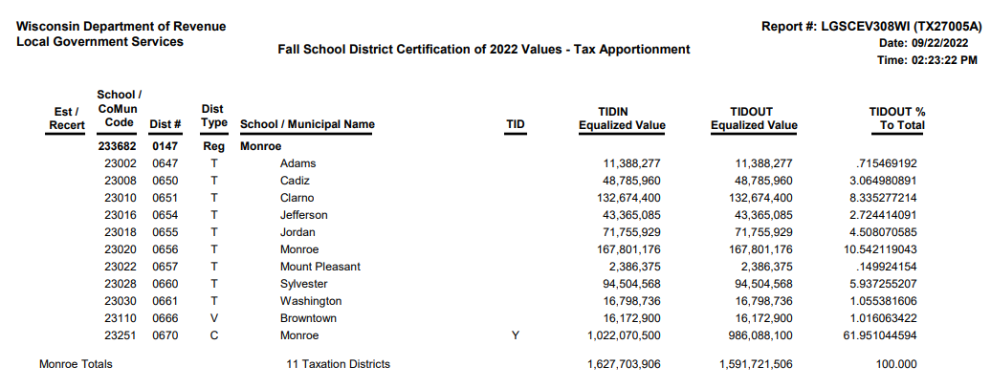
Fall School District Apportionment Report
School district equalized values – DOR website - Reports search fall school

Slide 43
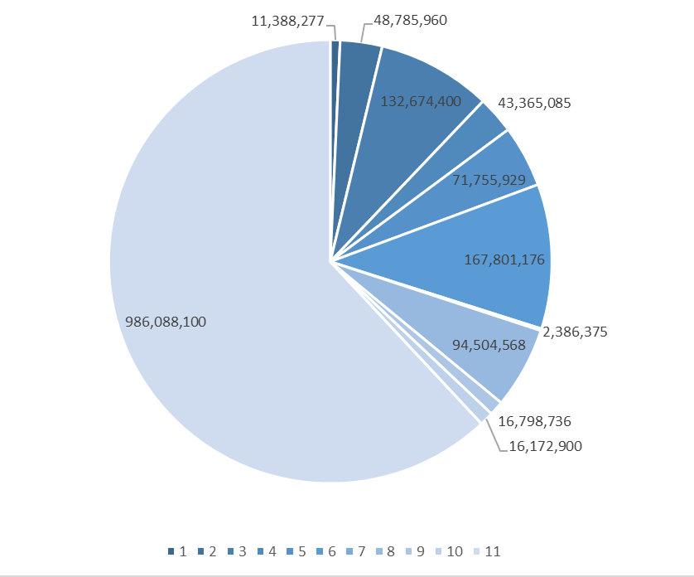
Fall School District Apportionment Report

Slide 44
Setting and Apportioning Levies
Taxing jurisdiction responsibilities
  Use levy or revenue limit formulas
  Use tax apportionment report values

Slide 45
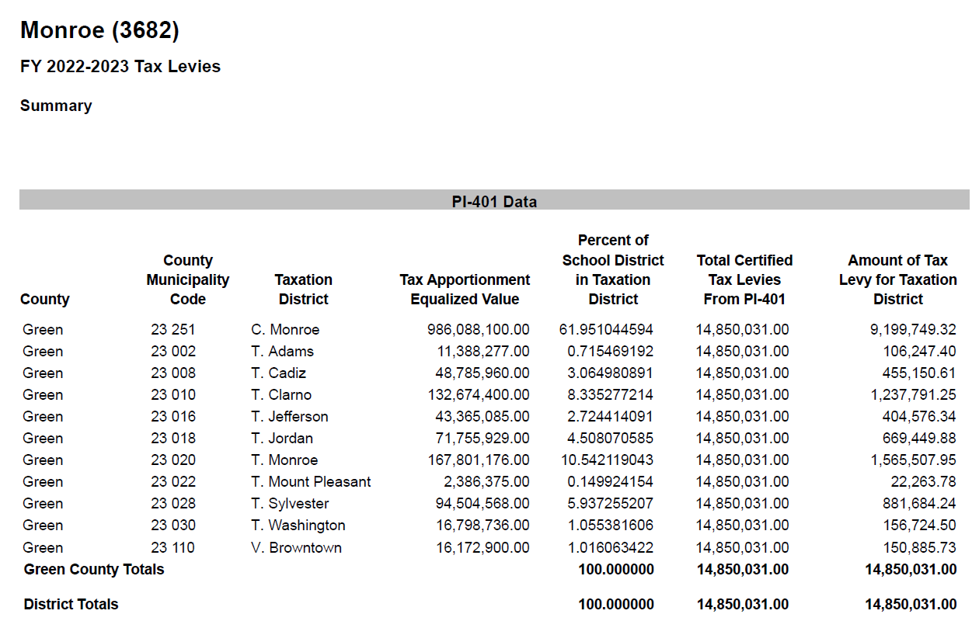

Slide 46
School District Levy Uses

Slide 47
DOR's Use of School Levies
Calculate lottery and gaming credit
Calculate first dollar credit
Calculate school levy tax credit
Tax Increment Worksheet
Statement of Taxes
Chargeback calculations
Omitted property taxes calculations

Slide 48
Local Government Services Role
Calculate Lottery and Gaming Credits
Based on available funds and an estimated number of properties qualifying for the credit, DOR determines a maximum credit value (MCV). 2023 MCV = $33,500.00
MCV is multiplied by the applicable school tax rate
This is the amount of lottery credit provided for that property
Lottery and gaming credit amounts by school district reports are available on the DOR website by November 20
Lottery and gaming credits are applied to the property tax bill

Slide 49
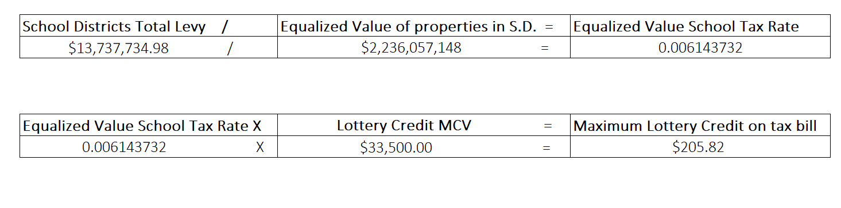
Lottery Credit Calculation Example

Slide 50
Local Government Services Role
First dollar credit calculation
  Based on available funds and an estimated number of properties qualifying for the credit, DOR determines a maximum credit value (MCV). 2023 MCV = $9,000.00
  MCV is multiplied by the applicable school tax rate
  This is the amount of First Dollar credit provided for that property
  First dollar credit amounts by school district reports are available on the DOR website by November 20
  First Dollar credits are applied to the property tax bill

Slide 51
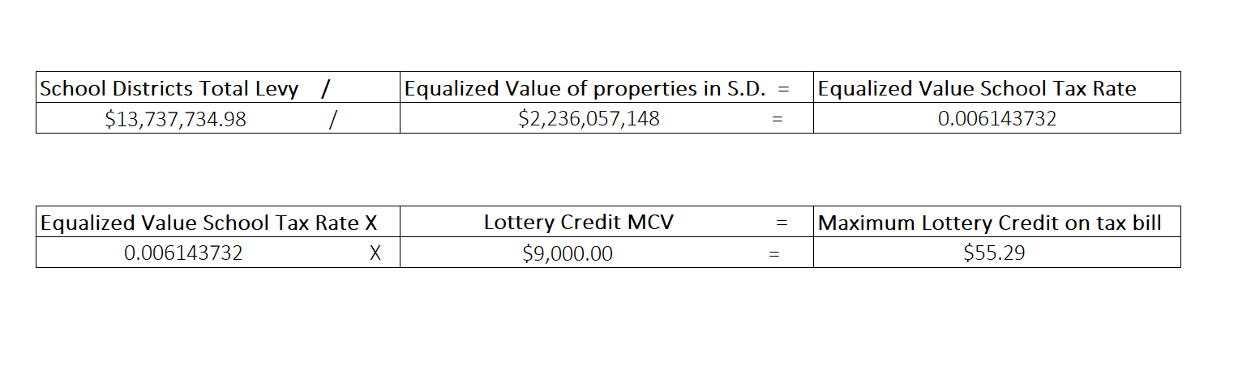
First Dollar Credit Calculation Example

Slide 52
School Levy Property Tax Credit
FY2024 – credit amount paid to municipalities increased from $940,000,000 to $1,195,000,000
FY2025 – credit amount paid to municipalities will increase from $1,195,000,000 to $1,275,000,000
  A portion of the school levy tax credit is paid the First Monday in May
  The remaining portion is paid in July

Slide 53
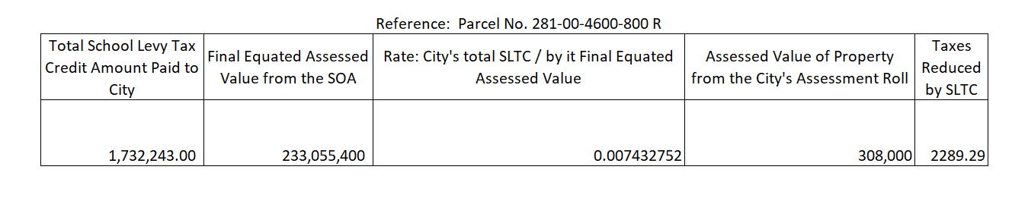
Local Government Services Role
School levy tax credit calculation
Notes:
The School levy tax credit is calculated
School levy tax credit is calculated by dividing the total school levy tax credit amount paid to the municipality by the final equated assessed value of the municipality. This rate is then multiplied by the property's assessed value to arrive at the parcels SLTC applied to the tax bill.

Slide 54
Local Government Services Role
School levies used on municipality forms filed with DOR
  Tax Increment Worksheet
  Statement of Taxes
School levies used to verify municipality calculations
  Chargeback requests
  Omitted taxes sharing requests

Slide 55
Thanks!
Any questions?

Slide 57
Take Survey
Click link or scan QR code
Link – surveymonkey.com/r/DOR-WSEC-1-17-24
QR code

Slide 58
January 1
Property assessment
June
SOA and MAR to DOR
August
Equalized values to munis and counties
October 1 Equalized values to DPI, schools
November
DPI sends school
levies to DOR
November 20
DOR issues credit notices to munis
December 1
Deadline to send levy info to munis clerks
December 8
Deadline for tax roll delivery to treasurers
Third Monday in December
Mail tax bills

Slide 59
State Education Convention 2024
Wisconsin School Finance
Revenue Limits and General Aids
Mark Elworthy, Director
Jennifer Buros, Assistant Director
School Financial Services Team

Slide 60
Agenda
Wisconsin School Finance is Complicated
Revenue Limits
General School Aids (Equalization Aid)
Referendum to Exceed Revenue Limits
Factors Impacting Estimated Costs
60

Slide 61
Learning Targets
School Finance begins with state-imposed revenue limits
Explain the difference between revenue limits and state equalization aid and describe the impact on school finance
Several factors will impact estimating the cost of referendum to exceed revenue limits
  Timing of referendum held in the Spring or Fall
  First year of levy impact
  Percentage of shared cost reimbursement - current and following year
  Specific school board decisions on levies for Fund 10, Fund 38, Fund 39, Fund 41 and Fund 80
61

Slide 62
U.S. Constitution on Education –
Education is a State Function
10th Amendment
“…powers not granted to the federal government by the Constitution, nor prohibited to the States, are reserved to the States or the people…”
1791
62

Slide 63
Wisconsin Constitution on Education
Article X, Section 2
“The legislature shall provide by law for the establishment of district schools, which shall be as nearly uniform as practicable; and such schools shall be free and without charge for tuition to all children between the ages of 4 and 20.”
1848
63

Slide 64
Wisconsin Constitution on Education
Article X, Section 4
“Each town and city shall be required to raise by tax, annually, for the support of common schools therein……”
1848
64

Slide 65
Basic Framework - What We Know So Far
State Responsibility
District Schools
As Nearly Uniform as Practicable (Equalization Aids)
Free
Funded by Local Property Tax
65

Slide 66
Modern-Day Wisconsin
In Wisconsin, the primary funding source for public schools is the property tax, but we know that property values across the state are not uniform.
The challenge is defining “uniform as practicable.”
66

Slide 67
Wisconsin Constitution on Education
Article X, Section 2
“The legislature shall provide by law for the establishment of district schools, which shall be as nearly uniform as practicable; and such schools shall be free and without charge for tuition to all children between the ages of 4 and 20.”
A child should not be unfairly disadvantaged
merely by where they live.
67

Slide 68
Constitutional Underpinnings
The State provides financial assistance in the form of Equalization/General Aid to school districts in order to:
  Reduce the reliance upon the local property tax as the sole source of revenue for educational programs.
  Guarantee that a basic educational opportunity is available to all pupils regardless of the local fiscal capacity of the district in which they reside.
68

Slide 69
Revenue Limits, State Aids, and Controlled Property Tax Levies
Revenue Limit Levy
“State Aid”
(General + Computer + Exempt Personal Property)
Revenue Limit
Notes:
More money in State Aid without a corresponding increase to the Revenue Limit won’t result in additional revenue for the district. It just results in property tax relief.
“State Aid” includes:
General School Aids (Equalization Aids, Chapter 220 Integration Aids, and Special Adjustment (Hold Harmless Aids);
High Poverty Aid;
State Aid for Exempt Computers; and
State Aid for Exempt Personal Property.
2022-23 general school aids includes: $5,141.7 million equalization aids; $37.2 million integration (Chapter 220) aids; and $22.7 million special adjustment aids (hold harmless aids).

Slide 70
What is Important to School Board Members?
What is the “Revenue Limit” and why is it important?
What causes it to increase and/or decrease?
How is the formula impacted by one-time or permanent increases – including operational referendums
Why districts must plan both short and long-term

Slide 71
Revenue Limit History
Established in 1993
Goal was to create levy controls for WI school districts
Created a calculation to determine the amount of revenue a district could generate through the sources of state general aid and the local tax levy
Provided operational referendums if calculation provided insufficient funds

Slide 72
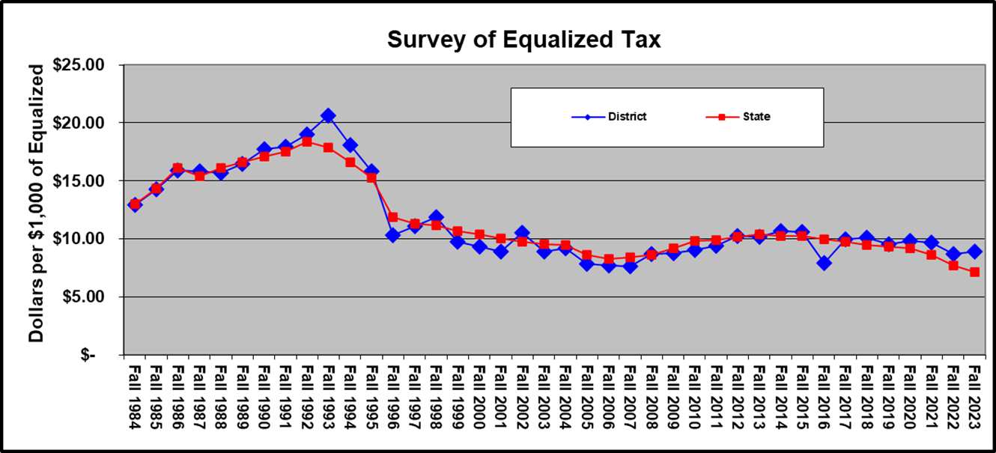
Revenue Limit Levy Controls
Source: Department of Public Instruction; sample school district shown

Slide 73
Importance of Revenue Limit Revenue
CONTROLLED
Although the mix of aid and taxes is different across districts, the Revenue Limit can control 70-90% of the General Fund revenue budget!
^ State General Aids includes: equalization aid, special adjustment aid, inter-district & intra-district
aids, and high poverty aid (i.e., state aids received under the districts’ revenue limit caps).
* Other Sources include: state categorical aids, federal aid, and non-property tax local revenue
(i.e., revenue received outside of the districts’ revenue limit caps).
Notes:
In 1993-94, the State enacted revenue limits to control the revenue a school district can collect from:
General Aid (Equalization Aid, for most districts)
Computer Aid
Aid for Exempt Personal Property
High Poverty Aid
Select Local Levies
General Fund (Fund 10)
Non-Referendum Debt Service (Fund 38)
Capital Projects (Fund 41)
It is not an expenditure control or spending limit.
Examples of what the Revenue Limit does not control (not exhaustive list):
School Fees
Categorical Aids (Per Pupil Aid, Special Education, Library Aid, Transportation Aid, etc.)
State and Federal Grants
Gate Receipts
Donations
Local Levies
Referendum Debt Service (Fund 39, at times called “Non-Fund 38”)
Community Service Fund (Fund 80)
Prior Year Levy Chargeback for Uncollectible Taxes (Fund 10)

Slide 74
Calculation
Sample Worksheet
Note: Fiscal Year begins July 1st; RLWS final figures received October 15th
Key Information
74

Slide 75

Revenue Limit Formula
Resident Membership (FTE)
$ per member
On-going and one-time exemptions
Revenue Limit Authority
Three-Year Average
September Full Time Equivalency (FTE)
40% Summer School
New Independent Charter School

Slide 76
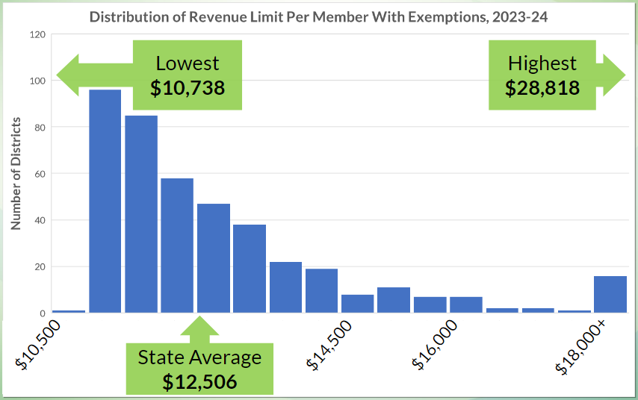
Revenue Limit Per Member with Exemptions
$12,506 average is $618 increase over 2022-23 average of $11,888
Source: Department of Public Instruction
Notes:
Legislature determines the per member increase. Originally, based it on the annual percentage change in the consumer price index (CPI) for all urban consumers, US city average. Recent years have been flat dollar amounts, zero, & even reductions.
The per member increase range was as low as -$554.00 in
2011-12 and as high as $274.68 in 2008-09.
For 2015-16, 2016-17, 2017-18, 2018-19, 2021-22, and
2022-23, the legislature set the increment at $0.00.
Within this slide, also need to talk about how money has been added to Per Pupil categorical aid ($654 million over the biennium) which is outside the revenue limit.
ONLY Decrease in Per member: Under the 2011-13 budget act, the per pupil adjustment in 2011-12 was set at a 5.5% reduction. The statewide average reduction was $554 per pupil.

Slide 77
Exemptions
Resident Membership (FTE)
$ per member
On-going and one-time exemptions
Revenue Limit Authority
District – specific “exemptions”
Some auto-calculate; others based on district reports or data
Recurring and Non-Recurring have differing long-term impacts

Slide 78
Recurring Exemptions
Once a district levies for a Recurring Exemption, that amount stays permanently in the base going forward.
78

Slide 79
Non-Recurring Exemptions
The exemption is only valid for a limited period of time –
usually one Revenue Limit cycle.
79

Slide 80
Types of Exemptions
Recurring
Prior Year Carryover
Transfer of Service
Recurring Referenda to Exceed
Transfer of Territory/Other Reorg and Federal Impact Aid Loss
Non-Recurring
Hold Harmless
Declining Enrollment Exemption
Non-Recurring Referenda to Exceed
Energy Efficiency Net Exemption
Prior Year Open Enrollment
WPCP, RPCP Private School Voucher and Special Needs Scholarship Program Deductions
Adjustment for Refunded or Rescinded Taxes, Fund 39 residual balance transfer, and Ineligible Fund 80 expenditures
80
Notes:
Recurring Referenda
Requires approval of the voters
Carryover
Eligible prior year unused authority
Other Recurring Exemptions (DPI approves and will populate amounts)
Transfer of Service
Transfer of Territory (rare to get)
Loss of Federal Impact Aid
Requires approval by Electors or Board
Non-Recurring Referendum [Line10 A.]
Energy Efficiency Projects [Line 10 C.]
Auto-determined in Revenue Limit Calculation
Declining Enrollment [Line 10 B.]
Other Non-Recurring Exemptions (DPI determined and populated amounts)
Refunded/Rescinded Taxes [Line 10 D.]
Prior Year Uncounted Open Enrollment Pupils [Line 10 E.]
Reduction for Ineligible Fund 80 Expenditures [Line 10 F.]
Environmental Remediation Exemption [Line 10 G.]
Private School Voucher Aid Deduction [Line 10 H.]
Private School Special Needs Voucher Aid Deduction [Line 10 I.]

Slide 81
“Base Revenue Limit” and Exemptions
Ave FTE * Max. Rev. / Member = majority of districts’ RL authority
Recurring exemptions, once levied, increase districts’ base
Non-recurring exemptions are received in the current year
81

Slide 82
Total Revenue Limit Authority
Resident Membership (FTE)
$ per member
On-going and one-time exemptions
Revenue Limit Authority
The “How Much” revenue a district can receive through the sources of General Aid and the Local Tax Levy

Slide 83
Revenue Limit, Equalization Aid, and Controlled Property Tax Levy
Revenue Limit Levy
EqualizationAid
Revenue Limit
Notes:
More money in State Aid without a corresponding increase to the Revenue Limit won’t result in additional revenue for the district. It just results in property tax relief.
“State Aid” includes:
General School Aids (Equalization Aids, Chapter 220 Integration Aids, and Special Adjustment (Hold Harmless Aids);
State Aid for Exempt Computers; and
State Aid for Exempt Personal Property.
2022-23 general school aids includes: $5,141.7 million equalization aids; $37.2 million integration (Chapter 220) aids; and $22.7 million special adjustment aids (hold harmless aids).

Slide 84
School Tax Levy Composition
Total School-Based Tax Levy
Revenue Limit Tax Levy
(Funds 10, 38 and/or 41)
Referendum Approved Debt Levy
(Fund 39)
Community Service Tax Levy
(Fund 80)
Prior Year Levy Chargeback
and Other

Slide 85
Basic Revenue Limit Concepts
The Revenue Limit controls revenues from general state aids and local property taxes.
Revenue Limit can control 70-90% of the General Fund revenue budget.
Revenue Limits are calculated by multiplying the Average Membership * a Per Member dollar amount and adding any exemptions.
It is very important to know the difference between recurring and
non-recurring exemptions. This is especially true when planning a referendum.
Calculating the property tax levy is a direct result of completing the Revenue Limit worksheet.
85

Slide 86
District Specific Revenue Limit Data
Prepopulated and Executable Revenue Limit worksheets
  https://dpi.wi.gov/sfs/limits/worksheets/revenue
Longitudinal data related to Revenue Limits
  https://dpi.wi.gov/sfs/statistical/longitudinal-data/revenue-limit
86

Slide 87
Revenue Limit
Questions?
87

Slide 88
Equalization Aid
Diving in….
…to the general aid portion of Revenue Limits
Revenue Limit
“State Aid”
Revenue Limit Levy
Notes:
More money in State Aid without a corresponding increase to the Revenue Limit won’t result in additional revenue for the district. It just results in property tax relief.
“State Aid” includes:
General School Aids (Equalization Aids, Chapter 220 Integration Aids, and Special Adjustment (Hold Harmless Aids);
High Poverty Aid;
State Aid for Exempt Computers; and
State Aid for Exempt Personal Property.
2022-23 general school aids includes: $5,141.7 million equalization aids; $37.2 million integration (Chapter 220) aids; and $22.7 million special adjustment aids (hold harmless aids).

Slide 89
Property Value and Fiscal Capacity
A student should not be unfairly disadvantaged as a result of where he or she lives.
Property Tax Base
This example is for hypothetical purposes only
89
Notes:
The fundamental purpose of the Equalization Aid formula is to “level the playing field” by providing assistance (distributing State general aid) to make up for what districts can’t get from their property tax base.
Equalizes the revenue. Thus, allows the opportunity for similar educational programming.
In general, districts with a higher property tax base receive less aid from the State.
District property value is a key factor.

Slide 90
Formula Equalizes Revenue to Mitigate Differences
Equalization Aid
Property Tax Base
This example is for hypothetical purposes only
90

Slide 91

Factor: Equalized Property Value
Property tax base is used to
determine district wealth and ability to
support district expenditures.
Uses Equalized Valuation or Fair Market Value.
(NOT Assessed Value)
Property values for each district are
certified in May each year
by the WI Department of Revenue
and used in the subsequent year’s aid calculations.
91

Slide 92




Key Local Factors
Membership
(Student FTE)
Spending (Shared Costs)
Equalized Property Value
Membership converts variables to per-pupil $s.
92

Slide 93

Equalization Aid
State “shares” in district costs funded by state aid and local levy.
$1 in debt service costs is treated the same as $1 in teacher salaries.
Aid is based on a district’s ability to fund expenditures, as measured by its property wealth per member.
Basic premise:
The more property wealth per member a district has, the less equalization aid it will receive…….and vice versa.
93

Slide 94
School Tax Levy Composition
Total School-Based Tax Levy
Revenue Limit Tax Levy
(Funds 10, 38 and/or 41)
Referendum Approved Debt Levy
(Fund 39)
Community Service Tax Levy
(Fund 80)
Prior Year Levy Chargeback
and Other

Slide 95
January 1
Property assessment
June
SOA and MAR to DOR
August
Equalized values to munis and counties
October 1 Equalized values to DPI, schools
November
DPI sends school
levies to DOR
November 20
DOR issues credit notices to munis
December 1
Deadline to send levy info to munis clerks
December 8
Deadline for tax roll delivery to treasurers
Third Monday in December
Mail tax bills
Notes:
Review the roles – who is responsible for what piece

Slide 96

School District Implications
Budget Development
Annual Meeting (most required)
October 15 General Aids Certification
Budget Approval (prior to November 1)
Setting the levy (prior to November 1)
Tax Levy to DPI (November 3)
Tax Levy to Municipalities (November 10)

Slide 97
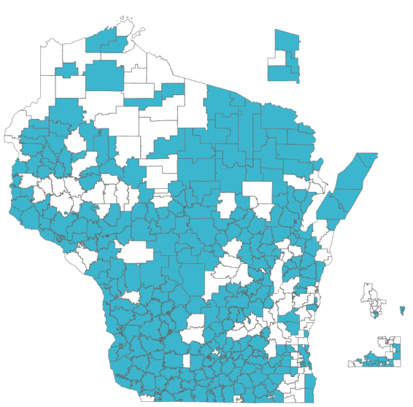
School District Implications
Referendum to Exceed Revenue Limits
Communications about the referendum
Prior referendums (voting results; prior commitments, results)
Understand in the impact of proposed referendum
The difference between recurring and non-recurring
Messaging of the impact on the levy (not mill rate)
Districts who have passed an Operational Referendum Question since 1992
97

Slide 98


School District Implications
Factors Impacting Estimated Costs of a Referendum
Debt capacity of the school district
Size of school district
Distribution of property values between the municipalities
Changes in equalization values in comparison to state
Retirement of debt
Payment of debt
Retirement of Tax incremental district (TID)
Future enrollment projections (membership)
98

Slide 99
January 1
Property assessment
June
SOA and MAR to DOR
August
Equalized values to munis and counties
October 1
Equalized values to DPI, schools
November 10
DPI sends school
levies to DOR
November 20
DOR issues credit notices to munis
December 1
Deadline to send levy info to munis clerks
December 8
Deadline for tax roll delivery to treasurers
Third Monday in December
Mail tax bills
Notes:
Review the roles – who is responsible for what piece

Slide 100
Understanding Your Tax Bill

Slide 101
WHEN DISCUSSING TAXES
TAXES ARE APPORTIONED –
    based upon Equalized Value
TAXES ARE CALCULATED –
    based upon Assessed Value

Slide 102
Calculation of Tax Bills
The information has all been compiled, levies have been apportioned/certified and all information has been dispersed to the municipal Clerk’s
  Information is entered into the County’s Land Information Software program
  Entered information is verified
  Tax bills are computed
  Proofs are sent to the municipality
  Once proofs are approved Tax bills are released

Slide 103
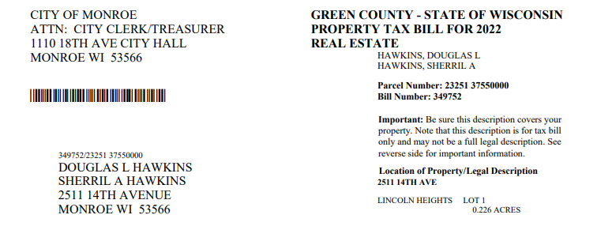
UNDERSTANDING YOUR TAX BILL
The Tax Bill will identify:
County
Year of the Tax Bill
Real Estate/Personal Property
Name of the Owner
Parcel Number/Account Number
Bill Number
Location of Property (Site Address)
Brief Legal Description

Slide 104

Assessed Values as determined by the Assessor
Average Assmt Ratio is the Aggregate Ratio which is a comparison of the municipality's total locally assessed value to the Department's non-manufacturing based Equalized Value.
Net Assessed Value Rate is the Tax Rate that multiplied (x) by your total Assessed Value equals your gross tax.

Slide 105
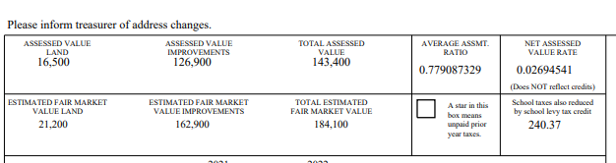
Estimated Fair Market value is calculated by taking the Assessed Value divided by the Average Assmt Ratio (Aggregate Ratio) to the nearest hundred.
This* will appear in the box if there are prior year taxes owing on the parcel
School Taxes also reduced by school levy tax credit – This amount is for the individual parcel and is deducted directly from the school districts next tax amount in the section below

Slide 106
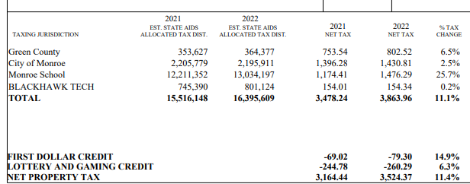
It is required to show both current and prior year tax information on the tax bill.
Taxing Jurisdictions are the entities that are authorized by law to levy taxes
The Estimated State Aids are allocated by the state and sent directly to the taxing jurisdictions
The Net Tax is required to be broken down by Taxing Jurisdiction and Year
Percentage of change shows the percentage the Net Taxes changed from Year to Year
The credits also show current and prior year amounts, percentage of change and are deducted from the Total Tax to give you the Net Property Tax.
***Be aware this may not be the actual total amount due***

Slide 107
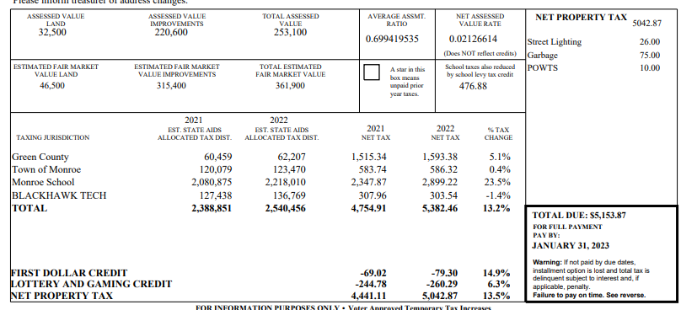
If you have any specials in the Net Property Tax box, those will be added to your “Net Property Tax” total for your “TOTAL DUE” amount

Slide 108

Referendums
This area of the tax bill shows if there were any referendums that impacted the tax bill. It shows:
  Taxing Jurisdiction that passed the referendum
  Total amount of the referendum levied against that municipality
  Individual tax impact to that specific parcel
  Year that the referendum will no longer show on the tax bill

Slide 109
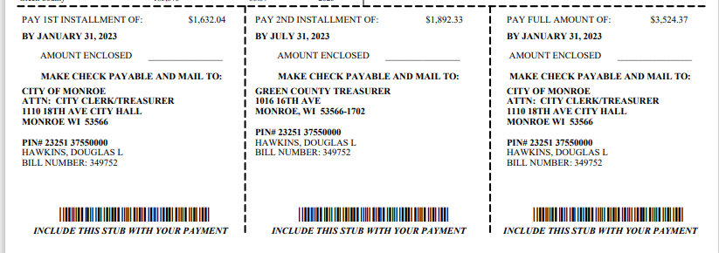
Payment Information
The stubs on the bottom of the tax bill provide the installment and the PAY FULL AMOUNT option amounts. They show:
Due date
Who to make your checks payable
Where the payment can be mailed.

Slide 110
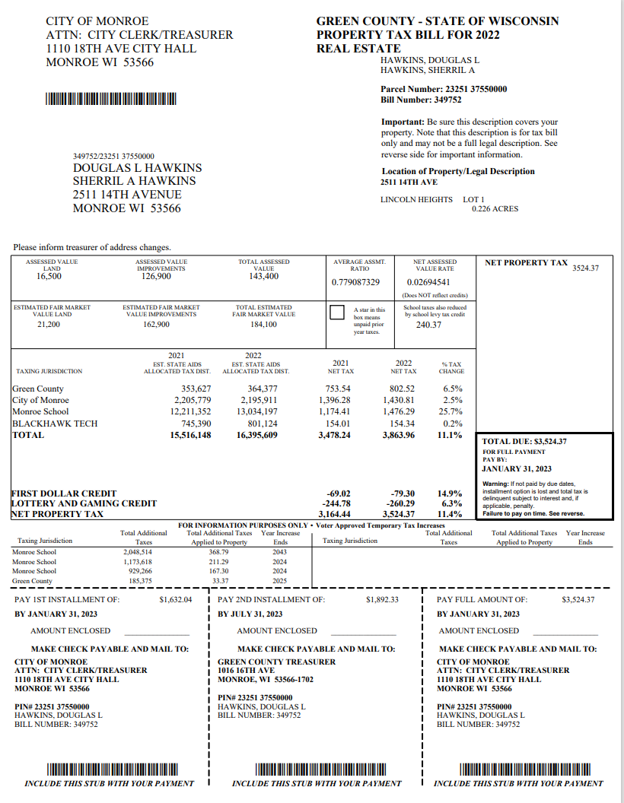
That is the explanation of
What information is needed, where the information comes from, how it is calculated and where that information is on the tax bill.
Any Questions?

Slide 111
Questions

