Slide 1
School Finance Puzzle: What Board Members Can and Can’t Influence
Presented by
Wisconsin Association of
School Business Officials
and
Wisconsin Department
of Public Instruction,
School Financial Services

Slide 2
Welcome!
Mike Barry,
Executive Director, WASBO
Steve Summers
Executive Director of Operations
Waunakee Community School District
Notes:
Clark

Slide 3
Learning Targets
At the end of the session, attendees should:
Enhance awareness and understanding of board members influence
Raise confidence level of board members in communicating on school finance topics
Help foster an environment of trust between citizens and elected officials
Notes:
Speaking points:
For over a decade the DPI & WASBO has been providing this session to help district leaders better understand the key funding formulas and programs that drive public education’s finances.
This year we will continue to touch on the key funding issues but also want to spend some time discussing the Board’s role in determining the overall goals of the district, the process to be utilized to reach a final budget and what areas local Board’s have significant input on and what areas state and federal regulations rule the day.
You should not expect to leave here as a school finance expert!

Slide 4
Introductions
Introductions:
The presenters will introduce themselves (name, organization, and role).
Each participant will introduce themselves to their table (name, school district, and role).
Notes:
Font consistency

Slide 5
The Puzzle Pieces with
Timeline
Introduction / School Budget Overview
Mike Barry, WASBO • 1:30 - 1:45 PM
The Formal Side of School Finance Mark Elworthy, DPI • 1:45 - 2:00 PM
TABLE TALK • 2:00 - 2:15 PM
Revenue Limit vs. State Aid Mark Elworthy, DPI • 2:15 - 2:30 PM
TABLE TALK • 2:30 - 2:45 PM
BREAK 2:45 - 3:00 PM
Revenues: Outside the Revenue Limit Formula Debby Brunett, Baird • 3:00 - 3:15 PM
Notes:
This session is designed to be interactive with both table activities and possibly Kahoot questions. Table coaches are here to provide assistance and guide the table discussions if needed. Don’t hesitate to ask them questions, they are here for that exact reason.
Also at the table are index cards to write down questions if you don’t want to ask the group as a whole. We will be coming around to pick up questions and will read then answer them at break points in the presentation.

Slide 6
The Puzzle Pieces with
Timeline (continued)
TABLE TALK • 3:15 - 3:30 PM
Process and Prioritization Jeff Pruefer, Nicolet • 3:30 - 3:45 PM
TABLE TALK • 3:45 - 4:00 PM
Expenses: Resource Allocation/Strategic Planning Sarah Viera, Mequon-Thiensville • 4:00 - 4:15 PM
TABLE TALK • 4:15 - 4:30 PM
Tax Levies/Tax Bills Dan McCrea, Janesville • 4:30 - 4:45 PM
From School Tax Levy to Property Tax Bill Steve Summers, Waunakee • 4:45 - 5:00 PM
Notes:
This session is designed to be interactive with both table activities and possibly Kahoot questions. Table coaches are here to provide assistance and guide the table discussions if needed. Don’t hesitate to ask them questions, they are here for that exact reason.
Also at the table are index cards to write down questions if you don’t want to ask the group as a whole. We will be coming around to pick up questions and will read then answer them at break points in the presentation.

Slide 7
School Budget Overview
Mike Barry,
Executive Director, WASBO
Notes:
Context matters.
Some boards operate in a traditional governance model yet give wide discretion to the administration generally, including budget development
Some boards operate in a traditional model yet have a very hands orientation, including during budget development
Some boards operate in a policy governance model (coherent policy model) wherein the admin is charged with budget development so long as it conforms to certain agreed upon policy outcomes
In traditional or common board-admin governance model, as it relates to budget development, boards tend to focus on key control points: the total levy increase, the teacher compensation package, major controversial cuts, changes in class sizes, admin staffing, and the overall consistency of the plan - does it hold together? These quite often the elements that board members focus on. (Sitting in the far end of the bleachers)
A well planned, agreed upon approach to annual budget development will produce better outcomes for all concerned

Slide 8
Getting Started:
Creating a Budget Framework
Establish Guiding Principles
Articulate Budget Goals
Build Budget Calendar & Stick to It
Define Public Engagement Plan
Notes:
Mike
Project management

Slide 9
Establish Guiding Principles
(Examples)
We will maintain a multi-year perspective
We will be guided by a strategic plan
We will be open and transparent
Think of these as ways of working that need to make sense in your organization and context
Notes:
Mike

Slide 10
Articulate Budget Goals:
(Examples)
The budget will address recruitment and retention of staff through a revised compensation plan
This budget will increase investments in school safety and school-based mental health resources by 2%
This budget will increase reading staff to elementary schools with the highest needs
Notes:
Mike
Budget goals can vary depending on which district you are in. Some places it is more strategic, some is new bleachers.
Common goal is what is best for the students. Safety enhancements, curriculum, etc.
Board involvement here, board member should know what those goals are for their district.

Slide 11
School District
Budget Development Calendar
(Common Elements)
Jan-Mar Admin Provides Budget Preview
Mar-May Admin Prepares Draft Budget
May-Jun Board Reviews Draft Budget
Jul-Oct Public Hearing & Annual Meeting
Oct-Nov 1 Certify Levy & Adopt Budget

Slide 12
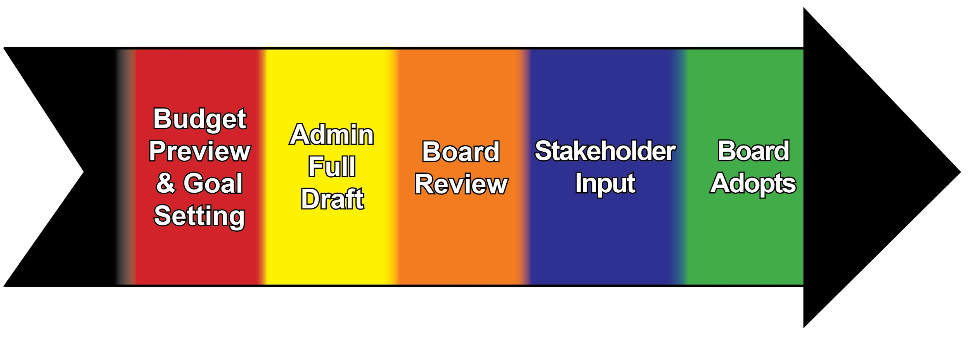
Your Budget Process Includes a Public Engagement Plan that Fits Your Community
Notes:
Mike
Change public input to stakeholder input.
Consider removing option C and maybe just verbalize it.
Reiterate the board’s involvement in this process. How, when? What works best for your communities wants/needs? Potentially remove and expand on it during budget calendar

Slide 13
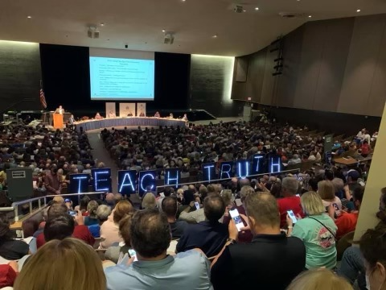
…AND STILL THIS HAPPENS!

Slide 14
The Formal Side of School Finance
Mark Elworthy Department of Public Instruction
School Financial Services Team

Slide 15
Structure
The Wisconsin school finance system is organized by the:
https://dpi.wi.gov/sfs/finances/wufar/overview

Slide 16
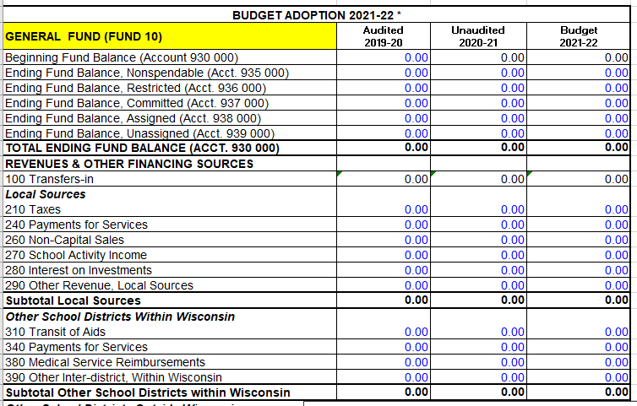
You’ve seen it before...

Slide 17
Business Accounting
Balance Sheet
+ Assets
Cash
Receivables
- Liabilities
Debt
Payables
= Equity
Profit & Loss
+ Income
Sales
Interest
- Expenses
Payroll
Operations
= Net Income
Notes:
Some of you are probably familiar with business accounting - at the end of the year, or quarter, or month, you have a balance sheet showing assets, liabilities & equity, and a income or P&L statement showing income, expenses, and net income.

Slide 18
Fund Accounting
General Fund (Fund 10)
Special Ed
(Fund 27)
Balance Sheet
+ Assets
Cash
Receivables
- Liabilities
Debt
Payables
= Fund Balance
Change in Equity
+ Revenues
Taxes
State Aids
- Expenditures
Payroll
Operations
= Net Equity
Food Service
(Fund 50)
Balance Sheet
+ Assets
Cash
Receivables
- Liabilities
Debt
Payables
= Fund Balance
Change in Equity
+ Revenues
Taxes
State Aids
- Expenditures
Payroll
Operations
= Net Equity
Balance Sheet
+ Assets
Cash
Receivables
- Liabilities
Debt
Payables
= Fund Balance
Change in Equity
+ Revenues
Taxes
State Aids
- Expenditures
Payroll
Operations
= Net Equity
Notes:
Most governments, including all Wisconsin school districts, use something called fund accounting. Think of fund as its own set of books for its own specific purposes. Usually there will be special funds, defined by restrictions on where money comes from and/or how it’s used, and then a catch-all General Fund for everything else.

Slide 19
WUFAR School Funds
“Each Fund Can be Thought of as a Separate Bucket”
General Fund
Special Education
Debt Service
10
27
38/39
Capital Projects
Food Service
Community Service
40s
50
80
Notes:
These are the most common funds that you’ll have in your district.

Slide 20
How We Budget
Each Fund has its own budget.
Expenses are budgeted by Fund and Function - what you’re buying in that fund.
Example: 120000 = Regular Curriculum (individual subjects)

Slide 21
How We Budget
Revenues are budgeted by Fund and Source - where dollars are coming from.
Example: 210 = Property Taxes

Slide 22
How We Budget
Funds 10 & 27 are the bulk of your district’s budget.
The main driver is your district’s Revenue Limit, which we’ll discuss next.

Slide 23
Table Talk
Do you know which WUFAR Funds are used by your district?
Are there any WUFAR funds that you are interested in learning more about?

Slide 24
Revenue Limit vs. State Aid
Mark Elworthy
Department of Public Instruction
School Financial Services Team
Notes:
Set expectations - we’re staying high level in this section, if you want to know more we have a “Deep Dive” session, details at the end of the section.

Slide 25
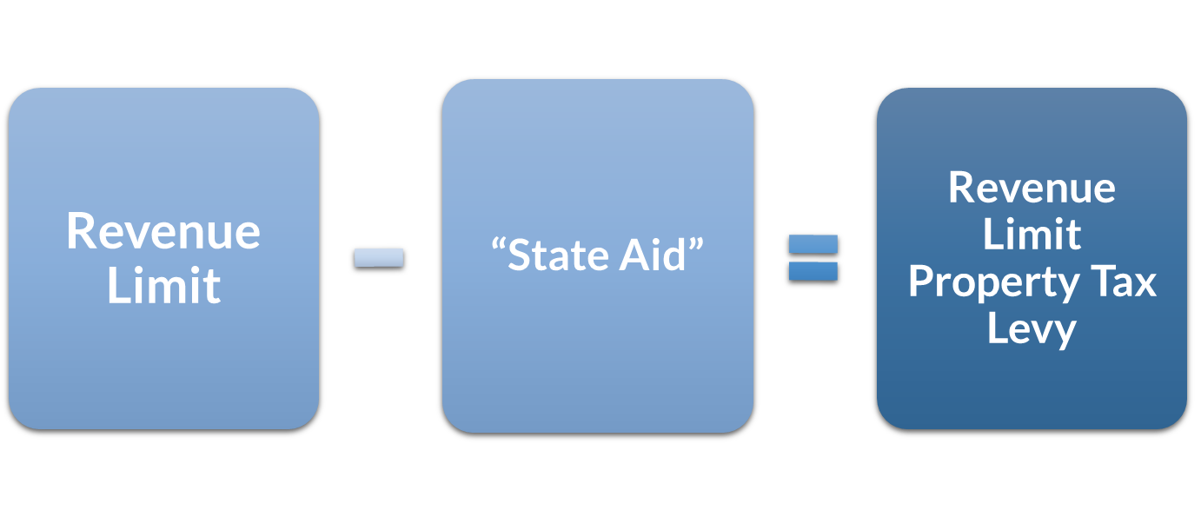
Basic Funding Equation
25
Notes:
25
More money in “State Aid” without a corresponding increase to the Revenue Limit won’t result in additional revenue for the district. It just results in property tax relief.
“State Aid” includes General School Aids, High Poverty Aid, State Aid for Exempt Computers and State Aid for Exempt Personal Property.
2022-23 general school aids includes: $5,141.7 million equalization aids; $37.2 million integration (Chapter 220) aids; and $22.7 million special adjustment aids (hold harmless aids).

Slide 26
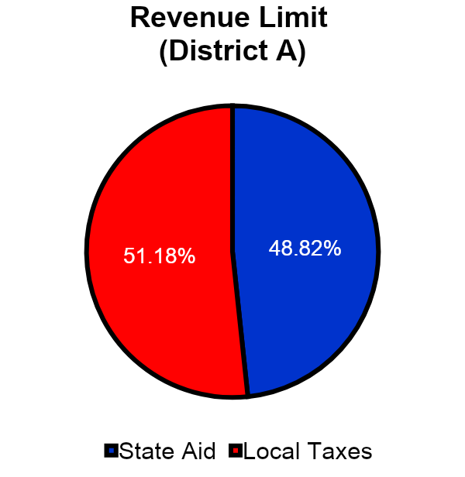
Pie (size) vs. Filling
(Revenue Limit) (State Aid & Property Tax)
Consider the Revenue Limit as the pie (size)
The Revenue Limit is defining the size of the pie (the outer crust).
The pie filling is made up of State Aid and Local Taxes.
As State Aid increases/decreases, the Local Taxes (“relief valve”) adjust inversely.
Notes:
The amount of “filling” from state sources is determined by the state aid formula.
The amount of “filling” from local taxes is based on the space available in the crust of the pie and whether the Board wants to fill the pie.

Slide 27
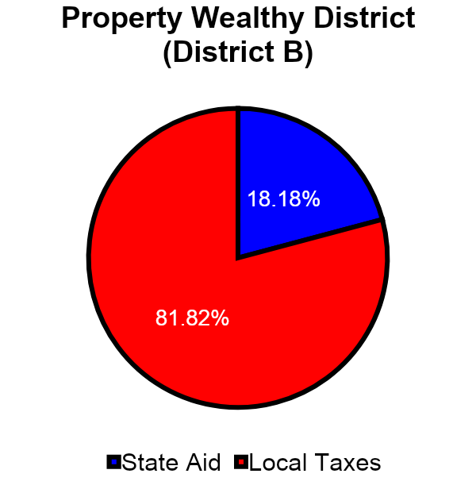
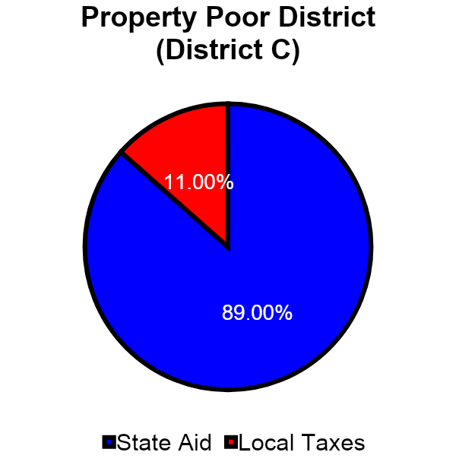
Different Flavors for Different Districts

Slide 28
Revenue Limit Factors
Critical factors in the revenue limit calculation include:
Base Revenue (Prior Year Revenue Limit)
Membership (Full-time equivalent resident students)
Allowable Annual Change Per Member ? ($0 in 2021-22 & 2022-23, 2023-24 and 2024-25 TBD)
Allowable Exemptions to the Limit

Slide 29
Revenue Limit Membership
Membership does not equal Students in Seats
Based on a 3-year rolling average
Based upon residents
Non-Residents Open Enrolling into the district are not in Membership
Notes:
Keep this conceptual – 3-year rolling average. Membership is residents, which is not the same as enrollment (kids in seats).
How does the size of the pie change?
Membership: Pie gets bigger or smaller as membership grows or shrinks
State lets you grow it (not too often as of late): Per-pupil adjustment has been $0 more often the last several years
Your voters let you grow it: Referenda

Slide 30
Impact of Per-Member Adjustment
Allowable Per-Member Adjustment
The amount of the per-member adjustment will impact how much or how little the revenue limit increases.
A drop in the revenue limit membership may offset any increase, when applicable, generated by the per-member amount.
Notes:
This adjustment would expand the size of the district’s revenue limit pie.
•The legislature has the authority to set the per member increase. Originally, they based it on the annual percentage change in the consumer price index (CPI) for all urban consumers, US city average. Recent years have been flat dollar amounts, zero, & even reductions.
•The per member increase range was as low as -$532.00 in 2011-12 and as high as $274.68 in 2008-09.
•For 2015-16, 2016-17, 2017-18, 2018-19, 2021-22, and 2022-23, the legislature has set the increment at $0.00.

Slide 31
Per Member Adjustment & Per Pupil Aid
Fiscal Year | Revenue Limit Per Pupil Increase (Cumulative) | Per Pupil Categorical Aid (One-Time)
2011-12 | -5.5%*
2012-13 | $50 | $50 (Prorated)
2013-14 | $75 | $75
2014-15 | $75 | $150
2015-16 | $0 | $150
2016-17 | $0 | $250
2017-18 | $0 | $450
2018-19 | $0 | $654
2019-20 | $175 | $742
2020-21 | $179 | $742
2021-22 | $0 | $742
2022-23 | $0 | $742
2023-24 | TBD | TBD
2024-25 | TBD | TBD
.
Notes:
93-94 ranged from and peaked
From 1993-94 to 2008-09 the Revenue Limit- Allowed Per-Member change ranged from $190 to as high as $274.68
The Per Pupil Categorical Aid was introduced in the 2012-13 year.
School Finance Issues
1/17/2019
31
Presented by Bambi Statz, Ph.D. Fall 2010

Slide 32
Revenue Limit Calculation
Membership
Maximum Revenue / Member
Revenue Limit with No Exemptions
If Membership or the Maximum Revenue per Member increase, the “Pie Crust” (Revenue Limit) can get bigger.
32
Notes:
32
As membership grows or declines, we can see the size of the pie will expand or shrink.

Slide 33
Impact of Exemptions
Additional Ways to Expand the Pie Crust:
Allowable Exemptions to the Limit
Exemptions typically increase a district’s revenue limit, but the impact is dependent upon whether the exemption is temporary or permanent in nature.
If an exemption is temporary, the district will need a plan to either fund the future expenditures with a different source or eliminate the expenditures.
Notes:
Touch on referenda here. This is an opportunity for the voters to decide if they want to expand the pie of the district.

Slide 34
Revenue Limit vs. State Aid
What you can spend (the pie) and how much you receive in general school aids (part of the filling) are two different things.
General school aids are purposeful tax relief.
The main general school aid program is Equalization Aid.
Notes:
How much of the pie is the blue slice?
More money in “State Aid” without a corresponding increase to the Revenue Limit won’t result in additional revenue for the district. It just results in property tax relief.
“State Aid” includes General School Aids, High Poverty Aid, State Aid for Exempt Computers and State Aid for Exempt Personal Property.
2022-23 general school aids includes: $5,141.7 million equalization aids; $37.2 million integration (Chapter 220) aids; and $22.7 million special adjustment aids (hold harmless aids).

Slide 35
Why Equalization Aid?
Wisconsin Constitution, Article X:
“The legislature shall provide by law for the establishment of district schools, which shall be as nearly uniform as practicable….”
“Each town and city shall be required to raise by tax, annually, for the support of common schools therein……”
Notes:
“As nearly uniform as practicable” does not mean the state guarantees a certain level of per-pupil funding.

Slide 36
What Does That Mean?
Different communities will raise different amounts of money with the same property tax rate.
Equalization Aid is the state chipping in toward “as nearly uniform as practicable.”
Basic idea is to provide similar financial resources “per student” across the state.

Slide 37
Aid Formula: Two Basic Questions
Last year…
How much did you spend “per member,” compared to the state as a whole?
How much was your property value “per member,” compared to the state as a whole?

Slide 38
Equalization Aid Factors
Equalized Property Value: Based on assessed values; Dept. of Revenue adjusts for local differences.
Shared Cost: About 80% of total spending, shared between local taxpayers & the state.
Membership: Your resident students who are your district’s financial responsibility.
Notes:
Editorialize on enrollment vs. membership - loop in summer school.

Slide 39
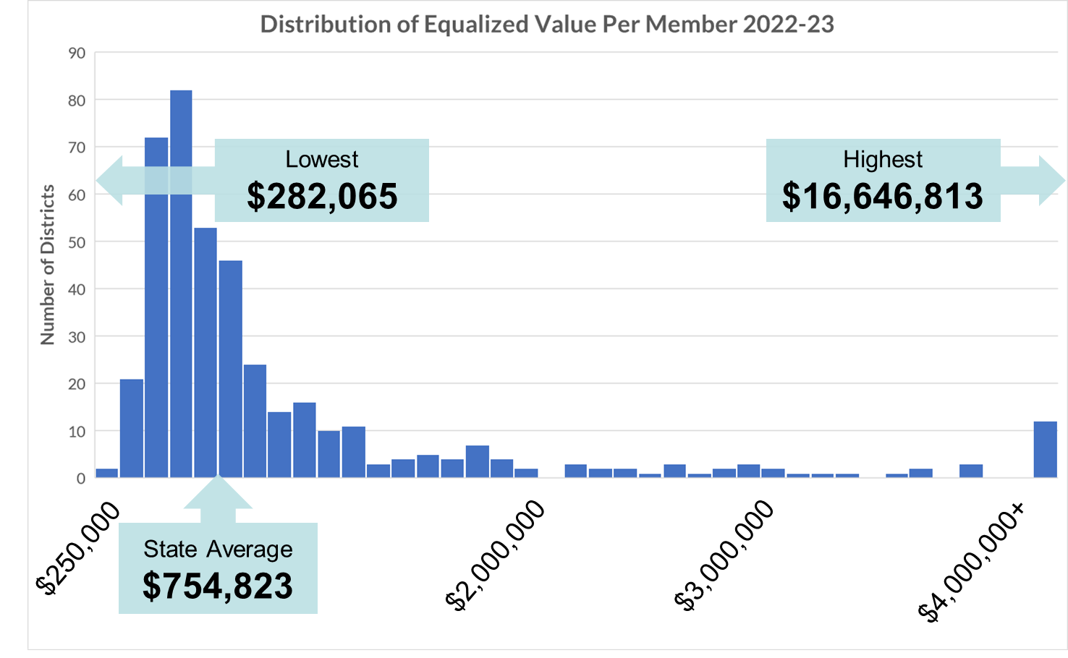
Notes:
For 2022-23 General Aid, Prior Year (PY) data from 2021-22, excluding Norris
Low – Abbotsford $282,065
High – North Lakeland $16,646,813
Ratio: 59 to 1

Slide 40
What Is Your Position?
It is very important to know where your district is positioned in the Equalization Aid formula to understand how it impacts your district.
“Positive Aid” districts that increase shared costs see an increase in state aid, while …
“Negative Aid” districts that increase shared costs see a decrease in state aid!
(all other factors being equal)
40
Notes:
Consolidate: Negative aid is how the state shifts from wealthier than average districts to poorer than average districts, it’s how the formula works
Districts that are in negative aid lose aid dollars as their shared cost increase.
40

Slide 41
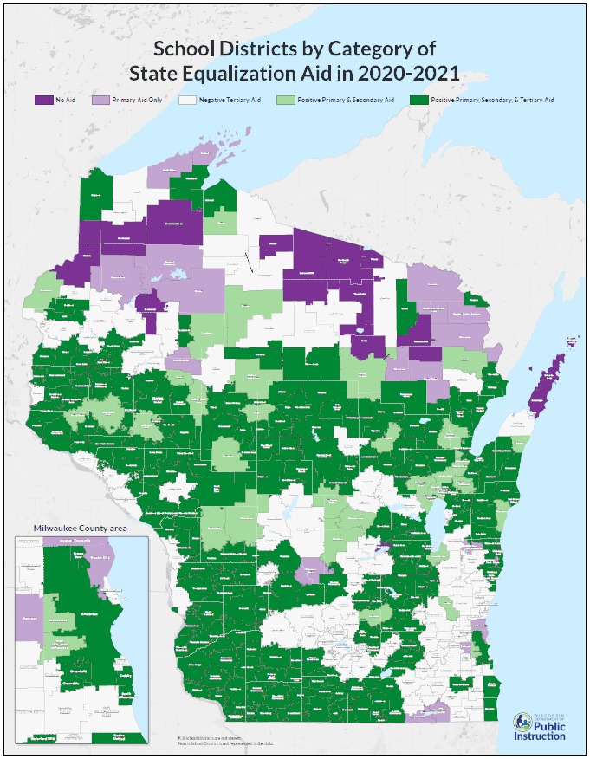
Notes:
2021-22 General School Aids
No equalization aid 23*
Primary only 27
Positive primary and secondary 41
Positive primary, secondary and tertiary 218
Negative tertiary 112
* 5 of these 23 school districts receive $0 General School Aids: Geneva J4, Green Lake, Mercer, North Lakeland, and Washington Island.

Slide 42
Final Points on Equalization Aid
Special Adjustment or “Hold Harmless” keeps your aid from falling more than 15% per year.
More aid means less to tax, not more to spend. Has to be combined with a Revenue Limit increase to make resources available.
Aid formula assumes value per member is the best measure of ability to pay.
Redistribution is the intent: for one district to get more, other districts have to get less.

Slide 43
What Are Referenda?
A referendum grants revenue authority.
It has a tax impact, but it doesn’t raise taxes by a specific dollar amount
Impact depends on how funds are used and where you live in the aid formula
Vote for one of two things:
Issue debt for a specific purpose
Raise additional dollars for operations

Slide 44
Referenda
Issue Debt
Borrow a specific amount of money for a specific purpose
Wording of the question is important!
Revenue authority: Whatever you need to make debt payments
Won’t know until you actually issue the debt
Work with financial advisor to forecast impacts

Slide 45
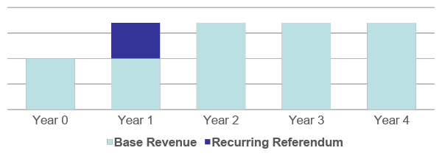
Referenda
Operating (Exceed Revenue Limit)
Increase your allowed revenue (Equalization Aid plus property taxes) in one or more years
Recurring: Ongoing increase

Slide 46
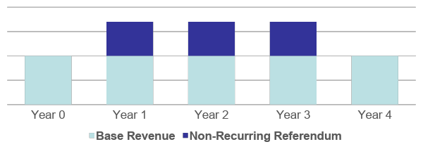
Referenda
Operating (Exceed Revenue Limit)
Increase your allowed revenue (Equalization Aid plus property taxes) in one or more years
Non-Recurring: Time-limited increase

Slide 47
A Note on Referenda
2017-2019 biennial budget (2017 Act 59) added significant restrictions:
Limit of 2 questions per calendar year
Only held with scheduled regular elections
Even years: Spring & fall, primary & general
Odd years: Spring primary & general
Careful referendum planning and wording even more important than before!
Notes:
Low revenue ceiling implications interplay with failed referenda
• If a district fails to pass a recurring or nonrecurring referendum during 2018-19 or after, for three years following the failed referendum the Low Revenue Ceiling amount is the amount from the year the referendum was failed.

Slide 48
For More Information
For more in-depth information on revenue limits & state aid attend:
A Deep Dive into School Finance
Thursday, January 19 – 8:45 AM
Room 102 D/E
Presented by DPI and School Business Experts

Slide 49
Table Talk
What is your district’s maximum revenue per member (line 5)?
What exemptions does your district have on the revenue limit formula (lines 8-10)?
Has your district recently passed a referendum, or does your district plan to propose a referendum in the near future?

Slide 50
Revenues: Outside the Revenue Limit Formula
Debby Brunett School Business Specialist Baird
Notes:
Debby

Slide 51
Revenues: Outside the Revenue Limit Formula
At the conclusion of this section participants will be able to:
Recognize the ratio of revenue limit : non-revenue limit revenue
Identify non-revenue limit revenues and describe how they’re received
Describe the impact of short- and long- term revenue sources on expenditure allocations
Notes:
RL Revenue typically comprises 75-85% of districts’ general fund operating revenue.
There are others!
While we report on Fund 10 and Fund 27 separate, this portion is going to discuss both.

Slide 52
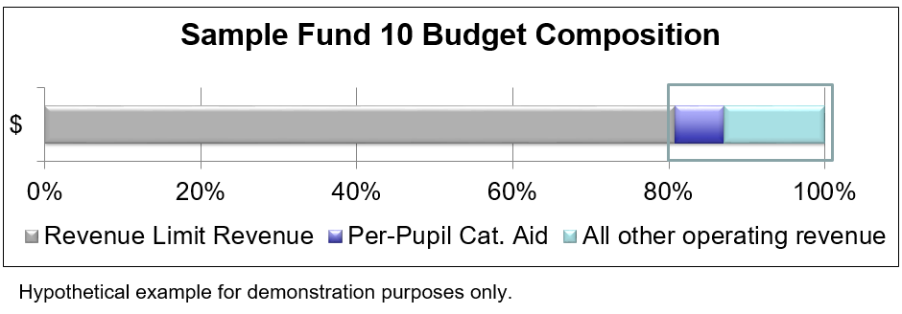
Revenues: Outside the Revenue Limit Formula
Notes:
RL Revenue typically comprises 75-85% of districts’ general fund operating revenue.
There are others!
While we report on Fund 10 and Fund 27 separate, this portion is going to discuss both.

Slide 53
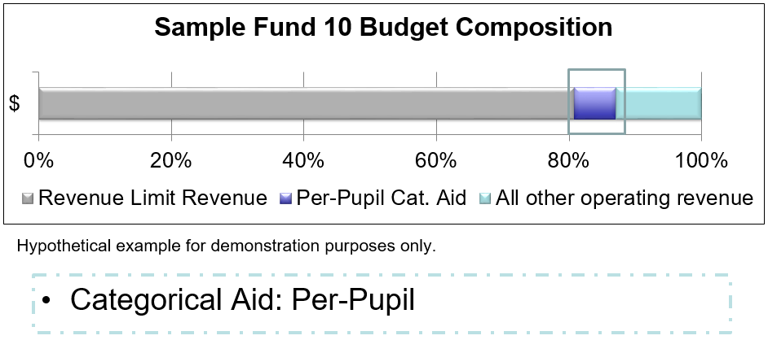
Revenues: Outside the Revenue Limit Formula

Slide 54
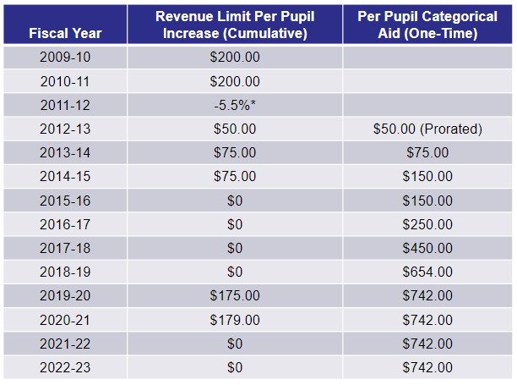
Revenues: Outside the Revenue Limit Formula
Notes:
Discussed prior or attend “Deep Dive” for more information on the impact of this

Slide 55
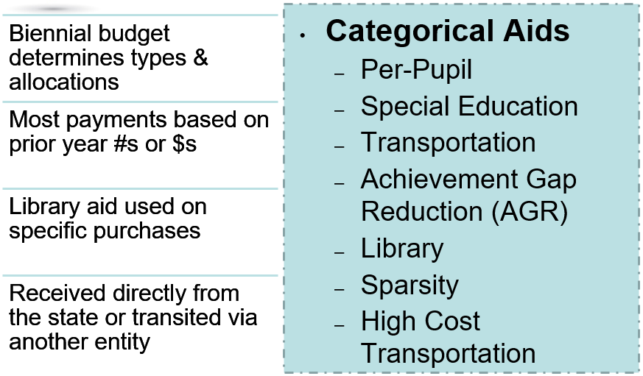
Revenues: Outside the Revenue Limit Formula
Notes:
While RL is “controlled”
Many others are controlled via the biennial budget allocations
AGR and Per-pupil categorical aid paid on current year counts

Slide 56
Revenues: Outside the Revenue Limit Formula
Open Enrollment Revenue
Open Enrolled In F.T.E * per-pupil $
2022-23 $s Regular Educ: $8,224
Special Educ: $13,076
Per-pupil amount is:
Prorated for part-time programs or partial-year attendance

Slide 57
Revenues: Outside the Revenue Limit Formula
State and Federal Grants/Aids examples:
Expensed on allowable items; then reimbursed
Consider grant duration vs. grant expense
Title IA
Flow Through
REAP
Title IIIA
Title IIA
Carl Perkins
Title IVA
PreK Flow Through
1:1 Technology
ESSER
Educator Effectiveness
Notes:
Impact aid not expensed and reimbursed and is an exception to the above
Other examples: Medicaid & ERATE
Can affect districts’ cash flow needs

Slide 58
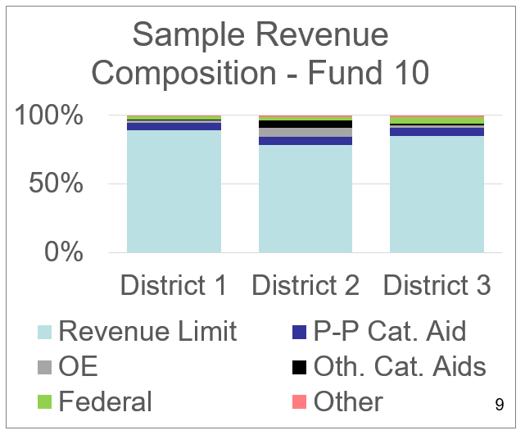
Revenues: Outside the Revenue Limit Formula
Other:
Payments between districts
School fees
Co-curricular fees / revenue
Other
Notes:
What does this leave?
“Others” are a very small $
COVID relief funds may cause temporary shifts in the federal revenue portion

Slide 59
Revenues: Outside the Revenue Limit Formula
Importance of Revenue Estimates In Budget Planning:
Most revenue formula-driven or allocated
Revenue Limit
Per-Pupil Categorical Aid
Other State / Categorical Aids
Open Enrollment
Federal Aids / Grants
Other
If goal = balanced budget; most often an expenditure adjustment

Slide 60
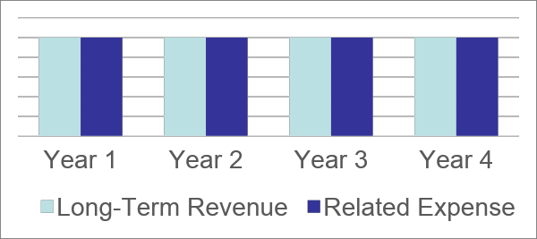
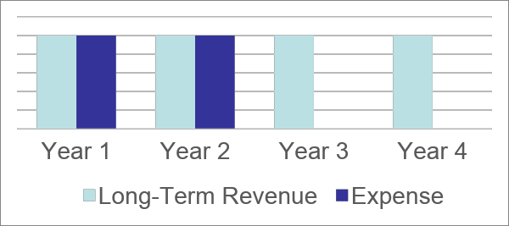
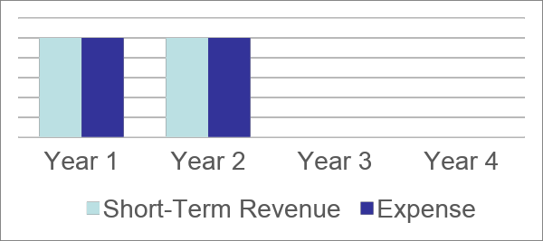
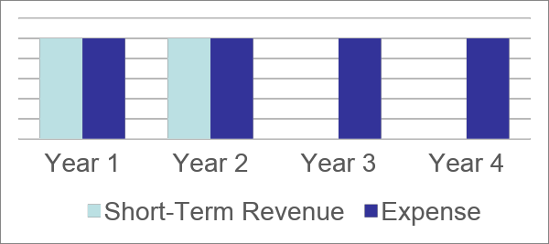
Revenues: Outside the Revenue Limit Formula
Short- vs. Long- term revenue important when making expenditure allocations
1
2
3
4
?
?

Slide 61
Revenues: Outside the Revenue Limit Formula
In summary:
Most districts’ operational revenue is determined by state or federal calculations/allocations
“Other” revenue small percent of overall budget
Long-Term Budgeting Considerations
Balanced budgets begin with revenue estimates
Consider revenue longevity when determining related expense

Slide 62
Table Talk
Describe an “ah-ha” you’ve experienced around school finance revenues this afternoon.
What are the implications of one-time revenues on a district’s budget?

Slide 63
Budgeting Process & Prioritization
Jeff Pruefer Director of Business Services Nicolet Union High School District

Slide 64
Budget Process
Preparation: Budget Calendar
Input: Budget Requests (Google Form Process)
Input: Budget Assumptions (Assumptions Worksheet)
Development / Planning: Budget Planning Guide and Department Budgeting
Decisions: Preliminary and Original Budgets
Staffing; Negotiations; Health Insurance; Transportation; Budget Requests; etc.

Slide 65
Start the Process Early
(November/December)
Budget Calendar (November/December)
Nicolet Budget Calendar
Waunakee Budget Calendar
Mequon Thiensville Budget Calendar
Budget Requests Process (December)
Nicolet Google Process
Requests tied to strategic goals (Administrative and Board)

Slide 66
Developing Assumptions
(December/January)
Build our budget without all factors known
Registration often concludes in March
State Budget not final
Enrollment for next year unknown
Assumptions
Develop assumptions with Internal Staff
Nicolet Budget Assumptions Worksheet
Develop assumptions with School Board
Nicolet Budget Assumptions Board Memo
Budget Prioritization happens HERE!

Slide 67
Developing Assumptions
(December/January)
Focus on impactful assumptions
Revenues
Enrollment Projections
State Budget (Revenue Limit; Special Ed Funding, etc.)
Expenses
Staffing Changes (Additions, Reductions, etc.)
Wages
Health Insurance
Transportation
Utilities
Consideration of Budget Requests

Slide 68
Budget Planning Guide
(February)
Assumptions provide data to build a plan
Nicolet Budget Planning Guide
Ultimate Goal of Planning Guide
Document used for budget creation
Preliminary financial projection for both short and long-term
Ensures link from funding to priorities
Typically utilized for negotiations

Slide 69
Budget Development
(March)
After Planning Guide approved, that is trigger to set off departmental budget development
At this point, departments know what they will get for their allocations
Decentralized - Department Heads budget their funds (Academic, Athletics, Rec, etc.)
All budgets are in GoogleSheets (easy to share)
Budgets due to Business Office by end of Spring Break
Notes:
Fund Balance is basically District equity (Assets minus liabilities)
So realize fund balance does not equal cash - rather it is a look at the District’s equity
The percentage that is typically dictated is Board policy is a dollar amount compared to expenses
Percentage can be based on Fund 10 only/Percentage can include Fund 27 expenses
All driven by Board Fund Balance Policy - Local Decision
Seem some as low as 10%, seem some as high as 30% - Different districts have different tolerances for risk due to the unexpected
Why does fund balance matter:
Financial stability (similar to emergency fund in household budget);
Greater the balance, typically less need to borrow on a short-term basis (less dollars paid on interest for LOC or TRAN debt);
Better rates on borrowings (strong balance helps contribute to better credit rating) - More than anything, be in compliance with Board policy
So talk with your administration about what yours is and what it should be - that will help you drive future budget decisions

Slide 70
Preliminary Budget Development
(April/May)
Lots of information known or becoming known at this point
Registration complete (staffing plan to Board in April)
Transportation renewal determined
Utilities cost for current year analyzed
Health insurance renewal close to finalized
PNC insurance renewal completed
Notes:
Fund Balance is basically District equity (Assets minus liabilities)
So realize fund balance does not equal cash - rather it is a look at the District’s equity
The percentage that is typically dictated is Board policy is a dollar amount compared to expenses
Percentage can be based on Fund 10 only/Percentage can include Fund 27 expenses
All driven by Board Fund Balance Policy - Local Decision
Seem some as low as 10%, seem some as high as 30% - Different districts have different tolerances for risk due to the unexpected
Why does fund balance matter:
Financial stability (similar to emergency fund in household budget);
Greater the balance, typically less need to borrow on a short-term basis (less dollars paid on interest for LOC or TRAN debt);
Better rates on borrowings (strong balance helps contribute to better credit rating) - More than anything, be in compliance with Board policy
So talk with your administration about what yours is and what it should be - that will help you drive future budget decisions

Slide 71
Preliminary Budget Board Approval
(May/June)
At Nicolet, both the DPI Approved format for approval AND narrative budget for better understanding
Nicolet Narrative Budget
Budget is presented in August at Budget Hearing / Annual Meeting

Slide 72
Original Budget Approval
(October)
Changes happen between May and October
State budget finalization (Summer)
Enrollment Updates (3rd Friday)
Staffing Changes
Tax Base/Aid/Revenue Limit Certification
Vouchers
Updated in October and brought to Board for Approval

Slide 73
Surplus Budgets
Strategies when revenues exceed expenditures:
Planned Surplus: Relatively uncommon
Often an end of year conversation versus beginning of the year
Caveat: In Districts with operational referendum, might see surplus budgets on front end
Evaluate options with your Board and administrative team
Operational Needs
Fund Balance, OPEB, Capital Projects, Fund 46

Slide 74
Deficit Budgets
When expenditures exceed revenues (More Common)
October: Tough to manage - Be conservative in the spring
Generate Revenue - Not much possibility
Reduce Expenditures - Focus in the spring
Contracts have been issued by May so can’t cut in fall
Consider Operating Referendum
Multiyear Planning Process
Consider use of Fund Balance (Fund Balance Policy)

Slide 75
Budget Challenges: Consider Operating Referendum
Requires advanced planning
Recurring vs. Non-Recurring
Requires educating your community
Why is current funding inadequate?
Each District has its story
Revenue Limit Per Pupil low
Decreasing enrollment
Community supports additional spending; etc.
Other Considerations - Financial Impact
Talk to your administration
Talk to your financial advisors
Once utilized, it’s difficult to pull back

Slide 76
Table Talk:
What are some areas where you think your District should be cautious when planning for 2023-24 and beyond?
What are some major priorities in your District? Are the priorities you mentioned also financial priorities?
What is one thing your District does programmatically that costs a significant amount of dollars? Do you agree with the allocation of those funds?
Notes:
Groups to report out ideas they had to close the budget
There will be things you can’t touch, others you have the ability to work through - Different Districts will approach a budget gap differently, this activity will give us insight into how different board members think
Revenue ideas? Raise school fees; Explore alternative revenue ideas (cell towers, other revenue generation ideas)
Expenditure Savings? What are items you can’t reduce? What are the items you can reduce? What would you prioritize?

Slide 77
Expenses:
Resource Allocation & Strategic Planning
Sarah Viera Executive Director of Business Services Mequon-Thiensville School District

Slide 78
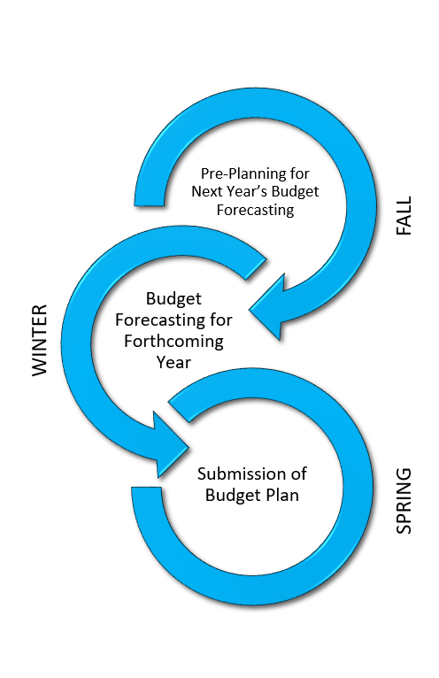
Budget Development
Our best estimates of the resources and costs necessary to operate the school district for the upcoming school year.
Budget planning begins in Fall of each year, and concludes the following October.

Slide 79
The Big Picture
Key Performance Indicators (KPIs)
Transparency
Collaboration
Budget
Strategic Plan
Engagement

Slide 80
Strategic Planning
Why a Strategic Plan?
A critical tool in guiding our school district’s mission, vision, and strategic direction, unifying efforts across our organization. that represents the observations and insights of stakeholders across the school community.
Notes:
the Board of Education launched a strategic planning process to determine where we are as an organization, come to a consensus on where we want to go, and map the trajectory to realizing our future. The development of the 2021-2024 Strategic Plan included an intense review of the District’s strategic direction.

Slide 81
Monitoring For Success
Mission
Vision
Goal
Goal
Goal
Goal
Goal
1
2
3
4
5
Why we exist
Our preferred future
Where we want to go
Guiding Principles
Non-Negotiables
The foundation to the systems, structures, instruction, and programming utilized to support improved student outcomes.
Objectives
Objectives
Objectives
Objectives
Objectives
Values that establish a framework for expected behavior and decision-making.
How We Get There
Key Performance Indicator
Key Performance Indicator
Key Performance Indicator
Key Performance Indicator
Key Performance Indicator

Slide 82
Monitoring For Success
Administration should communicate regarding budget development with the board throughout the school year so that school board members recognize the integrity of the district spending plan and its ability to support organizational improvement.
Guiding Principles

Slide 83
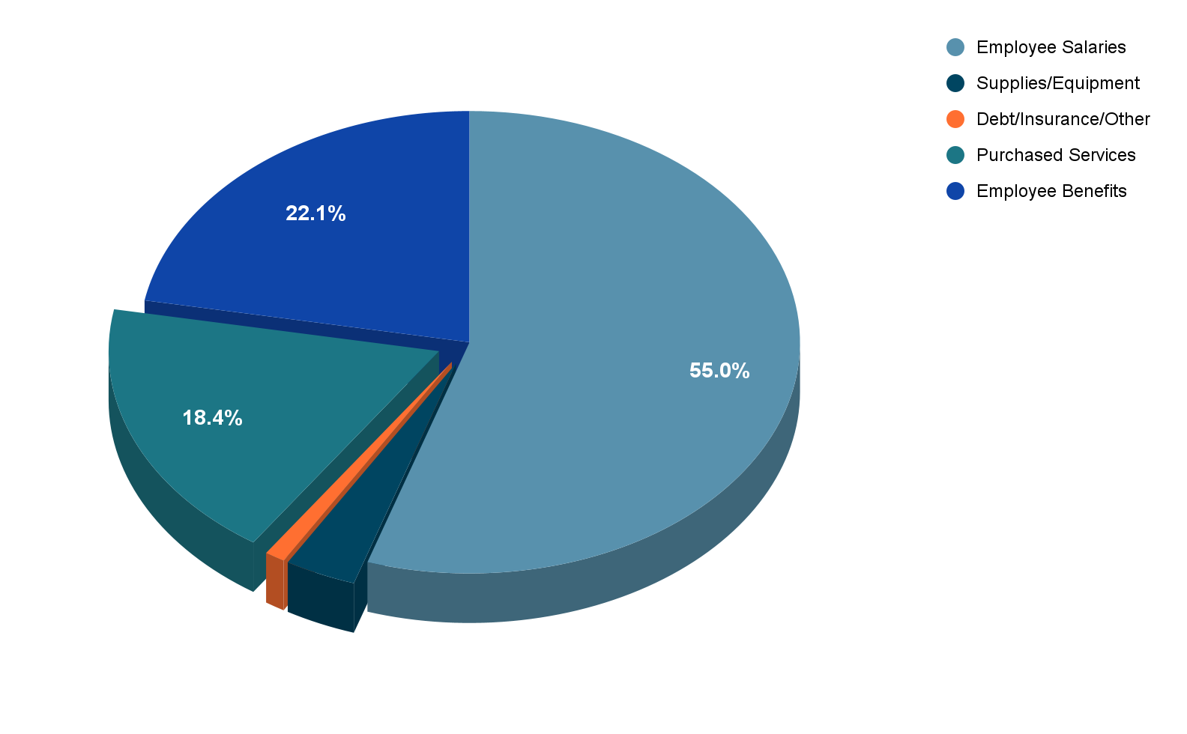
Expenditures By Major Category
Notes:
Salary and benefits = approx. 77%
Non-Personnel
Major expenditures:
Transportation
Open enrollment out
Capital improvement projects / utilities
Operational Debt
Special education transfer

Slide 84
Salaries and Benefits
A few key points:
Staffing is driven by enrollment and local class size expectations
Health Insurance Changes
Takes approximately six months to manage the change process
Post employment benefits are key to attracting and retaining employees
Compensation Expectations

Slide 85
Salaries & Benefits:
Strategic Compensation
Retain, grow and attract talented employees while aligning their behaviors and job performance with district goals and objectives.
Focus On:
Fiscal Sustainability
Recognize and Reward
Attract & Retain
Notes:
Align to Strategic Plan Goals

Slide 86
Salaries & Benefits: Strategic Compensation
Performance Increases
Cost of Living Increases
Wisconsin law allows for school districts and certified teacher unions to negotiate base wage increases. The negotiations process is constrained to the consumer price index for base wage increase calculations. A district may only settle base wage increases up to the consumer price index unless an increase is approved by referendum.
Medical Insurance Plan Design
Retirement Benefits
In times when adequate funds are not available for all compensation components, priorities will determine what is most important.

Slide 87
Open Enrollment Out
For the 2022-23 year:
$8,224 per regular education student
$13,076 per special education student
Pay attention to any trends in Open Enrollment Out
Notes:
MK

Slide 88
Student Transportation
Varies from school to school
Mandated by law
Must pay for transporting private school students
Transportation aid

Slide 89
Capital Improvements
Very expensive
Capital maintenance program
Preventative maintenance (proactive vs. reactive)
Long term plan
Notes:
Facility plan needs to be monitored and adjusted regularly

Slide 90
Transfers To Other Funds
Special Education (fund 27)
10% of General Operating Budget
Food Service Fund (fund 50)
Non Referendum Debt (fund 38)
Trust Fund
Capital Improvements (fund 46)
OPEB (fund 73)

Slide 91
Other Key Expenditures
Classroom Supplies & Operational Supplies
Liability insurance
Workers compensation
Utilities
Notes:
MK

Slide 92
In Summary
We are in a time of greater expectations and even greater budget constraints.
A district’s budget process needs to be collaborative, and student focused!

Slide 93
Table Talk
Does your district have a mission and vision?
As a board member, how do you carry out the district’s strategic plan?

Slide 94
Tax Levies/Tax Bills
Dan McCrea
Chief Financial Officer
School District of Janesville

Slide 95
Basic Funding Equation
YOU
95
Notes:
95
Note that this is controlled revenue limit levies.
More money in “State Aid” without a corresponding increase to the Revenue Limit won’t result in additional revenue for the district. It just results in property tax relief.
“State Aid” includes General School Aids, High Poverty Aid, State Aid for Exempt Computers and State Aid for Exempt Personal Property. 2021-22 general school aids includes: $4,924.42 million equalization aids; $38.3 million integration (Chapter 220) aids; and $28.05 million special adjustment aids (hold harmless aids).

Slide 96
Important to Know!
The Revenue Limit is about how much you can levy…
…but how much you do levy is a local political decision
Notes:
Emphasis on revenue limit “authority.” Remind audience that the levy is composed of different elements, Fund 10, 38, 41, within the limit and 39, 80 outside the limit.

Slide 97
Tax Levies Inside the Limit
General Fund (Fund 10)
Main fund for educational operations
Non-Referendum Debt (Fund 38)
Enough for principal & interest payments on debt issued without a referendum
Capital Expansion Fund (Fund 41)
Set aside for long-term capital improvements
10 levy + 38 levy + 41 levy ≤ Max Allowed
Notes:
Graphic with inside and outside

Slide 98
Tax Levies Outside the Limit
Referendum-Approved Debt (Fund 39)
Enough for principal & interest payments on debt issued with a referendum
Community Service Fund (Fund 80)
Community programs & services
Uncollectible Taxes

Slide 99
Debt Service Levies
Best Practice: Adopt separate levies for Fund 38 & Fund 39
Board has a statutory duty to levy “amount necessary” for debt obligations
Current year principal & interest payments
Accelerate or “defease” future payments
More information: dpi.wi.gov/sfs

Slide 100
Fund 80 Levy
Community Service Fund
Tax outside the Revenue Limit for allowable community programs & services
Questions about a new program? Avoid future headaches—talk with your business official!

Slide 101
Tax Levy vs. Mill Rate

Slide 102
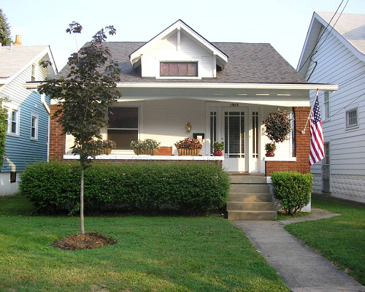
Imagine 2 Districts with varying, equalized property values
500 identical homes
$1 million each
Total value: $500 million
500 identical homes
$200,000 each
Total value: $100 million
Image credit: Wikimedia Commons

Slide 103
Imagine 2 Districts with an equal tax levy…
Tax levy $1.5 million
Mill rate $1.5 million levy ÷ $500 million value × $1,000
= $3.00
Tax levy $1.5 million
Mill rate $1.5 million levy ÷ $100 million value × $1,000
= $15.00
Image credit: Wikimedia Commons
Notes:
Use JVL as an example, compared to another district (Williams Bay).

Slide 104
Imagine 2 Districts…
One homeowner’s share $1 million ÷ $500 million EV = 0.2%
Their tax bill $1.5 million × 0.2%
= $3,000
One homeowner’s share $200,000 ÷ $100 million EV = 0.2%
Their tax bill $1.5 million × 0.2%
= $3,000
Image credit: Wikimedia Commons
Notes:
Notice the mill rate does not appear in this calculation! Takeaway: A homeowner cannot get directly from your mill rate to their tax bill – depending on circumstances, you could lower the mill rate and their bill could go up, or vice versa. Steve will talk a bit later about how taxes are actually assessed by your municipalities.

Slide 105
From School Tax Levy to Property Tax Bill
Steve Summers
Executive Director of Operations
Waunakee Community School District
Notes:
105

Slide 106
Assessed Valuation
Determined by municipalities
Consequently, equivalent properties in different municipalities may not be valued equally (Assessment Ratio)
Not required to be updated each year
Notes:
106

Slide 107
Why Equalized Value Is Used To Distribute Levy
Levy distribution based upon equalized value
Treats all municipalities as though they had been revalued during the year
Offsets variances in assessment practices between municipalities
Updated annually by the State Department of Revenue
Notes:
107

Slide 108
Assessed vs. Equalized Values
Assessed Value
The values placed on taxable real and personal property. An assessment determines the portion of property tax that will be due from a property.
Assessed valuation is determined by the local municipal assessor on January 1 in any given year.
Accurate assessed values ensure fairness between properties within the taxing jurisdiction.
Equalized Value
The estimated value of all taxable real and personal property. The value represents the fair market value (most probable selling price).
Equalized valuation is calculated by the WI Department of Revenue (DOR), and is finalized for school districts on October 1 in any given year.
The DOR applies an adjustment factor to the assessed value, which incorporates actual property sales in the municipality during the past year and is meant to ensure each type of property has comparable value regardless of local assessment practices.
Equalized values create fairness between municipalities.
Notes:
108
Update

Slide 109
Distribution of Levy Among Municipalities
A municipality’s total equalized value in school district
(divided by)
The total equalized value for all municipalities in school district
the municipality’s share of school district levy
=
Notes:
109
Update

Slide 110
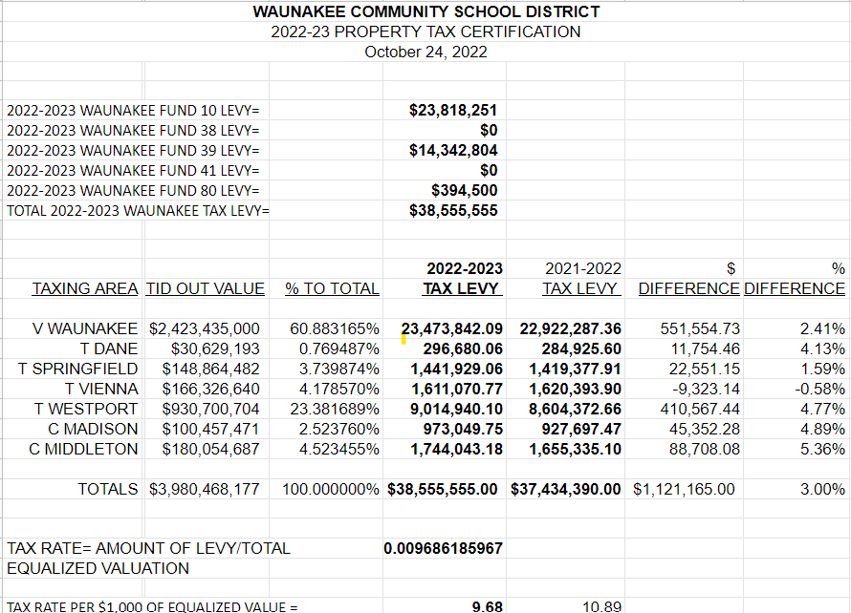
Distribution of Levy Among Municipalities (2022-23)
Notes:
110
Update
Link or print

Slide 111
Distribution of Levy Within Municipalities
Property Owner’s total assessed value in municipality
(divided by)
Total assessed value for all taxable property in the municipality
Property Owner’s share of school district levy
=
Notes:
111

Slide 112
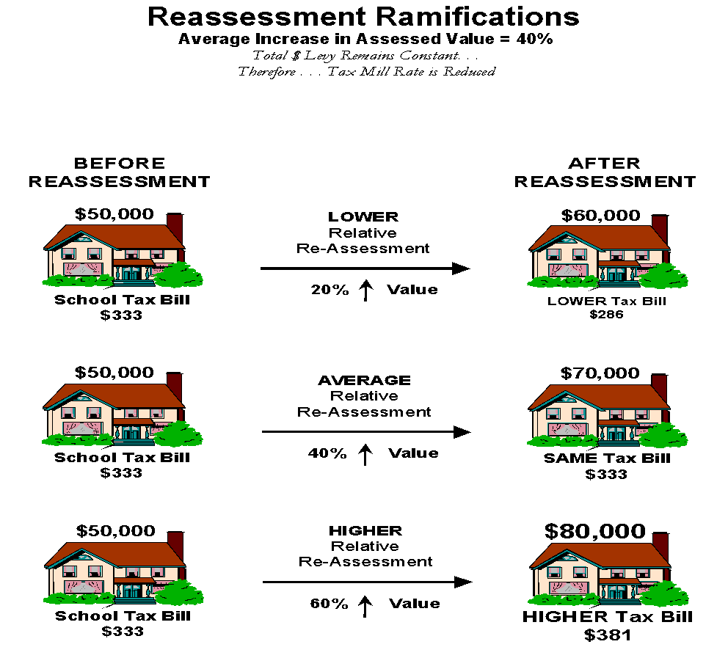

Slide 113
Levy and Assessed Value
The effect of a re-assessment on the school district’s tax levy or their ability to generate revenue is
$0
Notes:
113

Slide 114
Tax Incremental Districts
The effect of a tax incremental district on the school district’s ability to generate revenue is
$0
There is an effect on the tax distribution of the school district levy
Notes:
114

Slide 115
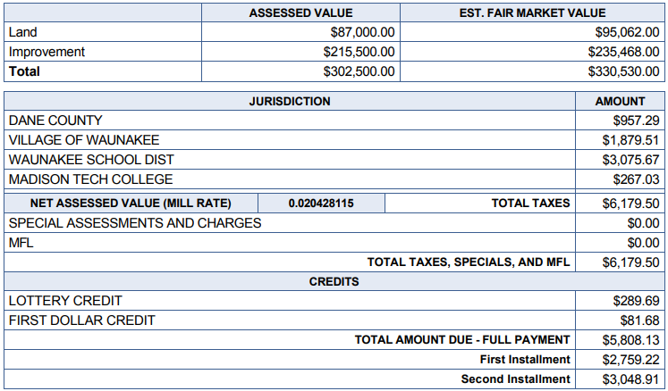
Example Property Tax Bill

Slide 116
For More Information
Joins us for more
discussion:
A Deep Dive into School Finance
Thursday, January 19 – 8:45 AM
Room 102 D/E
Presented by WI DPI and School Business Experts

Slide 117
Additional Resources
DPI School Financial Services Team - dpi.wi.gov/sfs
WASBO – WASBO.com
WI Department of Revenue - revenue.wi.gov/
Legislative Fiscal Bureau - legis.state.wi.us/lfb/
Wisconsin Policy Forum - wispolicyforum.org

Slide 118
Let’s Revisit Our Learning Targets
Enhance awareness and understanding of board members input areas
Raise confidence level of board members in communicating on school finance topics
Help foster an environment of trust between citizens and elected officials
Notes:
Speaking points:
For over a decade the DPI & WASBO has been providing this session to help district leaders better understand the key funding formulas and programs that drive public education’s finances.
This year we will continue to touch on the key funding issues but also want to spend some time discussing the Board’s role in determining the overall goals of the district, the process to be utilized to reach a final budget and what areas local Board’s have significant input on and what areas state and federal regulations rule the day.
You should not expect to leave here as a school finance expert!

Slide 119
Session Evaluation
This is the sixteenth year we have offered this session. We look forward to providing continuing education on school finance topics.
Please complete the evaluation form at the end of the session. We appreciate your feedback on what worked, what didn’t and what you would like to learn more about.
If you need more time you can drop off your evaluation at the WASBO booth - #901.

Slide 120
Thank you for joining us today.

Slide 121
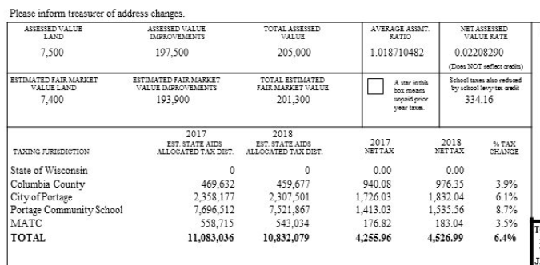
Concepts – Tax Levy
.00929125
A
B
C
D
Fair Market Value
School Levy Rate
School Levy Credit
Individuals’ School Levy
A
B
C
D
“In addition to changes in the school districts levy and mill rate, the individual taxpayers’ school levy impact can change year to year due to changes in assessed value, assessment ratio, resulting fair market value, and the school levy credit.”
Page 21

Slide 122
Calculating Tax Impact
Fair Market Value
School Mill Rate
School Levy Credit
Individuals’ School Levy
In addition to changes in the school district levy and mill rate, an individual taxpayer’s school levy impact can change year to year due to changes in assessed value, assessment ratio, resulting fair market value, and the school levy credit.

