Slide 1
Fiscal Year at a Glance WASBO Fall Conference Year of Success
Mark Elworthy, Director
School Financial Services
October 6, 2022
Notes:
Introductions
Survey group experience

Slide 2
Reminder: Juggling Three Years
Prior Year 2021-22 | Most of your DPI reporting involves submitting prior year data in the fall Affects most current year state aids
Current Year 2022-23 | Active budget you are working under Pupil counts are very important! October is about Revenue Limit and Tax Levy
Next Year 2023-24 | Budget-building process starts over the winter and goes into the spring and summer
Notes:
Depending upon the time of year you are working on up to three “budgets”
Annual Report and audited financial statements
Budget Report
Planning for the future, enrollment projections

Slide 3
How will I keep track of all this?
Fiscal Year at a Glance – Due dates for reports by name & purpose
Fiscal Year "Multi-tasker" Planning Calendar - What to do related to prior year, current year and next year
dpi.wi.gov/sfs/communications/calendars/ overview
Notes:
Fiscal Year at a Glance - One two-sided document listing most of the finance teams reports
Multi-tasker provides information for the three fiscal years on a bi-monthly basis

Slide 4
July to September:
Closing the Prior Year & Third Friday September Count

Slide 5
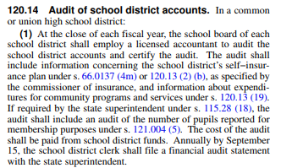
Audit
Notes:
Annual audit of the district’s financial records by an independent auditor is required under Wisconsin state law
Independent auditors will verify that the financial statements present fairly the balance sheet as of June 30th as well as the results of operations for the school year that ended on that date
Independent auditors will apply state and federal audit programs

Slide 6
Purpose of the Audit
Notes:
Independent auditors will verify that the financial statements present fairly the balance sheet as of June 30th as well as the results of operations for the school year that ended on that date
Maintain public confidence in the reliability of published financial data
Assure users that the financial statements are fairly presented in accordance with Generally Accepted Accounting Principles (GAAP)
Independent auditors will apply state and federal audit programs to determine compliance with state and federal requirements

Slide 7
Phases of the Audit
Planning
Preliminary Fieldwork
Final Fieldwork
Communication with Management

Slide 8
Audit Preparation
Notes:
Request a list of all items needed
Post all year-end items
Reconcile all balance sheet accounts
Have all manual journal entries available for review
Print year-end general ledger, revenue & expenditure reports
Reconcile Cash MONTHLY
Have OPEB information available in a timely manner

Slide 9
Audited Financial Statement Submission
2021-21 audits are due to DPI by December 15, 2021
This is a school board requirement

Slide 10
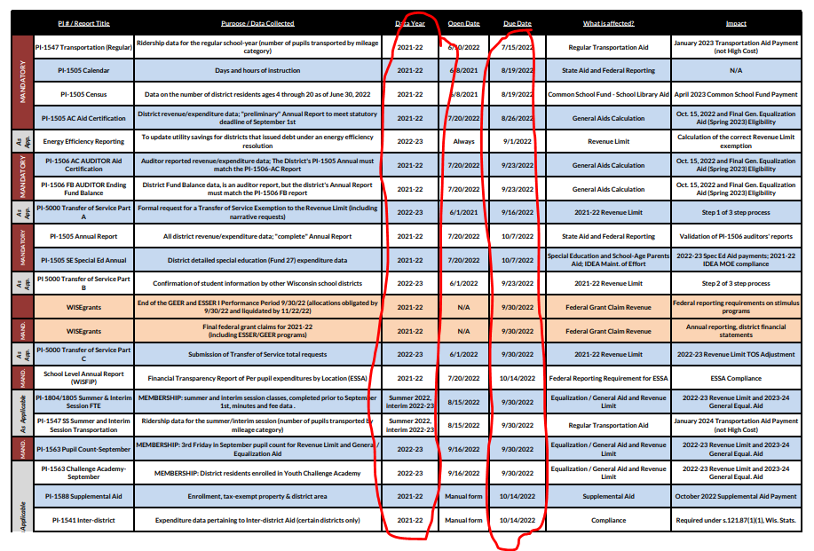
Prior Year DPI Reports
Notes:
Busiest DPI finance reporting cycle is late summer/early fall

Slide 11
Third Friday of September Count
Notes:
Fall Pupil Count PI-1563 – Third Friday in September- Do not confuse with WISE SIS data – this is membership FTE
Challenge Academy PI-1563CA
Critical data for revenue limit calculation-changes in membership will change calculation
Complicated as students may attend other districts, challenge academy and part-time
Data from the report is converted to FTE and used in the calculation of a district’s current year Revenue Limit and following year’s Equalization/General Aid

Slide 12
Membership vs. Enrollment
ENROLLMENT
MEMBERSHIP
Where kids live
Drives district revenues
Where kids learn
Drives district expenses
Notes:
Very important distinction!
Membership: Resident students whose education your district is financially responsible for – includes residents attending other schools under Open Enrollment, Independent Charter, or Choice (“Voucher”) programs
Enrollment: Students actually being educated in your district’s schools – includes nonresidents attending under Open Enrollment, may also include cooperative programs (usually in special ed)

Slide 13
This Year Affects the Future
School Year | Membership Data Funding Impacts
2022-23 | Revenue Limit (1/3 of 3-year average membership) …and Tax Levy Per Pupil Aid (also uses 3-year average)
2023-24 | General State Aids (last year’s membership) and Revenue Limit (3-year average)…and Tax Levy Per Pupil and Other Categorical State Aids
2024-25 | Revenue Limit and Per Pupil Aid
2025-26 | Revenue Limit (starts with comparison to the previous year’s 3-year average)
Notes:
This year’s count affects four years of school funding for your district

Slide 14
October to December:
Budget & Tax Levy

Slide 15
The Bottom Line
REVENUE LIMIT
GENERAL STATE AIDS
LOCAL PROPERTY TAXES
–
=
General State Aids function as tax relief under the Revenue Limit.

Slide 16
October 15 Aid Certification
On October 14th, the School Financial Services team will release the district’s current year General School Aid Certification.
This amount represents the amount of General Aid the district is eligible to receive during the current year. Adjustments could reduce, such as Open Enrollment, new Independent charter and Private School Voucher deductions.
This number is what is used in the current year Revenue Limit Worksheet.
Notes:
Make sure you have the correct revenue limit worksheet values

Slide 17
October 15 Revenue Limit Worksheet
On October 14th, the School Financial Services Team posts a pre-populated Revenue Limit Worksheet
Review for accuracy data used to populate the worksheet
Remember that the calculation is yours until DPI does the final, official version in May
Notes:
Do not grab and go to set your levy, the first posted worksheet
Make sure you have the correct revenue limit worksheet values
Note impact of membership changes, confirm membership is correct
Check back to make sure you have the most recent worksheet, even on the day of the meeting

Slide 18
Overview: Budget Adoption and Tax Levy
Adopt a budget at a school board meeting and set the tax levy
Step #5
The electors at the annual meeting vote a tax (Common School Districts only)
Step #4
Step #3
The public hearing is held, at which time residents of the district have an opportunity to comment on the proposed budget
Step #2
Publish a class 1 notice in the newspaper
Step #1
Create a proposed budget that identifies expected revenues, expenditures and fund balances for the upcoming/current year
Notes:
Steps in process – labeling
Common School District
Unified districts do not have an annual meeting, only a hearing

Slide 19
Tax Levies by Fund
INSIDE THE LIMIT | OUTSIDE THE LIMIT
Fund 10 – General Fund | Fund 39 – Referendum Debt Service Fund
Fund 38 – Non-Referendum Debt Service Fund | Fund 80 – Community Service Fund
Fund 41 – Capital Expansion Fund | Tax Chargebacks (Fund 10)

Slide 20
Tax Levy Helpful Hints
Figure out your Fund 38 and Fund 41 levies before Fund 10
Levy non-referendum debt service directly into Fund 38
Adopt separate Fund 38 and Fund 39 debt levies
Notes:
Newbies & veterans alike have made the mistake of levying Fund 10 up to their limit, and then also levying Fund 38, which results in their districts levying over the Revenue Limit and getting penalized the following year.
Some districts levy into Fund 10 and then transfer the cost of their Fund 38 debt service – this is allowed but not recommended.
We’ve seen districts adopt a single “debt service levy” and then misallocate it between Fund 38 and Fund 39.

Slide 21
Tax Levy Helpful Hints
Budget is school year but debt service is calendar year
This year’s levy is part of the 2022-23 budget
The levy pays for your March 2023 & September 2023 debt service payments
Money for the September 2023 payment is part of 2022-23 year-end fund balance
Notes:
This drives everyone crazy and is an easy thing to goof up.

Slide 22
Tax Levy Helpful Hints
ASK FOR HELP
Your first tax levy can be scary…
But there are resources for help
Your neighbors had their own first tax levies and most are glad to help if you reach out
Call the SFS Team if you still aren’t sure about something…better to fix it on the front end!

Slide 23
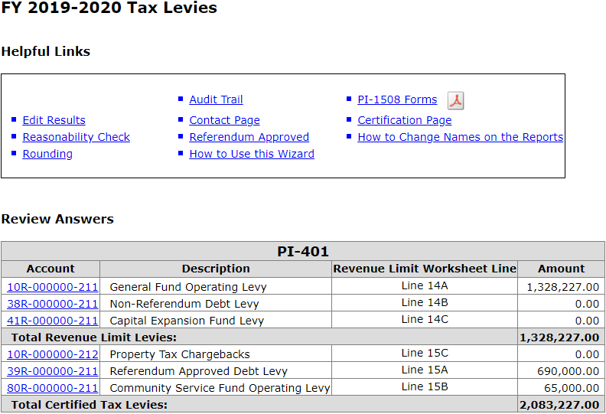
PI-401 Tax Levy Report for 2022-23
Levy set by Nov. 1
Report due Nov. 4
PI-1508 forms to local municipalities by Nov. 10

Slide 24
Budget Reporting in WISEdata Finance
PI-1504 Budget Report is retired
For the 2022-23 school year, the statutory requirement will be met if your district transmits budget data to WISEdata Finance by December 1

Slide 25
January to June
Current year reports and activities
Notes:
DPI reporting
Membership Audits if selected
Budget Amendments

Slide 26
DPI Reports and Requirements
2nd Friday in January membership count - PI-1563
Possible selection for Membership Audit
Debt Schedule Reporting (year round)
Referendum Reporting (year round)

Slide 27
January Pupil Counts PI-1563
Notes:
Same format as September count, but for the second Friday of January

Slide 28
Membership Audit
On or about February 1st, the School Finance Team will announce which districts are required to have a membership audit
The district’s auditor will verify the district’s reported counts for:
3rd Friday in September
2nd Friday in January
Summer and Interim Session (as well as fees)

Slide 29
Referenda Report PI-1572
BALLOT
Notes:
SAFR report used to collect data on any district referendums
Districts must notify DPI of upcoming referendum within 10 days of adopting the resolution
After the referendum vote, the district should update the vote to show the vote tally
April every year, November every other year

Slide 30
Referenda Report PI-1572
Notes:
Districts are also required to send to DPI a copy of the adopted resolution authorizing election
Districts are also required to send to DPI a copy of board of canvassers statement which reports official vote tally within 10 days of the election
Questions: Roger Kordus
http://dpi.wi.gov/sfs/reporting/safr/referendum/procedures

Slide 31
Debt Issues
Debt schedules must be reported to DPI within 10 days for all issues:
New debt
Refinancings
Bond Anticipation Notes (BANs)

Slide 32
Debt Issues
Review debt information on our WUFAR Issues & Examples page
dpi.wi.gov/sfs/finances/wufar/accounting-issues-examples
Notes:
Debt schedules and reporting are complex – no way to do it justice in a couple of slides!

Slide 33
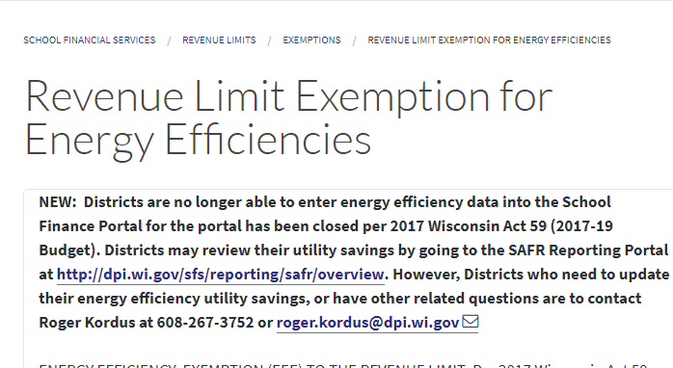
Energy Efficiency Savings Reporting
Notes:
Report before levy is determined so you may correctly reduce your revenue limit exception before levying
Data is used in the revenue limit calculation

Slide 34
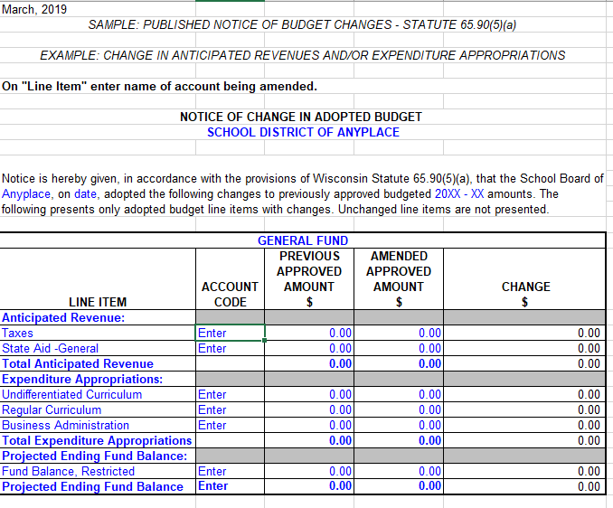
Budget Amendments
Changes in amount of appropriation and purposes (functions) must be approved by a two-thirds vote of the full school board.
Notes:
As the current budget year progresses, you may find expenditure needs that differ from the budget that was originally approved
Changes in amount of appropriation and purposes (functions) must be approved by a two-thirds vote of the school board
Publish a class 1 notice of the budget change within 10 days of Board approval
Usually the budget is where you get your spending authority

Slide 35
Budget Amendments
We will be asking for complete & current 2022-23 budget data in spring 2023 for the July 1 aid estimate for 2023-24.

Slide 36
January to June:
Planning for Next Year
Notes:
Planning for next year’s budget

Slide 37
2022-23 Budget Development
Notes:
Use data and look for trends
Student enrollment (headcount in buildings and resident counts
Private schools taking vouchers in your area
Real estate, housing, and property values

Slide 38
2022-23 Budget Development
Notes:
Review Board Policy to determine roles in the process, Board expectations
Enrollment trends for staffing needs and residents for revenue projections
Other trends
Salary and benefit costs
Transportation costs
State Aids and Grants Revenue projections
Revenue limit projections

Slide 39
Final Aid & Revenue Limits
Final determinations of General Aids & Revenue Limits are made in May
What should your aid eligibility have been vs. the October 15 certification?
Did you levy over your max?

Slide 40
Final Aid & Revenue Limits
General Aids: October-to-Final adjustments applied to the next year
Revenue Limits: “Overlevy” is a dollar-for-dollar penalty against next year’s aid & revenue limits

Slide 41
Points to Remember
Statutory requirements, reports, and deadlines
The SFS Team & our website are a resource
Board approves appropriations and purposes of the budget (authority for spending)
Membership FTE drives most of your funding
Revenue Limits will determine the majority of your resources and pre pops are available

Slide 42
If You Haven’t Done It Yet…
Subscribe today!
dpi.wi.gov/sfs/communications/bulletins
Notes:
SFS Team’s main method for communicating with the field

Slide 43
Contacting the SFS Team
Email: dpifin@dpi.wi.gov
Phone: (608) 267-9114
Web: dpi.wi.gov/sfs
Team Directory: dpi.wi.gov/sfs/communications/staff-directory

Slide 44
My Contact Information
Mark Elworthy Director School Financial Services Team mark.elworthy@dpi.wi.gov (608) 266-9536

Slide 45
Thank You!
Notes:
For choosing to work in a public school setting and sharing your talents with those that educate children
Best wishes in your pursuit of knowledge unique to public schools
Contact DPI or another peer if you need help
Thanks you for your participation and feedback so we can all learn something new

