Slide 1
WISEdata Finance is Here!
Updates on WDF and WiSFiP
Matt Baier
School Financial Services Team
WASBO Fall Conference
October 5, 2022

Slide 2
Background
In 2016 DPI changed how student data was reported…
ISES
Student

Slide 3
Background
…In 2022 we planned to do the same for financial data
SAFR
Finance
Notes:
State Aid Financial Reporting (SAFR) is the current school finance reporting portal https://dpi.wi.gov/sfs/reporting/safr/overview

Slide 4
What is WISEdata Finance?
DPI’s new secure application to accept the submission of financial data from LEAs’ financial systems
Data is sent directly to WISEdata Finance (WDF) via the Ed-Fi API from the LEA’s system, just as student data is sent directly from the LEA’s Student Information System (SIS)
Financial data is collected to meet reporting requirements and calculate state aid payments.

Slide 5
What is WISEdata Finance?
WISEdata Finance is the system responsible for the collection of financial data, including local accounts, budgeted amounts, and actual amounts.
The primary responsibility of users within WDF is to verify the accuracy of the financial data being pushed to DPI, with the help of validation messages displayed within the application.

Slide 6
What is WISEdata Finance?
Vendors pull the current Wisconsin Uniform Financial Accounting Requirements (WUFAR) Chart of Accounts (COA) from DPI
District crosswalks ledger to a local COA in WUFAR and pushed to WDF
Local COA rolls up to the required DPI COA level
District pushes budget amounts and year-to-date actual amount by account to DPI

Slide 7
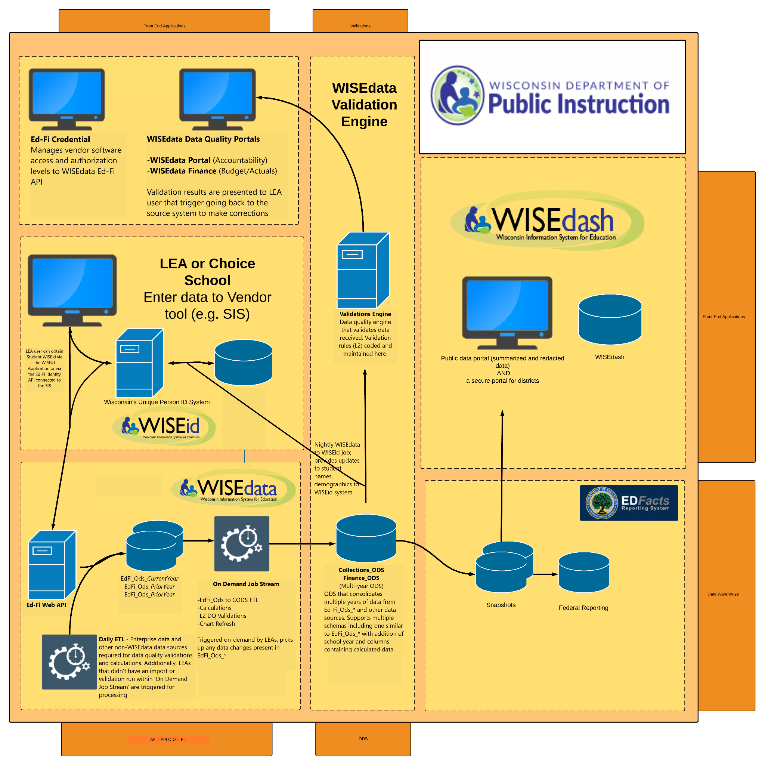

Slide 8
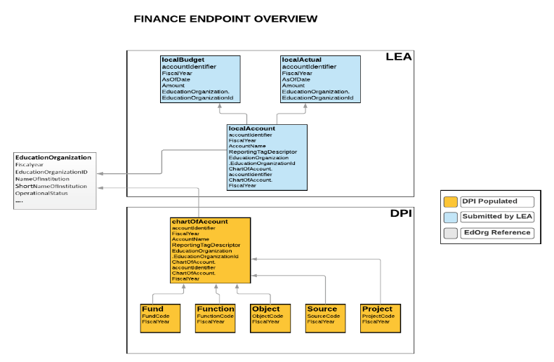
WISEdata Finance Ed-Fi API
Accounting system data available from DPI via the API
Notes:
Ed-Fi API
https://www.ed-fi.org/
The Ed-Fi Data Standard is the set of rules for the collection, management, and organization of educational data that allows multiple systems to share their information in a seamless, actionable way.

Slide 9
WISEdata Finance Ed-Fi API
Financial budget & actual data submitted by account using the API
Notes:
Ed-Fi API
https://www.ed-fi.org/
The Ed-Fi Data Standard is the set of rules for the collection, management, and organization of educational data that allows multiple systems to share their information in a seamless, actionable way.

Slide 10
Q & A / Feedback
Notes:
Q&A

Slide 11
Why WISEdata Finance?
Decrease the manual burden of financial reporting to DPI
Better consistency with DPI and local WUFAR accounts
Improved accuracy of financial data reported
Easier reporting compliance by utilizing data from WISEdata Finance (ESSA School Level Report, PI-1504 Budget, PI-1505 Actual, etc.)

Slide 12
What Does This Mean For LEAs?
LEA’s financial ledger (the local “books”) pushed to WDF must be consistent with WUFAR accounting and the DPI Chart of Accounts to avoid WISEdata Finance reporting quality issues
Validations are triggered within Ed-Fi and WDF
WiSFiP will be developed to collect additional information to supplement WISEdata Finance data
Notes:
Wisconsin Uniform Financial Accounting Requirements (WUFAR)
https://dpi.wi.gov/sfs/finances/wufar/overview

Slide 13
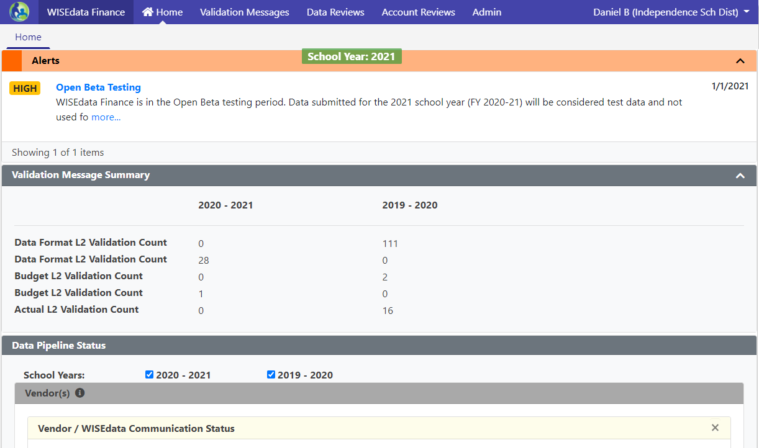
Mindset Shift: WISEdata Finance
Data submissions in WISEdata Finance are point-in-time looks, and it helps to think about data validations more as bringing issues to your attention than giving you a list of errors to clear
“Doing the report” will mean pushing clean data
Fixing your books and pushing that data to WDF is how you fix your reporting

Slide 14
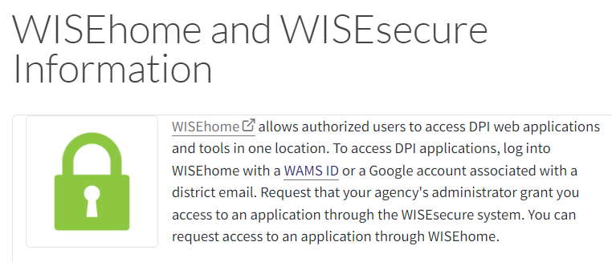
WISEhome/WISEsecure
WISEhome - Platform for most DPI Secure Applications (WISEgrants, WISEdata, WISEstaff, WISEdata Finance/WiSFiP)
WISEsecure - Tool to assign access to DPI Secure Applications for your LEA
Bookmark WISEhome landing page
Notes:
See slide

Slide 15
Parallel Reporting
PI-1504 Budget and PI-1505 Actual*
District-level Budget and Actual Reports Existed in SAFR (current SFS Team reporting portal)
PI-1504 Budget report in SAFR retired after 2020-21
Did not collect for 2021-22 and will not collect going forward
PI-1505 Actual planned retirement after 2021-22
Collecting all Actual data as the “source of truth” for the last time
* Includes multiple reports: PI-1505, PI-1505 SE, PI-1505 AC, PI-1506 AC, PI-1506 FB, etc.
Notes:
As you are all well aware at this point, we retired the PI-1504, and did not collect budget data via that report for 2021-22. We are currently performing outreach

Slide 16
WISEdata Finance - What’s Next?
As Annual Report data is submitted via the PI-1505 and PI-1505 SE, review Actual data being submitted to WDF.
Check your validation messages in WDF. Addressing validation messages is critical in preparation for annual reporting and the next fiscal year.
In the process of building the new Annual Report module in WiSFiP, which will be viewable for 2021-22 forward, although no data entry will be required.
For 2021-22, the report will display both SAFR and WDF data to help ensure submitted data reconciles with financials being pushed through WDF.
Notes:
See slide

Slide 17
WISEdata Finance - FY 2022-23
Opened fiscal year 2022-23 in WISEdata Finance.
Working with all vendors to ensure LEAs can begin pushing 2022-23 Budget data. This has been completed for some vendors. Check with your vendor if you have issues pushing 2022-23 data.
Updated WDF to display data for 2021-22 and 2022-23 fiscal years. The 2020-21 fiscal year has been hidden from view.
Ensure you and your vendor have updates the WUFAR COA to the latest revision
Push budget data for 2022-23.

Slide 18
WISEdata Finance - What’s Next?
Continue to report issues and provide feedback as we continue through the process of transitioning to new and improved systems.
Your input is KEY.
Notes:
See slide

Slide 19
Points to Remember
SAFR Addenda and Errors will continue to need to be “cleared”, but you will be required to update your financial ledger and submit revised data via WISEdata Finance.
Data from the completed reports in SAFR will need to match data being pushed to WDF.
SFS Team will develop new WiSFiP views during 2022-23
Notes:
The SFS and Collections Teams have begun the necessary work as part of the parallel reporting of 2021-22 actuals in WISEdata Finance and SAFR.

Slide 20
Alternative Reporting Mechanism (ARM)
WISEdata Finance includes an upload-based alternative reporting mechanism (ARM) available to LEAs for submitting financial data to DPI without the use of an Ed-Fi certified financial software vendor.
Primarily designed as an option for Independent Charter Schools to address concerns around the cost of school financial software and differences in accounting requirements for ICS versus school districts.
Notes:
ICS

Slide 21
Q & A / Feedback
Notes:
Q&A

Slide 22
Validations
Two levels of validation rules at work:
L1 validations reject your data before it can be stored in our data warehouse. Validation message are triggered when you push data to DPI. Some examples are rejected accounts, invalid school codes, etc.
L2 validations are run on data saved into the data warehouse (have passed the L1 validations). Examples include: WUFAR mismatches, Amount errors, Project/Program Tag issues
Although validations display in WISEdata Finance, all modifications to the data will happen within your SIS.

Slide 23
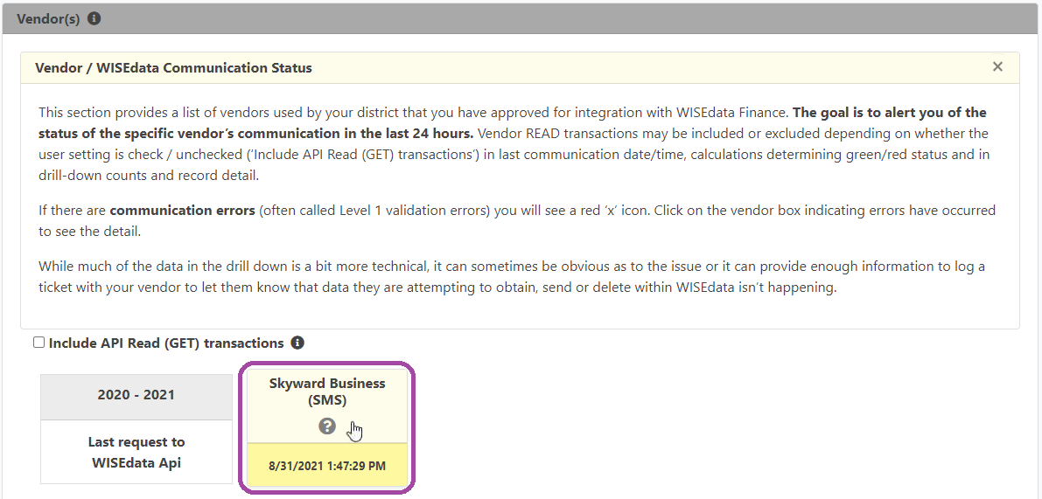
L1 Validations
“How do I see our rejected accounts?”
On the WISEdata Finance home screen, scroll down to the “Vendor(s)” section. There is a yellow box for each school year that shows when the WISEdata Finance API received the last submission from your vendor.
You can click on the box to get details:
Those details would include any rejected accounts, invalid school codes, and the like.

Slide 24
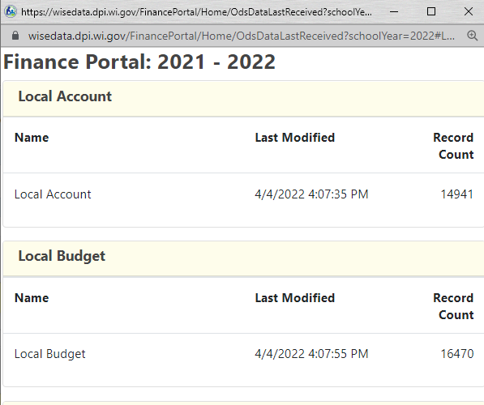
Current Areas of Focus
Compare the list of accounts being pushed from your vendor with the list of accounts being accepted into WISEdata Finance.

Slide 25
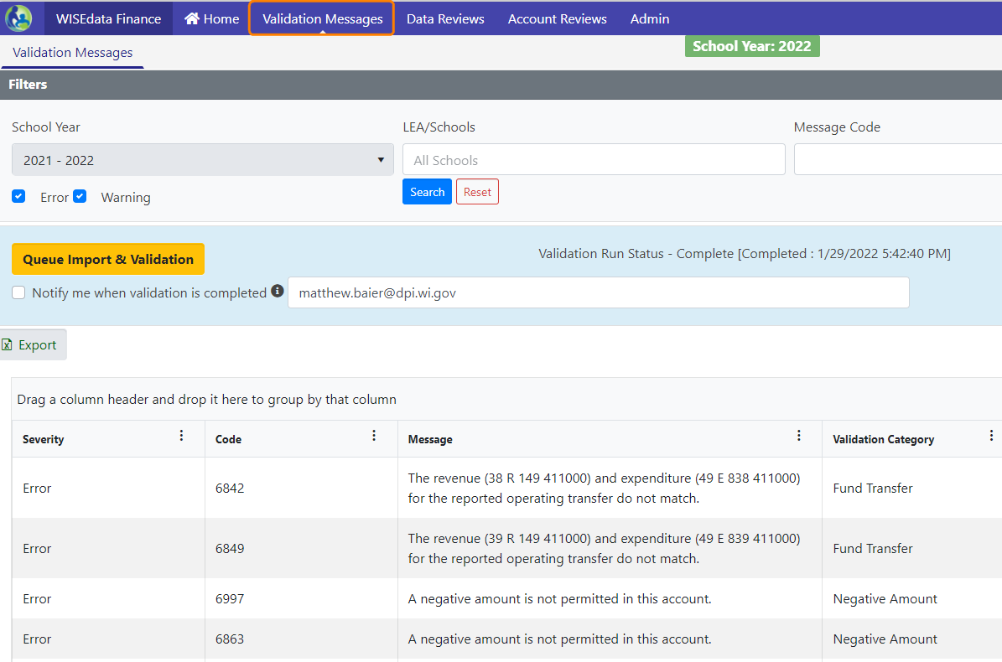
L2 Validations
“How do I see our validations?”
In the menu bar,
click on “Validation Messages”
This screen will list all L2 validations as of the last validation run.

Slide 26
Current Areas of Focus
L2 Validations
Review Data Format validations. These validations indicate issues related to COA mapping and should be reconciled.
Budget and Actual validations are more nuanced and have different meaning throughout the year.
Notes:
We are working on it

Slide 27
Current Areas of Focus
Data Format Validations - Indicates something is not mapped correctly and may not roll up as needed

Slide 28
L2 Validation Types
Data Format
Fund Transfer
Negative Amount
On Record
Trial Balance

Slide 29
Validation Messages
Our area of focus concerning validations displayed in the system:
Continue to ‘repackage’, as needed, existing validations interface to be clearer
Addressing an issue where updating budget information is not clearing validations
Update specific validations to align with actual requirements
Notes:
We are working on it

Slide 30
Negative Amount Validations
Recently updated the Negative Amount Validations in the system.
Previously triggered by any individual local account with a negative amount (Budget or Actual)
Updated to only trigger Negative Amount Error if the rolled up DPI Account has a total negative amount
Fund Balance validations to flag negative amounts still in place.
Notes:
We are working on it

Slide 31
Suggested Best Practice
Make pushing financial data to WISEdata Finance the last step of your monthly bank reconciliation

Slide 32
Q & A / Feedback
Notes:
What’s working

Slide 33
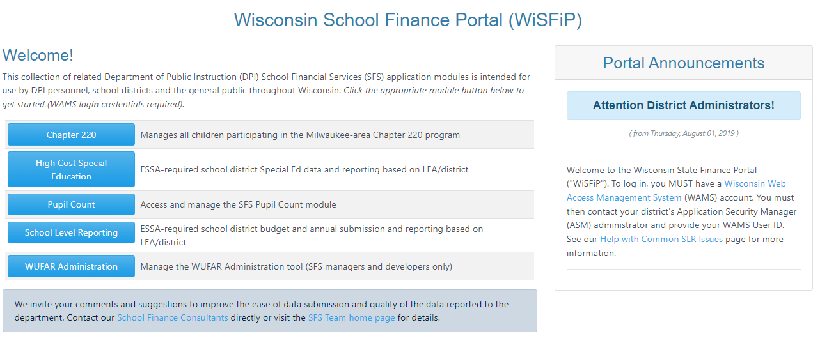
Wisconsin School Finance Portal
WiSFiP is the platform that will house all School Finance Reporting going forward.

Slide 34
Wisconsin School Finance Portal
Data views and reporting will be created for districts within WiSFiP.
PI-1505, PI-1505 SE, PI-1505 AC, PI-1506 AC, and PI-1506 FB will need to be entered through the SFS portal for this last year for 2021-22 data.
New reports in WiSFiP will include views to reconcile data submitted through existing reports with data submitted via WDF.
Most if not all of the reporting collected in SAFR (existing portal) will be moved to WiSFiP for 2022-23.

Slide 35
Wisconsin School Finance Portal
Budget Report (PI-1504)
Tax Levies Reporting (PI-401)/ Tax Levy Certification (PI-1508)
Annual Report (PI-1505)
Special Education Annual Report (PI-1505-SE)
On Record Amounts

Slide 36
WISEgrants - IDEA MOE
WISEgrants IDEA Maintenance of Effort module updated for 2021-22
Eligibility - Budget information necessary for IDEA MOE Eligibility is being pulled from WISEdata Finance.
Compliance - Updated to pull Actual amounts from WISEdata Finance.
We have updated the MOE module and technical assistance to reflect these changes. Compliance Data will pull in most recent Actual data. Compliance tests will not be completely relevant until the fiscal year is closed and full Actual data is present.

Slide 37
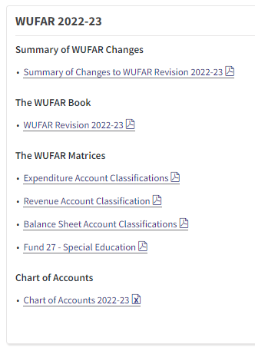
WUFAR Revision 2022-23
WUFAR Revision 2022-23 has been completed and is posted on the DPI WUFAR webpage. WUFAR COA in WDF has been updated.
minimal number of edits
addressing identified existing issues/discrepancies
updates due to requirements under GASB 96
Subscription-based IT Agreements

Slide 38
Pilot Program for Pupil Count Membership
Redesigning the application (PI-1563) to collect Pupil Count Membership
This module will reside in WiSFiP and is currently being developed and tested in 2022-23.
Testing will consists of multiple rounds, starting with a smaller group of external stakeholders, with a larger group of stakeholders for a second round of testing and feedback.
The report will go into production statewide for 2023-24.
Notes:
Timeline and road map for what’s next.
July Aid

Slide 39
Q & A / Feedback
Notes:
What’s working

Slide 40
Contact Us
For WISEdata Finance questions visit DPI's WISEsupport page to submit a help ticket
https://dpi.wi.gov/wisedata/help/request
General SFS questions: dpifin@dpi.wi.gov
Matt’s Booking page:
https://outlook.office365.com/owa/calendar/MatthewBaier@WIDPIPRD.onmicrosoft.com/bookings/

