Slide 1
WASBO Fall Conference 5 October 2023
Revenue Limits – Aid = Levy: Understanding Your Worksheets
Mark Elworthy, Director
School Financial Services Team
Ben Kopitzke, Finance Consultant School Financial Services Team

Slide 2
Agenda
Recap
Line-by-line breakdown
Exemptions
Over/underlevy
Timeline
Questions
Notes:
Effect on carryover

Slide 3
Revenue Limits, School Aids, and Property Tax Levies
Property Tax Levy
State Aid
(General + High Poverty + Computer + Exempt Personal Property)
Revenue Limit
Notes:
RL: only YOUR district; what neighbor spends does not impact your RL
RL are INDIVIDUAL to district—what is happening in YOUR school community
State Aid: $5.2 billion entirely dependent on everyone else; as others spend more/less, property values change → impacts your district’s share of the allocation; compared to state averages and guarantees set in law. RELATIVE position is important (you have 10% property value increase but everyone else had 15%)
The controllable property tax levy—NOT referenda-approved debt

Slide 4
What is within Revenue Limits?
Regulates Revenues for Funds 10, 38 and 41
General Fund (10)
Property Tax Levy
General State Aid
Computer Aid
Non-Referendum Debt Service Fund (38)
Property Tax Levy
Capital Projects Fund (41)
Property Tax Levy
Notes:
In 1993-94, the State enacted revenue limits to control the revenue a school district can collect from:
General Aid (Equalization Aid, for most districts)
Computer Aid
Aid for Exempt Personal Property
High Poverty Aid
Select Local Levies
General Fund (Fund 10)
Non-Referendum Debt Service (Fund 38)
Capital Projects (Fund 41)
It is not an expenditure control or spending limit.
Examples of what the Revenue Limit does not control (not exhaustive list):
School Fees
Categorical Aids (Per Pupil Aid, Special Education, Library Aid, Transportation Aid, etc.)
State and Federal Grants
Gate Receipts
Donations
Local Levies
Referendum Debt Service (Fund 39, at times called “Non-Fund 38”)
Community Service Fund (Fund 80)
Prior Year Levy Chargeback for Uncollectible Taxes (Fund 10)

Slide 5
What is outside the Revenue Limit?
Categorical Aids (Special Education, Per Pupil Aid, Library, Transportation, AGR, Sparsity, etc.)
State and Federal Grants
Student Fees, Gate Receipts, and Donations
Tax Levy for Referendum Approved Debt Service Fund (39)
Tax Levy for Community Service Fund (80)
Notes:
22% in slide 5 These sources are not limited by the revenue limit formula
Categorical Aid – Outside the revenue limit calculation but based on the three-year rolling membership.
Not restricted to a specific purpose. How is your district using the additional resources?
2021-22 and after = $742 per pupil, SUM SUFFICIENT=GUARANTEED

Slide 6
Notes:
Current view of Monona Grove’s RLW; mention shading: red. Yellow, green→ more/less flexibility different times of the year. Falls into place by October 15th. See what we have on hand, who submitted what: PI-1563
July 1 for now $325 per member change allowed, $11,000 LRC

Slide 7
Notes:
October 15th view of Monona Grove’s RLW

Slide 8
Revenue Limits
Membership
September Pupil Count FTE + 40% Summer School FTE (3YRA)
Four-Step Process
Step 1: Build the Base Revenue Per Member (Worksheet lines 1-3)
Step 2: Calculate New Revenue Per Member (Worksheet lines 4-7)
Step 3: Determine Allowable Exemptions (Worksheet lines 8-11)
Step 4: Determine Levy (Worksheet lines 13-16)
The revenue limit does not include all revenues and it is not a spending limit.
Notes:
Calculation of RL is a district responsibility→ DPI populates spreadsheets based on info provided by district
Our only responsibility by law is to provide a penalty if they levy too much
3 year rolling average for membership
Good time to open laptops and follow along?

Slide 9
Line 1: Base Revenue
Notes:
Data from final 2022-23 RLW
Prior year information; these two are subtracted out; aid penalty from overlevy and levied NR exemptions

Slide 10
Overlevy if Line 14 > Line 13
Notes:
These figures are located here final PY RLW; overlevy can be calculated by taking Line 14 minus Line 13
Monona Grove does not have an overlevy→ overlevy is typically 1-3 FTE, after membership is audited
Set up multiple tabs on a single spreadsheet, linked by formulae

Slide 11
Lines 2 & 6 and Per Pupil Aid
Notes:
PPA: $742/pupil→ sum sufficient, guaranteed $. Explain line 6 minus ICS
HOW ARE YOU USING IT?
Conduct late RL re-run; memb. Changes can affect your base/cause aid adjustment next year

Slide 12
Line 10B: Declining Enrollment Exemption
Notes:
Green cell=calculated, changes if your membership changes

Slide 13
Build the Base Revenue Per Member
Notes:
Lines 1-3

Slide 14
Calculate New Revenue Per Member
Notes:
Lines 4-7; Hold Harmless: line 7 cannot be less than Line 1
CCDEB value: 2022-23 Line 5 can be less than $10,000/member because of CCDEB
With no per member increase, DE=HH, not the case anymore

Slide 15
Determine Recurring Exemptions
Notes:
Emphasize 8E: first year of RR; can build RR up over sequential years FIRST YEAR of RR
Any unused NR exemption comes out of carryover 22-23: 162 w/RR 38%. 416->99% NR
No PY carryover here because NR exemptions ≥ Underlevy prior year 22-23: 9 w/carryover
Explain page three

Slide 16
Determine Non-Recurring Exemptions
NR exemptions are subtracted out when building next year’s base!
Notes:
Have RR with NR$ left on the table, will not carry forward all of it
In that situation (not setting to the max) and you are new, give us a call BEFORE your board sets the levy.
Consequences of deductions; voucher/SNSP are for residents. If you choose not to levy for it, board chooses to either use fund balance or to cut public school operations to match the loss of aid→ true budget hole at EOY. Will not be included in Oct 15th aid No good way to predict amounts

Slide 17
Line 10D vs Line 15C
Line 10D: Adjustment for Refunded or Rescinded Taxes
Property taxpayer contests assessment and value of property is reduced
Districts allowed to increase RL by the amount refunded as a result of a valuation re-determination under s. 74.41
DOR computes amounts each fall and sends letters in mid-November; DPI pre-populates this field based on certified amounts provided by DOR
Statutes do not permit RL exemption for any other kind of chargeback
Line 15C: Prior Year Levy Chargeback for Uncollectible Taxes
Municipality unable to collect full amount from property taxpayer after full levied amount provided to district
Municipality asks the district to return the uncollectible amount under s. 74.42
District recovers the amount returned to municipality through an outside of the RL “chargeback levy” instead of an adjustment
Notes:
10D: district legally entitled to full levy
Slow timeline→ year or two later

Slide 18
Determine Your Levy
Notes:
Revenue Limit Penalty→spoiler alert

Slide 19
Equalization Aid Factors
What affects the amount of a district’s Equalization Aid?
District Factors (Prior Year Audited)
Shared cost
Membership (Average of 3rd Friday in September + 2nd Friday in January FTE, plus 100% of Summer FTE, plus other adjustments)
Equalized property value
State Factors
Cost ceilings
Guaranteed valuations per member
Amount of funding the State puts into the formula
Notes:
Plug longitudinal EQ aid
Membership is more than 20 kids in first grade classroom looking at the board
3rd Friday in September often called 3FS, 2nd Friday in January 2FJ

Slide 20
Equalization Aid Factors
Notes:
Why is Monona Grove in Negative Tertiary Aid? Plug longitudinal
SCM>Sec Ceiling, VPM>Ter Ceiling

Slide 21
Determine Your Levy
Notes:
Allocate $ in 14 and 15
Final view→ Overlevy

Slide 22
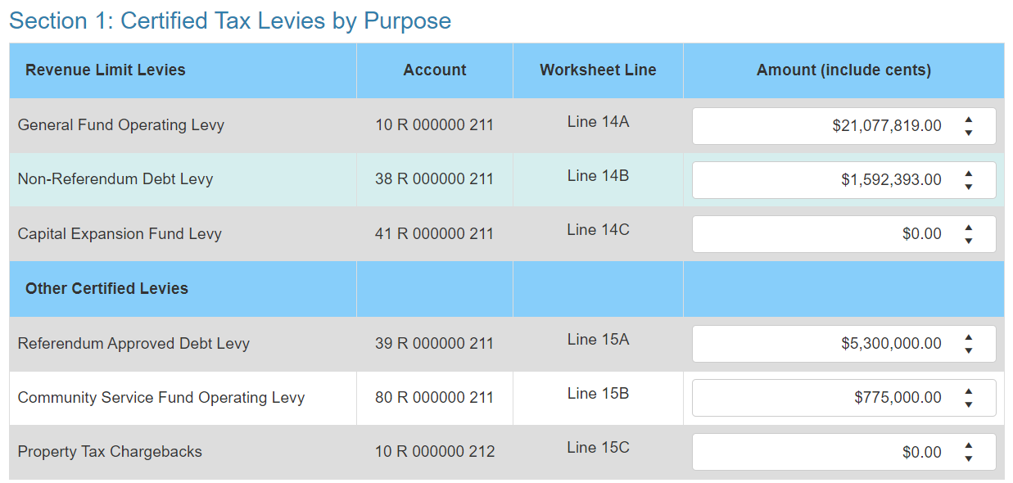
Tax Levy Report (former PI-401)
Notes:
Longitudinal data plug, will cover later

Slide 23
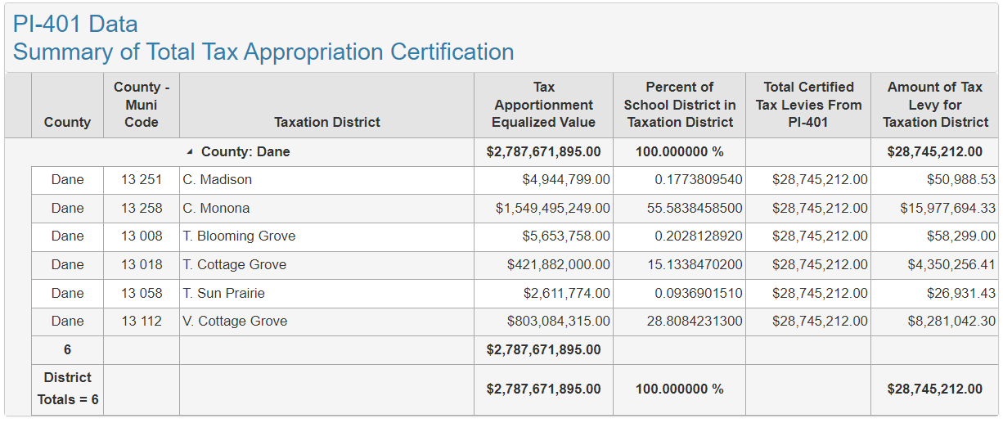
Tax Levy Report (former PI-401)
Notes:
Longitudinal data plug, will cover lat

Slide 24
Determine Your Levy
LEVY
FINAL
Between levy and final, memb. avg. ↓1 FTE
Overlevy decreased—Why?
Notes:
3,138 to 3,137 FTE
Why? Membership went DOWN, HH + DE went up. Started with an Overlev
Equalization Aid reduced by penalty amount→ subtracted off in Line 1 calc next year BUT SMALLER BASE 1/6 of districts had a penalty

Slide 25
Levy Rate
This
Divided by this
Yields your levy rate
Notes:
Managing rate vs levy; tradition of school board
RL: only YOUR district; what neighbor spends does not impact your RL
RL are INDIVIDUAL to district—what is happening in YOUR school community
State Aid: $5.36 billion entirely dependent on everyone else; as others spend more/less, property values change → impacts your district’s share of the allocation; compared to state averages and guarantees set in law. RELATIVE position is important (you have 10% property value increase but everyone else had 15%)
The controllable property tax levy—NOT referenda-approved debt

Slide 26
Timeline
October 13: Oct. 15th General Aid Certification released (this year)
November 1: Deadline for school boards to approve levies
November 3: Deadline to submit Tax Levies Report (usually the 4th) (Friday)
November 10: Deadline for district clerks to inform municipal clerks of their share of the tax levy

Slide 27
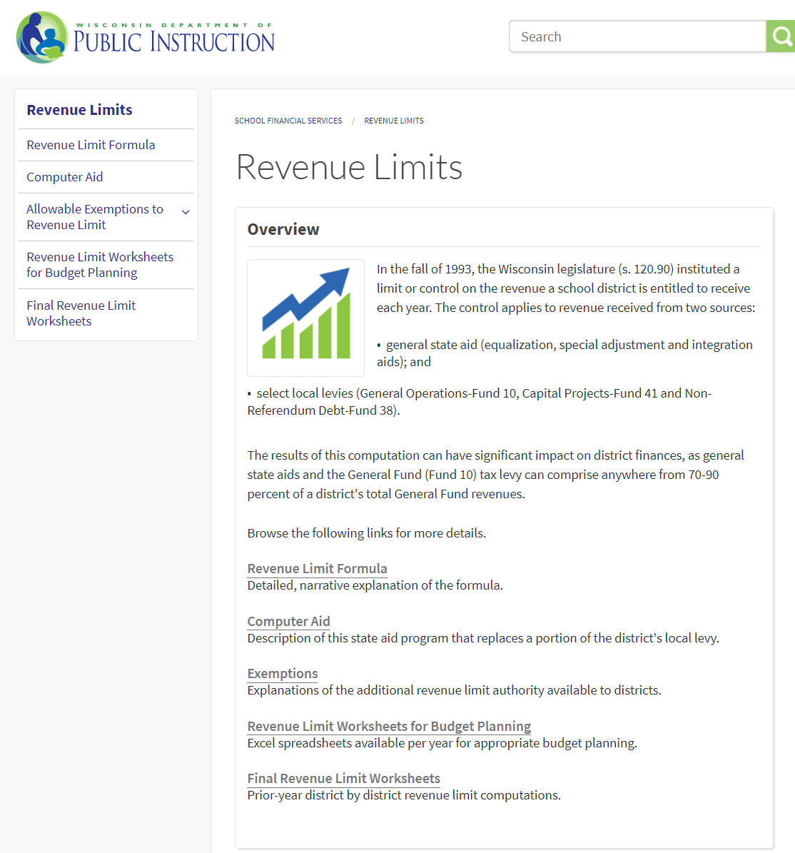
Revenue Limits
How can I predict future limits?
SFS Home
Revenue Limit Worksheets for Budget Planning
2023-24 Pre-Populated Revenue Limit Worksheet
Longitudinal Revenue Limit Data
Notes:
Don’t recreate the wheel 3 KEY POINTS: Line 11 YoY, Levy to the max, Communicate between teams
We’ve talked about what happens within the computation in a single year, but you need to also watch what happens from year to year.
Keep an eye on membership; membership drives RL (three-year rolling membership_
Base hold harmless and declining enrollment exemptions → temporary help written into RL calculation to give board chance to change: CUT COSTS or go to voters TO EXCEED LIMIT

Slide 28
Questions?
DPI School Financial Services Team
https://dpi.wi.gov/sfs
dpifin@dpi.wi.gov 608-267-9114
Mark Elworthy, Director 608-266-9534
Ben Kopitzke, Finance Consultant 608-267-9279
Notes:
Reminder to check newest RL worksheets constantly as we approach and pass Oct 15th
Call/email dpifin→will get routed

