Slide 1
WASBO Accounting Conference
20 March 2024
Understanding
Aid Worksheets
Jennifer Buros, Assistant Director
School Financial Services Team
Ben Kopitzke, Finance Consultant
School Financial Services Team

Slide 2
The Big Picture
Property Tax Levy
State Aid
(General + High Poverty + Computer + Exempt Personal Property)
Revenue Limit
Notes:
RL: only YOUR district; what neighbor spends does not impact your RL
RL are INDIVIDUAL to district—what is happening in YOUR school community
State Aid: $5.2 billion entirely dependent on everyone else; as others spend more/less, property values change → impacts your district’s share of the allocation; compared to state averages and guarantees set in law. RELATIVE position is important (you have 10% property value increase but everyone else had 15%)
The controllable property tax levy—NOT referenda-approved debt

Slide 3
State General Aids
The fundamental purpose of the Equalization Aid formula is to “level the playing field” by providing assistance (distributing aid) to poorer districts (those with lower property value) to make up for what they can’t get from their property tax base.
➔ reasonable tax burden
Notes:
One of the strongest K-12 education systems; state provides $5.4 billion so school boards can provide programs that are nearly equal to more property rich districts while keeping a reasonable tax burden

Slide 4
Equalization Aid Factors
What affects the amount of a district’s Equalization Aid?
  District Factors (Prior Year Audited)
    Shared cost
    Membership
    Equalized property value
  State Factors
    Cost ceilings
    Guaranteed valuations per member
    Amount of funding the State puts into the formula
Notes:
Plug longitudinal EQ aid
Membership is more than 20 kids in first grade classroom looking at the board
3rd Friday in September often called 3FS, 2nd Friday in January 2FJ

Slide 5
What is Shared Cost?
Shared Cost was developed to be used in the Equalization Aid computation and captures ONLY certain elements of the General (10) and Debt Service (38 and 39) Funds.
Shared Cost can be defined as the district expenditures for which the district has no other revenues except for local Property Tax and Equalization Aid.
Determine Shared Cost for the General Fund by starting with the total General Fund expenditures and remove from those expenditures the dollar amount of all the revenues EXCEPT for Property Tax and Equalization Aid.

Slide 6
Membership: Revenue Limit vs Aid
Revenue Limit | Equalization Aid
Three-year rolling average | Prior year audited data
100% of 3rd Friday in September FTE | Average of 3rd Friday in September and 2nd Friday in January FTE
40% of Summer School FTE | 100% of Summer School FTE
New Independent Charter School FTE | New Independent Charter School FTE and voucher students, including SNSP
 | Group and Foster + Part-Time Non-Resident

Slide 7
Property Value
Assessed valuation is property value as determined by the local municipal assessor on January 1 in any given year.
Equalized valuation results when the Department of Revenue applies an adjustment factor to assessed value. The adjustment factor is meant to ensure each type of property has comparable value regardless of local assessment practices. Most state computations use equalized value, also known as "fair market" value.
The October 1 Tax Apportionment Value Certification is used to apportion levies and set municipal tax bills. A "final" version is issued the following May (i.e., almost 1.5 years after the original assessment).
This final version is known as the School Aid Value Certification and will be used in the FOLLOWING year's Equalization Aid formula, e.g., property value as of January 1, 2024, will eventually be used in the 2025-26 Equalization Aid computation.

Slide 8
Assessed Value vs Equalized Value
 | Equalized Value | Assessed Value
Valuation date | January 1 | January 1
Updated Annually | Yes | No
Applies to individual properties | No | Yes
Uses | Apportionment of tax levy Allocation of state aids Debt limit calculation Municipal Compliance Equating of manufacturing assessments Levy limit calculations | Determines amount of tax levy covered by the property
Source: Department of Revenue

Slide 9
2023-24 General Aid Data
(From October 15th Aid Cert)
2022-23 Property Wealth Data
Highest Property Value District
  North Lakeland: $17,506,625 per pupil
    Equalization aid: $0 per pupil
Lowest Property Value District*
  Abbotsford: $308,910 per pupil
    Equalization aid: $9,625 per pupil
Statewide Average
  $861,627 per pupil
    Equalization aid: $6,361 per pupil
2022-23 Shared Cost Data
Highest Overall District
  Washington $26,106 per pupil
Lowest Overall District*
  Menominee Indian $8,548 per pupil
Statewide Average
  $12,450 per pupil
  * Excluding Norris
Source: Department of Public Instruction
Notes:
Per pupil or per member?
Terms largely interchangeable: student vs member vs pupil
Specific times when you need to calculate MEMBERSHIP
RL membership or state aid membership is common comparison used in WI
CANNOT COMPARE USING TOTALS

Slide 10
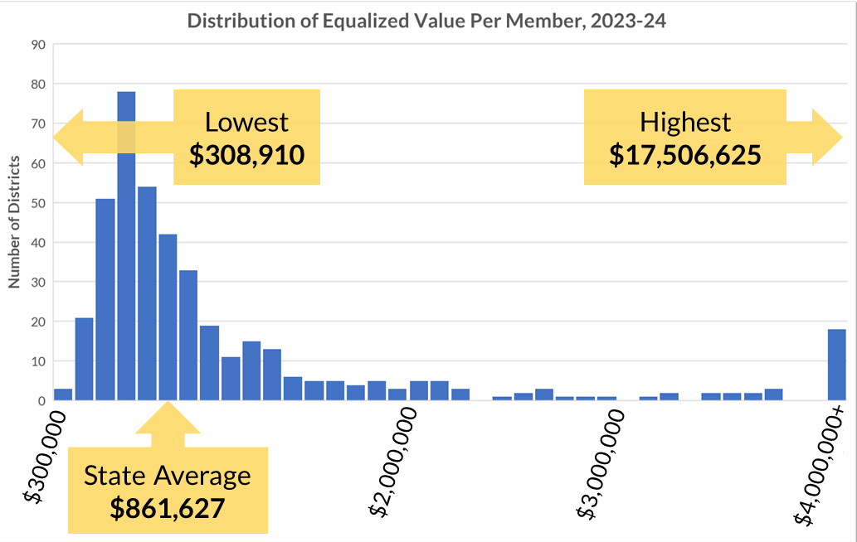
Property Value Per Member
Source: Department of Public Instruction

Slide 11
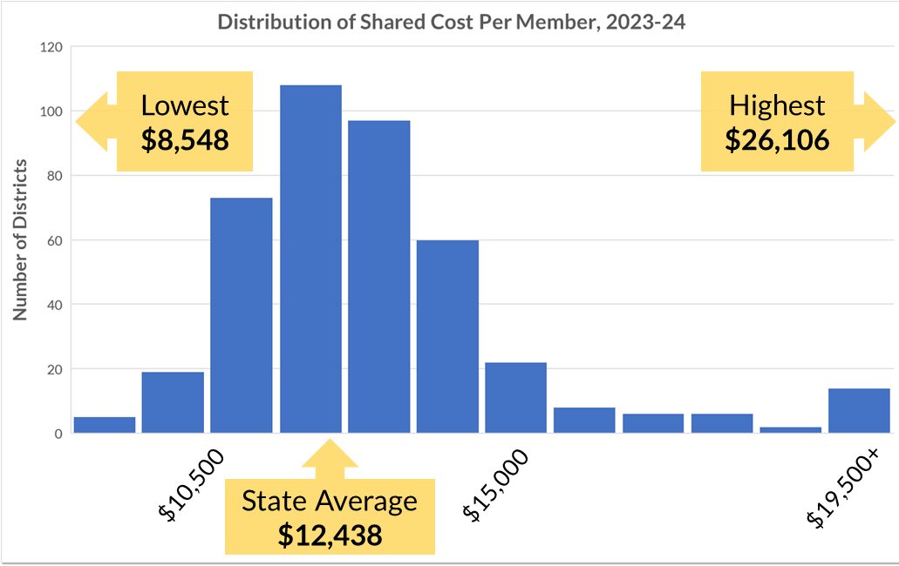
Shared Cost Per Member
Source: Department of Public Instruction

Slide 12
Property Value

Slide 13
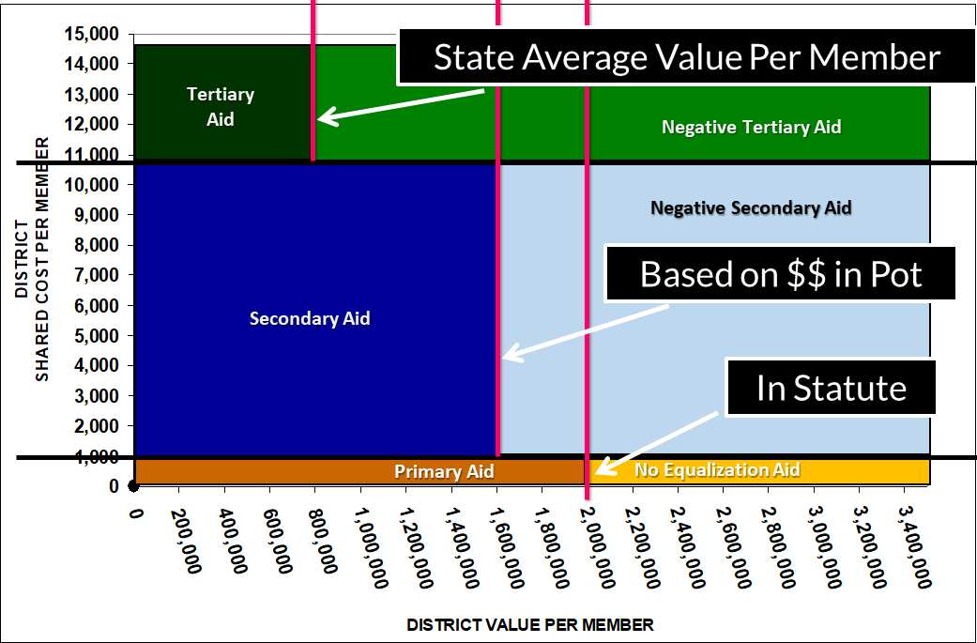
Ceilings and Guarantees
Secondary Ceiling
90% of PY costs
Primary Ceiling
Set in statute
Notes:
Illustrated values roughly correlate to 2022-23 aid calculation

Slide 14
Guarantees and Ceilings
Primary Ceiling: $1,000
Secondary Ceiling: $11,194
Source: Department of Public Instruction

Slide 15
Part A: Prior Year Audited Membership

Slide 16
Part B: Deductible Receipts

Slide 17
Part C: Net Cost of General Fund

Slide 18
Part D: Net Cost of Debt Service

Slide 19
Part E: Shared Cost

Slide 20
Part E: Shared Cost & Part F: EQ Property Value
High Spending & High Value = NEGATIVE TERTIARY AID

Slide 21
Part G: Equalization Aid by Tier
Primary (G5) + Secondary (G10) + Tertiary (G15) = $39,595,374.58

Slide 22
How the Formula “Works in Theory”
Primary Tier & Aid
Secondary Tier & Aid
Tertiary Tier & Aid
100% minus ($1,356,184 / $1,930,000) = 29.7%
Primary Aid: 29.7% * $26,904,000 = $7,998,936
100% minus ($1,356,184 / $1,984,342) = 31.7%
Secondary Aid: 31.7% * $274,259,376 = $86,818,815
100% minus ($1,356,184 / $861,627) = -57.4%
Tertiary Aid: -57.4% * $96,209,217 = -$55,222,204
Notes:
Sum up, get ~$40 million in aid

Slide 23
Ceilings and Guarantees
Secondary Ceiling
90% of PY costs
Primary Ceiling
Set in statute

Slide 24
Part H: EQ Aid & Part I: SA, Inter, and Intra

Slide 25
Special Adjustment
Wauwatosa

Slide 26
Longitudinal EQ Aid
1.
2.
3.
Notes:
Includes 2023-24; will be updated with final aid info in June

Slide 27
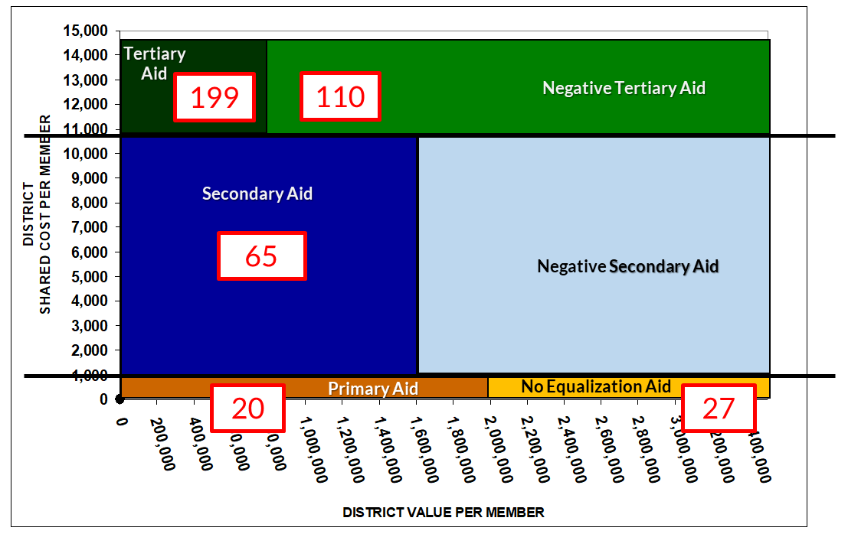
Final 2022-23 EQ Aid
Source: Department of Public Instruction
Notes:
2022-23 General School Aids (421 School Districts)
No equalization aid 27* (PY 23)
Primary only 20 (PY 27)
Positive primary and secondary 65 (PY 41)
Positive primary, secondary and tertiary 199 (PY 218)
Negative tertiary 110 (PY 112)
* 6 of these 27 school districts receive $0 General School Aids: Geneva J4, Green Lake, Mercer, North Lakeland, Northwood, and Washington Island.

Slide 28
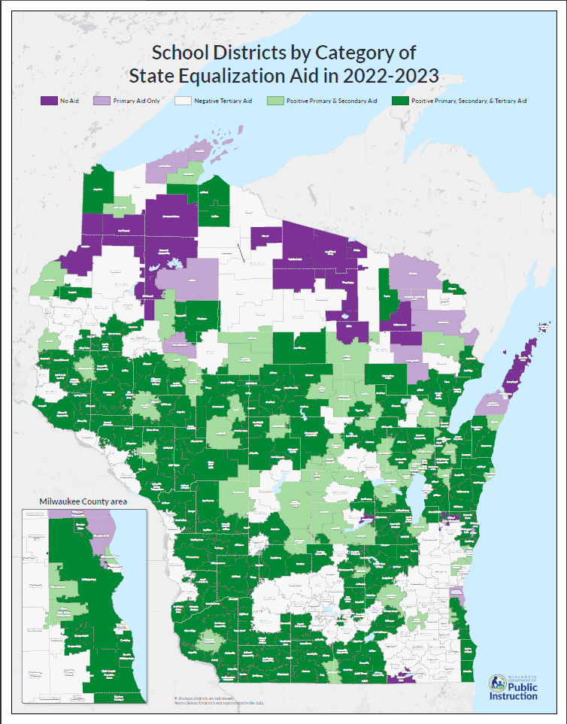
dpi.wi.gov/sfs/statistical/finance-maps/overview
Notes:
2022-23 General School Aids (421 School Districts)
No equalization aid 27* (PY 23)
Primary only 20 (PY 27)
Positive primary and secondary 65 (PY 41)
Positive primary, secondary and tertiary 199 (PY 218)
Negative tertiary 110 (PY 112)
* 6 of these 27 school districts receive $0 General School Aids: Geneva J4, Green Lake, Mercer, North Lakeland, Northwood, and Washington Island.

Slide 29
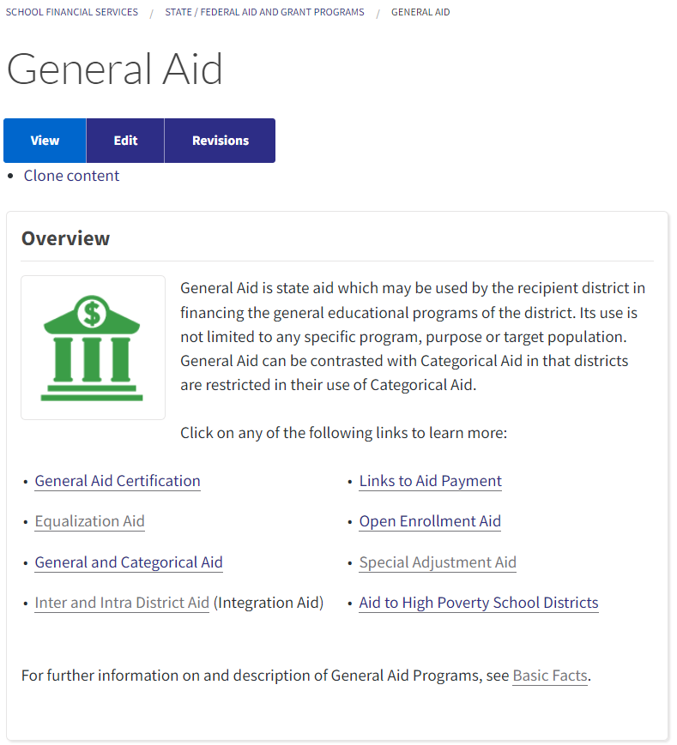
Aid Worksheets
How can I predict future aid amounts?
SFS Home
Current and historical July 1,
October 15, and final aid worksheets (and final aid adjustments)
Longitudinal Aid Data
Notes:
Don’t recreate the wheel 3 KEY FACTORS: Membership, Shared Cost, Property Value
We’ve talked about what happens within the computation in a single year, but you need to also watch what happens from year to year.
Keep an eye on membership; membership drives RL (three-year rolling membership_
Base hold harmless and declining enrollment exemptions → temporary help written into RL calculation to give board chance to change: CUT COSTS or go to voters TO EXCEED LIMIT

Slide 30
Questions?
DPI School Financial Services Team
https://dpi.wi.gov/sfs
dpifin@dpi.wi.gov 608-267-9114
Jennifer Buros, Assistant Director 608-266-1966
Ben Kopitzke, Finance Consultant 608-267-9279
Notes:
Reminder to check newest RL worksheets constantly as we approach and pass Oct 15th
Call/email dpifin→will get routed

