Slide 1
DPI Auditor Insights
Olivia Bernitt, School Finance Auditor
Kelly Bolin, School Finance Auditor
James Rhinerson, CPA, CMA, School Finance Auditor
May 2024

Slide 2
Agenda
State Single Audit Guidelines
Federal Single Audit Guidelines
Common Audit Findings
DPI Annual Report/Financial Statement Reviews
Debt Schedules
Membership Audit

Slide 3
State Single Audit Guidelines
Wisconsin School District Audit Manual is updated every year by DPI
Includes compliance requirements for DPI State Programs
Includes additional testing procedures including Compliance with State Statutes, Community Service Program and Employee Benefit Trust Fund Program
Notes:
General aids cluster, special education, pupil transportation, AGR, Common School Fund, Per Pupil Aid, etc.

Slide 4
State Audit Manual Overview
Dual-purpose document
DPI appendix to the State Single Audit Guidelines
Establishes auditing and program-specific compliance requirements for WI Public School Districts, CESAs, CCDEBs, and independently authorized charter schools that receive funding from the DPI but do not meet the single audit federal expenditure threshold
Notes:
This isn’t different as DPI appendix to SSAG and Audit Manual had similar/same wording and audit programs, but audit manual now states it’s serves as both.
Easier to maintain and provide consistency.

Slide 5
Updates – State Major Program Determination
Audits in accordance with SSAG
Risk-based approach outlined in SSAG Section 3.4 applied to all state funding to identify state major programs
Audits in accordance with WI School District Audit Manual
Risk-based approach outlined in SSAG Section 3.4 should be applied to the DPI funding to identify state major programs
Notes:
Previous inconsistencies between auditors when deciding what programs to audit for those audits not qualifying for SSAG.
During auditor WP reviews in the past few years, noted audits in accordance with SSAG had issues with state major program determination. Documentation did not always include all necessary information.

Slide 6
State Single Audit Guidelines - Updates
DOA updated the SSAG for fiscal years beginning after 6/30/2023
Updated state awards expended to be $250,000 or more for the guide to be applicable
Updated to better align with Uniform Grant Guidance
Removed the ability for state agencies to designate programs as Major or Type A programs
Notes:
We currently have equalization aid as designated major and special education and pupil transportation as type A programs. What this means is that these will no longer be allowed to be required to be major or type A programs by DPI so they will not be required to be tested every year for designated major or at least once every 3 years for type A. They will now go through risk assessment like federal programs.

Slide 7
GAAP to Regulatory Departures
Current DPI approved GAAP to regulatory departures:
For regulatory purposes, districts are allowed to record bid premiums in excess of the current year debt service payments for the issue generating the bid premium as a liability in account 816900 in the year of receipt. The bid premium must be recognized in Source 968 in the subsequent year.
For regulatory purposes, Districts may consider cash transfers to sinking funds as debt expenditures in the year of the transfer only for Q-Bonds issued from 2008 to 2011.

Slide 8
GAAP to Regulatory Departures
Current DPI approved GAAP to regulatory departures:
For regulatory purposes, grant revenue from the DPI received after the period of availability must be recorded as revenue in the fiscal year of the audit rather than a deferred inflow of resources.
Unique accounting circumstances discussed and approved by the DPI. Please contact a School Financial Services Team Auditor prior to reporting GAAP to Regulatory Departures not included on the list.
Notes:
We did move this back as this is something we hope to continue working with districts on

Slide 9
GAAP to Regulatory Departures
Previous DPI approved GAAP to regulatory departures:
Unrealized gains and losses were not allowable account combinations in the governmental funds in the WUFAR. For regulatory purposes, the districts would record a departure for not recording governmental funds unrealized gains and losses.
The account combinations have been added for FY22. Therefore, this is no longer an approved difference.

Slide 10
Federal Single Audit Guidelines
Required for Non-Federal entities that expend $750,000 or more in a fiscal year in federal awards
An audit of federal funds conducted in accordance with Uniform Grant Guidance (UGG) to provide assurance to the federal granting agencies that the funds are in compliance (2 CFR Part 200)
Office of Management and Budget (OMB) compliance supplement details compliance requirements
Notes:
Audit of financials and compliance with Federal award requirements - major programs - risk-based (determined by auditors)
Must be submitted to Federal Audit Clearinghouse

Slide 11
Proposed Changes to UGG
Increase in Single Audit Threshold from $750,000 to $1,000,000
Raise in equipment capitalization threshold from $5,000 per unit to $10,000 per unit
Updating “plain language”

Slide 12
Federal Funds not through DPI
Emergency Connectivity Fund (Source 791)
Through FCC, administered by USAC.
Part of ARPA Act of 2021
Eligible for Single Audit
Department of Administration
Governor’s CRF Funds
Back to School Supplemental Aid
Get Kids Ahead
None of these are eligible for State Single audit per DOA
Notes:
ECF yes for single audit. Not the same as e-rate so not 971.
Funds are to be spent on expenses necessary to respond to the COVID–19 pandemic, but there is no specific requirement to track expenditures and a project code will not be specified. CRF funds received should neither be included in a districts or ICS’ Schedule of Expenditures of Federal Awards (SEFA) nor count toward the Single Audit threshold.
Reached out to DOA for GKA but have not heard.

Slide 13
Audit Findings
If there is an audit finding, DPI will receive a Management Decision Letter (MDL). DPI will determine whether to sustain or not sustain a finding:
Sustained: Develop a corrective action on how to resolve the finding
Not Sustained: DPI responds to the letter stating the finding is not accurate
Notes:
If there is an audit finding DPI will receive a Management Letter. DPI will determine whether to sustain or not sustain a finding:
Sustained: Develop a corrective action on how to resolve the finding. Typically we will ask to see some sort of updated procedures. We will sometimes state the the corrective action plan included with the finding is sufficient and we do not need additional information.
Not Sustained: DPI responds to the letter stating the finding is not accurate
Ultimately the goal is for these to not continue to be findings for the district. We want to review what the district has in place to make sure these do not become findings again. It is possible that it will be a finding again in the following year due to the timing of the audit.
Districts need to respond to the MDL.

Slide 14
Common Federal Audit Findings
Allowable Costs
UGG Written Procedures
Procurement, Suspension and Debarment
Proper approval of claims, reports, etc.
Davis-Bacon Act
Documentation not kept
Notes:
ESSER, Child Nutrition, Titles, IDEA

Slide 15
Common State Audit Findings
Pupil Transportation
Lack of physical documentation or documentation does not tie.
Pupils in incorrect count category or mileage incorrectly calculated.
Pupils include in 0-2 mi. not in UHT plan or UHT plan not updated.
Special Education and School Age Parents
Individuals included in the NVL.
Specialized transportation routes related to student IEPs.
GL not reconciling to PI-1505-SE.
No documented review and approval of high cost special education claims.

Slide 16
Common Financial Audit Findings
Financial Statements Prepared by Auditor
Segregation of Duties
Material Audit Adjustments
SEFA Prepared by Auditor
Cash Reconciliation
Notes:
We see these a lot (specifically the top 3). Cash Reconciliation findings we do follow up.

Slide 17
DPI Annual Report Reviews
Coding
ECF (Emergency Connectivity Fund) <R791>
Private grants <R291>
Refunds <PY: R971; CY: expense>
Fund 21 / E999
Sales of capital <R86x>/non-capital items <R26x>
Notes:
ECF - Federal funds, part of ARPA, for laptops, wi-fi hotspots, etc. Should be wrapping up soon. Source 791
Private grants - Source 291
Refunds - if prior year, Source 971; if CY, against original expense
Fund 21/E999 - expense in fund 21 should generally be coded to detail objects (i.e. supplies)
Sales - capital: R860; non-capital: R26X

Slide 18
DPI Annual Report Reviews
Fund 73
ADC (Actuarially Determined Contribution)
Object 218
IRS (Implicit Rate Subsidy)
Notes:
ADC: unable to determine what ADC amount used to make contribution - important because it is basis for determining eligibility for categorical aid, and keeping plan appropriately funded
Object 218 - this should only be used for recording the expense side of trust contributions for OPEB and Pension
IRS - only if not self-funded; IRS is to “cover” the higher cost of care for retirees (everyone pays the same premium rate but they actually cost more)
Fund 73 was an addenda in SAFR, and will likely be an addenda again in WDF for 23-24.

Slide 19
DPI Annual Report Reviews
Addenda details
REMEMBER: Addenda are for DPI, not for the district.
Notes:
Write for your audience - DPI doesn’t necessarily know the details of your activities
Don’t need a novel, but need enough information to determine appropriate coding - will go over some examples in the next few slides

Slide 20
DPI Annual Report Reviews
A68 - Other Miscellaneous Revenue (R990)
“EFT Interface”
Notes:
Money that the district received through LGIP that they initially couldn’t determine source for
After more digging, was able to determine that it was state revenue (6xx)
IMPORTANT: best faith effort to determine where revenue is coming from and why it was received - proper coding (state/federal reporting, aid calc, may have to return $$ if not yours)

Slide 21
DPI Annual Report Reviews
A71 - Other Adjustments (E969/R969)
“Self-funded dental”
Notes:
District provided further detail that it was a correction to dental liability made before district switched to self-funded
Prior year corrections are appropriate in R/E 969
IMPORTANT - if it is a correction, make that clear; and make clear that it is from a prior year

Slide 22
DPI Annual Report Reviews
A81 - Other Miscellaneous (E999)
“Softball field redevelopment”
Notes:
District provided further detail that expenses were for redevelopment of a non-district owned softball field (local sports association)
This is essentially a donation to a private organization; E999 is appropriate for this
IMPORTANT: provide enough detail so DPI can determine infrequent/unusual transactions are coded correctly (in this case - is it the district’s field or someone else’s?)

Slide 23
DPI Annual Report Reviews
A23 - Refund of Prior Year Expenses (R971)
“Vendor refunds”
“Refund from Vendor-Overchg”
“Wire deposit refund overpayment”
Notes:
In each case, district provided additional detail
PY refunds are appropriate here
IMPORTANT - if a refund, indicate it was from expense paid in PY (if for a CY expense, it should be applied against the original expense)

Slide 24
DPI Financial Statement Reviews
AC fund balances
District
Auditor
Debt schedules
Notes:
Remember to push data if late changes are made.
If debt payments were accelerated or otherwise change, remember to update debt schedule (will talk more about this in next slide). Debt defeasance or refinancings updated.

Slide 25
Financial Statement Review
Common causes for differences between the audited financial statements and Fund Balance Report:
Entries made by district not reported to auditors,
Entries made by auditors not reported to districts, and
Immaterial changes found during our review of the annual report.
Notes:
If we require a change and the fs submitted and no change because immaterial, their job to opine on the financial statements. Go in and change the column that ties to the 1505 and we would expect the middle column to tie to the fs and we have documentation as to why that doesn’t match.

Slide 26
Reporting Late Changes
District or auditor entries made after the original submissions are required to be made in the books and the data repushed to WDF.
If changes are required after the books have been closed, districts will need to work with their vendor.
Notes:
We have instances where entries are not made by the district.

Slide 27
DPI Auditor Timeline
End of August/Early September:
District submits District Aid Certification
DPI reviews District Aid Certification
Friday on or Before September 15th:
Auditors submit Auditor Aid Certification and Fund Balance Reports
DPI reviews Auditor Reports
Following Friday:
District submits Annual Report
October 15th Aid is calculated

Slide 28
DPI Auditor Timeline
October through November:
DPI reviews District Annual Reports
End of November/Early December:
DPI Auditors reach out to Districts with Annual Report questions
December 15th:
District Audited Financial Statements are due
January through March:
DPI completed Audited Financial Statement Reviews and contacts Districts
Goal: March 31st Fiscal Year Data is Finalized

Slide 29
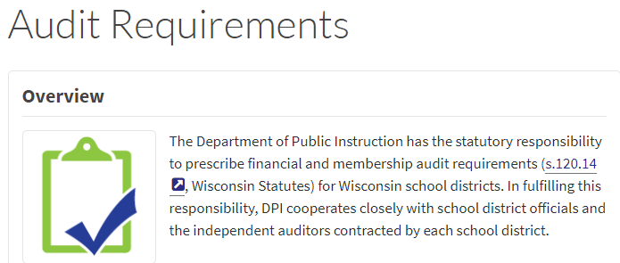
Timely Reporting to DPI Impacts Us All
Late submission of SAFR reports
Late submission of audited financial statements
Late submission of Actuarial studies
Notes:
FS used to review and “sign off” on 20-21 Annual Report Data which is then used to calculate General Aids & used by public.
FS used during auditor workpaper reviews which occur annually.
FS used to collect federal and state single audit information which we are required to follow up on.
LAB audits department with regard to SFS data collection.
Late FS Submission – letter gets sent to

Slide 30
Debt Schedules
Schedules have been moved to WiSFiP
Debt schedules must be updated in WiSFiP within 10 days of any changes
Sample journal entries and a BAN issuance and refinancing example can be found on our website
Accounting Issues and Coding Examples
Notes:
We have instances where entries are not made by the district.

Slide 31
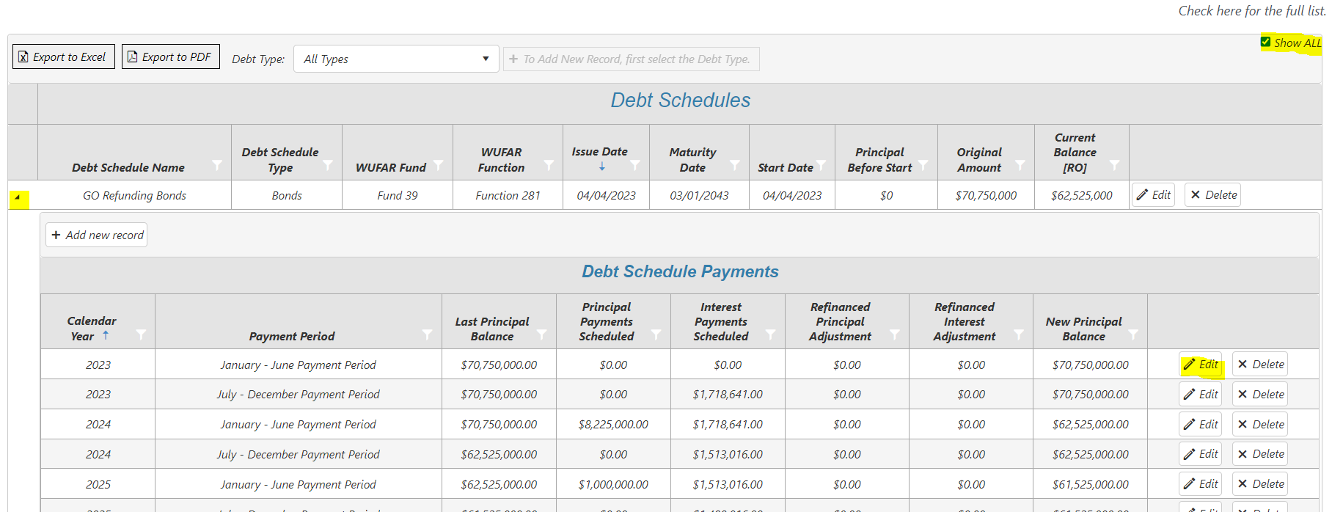
Debt Schedules
Notes:
Show all button
Drop down for editing
Reference the debt entry examples

Slide 32
Membership Audits
Memberships are required by State Statute for at least 25% of districts each year
Selected randomly, PY membership audit findings, late pupil counts or PY summer school fee issues
Districts are notified the first week of February
Membership Audits are due May 1st

Slide 33
Membership Audits
DPI releases the membership audit program and report sample
Obtain count documentation and compare it to the PI-1563, review count procedures, review reconciliation for completion and accuracy, test sample of pupils, test summer school and related fees (if applicable)

Slide 34
Membership Audits
Pupil Count Reconciliation is required each year, even if the district is not selected for audit
Reconciles the September Count to the January Count
If the district receives a finding for not completing the reconciliation, they will automatically be selected for membership the following year.
Pupil Count Reconciliation Online Course

Slide 35
Resources
WI School District Audit Manual
State Single Audit Guidelines
OMB Compliance Supplement
Membership Audit Webpage
WUFAR Webpage
SFS Webpage
WDF/WiSFiP Podcast

Slide 36
Questions?
Olivia Bernitt, SFS Auditor, DPI
608.261.2137
Olivia.Bernitt@dpi.wi.gov
Kelly Bolin, SFS Auditor, DPI
608.266.3892
Kelly.Bolin@dpi.wi.gov
James Rhinerson, SFS Auditor, DPI
608.266.7692
James.Rhinerson@dpi.wi.gov

