Slide 1
High-Cost Special Education Aid
Rick Cruz
School Financial Consultant
School Financial Services Team
With Derek Sliter
CESA 5 Business Services
March 2024
Notes:
Welcome to the High Cost Special Education Aid Presentation.The information is provided in snippets to provide targeted information so you should feel free to view the entire presentation or only those sections you find relevant. Links to online resources are included for easy lookup.

Slide 2
Quick Reminder about Excess Cost
For something to be an excess cost of special education, it must be a cost that would not otherwise exist but for the need to provide a free appropriate public education (FAPE) to students with disabilities, as specified in their individual education plans (IEPs). More information at S. 115.76, Wis Stats
Question: What are your examples of an excess cost?
DPI Guidance for Special Education Aid
Notes:
Only the excess costs of providing special education to students with disabilities (defined in s. 115.76, Wis. Stats.) and school-age parents are eligible for categorical aid. Aid is available for the salaries and benefits of licensed teachers, aides, and support staff, as well as transportation and a few other specific costs. Staff eligibility for categorical aid depends upon both licensure and assignment. The eligibility requirements for categorical aid are generally stricter than for funding under a federal IDEA grant.

Slide 3
High Cost Special Education Aid
The high-cost special education aid program provides partial reimbursement of certain special education costs for school districts, CESAs, CCDEBs, and operators of independent charter schools.
Eligible Costs = Total Student Costs – (Deductible Revenues > $30,000)
Only Non-Administrative Costs are eligible
If the administartive and nonadministrative costs are combined, you are eligible to claim 90% of the total cost claim
DPI Guidance for HCSE Aid
Notes:
This program provides additional special education aid to Wisconsin school districts, independent charter schools, CESAs and CCDEBs. An LEA is eligible if a student with disabilities has actual, additional, non-administrative costs of special education and related services in excess of $30,000.
Non-administrative costs are costs of providing special education and related services to an individual child with disabilities, excluding clerical or administrative costs.
If a cost includes both non-administrative and clerical or administrative components which cannot be separated, then the non-administrative component to be identified is 90 percent of that cost. This may be particularly true for private tuition as few private schools bill separately for administration or overhead.

Slide 4
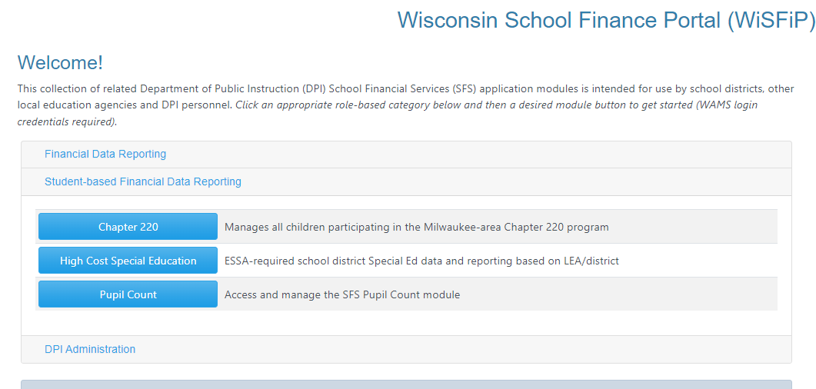
The Claim Process
LEAs submit expenses via an online claim application located in the Wisconsin School Finance Portal (WiSFiP)
Notes:
LEAs will submit their high cost claim application online using the Wisconsin School Finance Portal, or WiSFiP.

Slide 5
High Cost Special Education Aid
Items needed for your claim
Access to WiSFiP as Student Data Administrator Role by DSA
Accurate WISEid Student Data in your SIS
Student was enrolled during the 22-23 year
Student was identified as Special Ed with identified disability
No other district can claim enrollment
Accurate FAPE Student Data if student attends another LEA other than Resident LEA, may require LEA contact for record agreement
WISEid Not Found Error Fixes
DPI Guidance for HCSE Aid
High-Cost Special Ed Tracking Template
Notes:
This program provides additional special education aid to Wisconsin school districts, independent charter schools, CESAs and CCDEBs. An LEA is eligible if a student with disabilities has actual, additional, non-administrative costs of special education and related services in excess of $30,000.
Non-administrative costs are costs of providing special education and related services to an individual child with disabilities, excluding clerical or administrative costs.
If a cost includes both non-administrative and clerical or administrative components which cannot be separated, then the non-administrative component to be identified is 90 percent of that cost. This may be particularly true for private tuition as few private schools bill separately for administration or overhead.

Slide 6
Identifying High-Cost SPED Students
What if my special education director comes back and states we don’t have any eligible students?
Leading questions:
Any students in alternative programs/placements due to IEP?
Students with one-on-one aides in IEP?
SPED programs or classrooms with low student to teacher ratios?
Students with transportation in IEP?
It’s your responsibility to file and determine eligibility, start tracking early at the beginning of the year
DPI Guidance for HCSE Aid

Slide 7
Categories of Costs
Three categories of costs:
Child-Specific (1-on-1 aides, placements, etc.)
Program (transition, speech/language, etc.)
Specified Services (non-administrative pupil services)
Choose Student or Program Cost
High Cost Special Education FAQ
Notes:
Let’s talk about cost categories.
Child-Specific: Costs of salary and fringe benefits, purchased services, placement, transportation, supplies, depreciation, and extended school year that are particular to a child, and that child only. Example: one program aide, one student only, not shared with any other students.
Program: The costs of salary and fringe benefits, purchased services, transportation, supplies, and depreciation that are particular to a program serving multiple students. Example: A cross categorical teacher provides group instruction or one on one instruction with various students.
Specified Services: The costs of salary and fringe benefits, purchased services, and supplies for the provision of specified services including: nursing, social work, psychology, guidance counseling, speech-language pathology, and audiology. This is data pulled from your PI-1505-SE.

Slide 8
Common Issues
No Valid License
License entity number or license electronic file number (EFN) only, not license number
Wrong or no name match with license number
Incorrect coding
Duplicate Cost or Salary
Only eligible for time with the HCSE student(s)
One Program Entry for Multiple Staff
One Employee does not equal One Program
Same type of staff in one program
Cost Description will be Required FY2025
Example; 436000, 256000 will allow for more accurate review of data
High Cost Special Education FAQ

Slide 9
Other Questions
Rick Cruz School Finance Consultant
School Financial Services Team ricardo.cruz@dpi.wi.gov 608-266-8255
Derek Sliter CPA
CESA 5 Business Services sliterd@cesa5.org 608-745-5413
Notes:
I hope that you found this brief introduction of the high cost special education claim form helpful. Please contact me if you have any questions or concerns as you work through the claim process.

