Slide 1
Process of a Single Audit
Olivia Bernitt, SFS Auditor, DPI
Greg Pitel, CPA, Partner, KerberRose
Brianna Olson, CPA, Manager, KerberRose
WASBO Accounting Conference
March 2024
Notes:
Purpose of the presentation
Not getting into specific programs
Presentation tomorrow on single audits of stimulus funds

Slide 2
Process of a Single Audit Agenda
What is a Single Audit?
When is a Single Audit Required?
OMB Compliance Supplement
Written Procedures
How to Prepare for a Single Audit
What to Expect During the Single Audit
What to Expect After the Single Audit
Notes:
Agenda of what we plan to walk through today. We will start out with more specifics about the single audit itself and what it is and then go into the before, during and after of the process.

Slide 3
What is a Single Audit?
An audit of federal funds as required by 2 CFR part 200, subpart F of Uniform Guidance to determine that the receiving entity was in compliance with the direct and material compliance requirements of the program per the OMB Compliance Supplement. Specific Auditee responsibilities are Sections 200.508-512
Authority of the Single Audit comes the Single Audit Act of 1984, then updated in the Single Audit Act Amendments of 1996
Notes:
In technical terms
Probably is confusing right now but hopefully will become clearer by the end of the presentation

Slide 4
What is a Single Audit?
Specific Auditee responsibilities are Sections 200.508-512:
200.508 – Audit responsibilities
200.509 – Auditor selection
200.510 – Financial statements
200.511 – Audit findings follow-up
200.512 – Report submission
Notes:
District’s are the auditees
Arrange the audit, select auditor
Prepare FS and SEFSA, which mostly done by auditors. Need oversight
Corrective Action and working with DPI
Submitted on time. Have extended last 2 years.

Slide 5
What is a Single Audit?
Single audits are used to provide assurance to the federal agencies granting the funds that the use of the funds is in compliance with the program’s requirements and Uniform Guidance.
The single audit for Districts includes:
the financial statement audit in accordance with AICPA standards (GAAS) and Government Auditing Standards (Yellowbook or GAGAS) AND a compliance audit in accordance with GAAS and Uniform Grant Guidance

Slide 6
When is a Single Audit Required?
Non-Federal entities that expend $750,000 or more in a fiscal year in Federal awards shall have a single or program-specific audit conducted in accordance with the provisions of the Uniform Grant Guidance.
A single audit is required annually for districts that expend $750,000 or more in a fiscal year in Federal awards.
Notes:
Emphasize it is for expended $750K
Required annually when meet threshold
If fall below threshold, no longer required

Slide 7
OMB Compliance Supplement
The OMB Compliance Supplement details the compliance requirements that the awarding agency expects the auditor to test and suggests audit procedures.
The compliance supplement for 2023 was issued May 19, 2023.
Link to the compliance supplement: https://www.whitehouse.gov/omb/management/office-federal-financial-management/
Notes:
This is what the auditors use when testing so is a guide for districts to use
About 1700 pages in 2021, mostly individual requirements for each program
Released in August 2021 but addendum released in October for ESF funds
Use most recently available when reviewing

Slide 8
OMB Compliance Supplement
The compliance supplement is made up for 8 parts:
Part 1 – Background, Purpose, and Applicability
Part 2 – Matrix of Compliance Requirements
Part 3 – Compliance Requirements
Part 4 – Agency Program Requirements
Part 5 – Cluster of Programs
Part 6 – Internal Controls
Part 7 – Guidance for Auditing Programs Not Included in this Compliance Supplement
Part 8 – Appendices
Notes:
Made up of 8 parts, some of which we will go into in more detail in the coming slides
Part 4 specific grant programs
Part 5 Clusters
Part 6 requirements related to internal controls
Part 7 programs not in supplement
Part 8 Appendicies

Slide 9
OMB Compliance Supplement
Department of Education
84.010 Title I Grants to Local Educational Agencies (Title I, Part A Of The ESEA)
84.011 Migrant Education-State Grant Program (Title I, Part C Of ESEA)
84.027 Special Education—Grants to States (Idea, Part B)
84.041 Impact Aid (Title VII of ESEA)
84.048 Career and Technical Education—Basic Grants to States (Perkins V)
84.173 Special Education—Preschool Grants (Idea Preschool)
84.282 Charter Schools
84.287 Twenty-First Century Community Learning Centers
84.365 English Language Acquisition State Grants
84.367 Supporting Effective Instruction State Grants
84.424 Student Support and Academic Enrichment Program
84.425 Education Stabilization Fund (ESF)
84.425D Education Stabilization Fund Under the Coronavirus Aid, Relief, and Economic Security Act
Notes:
These are the programs currently included in the compliance supplement that we most commonly see with districts.

Slide 10
OMB Compliance Supplement
Department of Agriculture
10.553 School Breakfast Program (SBP)
10.555 National School Lunch Program (NSLP)
10.556 Special Milk Program For Children (SMP)
10.559 Summer Food Service Program For Children (SFSP)
10.558 Child and Adult Care Food Program (CACFP)
10.559 Summer Food Service Program for Children (SFSP)
10.582 Fresh Fruit and Vegetable Program
Department of Health and Human Services
93.778 Medical Assistance Program

Slide 11
OMB Compliance Supplement
Part 2 – Matrix of Compliance Requirements
There are 12 compliance requirements that could be applicable to be tested for each federal program.
The Matrix indicates what compliance requirement is subject to audit for each Federal program listed.
Notes:
Matrix of compliance requirements
There are 12 possible compliance requirements that could be tested, we will get to
This is a matrix that lists the programs in the compliance supplement, and which are applicable

Slide 12
OMB Compliance Supplement
Part 3 – Compliance Requirements (applies to all grants)
Each of the 12 compliance requirements have suggested audit procedures that Districts should familiarize themselves with
The 12 compliance requirements are:
- Activities Allowed or Unallowed - Allowable Costs/Cost Principles
- Cash Management - Eligibility
- Equipment Real Property Management - Matching, Level of Effort, Earmarking
- Period of Performance - Procurement, Suspension & Debarment
- Program Income - Reporting
- Subrecipient Monitoring - Special Tests and Provisions
Notes:
12 compliance supplements and detail about them and suggested audit procedures
Parts 4 and 5 will have more specific details to the programs if the are applicable

Slide 13
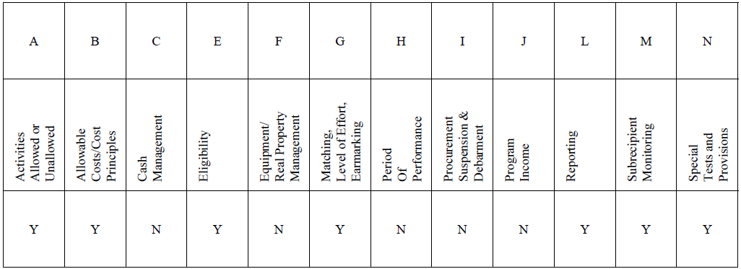
OMB Compliance Supplement
Part 4 – 12 compliance requirements from the Compliance Supplement for Title I are:

Slide 14
Written Procedures
Auditors will ask to review written procedures;
For single audits, if there are no written procedures there will be a finding; and
A finding will lead to terms and conditions being added to the subrecipient’s grants through DPI’s annual risk assessment.
DPI does not provide sample written procedures.
Part 6 of the compliance supplement
Notes:
Key here is written procedures
We do not have sample written procedures, but we do have some guidance as to what should be in them.
Help make sure district is in compliance with the federal grant program

Slide 15
Written Procedures
Written procedures are not policies. A policy may state, “Only allowable costs will be charged to the XXX grant.”
The procedures are the district’s internal steps for ensuring that only allowable costs will be charged to the grant.
Required to have written procedures for allowable costs, cash management, purchasing and conflict of interest
Uniform Grant Guidance Written Procedures: https://dpi.wi.gov/wisegrants/uniform-grant-guidance/writtenprocedures
Notes:
Different than a policy
Allowable costs, cash management, purchasing and conflict of interest which we will go into more
Site includes checklists for writing procedures on allowable costs, cash management, and conflict of interest.
Should be used to create if don’t have or can be used to review current written procedures

Slide 16
Written Procedures
Allowability of Costs:
Required written procedures must address how the subrecipient is ensuring that costs on the federal grant, and ultimately claimed, are allowed under the individual Federal program and in accordance with the cost principles established in the Uniform Grant Guidance. 200.302(b)(7)
For payroll, this includes documentation of time and effort. Charges to federal awards must be based on records that accurately reflect the work performed.
Notes:
Auditors will review these procedures and test a sample of both general disbursements and payroll if charged to the grant to determine the district is following these written procedures.
Time and effort must be documented not just estimated.

Slide 17
Written Procedures
Cash Management:
Required written procedures must address both advance payments and cost reimbursement. The written procedures should include steps involved in obligating, liquidating, and claiming of federal funds, 200.302(b)(6) and 200.305
Cost reimbursement is requesting federal funds for expenditures after they have been liquidated.
Advance payment is requesting federal funds for expenditures not yet incurred.
Notes:
Again, auditors will review and test the written procedures related to cash management.

Slide 18
Written Procedures
Procurement:
The district must use its own documented procurement procedures which reflect applicable State and local regulations, provided that the procurements conform to applicable Federal laws and the UGG, 200.319(d)
The district must have written procedures regarding solicitations to ensure that all procurement transactions are conducted in a manner providing full and open competition.
Maintain written standards for “Conflict of Interest” 200.318(c)(2)
Notes:
Need to have these in place and follow them
Conflict of interest: The LEA’s written procurement procedures must include written standards of conduct covering how to identify conflicts of interest and how it governs the actions of its employees engaged in the selection, award, or administration of contracts. If an employee has a real or apparent conflict of interest, that employee may not participate in the selection, award, or administration of a contract supported by a Federal award.

Slide 19
Written Procedures
Procurement:
The district must maintain records sufficient to detail the history of procurement. Records must include, but not limited to: 200.318(i)
Rationale for the method of procurement
Selection of contract type
Contractor selection or rejection
The basis for contract price
Notes:
Need to keep the documentation related to procurement for testing completed by the auditors.

Slide 20
Written Procedures
5 Methods of Procurement 200.320
Micro-purchase
Small Purchase
Sealed Bids
Competitive Proposals
Noncompetitive Proposals

Slide 21
Written Procedures
Micro-purchases:
The non-federal entity is responsible for determining an appropriate micro-purchase threshold based on internal controls, an evaluation of risk and its documented procurement procedures.
Aggregate dollar up to $10,000 but under certain conditions may be increased to $50,000
When practical, distribute equitable among qualified suppliers
No competitive quotes required if management determines price is reasonable.
Notes:
A Micro-purchase is the acquisition of supplies or services, where the aggregate dollar amount does not exceed the micro-purchase threshold, typically the lesser of 10K or lower local amount. Changes to this threshold are published to the Federal Acquisition Regulation (FAR).
When practical, districts should distribute micro-purchases equitable among qualified suppliers. If a district does use on vendor for everything, they should have documentation as to why.
Micro-purchases may be awarded to vendors without competitive quotes if the district considers the price to be reasonable.

Slide 22
Written Procedures
Small purchases:
Purchases up to the Simplified Acquisition threshold
Informal procedures acceptable
Price or rate quotes must be obtained from an adequate number of sources
Notes:
Small purchase procedures are informal and simple procedures used to secure services, supplies, or other property that do not cost more than the Simplified Acquisition Threshold ($250,000 or lower local amount).
If small purchase procedures are used, then the subrecipient must obtain price or rate quotes from an adequate number of sources before a vendor is selected.

Slide 23
Written Procedures
Sealed Bids:
Purchases over the Simplified Acquisition Threshold
Formal Solicitation required
Fixed Price awarded to a responsible bidder who conformed with all material terms and is the lowest in price.
Most common for construction contracts
Notes:
On the other hand, sealed bids are used to secure services, supplies, or other property that are over the Simplified Acquisition Threshold.
Bids are publicly solicited and result in a fixed price awarded to the bidder who conformed with all the material terms and conditions; and who is the lowest in price.
Additional details on necessary conditions for sealed bids can be found in 200.320(c). An example of one of these conditions is the requirement for providing specifications to define requested items and/or services.

Slide 24
Written Procedures
Competitive Proposals:
Purchases over the Simplified Acquisition Threshold
Formal Solicitation required
Fixed Price or cost-reimbursement contracts
Used when sealed bids not appropriate
Awarded to responsible firm whose proposal is most advantageous to the program, with price being one of the considered factors.

Slide 25
Written Procedures
Noncompetitive Proposal:
May be used only when one or more of the following apply:
The item is available from a single source
The public exigency or emergency for the requirement will not permit a delay resulting from competitive solicitation
The federal awarding agency (or pass-through entity-DPI) express authorizes this method in response to a written request from the non-federal entity
After solicitation of a number of sources, competition is determined inadequate

Slide 26
Suspension and Debarment
Non-federal entities are prohibited from contracting with or making subawards under covered transactions to parties that are suspended or debarred.
Must verify the entity is not suspended or debarred
System for Award Management (SAM.gov)
Certification from entity
Clause or condition

Slide 27
How to Prepare for a Single Audit
Review the compliance supplement to know what the auditors will be reviewing
Assess the district’s control environment and ensure they have written procedures
Have documentation for each grant readily accessible for auditors to review
Additional cost - Charge additional costs back to grant
Let auditors know you believe you may need a single audit early so they can plan accordingly
Notes:
By the time of the SA, the districts will already have the first two auditee requirement completed, selecting auditor and setting up the time.
Ensure written procedures are in place
200.508 states it is auditee’s responsibility to provide auditor access to personnel, accounts, books, records, supporting documentation and all other requested information. That includes WISEgrants
Do not need to have every invoice pulled for a grant before they get there but should know where to get them so they can be provided in a reasonable time
Additional costs associated with a SA. Will need to discuss with them.
If you believe you may need a SA, reach out sooner than later.

Slide 28
How to Prepare for a Single Audit
The auditee prepares the Schedule of Expenditures of Federal Awards (SEFA) for the year ended.
SEFA is a financial statement schedule that lists the LEA’s expenditures of federal awards for the fiscal year by federal agency, grant number and amount.
Notes:
Districts should prepare the SEFA or do their best to prepare this for the auditors. This also helps with determining if a SA is needed.
As stated earlier, a federal single audit is required if the entity expended $750K or more during the year (in total, not per grant)

Slide 29
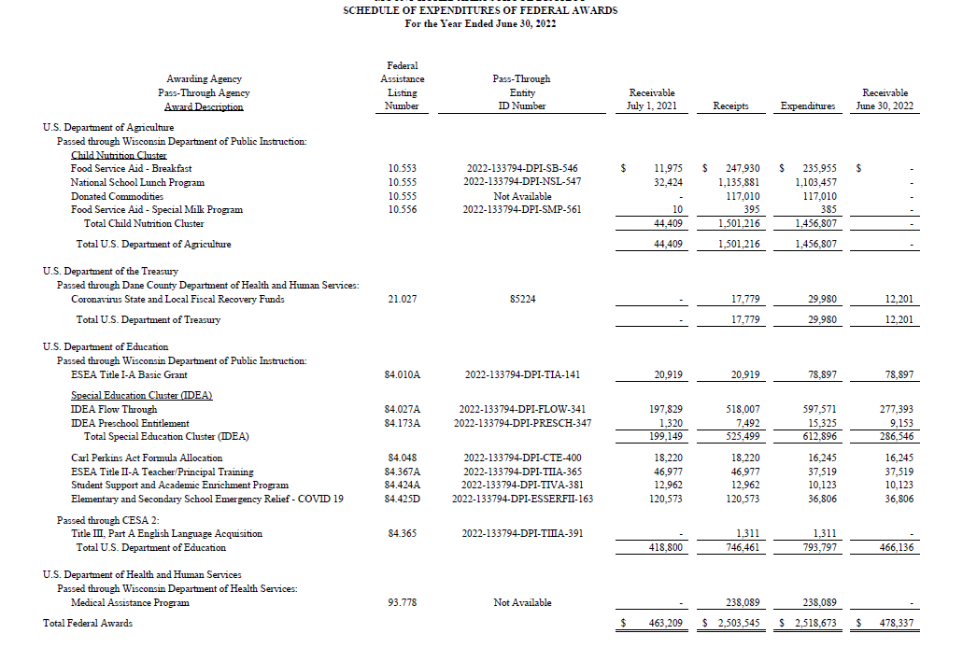
Example SEFA

Slide 30
How to Prepare for a Single Audit
Risk Assessment and Major Program Determination:
Major programs are the programs that the auditor will test during the Single Audit.
Auditors complete a risk assessment on the programs and the district.
The district can either be high risk or low risk. The risk level determines the total dollar amount to test to meet coverage.
Notes:
During SA, auditors do risk assessment. Not done by district but district’s should be aware of the process.
Not all programs tested
Low risk or high risk
To be low risk, district need to: have unmodified opinion, no material weaknesses in IC over financial reporting, no findings in type A programs, no going concern, timely submission of the single audit report and filing with FAC.
Districts that are considered high risk may have more than one program tested to meet coverage. 20% coverage for low, 40% coverage for high.
Assess all type A programs to identify low risk program. Type A is programs over $750K. Must have been tested as major in at least one of the two most recent audit periods, and no modified opinion, material weakness in IC over compliance, or QC. Other risks that auditors assess, for example significant changes in staffing.
Remaining programs are type B. Assess for high risk B for ¼ of low risk A programs.
Any not low risk A programs or high risk B programs must be tested. Then test additional for coverage.

Slide 31
What to Expect During the Single Audit
Additional time needed during fieldwork
Walk through with grant administrator on controls and compliance relating to the grant
Go through the written procedures
May be more than one program being tested depending on the auditor's risk assessment
Notes:
Those who work with the grant should be made available. If communication is open, it is likely the district will know what program is being tested prior to the audit so those who need to be available during the audit will need to be.

Slide 32
What to Expect During the Single Audit
Have supporting documentation readily available.
Auditors will be reviewing supporting documentation for the major program/programs they are testing.
There will likely be samples to test each of the different compliance requirements noted earlier that are direct and material to the program.
Testing will be done both for internal controls over compliance and compliance requirements.
Notes:
Having support ready will help with making the process smoother and will reduce the likelihood of findings.
If the auditors don’t see it they have to assume it’s not there.
Tests will be of internal controls over compliance and compliance requirements. Compliance requirements are those discussed earlier to make sure the federal program is in compliance. Internal controls are what the district has in place to make sure they are in compliance.
It is possible to not have findings related to being in compliance but have findings over controls if there are none in place.

Slide 33
What to Expect After the Single Audit
Communication of Findings
If there were findings, providing a corrective action plan
If any noncompliance is identified, Districts should be prompt when completing any required follow up action
Data Collection Form
Notes:
Submitted to the federal audit clearinghouse. Likely that auditors will fill out but reviewed by district administrator.
Corrective action plan done by district
Discuss with auditors as soon as possible to determine if there were findings. Sooner they are discussed, sooner district can implement.

Slide 34
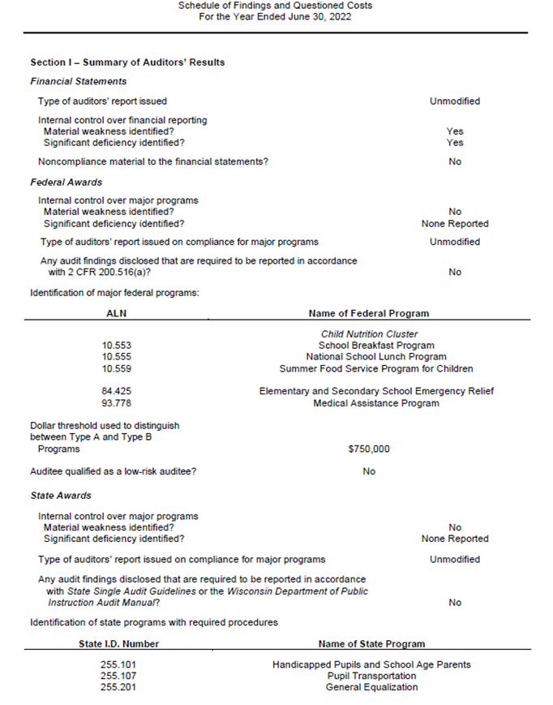
Where to Review Findings

Slide 35
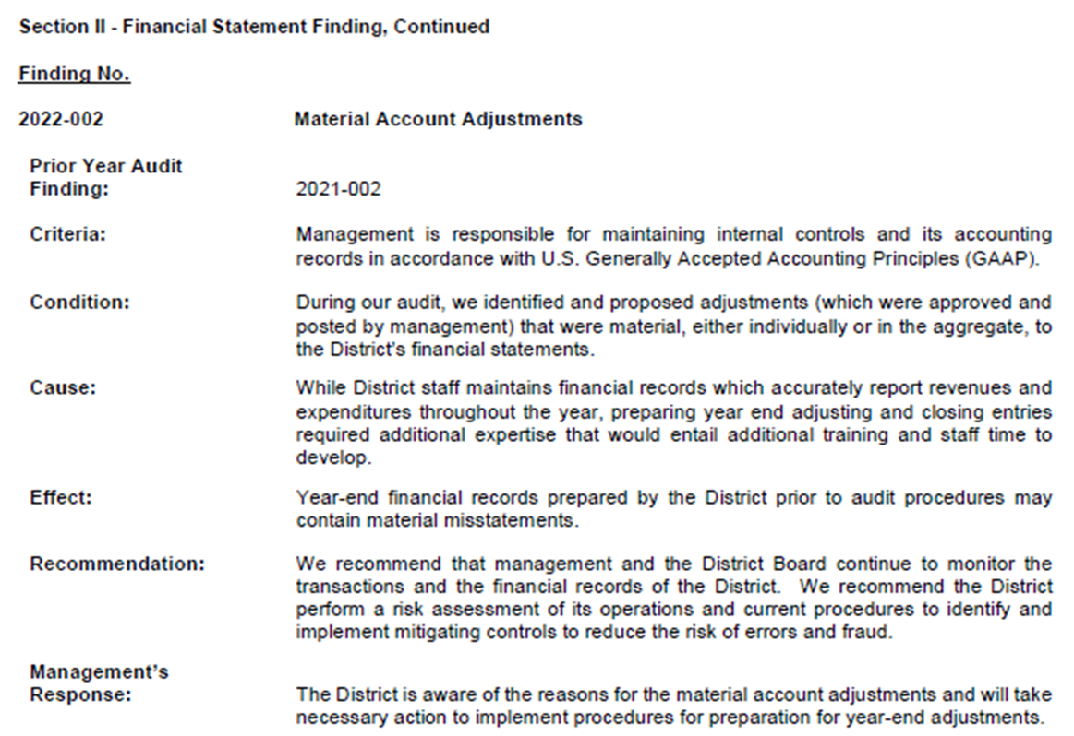
Where to Review Findings

Slide 36
What to do if there is an audit finding?
Opportunity for improving your systems
Contact DPI for support
If non-compliance is identified, LEAs should be prompt when completing any corrective action
Notes:
Olivia
What to do if there is an audit finding? An audit finding should be considered an opportunity for improving your system and how to advance your systems to ensure transparency and compliance in documenting your internal controls. If there is an audit finding you can always contact DPI for support and DPI can help you comply with the corrective action. If non-compliance is identified, LEAs should be prompt when completing the corrective action.

Slide 37
Audit Findings
If there is an audit finding, DPI will receive a Management Letter. DPI will determine whether to sustain or not sustain a finding:
Sustained: Develop a corrective action on how to resolve the finding
Not Sustained: DPI responds to the letter stating the finding is not accurate
Notes:
Olivia
If there is an audit finding DPI will receive a Management Letter. DPI will determine whether to sustain or not sustain a finding:
Sustained: Develop a corrective action on how to resolve the finding. Typically we will ask to see some sort of updated procedures. We will sometimes state the the corrective action plan included with the finding is sufficient and we do not need additional information.
Not Sustained: DPI responds to the letter stating the finding is not accurate
Ultimately the goal is for these to not continue to be findings for the district. We want to review what the district has in place to make sure these do not become findings again. It is possible that it will be a finding again in the following year due to the timing of the audit.
Districts need to respond to the MDL.

Slide 38
Common Federal Findings
No proper approval of claims, verification reports, etc.
Proper documentation was not kept
Procurement, Suspension and Debarment
Davis-Bacon Act related to ESSER grants
UGG written procedures
Allowable costs
Notes:
Olivia
We had findings in the following programs in FY21: Child Nutrition Cluster, IDEA, ESSER, and Title II.
Even if it is done, it is important to keep and document. If the auditors cannot see that the review was done, they cannot sign off that it was done.
Add on types of procurement, suspension, and debarment

Slide 39
Proposed Changes to UGG
Increase in Single Audit Threshold from $750,000 to $1,000,000
Raise in equipment threshold from $5,000 per unit to $10,000 per unit
Updating “plain language”

Slide 40
Resources
WISEgrants for Auditors
Preparing for the Single Audit
Guidance on Allowable Costs
Written Procedures
WI School District Audit Manual
Equipment Purchased with Federal Funds
Federal Procurement Standards
Conflict of Interest
Allowable Costs Written Procedures
NVL Audit Report Guidance
Notes:
Olivia
Instructions WISEgrants access is in the NVL Audit Report Guidance document.

Slide 41
THANK YOU!
Olivia Bernitt, SFS Auditor, DPI
608.261.2137
Olivia.Bernitt@dpi.wi.gov
Greg Pitel, CPA, Partner, KerberRose
715.318.7737
Greg.Pitel@kerberrose.com
Brianna Olson, CPA, Manager, KerberRose
715.318.7726
Brianna.Olson@kerberrose.com
Visit our website: http://dpi.wi.gov/sfs
Notes:
Questions

