Slide 1
Title Slide
Transfer of Service
Kathy Fry, School Administration Consultant
Jennifer Buros, Assistant Director
School Financial Services Team
March 20, 2024
Notes:
Intros

Slide 2
Sample Text Slide
What is Transfer of Service (TOS)
The Transfer of Service Exemption Wis. Stat. § 121.91(4)(a)2 and Wis. Stat. § 121.91(4)(a)3 provides that a school district which assumes responsibility for providing a program or service from another governmental unit may request and may be granted an exemption to the district revenue limit per state statute.
2

Slide 3
Sample Text Slide
What is Transfer of Service (TOS)
A TOS request can be for an individual student with a disability or for a limited-English proficient student.
The Transfer of Service (TOS) request for an individual student is for the estimated additional, increased cost as determined after a review of the district’s current staffing and service capacity of that program or service less the estimated amount of aid the district will receive for the child or pupil in the following school year.
Individual student requests are processed through the PI-5000 TOS online portal. Majority of requests are for individual students.
3

Slide 4
Sample Text Slide
What is Transfer of Service (TOS)
A TOS request can also be for the increased cost for providing a service transferred between the school district and a local municipality, such as city or county.
Transfers of providing the service and financial responsibility between a school district and a local municipality where the municipality previously provided the service and paid related costs are processed through a Narrative Transfer of Service application. Does the district have sole responsibility for determining and directing the service?
4

Slide 5
Sample Text Slide
Transfer of Service (TOS) Request for a Student
Review six steps to determine eligibility.
If eligible, enter request in the online application system.
5

Slide 6
Sample Text Slide
TOS Eligibility
Eligibility Requirement #1: The student came to your district from another governmental unit that had responsibility for their education.
  Wisconsin school districts, including:
  A district that educates a student as a result of their residing in a juvenile detention facility, county jail, group or foster home, or another county-ordered placement without an educational program (whether or not that district received State Tuition reimbursement for the student)
  A district that places a student with one of the DPI schools (WCVBI or WESP-DHH)
  A district charter school
6

Slide 7
Sample Text Slide
TOS Eligibility
Eligibility Requirement #1: The student came to your district from another governmental unit that had responsibility for their education.
  Other Wisconsin governmental units :
  Independent (2r or 2x) charter schools
  Wisconsin counties with birth-to-three programs for children with disabilities
  Facilities run by the State of Wisconsin which are considered LEAs: Lincoln Hills School, and the Winnebago and Mendota Mental Health Institutes
7

Slide 8
Sample Text Slide
TOS Eligibility
Eligibility Requirement #1: The student came to your district from another governmental unit that had responsibility for their education.
  Public schools outside Wisconsin, including :
  Schools operated by another state or sub-unit of another state,
  Schools operated by the federal government; and
  Schools operated by a foreign country or sub-unit of a foreign country
8

Slide 9
Sample Text Slide
TOS Eligibility
Eligibility Requirement #2: The student is a student with a disability or limited English proficiency
Transferred into the district with an identified need
Typically, the need will be identified by an Individualized Education Program (IEP) or English Learner (EL) service plan with a Limited English Proficient (LEP) classification of 1 through 5.
A district is not eligible to receive a Transfer of Service exemption for new services required by an evaluation or re-evaluation of a student after they transfer into the district.
9

Slide 10
Sample with XL chart or image
TOS Eligibility
Eligibility Requirement #3-4: Be within the current application timeline
10

Slide 11
Sample Text Slide
TOS Eligibility
Eligibility Requirement #5: The district has not already received a TOS exemption for the student
    Students enrolled between June 2023 – September 2024 are eligible for the application in the fall of 2024
    Students enrolled between June 2024 – September 2025 are eligible for the application in the fall of 2025
      The timeline crosses two school years – the district can only submit one exemption request per student
        Did the student start after the fall of 2024 application period? Did the student have an evaluation that added services?
11

Slide 12
Sample Text Slide
TOS Eligibility
Eligibility Requirement #6: There is an increased cost for a service the district provides
An increased cost is defined as a new and additional district service compared to the prior year. Increased taxes, fees or compensation do not qualify as an increased cost.
This is an increased cost due to additional services provided. It is not the same as just an increase in cost.
District can demonstrate an increase in cost over prior year and current transfer of service exemptions are being fully utilized.
12

Slide 13
Sample Text Slide
TOS Eligibility
Eligibility Requirement #6: There is an increased cost for a service the district now provides
TOS Eligible Example: The district never had a speech and language teacher before, now they have a new student who needs that service so they must hire a speech and language teacher.
Not TOS Eligible Example: The district has a new student who needs speech and language services and will now participate in their existing speech and language program.
13

Slide 14
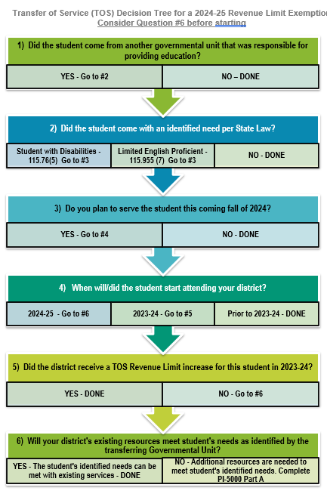
Sample Text Slide
Using the Decision Tree
Please use our Transfer of Service Decision Tree, located on our website at https://dpi.wi.gov/sfs/limits/exemptions/transfer-service
to assist you with the TOS process
14

Slide 15
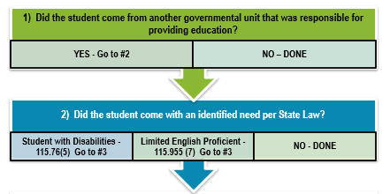
Sample Text Slide
Using the Decision Tree
Your district registrar or other designated person should document students who move into your district each school year, where the students come from (another governmental unit), and if they arrived with:
an identified disability or
participating in a limited English proficiency program.
15

Slide 16
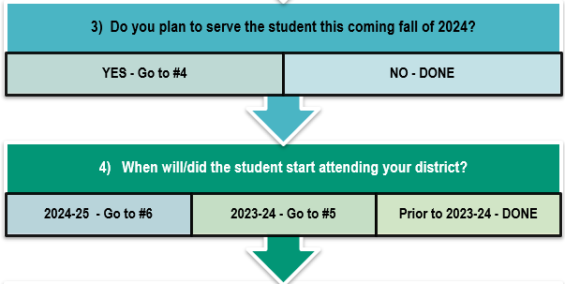
Sample Text Slide
Using the Decision Tree
In late April, the district should review the list of students identified and determine the following for each student:
Did the student’s arrival cause the district to incur a cost that was not budgeted prior to their arrival?
Does the district believe this student will return in the fall?
16

Slide 17
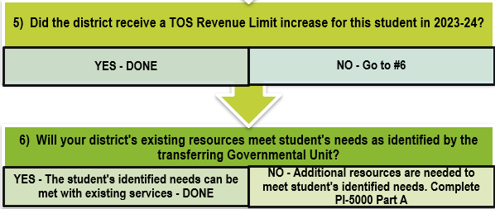
Sample Text Slide
Using the Decision Tree
Determine what additional resources the district will need in the coming year (not including the current year cost) to meet the identified needs the student arrived with.
Review available resources
Will resources be made available because other students have graduated or relocated?
Was a previous TOS request approved?
17

Slide 18
Sample Text Slide
Sample District Process
Create a shared spreadsheet
Keep separate tabs for ELL and Special Education Students
FY25 Timeline: June 2023 – September 2024
Track expenses for the school year and the summer
Track new students coming into the district from other governmental units with an IEP or LEP need
Hold a meeting in late May/early June with key staff who work with IEP or LEP students to evaluate possible TOS requests
18

Slide 19
Sample Text Slide
Sample District Process
In late June/early July enter each TOS request that can be justified.
Monitor enrollment of students that leave the district over the year and during the summer.
Reevaluate staffing ratios/double check staffing levels
Utilize the decision tree to determine eligibility
19

Slide 20
Sample Text Slide
TOS Request
Getting Access to the PI-5000
TOS online application security is processed through the Application User Management (AUM) system.
District administrators already have access to AUM for Open Enrollment (OPAL) and Homeschool Reporting (HOMER) applications.
Only your district administrator can authorize district staff to have access to Transfer of Service-LEP and/or Transfer of Service-SPED applications.
20

Slide 21
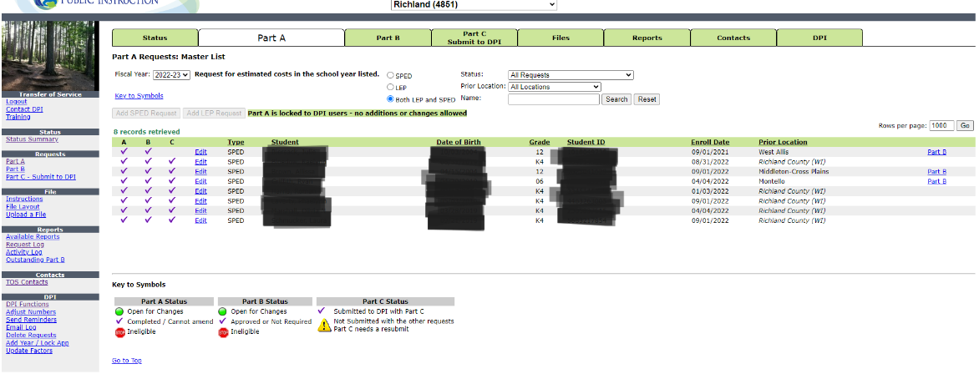
Sample Text Slide
TOS Request
Completing Part A
Questions similar to the Decision Tree:
Where did the student come from?
Enrollment date
Confirm the student came to you with a disability or limited English proficiency
Verify the district’s current resources cannot meet the student’s needs and provide financial information to support that
Due date mid-September
21

Slide 22
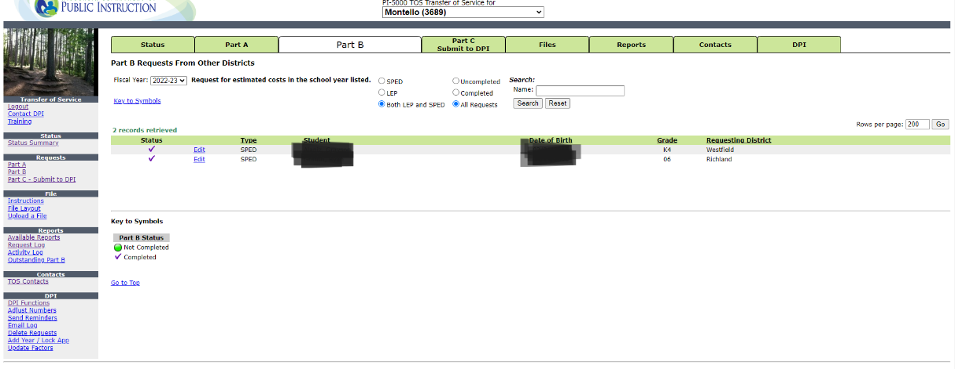
Sample Text Slide
Making a TOS Request
Completing Part B
If the student transferred from a WI school district, the other school district now confirms the information from Part A:
Confirms the student was a resident in that district
Confirms withdrawal date
Withdrawal date to enrollment in your district must be within 45 days
Confirms the student has a disability or limited English proficiency
Verifies there were costs involved to meet the student’s needs
Due date mid-September
22

Slide 23
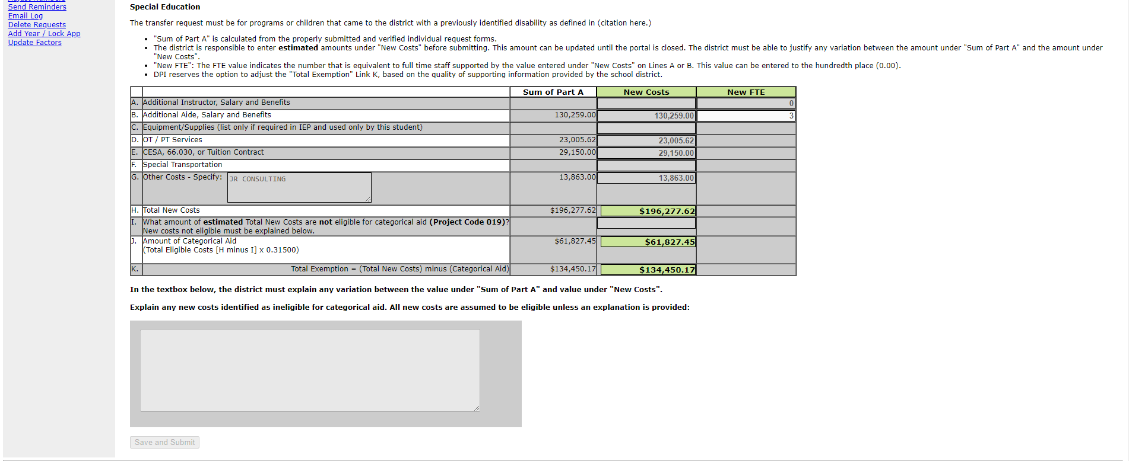
Sample Text Slide
Making a TOS Request
Completing Part C
Review your information entered from Part A
You will need to enter values in the New Costs column
The values entered by the district under the New Costs will be the amount being requested by the school district
If totals have changed between Part A and Part C, provide a narrative in the text box at the bottom of the screen to further explain reason for the change
Due date late-September
23

Slide 24
Sample Text Slide
Narrative Transfer of Service
Transfers of providing the service and financial responsibility between a school district and a local municipality where the municipality previously provided the service and paid related costs are processed through a Narrative Transfer of Service application.
24

Slide 25
Sample Text Slide
Narrative Transfer of Service
25

Slide 26
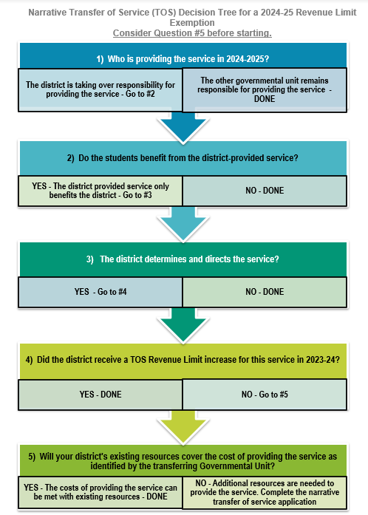
Sample Text Slide
Using the Decision Tree – Narrative Application
Please use our Transfer of Service Decision Tree, located on our website at https://dpi.wi.gov/sfs/limits/exemptions/transfer-service
to assist you with the TOS process
26

Slide 27
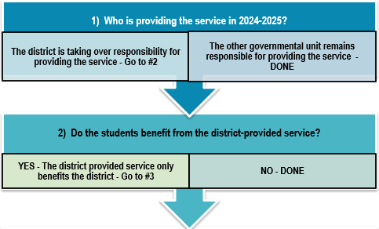
Sample Text Slide
Using the Decision Tree – Narrative Application
Is another governmental unit transferring responsibility for providing a service?
Do the students benefit from this service the district will begin providing?
27

Slide 28
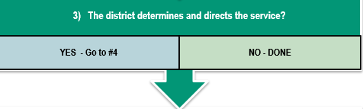
Sample Text Slide
Using the Decision Tree – Narrative Application
Does the district have sole responsibility for determining and directing the service?
28

Slide 29
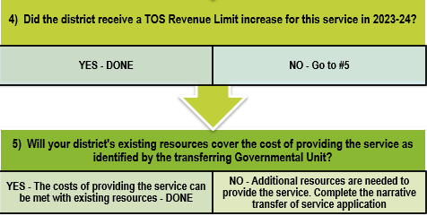
Sample Text Slide
Using the Decision Tree – Narrative Application
The district determines if additional resources are needed to cover the cost of providing the service that was transferred. If additional resources are required, the district needs to complete the narrative transfer of service application.
Narrative Transfer of Service Application
29

Slide 30
Sample Text Slide
Submitting a Narrative TOS Request
Narrative Request Process
Explain the program or service that the local municipality will no longer provide to the school district and a brief historical description of this working relationship. Also, include when the district took responsibility for providing the service.
Name the local municipality that was financially responsible for the program or service.
Did the local municipality charge a fee for providing the service in the previous school year? If yes, provide the amount paid in the previous school year. The amount should be deducted in your calculation.
30

Slide 31
Sample Text Slide
Submitting a Narrative TOS Request
Narrative Request Process
Is the school district able to receive this program or service from another source? If yes, explain.
Provide the Transfer of Service amount being requested and a breakdown on how the value was determined.
If there is financial support available to offset the cost to the school district, provide an explanation.
31

Slide 32
Sample Text Slide
Making a TOS Request
Examples of Allowable Narrative Requests
The city previously paid for crossing guards but are eliminating the item from its budget. The district would like to continue this service and hires the crossing guards as employees of the district.
The county previously provided the services and paid for staff to investigate health related diseases. The county does not have staffing available. The district would like to continue this service and hires a health aide to perform the investigations.
The city previously provided bussing services for the district and is now not able to accommodate school start times. The district needs to hire a bus company to provide bussing. The request is for the additional cost.
32

Slide 33
Transfer of Service 15-Year History
33

Slide 34
Sample Text Slide
TOS Frequently Asked Questions
Question: I understand to qualify for TOS there must be an increased cost but what about shifting costs? For example, we have 5 students with 1:1
aides. One student graduates so we would lay off one of those aides;
However, a new student enters the district from another governmental unit that requires a 1:1 aide. Can I request a TOS? After all, if the new student did not arrive the aide would have been dismissed.
34

Slide 35
Sample Text Slide
TOS Frequently Asked Questions
Answer: No, in this example the district is not eligible for a TOS. The law states “if a school board increases the services that it provides by adding responsibility for providing a service that is transferred to it from another governmental unit for a child with a disability”. TOS allows a district to increase its revenue limit if its costs increase because of the need to increase services above the level of services currently provided.
35

Slide 36
Sample Text Slide
TOS Frequently Asked Questions
Question: I have a student who moved to our district from another Wisconsin school district, but I learned that student did not actually attend that school district. They opened enrolled to a different school district
during those years. Which district do I identify in my TOS request,
the district the student lived in or the district the student actually
attended?
36

Slide 37
Sample Text Slide
TOS Frequently Asked Questions
Answer: Transfer of service always goes to the resident district. A student who was open enrolled out will have student records from a different school district; however, for the transfer of service process, enter the school district where the student lived in the previous year even though that may or may not have been the district that served the student.
37

Slide 38
Sample Text Slide
TOS Frequently Asked Questions
Question: We have a student who open enrolled to our district with significant special needs; can we do a transfer of service?
38

Slide 39
Sample Text Slide
TOS Frequently Asked Questions
Answer: No, when a special education student open enrolls, the nonresident district does collect the basic open enrollment amount. Open enrolled students do not qualify for TOS because the student is not a resident.
In the second year of open enrollment, the nonresident district can choose to continue to receive the open enrollment basic aid amount or be reimbursed for actual costs of providing FAPE to the pupil in the previous school year, up to $30,000; therefore, even though the nonresident district is increasing services, they are being compensated by the resident district.
39

Slide 40
Sample Text Slide
TOS Frequently Asked Questions
Question: Our district forgot to file the transfer of service last year when it was due. Can we do one this year?
40

Slide 41
Sample Text Slide
TOS Frequently Asked Questions
Answer: No, while we understand oversights like this can happen, both state law and our transfer of service guidance are clear that requests must be submitted timely with the eligible increase in cost. Transfer of service is based on increased services provided and a cost increase from one fiscal year to next. If you miss submitting your request the year the increase happened, then technically there is no increase from the missed year to the current year and the request no longer meets the requirement of a TOS.
41

Slide 42
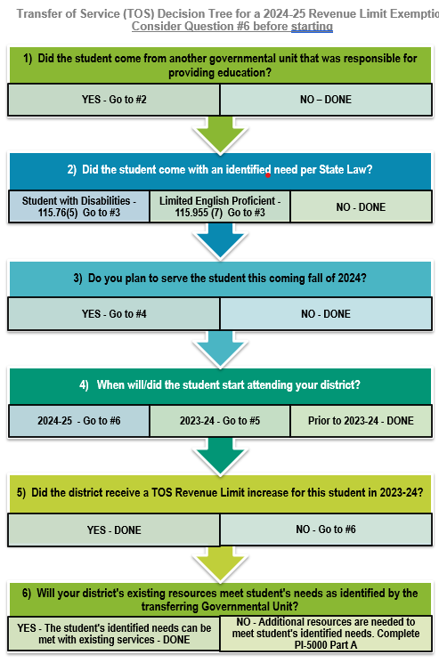
Sample Text Slide
Example
A high needs 4th grade student from a public school in Ohio enrolls in late January of 2024. This student comes with an IEP calling for a full-time registered nurse (RN).
The estimated cost will be $80,000 for an additional RN as a district hire.
42

Slide 43
Sample Text Slide
Example
Currently, your district receives standard nursing services from the County at no cost.
However, in March of 2024 the County gives the District formal notice that as of July 1, 2024, they will no longer provide any nursing services.
The estimated cost will be $80,000 for a RN as a district hire.
43

Slide 44
Sample Text Slide
Examples
Two TOS requests can be submitted.
The first request (student from Ohio with an IEP that identifies a full-time RN) will be made through the PI-5000 portal for the student in the amount of $80,000.
The second request for the standard nursing services previously provided by the county would be a Narrative TOS request submitted in writing following the steps outlined in slides 29 & 30 in the amount of $80,000.
44

Slide 45
Sample Text Slide
TOS Takeaways
PI-5000
Keep track of students moving in and what governmental unit they are coming from.
Does the student have an identified disability or are they participating in a limited English proficiency program?
Will the district continue serving the student into the fall?
Review available resources and determine if more are needed to meet the identified needs for the student.
Did another governmental unit transfer the responsibility for providing a service?
Use the Decision Trees to help you through the process.
Don’t be afraid to ask questions.
45

Slide 46
Sample Text Slide
More Information
Transfer of Service Website:
Transfer of Service | Wisconsin Department of Public Instruction
SFS Consultant:
kathleen.fry@dpi.wi.gov or 608-224-5343
46

