Slide 1
Do’s and Don’ts of Post Employment Benefits with Trusts
Olivia Bernitt
School Finance Auditor, School Financial Services Wisconsin Department of Public Instruction 608-261-2137
Olivia.Bernitt@dpi.wi.gov
John Lavarda
Actuarial Consultant
Johnl@keybenefits.com
Sarah Plohocky
Benefit Consultant/Operations Manager
Sarahp@keybenefits.com
Key Benefit Concepts, LLC
262-522-6415
WASBO Accounting Conference March 2021
Notes:
Sarah

Slide 2
Agenda
Types of Trusts benefits
Types of Funding
Eligibility for Categorical Aid
Trust Contributions and the ADC
COBRA and Implicit Rate Subsidy
When does a district no longer need valuation/reporting?
What happens when…
The benefit ends and trust assets still exists?
COBRA and Implicit Rate Subsidy still exist?
Reallocating Assets
Notes:
Sarah

Slide 3
Types of Post Employment Benefits
Compensated Absences
Pensions (Stipends)
Health, Dental, Vision, Life, Implicit Rate Subsidy
Sick Leave, vacation pay, etc.
Cash or cash equivalents including post employment TSA contributions
Continued insurance coverages or HRA contributions available for premium reimbursement or other expenses
16
67, 68, 73
Other Post Employment Benefits
74, 75
Notes:
Sarah

Slide 4
Questions to the audience regarding benefits
What post employment benefits do you offer?
a. OPEB only
b. OPEB and Pension benefits
2. Do you have a sick leave benefit paid in/upon retirement/termination too?
a. Yes
b. No
Notes:
Sarah
If this had been a live presentation as originally planned, we would be asking questions throughout the presentation and receiving feedback from the audience so we could determine what was most important to spend time on during the presentation. Since this is a pre-recorded webinar, we decided to keep the questions throughout the presentation so that each attendee can answer the questions specifically to your District situation. Hopefully this will provide more understanding of the presentation to you on a personal level.

Slide 5
Types of Funding
Pay-as-you-go
Irrevocable Trust (Fund 73)
Funded based upon benefits accrued and expected to be paid out in the future, usually retirement
In essence – under-funded or funded based upon amount earned
Will payout more than is funded unless benefit changes
Funded each year as earned by individual; may be paid out at severance based upon vesting schedule or retirement
In essence – overfunded
Will not payout all that is funded –
Forfeited dollars used to offset next contribution
Notes:
Sarah
Pay-as-you-go means drawing money from general funds as need to fund post employment benefit each month on a pay-as-you-go basis.
An irrevocable Trust, known to Districts as Fund 73, is a specific trust account set up for the sole purpose of funding or pre-funding post employment benefits. The funds cannot be used for any other purpose. Instead of drawing money from Fund 10 when someone receives a post employment benefit, the funds are drawn from the irrevocable trust.
There are 2 types of irrevocable trust buckets
a. Those funded based upon benefits accrued and expected to be paid out in the future, usually retirement
In essence – under-funded or funded based upon amount earned
Will payout more than is funded unless benefit changes
We at KBC call this retirement funding
b. Funded each year as earned by individual; may be paid out at severance based upon vesting schedule or retirement
In essence – overfunded
Will not payout all that is funded –
Forfeited dollars used to offset next contribution
We at KBC call this actively funding

Slide 6
Example of Post Employment Benefit Trust
Retirement Funded
Other
Medical & Dental
Prem Only HRA
Sick Leave
Stipend/
Cash
403(b)
OPEB
Supp Pension
Actively Fully-Funded
HRA Carry over
Post Emp HRA
Med Plan
HRA
403(b)
Match
403(b)
TSA
Actively Funded means the amount earned each year is funded each year via a Trust
Notes:
Sarah
To better understand the types of benefits that can be funded via an irrevocable account, we have prepared the attached visual.
Benefits on the top half of the page are Retirement funded. On the left you can see a trust bucket for retiree medical and dental and an HRA bucket
In the middle you can see a sick leave bucket. There are not many, but a few districts that have a retirement funded trust bucket for sick leave benefits they are pre-funding to payout out sick leave benefits in retirement.
On the right side of the top half, you see cash stipends and 403(b) contributions that are paid in retirement funded via separate trust buckets.
It is important that, even though you have 1 irrevocable trust, the assets in the trust are segregated by the type of benefits and the type of funding.
On the bottom half of the page, you see similar trust buckets. However, the bottom buckets are funded by current active employee eligible for the benefit and based upon the amount earned each year. So, for example, if an active employee years $300 in post employment HRA benefits for working for the District in the 19/20 fiscal year, if the District is funding the benefit each year as earned, an amount of $300 earmarked for that employee will be placed in the actively-funded post employment HRA bucket on the bottom right side.
If the district is not funding the HRA by individual but collectively making contributions each year to the trust to fund benefits paid out at retirement, the benefits are paid into the trust on the top half of the page. If you are interested, please contact me for a page like this one with unmarked buckets that you can personalize for your district. It can be a great visual to share with your board or finance committee to visual understand the District’s post employment benefits, what trust buckets are being funded and how.

Slide 7
Questions to the audience regarding funding
4. Do you have a trust wherein the District funds a post employment benefit annually based upon the amount earned by individual?
a. Yes
b. No
3. Do you have a trust that is funded for benefits earned by the group (in total) and paid out in retirement?
a. Yes
b. No
Notes:
Sarah
Having looked at the previous slide, take a minute to ask yourself questions 3 and 4.
3. Do you have a trust that is funded for benefits earned by the group (in total) and paid out in retirement?
4. Do you have a trust wherein the District funds a post employment benefit annually based upon the amount earned by individual?
If you don’t know the answers, these are good questions to ask the District office staff.

Slide 8
Questions to the audience
5. What types of benefits does your District fund during active years of service via a trust?
a. HRA benefit
b. 403(b) benefit
c. Both
6. Is the District maintaining separate fund balances for each benefit type and funding arrangement?
a. Yes
b. No
c. Unsure
Notes:
Sarah
What types of benefits does your District fund during active years of service via a trust?
Is the District maintaining separate fund balances for each benefit type and funding arrangement?

Slide 9
The Importance of maintaining separate fund balances
All activities must be accounted for by the type of benefit and funding:
Recording trust contributions
Deducting benefit payments
Subtracting administrative fees
Applying investment earnings
If there is no distinction between Pension and OPEB benefit assets, contributions, etc., how can the obligations be reported correctly in separate areas of the financial statements?
Notes:
John
The different benefits are governed by different GASB pronouncements and require different reporting by your auditors in the Audited Financial statements.
Therefore, the activities related to different trust buckets must be segregated so that contributions made to the post employment 403(b) benefit, for example are not assumed to be included in the contribution made to the actively-funded HRA benefit. Not only the trust contributions, but the benefit payments, administrative fees and investment earnings must be broken out for each trust bucket.

Slide 10
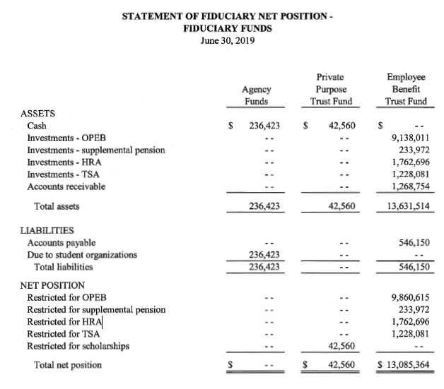
Notes:
John
Example of a fiduciary fund section of the financials for a District that funds multiple benefits via Fund 73
Typically we see that the amounts shown in this section, for Districts funding multiple benefits, are not broken out, and rather reported as totals
While it is not necessarily required to break out amounts here, it is extremely helpful to us as the actuary when we are preparing the exhibits

Slide 11
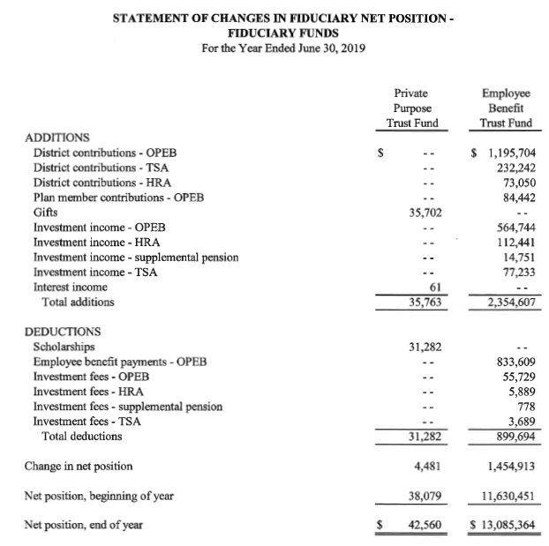
Notes:
John

Slide 12
Reconciliation Example
 | 6/30/2018 | EE Contrib | ER Contrib | Inv Inc | Bft Pmts | Admin Exp | 6/30/2019
OPEB | 1,820,753.00 | 43,154.00 | 250,000.00 | 52,549.00 | (411,589.00) | - | 1,754,867.00
Pension | 1,127,750.00 | - | 80,000.00 | 37,584.00 | (115,418.00) | - | 1,129,916.00
Active HRA | 708,944.00 | - | 82,125.00 | 11,549.00 | (62,000.00) | - | 740,618.00
Total | 3,657,447.00 | 43,154.00 | 412,125.00 | 101,682.00 | (589,007.00) | - | 3,625,401.00
 | 6/30/2019 | EE Contrib | ER Contrib | Inv Inc | Bft Pmts | Admin Exp | 6/30/2020
OPEB | 1,754,867.00
Pension | 1,129,916.00
Active HRA | 740,618.00
Total | 3,625,401.00
Notes:
John
An example of KBC’s internal “reconciliation” that we prepare for District’s funding multiple benefits via Fund 73
Helpful for us as the actuary’s to breakout the various transactions as well as verify the assets/net position for each benefit
Can be requested from us and occasionally if we have questions or concerns with certain amounts we will pass it along to the District/auditor for review to help ensure accurate reporting.
If the District’s plan administrator is not currently tracking or breaking out the transactions occurring in Fund 73 for each benefit, consider preparing a similar excel spreadsheet internally or using ours to help track things year to year.

Slide 13
Questions to the audience
7. Are funds deposited into the trust eligible for categorical aid?
a. Only those for post employment funding earned/paid at retirement
b. Only those actively-funded post employment benefits
c. Both
Notes:
Sarah – read question
Olivia – answer is both but only if they meet one of the 3 criteria on the next slide and only up to the amount of the ADC.

Slide 14
Categorial Aid
3 methods to meet requirements for categorical aid on contributions made to the trust:
Contributions must be equal to or exceed the Actuarially-Determined Contribution (ADC)
Contribution for current year exceeds expenditures (Pay-As-You-Go) plus Implicit Rate Subsidy (IRS) by 5%
Over the last 3 year period, 3-year contribution totals must exceed total 3-year expenditures by 5%
If the district does not meet any of these three criteria, the district should not charge any of the contribution for special education staff to project 011 in the PI-1505-SE.
Notes:
Olivia
-Note that the contribution over the ADC is not eligible for categorical aid and must be coded to function 292000

Slide 15
Examples of Meeting Categorical Aid Requirements
This Year |  |  | 3-Year Review
ADC | $150,000 |  | ADC | $150,000
PAYG | $35,000 |  | PAYG (30,000 + 35,000 + 40,000) | $105,000
IRS | $21,000 |  | IRS | $63,000
Total PAYG + IRS | $56,000 |  | Total PAYG + IRS | $168,000
Add'l 5% | $2,800 |  | Add'l 5% | $8,400
Total Trust Contribution must be at least | $58,800 |  | Total 3-Yr Trust Contribution must be at least | $176,400
Notes:
Olivia – reference the spreadsheet we provide on our website and that this is also calculated in Addendum A89 in the annual report.

Slide 16
Employer Contributions and the ADC
District determines ADC from the table provided by their actuary
Review:
Total contributions made for the year as it compares to the ADC schedule
Districts PAYG + IRS + 5% (current and three year calculations)
If the District’s contribution does not equal the PAGY + IRS +5% for either calculation, the district must contribute at lease the amount of the ADC to be eligible for categorical aid.
ADC option chosen does not have to be the same each year.
Categorical aid is a one-time opportunity.
Not eligible for categorical aid if net obligation in the actuary study is negative
Calculate your own IRS – do not use the example in the PAYG table
Notes:
The actuarial determined contribution (ADC) are figures required in the post employment valuation if the district is funding the post employment benefit via a retirement-funded post employment trust bucket. It identifies the amount to fund annually by the District in order to be appropriately funding the post employment benefit. More about this on an upcoming slide.
John/Olivia
-If the district does meet the current or three year calculation and does not contribute at least the amount of the ADC, then they are not eligible for categorical aid and cannot code the portion for special education to project 011 in the PI-1505-SE.
-Categorical aid being a one-time opportunity, if the district funds over the ADC that was selected from the study, that portion above the ADC cannot be claimed in categorical aid. The ADC is recalculated every 2 years so if the district underfunds, the ADC options will likely be higher-to calculate their own IRS, use the . It is important to determine to fund the ADC or the pay-as-you-go plus IRS plus 5% looking at 1 year or 15% looking back 3 years. Otherwise, the amount funded into the trust will not now or ever be eligible for categorical aid.
sample entries excel document that DPI provides on our website on the employee benefit trust fund page.

Slide 17
 |  |  | Sample Chart
Actuarially Determined Contribution Options using the OPEB Liability as of June 30, 2020
 | For Use in Fiscal Years Ending June 30, 2021 and June 30, 2022
 | Total OPEB Liability |  |  |  | $ 2,312,106
 | Fiduciary Net Position |  |  |  | 1,201,597
 | Net OPEB Liability |  |  |  | $ 1,110,509
 | Service Cost |  |  |  | 68,155
 | Discount Rate |  |  |  | 5.00%
 | Salary Inflation |  |  |  | 3.00%
 | Amortization Period |  | Level % |  | Level $
 |  |  | ADC |  | ADC
 | 30 |  | $ 122,226 |  | $ 143,803
 | 29 |  | 123,519 |  | 144,907
 | 28 |  | 124,906 |  | 146,103
 | 27 |  | 126,398 |  | 147,401
 | 26 |  | 128,008 |  | 148,815
 | *** |  | *** |  | ***
 | 5 |  | 313,825 |  | 328,062
 | 4 |  | 371,534 |  | 384,739
 | 3 |  | 467,739 |  | 479,351
 | 2 |  | 660,186 |  | 668,800
 | 1 |  | 1,237,597 |  | 1,237,597
Please note: The valuation was prepared using a measurement date that is 12 months prior to the reporting date, i.e. June 30, 2020 and June 30, 2021, respectively. Thus, this chart may be used to select an ADC for the fiscal years ending June 30, 2021 and June 30, 2022 to be shown in subsequent exhibits and reporting periods.
Notes:
John
Example of the ADC Options chart that is provided to all of our clients funding Supplemental Pension or OPEB benefits via Fund 73
Net liability can be amortized over a period of 30 years (or potentially less if any/all expected payouts end in less than 30 years)
Reference this chart when determining what the District plans to contribute to Fund 73. This ADC chart provides ADCs for 2 fiscal years. Look on the top of your schedule to see what years it applies. KBC tries to give you this schedule in advance so that you know during the fiscal year what ADC amount to fund depending upon the amount the district contributes and the amortization period chosen.
We spoke with the auditors at the WICPA conference a few years ago and asked if it matter to them if the district were to use say a 30 year amortization one year, then 10 the next and 25 the following year. They said it was a footnote and didn’t really matter. However, it does matter for being able to obtain categorical aid on the full amount contributed. So, please take the time to review the table and use it for funding. If you have questions throughout the year about this table or how to determine what ADC to use, don’t hesitate to email or call KBC. We want you to get the most out of the contributions made to the trust.
Of course, no ADC is needed for actively funded post employment benefits. The ADC is always the total of the amount earned by each individual eligible for the post employment benefit. It is imperative that the District fund the full amount earned each year to each actively-funded trust bucket. If that does not happen, the it must be valued as part of the actuarial valuation as a retirement-funded trust.

Slide 18
OPEB Table VII
Sample Client
Schedule of Employer Contributions
Last 10 Fiscal Years
 |  | Fiscal Year Ending
 |  |  | 2020 |  |  | 2019 |  | 2018 |  | 2017
Actuarially Determined Contribution (ADC) |  |  | $ 275,389 |  |  | $ 267,368 |  | $ 155,279 |  | $ 155,279
Contributions in Relation to the ADC |  |  | 375,000 |  |  | 143,500 |  | 155,279 |  | 155,279
Contribution Deficiency/(Excess) |  |  | $ (99,611) |  |  | $ 123,868 |  | $ - |  | $ -
Covered-Employee Payroll |  |  | $ 4,827,885 |  |  | $ 4,687,267 |  | $ 4,550,745 |  | $ 4,418,199
Contributions as a percentage of Covered-Employee Payroll |  |  | 7.77% |  |  | 3.06% |  | 3.41% |  | 3.51%
Key Methods and Assumption Used to Calculate ADC
Actuarial cost method |  |  | Entry Age Normal |  |  |  |  | Entry Age Normal
Asset valuation method |  |  | Market Value |  |  |  |  | Market Value
Amortization method |  |  | 8 year Level % |  |  |  |  | 30 year Level $
Discount rate |  |  | 5.00% |  |  |  |  | 5.00%
Amortization growth rate |  |  | 3.00% |  |  |  |  | N/A
Inflation |  |  | 2.50% |  |  |  |  | 3.00%
Valuation Date |  |  | June 30, 2018 |  |  |  |  | June 30, 2016
Notes:
John
Example of an RSI exhibit that is provided in our reports for those funding their Supplemental Pension and/or OPEB benefits via Fund 73.
Eventually a 10 year history
As mentioned on the prior slide, the ADC does not necessarily have to be the same year to year. In this illustration, a 30 yr level $ ADC was chosen for the FYE 2017 and 2018 and the full ADC was contributed. Aid on full amount
Shorter period was selected for the FYE 2019 and 2020, and amounts contributed were less than the ADC in 2019 and greater than the ADC 2020.

Slide 19
Questions to the audience regarding COBRA
7. Can the District have an OPEB liability when COBRA is all that is offered?
a. Yes
b. No
c. Sometimes
Notes:
Sarah –question
John - Answer is C, sometimes. It can depend on a number of difference factors

Slide 20
OPEB liability when COBRA is all that is offered
Can expect COBRA participants to be limited to a very small group of former employees which could include a range of demographics.
If COBRA participation is primarily retirees, continuation will be included in current, historical and future expectations.
For some districts, COBRA can become a significant OPEB liability due to the number of retirees/former employees electing to maintain coverage
Notes:
John
Determining whether or not there is an OPEB liability if COBRA is the only benefit offered is different from District to District.
Potential determining factors – average number of yearly COBRA participants, demographics such participants (younger or over 55,60 etc…), percentage of yearly retirees who elect COBRA (is is 5% 25% 75%...)
In some cases, benefits are tiered in a way that the group or subset of employees only offered COBRA have not yet reached retirement eligibility, and therefore we do not have any sort of COBRA participation history/experience to help determine whether or not a liability exists. A reasonable assumption will need to be made in these cases, which in turn will be monitored and adjusted accordingly (can go from no assumption to including one and vice versa)

Slide 21
When does a district no longer need valuation/reporting?
Notes:
Olivia

Slide 22
Questions to the audience the need for future valuations
8. My District has a retirement-funded post employment trust wherein I believe:
a. I no longer need an actuarial valuation
b. I continue to need an actuarial valuation
Notes:
Olivia - If you think your district may no longer need an actuarial valuation or you think your benefits/funding may be headed in that direction, then this next section will be important to you.

Slide 23
Valuation Needed?
Totally Funded – funded as earned each year
Should be totally and fully funded (Total benefits earned equals assets)
MUST continue funding according to plan each year or it becomes an unfunded or under-funded liability
Applies to:
Retirement funded trusts
Actively funded trusts
Notes:
Olivia
A post employment valuation is not needed if the benefit is totally and fully funded based upon funding each year as earned for each eligible employee (and all past contributions for each person are totally funded). This applies to actively-funded benefits.
If the district stops fully funding the benefit each year as it is earned, then it becomes a post employment benefit that must be part of the actuarial valuation. The amount of obligation must be calculated against the amount of assets held.
Typically a ‘fully-funded’ retirement funded trust account continues to be valued until it is a) all paid out and not benefits exist or b) the obligation becomes immaterial.

Slide 24
Valuation Needed?
No longer have an obligation – no one eligible to receive a benefit, minimal/nil COBRA participation
May have still have assets in the trust but obligation is not significant to warrant itemization on financials
Immaterial benefit
Notes:
Olivia – valuation not needed

Slide 25
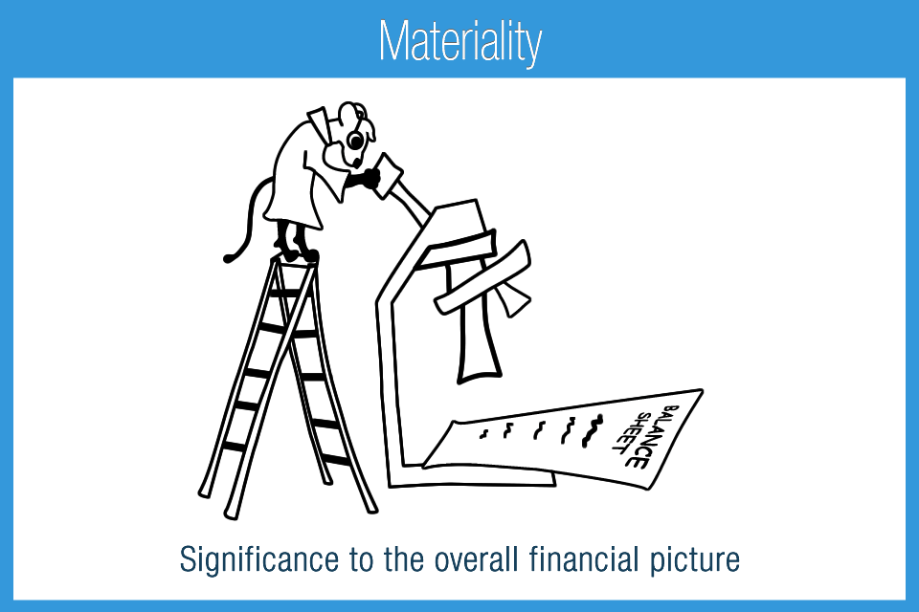
Materiality
Financial statement items are material if they could influence the economic decisions of users.
An obligation isn’t required to be identified if the net impact of doing so has such a small effect on the financial statements that a reader of the financial statements would not be misled.
Determination of immateriality of an OPEB or pension benefit obligation should be determined by the auditor.
Notes:
Olivia – this is not something that we can determine. If you have a question on if you need a study anymore because of the size, that is something that has to be determined by the auditor. They are the ones who determine materiality. Be careful because one auditor may not have the same materiality amount as another auditor, either within the same firm or if you switch firms. Can become a pain if district stops getting an actuary study but then later determines they need one.

Slide 26
Changes Impacting Total Liability
The auditor is not able to make a decision regarding materiality until they are aware of the amount of the liability.
Two situations currently exist:
Significant changes are occurring that may cause the benefit and its related obligation to increase or decrease substantially over time and in some cases be eliminated after a number of years.
New benefit added or change in retiree utilization
Notes:
Olivia – liability should be calculated every year.
John – provide situations – watch time - explain that KBC will cost out changes BEFORE you make changes

Slide 27
Questions to the audience regarding the need for an actuarial valuation; Yes or no for each question
9. Do I need an actuarial valuation if:
Totally Funded
No longer have an obligation – no one eligible to receive a benefit, minimal/nil COBRA participation
Immaterial obligation - liability is less than what auditor considers material
Notes:
Sarah
Yes and No. If the benefit is totally funded and has been funded on an annual basis by employee – that is an actively-funded benefit, then we would not value it UNLESS the district stops funding the full amount earned each year. If the benefit is retirement funded – that is prefunded through a trust but not by individual and used to pay benefits in retirement from this trust, then even if it is fully-funded (that is the benefits earned through the measurement date are fully funded via the trust), the district will still need to continue valuations until either a) the benefit for all eligible individuals is totally paid out and no one else is eligible or b) the remaining obligation becomes immaterial.
No. Of course, if there is no one eligible to receive a benefit and/or the District does not provide for any benefit and the expected rate of self-pays for COBRA is minimal, then there really is nothing to value.
No. If the obligation is immaterial, the valuation is not needed. However, this has to be monitored and updated as benefits may change and/or rates of self-pays on the district's health plan.

Slide 28
Valuation may not be needed, but… Do I need to show on financial statements?
Totally Funded
No longer have an obligation – no one eligible to receive a benefit, minimal/nil COBRA participation
Immaterial benefit – obligation is less than what auditor considers material
Notes:
Olivia –
Yes you need to have it on there. You are still paying the liability and have activity to show on the statements.
Yes/No – in the final year of paying the liability, it should still be on there even if the obligation at the end of the year is zero. However, in future years when there is no liability then it does not need to be shown
Yes/No – in the year it is determined to be immaterial it should not just disappear. It needs to have some sort of a write off.
John – consider any changes to benefit – as they could be material.

Slide 29
Questions to the audience regarding showing on financials; Yes or no for each question
10. Does your District have (or are close to having) a post employment benefit trust wherein the obligation is ending and there are assets remaining?
A. Yes
B. No
C. Unsure
Notes:
Sarah and Olivia
It is better to run out of trust assets before your run out of benefits to pay than the other way around. If you know that your district’s post employment benefits are ending in the near future, then you should reduce or stop funding the trust so that you use the remaining trust assets before the last payouts. The valuation report includes the expected remaining estimated payouts in the pay-as-you-go table. This will aid in monitoring.

Slide 30
What happens to Trust Assets
Redesign Benefit
Draining trust assets
Pay out all benefits remaining until IRS only, or
Immaterial
Reallocation of Assets
Health care to health care
Pension to pension
Sick leave to sick leave
What if there is no post employment benefit of a similar type?
Notes:
Olivia
Let’s say there is a small amount remaining in the trust, but the district has an implicit rate subsidy benefit. These assets can be drawn out to pay the IRS until depleted.
If there are remaining assets and no liability at all for a given trust bucket, the first thing to look at is the trust agreement. Does the trust agreement indicate what must be done with the remaining assets. For example, some trust agreements say that if there is no longer a post employment health care benefit, the remaining assets are used to fund active health care benefits. Some trust documents are silent on the matter.
Some districts are redesigning their post employment benefits and may be able to use the assets within the same trust bucket for the new benefit. For example, the district may no longer pay 80% of the health premium for 5 years when an individual retires, but decides to provide a post employment HRA for employees hired after a given date. An HRA and continued medical benefits are both OPEBS, so there is no need to do a formal reallocation if this is a new OPEB benefit, then the assets are applied to the newly structured OPEB.
If there isn’t a redesign of the benefit, but rather an OPEB benefit that has ended but the district has an actively-funded HRA, then it is possible to reallocate the OPEB – which is a health care benefit to the actively-funded HRA bucket which is also a health care benefit.
The same is true if the district had a cash stipend that is no longer paid out but has a 403(b) benefit paid out. In this case it is a reallocation of a pension benefit to another pension benefit.
But, if there is no longer a post employment benefit of a similar type (OPEB to OPEB or pension to pension), then there are steps working with legal counsel, the trust and DPI to reallocate assets from one type to another such as OPEB to pension or pension to OPEB. However, all other options must be exhausted first.

Slide 31
What happens to Trust Assets
What if there is no post employment benefit of a similar type?
Contact DPI
Assure appropriate timing
Review of categorical aid
Help with journal entries
Use funds for ‘other purpose’ as defined in trust agreement
May want to add a trust amendment
Notes:
John
-we will always refer you first to legal counsel to determine what the trust states for how the remaining balance should be used.

Slide 32
Steps for Reallocation
Determination of direction
Assistance from legal counsel
Approval by board
Board Resolution
Date of change
Assets reallocated in cash
New obligation as of given date (funding a new benefit)
DPI approval and Journal entries
Notes:
Olivia
-no journal entries needed if they are leaving it in fund 73. If it is determined that the funds are to revert to fund 10, then there is a journal entry.

Slide 33
Olivia Bernitt
School Finance Auditor, School Financial Services Wisconsin Department of Public Instruction 608-261-2137
Olivia.Bernitt@dpi.wi.gov
John Lavarda
Actuarial Consultant
Key Benefit Concepts, LLC
262-522-6415 Johnl@keybenefits.com
Sarah Plohocky
Benefit Consultant/Operations Manager Key Benefit Concepts, LLC
262-522-6415 lmont@keybenefits.com

