Slide 1
Spring Finance Workshop
School Financial Services Team
WASBO Accounting Conference March 17, 2021

Slide 2
ESSER II & III Update

Slide 3
ESSER II (CRRSA Act)
$686.1 million to WI public K-12
Broadly similar to ESSER I
Allocation plan adopted by Joint Finance Committee 2/10/2021

Slide 4
ESSER II Allocation Plan
Title I formula (required): $617.5 million
$100K minimum (33 LEAs): $2.4 million
Proportional to in-person instructional hours (174 LEAs): $65.0 million
Administration: $700,000

Slide 5
ESSER II Allocation Plan
In-person instructional hours
LEAs report total in-person instructional hours provided this year
Each LEA’s share is their in-person hours divided by the 174 LEAs’ total

Slide 6
What are “in-person instructional hours?”
JFC Motion #16 In-person instructional hours are “hours in which pupils are together in a classroom, being taught by an instructor who is in the same classroom.”

Slide 7
What are “in-person instructional hours?”
Questions
What data do you have?
How would we collect it?
How can the definition be applied most clearly & consistently?

Slide 8
ESSER III (ARP Act)
Signed into law last Thursday 3/11/2021
Public K-12 funding nearly double of ESSER I & II combined
More targeted toward summer school & addressing learning disruption
Goes one year beyond ESSER I & II

Slide 9
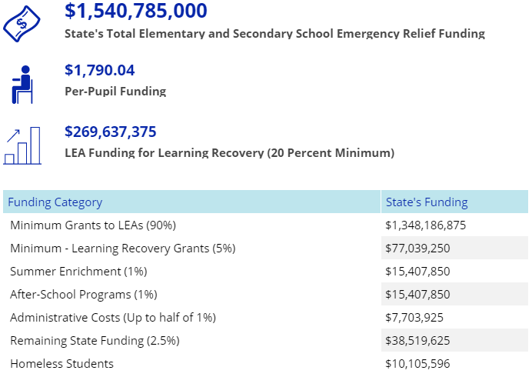
ESSER III (ARP Act)
Final allocations not available yet
Unofficial public estimates have WI K-12 getting about $1.5 billion ($1,800 pp)
https://www.edweek.org/policy-politics/see-what-the-huge-covid-19- aid-deal-biden-has-signed-means-for-education-in-two-charts/2021/03

Slide 10
Also Included in the ARP Act
$800 million for homeless students
$2.6 billion for special education
$2.8 billion for private schools
$7 billion for E-Rate
$350 billion for state & local gov’ts
Source: Ujifusa, A. (2021, Mar. 11). “See what the huge COVID-19 aid deal Biden has signed means for education, in two charts.” Education Week.

Slide 11
ESSER III (ARP Act)
90% allocated under Title I formula
20% of these funds have to be used by LEAs for learning recovery

Slide 12
ESSER III (ARP Act)
10% administered directly by DPI
5% for learning recovery grants
1% for summer enrichment
1% for after-school programs
Remaining 2.5% for administration (0.5% max) or other purposes

Slide 13
ESSER III Next Steps
DPI working on proposal to JFC, they will review and approve/modify/deny
Allocations, guidance, WISEgrants, and other information to follow
60-day turnaround in ARP Act

Slide 14
2021-2023 Biennial Budget

Slide 15
2021-2023 Biennial Budget
GOVERNOR EVERS’ PROPOSAL:
Introduced on February 16
Big Picture:
Supports 2/3’s funding for K-12 Schools
Maintains DPI’s priorities for school aids (Special Education, Mental Health, English Learners, etc.), public libraries, and College and Career Readiness (ACP, GED)
A few new grant programs and policy changes

Slide 16
Governor’s Budget – Aid & Revenue Limits
REVENUE LIMITS & GENERAL SCHOOL AIDS
Revenue Limits (allowable revenues from state General Aid and school property levy)
Increases revenue limit authority for all districts ($200/pupil in FY22 and $204/pupil in FY23)
Increases low revenue ceiling threshold (by $250 each year): $10,250 in FY 22 and $10,500 in FY 23
Decouple authority to use the low-revenue ceiling from failure to pass referenda

Slide 17
Governor’s Budget - Aid & Revenue Limits
REVENUE LIMITS & GENERAL SCHOOL AIDS
General Aid (Equalization Aid / Special Adjustment Aid)
Provides $221.4 million in FY22 and $391.4 million in FY23 for general equalization aid
Increase Special Adjustment Aid (Hold Harmless) threshold from 85% to 90% in FY 22 and FY 23
Counting Kids
Greater of 2019 or 2020 pupil count for revenue limit purposes (3 year rolling average) to mitigate the impact of steep enrollment declines in fall 2020 in some districts (COVID)
Full-day/Full-week 4K pupils would count as 1.0 FTE for revenue limit and general aid

Slide 18
Governor’s Budget - Categorical Aids
Special Education Aids
Special Education Categorical Aid (+$709 M over biennium):
Raise reimbursements to 45% (FY22) & 50% (FY23) - up from est. 28.2% (FY21)
Specify these rates in statute and make the appropriation sum-sufficient
High-Cost Special Education Aid (+$9.6 M over biennium):
Raise reimbursements to 40% (FY22) & 60% (FY23) - up from est. 30% (FY21)
Transition Readiness Grants (+$1.5 M in FY23 – doubles current allocation)

Slide 19
Governor’s Budget - Categorical Aids
School Mental Health and School Climate
Mental Health Categorical Aid (+$46.5 M over biennium)
Expand to all pupil services categories
Reimburse 10% of eligible costs
School-Based Mental Health Services Grant (+$7 M over biennium)
Mental Health Training (+$1.0 M over the biennium)*
Expand scope and volume of trainings offered
*Not a direct aid to schools; rather, allows DPI to expand training offerings.

Slide 20
Governor’s Budget - Categorical Aids
Bilingual-Bicultural Program Aid (BLBC) / Aid for English Learners (ELs)
BLBC / EL Categorical Aid ($28.0 M over the biennium)
Reimburse costs at 15% in FY22 (up from ~8%) for districts required to offer a BLBC program ($9.7 M)
New structure to aid all LEAs that serve ELs, beginning in FY23 ($18.3 M)*:
$10,000 to each LEA that serves at least 1, and up to 20, ELs
Additional $500 per EL student above 20 (in the LEA)
NEW Grant to Build Capacity for BL- & EL- Licensed Teachers ($750,000 in FY23)
Help LEAs identify and help teachers and staff obtain licensure as a bilingual teacher or teacher of English as a second language (“grow your own”)
*ELs enrolled in the school district in the prior school year.

Slide 21
Governor’s Budget - Categorical Aids
Supporting Rural School Districts
Sparsity Aid ($19.9 M over the biennium): create a second tier of aid eligibility for school districts that are sparse (fewer than 10 students per square mile), but are not the “smallest” districts:
Sparse districts with 745 or fewer students receive $400/student (current law)
Sparse districts with more than 745 student receive $100/student
Pupil Transportation Aid: increase rate for students transported 12+ miles, from $365 to $375 (no additional funding required)
High-Cost Transportation Aid ($4.0 M over the biennium): to fully fund estimated eligibility

Slide 22
Governor’s Budget - Categorical Aids
Targeted Supports
Per Pupil Aid ($60.8 M over the biennium):
$750/pupil in both FY22 & FY23 (sum-sufficient)
Weight payments for poverty (10% - additional $75 for each student in poverty)
School Breakfast Grant: fully fund at 15 cents/meal ($5 M over biennium)
NEW Supplemental Nutrition Aid ($4.9 M over biennium):
Eliminate meal charges to families of students who qualify for reduced-price meals
School Library Aids ($6.4 M over the biennium) [reestimate, Common School Fund)
(raises allocation from $40.3 million, to $42 million in FY22 and $47 million in FY23)

Slide 23
Governor’s Budget - Categorical Aids
Targeted Supports
NEW Out-of-School Time Grants: $20 M annually beginning in FY23
NEW Drivers Education Grant: $2.9 M annually beginning FY23
Reimburses public and private providers of Drivers Education for 50% of cost of the classroom and behind the wheel instruction
For students in poverty – provider must waive / reduce fees
Transportation Aid for Open Enrolled Students and ECCP* Participants: increase reimbursement rates ($1.4 M over the biennium)
*ECCP – Early College Credit Program

Slide 24
Governor’s Budget - Categorical Aids
New Programs Proposed by the Governor
Grants for Energy Efficiency ($10 M annually, beginning in FY22): to assist school districts in completing energy efficiency projects that improve student health
Grants to build Capacity for Computer Science Licensed Teachers ($750,000 beginning in FY23): to support professional development resulting in the licensing of computer science teachers
Give preference for school districts serving disproportionate shares of economically disadvantaged students and students of color.
Grants to Replace Race-Based Logos, Mascots, Nicknames, Team Names ($200,000 annually beginning in FY22)

Slide 25
Governor’s Budget – K-12 Policies
Other Provisions (policy changes)
American Indian Studies Requirements
Expand the teacher licensing requirements to include contemporary and historical events
Increase the frequency of instruction in school districts beginning in the 2022-23 school year
Require independent charter schools and private schools participating in a parental choice program to provide instruction beginning in the 2022-23 school year
Climate Change Standards: incorporate climate change & the human effect on climate change into model academic standards across multiple subject areas
Allow districts to rehire a retired annuitant teacher if at least 15 days (rather than 75 days under current law) have passed since the teacher left employment with a district

Slide 26
Governor’s Budget – Other Agencies
New Programs Proposed by the Governor – Budgeted in other agencies (not DPI)
TEACH Grants ($3 M annually, DOA): extend the information technology infrastructure block grant program for schools and libraries to June 30, 2025
Farm to School Grants ($200,000 annually, DATCP): to create and expand farm to school programs, with priority to school districts with higher levels of students in poverty, and or successful programs that can be replicated in other schools
Free Admission to State Parks for Fourth Grade Students (DNR) – waive park fees for families of fourth graders
Youth Apprenticeship ($250,000 annually, DWD): to expand Youth Apprenticeship opportunities
Broadband Infrastructure Grants ($150 M over the biennium, PSC): to expand access to broadband to communities around the state

Slide 27
Governor’s Budget – Choice & Charters
Freeze Enrollments (Private Parental Choice Schools)
Beginning in FY23, freeze number of spaces in private choice schools and SNSP schools (cap = FY22 enrollments)
Payments to Private Parental Choice & Charter Schools
Link payment amount for Choice/Charter students to amounts public schools receive under revenue limit adjustment and Per Pupil Aid
Eliminate ability to use “actual cost” basis for SNSP (and for Spec Ed Open Enrollment)
Accountability Measures
Require all teachers at private Choice schools and SNSP private schools to hold a DPI license or permit (with some exceptions) beginning July 1, 2024
Require that aid deductions to school districts’ general aid related to the Choice and Charter schools be shown on property tax bills

Slide 28
2021-2023 Biennial Budget – Next Steps
Public Joint Finance Hearings
Fri. 4/9: UW-Whitewater
Wed. 4/21: Hodag Dome, Rhinelander
Thu. 4/22: UW-Stout, Menomonie
Wed. 4/28: Virtual hearing

Slide 29
2021-2023 Biennial Budget – Next Steps
Agency briefings (soon, dates TBA)
JFC action on budget items (April-May, K-12 usually toward the end)
Assembly & Senate pass budget & submit to Governor (by June 30?)
Signing with/without partial vetoes

Slide 30
2021-2023 Biennial Budget
Information on the 2021-23 Biennial Budget will be posted on DPI Policy and Budget Team Page:
2021-23 Biennial Budget | Wisconsin Department of Public Instruction
https://dpi.wi.gov/policy-budget/2021-23-biennial-budget

Slide 31
SFS Team Spring Reminders

Slide 32
Please Update Your Data!
Accurate data impacts the July 1st General Aids estimate and final Revenue Limit determinations
2020-21 SAFR reports will close Monday, June 7:
PI-1563 September, January and May 2020-21
2020-21 PI-1504 Budget Report
Reports will reopen on Monday, June 28.

Slide 33
Transfer of Service (TOS) for 2021-22
The PI-5000 TOS portal will open on Thursday, May 20, 2021. Steps to help you in making any student entries in the portal:
Collect a list of all new student who arrived during 2020-2021 school year with an IEP or LEP need.
For each student work through the TOS Decision Tree to decide if a TOS request should be entered found on the Transfer of Service webpage. dpi.wi.gov/sfs/limits/exemptions/transfer-service

Slide 34
Transfer of Service (TOS) for 2021-22
Double check to determine the school district the student was a resident before the move to your district, as it will be used within the PI-5000 portal.
Be careful with Open Enrollment—a Transfer of Service is from a student’s former resident district, not a district they may have attended through Open Enrollment.
Each TOS request is for estimated cost to meet this student’s needs during the 2021-22 school year only.

Slide 35
Transfer of Service (TOS) for 2021-22
If your district will have key staff changes over the summer months, your district administrator will need to update PI-5000 access through OPAL Application User Management.
The PI-5000 should be monitored weekly for Part B replies your district needs to complete and Part A requests that have not yet been responded to by the WI district who received it.
Narrative TOS requests can be made at the same time as the PI-5000 is open.

Slide 36
High Cost Pupil Transportation Aid
COVID-19 during the 2019-20 school year could impact calculations for the June 2021 payment. How?
The cost of pupil transportation starting in late March of 2020 was reduced in many school districts due to limited busing.
Extra bus trips to tournaments, spring sporting events, the State Capitol, etc. never happened.

Slide 37
High Cost Pupil Transportation Aid
Fund 10 pupil transportation costs and audited membership are used for aid calculations.
The statewide Fund 10 transportation cost per member is determined for 2019-20.
The district’s transportation cost/member is also determined.
District with a cost/member that is equal to or greater than 145% of the statewide cost per member and have 50 or less members per square mile qualify for this aid program.

Slide 38
High Cost Pupil Transportation Aid
The $13,500,000 allocation will be paid out this June.
There is a “hold harmless” provision for districts that qualified in 2018-19 but fall out of eligibility in 2019-20.
How in-person/virtual and transportation played out this year will drive next year’s aid—be careful in your 2021-22 budget development with this aid estimate!

Slide 39
High Cost Special Education Aid
Districts, CESAs, CCDEBs, independent charter schools are eligible for their students
Based upon claims from LEAs
Prorated as necessary for available funding
Paid in June

Slide 40
HC Spec Ed - Aid Eligibility
Eligible for additional aid if the applicant incurred, in the previous school year, more than $30,000 of non-administrative costs for providing special education and related services to a child
Does not include reimbursement from other sources or revenue received
Notes:
Costs reimbursed under the state special education and school age parents aid program; the federal Individual with Disabilities Education Act or other grant programs; federal Medicaid; revenue from an Open Enrollment transfer based on the exact cost of special education and related services.

Slide 41
HC Spec Ed – Rule Change
Admin rule (PI 30 subch. II) was updated last year with the new calculation
Biggest change: External revenues only affect eligibility if they total more than $30,000
Includes state special education aid, IDEA, Medicaid SBS, and Open Enrollment Exact Cost Statement revenues

Slide 42
HC Spec Ed - Categories of Costs
Three categories of costs:
Child-Specific (1-on-1 aides, placements, etc.)
Program (transition, speech/language, etc.)
Specified Services (non-administrative pupil services)

Slide 43
HC Spec Ed - Calculation
Eligible Costs
Deductible revenues only affect eligibility if they total more than $30,000
Eligible Costs = Total Student Costs – (Deductible Revenues > $30,000)
Aid Eligibility: 90% of Eligible Costs (defined in statute)
Aid Payment: Prorated from total appropriation
$30,000
Open Enrollment
Medicaid
Special Ed Categorical Aid
IDEA
Notes:
For a student to be eligible, the applicant must have spent more than $30,000 of non-administrative costs for providing special education and related services to a child; BUT your revenues count towards meeting that $30,000. If your revenues are less than $30,000, the difference is made up by pulling out of your eligible costs. If the revenues are more than $30,000, the total amount of revenues must be deducted out. and aid eligibility is based on 90% of the eligible costs.

Slide 44
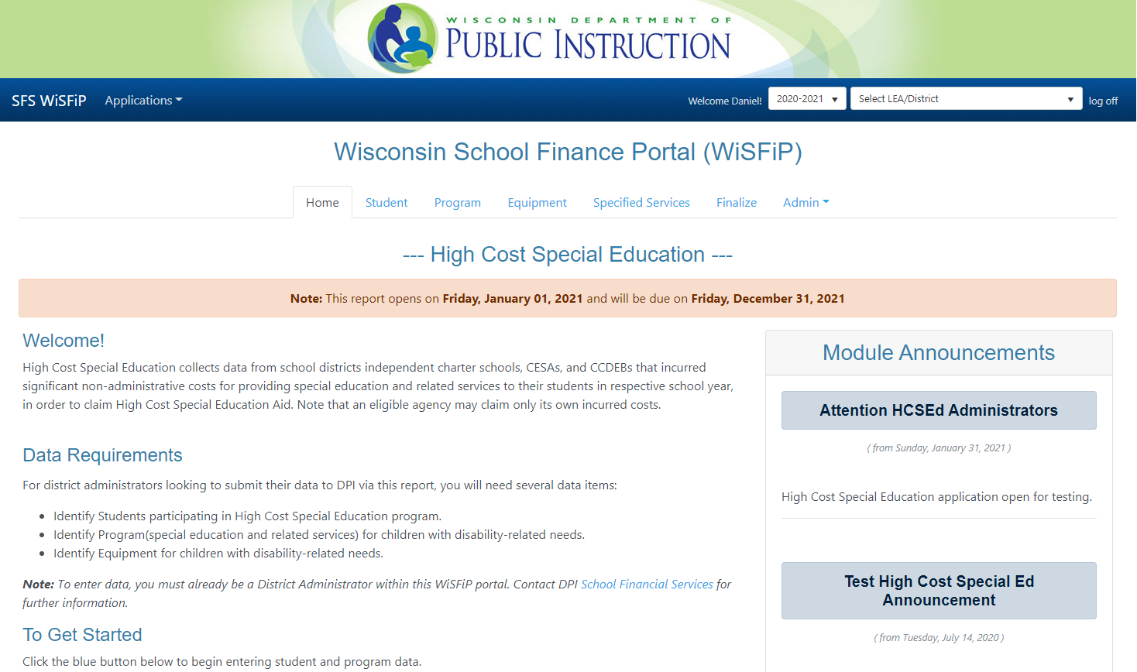
HC Spec Ed – New Claim App
Development in WiSFiP is complete, working to get test districts in for final review
Get ready by filling out the Excel workbook at dpi.wi.gov/sfs/aid/ special-ed/high-cost

Slide 45
GASB 84 & 87

Slide 46
GASB 84 Reminders
Effective beginning fiscal year 2020-21.
Potential implications for both Fund 60 and 72.
Heavy emphasis on “administrative involvement” for student activities.
Any remaining activity in Fund 72 MUST be in a Trust.

Slide 47
GASB 84 Accounting
Adjusting entries must move beginning balances as of 7/1/20.
All 2020-21 revenue and expenditures must be recorded in the appropriate GASB 84 funds.
Year End: 60B 81x000 - 72E 969 = 21R 969 + 10R 969 + 60R 969
Not all accounts may apply, and only the 969 activity indentified as GASB 84 implementation applies.

Slide 48
GASB 84 Questions
Attend the GASB 84 roundtable session
Discuss implementation with your auditor
Contact terry.casper@dpi.wi.gov 608-267-9218
dpi.wi.gov/sfs/finances/wufar/overview – includes GASB 84 summary, presentation, and sample journal entries.

Slide 49
GASB Statement 87
Establishes single model for lease accounting
No longer a distinction between capital and operating leases
Based on principle that leases are financing of right to use an underlying asset
Notes:
This portion will focus on governmental fund accounting implications. NOT government-wide as majority of District’s do not prepare government wide journal entries or financial statements.

Slide 50
GASB Statement 87
Effective beginning fiscal year 2021-22
Must be applied to existing contracts
Recognition and measurement using the facts and circumstances as of the beginning of the period of implementation (7/1/2021)

Slide 51
GASB Statement 87 Questions
Attend GASB Statement 87 presentation
Thursday, March 18 12:15 PM – 1 PM
SFS GASB Statement 87 Summary
Discuss implementation with your auditor

Slide 52
Summer School PI 17 Update

Slide 53
Background
Statute & admin rule* allow summer FTE minutes for virtual classes IF:
They are for high school credit
They are taken AND completed by students in grades 7-12
* Wis. Stat. § 121.004(8)(b), Wis. Adm. Code § PI 17.03(2)(d)

Slide 54
Background
Emergency Rule 2003 allowed summer FTE minutes for non-credit virtual classes to students in all grades
Was in effect last summer and expired in October

Slide 55
Background
DPI proposed a permanent update to PI 17 allowing summer FTE minutes for virtual non-credit instruction
Does not alter or repeal the 8,100 minute equivalency for one high school credit

Slide 56
Status
Gov. Evers approved the proposed permanent rule for submission to the Legislature
Joint Committee on Review of Administrative Rules (JCRAR) and Senate & Assembly Ed Committees will have the opportunity to review, hold hearings on, or block the rule

Slide 57
Status
If the rule goes through, DPI will apply it to all virtual non-credit summer classes this summer
DPI cannot guarantee at present that virtual non-credit minutes will be able to be counted for summer FTE

Slide 58
SFS Team Updates
Cody Loew, former Assistant Director, departed end of last week
Chris Babal, Consultant, departing end of next week
Bruce Anderson, Consultant and Tim Coulthart, Assistant Director, retiring June 30

Slide 59
SFS Team Contacts
General inquiries: dpifin@dpi.wi.gov or 608-267-9114
Daniel Bush, Director: daniel.bush@dpi.wi.gov or 608-266-6968

Slide 60
THANK YOU for all your work during this pandemic year!

