Slide 1
SPRING AT A GLANCE
Dan Bush
Director, School Financial Services Team
March 17, 2021
Notes:
Introduction, Survey, Summary - feedback

Slide 2
Spring Activities
Current Fiscal Year
Notes:
DPI reporting
Fiscal audit
Preparation of financial statements

Slide 3


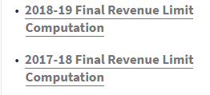
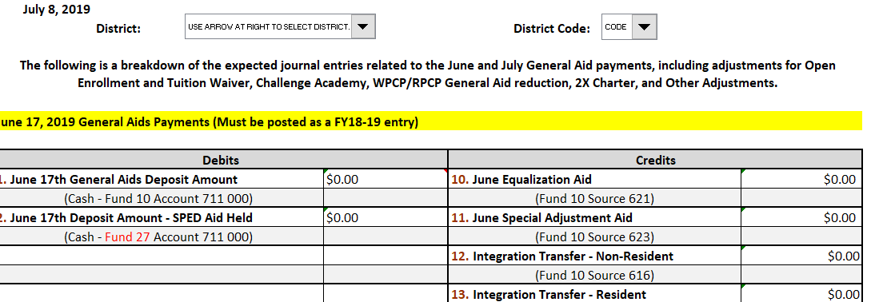
Upcoming Reports and Activities
Membership Audits Due May 3
Monitor and Amend Current Year Budget
Final 2020-21 Revenue Limit Calculation
June and July aid withholding

Slide 4
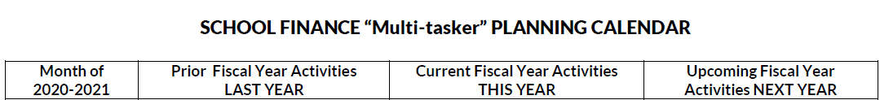
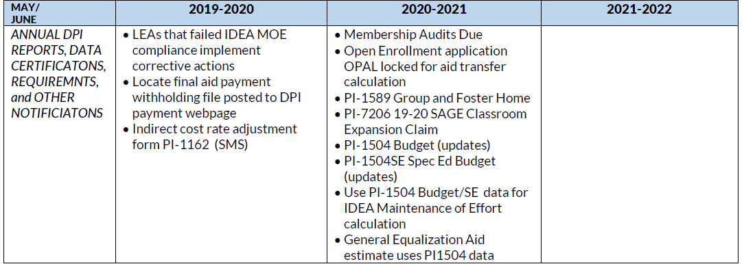
Upcoming Reports and Activities
Notes:
Snip it from Multi-tasker (tool reminder) https://dpi.wi.gov/sfs/communications/calendars/overview

Slide 5
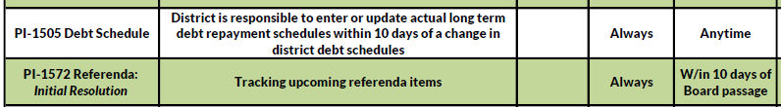
Upcoming Reports and Activities
Notes:
Snip it from Year- at – Glance resource and due date calendar (tool reminder) https://dpi.wi.gov/sfs/communications/calendars/overview
Remember to go in and make any changes to the district’s debt schedule that have occurred during the fiscal year. Debt Service information at: http://dpi.wi.gov/sfs/finances/debt/overview

Slide 6
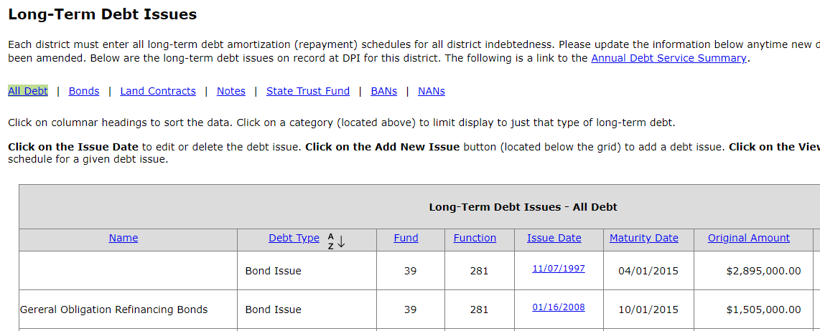
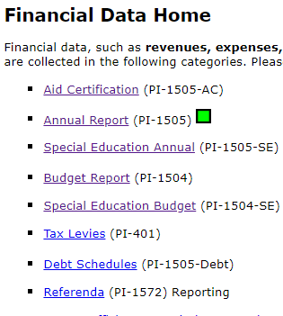
PI-1505 Debt Schedule Report
Notes:
Your debt schedule includes your principle and interest payment. Make any changes to the schedule to reflect your payments. Your PI1504/5 financial reports compare your reported info to the debt schedules
Report used to collect the district’s long-term debt repayment schedules for all district indebtedness
Data used to project future equalization aid payments from a state-wide perspective
Debt schedule report should be updated anytime new debt has been issued or existing debt has been amended
https://dpi.wi.gov/sfs/finances/debt/overview

Slide 7
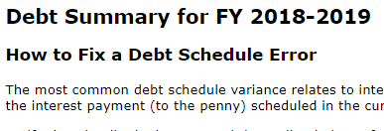
PI-1505 Debt Schedule Report
Report any changes within 10 days
2020-2021
Notes:
Your debt schedule includes your principle, interest, and outstanding debt
Make any changes to the schedule to reflect your payments
Submit changes to debt schedule within 10 days of the change
Report New debt issues
Report Changes to existing debt schedules
Update to keep current
Contact Jillian.Raff@dpi.wi.gov
Your PI1504/5 financial reports compare your reported info to the debt schedules

Slide 8


Referenda Report PI-1572
BALLOT
Notes:
Districts must notify DPI of upcoming referendum within 10 days of adopting the resolution
SAFR report used to collect data an any district referendums
Issue debt
Operational costs that are recurring or non-recurring
Districts are also required to send to DPI a copy of the adopted resolution authorizing election
After the referendum vote, the district should update the vote to show the vote tally
April every year, November every other year

Slide 9

Referenda Report PI-1572
Notes:
Districts are also required to send to DPI a copy of board of canvassers statement which reports official vote tally within 10 days of the election
The morning after the election report the preliminary results to DPI
Update the vote in the SAFR referendum portal or
Email roger.kordus@dpi.wi.gov
Questions: Roger Kordus
http://dpi.wi.gov/sfs/reporting/safr/referendum/procedures

Slide 10
Membership and Pupil Count Changes
All changes after audit reports are due must be requested
Changes may impact revenue limit
Notes:
Send an email indicating the reason for the change and request the report be opened, cc auditor if you have a membership audit
Districts that were selected for a membership audit will need to have after the audit confirmed by their auditor
Bruce Anderson or Roger Kordus are the contacts for membership changes

Slide 11
Open Enrollment
Notes:
Double check and confirm OE residency status
Contact SMS for corrections until June 19th
Update PI-1563 September and January Pupil Counts for any membership changes (need to request report be opened s described on the prior slide)
Aid adjustments for July are then calculated by the School Management Services Team
Update (amend) your Budget if needed

Slide 12
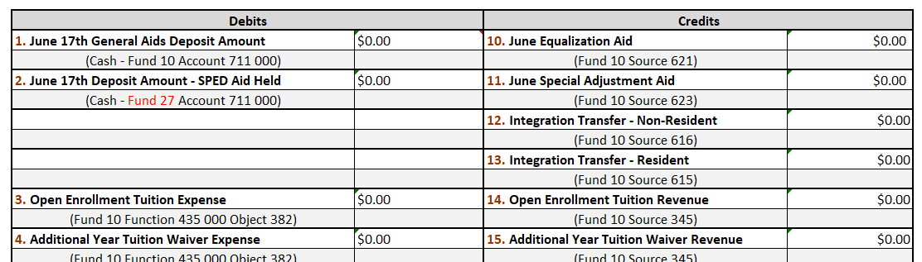
Open Enrollment
Notes:
Your aid payment will be adjusted for the cost of these students
Aid withheld for Open Enrollment adjustment in June/July
Aid withheld for Private Vouchers adjustment in June/July
https://dpi.wi.gov/sfs/finances/aids-register/aid-payment-adj-exp

Slide 13
Actual and Projected State Aid Adjustments
Aid withheld for Open Enrollment adjustment in June
Worksheet posted showing aid withheld in anticipation of June deductions
Revised worksheet for 2021 includes aid eligibility, withheld and paid
https://dpi.wi.gov/sfs/finances/aids-register/aid-payment-adj-exp
Notes:
Cash flow impact
Budget impact
Use to compare to aids register

Slide 14

Budget Report PI-1504 (SE, SLR)
Update with Board (Amended) Adopted Budget
Notes:
Don’t forget to update the 1504SE as well
MOE impact, this will help you to monitor
Report used to collect the district’s proposed special education (Fund 27) expenditures and revenues.
Data is used by the Special Education and Federal Grants Teams in determination of Maintenance of Effort (MOE) for the IDEA Grant.
If your district revises its budget due to MOE requirements, be sure to update the Special Education Budget Report.

Slide 15

Bank Reconciliations
Someone in your office needs to reconcile the bank statement to the district ledger EVERY MONTH
You cannot balance your reports if you don’t account for your CASH
Segregation of duties would suggest that the person making deposits should not reconcile the account
If necessary, the district may/should hire an accounting service to reconcile
Notes:
Many of the districts that struggle to meet the financial reporting deadlines have issues related to cash reconciliation

Slide 16
Annual Financial Audit
Select firm to complete your audit
Determine if your employee benefits require and actuarial study or table update and select a vendor
Determine if there are any other needs to complete your financial statements
Have a plan and schedule the work if possible to meet report deadlines
Notes:
Untimely OPEB and Pension benefit studies was one of the most frequent reasons reports were late.

Slide 17
Early DPI Reports
Achievement Gap Reduction (AGR) / SAGE Classroom Expansion – due May 10th
Transfer of Service (PI-5000) opens May
Pupil Transportation
Census
Calendar
Group and Foster home Membership
Notes:
Pupil Transportation – you have the data and only need to identify students that move or rode the bus in after you compiled the data
If you contract, suggest you request before school is out and final payment due
Census – if using the mathematical calculation, use have the 3rd Friday

Slide 18
Budget Adoption and Amendment

Slide 19
Budget Adoption, Tax Levy and Amendments
Amend the Adopted budget at a school board meeting
Step #6
Step #5
Adopt a budget at a school board meeting and set the tax levy
The electors at the annual meeting vote a tax (Common School districts)
Step #4
Step #3
The public hearing is held, at which time residents of the district have an opportunity to comment on the proposed budget
Publish a class 1 notice in the newspaper
Step #2
Create a proposed budget that identifies expected revenues, expenditures and fund balances for the upcoming/current year
Step #1
Notes:
Remember the steps in the process, we need to add one more for amending the adopted budget
As we said, the budget is a plan based on the information you have at the time, things can change
The purposes and appropriations should be reflected in the amended budget (e.g.. Grant carryover or new grants)
The adopted budget is amended as needed throughout the year and resources and needs change

Slide 20

2020-21 Budget Changes
Budget Impact Areas
Board approves a Budget for the hearing
Board adopts a Budget (original) and approves a Tax Levy after the hearing
Board amends Budget when appropriation and purposes change
Student Needs (Enrollment)
Estimates based on trends
3rd Friday in September
New course needs teacher
Final Board Amended Budget
Grant Revenue Availability
Base amount
Carryover is calculated
Change in plans/needs
Equipment Failures
Estimated expense
Boiler Fails
Roof Fails
Weather
Utility based on trends
Heavy Snow (Removal costs)
Late spring (Heating)
Notes:
The district’s budget is a roadmap based on the district’s best estimations
Board prepares a budget for presentation at the hearing
Board adopts a Fall budget that is used to set levy, often the district’s “original” budget
Estimates are updated or become actuals - Budgets can change
The annual “original” budget provides the best estimates at the time of adoption
The adopted budget is amended as needed throughout the year and resources and needs change

Slide 21
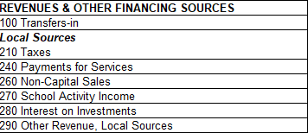
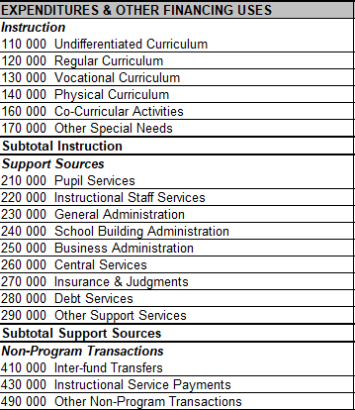
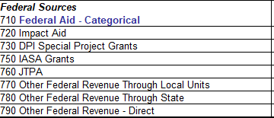
Budget Adoption Format
Minimum detail to the second digit.......
Notes:
The annual “original” budget provides the best estimates at the time of adoption
DPI format requires that both Appropriations and Purposes are to the second digit. Your BOE may approve a budget at a greater level of detail. This is the detail level required for changes and publication
Changes in subordinate line items from which the adopted budget evolved (but which are not detailed in the adopted budget) do not require the two-thirds vote and publication

Slide 22
Changes to the Current Budget
School District Treasurers must also comply with Wis Stat § 120.16(2) to assure disbursements from the school district treasury are made within the law
Class 1 notice within 15 days after the change is made (publication)

Slide 23
Spring Activities Related to the Next Fiscal Year (2021-22)

Slide 24
Impact of State Biennial Budget Cycle
Fall 2020:
Agencies submit budget requests
Gov reviews requests & proposes budget (Jan/Feb 2021)
JCF reviews & takes action (Spring 2021)
Leg votes on Budget Bill & sends to Gov (June/July 2021)
Gov signs Budget Bill w/ vetoes (July 1 2021?)
State budget is for a two-year period
From agency requests to a signed budget bill: 9 to 12 months (or longer)
Advocates, Interest Groups, & Public
Current requests: July 1, 2021 through June 30, 2023
Notes:
You are planning for the first year of the biennium—watch the process

Slide 25
Budget Planning
Learn from the past
Forecast the future
Review today
Notes:
The school district budget development process is cyclical in nature and builds upon itself from year to year.
Learn from prior years - budget performance, enrolment trends, staff cost trends
Review current year budget performance and success in meeting needs
Project (changes) for future trends, costs and needs

Slide 26
Budget Building
Budget Process
Learn from the past
Forecast the future
Review today
Board and Policy
Develop goals , priorities, timelines
Administration
Notes:
With the Board of Education and/or superintendent develop budget goals and priorities to guide the upcoming budget cycle
Example Review Fee Policy and share your findings, as appropriate, with Board of Education
Develop a timeline for Budget development including roles and responsibilities
Project Revenue Limit

Slide 27
Budget Building- Revenues
CONTROLLED BY REVENUE LIMITS
OUTSIDE REVENUE LIMITS
FEES
GENERAL AIDS
REF. DEBT
PROPERTY TAXES
GRANTS
CATEGORICAL AIDS
Notes:
Revenue Limits control greatest share of revenues
Authority to exceed the revenue limit (except for exemptions identified by law) is given by a referendum
Start work on Revenue Limit projection for 2020-21 fiscal year
http://dpi.wi.gov/sfs/limits/worksheets/revenue
You will have to estimate Fall 2020 enrollments and other data not on file at DPI yet
Use 2019-20 property values until new ones are released from DOR
Estimate Revenue Limit exemptions and debt payments based on prior year and knowledge of changes
Remember that the pre-populated worksheet only reflects the information we have on file
Estimate the (missing) information not yet available
Review and confirm the populated figures for accuracy
Recognize how current year membership changes impact your calculation
Review Current Year Budget and Actuals
Estimate Revenue outside of “controlled” revenues
Per Pupil and Special Education are the largest categorical aid programs
Federal Grants such as Title I and IDEA (largest) and State grants
Payment for referendum approved Debt Issues are outside the limit (Levy on a CY basis)
Student Fees may be not be assessed generally and must be related to the cost of an item, BOE policy and fee waiver for indigent students required
Incoming Open enrollment (make sure to adjust expense as well)

Slide 28

Budget Building
Notes:
Use data and look for trends
Student enrollment (headcount in buildings and resident counts)
Private schools taking vouchers in your area
Real estate, housing, and property values

Slide 29
Budget Building - Expenses
Notes:
Review Current Year Budget and Actuals
Review Trends
Review enrollment projections and staffing needs for the upcoming year
Develop preliminary expenditures
Identify budgets for Debt Service (Funds 38 & 39)
Consider impacts of Private School Vouchers and Open Enrollment out

Slide 30







Budget Building - Expenses
Notes:
Review enrollment projections and staffing needs for the upcoming year- class size policy
Consider impacts of Private School Vouchers and Open Enrollment
Plan for overall increases in salaries, benefits, utilities, and transportation
Look at other big ticket items – worker compensation and other business insurances, maintenance
Identify budgets for Debt Service (Funds 38 & 39)

Slide 31
Budget Adoption, Tax Levy and Amendments
Amend the Adopted budget at a school board meeting
Step #6
Step #5
Adopt a budget at a school board meeting and set the tax levy
The electors at the annual meeting vote a tax (Common School districts)
Step #4
Step #3
The public hearing is held, at which time residents of the district have an opportunity to comment on the proposed budget
Publish a class 1 notice in the newspaper
Step #2
Create a proposed budget that identifies expected revenues, expenditures and fund balances for the upcoming/current year
Step #1
Notes:
We have come full circle since last August
Remember the steps in the process, we need to add one more for amending the adopted budget
As we said, the budget is a plan based on the information you have at the time, things can change
The purposes and appropriations should be reflected in the amended budget (e.g.. Grant carryover or new grants)
The adopted budget is amended as needed throughout the year and resources and needs change

Slide 32
Points to Remember
Statutory requirements, reports, and deadlines
Board approves appropriations and purposes of the budget
Revenue Limits will determine the majority of your resources and pre pops use the data on file at DPI (you need to estimate)
You will often have three budget years cycling at the same time

Slide 33
Points to Remember
Board approves appropriations and purposes of the budget (authority for spending)
Membership FTE drive the revenue limit
Revenue Limits will determine the majority of your resources and pre pops are available
State aids are paid on prior year data

Slide 34
Contact Us
Team Directory:
dpi.wi.gov/sfs/communications/
staff-directory
General Mailbox: dpifin@dpi.wi.gov

