Slide 1
Title Slide
Special Education
Fiscal Auditing
Roselynn Bittorf – SFS Consultant
School Financial Services Team
WASBO Accounting Conference 2022

Slide 2
Sample Text Slide
Topics
Audit Program Overview
Findings and Issues
Grant Expenditures Reconciliation
2

Slide 3
Sample Text Slide
Audit Program Overview
What are auditors looking for?
Why do we care?
3

Slide 4
Sample Text Slide
Special Education Audit Program
Program audit, not fiscal audit
Required for all LEAs
Audit Program Overview
4

Slide 5
Sample Text Slide
Special Education Audit Program
Purposes
Verify compliance with licensure and other program requirements
Verify accurate reporting for state aid calculation and federal IDEA Maintenance of Effort
Audit Program Overview
5

Slide 6
Sample Text Slide
Program Compliance Requirements
“No Valid License” audit
Payroll testing
Personal services and employee travel
Audit Program Overview
6

Slide 7
Sample Text Slide
Program Compliance Requirements
Private vendor contracted services
Specialized transportation
Vehicle/equipment purchases
Audit Program Overview
7

Slide 8
Sample Text Slide
Staff Must Be Properly Licensed
License must be current and valid
License must be appropriate for the individual’s actual assignment
Audit Program Overview
8

Slide 9
Sample Text Slide
Staff Must Be Properly Licensed
Valid Reporting and License Codes for Special Education/Pupil Services Staff available at dpi.wi.gov/sfs/aid/special-ed/sped-sap/eligibility
9

Slide 10
Sample Text Slide
License Checking Responsibility
DPI generates NVL list from cross-check between district’s position report and license database - Auditor does not check the license
Auditor completes & submits worksheet, attaches district representation letter (if provided)
Audit Program Overview
10

Slide 11
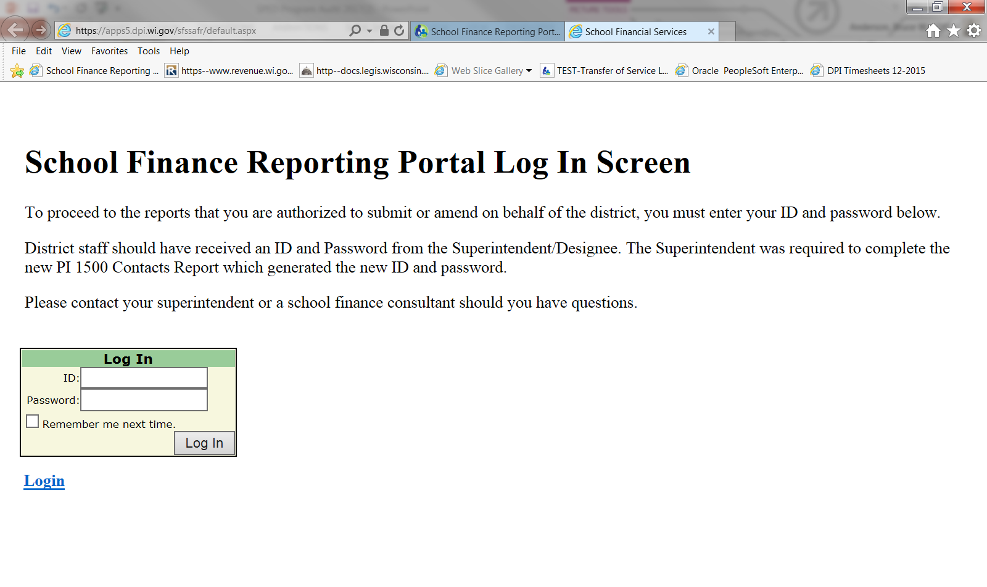
Sample Text Slide
NVL in SAFR
Audit Program Overview
11

Slide 12
Sample Text Slide
NVL/QC Worksheet
Supporting documentation is given to your auditor for submission along with the workbook
Audit Program Overview
12

Slide 13
Sample Text Slide
NVL/QC Worksheet
Due before audited financial statements
Aid payments begin in November, need worksheets in September
Note whether LEA is requesting license status review
Reviews are not automatic!
Audit Program Overview
13

Slide 14
Sample Text Slide
ISSUE: NVL/QC Reporting
1) Completed NVL/QC worksheet—submit actual Excel workbook, not PDF or scan
List all “Educators Without Valid Licenses”
Any additional questioned costs
Reflect account coding after any corrections
14

Slide 15
Sample Text Slide
ISSUE: NVL/QC Reporting
2) Confirm whether district agrees or disagrees
3) Supporting documentation as appropriate
15

Slide 16
Sample Text Slide
ISSUE: NVL/QC Reporting
4) District’s representation letter
Copy of license certificate—not DPI website printout
Payroll records
Other appropriate documentation
16

Slide 17
Sample Text Slide
Future License Checking
Wisconsin School Finance Portal (WiSFiP) will make license checks easier with real time access to staffing and licensing databases
For more information regarding the rollout of WiSFiP, please see our website at https://dpi.wi.gov/sfs/wdf
Audit Program Overview
17

Slide 18
Sample Text Slide
Specialized Transportation
Pupil transportation in Fund 27, project 011
Did all students have transportation in IEP?
Exceptions:
Listed in another student’s IEP (e.g. peer mentor)
“Incidental Benefit”: Picked up at same household, didn’t displace another pupil with IEP, didn’t increase route cost/capacity
Accommodation for newly homeless students or foster care in first 20 days to use specialized route w/o disqualifying it
Audit Program Overview
18

Slide 19
Sample Text Slide
Specialized Transportation
Can a student be counted for Pupil Transportation Aid AND eligible for special education aid for specialized transportation?
MAYBE
Audit Program Overview
19

Slide 20
Sample Text Slide
Specialized Transportation
An LEA’s excess costs of fulfilling the transportation needs of special education students, as prescribed by each student’s IEP, are eligible for state Special Education Aid or IDEA grant funding.
Audit Program Overview
20

Slide 21
Sample Text Slide
Vehicle/Equipment Purchase
Vehicles
Prior approval from DPI required
Equipment with unit cost at least $10,000
Prior approval from DPI required
See Specialized Transportation Aid Eligibility and Funding document
Equipment with unit cost less than $10,000
No review
Audit Program Overview
21

Slide 22
Sample Text Slide
Reporting Compliance Requirements
Match aid-eligible expenditures to PI-1505-SE
Verify proper coding
Report questioned costs
Audit Program Overview
22

Slide 23
Sample Text Slide
Ledger vs. PI-1505-SE
Compare general ledger to PI-1505-SE
Trace:
Total Fund 27 expenditures
Fund 27 project 011 (aid-eligible) expenditures
Audit Program Overview
23

Slide 24
Sample Text Slide
Proper WUFAR Coding
No specific procedure beyond auditor’s usual scope of work
Miscoding should be fixed during audit
Audit Program Overview
24

Slide 25
Sample Text Slide
Proper WUFAR Coding
Only issue a finding for:
Deliberate miscoding to claim state special education aid or federal IDEA funds
Deliberate miscoding between Funds 10 & 27 for misstating IDEA MOE
Auditor’s judgment of a significant, ongoing fiscal management issue
Audit Program Overview
25

Slide 26
Sample Text Slide
ISSUES: Proper WUFAR Coding
Please review 290 object codes to make sure you are coding as aidable only the eligible 290 objects to project 011 (292,293,295,296 Only)
26

Slide 27
Sample Text Slide
Grant Payment Reconciliation
Identifying your grant payments in (GPI)
Identifying your grant payments out (GPO)
Reported/Expected GPO
27

Slide 28
Sample Text Slide
ISSUES: Grant Payment Reconciliation
Project 340 expenses vs. final IDEA claims
GPI/GPO lines on PI-1505-SE
GPO = Project 340 w/ certain 380 objects?
Other challenges
28

Slide 29
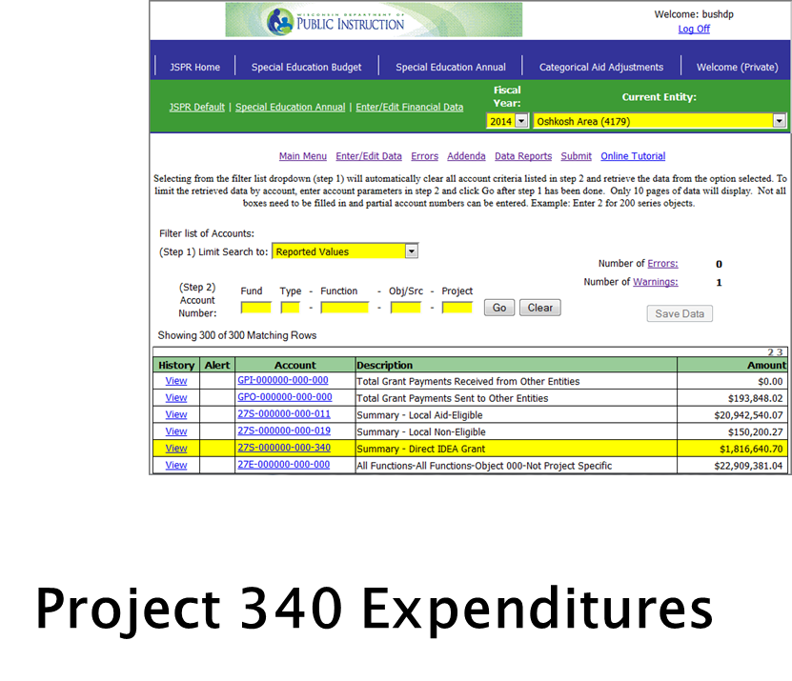
Sample Text Slide
Grant Expenditures Reconciliation
=
FINAL IDEA CLAIMS
EQUAL
29

Slide 30
Sample Text Slide
ISSUES: Grant Payment Reconciliation
Project 340 expenses vs. final IDEA claims
GPI/GPO lines on PI-1505-SE
GPO = Project 340 w/ certain 380 objects?
Other challenges
30

Slide 31
Sample Text Slide
Grant Payment Reconciliation
Did you use grant funds to pay another aid eligible entity?
Did another aid eligible entity pay you with grant funds?
31

Slide 32
Sample Text Slide
Grant Payment Reconciliation
Record Grant Payments In (GPI) &
Grant Payments Out (GPO) in your PI-1505-SE
32

Slide 33
Sample Text Slide
ISSUES: Grant Payment Reconciliation
Project 340 expenses vs. final IDEA claims
GPI/GPO lines on PI-1505-SE
GPO = Project 340 w/ certain 380 objects?
Other challenges
33

Slide 34
Sample Text Slide
Grant Payments Reported v. Expected
GPO = Project 340 w/ certain 380 objects?
Object 382 Payments to WI District
Object 383 Payments to CCDEB
Object 386 Payments to CESA
34

Slide 35
Sample Text Slide
Grant Payments Reported by You v. Others
Need to communicate with other LEA
Answer the question who did you pay with grant funds
Private tuition is object 370 and not reported here
35

Slide 36
Sample Text Slide
Grant Payment Reconciliation
So grant reconciliation is always about how I used my IDEA funds?
NO
Audit Program Overview
36

Slide 37
Sample Text Slide
What should be included in GPO and GPI?
Any grant money accounted for in Fund 27 OR related to special education that is grant money received from or paid to another district, CESA or CCDEB
Money received directly from DPI is NOT included
The purpose of identifying these grant payments is to ensure state aid is not paid on expenditures funded with grant money
37

Slide 38
Sample Text Slide
Recap GPO/GPI Process
You put your GPI in,
You take your GPO out,
You put your Detail in
And Reconcile all about.
You do a little Checking
And find out Who you Paid,
And that’s what its all About!
38

Slide 39
Sample Text Slide
ISSUES: Grant Payment Reconciliation
Project 340 expenses vs. final IDEA claims
GPI/GPO lines on PI-1505-SE
GPO = Project 340 w/ certain 380 objects?
Other challenges
39

Slide 40
Sample Text Slide
Grant Payments Reconciliation- Other
Late claims
Budget changes shifting payments to other LEAs on/off the grant
Lengthy CESA reconciliations
40

Slide 41
Sample Text Slide
Problems - Reporting vs. Grant Timelines
Annual reports due mid-September
IDEA claims open through September 30
41

Slide 42
Sample Text Slide
Problems
Disconnect between grant managers and business offices
Timing: federal (obligations) vs. WUFAR (expenditures)
Unclaimed expenses are not reclassified
42

Slide 43
Sample Text Slide
Federal Grant Timeline
Grant Period
Liquidation Period
Forward Funding
Federal Fiscal Year
7/1
9/30
6/30
9/30
43

Slide 44
Sample Text Slide
Obligations vs. Expenditures
Obligation
Orders placed for property and services, contracts and subawards made, and similar transactions during a given period
Require payment by the grantee during the same or a future period
Expenditure
Recognized when liability is incurred
44

Slide 45
Sample Text Slide
Obligations vs. Expenditures
Liquidation
Payment to resolve the liability
May not submit grant claim until obligation is liquidated
General Federal Award Guidance at http://dpi.wi.gov/sms/fedaids
45

Slide 46
Sample Text Slide
Problems – Incorrect Reporting
USDE has been emphasizing the difference within federal programs between subgranting and contracting, particularly with regard to IDEA
Grants from CESA (i.e. Transition Improvement Grant) lose their federal identity & are coded to Project 019 in the SE
The key is when you use your direct DPI grants (state or federal) to pay another aid eligible entity are reported as GPI and GPO
46

Slide 47
Sample Text Slide
Why Do We Care?
s. 115.88 (7), Wis. Stats.:
Offsetting receipts. In any school year, the following revenues shall be deducted from costs aidable under this section before aids are calculated under this section:
(a) Any federal operational revenues expended on costs aidable under this section.
Grant Reconciliation
47

Slide 48
Sample Text Slide
Why Do We Care?
So why can’t we just subtract 27R 730 from 27E project 011?
Aid-eligible LEAs buy services from each other
Differences in recording between LEAs can result in state aid paid on federally-funded expenditures
Grant Reconciliation
48

Slide 49
Sample Text Slide
Next Steps
Revisit communication with grant managers
Make sure you know what your SPED/C&I director or CESA is doing!
Write reconciliation into your procedures
Communicate with the other LEA
49

Slide 50
Sample Text Slide
More Information
Audit Manual: dpi.wi.gov/sfs/finances/auditors/overview
Special Ed/SAP Categorical Aid: dpi.wi.gov/sfs/aid/special-ed/sped-sap/overview
SFS Consultant: roselynn.bittorf@dpi.wi.gov or 608-267-9212
50

