Slide 1
Text Slide Master
WISEdata Finance and WiSFiP Implementation Timeline
School Financial Services Team
DPI Spring Workshop
March 17, 2022

Slide 2
WISEdata Finance
PI-1504 Budget and PI-1505 Actual*
District Level Budget and Actual Reports Existed in SAFR (current SFS Team reporting portal)
PI-1504 Budget in SAFR retired after 2020-21
Completed
PI-1505 Actual planned retirement after 2020-21
Revised to continue for 2021-22
* Includes multiple reports: PI-1505, PI-1505 SE, PI-1505 AC, PI-1506 AC, PI-1506 FB, etc.
Notes:
State Aid Financial Reporting (SAFR) is the current school finance reporting portal https://dpi.wi.gov/sfs/reporting/safr/overview
First DPI online reporting tool over 18 years ago. SAFR replaced school districts sending (in reverse order) diskettes, floppy” disks, and originally paper reports.

Slide 3
Background
In 2016 DPI changed how student data was reported…
ISES
Student

Slide 4
Background
…In 2022 we planned to do the same for financial data
SAFR
Finance
Notes:
State Aid Financial Reporting (SAFR) is the current school finance reporting portal https://dpi.wi.gov/sfs/reporting/safr/overview

Slide 5
What is WISEdata Finance?
Extension of the Ed-Fi API for robust financial data collection
New financial data reporting system for Wisconsin LEAs (districts and independent charter schools)
Notes:
Ed-Fi API
https://www.ed-fi.org/

Slide 6
What is WISEdata Finance?
Financial data is sent directly to DPI via the WISEdata Ed-Fi API from the LEA’s financial system, just as student data is sent directly from the LEA’s Student Information System (SIS)

Slide 7
Why WISEdata Finance?
Eliminate the manual part of financial reporting to DPI
Better consistency with DPI and local accounts
Improved accuracy
Easier reporting compliance (ESSA School Level Report, PI-1504 Budget, PI-1505 Actual, etc.)

Slide 8
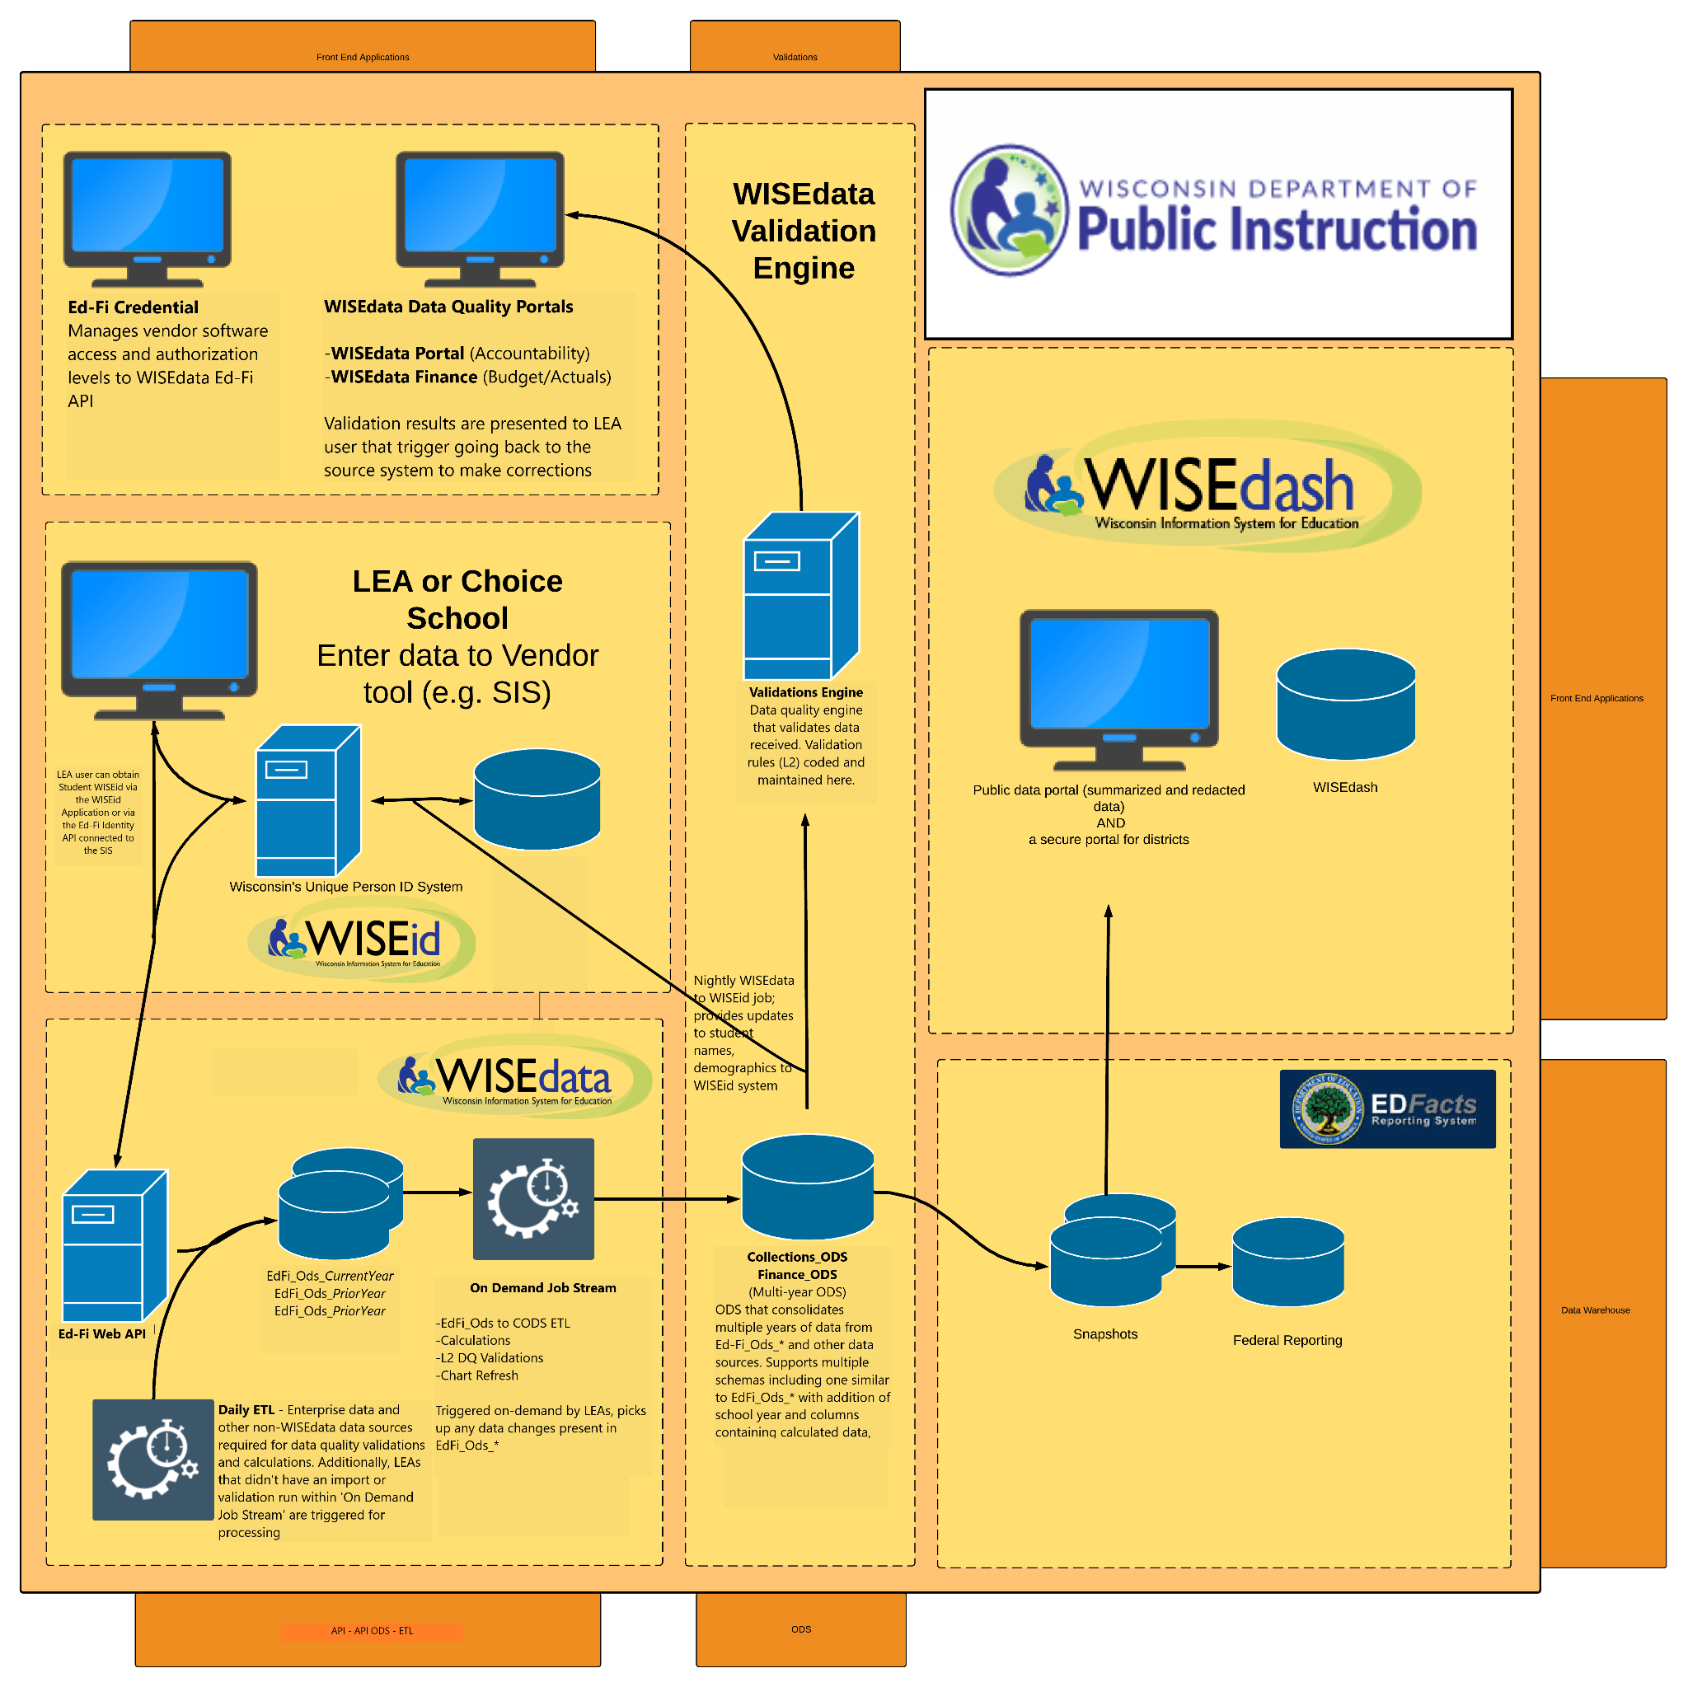

Slide 9
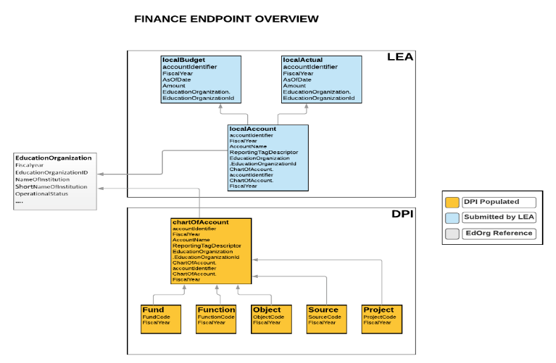
WISEdata Finance Ed-Fi API
Accounting system data available from DPI via the API
Notes:
Ed-Fi API
https://www.ed-fi.org/
The Ed-Fi Data Standard is the set of rules for the collection, management, and organization of educational data that allows multiple systems to share their information in a seamless, actionable way.

Slide 10
WISEdata Finance Ed-Fi API
Financial budget & actual data submitted by account using the API
Notes:
Ed-Fi API
https://www.ed-fi.org/
The Ed-Fi Data Standard is the set of rules for the collection, management, and organization of educational data that allows multiple systems to share their information in a seamless, actionable way.

Slide 11
What Does This Mean For LEAs?
LEA’s financial ledger (the local “books”) must be consistent with WUFAR accounting and the DPI validations to avoid WISEdata Finance reporting quality issues
Validations are triggered via WISEdata Finance
WiSFiP will be developed to collect additional information to supplement WISEdata Finance data.
Notes:
Wisconsin Uniform Financial Accounting Requirements (WUFAR)
https://dpi.wi.gov/sfs/finances/wufar/overview

Slide 12
WISEdata Finance and WiSFiP Implementation Timeline
Original Timeline | Current Timeline (Revised Once) | Recommended Timeline
Spring 2018 – Summer 2019: Development | No change | No change
Fall 2019 – Spring 2020: Vendor and District Piloting | Spring – Fall 2020: Vendor and District Piloting | No change
Summer – Fall 2020: Training for Districts and Vendors | Fall 2020 – Spring 2021: Open Beta Testing (districts work with vendors, test the system and identify issues) | No change
 | Winter 2020—Summer 2021: Training for Districts and Vendors | No change
Fall 2020: 2020-21 Budget Collection | Fall 2021: 2021-22 Budget Collections | In process, but delays
Summer 2021: 2020-21 Annual Collection | Summer 2022: 2021-22 Annual Collection | Continue WDF, but use SAFR as a parallel reporting system.
Notes:
WISEdata Finance (WDF) exists today. 2021-22 budget data has been submitted by 93% of school districts. The WDF alternative reporting mechanism (ARM) will be used by at least one district and the majority of the independent charter schools for 2021-22 actuals.
There is a change in the implementation timeline to allow us to complete the WDF additions/improvements and the development of the necessary WiSFiP views/reports. Allows DPI and the SFS Team to seek additional input from the LEAs. Once received, we will collaborate with both the LEAs and the vendors to complete the project.

Slide 13
WiSFiP Implementation
Budget data views will be created for districts.
Budget data view/report will be created for SFS Team to calculate the July 1 General School Aids estimate for 2022-23.
PI-1505, PI-1505 SE, PI-1505 AC, PI-1506 AC, and PI-1506 FB need to be validated/confirmed in Wisedata Finance and created in WiSFiP.
Public views via WISEdash will be developed.
Notes:
The SFS and Collections Teams have begun the necessary work as part of the parallel reporting of 2021-22 actuals in WISEdata Finance and SAFR.

Slide 14
Points to Remember
Parallel reporting of 2021-22 actual revenues and expenditures in WISEdata Finance and SAFR.
SAFR Addenda and Errors will need to be “cleared”, but you will be required to modify your financial ledger and submit revised data via WISEdata Finance.
SFS Team will use 2021-22 data and experiences to develop new WiSFiP views during 2022-23.
Notes:
The SFS and Collections Teams have begun the necessary work as part of the parallel reporting of 2021-22 actuals in WISEdata Finance and SAFR.

Slide 15
Questions? Comments?

Slide 16
Contact Us
Team Directory: dpi.wi.gov/sfs/communications/staff-directory
General Mailbox: dpifin@dpi.wi.gov

