Slide 1
Title Slide
WPEN Summer Summit
School Finance 101
Dee Pettack
Bob Soldner
Department of Public Instruction
July 21, 2022

Slide 2
Student Enrollment Option
Traditional Public School
Neighborhood school
  Within district transfer
  Open enrollment
Charter School
  Instrumentality
  Non-instrumentality
  Independent
Virtual Charter
  Within district
  Open enrollment
Private School
Milwaukee PCP
  Racine PCP
  Wisconsin PCP
  Special Needs Scholarship Program
  Tuition
Home School
Dual Enrollment
  Early College Credit
  Transcripted Credit
  AP/IB classes
  Whole grade sharing

Slide 3
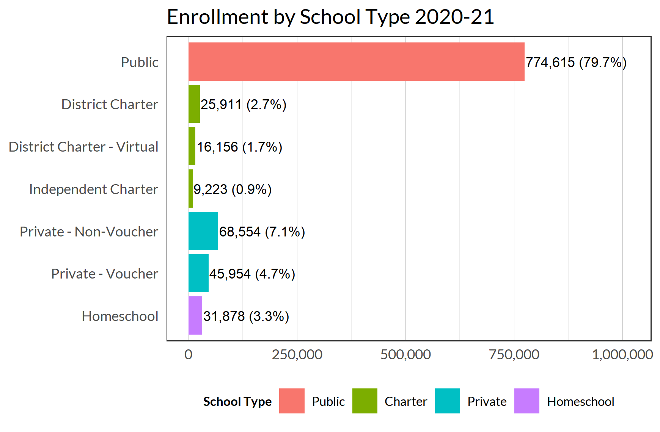
Snapshot of School Enrollment
Wisconsin has almost
1 million K-12 students.
Over 86% of publicly-funded students attend a school overseen by a local school board (public, district charter, or district charter - virtual).
Source: Public and charter - Department of Public Instruction 2020-21 data warehouse data, private - https://dpi.wi.gov/wisedash/download-files and https://dpi.wi.gov/sms/choice-programs/data, homeschool - https://dpi.wi.gov/sms/home-based/statistics. It is not possible to enroll in a homeschool program for Kindergarten so homeschool is grades 1-12 only. Pre-Kindergarten students are not included in any count.
Notes:
2020-21 Enrollment
Public 774,615 79.7%
District Charter 25,911 2.7%
District Charter - Virtual 16,156 1.7%
Independent Charter 9,223 0.9%
Private - Non-Voucher 68,554 7.1%
Private - Voucher 45,954 4.7%
Homeschool 31,878 3.3%
Total 972,291

Slide 4

Growing Poverty

Slide 5
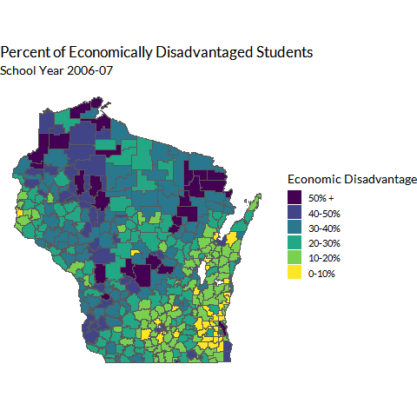
Poverty is Growing in Wisconsin
Statewide, about 2 in 9 districts have student populations that are more than 50% economically disadvantaged.
Source: Department of Public Instruction WISEdash (https://wisedash.dpi.wi.gov/).

Slide 6
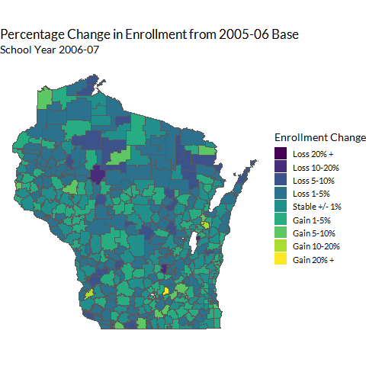
Students are in Fewer Districts
The percent of districts
in declining enrollment increased from 59% in 2006-07 to 74% in 2021-22.
Today, 75% of students
are located in just 30%
of districts.
Source: Department of Public Instruction WISEdash (https://wisedash.dpi.wi.gov/) and https://dpi.wi.gov/sfs/statistical/longitudinal-data/revenue-limit. Note: declining enrollment means that the current three-year average of pupils enrolled is less than the prior three-year average of pupils enrolled. See https://dpi.wi.gov/sfs/limits/exemptions/nonrecurring.

Slide 7
2021-22 Decreasing Enrollment
Cumulative Enrollment (2021-22) | Percentile | # of Districts | % of Districts
207,080 | 25% | 10 | 2%
412,712 | 50% | 46 | 11%
615,445 | 75% | 126 | 30%
818,471 | 100% | 421 | 100%
Today, 75% of our students
are located in just 30% of
our districts.
More than half of our students attend districts with fewer than 1,000 students.
District Enrollment (2021-22) | % of Districts
Under 1,000 | 54%
Under 3,000 | 83%
Under 10,000 | 98%
Source: Department of Public Instruction WISEdash (https://wisedash.dpi.wi.gov/). Updated July 13, 2022.

Slide 8
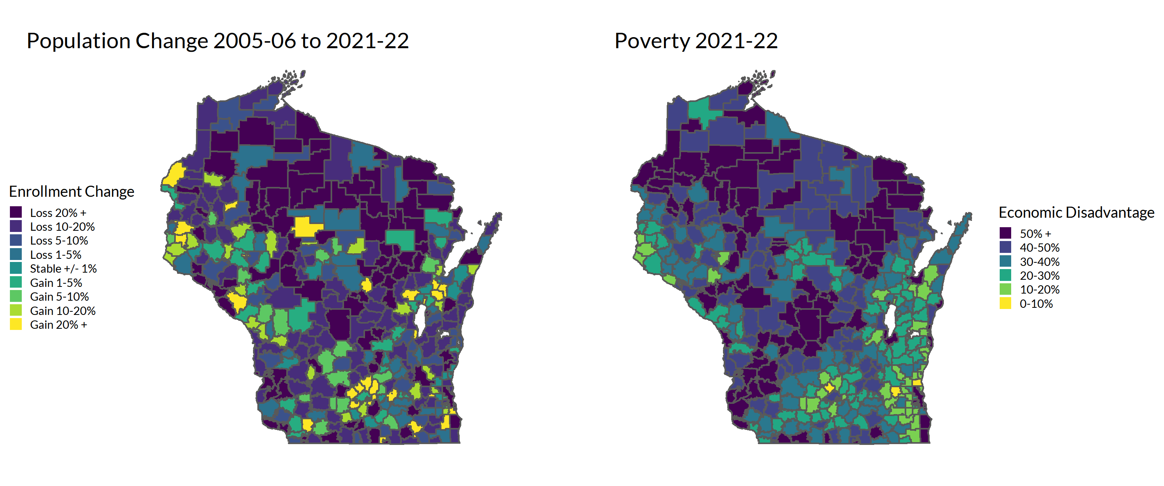
Rural Areas: Fewer Kids, More Poverty
Source: Department of Public Instruction WISEdash (https://wisedash.dpi.wi.gov/).

Slide 9
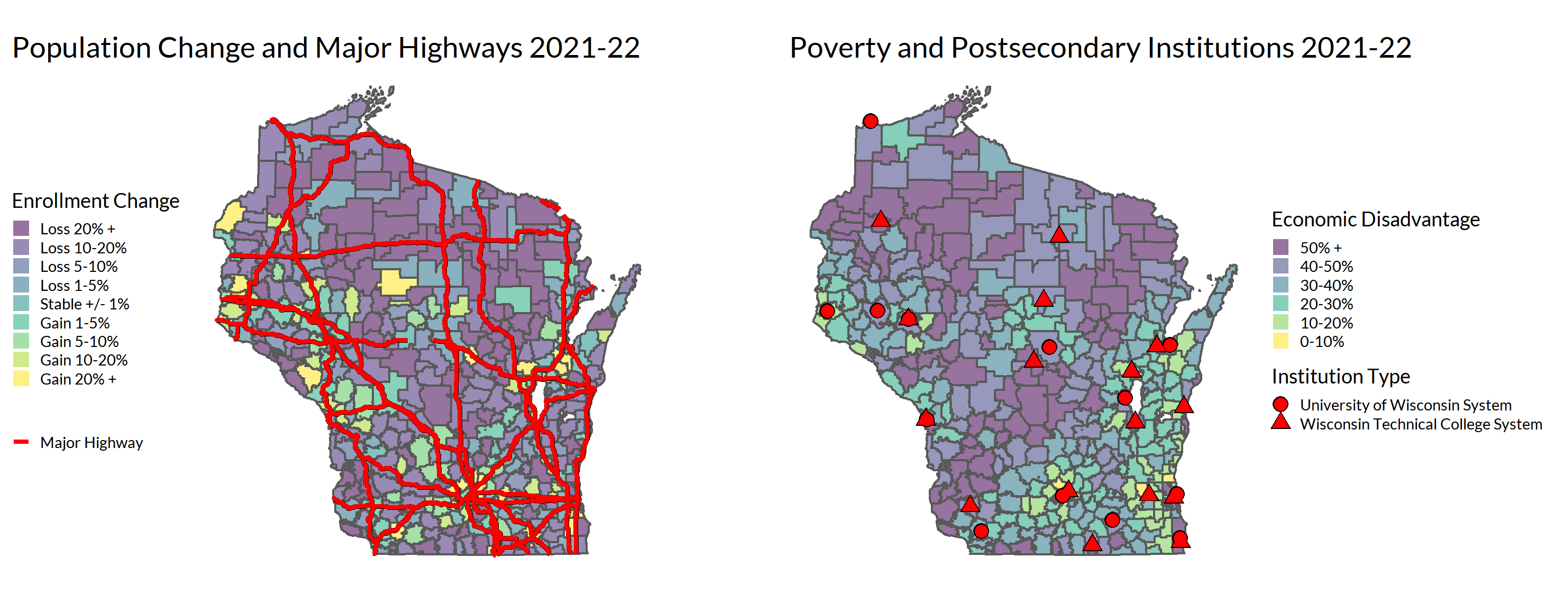
Rural Areas: Fewer Kids, More Poverty
Department of Public Instruction. WISEdash (https://wisedash.dpi.wi.gov/)

Slide 10
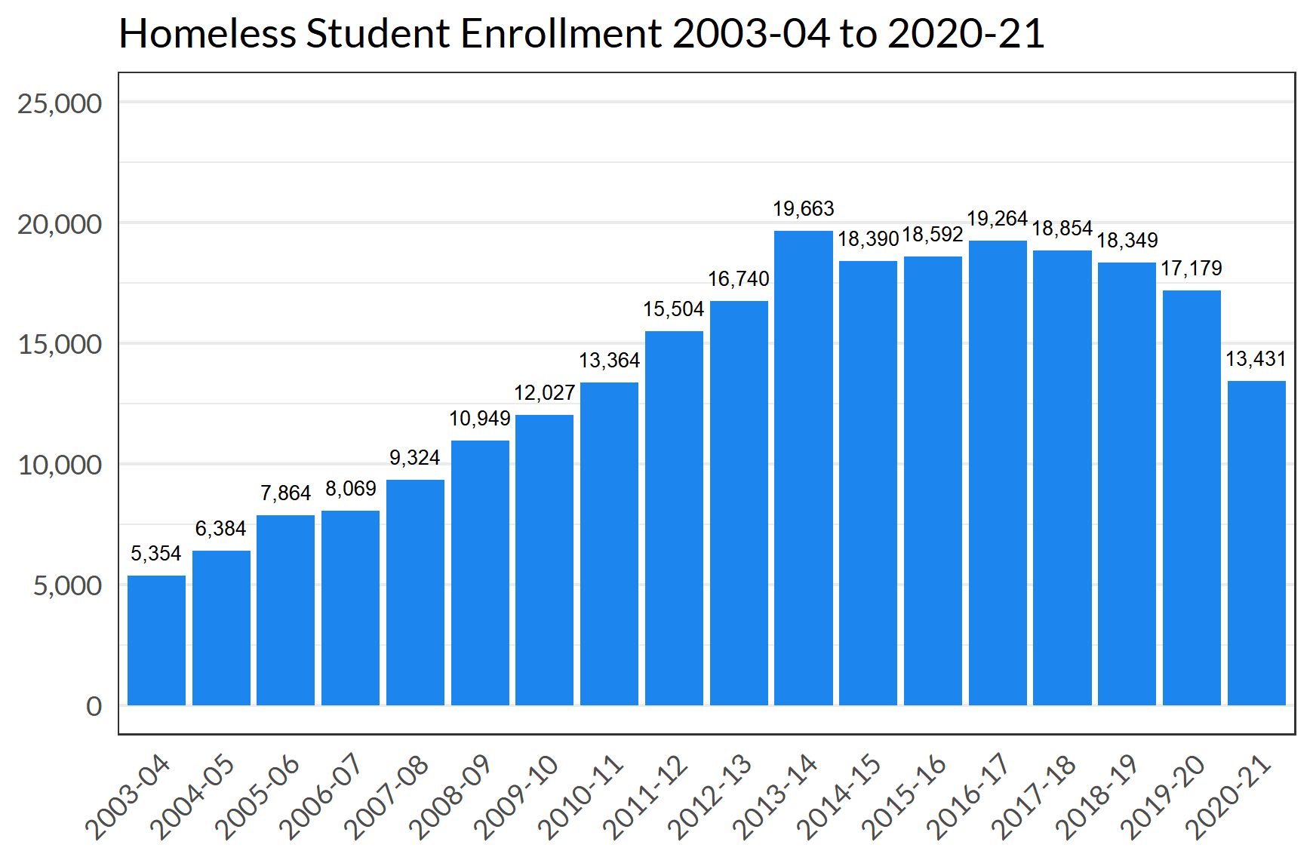
The Number of Homeless Students is Decreasing
Half of Wisconsin's students experiencing homelessness can be found in just 13 school districts.
Sources: Wisconsin Department of Public Instruction Homeless Children and Youth data (https://dpi.wi.gov/homeless/data) through 2017-18. Department of Public Instruction data warehouse data 2018-19 and later.

Slide 11
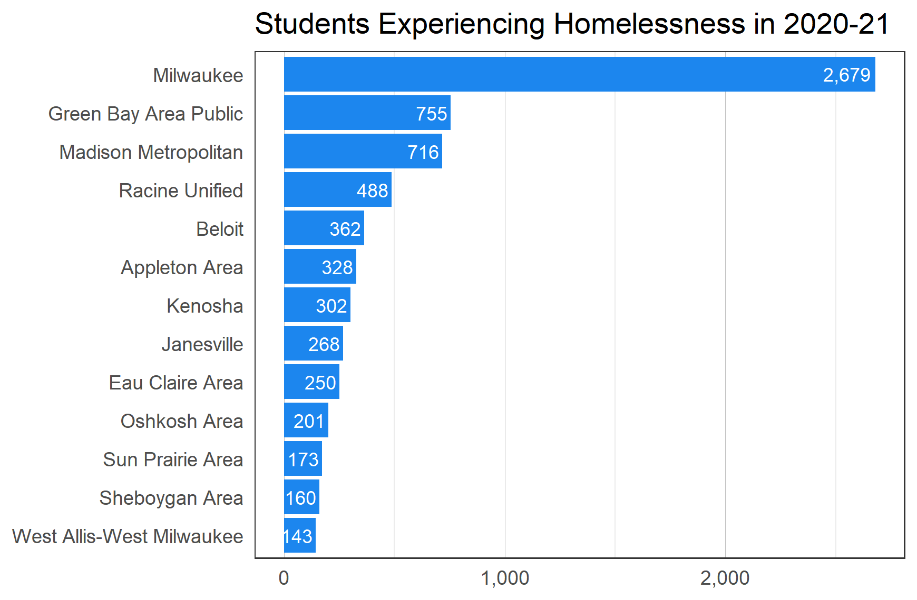
Half of Students Experiencing Homelessness are in 13 Districts
50% of students experiencing homelessness are in just 13 districts, but almost every district has at least one student experiencing homelessness.
Source: Department of Public Instruction 2020-21 data warehouse data.

Slide 12
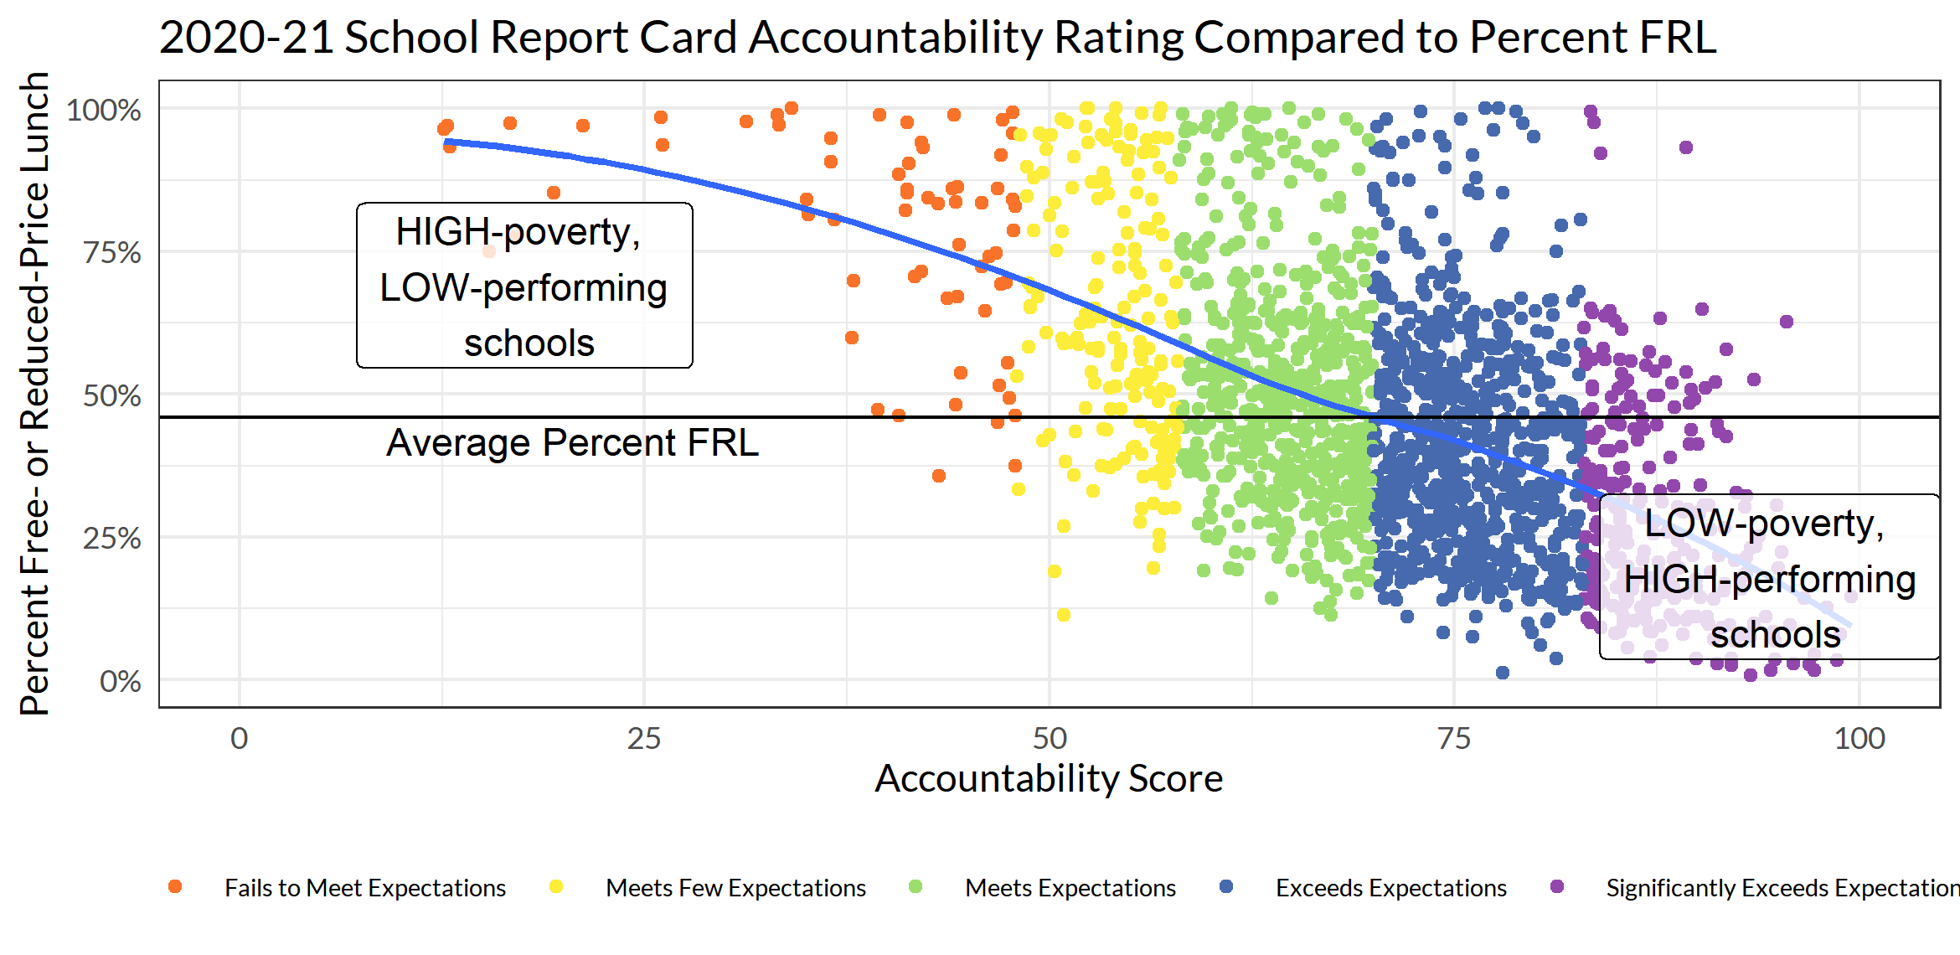
Poverty Impacts Achievement
Source: Department of Public Instruction 2020-21 report card data (https://dpi.wi.gov/accountability/report-cards).

Slide 13
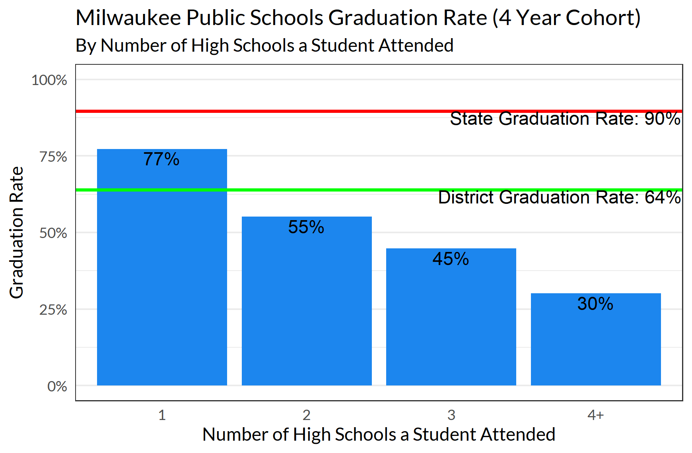
Mobility Impacts MPS Graduation
Consistent enrollment improves outcomes in open enrollment, choice, charter, virtual and traditional public schools.
Source: Department of Public Instruction 2020-21 data warehouse data.

Slide 14

Changing Faces of Wisconsin

Slide 15
Schools are leading indicators
of population changes
In 2021…
20% of Wisconsin’s overall population identified as people of color
Source: United States Census Bureau: https://www.census.gov/quickfacts/fact/table/WI/

Slide 16
Students are much more diverse
That same year…
32% of Wisconsin’s public school population identified as students
of color.
Source: Department of Public Instruction WISEdash 2020-21 data: https://wisedash.dpi.wi.gov/Dashboard/portalHome.jsp

Slide 17
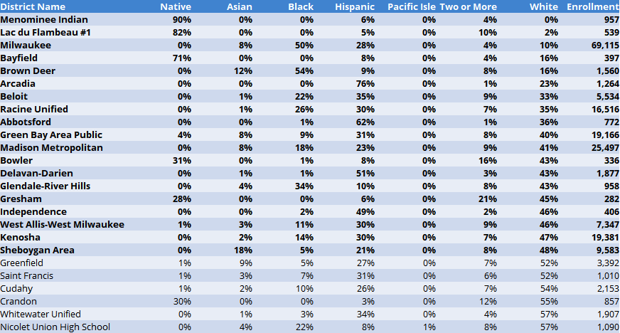
25 Districts with the
Most Students of Color
These districts enroll 23% of all Wisconsin public school students.
Nineteen have fewer than 50% white students.
Source: Department of Public Instruction WISEdash (https://wisedash.dpi.wi.gov/) 2021-22 data.

Slide 18
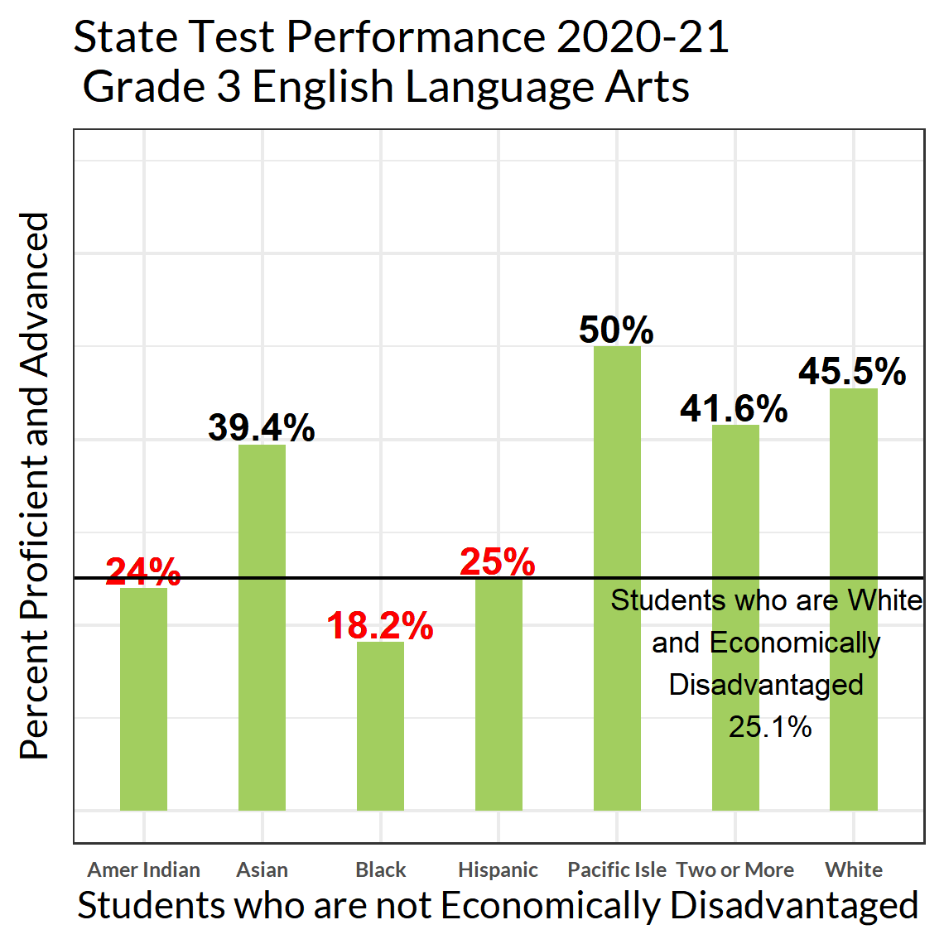
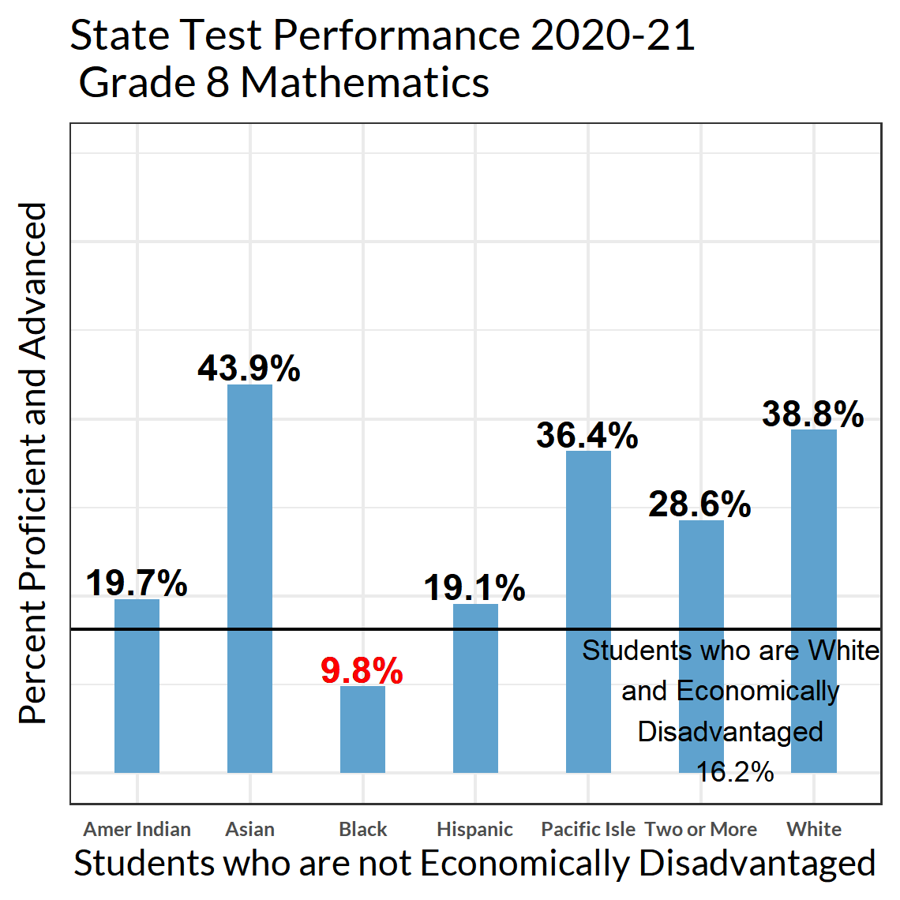
Poverty Can't Explain All of the Racial Achievement Gap
Source: Department of Public Instruction 2020-21 data warehouse data.

Slide 19

Understanding School Finance

Slide 20
School Funding – Simplified!
Property Tax Levy
State Equalization Aid
Revenue Limit
Outside the Revenue Limit
Per-Pupil Aid
Other Revenue
Federal Funds
Categorical Aid

Slide 21
Revenue Limits & Per-Pupil Aid
Source: Department of Public Instruction. 2021-23 State Budget. https://dpi.wi.gov/policy-budget/2021-23-biennial-budget

Slide 22
Revenues
Controlled by Revenue Limits
Outside Revenue Limits
GENERAL AIDS
FEES
REF. DEBT
PROPERTY TAXES
GRANTS
CATEGORICAL AIDS
Notes:
Revenue Limits control greatest share of revenues
Authority to exceed the revenue limit (except for exemptions identified by law) is given by a referendum
Revenue outside of “controlled” revenues
Per Pupil and Special Education are the largest categorical aid programs
Federal Grants such as Title I and IDEA (largest) and State grants
Payment for referendum approved Debt Issues are outside the limit (Levy on a calendar year (CY) basis)
Student Fees may be not be assessed generally and must be related to the cost of an item, Board of Education (BOE) policy and fee waiver for indigent students required

Slide 23
State Totals - School District Revenues
CONTROLLED
Although the mix of aid and taxes may be different across districts, the Revenue Limit can control 70-90% of the General Fund budget!
^ State General Aids includes: equalization aid, special adjustment aid, inter-district & intra-district aids, and high poverty aid (i.e., state aids received under the districts’ revenue limit caps.
* Other Sources include: state categorical aids, federal aid, and non-property tax local revenue (i.e., revenue received outside of the districts’ revenue limit caps).
Notes:
In 1993-94, the State enacted revenue limits to control the revenue a school district can collect from:
General Aid (Equalization Aid, for most districts)
Computer Aid
Aid for Exempt Personal Property
High Poverty Aid
Select Local Levies
General Fund (Fund 10)
Non-Referendum Debt Service (Fund 38)
Capital Projects (Fund 41)
It is not an expenditure control or spending limit.
Examples of what the Revenue Limit does not control (not exhaustive list):
School Fees
Categorical Aids (Per Pupil Aid, Special Education, Library Aid, Transportation Aid, etc.)
State and Federal Grants
Gate Receipts
Donations
Local Levies
Referendum Debt Service (Fund 39, at times called “Non-Fund 38”)
Community Service Fund (Fund 80)
Prior Year Levy Chargeback for Uncollectible Taxes (Fund 10)

Slide 24

Membership in the Data Cycle
Resident Full Time Equivalency (FTE)
Notes:
Membership drives resources
Full Time Equivalency (FTE) – Not head count
Residents the district is responsible for educating
Count related to responsibility for cost to educate
3rd Friday in September and 2nd Friday in January (two Count dates) plus summer school/interim session
PI-1563, PI-1840, Challenge Academy PI-1563CA
General Aid membership is different than Revenue Limit membership

Slide 25
Revenue Limit Membership
3rd Friday in September Count
Summer FTE
Charter Addition by DPI
3 Year Averages
Notes:
Three (3) Year Average Membership drives your Revenue Limit calculation (September PI-1563, 40% Summer PI-1804)
Three year averages
Line 2: Base - three prior years (past)
Line 6: Current year plus two prior
Middleton-Cross Plains School District

Slide 26
2022-23 Revenue Limits
BASE: PY $/FTE
(PY $/FTE ) * CY FTE
Notes:
The revenue limit does not include all revenues and it is not a spending limit – but it does control a significant portion of a district’s budget (70% to 90%)
Revenue limits are determined on an individual district basis and are not affected by changes in other districts
Sum of Revenue from controlled sources divided by prior year 3 year membership = Prior Year (Base) Revenue Per Member
Base (Prior) year value per member times new 3 year average membership
Plus or Minus Exemptions
Equals = Total Allowed Controlled Revenue Line
NOTE: 4A is $0 in 2021-22 and 2022-23

Slide 27
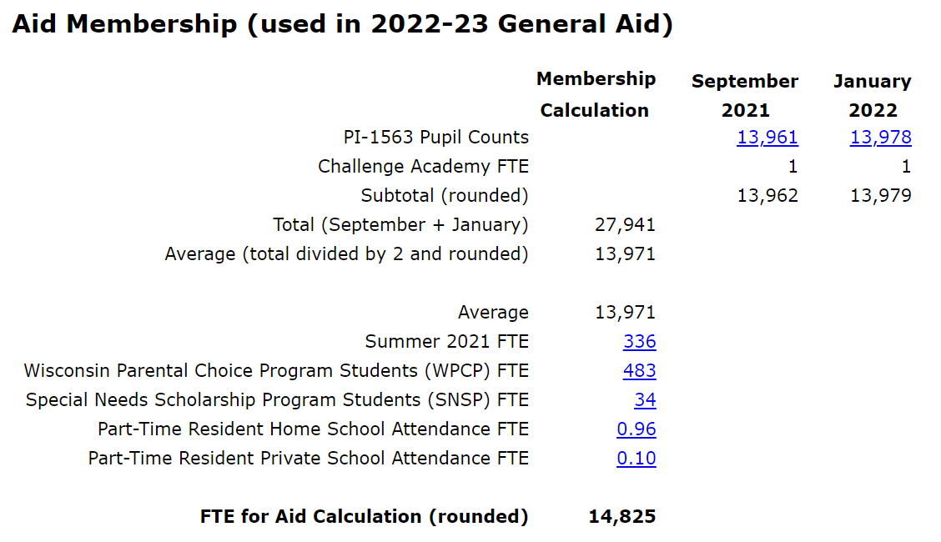
Equalization Aid Membership in the Data Cycle
One of the three factors used to calculate Equalization Aid
Notes:
Equalization Membership is Prior year Membership including data from
PI-1563 September and January and Challenge Academy
PI-1804 Summer and Interim Session
Voucher programs, ICS
Group and Foster Home
Part-time

Slide 28
State Aids – Equalization Aid Formula
General school aids primarily composed
of Equalization Aids, which is a
cost-sharing formula that incorporates:
  Spending = Shared Costs
  Number of Students to Educate = Members
  Property Value
All Prior-Year Data
(2021-22 data is used for 2022-23 aid)

Slide 29
Equalization Aid
Shared Cost per Pupil
Membership FTE
Shared Cost
Equalized Value per Pupil
Property Value
Membership FTE
Notes:
Equalization aid Factors
Prior year Membership including data from the PI-1563 September and January and PI-1804 Summer and Interim Session
Prior year Shared costs including data from the PI-1506 AC
Prior year Property value (Equalized Value May 1st)

Slide 30
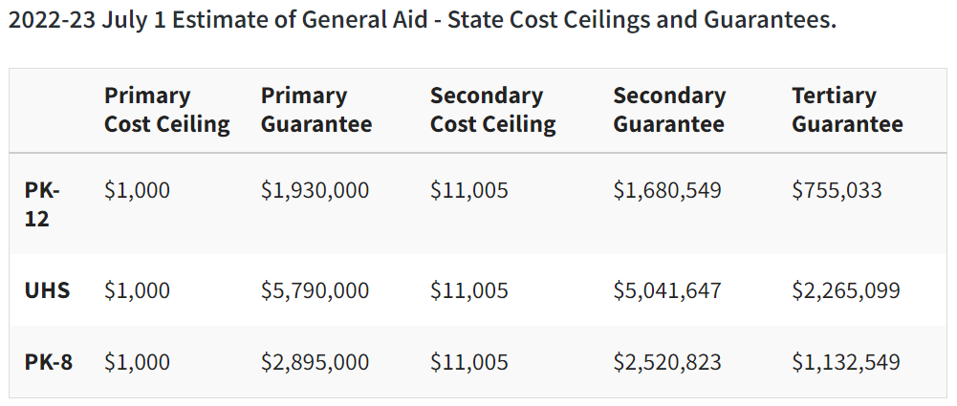
Equalization Aid : 2022-23
Notes:
Equalized Value Per Pupil is an indication of property tax base or wealth (often seen as ability to pay)
Cost Per Pupil is used to pay aids at different levels and redistribute aids when costs are above the secondary ceiling (increase resources for the less wealthy)

Slide 31
2021-22 General School Aid Reductions*
Program | Impact | Amount (in Millions)
[Independent Charter Schools - Legacy | 416 Districts* | $94.8]
Independent Charter Schools - New Authorizers | 65 Districts | $13.7
Milwaukee Parental Choice (Vouchers) | Milwaukee | $15.4
Wisconsin Parental Choice (Vouchers) | 309 Districts | $116.2
Racine Parental Choice (Vouchers) | Racine | $27.9
Special Needs Scholarship (Vouchers) | 160 Districts | $22.2
Total |  | $195.4**
*Effective 2021-22, Legacy Independent Charter Schools are funded directly from the State General Fund and not funded with general aids. Five districts receive no state general aid.
**$5,088.6 million in general school aids; $195.4 million is 3.8% of total general school aids.

Slide 32
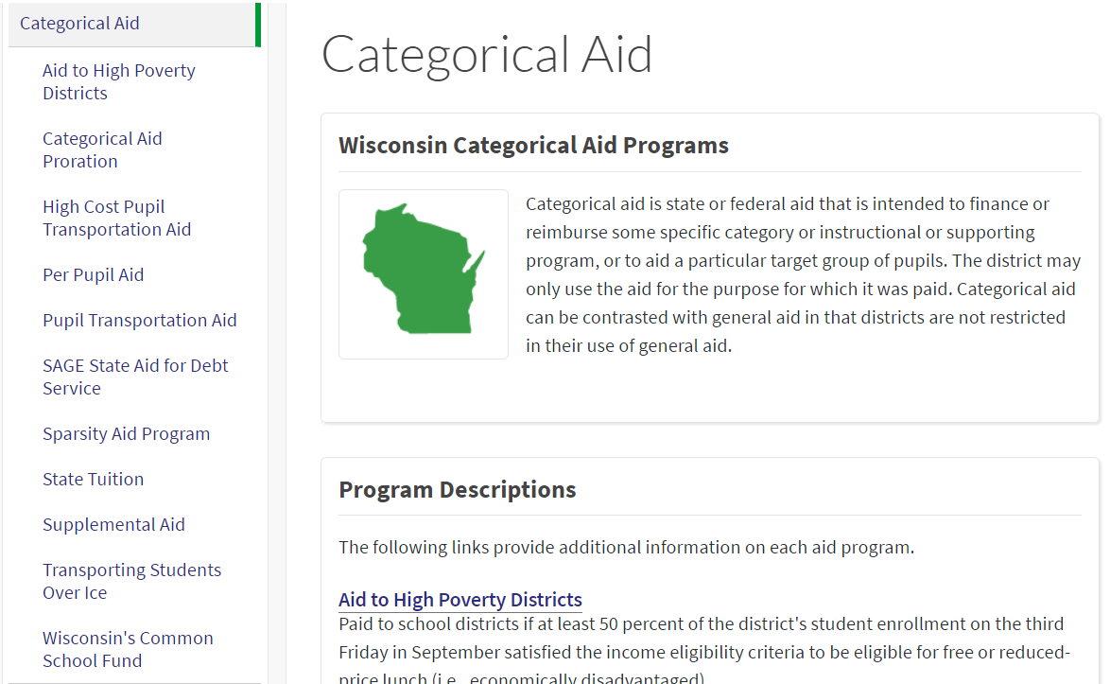

Categorical Aids
https://dpi.wi.gov/sfs/aid/categorical/overview
Notes:
Outside revenue limit
May be related to specific needs or purposes
May be prorated reimbursement of expenses
Used to offset costs
https://dpi.wi.gov/sfs/aid/overview

Slide 33

Categorical Aids
Per Pupil Aid
$742 multiplied by the current three-year average membership
Notes:
2021-2022 (FY22) amount is $742 multiplied by the current three-year average membership from the district's Revenue Limit worksheet - Line 6
Sources PI-1563 and PI-1804

Slide 34
K-12 School Aids as a Share of the State’s General Fund Has Decreased Over Time
Source: Legislative Fiscal Bureau

Slide 35
Top Ten State General Fund Programs and % Share of State’s 2021-23 General Fund Budget
Category % of State Budget
1. K-12 General and Categorical School Aids 33.3%
Medical Assistance 17.6%
State Correctional Operations 6.4%
4. University of Wisconsin System 6.1%
5. School Levy/First Dollar Tax Credits 5.5%
Shared Revenues 4.5%
Technical College System Aids 2.9%
Private Choice/Voucher Programs 2.2%
Judicial and Legal Services 1.7%
Community and Juvenile Corrections 1.6%
All Other State Funding 18.2%
Source: Legislative Fiscal Bureau (2021-23 Biennial Budget Summary, Table 9)
Notes:
The 9 largest programs make up ≈ 80% of state spending.
https://docs.legis.wisconsin.gov/misc/lfb/budget/2021_23_biennial_budget/101_summary_of_provisions_2021_act_58_august_2021.pdf

Slide 36
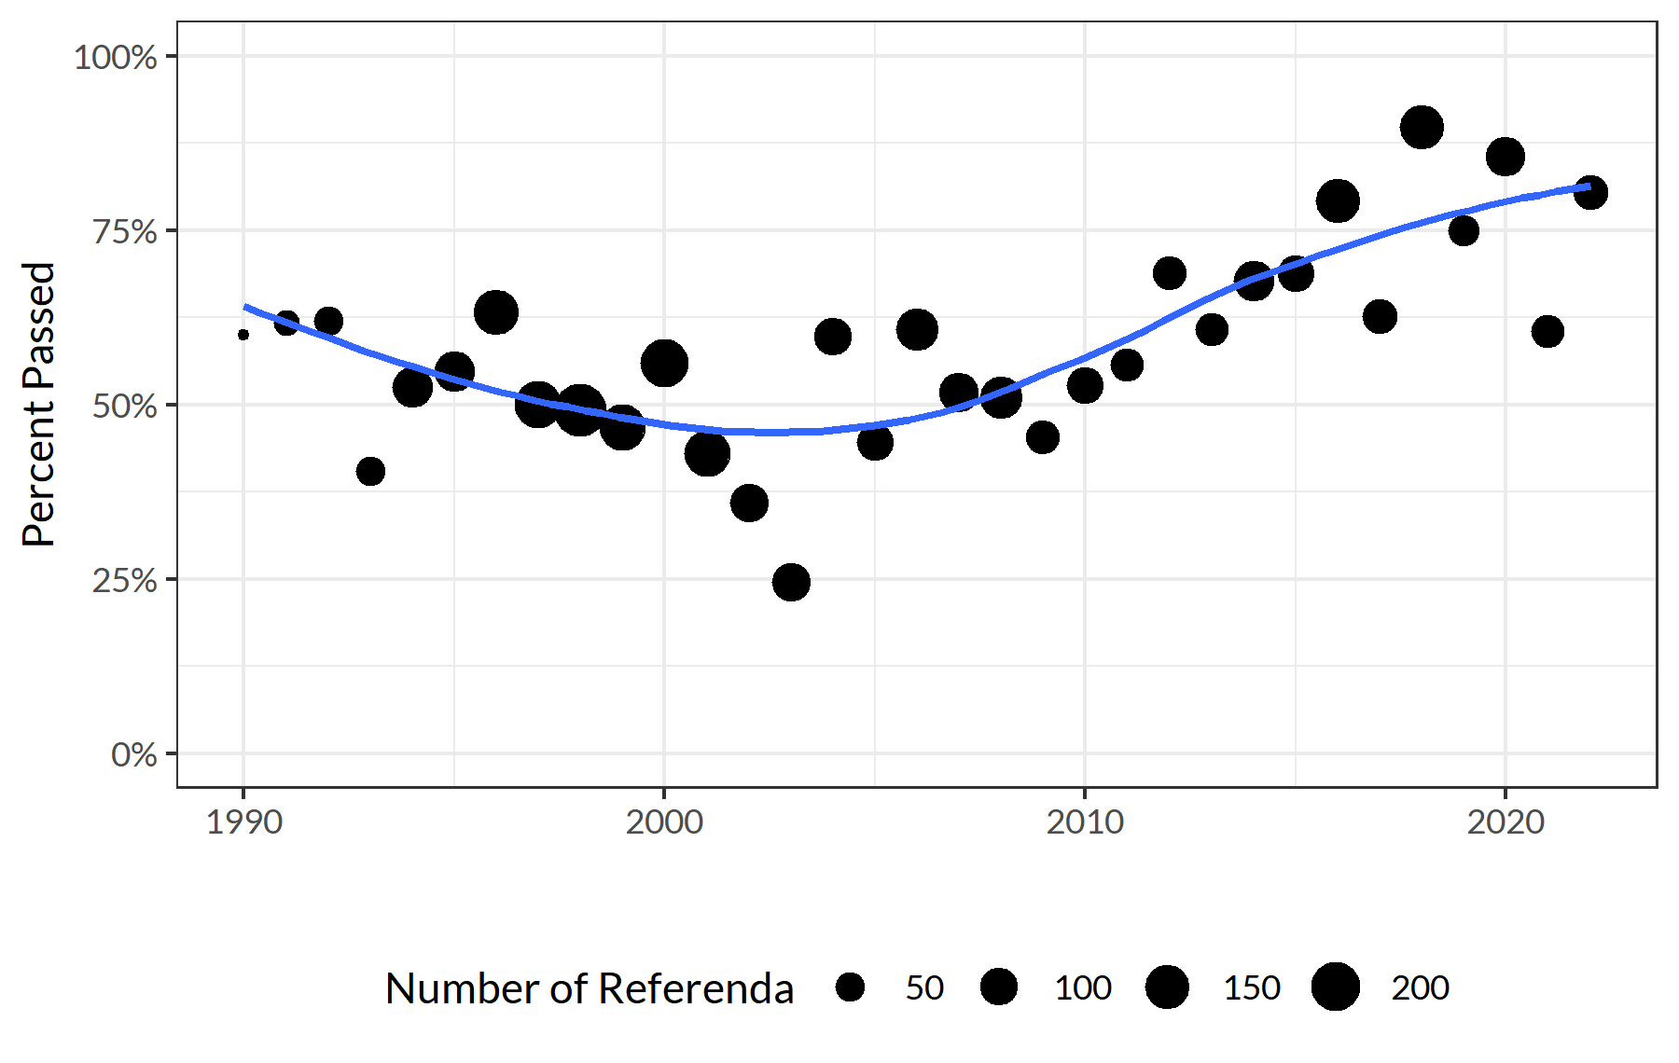
An Increased Reliance on Referenda
There have been over 3,500 separate referenda questions since 1990.
Since the low point between 2000-2005, the passage rate has increased from 45% to 71%.
Source: Department of Public Instruction Custom Reporting (https://sfs.dpi.wi.gov/Referenda/CustomReporting.aspx). Percent of successful referenda (recurring, nonrecurring, and debt) for elections held June 18, 1990 to April 5, 2022.

Slide 37

Moving Forward

Slide 38



The Public is With Us
Student Achievement
    Increased graduation rate; fewer drop outs
    Consistent high attendance; fewer suspensions
    More college credits; less alcohol & drugs
Winning in the Polls
    A Spring 2019 Marquette poll shows a majority of
    voters support raising taxes for schools and oppose further education funding cuts.
  Passing Referenda
    Over the last five years, the referenda pass rate
    was 81% (up from 54% the prior 20 years)

Slide 39
Summary of Challenges
74% of districts are in declining enrollment
Poverty has exploded, but is not addressed
in the school finance system
Voucher expansion is straining the system

