Slide 1
GASB Statement No. 96 Subscription Based Information Technology Agreements
Lauterbach & Amen, LLP
Notes:
Good Morning
Brad Porter, Principal here on behalf of Lauterbach & Amen, an accounting firm based out of the Chicagoland area
I am very excited to be here to share some insight with you on the new adventure of GASB 96
It’s my goal to ensure that everybody walks out of here feeling more confident on this standard than when you walked in
I also have a pretty big challenge on my hands and that’s to keep everybody awake during a 50-minute session on Subscription Based IT Agreements
Fortunately, a lot of you have gone through the GASB 87 implementation process for FY2022 so a lot of this will be commonly applied
I’ll preface my presentation with this standard is equally as new for auditors as it is for you
A detailed implementation guide has NOT been issued by GASB on this standard yet, so please be patient with your auditors too because we are still piecing together the GASB 96 puzzle
This standard is VERY specific to the agreements that are being evaluated so it will be tough to answer specific questions today without a review of the agreements
I also know that there may be some other firms in attendance today and I certainly value insight from other industry experts, so please don’t hesitate to chime in if you feel you can provide valuable guidance to attendees during this session
I hope everybody has a tall cup of coffee today because you’re going to need it!

Slide 2
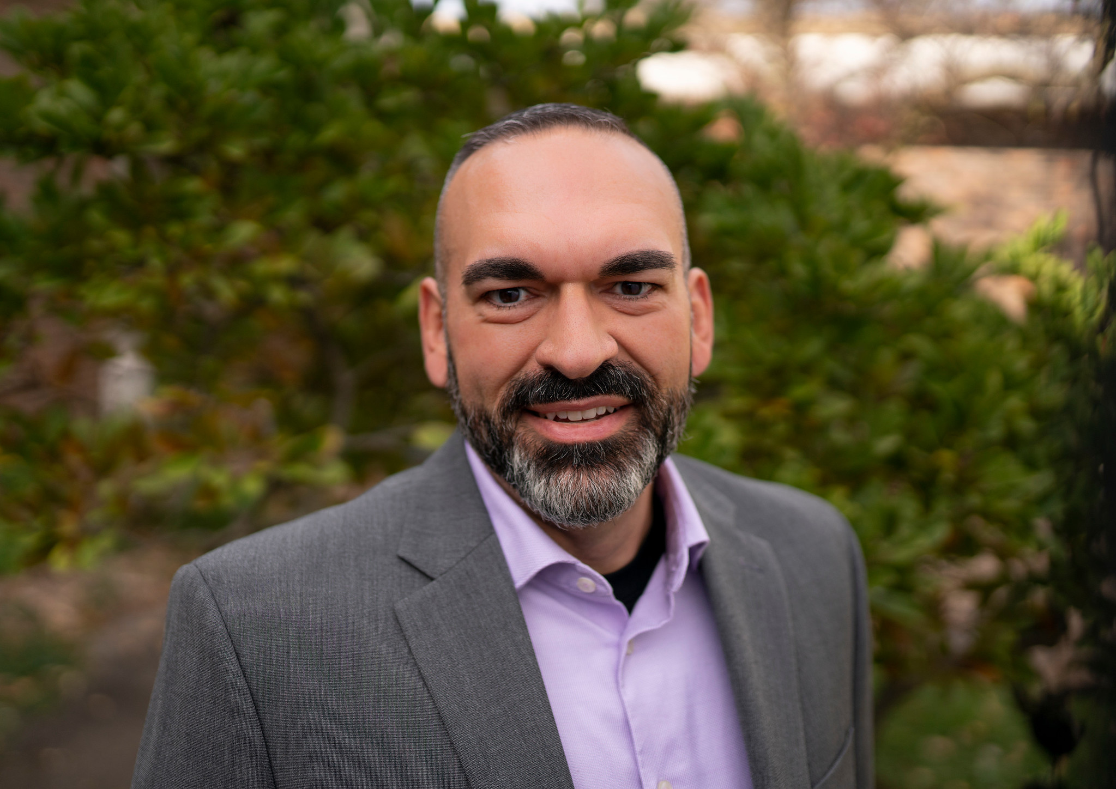
Introductions
Brad Porter, CPA
Principal
Lauterbach & Amen, LLP
Jason Demerath, SFO, CSRM
Director of Business Services
School District of Fort Atkinson
Olivia Bernitt
School Finance Auditor, School Financial Services
Wisconsin Department of Public Instruction
Notes:
- Introduce Jason – let attendees know that he will be providing a District’s perspective on how they’re preparing for GASB 96, along with frequently used vendors in the School District space
- Olivia will have a few minutes towards the end of the presentation to shed some light on GASB 96 reporting after having gone through GASB 87 for FY2022 reporting

Slide 3
Agenda
Overview
Goals of GASB 96
Implementation Dates
SBITA: Defined
District vs. Auditor Responsibilities
Decision Tree
Measurement of Subscription Period
Notes:
- We will save some time for questions at the end

Slide 4
Overview
GASB Statement No. 96 provides guidance on the accounting and financial reporting for subscription-based information technology arrangements (SBITAs) for government end users
The statement:
Defines a SBITA
Establishes that a SBITA results in a right-to-use subscription asset (an intangible asset) and a corresponding subscription liability
Provides criteria for capitalization of outlays other than subscription payments
Outlines the framework for additional note disclosures in financial statement audits
Notes:
- I will refer to Subscription Based IT Agreements as “SBITA’s” from here on out because trying to say that 25 times today is going to get exhausting
- Key terms being “right to use asset” and “subscription liability”

Slide 5
Goals of GASB 96
Transparency
Better meet the information needs of financial statement users by disclosing right-to-use assets and future SBITA liabilities
Comparability
Improve the comparability of financial statements by establishing uniform guidance for SBITA reporting
Consistency
Apply consistent accounting practices from its counter-part, GASB 87
Notes:
GASB has been on a “Transparency” kick lately, with many recent standards seeking to provide more useful information on the face of the financial statements and note disclosures
From a Comparability standpoint, a primary responsibility of GASB is to ensure that financial statements are comparable across all governmental audits
Consistency – important that the same practices are applied across similar types of arrangements – GASB 96 is essentially a copy/paste of GASB 87 for lease reporting. Having spent more time than I’m proud to admit, reading through GASB 96, I can tell you that the two are practically identical in terms of application

Slide 6
Implementation Date
GASB Statement No. 96 is effective for fiscal years beginning after June 15, 2022, so District’s will be required to implement for fiscal years ended June 30, 2023

Slide 7
What is a SBITA?
Contract that conveys control of the right to use another party’s (a SBITA vendor’s) IT software, alone or in combination with tangible capital assets (the underlying IT assets), as specified in the contract for a period of time in an exchange or exchange-like transaction
To determine whether a contract conveys control of the right to use asset, assess whether it has both of the following:
The right to obtain the present service capacity (the right to the benefits generated) from use of the underlying IT asset as specified in the contract.
The right to determine the nature and manner of use of the underlying IT asset as specified in the contract.
AND
Notes:
Now I’m not usually a fan of reading off the slides, word for word, but I think it’s important here
GASB defines a SBITA as the following & pay specific attention to the words that have been bolded, underlined, and italicized
READ SLIDE
From a “Control” standpoint, the vast majority of contracts that you’ll be reviewing are going to have Control (i.e. the right to use the vendor’s software)
Likewise, most contracts that you’re considering will meet the “exchange or exchange-like transaction” criteria too, as you’re paying a fair market price for the services being provided to you

Slide 8
Cloud Computing Arrangements
Software as a Service (SaaS) - provides a customer with the ability to use a SBITA vendor’s applications (software) through a cloud infrastructure
Platform as a Service (PaaS) - allows a customer to use a SBITA vendor’s tools or coding language (software) to create applications that will run on the SBITA vendor’s cloud infrastructure
Infrastructure as a Service (IaaS) – allows a customer to remotely access the SBITA vendor’s network, server, and other fundamental computing tools to process, store, and operate the customer’s data
Notes:
Software as a Service: Use of vendor application through cloud infrastructure (most common in industry)
Platform as a Service: Allows the District to use vendor’s tools or coding language to CREATE applications (very uncommon)
Infrastructure as a Service: Remoting into a vendor’s network, server, and other tools (also relatively uncommon)

Slide 9
What is a not a SBITA?
Exclusions:
Contracts that include a hardware component, where the software component is insignificant
Contracts that have cancellation clauses at any time by both parties or contracts in which the “non-cancellable” period has already passed
Contracts that solely provide IT support services
Short-term SBITA’s
Contracts with a term of less than 12 months (including any options to extend, regardless of probability of renewal)
Payments on short-term contracts are expensed
Perpetual Licensing Arrangements (considered a software purchase, not subscription)
Immaterial SBITAs ~ work with your auditors
Notes:
It is almost MORE important for all of you to understand what is NOT going to apply under GASB 96
This is where I get to share good news with you for a change ☺
One that is not on here that I wish I had added after a discussion that was had with a client of ours after the slides were submitted was PREPAID subscriptions
You cannot measure the present value of future cash flows on a subscription liability if the contract was paid up front because there aren’t any future outflows to value
Therefore, prepaid subscriptions would not apply if the entirety of the contract payment is made up front
Now it’s important to note that if you have a 5 year agreement with a vendor that requires prepayment for that fiscal year up front, this will still be measured under GASB 96 because you’d have four additional years of future cash outflows on this contract
Pay specific attention to the full contract term and not the annual payment provisions

Slide 10
Common SBITA’s to Consider for School Districts
Student Information Systems
Amazon Web Services (AWS)
Records Management Systems
Library Management Systems
Teacher Evaluation Systems
Career Planning Sites
Content Management Systems
Remote Learning Platforms
Professional Development Tracking
Emergency Notification Systems
Server Hosting Services
Cloud Storage
Email Services
Data Backup
E-books
Accounting Software
Notes:
Read through some of the more common SBITA’s to consider for School Districts
Turn over the keys to Jason to talk through a couple of the commonly used vendors for some of these noted above, as well as to provide some insight on how the District is preparing for GASB 96

Slide 11
District Responsibilities
“Gathering” Phase
Step 1: Prepare list of all subscription-based IT arrangements
Relevant Information: Subscription terms, interest rates, payment information
Work with IT Department and those responsible for tracking SBITA’s
Keep agreements and all subsequent amendments in a folder for auditors
Step 2: Rule out contracts that do not meet the necessary criteria
Step 3: Work with auditors on their preferred method of preparing necessary schedules
Each firm may have their own template that will assist with present value calculation and amortization
Notes:
Jason’s slide

Slide 12
Auditor Responsibilities
“Analyzing” Phase
Step 1: Review District’s list of potential SBITA’s that they felt met SBITA requirements
Step 2: Helping to interpret certain pieces of SBITA agreements that Districts are unsure on
Examples: measurement of agreement period, termination clauses, optional renewal periods
Step 3: Assisting Districts with government-wide journal entries for audit reporting
Step 4: Preparation of related footnote disclosures
Notes:
I’m sure you can understand that each audit firm is going to be handling the GASB 96 implementation process differently
I tried to keep it generic to tasks most firms will be taking to help their clients through the implementation process
Step 1: Reviewing the initial list of SBITA’s put together by the Districts
This will also include cross-reference to the District’s GL to make sure that there were no additional subscription payments made to vendors that weren’t included in the District’s evaluation
Step 2: These contracts are COMPLICATED! Auditors will assist with questions as you work through your review
Step 3: Because school districts account for their funds on the modified accrual basis with the current financial resources measurement focus, the subscription asset and liability are really recognized on the Government-wide level only from a balance sheet perspective. Auditors will assist with the conversion process to carry these balances at the Gov-Wide level on the full accrual basis
Step 4: During the report writing phase, auditors will be adding the necessary footnote disclosures that we will discuss later in the presentation

Slide 13
GASB 96: Decision Tree
STEP 1
Does the contract convey the right to use another party’s IT software?
Yes
STEP 2
Is the IT software contract alone or in combination
with tangible capital assets?
No – Not a GASB 96 Subscription
In Combination
Alone
STEP 4
Is the contract a licensing arrangement that provides perpetual use of a vendor’s software?
Yes – Non GASB 96 Subscription
No
STEP 5
Is the IT software controlled for a period of time in an exchange or exchange like transaction?
Yes – GASB 96 Subscription
No – Non-GASB 96 Subscription
STEP 3 Is the cost of the software component insignificant when compared to the costs of the underlying tangible asset?
Yes – Potential GASB 87 Lease
No – Go to STEP 4
Notes:
- This is really the byproduct of all of the definitions and things we’ve already discussed

Slide 14
Measurement of Subscription Period
Period in which a government has a noncancellable right to use an underlying IT Asset
Include any of the following, if applicable:
Periods covered by a government’s option to extend or terminate the SBITA, if it is reasonably certain that the government will exercise the option
Periods covered by a SBITA vendor’s option to extend and/or terminate the SBITA, if it is reasonably certain that the vendor will exercise the option
Notes:
In most cases, it will be clearly stated within the contract itself
However, there are a few periods that we need to ensure that we are including or excluding from the measurement period
Can’t stress enough that if there is a cancellation clause that gives both parties the right to terminate the contract, the period beyond the optional cancellation is excluded from the measurement period
If it is reasonably certain that a vendor or District will extend or terminate the contracts, we need to ensure that the measurement period is adjusted to increase or decrease the term, respectively.
In most cases, the District will have a general understanding on whether they’re happy with the services provided, pricing, and other contract terms to conclude on whether it’s likely they’ll renew

Slide 15
When to Remeasure the Liability
A District should remeasure the subscription liability annually if one or more of the following changes have occurred:
There is a change in the subscription term
There is a change in the estimated amounts for subscription payments already included in the measurement
A change in the interest rate the SBITA vendor charges
An event occurs that causes variable payments that were contingent on the performance or use of the underlying IT assets to become fixed for the remainder of the subscription term
Notes:
- I feel these situations will be very uncommon, but I did want to comment on situations that could arise where the subscription period will need to be remeasured

Slide 16
Accounting for SBITAs Under GASB 96
Initial Liability Recognition
Present value of subscription payments expected to be made during the term
Discounted using the interest rate the SBITA vendor charges the government. If the interest rate cannot be readily determined, estimated incremental borrowing rate should be used.
Initial Asset Recognition
Initial Subscription Liability plus
Incentives received by the vendor
Annual Amortization
Amortization of the discount on the subscription liability as an outflow of resources (i.e., interest expense)
Payments made to vendor before the commencement of the subscription plus
Capitalizable implementation costs* less
Asset amortized in a systematic and rational manner over shorter of subscription term or useful life of IT asset
*Implementation costs are all ancillary charges necessary to place the subscription asset into service
Configuration, coding, testing, installation
Data conversion to the extent required to place the asset into service
Notes:
Now for the fun stuff… the actual accounting treatment for GASB 96
I apologize for the small font, but I thought it was important to squeeze every bit of information on this slide as I could, given that you’ll have these slides available to you for reference
Initial Liability = Present value of future outflows on the subscription period (using defined interest rate or an incremental borrowing rate)
Initial Asset = Liability + certain allowable capitalized implementation costs, less any incentives received
Allowable capitalization costs = Configuration, coding, testing, installation costs, and data conversion
ONLY those that fall within those categories are allowed to be added to the capitalizable base
You are then Amortizing the PV discount as interest expense AND the intangible asset as amortization expense (just like we would depreciation expense for capital assets)

Slide 17
SBITA Example and Journal Entries
Anywhere School District – June 30 Year-End
SBITA Information
Subscription Start Date: July 1, 2022
Subscription End Date: June 30, 2025
First Payment: July 1, 2022
Payments: $5,000 annually, paid at the beginning of the period
Interest Rate: 3.50%
Additional Costs
Preliminary Project Stage Costs - $1,000 to a consultant for assistance in selection of software (expensed as incurred)
Implementation Stage Costs - $3,000 to transfer data to the new software (capitalized and amortized)
Operation and Additional Implementation Stage Costs - $2,000 to convert legacy data on an old server to vendor’s cloud storage (expensed as incurred)
Notes:
Again, please note that ONLY Implementation State Costs can be capitalized
Preliminary Project State and Operation State Costs are not allowed to be capitalized

Slide 18
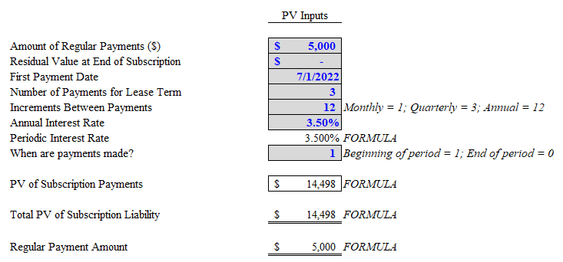
SBITA Example and Journal Entries
Anytown School District – June 30 Year-End - Continued
PV Calculation of Subscription Liability
Notes:
Because the payment was made at the beginning of the period, you’ll notice that the first payment is 100% principal.
Each subsequent payment is calculating the interest component using the Present Value calculator
Pay close attention to the PV of the future subscription payment figure of $14,498 for our entries on a later slide

Slide 19
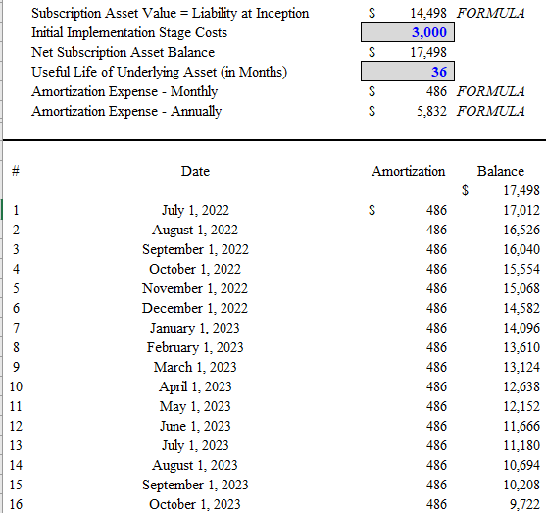
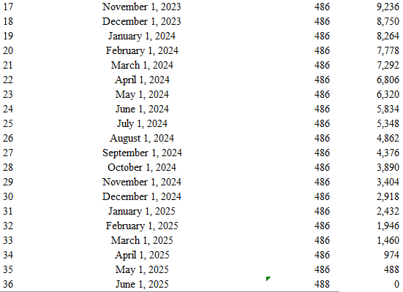
SBITA Example and Journal Entries
Anytown School District – June 30 Year-End - Continued
Calculation of Subscription Asset
$14,498 Subscription Liability + $3,000 Initial Implementation Costs = $17,498 Subscription Asset
Notes:
Given a contract start date of 7/1, it’s worth pointing out we still want to ensure monthly amortization because not every contract works out perfectly to start 7/1
As discussed on the previous slide, certain implementation costs allowed to be added to the base of the Intangible Asset for capitalization purposes
You’ll see we’ve added the $3000 of implementation stage costs to calculate the Asset amount, which is then amortized over the life of the subscription period

Slide 20
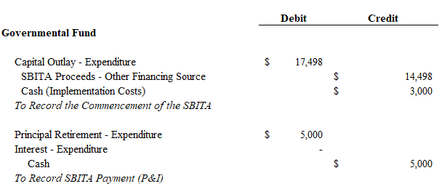
SBITA Example and Journal Entries
Anytown School District – June 30 Year-End – Continued
Adjusting Journal Entries
Notes:
Again, important to note that School Districts report on the modified accrual basis of accounting under the current financial resources measurement focus
This transaction should look very familiar, as they are the same income statement entries that you would have made under some of your capital lease-related entries in the past
Had we not paid $3,000 in implementation costs, the entry would simply be debit expense/credit SBITA proceeds (other financing source at the fund level)
You’ll also notice that the first contract period is 100% principal. Had the payments been made at the end of the period, you would have had an interest amount to allocate to FY2023 too. I’ve added that line item into the sample entries so you can refer back

Slide 21
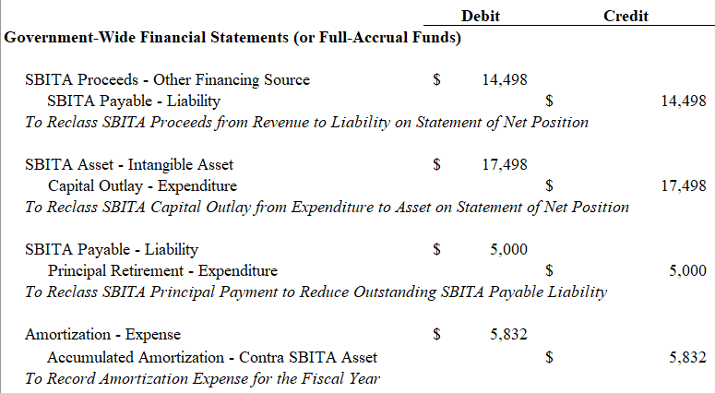
SBITA Example and Journal Entries
Anytown School District – June 30 Year-End – Continued
Adjusting Journal Entries – Government-Wide

Slide 22
Footnote Disclosures
General Description of SBITAs
Include basis, terms, and conditions on which variable payments not included in the measurement are determined
Total Amount of subscription assets and related amortization
Disclosed Separate from other Capital Assets
Amount of Outflows recognized in the current year
Variable payments not previously included
Other payments such has termination penalties not previously included

Slide 23
Footnote Disclosures - Continued
Principal and Interest Requirements to Maturity
Separately for each of the subsequent five years
Five-year increments thereafter
Commitments under SBITAs before the commencement of the subscription term
Ex: Significant contract entered into prior to year-end, but subscription term has not started at the financial statement date
Impairment losses, if applicable
Very unlikely

Slide 24
DPI’s Perspective

Slide 25
Questions? Brad Porter, CPA bporter@lauterbachamen.com 815-671-1608

