Slide 1
Title Slide
SUMMER AT A GLANCE
Mark Elworthy, Director
School Financial Services Team
WASBO Spring Conference,
May 11, 2023

Slide 2
Title Slide
Spring 2023 Updates

Slide 3
2023 Spring Updates
WDF and WiSFiP - LEA’s financial ledger (the local “books”) pushed to WDF must be consistent with WUFAR accounting and the DPI Chart of Accounts to avoid WISEdata Finance reporting quality issues
WDF and WiSFiP - We recommend LEAs push financial data to WISEdata Finance at least monthly, suggested as a task after the monthly bank reconciliation

Slide 4
Title Slide
Summer Activities Current Fiscal Year

Slide 5




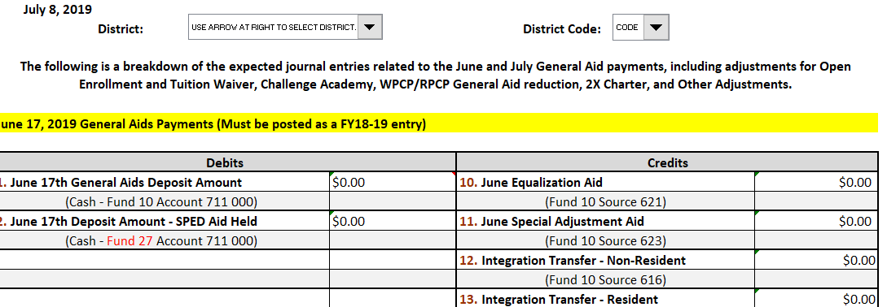
Upcoming Reports and Activities
Fiscal Audit
2022-23
Budget UPDATES
Monitor and Amend Current Year Budget
WISEdata Finance
Final 2022-23 Revenue Limit Calculation
GENERAL AIDS
PROPERTY TAXES
June aid withholding
Notes:
Get ready letter from your auditor
Update WISEdata Finance: 2021-22 Budget Reports with any amendments
Monitor MOE in WISEgrants
Review your 2021-22 Revenue Limit Calculation Final - posted in June with final June Aid Payment
Membership Audits and Changes, verify open enrollment
Review your 2021-22 Revenue Limit Calculation - did you over or under levy due to membership changes?
Membership Audits and Changes, verify open enrollment
Update WISEdata Finance: 2021-22 Budget with any amendments
Remember to go in and make any changes to the district’s debt schedule that have occurred during the fiscal year. Debt Service information at: http://dpi.wi.gov/sfs/finances/debt/overview

Slide 6
PI 1563 Membership Report
All changes after audit reports are due must be requested
Changes may impact revenue limit
Notes:
Send an email indicating the reason for the change and request the report be opened, cc auditor if you have a membership audit
Districts that were selected for a membership audit will need to have after the audit confirmed by their auditor
Roger Kordus is the contact for membership changes
Data is used to calculate the July 1 General School Aids estimate for 2022-23
Update/revise entries on or before June 1, 2022
Further adjustments may be made up to September 30th

Slide 7

Open Enrollment for June Aid
Notes:
Double check and confirm OE residency status
Complete changes in OPAL – Was due before May 1st
Update PI-1563 September and January Pupil Counts for any membership changes (need to request report be opened as described on the prior slide)
Aid adjustments for June are then calculated by the Parental Education Options Team
Update (amend) your Budget if needed

Slide 8
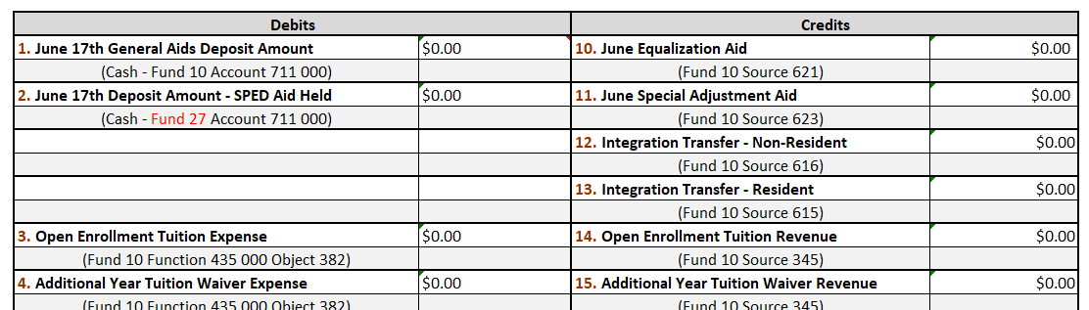
Open Enrollment
Notes:
Your aid payment will be adjusted for the cost of these students
Aid withheld for Open Enrollment adjustment in June
Aid withheld for Private Vouchers adjustment in June
https://dpi.wi.gov/sfs/finances/aids-register/aid-payment-adj-exp

Slide 9
Open Enrollment for July
Contact Parental Education Options Team with corrections by mid-June
Update PI-1563 September and January Pupil Counts for any membership changes
Aid adjustments are then calculated by the Parental Education Options Team

Slide 10
Actual and Projected State Aid Adjustments
Aid withheld for Open Enrollment adjustment in June
Worksheet posted showing aid withheld in anticipation of June deductions
Revised worksheet for 2023 includes aid eligibility, withheld and paid
https://dpi.wi.gov/sfs/finances/aids-register/aid-payment-adj-exp
Notes:
Cash flow impact
Budget impact
Use to compare to aids register

Slide 11
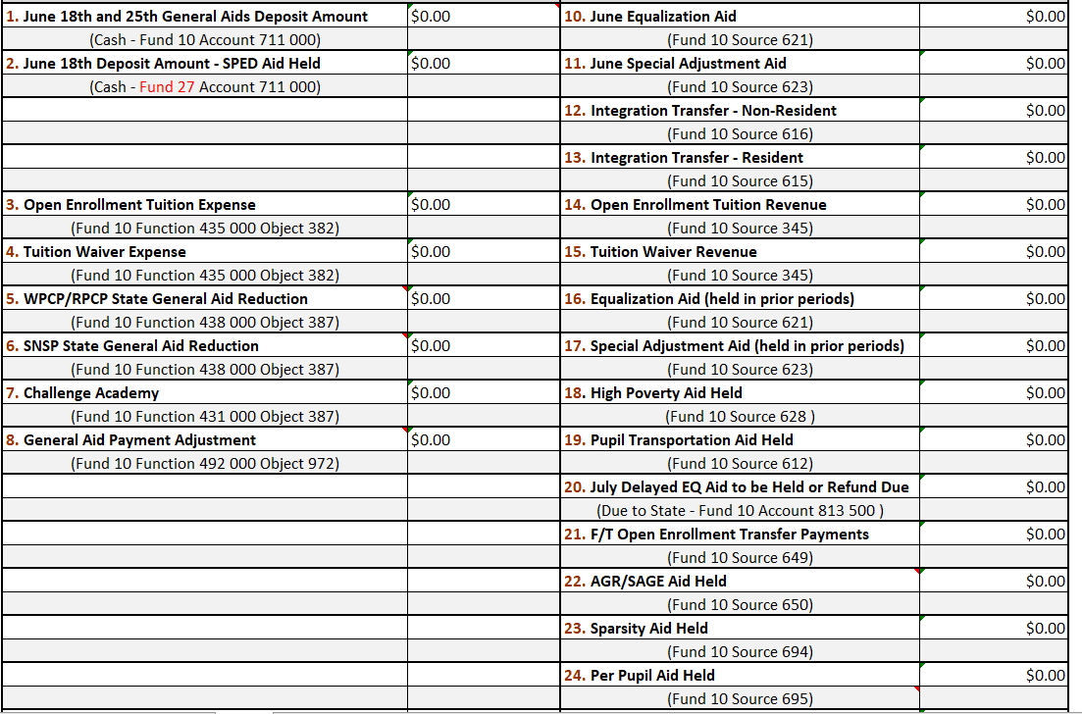
State Aid Payment Adjustments
Aid withheld for Open Enrollment and Voucher adjustment in June
Notes:
Biggest adjustments to aid your aid payments are withholding for voucher and OE

Slide 12

Bank Reconciliations
Someone in your office needs to reconcile the bank statement to the district ledger EVERY MONTH
You cannot balance your reports if you don’t account for your CASH
Segregation of duties would suggest that the person making deposits should not reconcile the account
If necessary, the district may/should hire an accounting service to reconcile
Notes:
Many of the districts that struggle to meet the financial reporting deadlines have issues related to cash reconciliation

Slide 13
Annual Financial Audit
Select firm to complete your audit
Determine if your employee benefits require and actuarial study or table update and select a vendor
Determine if there are any other needs to complete your financial statements
Have a plan and schedule the work if possible to meet report deadlines
Actuarial Study required by statute
Notes:
Untimely OPEB and Pension benefit studies was one of the most frequent reasons reports were late.

Slide 14
Early DPI Reports
Transfer of Service (PI-5000) - Opens June 1
WDF Snapshot – June 9
Pupil Transportation
Census
Calendar
Group and Foster Home Membership
Notes:
Pupil Transportation – you have the data and only need to identify students that move or rode the bus in after you compiled the data
If you contract, suggest you request before school is out and final payment due
Census – if using the mathematical calculation, use the 3rd Friday September

Slide 15

2022-23 Budget Changes
Budget Impact Areas
Board approves a Budget for the hearing
Board adopts a Budget (original) and approves a Tax Levy after the hearing
Board amends Budget when appropriation and purposes change
Student Needs (Enrollment)
Estimates based on trends
3rd Friday in September
New course needs teacher
Final Board Amended Budget
Grant Revenue Availability
Base amount
Carryover is calculated
Change in plans/needs
Equipment Failures
Estimated expense
Boiler Fails
Roof Fails
Weather
Utility based on trends
Heavy Snow (Removal costs)
Late spring (Heating)
Notes:
The district’s budget is a roadmap based on the district’s best estimations
Board prepares a budget for presentation at the hearing
Board adopts a Fall budget that is used to set levy, often the district’s “original” budget
Estimates are updated or become actuals - Budgets can change
The annual “original” budget provides the best estimates at the time of adoption
The adopted budget is amended as needed throughout the year and resources and needs change

Slide 16
Changes to the Current Budget
Per Statute § 65.90(5) “ … the amounts of the various appropriations and the purposes for such appropriations state in a budget …”
Appropriation = $ amount
Purpose = in the WUFAR, this is the Function
DPI recommends budgets and changes are approved at the two digit function level by the Board of Education
Notes:
2021-22 data is used to calculate the July 1 General School Aids estimate for 2022-23 (§121.15(4)(b)) and MOE for IDEA in WISEgrants

Slide 17
Changes to the Current Budget
Per Statute § 65.90(5) “ … the amounts of the various appropriations and the purposes for such appropriations state in a budget …”
Appropriation = $ amount
Purpose = in the WUFAR, this is the Function
DPI recommends budgets and changes are approved at the two digit function level by the Board of Education
Notes:
2021-22 data is used to calculate the July 1 General School Aids estimate for 2022-23 (§121.15(4)(b)) and MOE for IDEA in WISEgrants

Slide 18
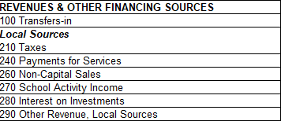
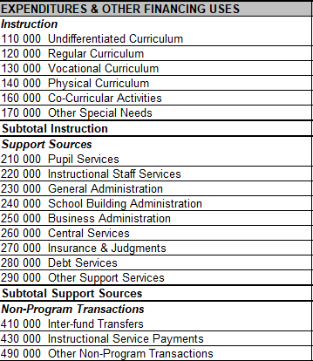
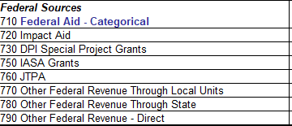
Budget Adoption Format
Minimum detail to the second digit.......
Notes:
The annual “original” budget provides the best estimates at the time of adoption
DPI format requires that both Appropriations and Purposes are to the second digit. Your BOE may approve a budget at a greater level of detail. This is the detail level required for changes and publication
Changes in subordinate line items from which the adopted budget evolved (but which are not detailed in the adopted budget) do not require the two-thirds vote and publication

Slide 19

WISEdata Finance Budget
Update with Board (Amended) Adopted Budget
Notes:
Don’t forget to update
MOE impact, this will help you to monitor
Report used to collect the district’s proposed special education (Fund 27) expenditures and revenues.
Data is used by the Special Education and Federal Grants Teams in determination of Maintenance of Effort (MOE) for the IDEA Grant.
If your district revises its budget due to MOE requirements, be sure to update the WISEdata Budget information

Slide 20
Changes to the Current Budget
School District Treasurers must also comply with Wis Stat § 120.16(2) to assure disbursements from the school district treasury are made within the law
Class 1 notice within 15 days after the change is made (publication)

Slide 21
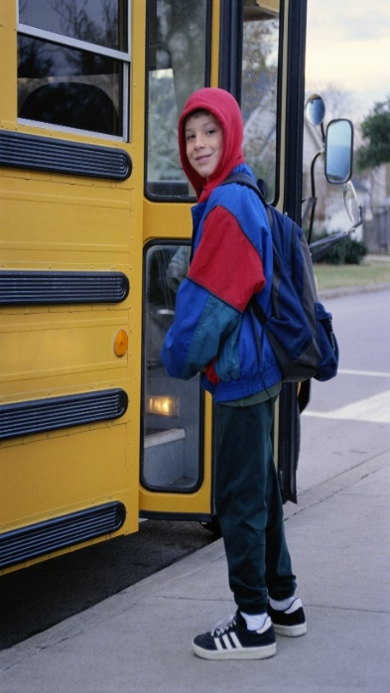
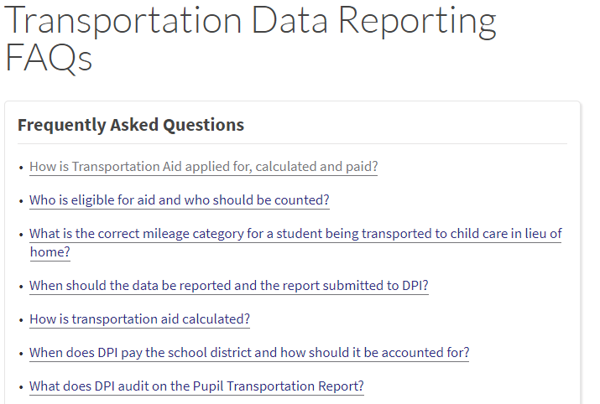
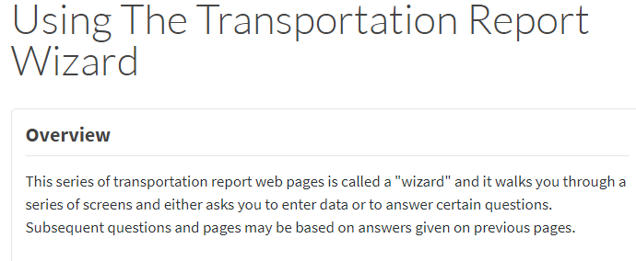
PI-1547 Transportation Report
Regular School Year Transportation
Specialized Transportation Route
Notes:
2021-22 report is due mid August 2022
Actual home to school ridership on regular bus route (may include students using supports per an IEP)
Number of students by mileage category
Initial Aid Payment: January 2023, based on 2021-22 data; if eligible for additional payment: June 2023
_________________________________________________________________________________________________________________
Based on enrollment eligibility multiplied by flat rate amount per pupil in each distance category
Distances are measured from the pupil's residence to the school attended, following the shortest commonly traveled route
Pupil transportation aid for the current year is based on the number of children transported during the prior school year
https://dpi.wi.gov/sfs/aid/categorical/pupil-transportation-aid

Slide 22
PI-1547 Transportation Report
Districts need to document the procedures used to determine actual ridership. Auditors review this documentation as part of the year end audit
Notes:
If you contract consider getting the data before the end of the school year or final payment is made

Slide 23


PI-1505 Calendar Report
Notes:
Report collects data for the school year that just ended
2021-22 report is due mid-August 2022
Days of instruction
Hours of instruction (by building)
Charter Schools do not need to meet the requirement but are flagged in the report
Data is used to verify compliance with §121.02(1)(f)
Worksheet available on website

Slide 24

PI-1505 Census Report
Includes ALL (K-12) district children ages 4-20
Actual physical count of children by June 30th or
Use a mathematical calculation which is based on the prior year September count
Notes:
Report collects data for the school year that just ended:
2021-22 due date is mid-August 2022
Includes children in private & homeschools
Excludes children in penal institutions
Data is used to calculate categorical Library Aid (Common School Fund)
K-8 District at least 4 but not yet 14, count ages 4 -13
UHS District 14-20 (Wis. Stats 120.18 (1)(a)

Slide 25

PI-1505 Census Report
Residents Enrolled in a Public School District or attending a State School
Residents Enrolled in Private Schools
Home-based private education programs
Other Children ages 4 and 20 – graduates from the two prior classes both public and private
Notes:
Use the September adjusted headcount of residents in the PI-1563
Use this same point in time for other children
Do not count Open Enrolled students into your district
Do Count Students that Open Enroll out of your district
If you are using your Student software application to generate the figure, please check to see if it includes only residents
Use the reasonability check
https://dpi.wi.gov/sfs/reporting/safr/census-instructions

Slide 26
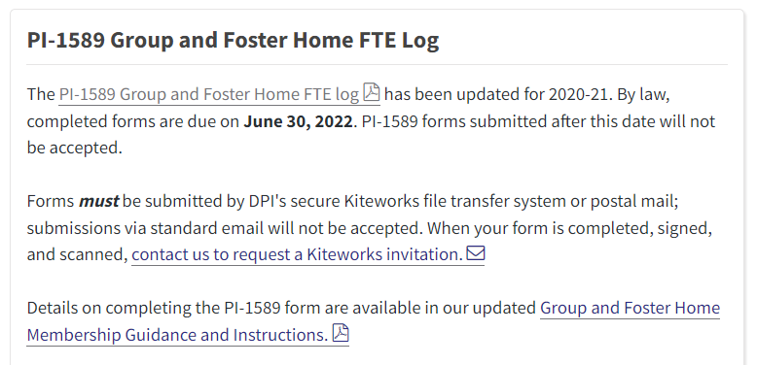
PI-1589 Foster and Group Home Membership
Notes:
Claim uses data for the school year that just ended:
2021-22 cost claim is due on June 30
Aid membership adjustment for pupils place in certain group or foster homes
Served by the district that were not included in the filing district’s pupil counts
You may be contacted by DPI if another district reported a student you shared to see if you counted the student
FTE Adjustments are made by DPI for Group and Foster home members
Remember, only aid membership
https://dpi.wi.gov/sfs/children/foster-group-home

Slide 27
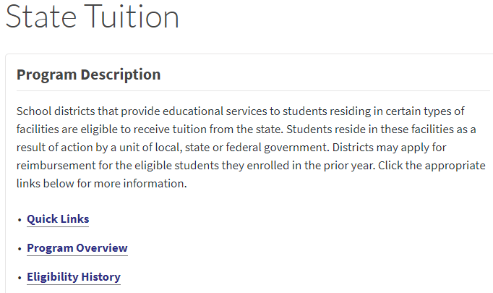

PI-1524 State Tuition Claim
This report is not in SAFR – for more info see http://dpi.wi.gov/sfs/aid/categorical/state-tuition
Notes:
Claim uses data for the school year that just ended:
2021-22 cost claim is due November 1st
Report is used to collect data on the costs of educating pupils living in certain institutions or homes (juvenile correction facilities) within the district
Data is used to calculate eligibility for State Tuition Payments

Slide 28
PI-1505 Full Annual Report
1. PI-1505 must match the PI-1506 AC auditor report to be approved
2. PI-1506 AC must be approved before the PI-1505 can be submitted
Notes:
Report collects data for the school year that just ended:
2021-22 report is due mid-September 2022 (auditor’s report due 1 week before)
May be used to populate the PI-1505 AC (Aid Certification)
Collects the district’s final revenues, expenditures, liabilities and equity for all funds for the just completed fiscal year
Must match the PI-506 AC auditor report before AC will be approved and may not be submitted until the AC is approved
Data used to calculate several aids, Maintenance of Effort and Federal Reporting

Slide 29


PI-1505 SE Annual Report
The PI-1505 SE values must match the PI-1505 values for successful PI-1505 submission
Notes:
Report collects data for the school year that just ended:
2021-22 report is due in mid-September 2022 (same as PI-1505)
Collects the district’s Special Education (Fund 27) in greater detail
Data used to calculate the districts special education categorical aid
PI-1505 SE will give you a warning if it does not match PI-1505 – Always check the Full annual for errors by running edits after changes to either report
WISEgrants will compare your claims to expenditures in the SE
Data is used for the IDEA maintenance of effort calculation

Slide 30
Final Grant Claims
Claims for budgeted expenditures* 7/1/2022 through 6/30/2023
Feds require DPI to accept claims through 9/30 but it’s best for you & your auditor to get it done sooner
* Technically “liquidated obligations” which has nearly the same meaning as expenditures; difference comes into play most often with grant-funded renovation work over the summer. Talk with your grant consultant for details.

Slide 31
ESSER II & III Claims
Plan for quarterly claiming next year onward
  Additional federally required reporting will be included for certain quarters
  Good practice to adopt across all your grants

Slide 32
Transfer of Service
Exemption to the Revenue Limit

Slide 33
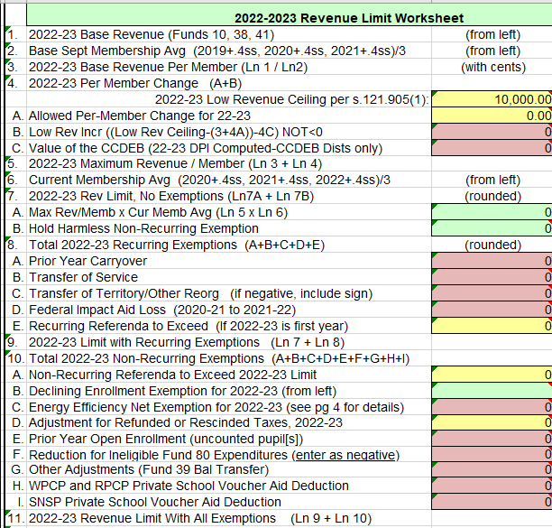
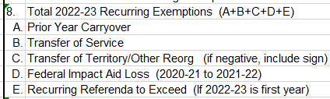
PI-5000 Transfer of Service
Notes:
If a district becomes responsible for a service provided by another school district, municipally, or governmental unit they may increase their levy authority by the new cost
The added tax authority increases the ability of districts to fund actual additional costs related to serving incoming students with Special Education and/or Limited English needs providing services that were previously provided by another municipality
The Transfer of Service (TOS) Report (portal) is used to determine whether a district can claim an TOS exemption in the Revenue Limit calculation
TOS is a recurring revenue limit exemption (allows a district to increase local tax levy to cover estimated eligible costs for coming year)
NOT an aid payment
Applications are online for most student related costs

Slide 34
PI-5000 Transfer of Service
Three Parts to the Process
    Part A initial request for a student
    Part B former district response
    Part C final submission
Notes:
Three due dates:
Part A is due September 16th
Part B is due September 23th
Part C is due September 30th

Slide 35
Transfer of Service
Now is the time to gather TOS information:
  Establish the contact person in your district who is responsible for this report (PI-5000)
  Gather information related to costs associated with student transfers into your district
  Application opens June 1, 2023
  Decision Tree and other resources https://dpi.wi.gov/sfs/limits/exemptions/transfer-service

Slide 36
Summer Activities
Next Fiscal Year

Slide 37
PI-1547-SS Transportation Report
Summer and Interim Session Transportation
Notes:
Routes may offer less service than during the school year, ridership on regular bus route (may include students using supports per an IEP)
Separate report from school year transportation, for aid purposes summer starts the school year
Number of students by mileage category (basis of categorical aid)
Report opens August 16, due October 1

Slide 38
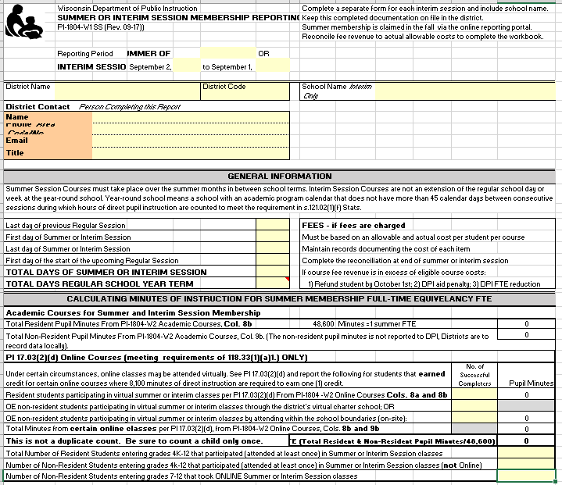
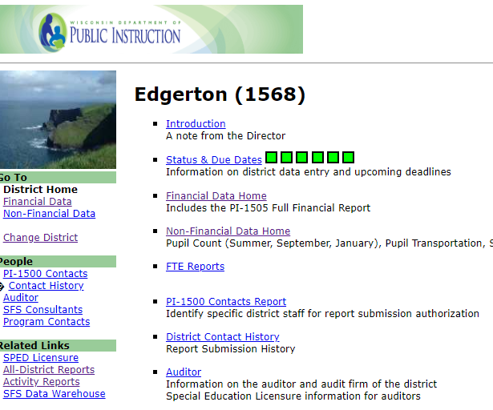
PI-1804-1805 Summer & Interim Session
Notes:
Complete workbook, including fee reconciliation and report in SAFR, http://dpi.wi.gov/sfs/children/summer-school
Report used to collect district FTE (full time equivalency) data for the just-ended summer term.
Remember: Summer starts the (membership) school year, not FY expenses
FTE data is used in the calculation of a district’s current year Revenue Limit* and following year’s Equalization/General Aid
*For Revenue Limit: summer school is counted at 40%
Report opens August 16, due October 1

Slide 39
School Fees
Fees for the resident student or parent may be charged for individual use supplies (towels, gym clothes, band instruments, notebooks, pencils), textbooks, or similar items (workbooks) if the district claims state aid under state statute 121.14.
Fees may be charged for social, recreational, or extracurricular summer classes and programs which are neither credited toward graduation nor eligible for state aid [s. 118.04(4)].
Notes:
Why are you collecting a fee? Is it Eligible?
What is the student receiving of value that is equal to the fee collected?
Do you have a fee waiver policy?
Reconcile fees in the PI1804 workbook, it you overcharged either provide a refund or an additional item of required value to the student

Slide 40
Audit of Summer School Fees
Complete the fee reconciliation tab in the PI1804 workbook
If your district is required to have a membership audit, the auditor will review your summer school FTE and the PI1804 reconciliation spreadsheet
The auditor will question fees if:
    the fee does not appear to be legal
    the amount of the fee charged per course exceeds the actual cost of the course

Slide 41
Budget Adoption, Tax Levy and Amendments
Amend the Adopted budget at a school board meeting
Step #6
Step #5
Adopt a budget at a school board meeting and set the tax levy
The electors at the annual meeting vote a tax (Common School districts)
Step #4
Step #3
The public hearing is held, at which time residents of the district have an opportunity to comment on the proposed budget
Publish a class 1 notice in the newspaper
Step #2
Create a proposed budget that identifies expected revenues, expenditures and fund balances for the upcoming/current year
Step #1
Notes:
We have come full circle since last August
Remember the steps in the process, we need to add one more for amending the adopted budget
As we said, the budget is a plan based on the information you have at the time, things can change
Depending upon the date of your annual meeting and budget hearing Step 3, you may be a different stages of the process over the summer
Getting ready for fall adoption

Slide 42
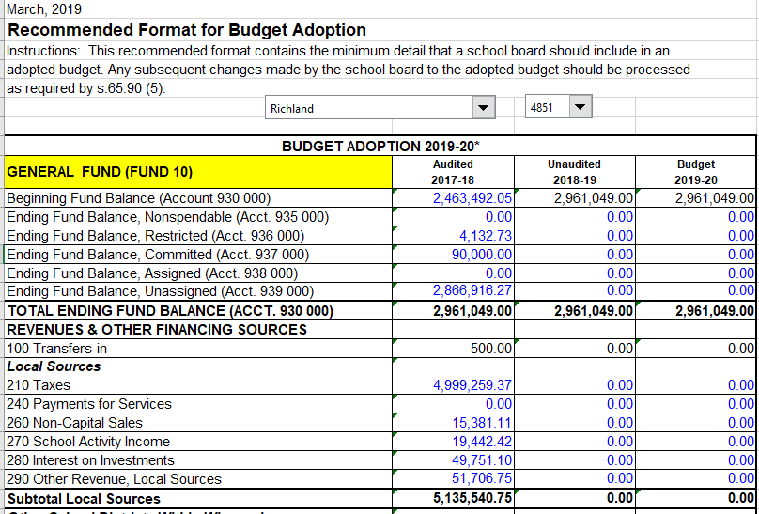
Budget Adoption Format
Pre-Populated Budget Hearing and Adoption Workbooks available
Notes:
Prepopulated workbook select from drop down and will populate audited column
Activity if time permits: Locate on Website and find your district
https://dpi.wi.gov/sfs/finances/budgeting/budget-hearing-adoption

Slide 43
Budget Adoption Format
Pre-Populated Budget Hearing and Adoption Workbooks available
Notes:
Prepopulated workbook select from drop down and will populate audited column
Activity if time permits: Locate on Website and find your district
https://dpi.wi.gov/sfs/finances/budgeting/budget-hearing-adoption

Slide 44
Energy Efficiency Savings Reporting
Districts should review their reported utility savings in the SAFR Reporting Portal
Report/update savings within two weeks of the budget hearing date. Confirm before setting your levy in the fall
Districts needing to update their energy efficiency utility savings are to contact Roger Kordus at 608-267-3752 or roger.kordus@dpi.wi.gov

Slide 45
Getting Ready for WISEdata Finance
Access info available at:
dpi.wi.gov/sfs/wdf
You have submitted 2022-23 budget data. This summer, you will provide 2022-23 actual data via WISEdata Finance

Slide 46
Points to Remember
Board approves appropriations and purposes of the budget (authority for spending)
Update your WISEdata Finance 2022-23 budget, monitor MOE
Revenue Limits will determine the majority of your resources and pre pops are available as a resource, the calculation is yours until May
Transfer of Service Requests must be timely

Slide 47
Contact Us
Team Directory:
dpi.wi.gov/sfs/communications/
staff-directory
General Mailbox: dpifin@dpi.wi.gov

